Slide 1
Title III Language Instruction for
English Learners and Immigrant Students
Rachel Pettigrew
Education Program Consultant
Federal Programs Bureau

Slide 2
Overview
Introduction
English Learners in Iowa
Purposes of Title III
Title III Grants and Subgrants
English Learners and Immigrant Students
Within-State Allocations
Purposes of Subgrants
Direct Administrative Expenses
Title III–English Learners
Required Activities
Authorized Activities
Title III–Immigrant Students
Authorized Activities
Supplement Not Supplant
CARE
Funding Distinctions
Title III Requirements in CASA
Title III Plan
Assurances
Resources
Iowa Department of Education
U.S. Department of Education
Contact Information

Slide 3
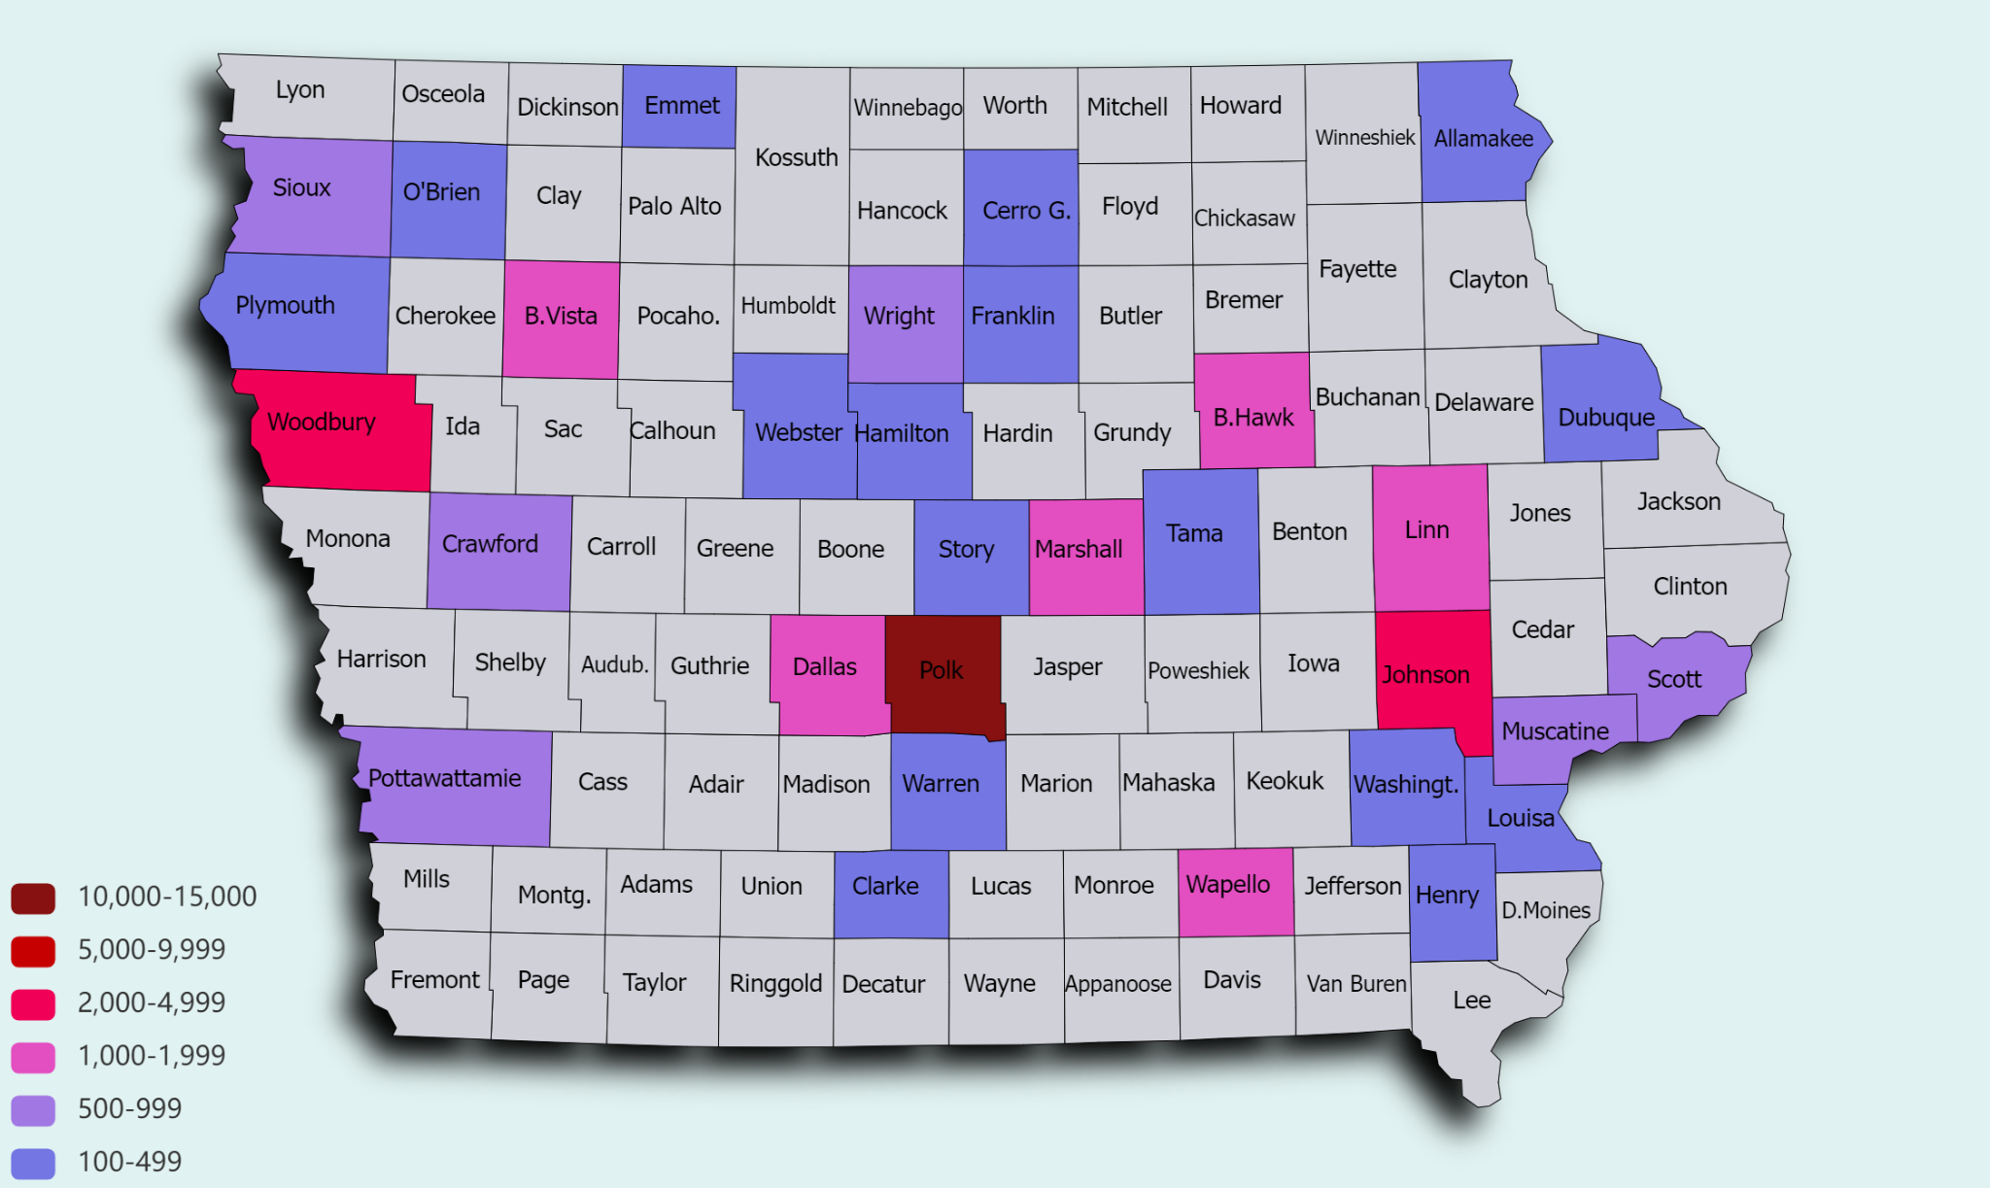
English Learners in Iowa
Notes:
2023-24…35,187 public school ELs
2022-23…1034 nonpublic school ELs

Slide 4
Purposes of Title III (ESEA § 3102)
The purposes of this part are—
to help ensure that English learners, including immigrant children and youth, attain English proficiency and develop high levels of academic achievement in English;
to assist all English learners, including immigrant children and youth, to achieve at high levels in academic subjects so that all English learners can meet the same challenging State academic standards that all children are expected to meet;
to assist teachers (including preschool teachers), principals and other school leaders, State educational agencies, local educational agencies, and schools in establishing, implementing, and sustaining effective language instruction educational programs designed to assist in teaching English learners, including immigrant children and youth;
to assist teachers (including preschool teachers), principals and other school leaders, State educational agencies, and local educational agencies to develop and enhance their capacity to provide effective instructional programs designed to prepare English learners, including immigrant children and youth, to enter all-English instructional settings; and
to promote parental, family, and community participation in language instruction educational programs for the parents, families, and communities of English learners.

Slide 5
Title III
Grants and
Subgrants
Formula Grants to States (ESEA § 3111)
$4,350,716 (2023-24)
$4,431,621 (2024-25)
Within-State Allocations (ESEA § 3114)
Serving English Learners
Serving Immigrant Students
Notes:
18 subgrants 23-24

Slide 6
Title III, Part A–Language Instruction for
English Learners and Immigrant Students
English Learners
Immigrant Students (ESEA § 3201(5)(13))
Age 3 through 21
Enrolled in K-12
Home Language Survey indicated a language other than English
ELPA21 status:
Emerging or
Progressing
Age 3 through 21
Were not born in any State
Have not been attending one or more schools in any one or more States for more than three full academic years
Note: The term “State” means each of the 50 States, the District of Columbia, and Puerto Rico.
Standardized Entrance and Exit Procedures for Iowa’s English Learners

Slide 7
Within-State Allocations
Allocations for Title III–
English Learners
Allocations for Title III–
Immigrant Students
85% of Iowa’s total Title III federal grant
Fund amount per EL
Direct result of entrance/exit data
Allocated to individual LEAs or
Allocated to consortia of LEAs
10% of Iowa’s total Title III federal grant
Allocated to the LEAs with the most significant increases in immigrant student counts compared to the average of their immigrant student counts from the previous two years
Note: 5% of Iowa’s total Title III Grant is reserved for State Activities.

Slide 8
Purpose of Subgrants (ESEA § 3115)
Developing and implementing new language instruction educational programs and academic content instructional programs for English learners and immigrant children and youth, including early childhood education programs, elementary school programs, and secondary school programs.
Carrying out highly focused, innovative, locally designed activities to expand or enhance existing language instruction educational programs and academic content instructional programs for English learners and immigrant children and youth.
Implementing, within an individual school, schoolwide programs for restructuring, reforming, and upgrading all relevant programs, activities, and operations relating to language instruction educational programs and academic content instruction for English learners and immigrant children and youth.
Implementing, within the entire jurisdiction of a local educational agency, agencywide programs for restructuring, reforming, and upgrading all relevant programs, activities, and operations relating to language instruction educational programs and academic content instruction for English learners and immigrant children and youth.

Slide 9
Direct Administrative Expenses (ESEA § 3115(b))
Each eligible entity receiving funds under Title III for a fiscal year may use not more than 2 percent of such funds for the cost of administering this subpart.
Note: Direct Administrative Expenses may only be calculated from the current year’s allocation.

Slide 10
Title III–English Learners
SUPPLEMENTAL FUNDING FOR SERVING ENGLISH LEARNERS
Notes:
Language assistance plans are referred to by a variety of names often associated with the specific educational approach adopted by a district.
(Lau Plan, LIEP Plan, Provision of EL Services, etc.) For purposes of these materials, we have used the generic term ELL plan.

Slide 11
Required Subgrantee Activities
(ESEA § 3115(c))
Increase the English language proficiency of English learners by providing effective language instruction educational programs that meet the needs of English learners and demonstrate success in increasing—
English language proficiency; and
student academic achievement;
#1

Slide 12
Required Subgrantee Activities
(ESEA § 3115(c))
Provide effective professional development to classroom teachers (including teachers in classroom settings that are not the settings of language instruction educational programs), principals and other school leaders, administrators, and other school or community-based organizational personnel, that is—
designed to improve the instruction and assessment of English learners;
designed to enhance the ability of such teachers, principals, and other school leaders to understand and implement curricula, assessment practices and measures, and instructional strategies for English learners;
effective in increasing children’s English language proficiency or substantially increasing the subject matter knowledge, teaching knowledge, and teaching skills of such teachers; and
of sufficient intensity and duration (which shall not include activities such as 1-day or short-term workshops and conferences) to have a positive and lasting impact on the teachers’ performance in the classroom, except that this subparagraph shall not apply to an activity that is one component of a long-term, comprehensive professional development plan established by a teacher and the teacher’s supervisor based on an assessment of the needs of the teacher, the supervisor, the students of the teacher, and any local educational agency employing the teacher, as appropriate;
#2

Slide 13
Professional Development (20 U.S. Code § 7801)
The term “professional development” means activities that—
are an integral part of school and local educational agency strategies for providing educators (including teachers, principals, other school leaders, specialized instructional support personnel, paraprofessionals, and, as applicable, early childhood educators) with the knowledge and skills necessary to enable students to succeed in a well-rounded education and to meet the challenging State academic standards; and
are sustained (not stand-alone, 1-day, or short term workshops), intensive, collaborative, job-embedded, data-driven, and classroom-focused.
Notes:
, and may include activities that—
improve and increase teachers’—
knowledge of the academic subjects the teachers teach;
understanding of how students learn; and
ability to analyze student work and achievement from multiple sources, including how to adjust instructional strategies, assessments, and materials based on such analysis;
are an integral part of broad schoolwide and district-wide educational improvement plans;
allow personalized plans for each educator to address the educator’s specific needs identified in observation or other feedback;
improve classroom management skills;
support the recruitment, hiring, and training of effective teachers, including teachers who became certified through State and local alternative routes to certification;
advance teacher understanding of—
effective instructional strategies that are evidence-based; and
strategies for improving student academic achievement or substantially increasing the knowledge and teaching skills of teachers;
are aligned with, and directly related to, academic goals of the school or local educational agency;
are developed with extensive participation of teachers, principals, other school leaders, parents, representatives of Indian tribes (as applicable), and administrators of schools to be served under this Act;
are designed to give teachers of English learners, and other teachers and instructional staff, the knowledge and skills to provide instruction and appropriate language and academic support services to those children, including the appropriate use of curricula and assessments;
to the extent appropriate, provide training for teachers, principals, and other school leaders in the use of technology (including education about the harms of copyright piracy), so that technology and technology applications are effectively used in the classroom to improve teaching and learning in the curricula and academic subjects in which the teachers teach;

Slide 14
Required Subgrantee Activities
(ESEA § 3115(c))
Provide and implement other effective activities and strategies that enhance or supplement language instruction educational programs for English learners, which—
shall include parent, family, and community engagement activities; and
may include strategies that serve to coordinate and align related programs.
#3

Slide 15
Authorized Activities of Title III–English Learners (ESEA § 3115(d))
Upgrading program objectives and effective instructional strategies.
Improving the instructional program for English learners by identifying, acquiring, and upgrading curricula, instructional materials, educational software, and assessment procedures.
Providing to English learners—
tutorials and academic or career and technical education; and
intensified instruction, which may include materials in a language that the student can understand, interpreters, and translators.
Developing and implementing effective preschool, elementary school, or secondary school language instruction educational programs that are coordinated with other relevant programs and services.
Improving the English language proficiency and academic achievement of English learners.
Providing community participation programs, family literacy services, and parent and family outreach and training activities to English learners and their families—
to improve the English language skills of English learners; and
to assist parents and families in helping their children to improve their academic achievement and becoming active participants in the education of their children.
Improving the instruction of English learners, which may include English learners with a disability, by providing for—
the acquisition or development of educational technology or instructional materials;
access to, and participation in, electronic networks for materials, training, and communication; and
incorporation of the resources described in subparagraphs (A) and (B) into curricula and programs, such as those funded under this subpart.
Offering early college high school or dual or concurrent enrollment programs or courses designed to help English learners achieve success in postsecondary education.
Carrying out other activities that are consistent with the purposes of this section.

Slide 16
Title III–Immigrant Students
SUPPLEMENTAL FUNDING FOR SERVING IMMIGRANT STUDENTS

Slide 17
Authorized Activities of Title III–Immigrant Students (ESEA § 3115(e))
Family literacy, parent and family outreach, and training activities designed to assist parents and families to become active participants in the education of their children;
Recruitment of, and support for, personnel, including teachers and paraprofessionals who have been specifically trained, or are being trained, to provide services to immigrant children and youth;
Provision of tutorials, mentoring, and academic or career counseling for immigrant children and youth;
Identification, development, and acquisition of curricular materials, educational software, and technologies to be used in the program carried out with awarded funds;
Basic instructional services that are directly attributable to the presence of immigrant children and youth in the local educational agency involved, including the payment of costs of providing additional classroom supplies, costs of transportation, or such other costs as are directly attributable to such additional basic instructional services;
Other instructional services that are designed to assist immigrant children and youth to achieve in elementary schools and secondary schools in the United States, such as programs of introduction to the educational system and civics education; and
Activities, coordinated with community-based organizations, institutions of higher education, private sector entities, or other entities with expertise in working with immigrants, to assist parents and families of immigrant children and youth by offering comprehensive community services.

Slide 18
Supplement
Not Supplant
(ESEA § 3115(g))
Federal funds made available under this subpart shall be used so as to supplement the level of Federal, State, and local public funds that, in the absence of such availability, would have been expended for programs for English learners and immigrant children and youth and in no case to supplant such Federal, State, and local public funds.

Slide 19
Civil Rights
All students
Regulations Existed previously
If yes, it is supplanting and is NOT allowable:
Is it required under Civil Rights?
Is it offered to all students?
Is it required by federal, state, or local regulations?
Did it exist previously through other federal, state, or local funds?

Slide 20
Funding
Distinctions

Slide 21
Title III Requirements in CASA
CONSOLIDATED ACCOUNTABILITY AND SUPPORT APPLICATION

Slide 22
Title III Plan Required (ESEA § 3116(a))
Each eligible entity desiring a subgrant from the State educational agency under section 3114 [Title III] shall submit a plan to the State educational agency at such time, in such manner, and containing such information as the State educational agency may require.
Note: Title III Plans are supplemental to requirements under OCR and Iowa Code described in district ELL Plans (i.e. Lau Plans).

Slide 23
Contents of
Title III Plans
(ESEA § 3116(b))
Each plan submitted shall–
describe the effective programs and activities, including language instruction educational programs, proposed to be developed, implemented, and administered under the subgrant that will help English learners increase their English language proficiency and meet the challenging State academic standards;
#1

Slide 24
Contents of
Title III Plans
(ESEA § 3116(b))
Each plan submitted shall–
describe how the eligible entity will ensure that elementary schools and secondary schools receiving funds under this subpart assist English learners in—
achieving English proficiency based on the State’s English language proficiency assessment under section 1111(b)(2)(G), consistent with the State’s long-term goals, as described in section 1111(c)(4)(A)(ii); and
meeting the challenging State academic standards;
#2

Slide 25
Contents of
Title III Plans
(ESEA § 3116(b))
Each plan submitted shall–
describe how the eligible entity will promote parent, family, and community engagement in the education of English learners;
#3

Slide 26
Assurances (ESEA § 3116(b)(4))
Each plan submitted shall contain assurances that–
each local educational agency that is included in the eligible entity is complying with section 1112(e) [Parents Right-to-Know] prior to, and throughout, each school year as of the date of application;
the eligible entity is not in violation of any State law, including State constitutional law, regarding the education of English learners, consistent with sections 3125 [State Law] and 3126 [Civil Rights Laws];
the eligible entity consulted with teachers, researchers, school administrators, parents and family members, community members, public or private entities, and institutions of higher education, in developing and implementing such plan; and
the eligible entity will, if applicable, coordinate activities and share relevant data under the plan with local Head Start and Early Head Start agencies, including migrant and seasonal Head Start agencies, and other early childhood education providers.

Slide 27
Teach English Fluency (ESEA § 3116(c))
Each eligible entity receiving a subgrant under section 3114 [Title III] shall include in its plan a certification that all teachers in any language instruction educational program for English learners that is, or will be, funded under this part are fluent in English and any other language used for instruction, including having written and oral communications skills.

Slide 28
Resources
Iowa Department of Education
English Learners Webpage
ESSA Guidance & Allocations Webpage
Iowa Administrative Code 281.60–Programs for Students Who Are English Learners
Serving Nonpublic School English Learners
Standardized Entrance and Exit Procedures for Iowa’s English Learners
TransACT ParentNotices
U.S. Department of Education
National Clearinghouse for English Language Acquisition
Non-Regulatory Guidance: English Learners and Title III of the Elementary and Secondary Education Act (ESEA), as amended by the Every Student Succeeds Act (ESSA)
Office of Elementary and Secondary Education: Title III Legislation
Office of English Language Acquisition
US Secretary Cardona's Letter and Resources to Support English Learners

Slide 29
Contact Information
Rachel Pettigrew
rachel.pettigrew@iowa.gov
515-380-5115

