Slide 1
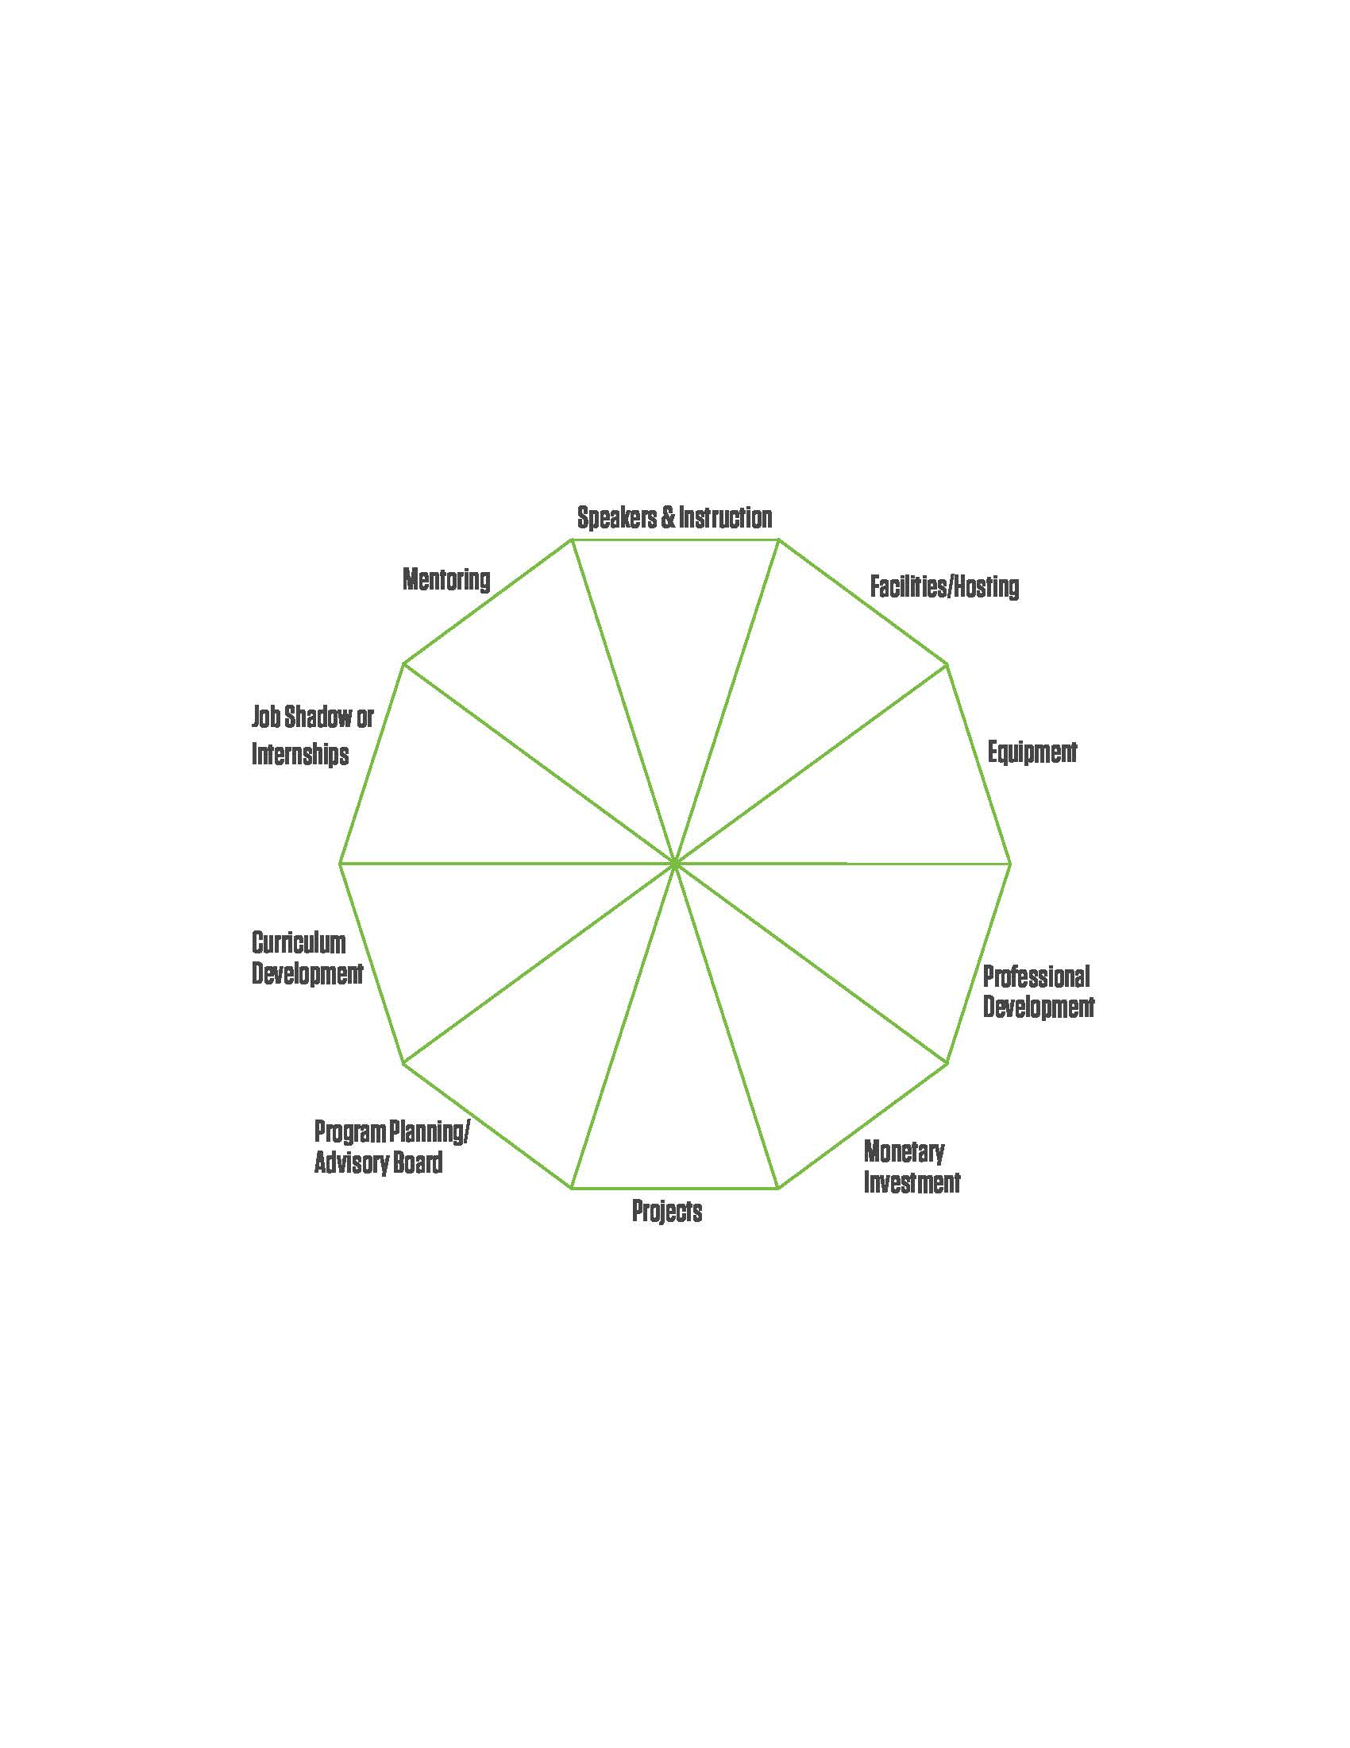
Potential Roles of Partners
Through the STEM BEST Program, quality partnerships are prioritized over the quantity of partnerships between education, business and industry and other community partners.

Slide 2
The diagram depicts what a single Education+Business partnership may potentially look like. A single partner providing many supports.
Despite having one partner, there is still quality collaboration happening.
Partner #1

Slide 3
Partner #1
The diagram depicts what a few Education+Business partnerships that provide different supports.
Both examples could be providing sufficient supports to the STEM BEST model. The ideal is to start the partnership(s) and grow until all of the pieces of the pie are being filled.
Partner #1
Partner #2
Partner #3

