Slide 1
Title II, Part A
Supporting Effective Instruction
Amy Huebner
Education Program Consultant
Division of PK-12 Learning
Bureau of Federal Programs
Spring 2024

Slide 2
Overview
Purpose
Supplement versus Supplant
Professional Development,
Other School Leaders, and Highly Effective
Evidence-Based Definition
Non-Regulatory Guidance
Needs Assessment & Consultation Process
CASA - Consolidated Accountability and Support Application
Appropriate Uses of Funds
Understanding Allowability
Contact Information and Resources

Slide 3
Purpose (ESEA § 2001)
The Every Student Succeeds Act of 2015 reauthorized the Elementary and Secondary Education Act of 1965’s (ESEA) Title II, Part A (Title II-A) – Supporting Effective Instruction program (ESEA § 2101)
Increase student achievement consistent with the challenging State academic standards;
Improve the quality and effectiveness of teachers, principals, and other school leaders;
Increase the number of teachers, principals, and other school leaders who are effective in improving student academic achievement in schools; and
Provide low-income and minority students greater access to effective teachers, principals, and other school leaders.

Slide 4
Supplement versus Supplant
Supplement | Supplant
Title II, Part A federal funds must be supplemental in nature meaning activities supplement the professional development made available of which wouldn’t otherwise be received through other federal, state and local funding sources. | Title II, Part A must not take the place or serve as a substitute for an activity that currently exists or is required by the school or district because this would be considered supplanting.
Title II, Part A 2113(f), 2123(b)

Slide 5
Supplement versus Supplant
Assisting Questions & Answers
Questions:
In the event of the unavailability of Title II, Part A funds, would this activity be otherwise funded in another capacity (federal, state, local funds)?
Is the proposed activity required by law?
Answer:
Title II, Part A funds for Supporting Effective Instruction must not be used if the questions were answered yes. This means it would be considered supplanting.
Title II, Part A funds for Supporting Effective Instruction may be used if the questions were answered no. This is in terms of the funds being supplemental and means funds meet the allowability for this purpose.
Note: The allowability is also dependent on the ESSA requirements for the activity regarding the use of federal funds.

Slide 6
Professional Development
Important Definition - (ESEA § 8101(42)(B))
All professional development services and programs must meet the definition of “professional development” in ESEA section 8101(42), which requires that the activity is both
(1) part of the strategies for providing educators with the knowledge and skills necessary to enable children to succeed in a well-rounded education and
(2) sustained (not stand-alone, 1-day, or short-term workshops), intensive, collaborative, job-embedded, data driven, and classroom focused.

Slide 7
Other School Leaders
Important Definitions - (ESEA § 8101(44))
The term "other school leader" means principal, assistant principal, or an individual who is both
(1) an employee of an elementary school or secondary school; and
(2) responsible for the daily instructional leadership and managerial operations in the elementary or secondary school (ESEA § 8101(44)).

Slide 8
Highly Effective Teaching
Effective teaching contributes to and results in student learning; therefore, students become increasingly knowledgeable and skilled across the breadth and depth of the curriculum. Instructional practices can be reviewed in six research-based domains and have been shown to be important for improved student learning.

Slide 9
Highly Effective Attributes
A highly effective teacher is an individual who exhibits:
Utilization of a repertoire of instructional skills, strategies, and models to facilitate learning;
Commitment to students and their learning;
Deep content knowledge in their subject area;
Ability to manage the learning environment to enhance learning;
Ability to think systematically about their practice and continually work to improve it; and
Regular use of data to make decisions regarding their practice to enhance learning outcomes.

Slide 10
Evidence-Based Definition
Title II, Part A funds should be used to support an activity, strategy or intervention described in section 8101(21) A:
(i) demonstrates a statistically significant effect on improving student outcomes or other relevant outcomes based on ⎯
strong evidence
moderate evidence
promising evidence

Slide 11
Evidence-Based Definition
(I) strong evidence from at least one well-designed and well-implemented experimental study;
(II) moderate evidence from at least one well-designed and well-implemented quasi-experimental study;
(III) promising evidence from at least one well-designed and well-implemented correlational study with statistical controls for selection bias;

Slide 12
Evidence-Based Definition
(ii) (I) demonstrates a rationale based on high quality research findings or positive evaluation that such activity, strategy, or intervention is likely to improve student outcomes or other relevant outcomes; and
(II) includes ongoing efforts to examine the effects of such activity, strategy, or intervention.

Slide 13
Non-Regulatory Guidance
Strengthening Investments
Collaboration & Partnerships with Nonpublic Schools
Equitable services and benefits are for students and educators such as teachers or other eligible educational personnel.
ESEA section 8501 outlines the provisions under which eligible nonpublic school children and educators are provided equitable services.
The LEA must provide services if funds are received under an ESEA program.
Title VIII, Part F Non-Regulatory Guidance

Slide 14
Consultation
LEA contacts the nonpublic school; however, the nonpublic school may contact public and the State ombudsman may also become involved in some capacity, if necessary.
Intent to Participate Document - LEA may set a reasonable deadline for participation confirmation, and may provide a written affirmation including reasoning for not allowing activity and/or use of contractor.
Record of agenda, topics for discussion, & decisions should be kept in consultation.
Remember, it is important to maintain a record of notes including those in attendance.

Slide 15
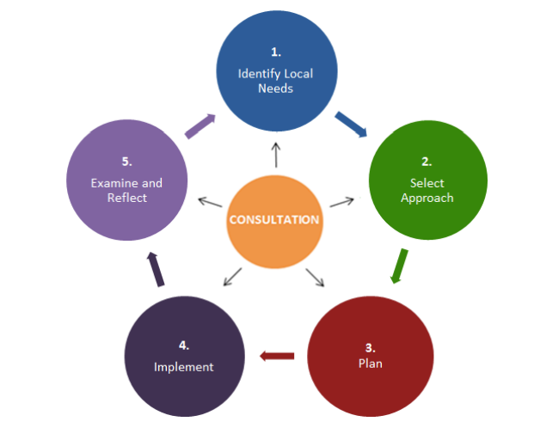
Consultation
Framework
Assessment of Needs
🠋
Evidence-Based Approach
🠋
Plan for Implementation
🠋
Implementation of Activity
🠋
Reflection on Impact
U.S. Department of Education Non-Regulatory Guidance Title II, Part A of the Elementary and Secondary Education Act of 1965, as Amended by the Every Student Succeeds Act of 2015 September 27, 2016

Slide 16
Needs Assessment
Data Depicts Need for Professional Development:
What is the need showing? In (core) academic areas? For staff?
Is there a need for highly qualified and highly effective teachers? What content knowledge or knowledge of effective strategies might supplement the effectiveness of teachers?
What is the impact of services? How will the services be monitored and evaluated to determine the impact towards the activity or activities and the teacher effectiveness?
What is working? What supplemental professional development could enhance the effectiveness? Is data showing a need for a new program(s) to supplement what is currently in place?

Slide 17
Needs Assessment
Data Depicts Need for Class Size (Public LEAs Only):
What is the elementary school with the largest average class size or the largest average class size by grade level?
What teachers are determined to be highly effective?
How are low achieving students ensured access to those educators determined to be highly qualified and highly effective?

Slide 18
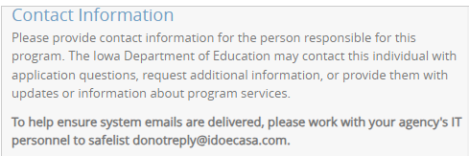
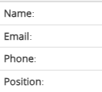
Consolidated Application
Consolidated Accountability and Support Application Contact
Additional questions or information is sometimes necessary or needed by the Iowa Department of Education.
Please keep the contact updated - Name, Email, Phone, Position

Slide 19
Consolidated Application
Consolidated Accountability and Support Application
Components of the Title II, Part A Application
Program Assurances
Program Budget
Program Questions

Slide 20
Consolidated Application
Program Assurances
The LEAs assurances are required for compliance of the 8501 (Participation by Private School Children and Teachers) and ensuring Title II, Part A (Supplemental Professional Development) activities will be coordinated with other federal, state, and local programs for professional development.
This includes the assurance of evidence-based activities and definitions for professional development and other school leaders.

Slide 21
Consolidated Application
Program Questions
This component assures the authorized activities ⎯
are in alignment with states challenging academic standards,
use a data assessment to depict system needs for growth in particular areas,
use ongoing consultation in addition to data to depict the direction with description(s) and/or explanation(s) regarding the impact of the activity; and
meet minimum requirements of class size reduction.

Slide 22
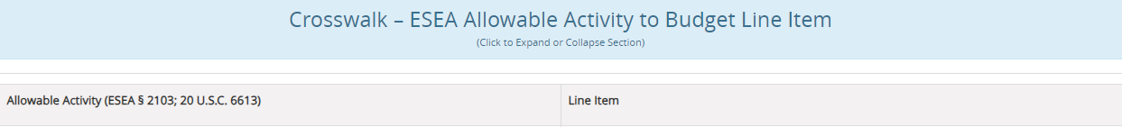
Consolidated Application
Program Budget
LEAs planned funds ensure alignment with program requirements
Choose allowable activity or activities using the “Crosswalk”
LEAs determine how (100%) funds are intended to be allocated
Once the superintendent or school business official mark the Allocations and Transfers section as complete, the budget status can be indicated “Complete”

Slide 23
Appropriate Uses of Funds
Professional Development Activities (Slide 1 of 7)
ESEA Allowable Activity | Budget Line Item
Providing professional development on effective strategies to integrate rigorous academic content, career and technical education, and work-based learning. | Providing professional development on effective strategies to integrate rigorous academic content, career and technical education, and work-based learning.
Developing or improving a rigorous, transparent, and fair evaluation and support system for educators. | Implementation of a rigorous, transparent, and fair evaluation and support system for educators.

Slide 24
Appropriate Uses of Funds
Professional Development Activities (Slide 2 of 7)
ESEA Allowable Activity | Budget Line Item
Developing and implementing initiatives to assist in recruiting, hiring, and retaining effective educators, particularly in low-income schools with high percentages of ineffective educators and high percentages of students who do not meet the challenging State academic standards, to improve within-district equity in the distribution of educators, consistent with section 1111(g)(1)(B). | Initiatives to recruit and retain effective educators, particularly in low income schools.
Recruitment of qualified individuals from other fields to become educators. | Recruitment of qualified individuals from other fields to become educators.

Slide 25
Appropriate Uses of Funds
Professional Development Activities (Slide 3 of 7)
ESEA Allowable Activity | Budget Line Item
Reduction of class size to a level that is evidence based. | Reduction of class size to a level that is evidence based.
Providing high-quality, evidence-based personalized professional development for educators, that is focused on improving teaching and student learning and achievement, including supporting efforts to train educators. | Providing professional development on improving teaching and student learning.
Development of programs and activities that increase the ability of teachers to effectively teach children with disabilities or English language learners. | Providing professional development to effectively teach children in Special Education or English learners.

Slide 26
Appropriate Uses of Funds
Professional Development Activities (Slide 4 of 7)
ESEA Allowable Activity | Budget Line Item
Providing programs and activities to increase the knowledge base of educators on instruction in the early grades, and the ability to support teachers, teacher leaders, early childhood educators, and other professionals to meet the needs of students through age 8. | Increasing the knowledge of educators on instruction in the early grades to meet the needs of students through age 8.
Developing a feedback mechanism for improved working conditions. | Developing a feedback mechanism for improved working conditions.

Slide 27
Appropriate Uses of Funds
Professional Development Activities (Slide 5 of 7)
ESEA Allowable Activity | Budget Line Item
Providing training, technical assistance, and capacity-building in districts to assist educators with designing, selecting and implementing formative assessments, designing classroom based assessment, and using the data from those assessments to improve instruction and student academic achievement. | Providing training to assist educators with designing, selecting and implementing formative assessments to improve instruction and student academic achievement.
Carrying out in-service training for school personnel in techniques and supports needed to help educators understand when and how to refer students affected by trauma, and children with, or at risk of, mental illness. | Providing in-service training for school personnel in techniques to help educators understand how to refer students affected by trauma, and children with, or at risk of, mental illness.

Slide 28
Appropriate Uses of Funds
Professional Development Activities (Slide 6 of 7)
ESEA Allowable Activity | Budget Line Item
Providing training to support the identification of students who are gifted and talented. | Providing training to support the identification of students who are gifted and talented.
Supporting the instructional services provided by school library programs. | Supporting the instructional services provided by school library programs.
Providing training for all school personnel regarding how to prevent and recognize child sexual abuse. | Providing training for all school personnel regarding how to prevent and recognize child sexual abuse.

Slide 29
Appropriate Uses of Funds
Professional Development Activities (Slide 7 of 7)
ESEA Allowable Activity | Budget Line Item
Developing and providing professional development and other comprehensive systems of support for educators to promote high-quality instruction and instructional leadership in STEM. | Providing professional development to promote high-quality instruction and instructional leadership in STEM.
Other (any other activity must be approved by the State prior to the approval of the application). | Other (any other activity must be approved by the State prior to the approval of the application).

Slide 30
Understanding Allowability
Conference/Workshop/Training
Professional development that is short-term or stand-alone may not meet the definition as an allowable expenditure under ESEA section 2103(b)(3) without further integration into a comprehensive plan for professional development.
The supplemental activity must be comprehensive and integrated in a professional development plan.
There should be a form of participation verification; including title and descriptions of the attended class, session(s), etc.
The allowability is also dependent on the content and substance of the activity.
*Note: Contact the Title II, Part A Education Program Consultant prior to activity to determine allowability.

Slide 31
Understanding Allowability
Only Secular, Neutral, and Non-Ideological Content
A conference, workshop and/or training conducted by a religious organization often includes both secular and religious content. Title II, Part A may pay only for participation in that portion of the activity that is secular, neutral, and non- ideological.
Process: The LEA would need to ⎯
determine the sessions of the conference that provide secular, neutral, and non-ideological professional development; and
have the teacher document participation in such program sessions in such a way that the LEA is able to determine the percentage of the teacher’s overall time spent attending those sessions; and
apply that percentage against the overall cost of attending the conference as a whole. All costs must be allocable to the Federal program (2 C.F.R. § 200.405).

Slide 32
Understanding Allowability
Class Size Reduction Activity Requirements (Public LEAs Only)
All of the following criteria must be met for the activity - reduction of class size to a level that is evidence based:
Needs assessment must indicate the need for class size reduction activity.
A kindergarten through third grade (K-3) class must be added with the intent to reduce class size to a reasonable, evidence-based level, to further student achievement.
Title II-A funds must be assigned only to certified licensed teachers resulting in “highly qualified” teachers instructing those in kindergarten through third grade classrooms; and are highly effective teachers who have necessary subject-matter knowledge and teaching skills to adjust instruction based on the needs of all learners and to assist in achievement towards meeting the academic state standards.
*Note: The LEA must consult with the State during the application process to determine allowability.

Slide 33
Resources
Important Department Link(s)
ESSA Guidance and Allocation
Non-Regulatory Guidance for Title II, Part A
Non-Regulatory Guidance for Title VIII, Part F

Slide 34
Contact Information
Amy Huebner
Bureau of Federal Programs
Iowa Department of Education
Grimes State Office Building
Des Moines, IA 50319
amy.huebner@iowa.gov
(515) 689-9749

