Slide 1
Preschool and ACHIEVE: Reminders and Tips
Spring, 2024
Link to Recording
Notes:
Thank you for joining me for this brief webinar on Preschool and ACHIEVE-Reminders and Tips

Slide 2
Topics
Background for Preschool IEP Processes
Preschool Environments
OSEP Indicator
Entering the RECP
Documenting Services
Additional Reminders for Preschool Environments
PK to K Transitions
Early Childhood Outcomes
OSEP Indicator
Completing the Final ECO
Additional Resources
Notes:
Here are the topics that will be covered during this webinar

Slide 3
Preschool IEP Processes in ACHIEVE
ACHIEVE includes new processes for IEPs, including steps that are specific for preschool learners
We will review two processes in particular:
Preschool Environments (aka Early Childhood Settings) and
Early Childhood Outcomes (ECO) for learners who are transitioning to kindergarten.
If you are experiencing technical difficulties with completing any of these processes, it is very important to submit a Support Request in ACHIEVE so fixes can be made as soon as possible
Notes:
Read slide
Also, to stay updated on system updates, there is link the left hand bar where you can track the updates that have happened and that are yet to come

Slide 4
Background for Preschool IEP Processes
Notes:
I would like start with information about the background for some of the new Preschool IEP processes found in ACHIEVE

Slide 5
Background for Preschool IEP Processes
Reporting Requirements
IDEA (Individuals with Disabilities Education Act) requires data to be collected and reported annually to the federal government, OSEP (Office of Special Education Programs)
The State Performance Plan/Annual Progress Report (SPP/APR) includes indicators for preschool learners
Much of the data that is used for SPP/APR comes directly from ACHIEVE, including information from the IEP for each learner
Data collected from ACHIEVE is also used in the IDEA-DA (Differentiated Accountability) process and contributes to how Districts are assigned to levels of support
Notes:
In addition to the importance of ensuring the IEP is written per the requirements of IDEA, I also want to describe another way the information entered into ACHIEVE is used for reporting requirements
Read slide
For all of these reasons, we want to ensure that all users of ACHIEVE are able to access and complete the various process with an understanding of how they are completed and why we need to ensure accuracy of the information we are providing to families, providers, as well as state and federal agencies

Slide 6
Preschool Environments
Notes:
The first process we will review is around preschool environments

Slide 7
Preschool Environments-OSEP Indicator
One of the indicators reported annually to OSEP and also used in the IDEA-DA process:
Indicator 6: Percent of children with IEPs aged 3, 4, and aged 5 who are enrolled in a preschool program attending
Regular early childhood program and receiving the majority of special education and related services in the regular early childhood program.
Separate special education class, separate school or residential facility.
Receiving special education and related services in the home.

Slide 8
Preschool Environments
Based on information entered into ACHIEVE, each preschool learner is assigned an Early Childhood Setting Code that is used to report the data in this indicator.
Previously, in Legacy, teams would complete a worksheet outside of the IEP process to determine the EC Setting Code.
Now, in ACHIEVE, the system is using data entered in the IEP and on the Learner Dashboard to determine the EC Setting Code in place of asking teams to complete an extra step outside of the IEP process.
Because of the change in this process, we want to ensure that teams understand the new process and how to ensure it’s completed accurately.

Slide 9
Preschool Environments
Indicator 6: Percent of children with IEPs aged 3, 4, and aged 5 who are enrolled in a preschool program attending
Regular early childhood program and receiving the majority of special education and related services in the regular early childhood program
Separate special education class, separate school or residential facility
Receiving special education and related services in the home
The regular early childhood program (RECP) is documented on the Learner Dashboard for ALL preschool learners who attend an RECP (including support-only)-if a Regular Early Childhood Program is not entered accurately, then the learner will not be included in the correct data set
Notes:
In looking at this indicator, you see that it uses the term regular early childhood program

Slide 10
Reminders about Regular Early Childhood Programs (RECP)
A Regular Early Childhood Program is any session, class, or recurring activity that enrolls less than or equal to 50% of children with an IEP
Ex. A learner attends licensed child care in the morning and SWVPP in the District in the afternoon. BOTH programs must be entered on the Learner Dashboard under RECP, even if the IEP is not implemented in both settings.
Ex. A learner is goes to an in-home childcare in the neighborhood in the morning and Head Start in the afternoon. ONLY the Head Start program would be entered into the RECP section because in-home childcare, or child development homes, are not included in the OSEP definition of RECP.
Notes:
Examples could include:
Statewide Voluntary Preschool Programs operated by Districts and Community Partners
Head Start Programs
Shared Visions Preschools
Preschool Programs operated by community organizations
Child Care Centers licensed by the Iowa Department of Human Services (DHS)
Examples that are NOT INCLUDED: child development homes, library story times, or informal playgroups

Slide 11
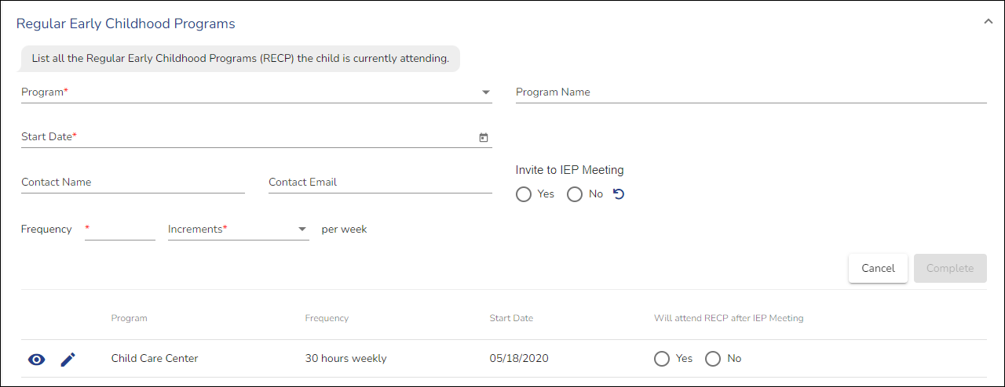
Documenting the Regular Early Childhood Program (RECP) on the Learner Dashboard
NEW in ACHIEVE
Notes:
This is the entry screen for the RECP and a reminder that it is located on the Learner Dashboard, not in the IEP itself.
When you enter the RECP, you will see there are a few fields that are required, including the program type, which is a dropdown, the start date, which can be an estimate, and the frequency of the program, or how many hours per week
Any RECP that is entered will be added to a table below. Teams will see an additional question in the table: Will attend RECP after IEP meeting? Yes/No?
Teams should not answer this question until after the IEP team decides where the learner will receive their services. There will be a prompt later in the system on the LRE page to go back and answer this question for all REPs entered.

Slide 12
FAQ’s: Documenting the RECP on the Learner Dashboard
Do we enter an RECP that will not start until the next school year?
Yes, if it is confirmed the learner will start the RECP in the Fall; teams can enter the start date of the RECP on the learner dashboard and should answer “yes” to the question “Will attend RECP after IEP meeting?”
Ex. IEP team is meeting at the end of May and as a result of the IEP, the learner will start attending SWVPP in August. Teams DO enter the RECP and mark “yes,” the learner will be attending the RECP after the IEP meeting
Non-Ex. IEP team is meeting in March and decides the learner will be coming in to a provider location to receive speech-only services (the learner does not attend any other RECP). The parent has shared that they might be interested in having their child start preschool in the fall, but no decision has been made. Teams DO NOT enter the possible RECP for the Fall since it’s not confirmed. If the parent does decide to send their child to preschool in the Fall, the RECP can be added at that time.
Notes:
There are a couple of frequently asked questions

Slide 13
FAQ’s: Documenting the RECP on the Learner Dashboard
Do teams amend an IEP if the RECP changes during the duration of the IEP?
It depends. An RECP can be added or updated on the Learner Dashboard at any time without an amendment.
If, however, the change will impact how the IEP is implemented or the content of the IEP (such as the amount of services or where the services are being provided), the IEP team should convene and make any needed amendments.
If a learner does not currently attend nor will they start a new RECP, what do we enter on the Learner Management page under RECP, since those fields appear to be required?
The fields under RECP are only required IF the learner attends an RECP. It is not required to enter one if the learner is not attending nor will they start an RECP. The team should be able to finalize an IEP without entering RECP.

Slide 14
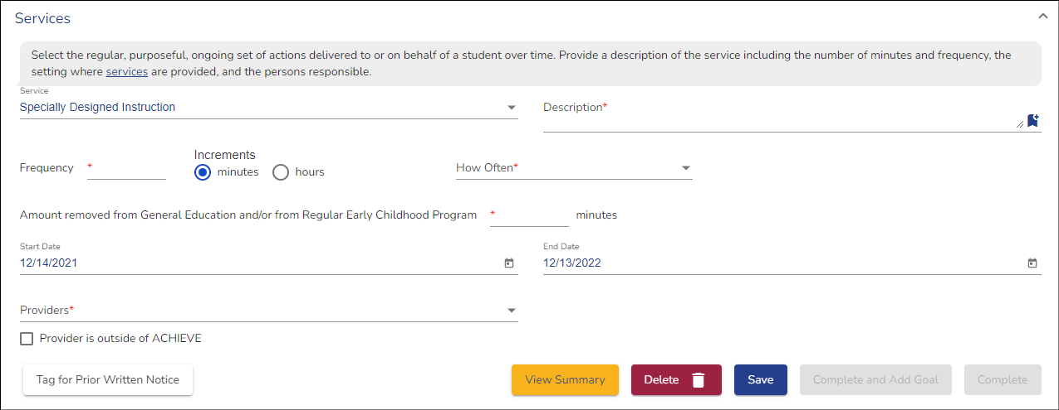
Documenting Removal from the RECP in the IEP
At this point, teams are not considering a specific RECP location. Instead, teams are discussing whether or not this service could be provided within the context of any general education environment (aka regular early childhood program). The actual location (specific building or program) where the IEP will be implemented is determined later as part of the LRE decision.
Notes:
The next important step in documenting the preschool environment is to consider the services the learner will be getting and if any of those services will be removed from general education or RECP
This screen shows the services section of the IEP.
After entering the service type, description, and frequency, the team indicates how much, if any, of the service is removed from an RECP

Slide 15
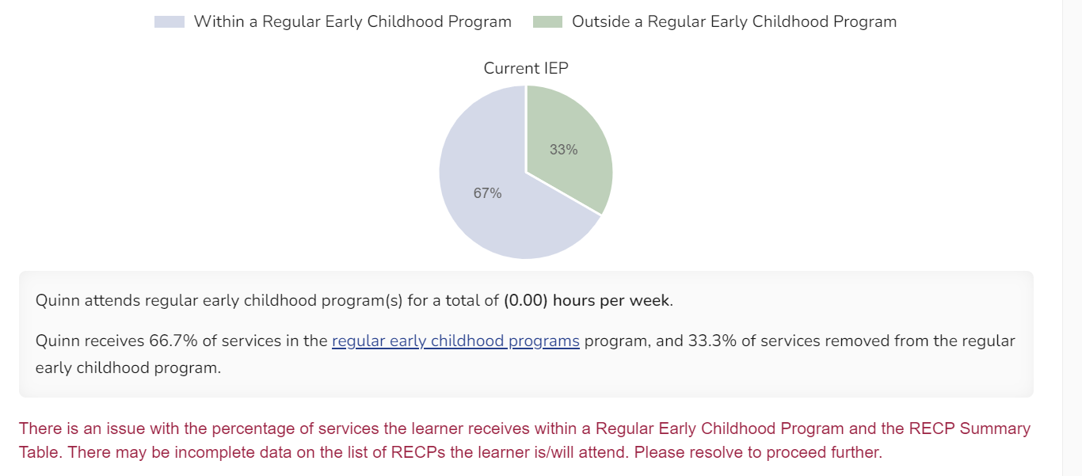
Verify Accuracy (LRE section in the IEP)
It is very important that teams ensure these two statements are correct!
Notes:
Once all of the services have been entered, the Least Restrictive Environment, or LRE, section of the IEP can help teams verify accuracy.
The pie chart represents the percentage of services that within or outside of the RECP, based on the services entered as was just described
click
Under the pie chart, there are two statements that teams will want to read carefully to make sure that they are correct.
The first statement represents the total number of hours the learner is going to attend an RECP. This is based on the RECPs that have been entered on the Learner Dashboard. If the learner is going to attend more than one RECP, such as child care for half the day and SWVPP the other half of the day, this statement should represent the total amount of hours of both those programs together.
The second statement is a description of the pie chart and is again based on the services previously entered and represents the total amount of services provided in and out of the an RECP environment

Slide 16
Verify Accuracy (LRE section in the IEP)
If you see this red warning sentence, then the pie chart and RECP do not align
Notes:
If teams are seeing a red warning statement as is displayed here, then this is an indication that there is something wrong with what has been entered.
In this example, you can see that the pie chart shows that 67% of the services are being provided in an RECP but the 1st statement under the pie chart states that the learner is attending an RECP 0 hours per week
The system recognizes that this does not match because if there are any services being provided in an RECP (the blue section of the pie chart), then there should be at least one RECP listed. The red warning displays this statement for the team as a check to make sure everything is correct. Even if teams are not seeing the red warning, they should still verify accuracy of the two statements under the pie chart

Slide 17
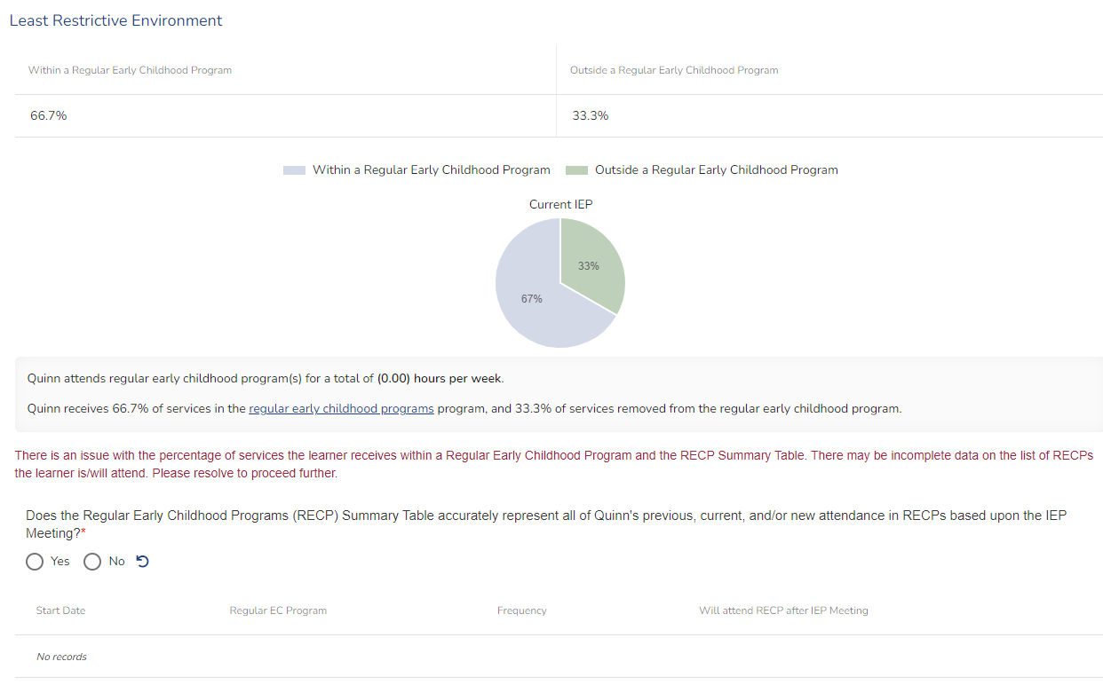
ACHIEVE LRE Section
Notes:
Under the red warning, the teams will see a question about whether or not the RECPs are correct and it shows a summary table of what is currently entered on the Learner Dashboard.
In this example you can see that an RECP has not yet been entered and that is okay, this is the point in the IEP team meeting process when teams will now want to discuss where the services will be provided. Once the team has agreed, the facilitator will go back to the Learner Dashboard to the RECP section on the Learner page and update any RECPs the learner is going to attend and then come back to this section to make sure it has been updated. Again, check the statement directly under the pie chart to make sure the hours have been updated and the new RECP is now reflected in the table, like this

Slide 18
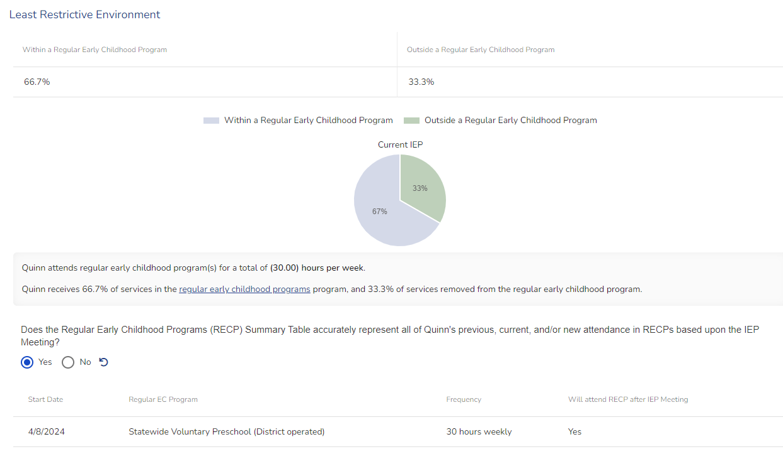
ACHIEVE LRE Section
Notes:
You can see that the new RECP has been entered on the Learner Dashboard and is now in the summary table
And the statement under the pie chart has been updated with the number of hours the learner will be attending the RECP
And the red warning has gone away

Slide 19
ACHIEVE LRE Section
The pie chart and RECP table represent two different things and do not inform each other…however, these two data points are combined to create the EC Setting Code reported to OSEP
Notes:
One common misconception to point out is that…
So in other words, the RECP hours are not factored into the pie chart calculations and the pie chart minutes are not factored into the RECP hours, these are two separate data points but we use them together to calculate the setting code so it’s very important that both are correct

Slide 20
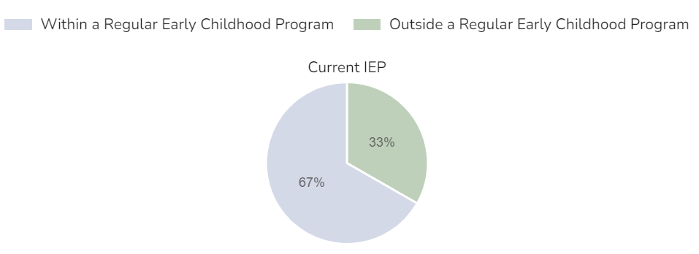
Additional Questions Regarding Preschool Environments
What are the reasons ____ cannot be provided all special education services in a regular early childhood program?
This question will show if the learner has any services listed as being removed from the Regular Early Childhood Program. This is NOT about the specific RECP they are attending, but rather why are services not able to be provided in any regular early childhood program?
Notes:
We are going to take a look now at a few different questions that you might see as part of the LRE section in ACHIEVE. Since ACHIEVE is a dynamic system, the questions that are displayed are dependent on other information that has been entered into ACHIEVE. Please take a look at each of these questions and the scenarios of when you should or should not be seeing them because that will be another way to know if information in other areas, such as LRE and RECP have been entered accurately.
The first question you might see is ….

Slide 21
Additional Questions Regarding Preschool Environments
Will _____’s special education services be provided in the regular early childhood program or school they currently attend?
This question will show if the learner has at least one Regular Early Childhood Program listed on the Learner Management page with a start date before the IEP team meeting. This question IS about the specific RECP the learner will be attending once the IEP is implemented.
If the learner is going to stay in their current RECP and receive their special education services in that location, answer YES.
If the learner will NOT receive their special education services in their current RECP and will begin attending a NEW RECP, answer NO and Explain Why the learner is not able to receive their special education services in their current program.
Notes:
Another question you might see is….
An example of when you might answer no to this question would be if the learner was attending a child care program before the IEP team met, and as a result of the IEP, will no longer be attending that program but is now going to start attending a district preschool program. The team would answer “NO”, because the special education services are not going to be provided in the learner’s current RECP, the day care. The team would then explain why, which could include statements like “The child care program does not follow required program standards therefore the learner will begin attending the district preschool in order to received special education services” OR another example might be “the parent has chosen to move the child from the child care program to the district preschool program”
There are a couple of additional questions that we are not going to review during this webinar but they are included in the quick reference sheet that goes along with this webinar, so please check them out there.

Slide 22
Additional Reminders for Preschool Environments
Teams may use this brief quick reference sheet to verify that the RECP is accurate.
If the learner is not attending any RECP and 100% of the special education services are removed, teams will choose a location for where the special education services are provided in the LRE section of the IEP using a dropdown with these options: Special Education, Special School, Residential Facility, Home, or Service Provider Location
If you are receiving this dropdown question in error, check to make sure that you have entered an RECP on the Learner Dashboard and answered the yes/no question
Administrators can look at the preschool environment data and EC Setting Codes for learners with finalized IEPs by running the special education report called “Service Roster” and comparing the EC Code for each learner to the definition of the EC Setting Codes.
Reminder, if a learner is attending any RECP, they should have an A1, A2, B1, or B2 code, even if the IEP is not being provided in that program.
Notes:
A few additional reminders about Preschool Environments in ACHIEVE…

Slide 23
PK to K Transitions
Notes:
Next, we are going to briefly review a few important things to remember about PK to K transitions

Slide 24
Reminders about PK to K Transitions
During the spring prior to the learner starting kindergarten, IEP teams should plan to hold an IEP meeting for children transitioning from preschool (PK) to kindergarten late enough in the school year that the new IEP team will have appropriate information for planning and decision making for a learner’s kindergarten program.
The meeting should include the current IEP team members as well as IEP team members from the kindergarten grade level (if known, otherwise representatives should attend).
Notes:
Read slide
Examples of those new team members might include
Building principal, if different than preschool
Receiving special education teacher or representative
Receiving kindergarten teacher or representative
And if applicable or different, the School-age AEA special education consultant
Support Service providers (if different from current providers)
And any Additional team members that will be involved in the implementation of the IEP in kindergarten

Slide 25
Reminders about PK to K Transitions
Topics should include but are not limited to: the current IEP and any amendments that might be needed and why (PWN), developing a new IEP if an annual is due, sharing strategies that have helped the learner be successful in preschool, discussing what will be needed to ensure a smooth transition to kindergarten, and any other questions or concerns the family may have regarding the transition. The Final ECO ratings should also be completed during the PK to K Transition.
ACHIEVE processes to support the PK to K Transition:
Services can be designed for PK only, K only, or both, eliminating the need to amend the IEP in the fall to add kindergarten services.
LRE will be calculated and displayed for the both the PK year and the K year, based on the services entered.

Slide 26
Early Childhood Outcomes (ECO)
Notes:
Our final topic is Early childhood outcomes, or ECO, and we are going to focus on completing the final ECO rating

Slide 27
Early Childhood Outcomes (ECO)
This is an additional indicator that is reported annually to OSEP:
Indicator 7: Percent of preschool children aged 3 through 5 with IEPs who demonstrate improved:
Positive social-emotional skills (including social relationships);
Acquisition and use of knowledge and skills (including early language/communication and early literacy); and
Use of appropriate behaviors to meet their needs.
Notes:
Let’s start by talking about an additional data point or indicator that is reported annually to OSEP…
You may notice that bullets A, B, C are the early childhood outcome or ECO areas

Slide 28
Early Childhood Outcomes (ECO)
In order to calculate improvement in the three ECO areas, there must be an initial ECO rating (documented in the initial IEP) AND a final ECO rating
In ACHIEVE, the final ECO is completed using a Quick Link on the Learner Dashboard (described on the next slide).
The final ECO rating should be completed no more than 90 days before the learner will leave preschool but before they move on to Kindergarten, if they are staying in special education.
Once the learner’s grade level in the school’s information system (SIS) changes to kindergarten, often during the summer, the link to complete the final ECO will go away, so teams need to complete the final ECO before the grade level changes.

Slide 29
Early Childhood Outcomes (ECO)-Final Rating
Only use the end/exit quick link if the learner will NOT receive special education services in kindergarten and the team is exiting the learner from special education.
This should be used at any time a learner is exiting special education, PK-12. For PK learners, the final ECO ratings as part of the exit process.
For a learner who is staying in special education and transitioning to Kindergarten, use this link to complete their final ECO ratings.
ACHIEVE | Iowa IDEA 29
Notes:
On the Learner Dashboard, under Quick Links, you will see two links that are available for completing the final ECO
The first link is the End/Exit from Special education link. (read box)
The second link is Transition to Kindergarten-Final ECO. (read box) This link is always available for a preschool learner, however it will go away once it has been completed OR if the learner’s grade level is changed to Kindergarten
For this webinar, I am going to focus on this second link and how teams complete the Final ECO for the learner who is staying in special education but moving on to kindergarten

Slide 30
Transition to Kindergarten-Final ECO
Notes:
Once you click on the link to complete the final ECO for a learner transitioning to K, users will see this warning to make sure they are choosing the correct process.

Slide 31
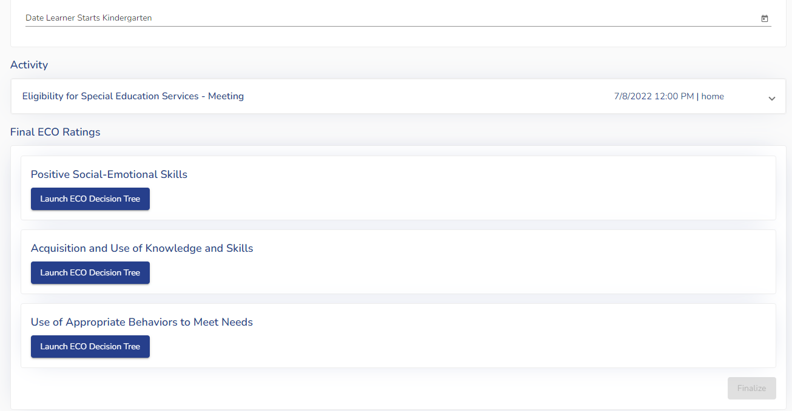
Early Childhood Outcomes (ECO)-Final Rating
Notes:
After confirming the process, the Final ECO Scores section will display beneath the RECP and Activity sections at the bottom of the Learner Dashboard

Slide 32
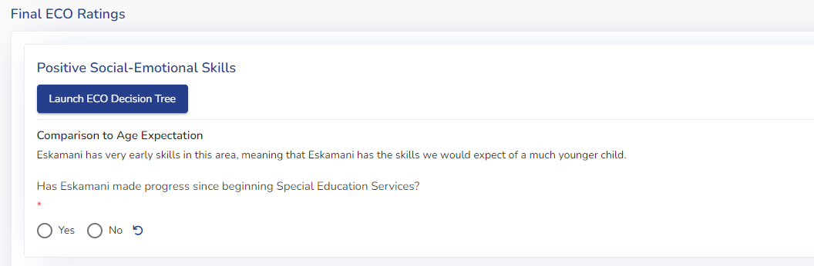
Early Childhood Outcomes (ECO)-Final Rating
*If the team recently completed AND finalized a PK-K IEP, the ECO Descriptions that were entered as part of the PLAAFP are pre-filled in the Comparison to Age Expectations here and the team does not need to revisit this, they would only need to answer the progress question.
If a PK-K IEP was not recently completed, teams will need to complete both the ECO Decision Tree to determine the final comparison to age expectations (rating) and the progress questions.

Slide 33
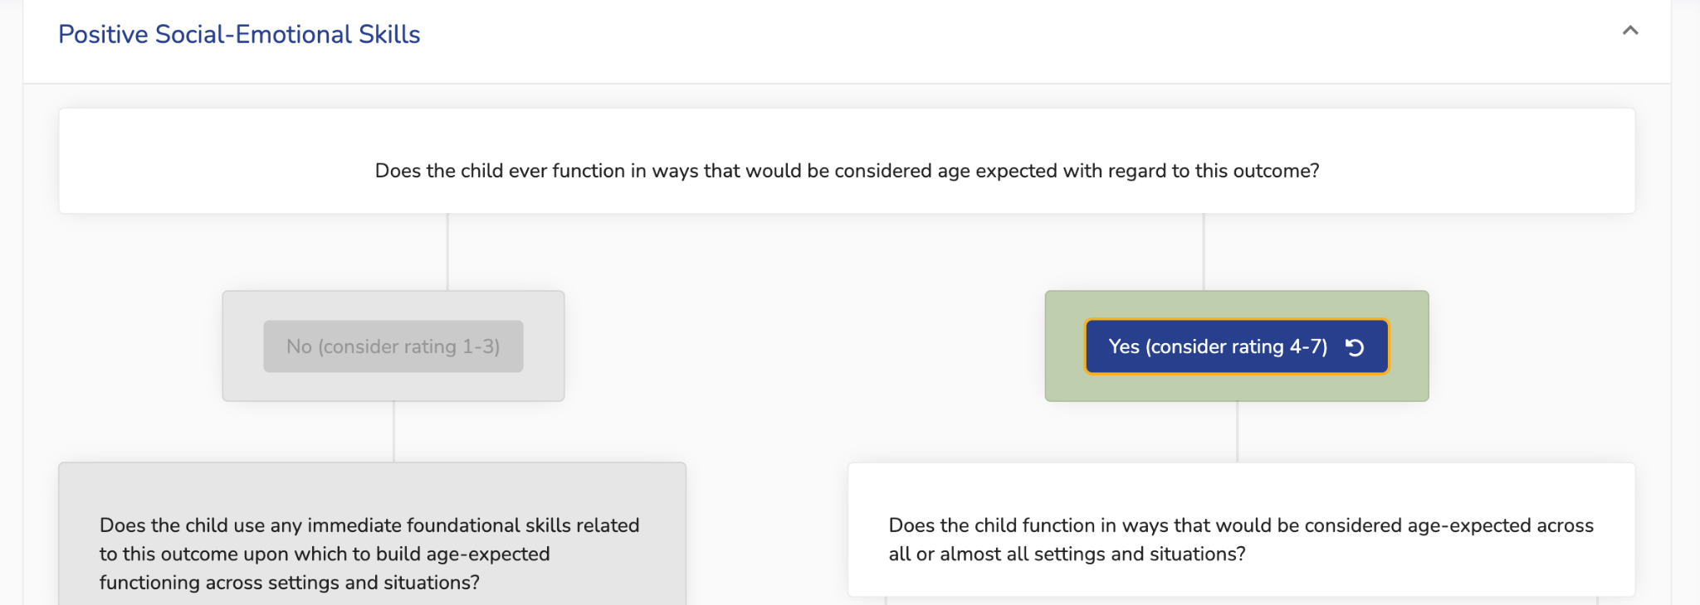
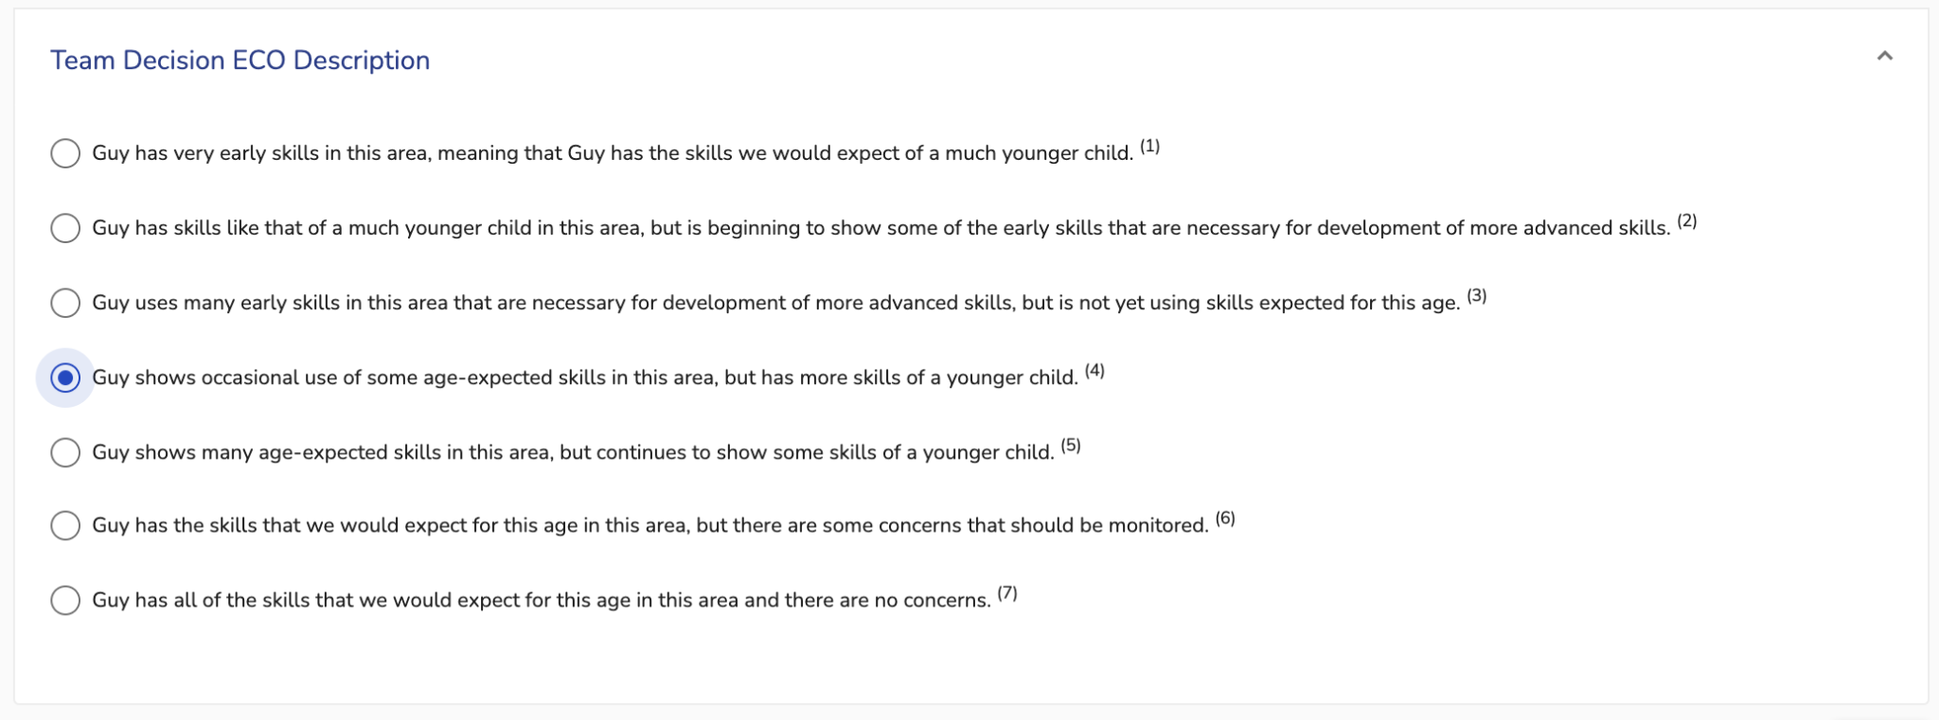
Early Childhood Outcomes (ECO)-Final Rating
Notes:
If teams need to complete the ECO rating, they will use the same process as before, answering the yes/no questions in the ECO Decision Tree and then choosing the final ECO description statement
Since all ECO areas must be completed for all preschoolers with IEPs, including support service only IEPs, teams will need to make sure they have gathered comprehensive information to be able to describe and choose a description statement for each area, even if that area was not an area of concern in the IEP.

Slide 34
Early Childhood Outcomes (ECO)-Final Rating
Notes:
Once the final ECO Comparison to Age Expectations or ratings have been chosed, you must also document if the learner has made progress since starting Special Education in that ECO area.

Slide 35
Early Childhood Outcomes (ECO)-Final Rating
The question about progress refers to any progress made since the learner began receiving special education services. This might include progress made on IEP goals, progress in the general education curriculum, and/or progress in their independence and functioning, within that ECO Area.
Why ask about progress?
For some children, their ECO Comparison to Age Expectations statement (rating) may not change from entry to exit in preschool due to having more significant needs, but that does not mean the learner has not made progress. OSEP wants to ensure that even for children who may not have changed in their ECO ratings, we still make sure to capture that they have made progress, which could include gaining one new skill in an area, even if the ECO rating did not change.
Notes:
We often get the question about why teams would need to answer the progress question and not just use the ECO ratings to see if the rating has increased? read
It should be rare that the answer to this question would be “no” unless the child regressed or is in the exact same place as where they started.

Slide 36
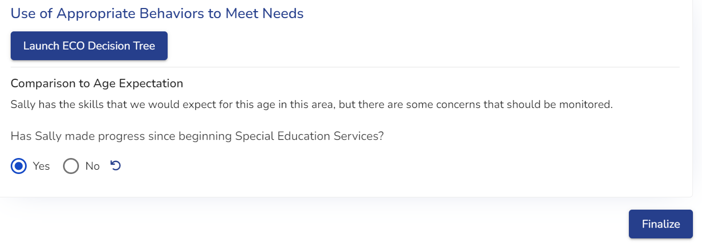
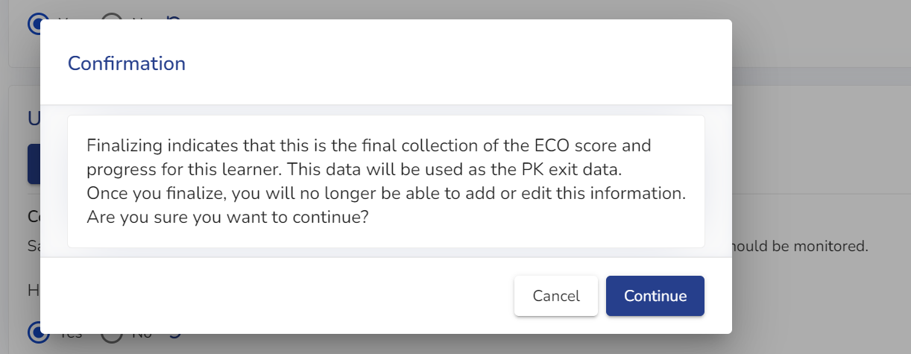
Early Childhood Outcomes (ECO)-Final Rating
Notes:
Once progress for all ECO areas has been documented, the Finalize button will become active.
Clicking the Finalize button will pop up a modal reminding you that finalizing this information indicates that this is the final collection of ECO scores, and the information will be used as the PK exit data. By clicking Continue, you will no longer be able to add to or edit the Final ECO Scores.
If you click Continue, the Final ECO Scores section on the Learner Dashboard will disappear, and the finalized ECO ratings can be viewed in the learner’s ECO History by clicking on the Data History button in the yellow band at the top of the page.

Slide 37
Additional Resources
Quick Reference for Preschool Environments and Final ECO in ACHIEVE
Initial ACHIEVE Trainings with more detailed information on related Preschool topics:
PK-K Transition
Preschool Evaluation and ECO Matrix
Preschool PLAAFP and ECO Decision Tree
Preschool Services and LRE/Reg EC Program Documentation
Iowa IDEA Information (i3)-Early Childhood Special Education procedures
Dear Colleague Letter on Preschool LRE (2017, OSEP)
Child Outcomes Quick Reference Guide
Notes:
Here are some additional resources that can provide more detailed information on these topics, including the handouts from the original ACHIEVE trainings that were provided when the ACHIEVE was launched.

Slide 38
Thank you!

