Slide 1
CLNA Alignment of CTE Programs with Labor Market Information
February 14, 2024

Slide 2
Element 3: Labor Market Alignment
Review CTE programs in SCTERA or STICS (secondary) and STICS (community college)
Review Iowa Workforce Development (IWD) state and local labor market data aligned with CTE programs. Occupational Projections
Engage in conversations with stakeholders
Local workforce development, business and industry
https://drive.google.com/drive/folders/1QTIDQer6pKLwx-g9UJhFMOVHItipvQTX?usp=drive_link

Slide 3
Element 3: Conversations with Stakeholders
Build a table of CTE program data.
SCTERA - Review FY 2024 Programs
Notes:
9-12 Total Enrollment 945 CTE Enrollment 1213

Slide 4
Element 3: Conversations with Stakeholders
Build a table of CTE program data.
SCTERA – Review Participants and Concentrators for Auto Tech and determine size, scope, quality, classes, resources, equipment, supplies, instructors, stakeholder feedback other relevant changes, if necessary.
Determine what this looks like in the Perkins Budget for FY 2025
Notes:
9-12 Total Enrollment 945 CTE Enrollment 1213

Slide 5
Element 3: Conversations with Stakeholders
Determine the labor market data points available - Iowa Workforce Development (IWD) Occupational Projections
Enter the first CTE Program into the table (CTE Participants in parenthesis).
“Select an Occupation” from the Occupational Projections website.
When more than one is available, add all relevant occupations.
*CTE Program By CIP Title | Enrolled | Concentrators | Iowa Projected Employed 2030 | Iowa Annual Openings | Regional Total Employed by 2030 | Regional Annual Openings LWDA | Average Wage | Entry Level Education | Registered Apprenticeship Opportunities
Accounting Tech |  |  | 2391 | 2,665 | 5,520 | 700 | $21.62 | Some College No Degree
Auto Mechanic Tech (Enrolled 213) | 213 | 20 | 8550 | 850 | 875 | 90 | $21.58 | PS Non-Degree | 10
Business Commerce |  |  | 12,760 | 1,040 | 3,200 | 250 | $31.51 | PS Non-Degree
Construction Trades |  |  | 13,610 | 1,810 | 3,965 | 420 | $21.34 | HS or RA
FCS General |  |  | 1,265 | 170 | 275 | 35 | $11.00 | HS or Some College
Health Services General |  |  | 98,955 | 5,359 |  |  | $20.47 | Associates 2-Year Deg
Welding | 156 | 9 | 11365 | 9965 | 1265 | 165
Notes:
9-12 Total Enrollment 945 CTE (Duplicated) Enrollment = 1,213
Welding Use both welding entries in Occupational Projections.

Slide 6
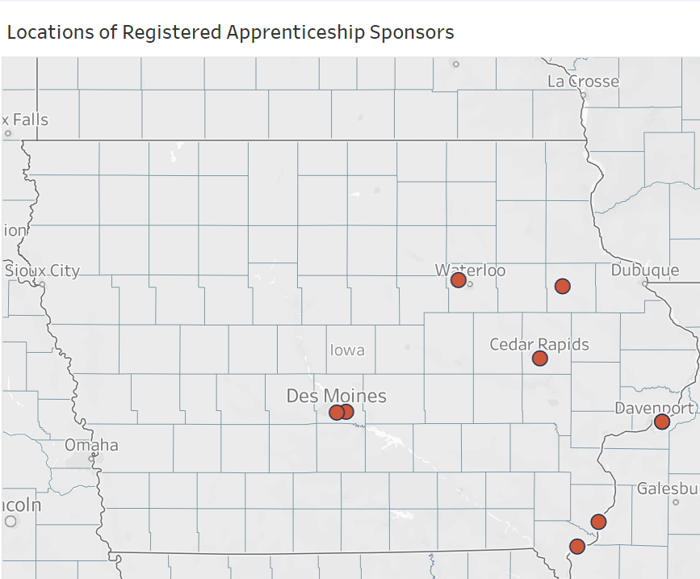
Element 3: IWD Registered Apprenticeship Business Contact Information
.
Iowa Registered Apprenticeships Contract information for Automotive Mechanics/Technicians
Additional Information
Iowa Hot Jobs (High Demand & High Wage)
Top 25 Job Postings in Iowa (Updated monthly)
Registered Apprenticeship Data in Iowa
Iowa Licensed Occupations

Slide 7
Element 3: CTE Program and Labor Market Alignment
.A deeper dive of courses in a program allows for rigorous review of projections with students and stakeholders.
CTE Program | 10 Year Annual Openings Region | 10 Year Annual Openings State | Entry Wage | Average Wage | Registered Apprenticeship Opportunities
Auto Mechanic Tech (213/21) | 215 | 850 | $ 13.64 | $ 21.37 | 10
Business Commerce, General (20) | 250 | 10 40 | $ 19.82 | $ 33.15 | 3
Accounting | 700 | 2665 | $ 15.92 | $ 22.60 | 4
Advertising | 350 | 875 | $ 16.84 | $ 32.03 | 2
Marketing | 310 | 430 | $ 19.10 | $ 32.41 | 8
Business and Management 12 | 250 | 1040 | $ 19.82 | $ 33.15 | 0
Computer Science (Occupations) 28 | 55 | 240 | $ 24.64 | $ 41.38 | 4
Technology | 165 | 385 | $ 47.86 | $ 66.19 | 1
Coding I & II | 60 | 205 | $ 22.28 | $ 37.73 | 12
Microsoft I & II | * | 20 | $ 26.25 | $ 45.87
Video Design and Editing I & II | 30 | 70 | $ 16.85 | $ 23.06 | 1
Cooking and Related Culinary Arts **** | 10 | 195 | $ 17.40 | $ 24.19 | *
Food and Nutrition | 15 | 60 | $ 21.83 | $ 28.72 | 2
Culinary Intro and Advanced | 35 | 170 | $ 13.85 | $ 21.57 | 1
Baking Intro and II | 65 | 275 | $ 10.95 | $ 14.03 | 0
Manufacturing Engineering and Technology 29 | 475 | 1810 | $ 18.72 | $ 34.97 | *
Welding (156 Enrolled) | 185 | 1085 | $ 17.47 | $ 22.12 | 5

Slide 8
Element 3: Align CTE Programs with Labor Market Information
Regional and Iowa (State) Information.
Determine Size and Scope of CTE Programs in place. Review Labor market information related to each CTE program.
–Iowa Workforce Development (IWD) Occupational Projections
Enter the first CTE Program into the table (See slide seven of PowerPoint for example)
“Select an Occupation” from the Occupational Projections website. (begin typing occupation i.e., “auto” and website will populate relevant careers).When more than one is available (welding has two occupational codes), add all relevant occupations.
When none are available, choose similar, or use the Occupational Outlook Handbook or Bureau of Labor Statistics
CTE Program and CIP SCTERA STICS | Iowa Annual Openings | Statewide Projected Employed by 2030 | Regional Annual Openings | Average Wage | Entry-Level Education | Registered Apprenticeships
Agriculture General
Auto Mechanics Tech
Business General
Computer Programming
Construction Trades
Criminal Justice/Police
Drafting Design Engineering
Family and Community Serv.
Health Services
Manufacturing Tech

Slide 9
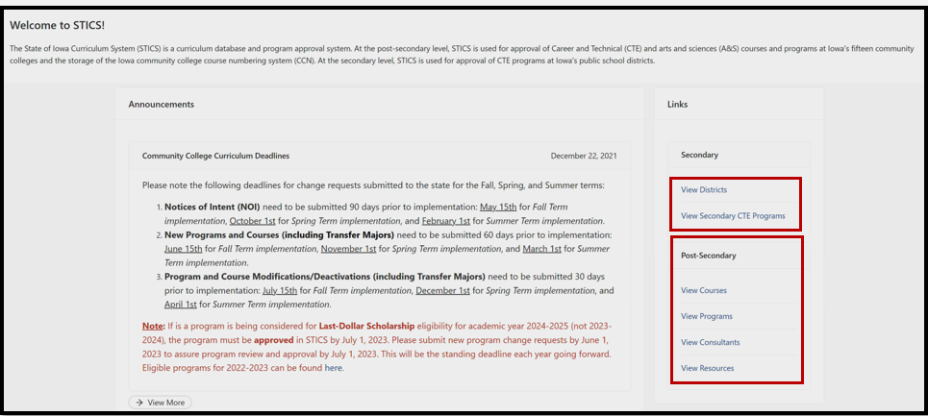
SECONDARY STICS SCREENSHOTS

Slide 10
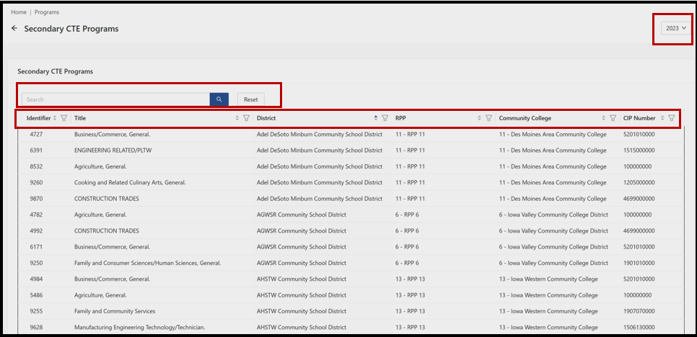

Slide 11
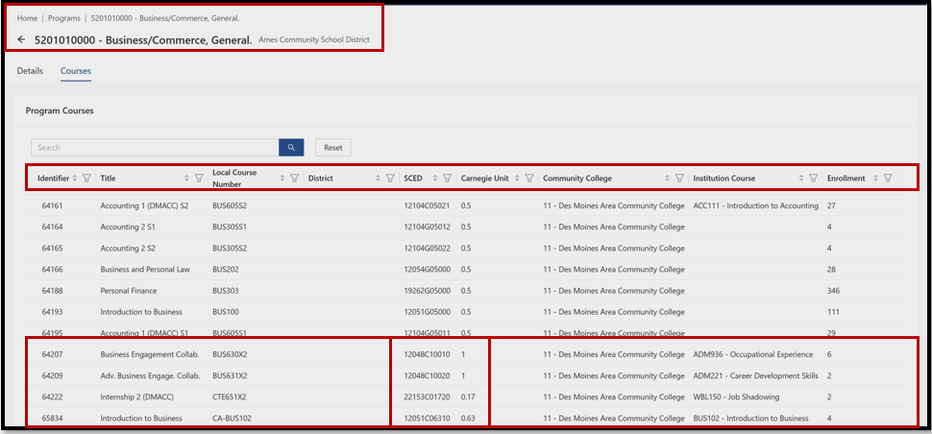

Slide 12
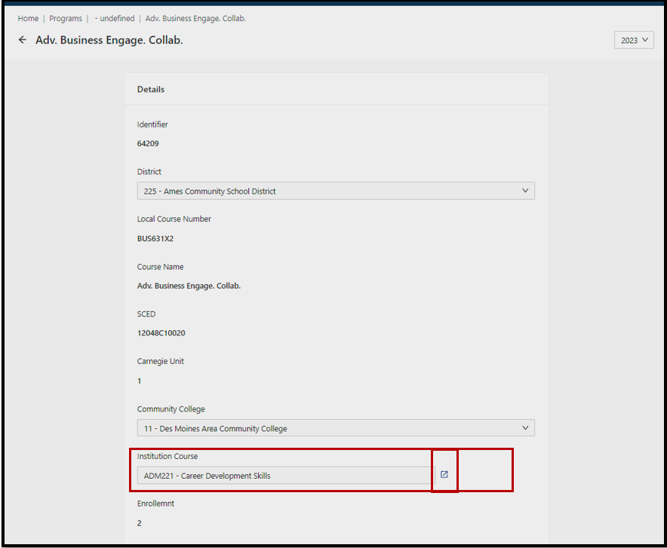

Slide 13
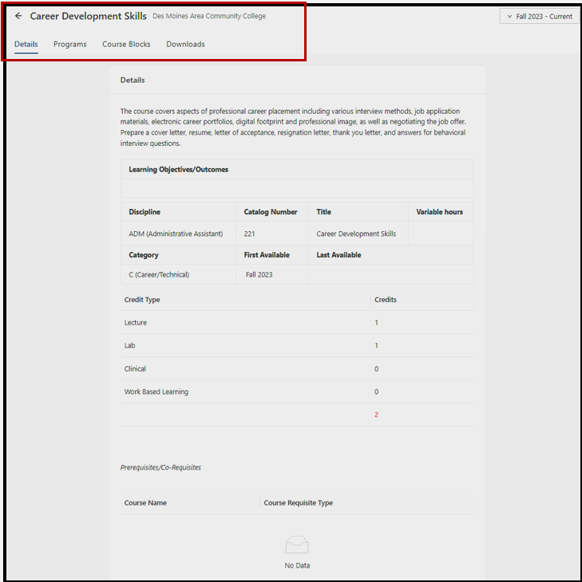

Slide 14
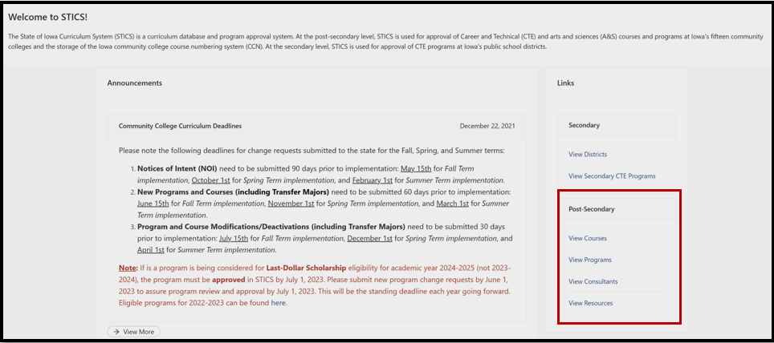
COMMUNITY COLLEGE STICS SCREENSHOTS

Slide 15
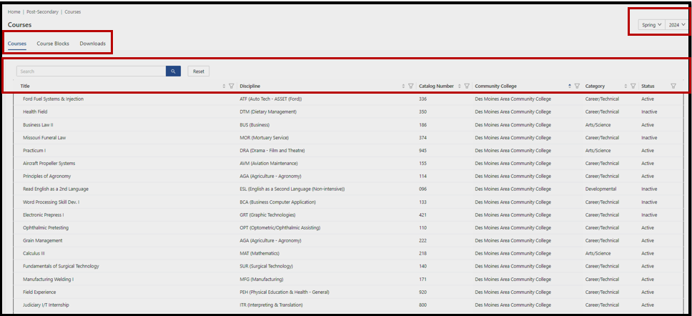

Slide 16
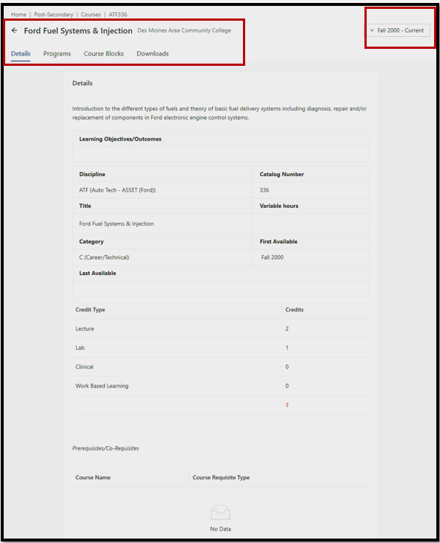

Slide 17
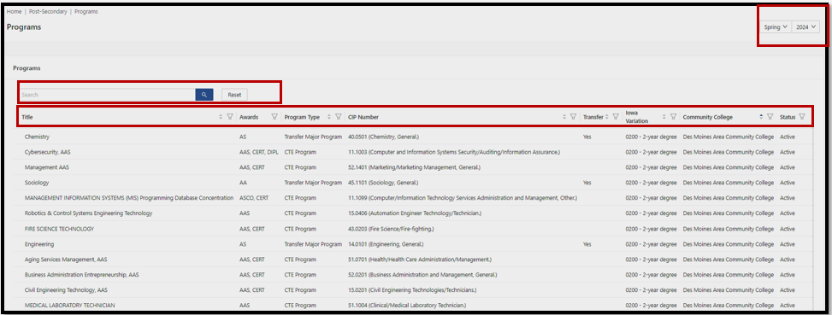

Slide 18
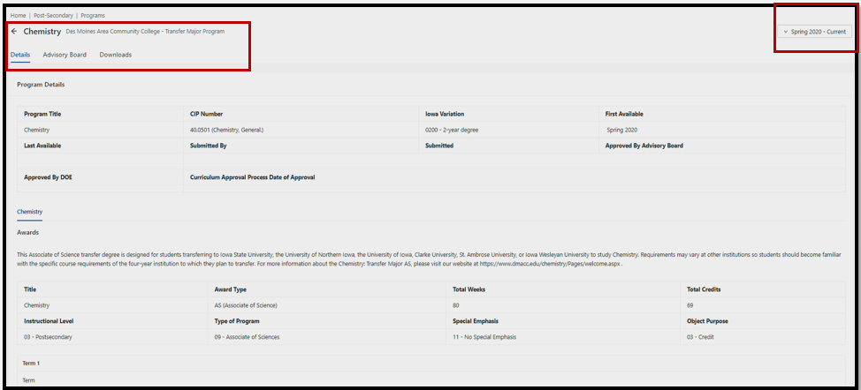

Slide 19
Purchases Align with Perkins Activities and CLNA Elements
.
Iowa Service Areas (6) | CTE Program | Purchase or Item Description | Perkins Activities (6) | CLNA Elements (6)
Applied Science, Technology, Engineering, and Math | Automobile/Automotive Mechanics Technology/Technician | Software | Activity 5 – Implementation of CTE | Element 2 – Size, Scope, and Quality
Applied Science, Technology, Engineering, and Math | Construction Trades | CTSO Affiliated Membership | CTSO Institutional Membership | Element 1 – Student Performance
Applied Science, Technology, Engineering, and Math | Welding Technology | Certification for Instructor | Activity 2 – Professional Development | Element 4 – Recruitment, Retention, and Training of CTE Staff
Business, Finance, Marketing, and Management | Accounting Technology/Technician, Bookkeeping | Microsoft Office Certification Testing - Students | Activity 6 – Evaluation Development and Implementation | Element 1 – Student Performance
Business, Finance, Marketing, and Management | Business Commerce General | Espresso Bar Instructor Training Student Based Enterprise | Activity 2 – Professional Development | Element 4 – Recruitment, Retention, and Training of CTE Staff
Health Sciences | Health Services/Allied Health Sciences General | Prior Approved Non-Trad Advertising to Recruit and Retain Special Pops | Activity 1 - Career Exploration and Development | Element 5 – Progress toward Equity and Access
Human Services | Family and Consumer Sciences | Teacher Travel to ACTE | Activity 2 – Professional Development | Element 4 – Recruitment, Retention, and Training of CTE Staff
Beginning in FY 2025, Districts, consortia, and regional priorities are aligned within the CLNA elements. No regional or district priorities. Elements replace priorities.

Slide 20
For more information about CTE Program and Labor Market Alignment, contact:
Amy Vybiral
amy.vybiral@iowa.gov
515-339-4520
Jeff Fletcher
Jeffrey.fletcher@iowa.gov
515-321-7309
Bureau of Community Colleges & Postsecondary Readiness
Iowa Department of Education
Iowa Department of Education
Grimes State Office Building
400 E 14th St
Des Moines, IA 50319-0146

