Slide 1
Perkins V
#6 FY 2025 Budget & Use of Funds
March 13, 2024
10:00 a.m. - 10:55 a.m.
Amy Vybiral, MS Ed.
Education Program Consultant
Bureau of Community Colleges and Postsecondary Readiness
515-339-4520
amy.vybiral@iowa.gov

Slide 2
Agenda
FY 2024 Claims and Wrap-up Year End Expenditures
FY 2025 Budget Templates
Timelines and Due Dates through June 30, 2024
Perkins Allowable Use of Funds

Slide 3
FY 2024 Wrap-Up
Spend the 2024 allocation and submit claims.
Equipment and Supplies. All purchases should be completed and claimed.
Next claim due date is April 12 (15th).
Purchased Services, Salaries and off contract stipends
Final claim due date July 15, 2024.

Slide 4
2025 Budgets
2025 Budgets
Released March 13, 2025
Determine purchases based on CLNA outcomes.
Intentional alignment of purchases with Perkins Activities and CLNA Outcomes
Iowa Service Areas are now Iowa Content Areas
Perkins Activities
Career Exploration and Development
Professional Development
CTE Development
Integration of Academic Skills
Implementation of CTE Programs
Development and Implement Evaluations
CLNA Elements
Student Performance
Size, Scope, and Quality
Labor Market
Teacher Recruitment, Retention, and Training
Equity and Access (progress toward)
Safety in CTE Programs

Slide 5
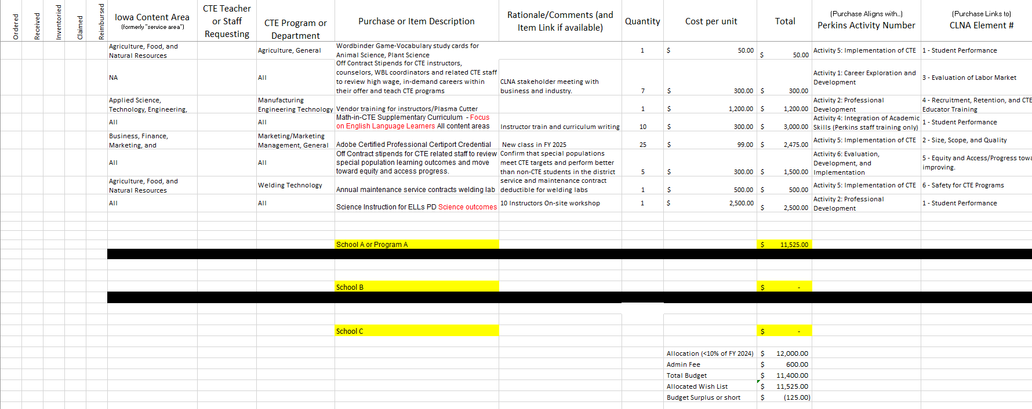
2025 Budget Template
Notes:
Note: Removal of Local, Consortium, and Regional Priorities
May be used for consortiums with multiple districts.
May be used for districts with multiple schools (middle school - prior approval required)
Note “Content” area

Slide 6
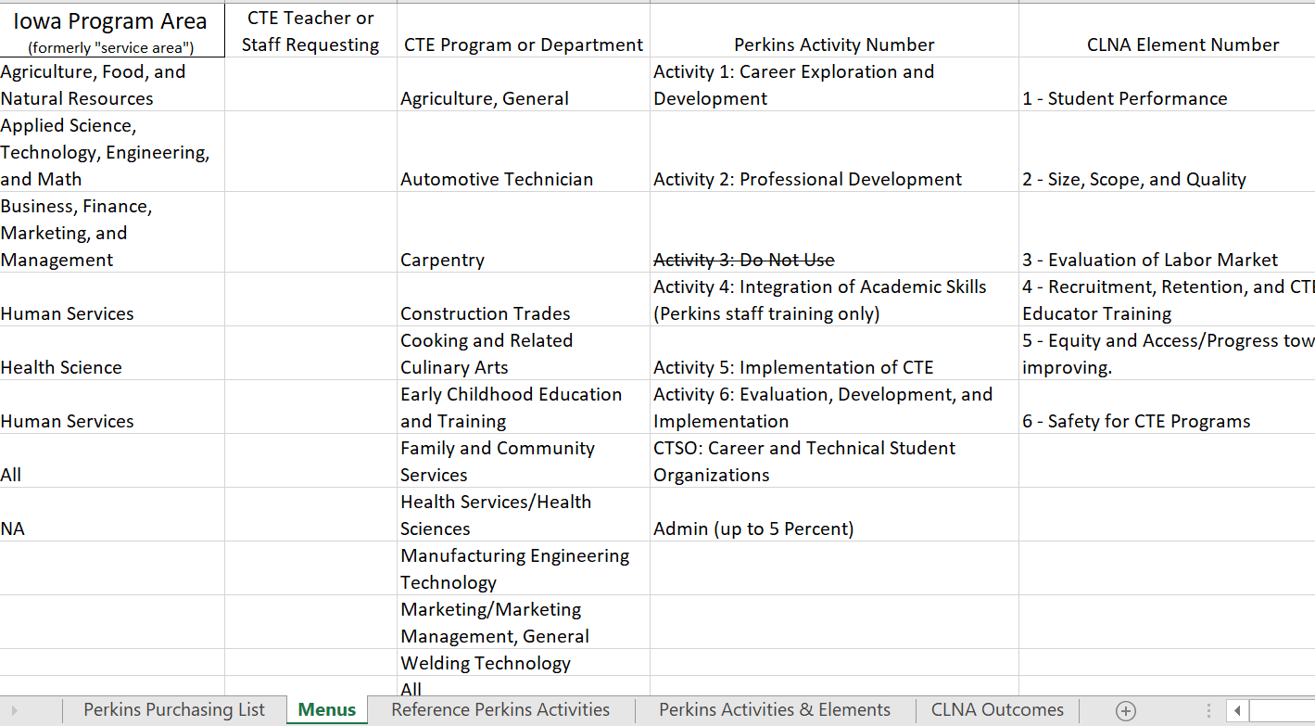
2025 Budget Menu
Notes:
Add or remove information

Slide 7
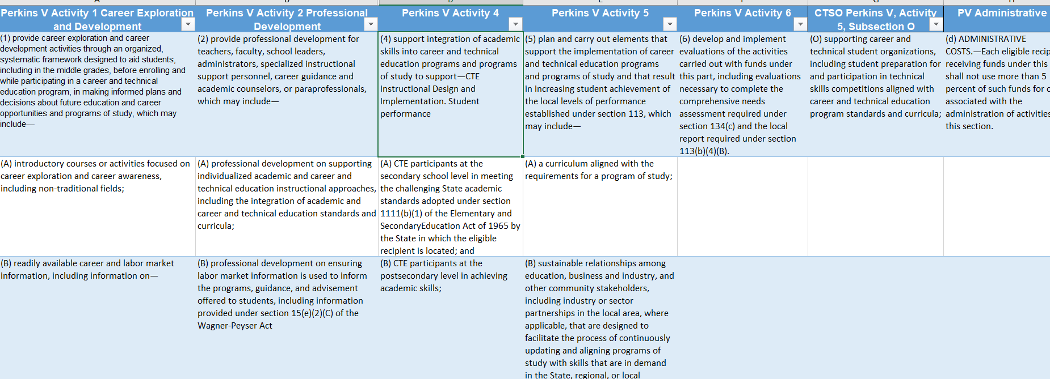
2025 Reference Perkins Activities One through Six, CTSO and Admin

Slide 8
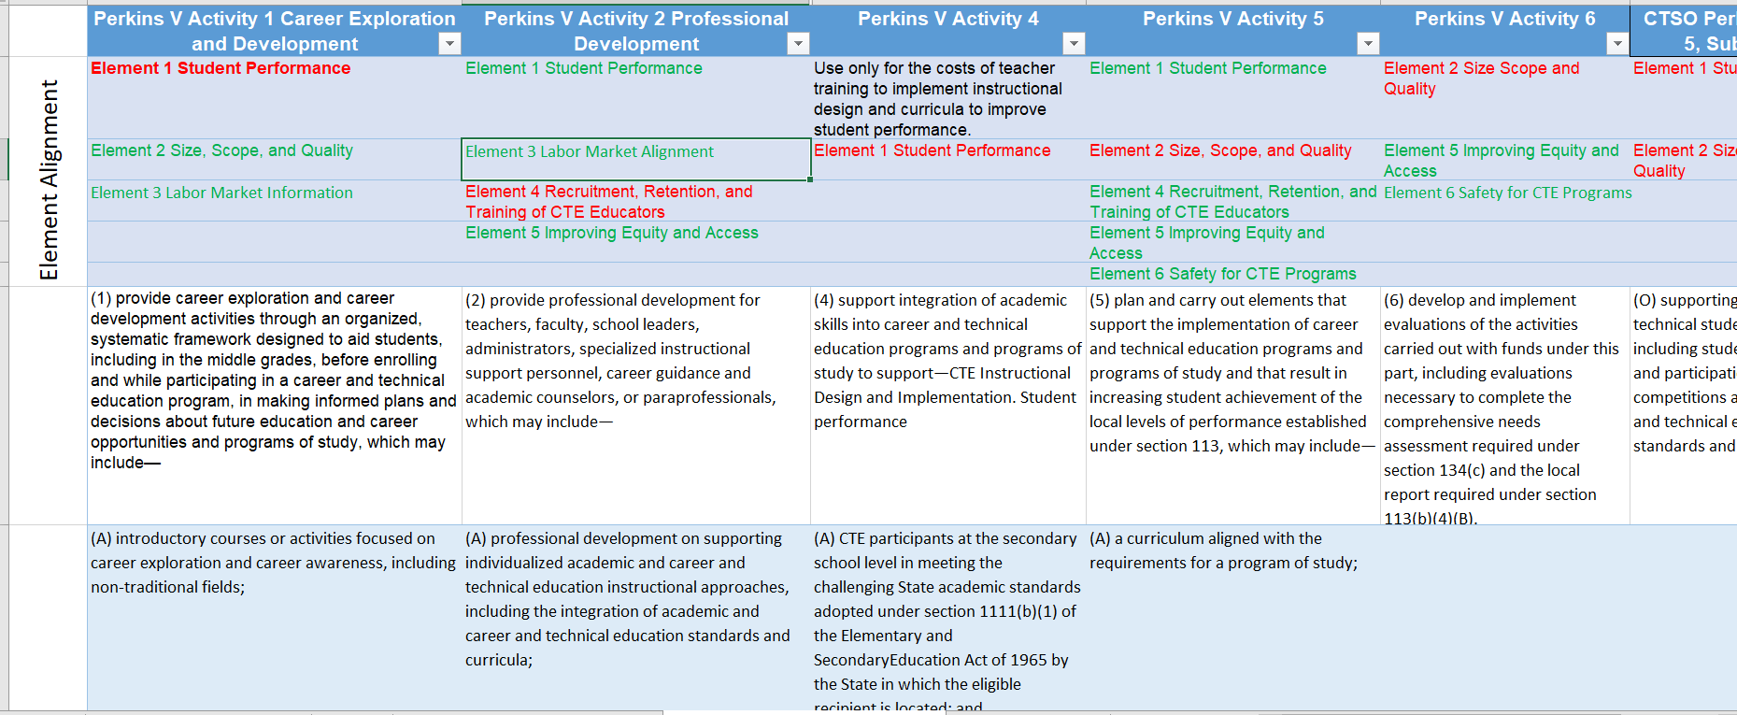
2025 Align Activity with Appropriate CLNA Element
Red aligns best. All are possible choices. No Element choices are incorrect.

Slide 9
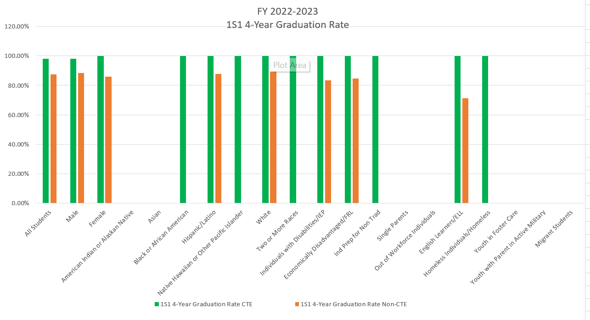
2025 Budget Purchases and Data Driven Decisions
Make data and needs based decisions. Include outcomes in the budget template for ease of access.
Notes:
Exceeds

Slide 10
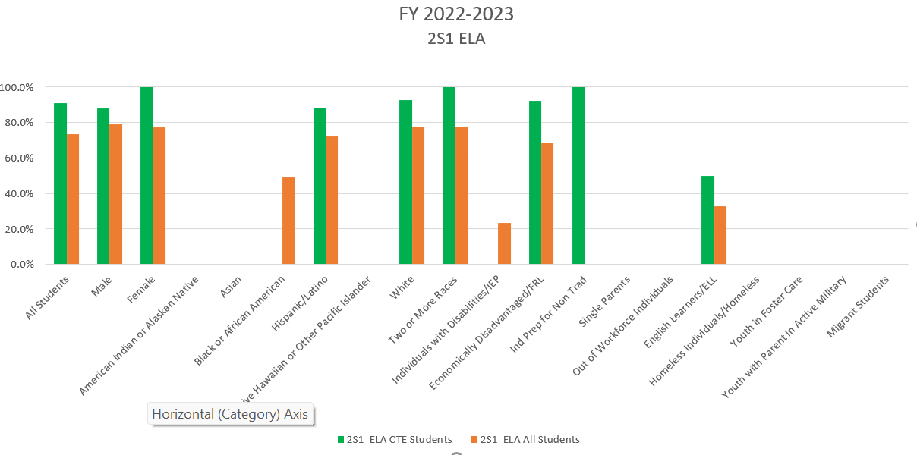
2025 Budget Purchases and Data Driven Decisions
Make data and needs based decisions. Include outcomes in the budget template for ease of access.
Notes:
Exceeds

Slide 11
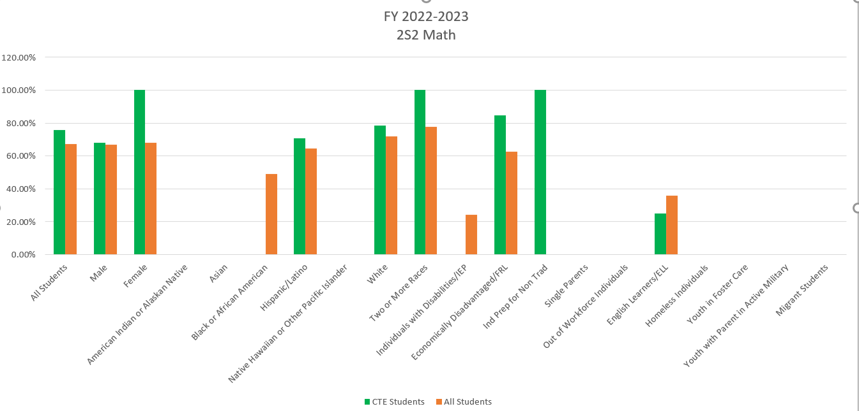
2025 Budget Purchases and Data Driven Decisions
Make data and needs based decisions. Include outcomes in the budget template for ease of access.
Notes:
See purchase four on slide three to address math in CTE for ELL population.

Slide 12
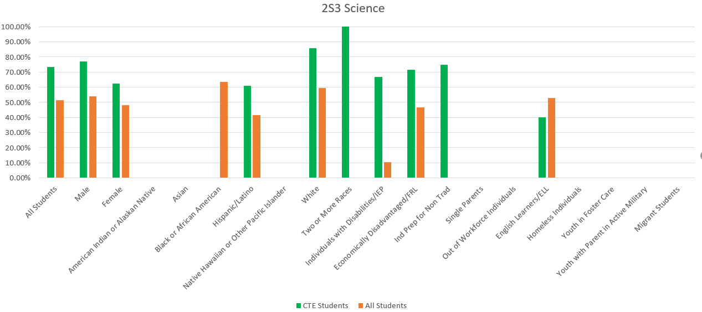
2025 Budget Purchases and Data Driven Decisions
Make data and needs based decisions. Include outcomes in the budget template for ease of access.
Notes:
See Slide five, Row nine to address science with ELL population

Slide 13
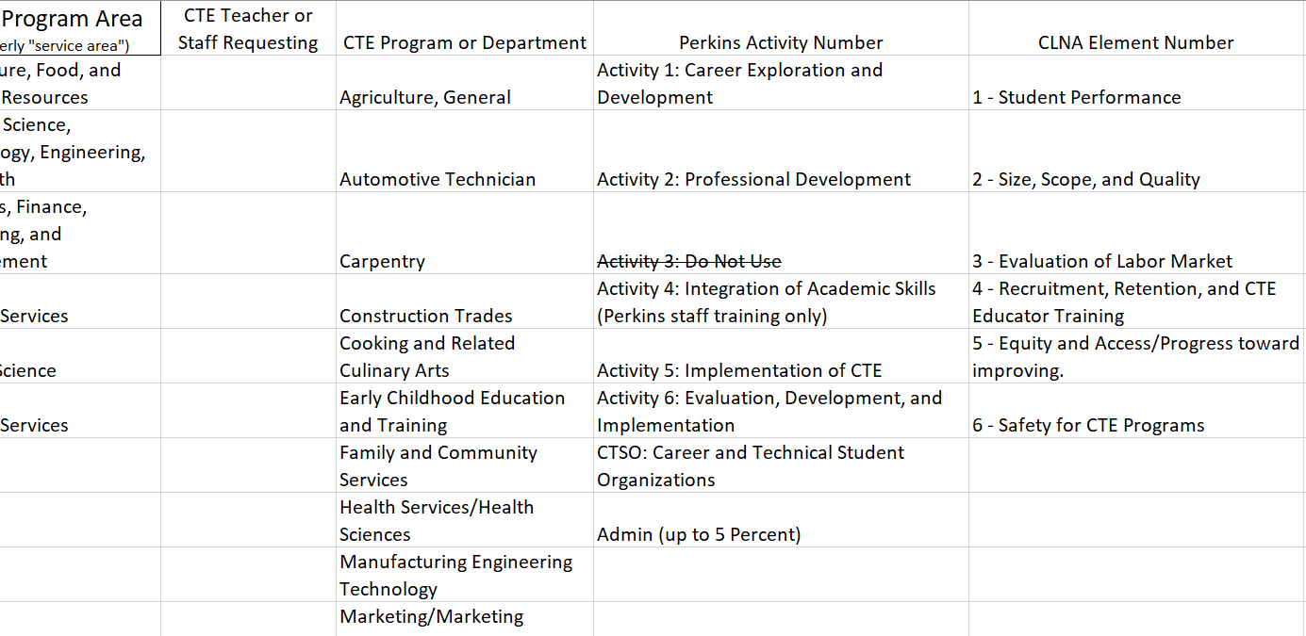
2025 Menu Editing
Edit Menus to Populate Purchasing List Options
Notes:
See Slide five, Row nine to address science with ELL population

Slide 14
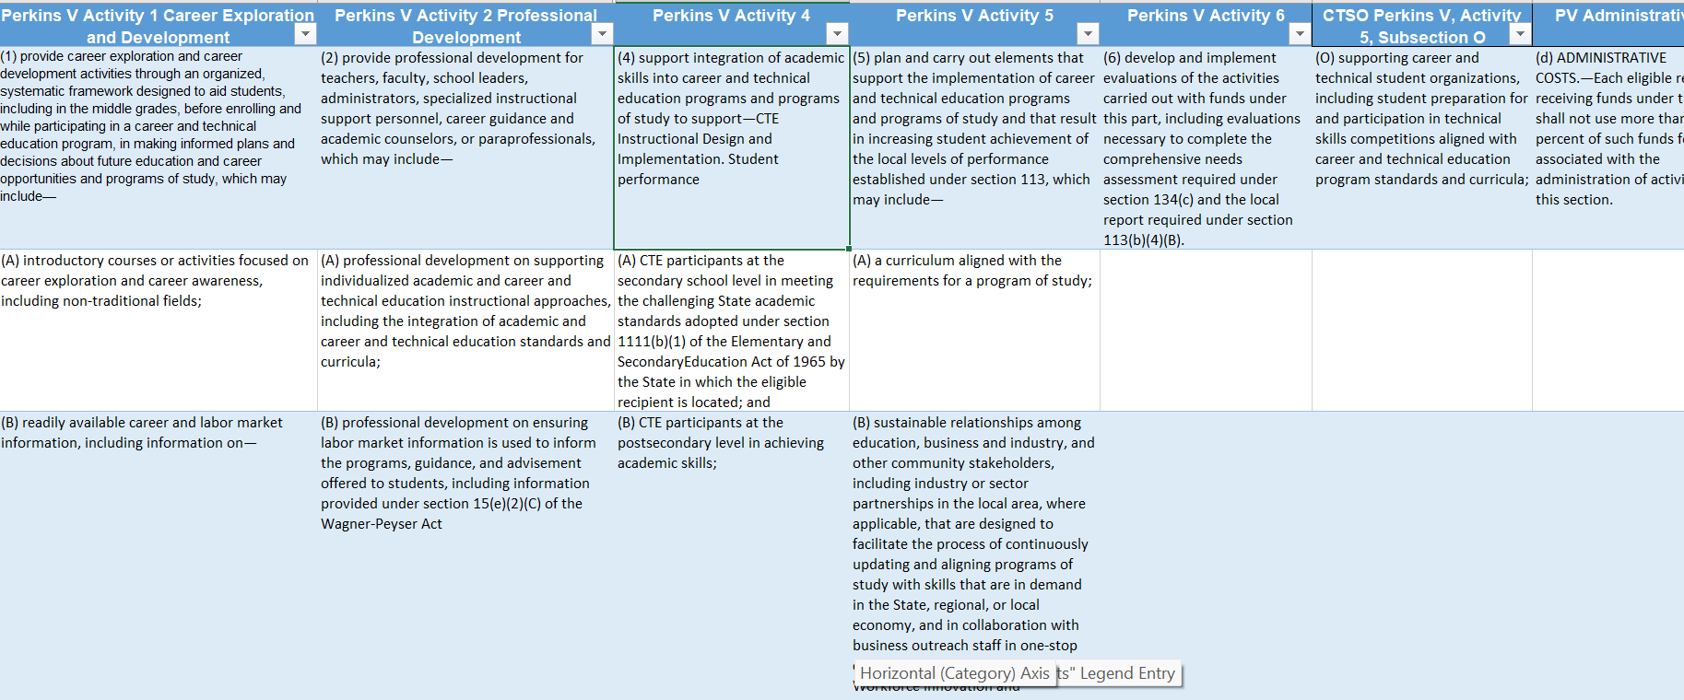
2025 Perkins Activities
Perkins Activities Stated in 2018 Statute

Slide 15
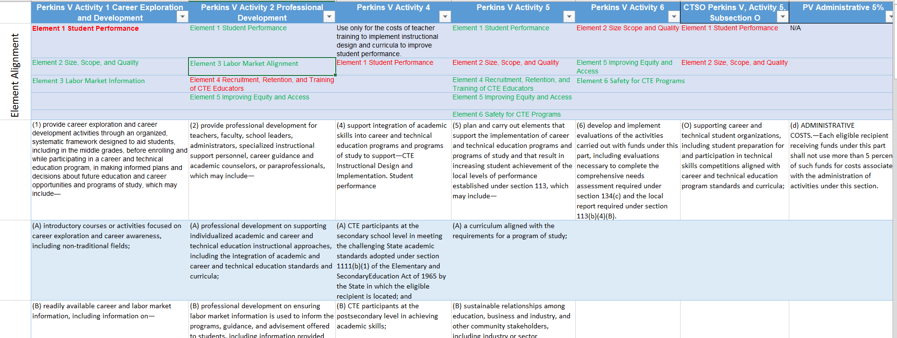
2025 Perkins Activities
CLNA Elements Aligned with Perkins Activities
Red CLNA Element is the most likely aligned with each Perkins Activity
Green may also be appropriate

Slide 16
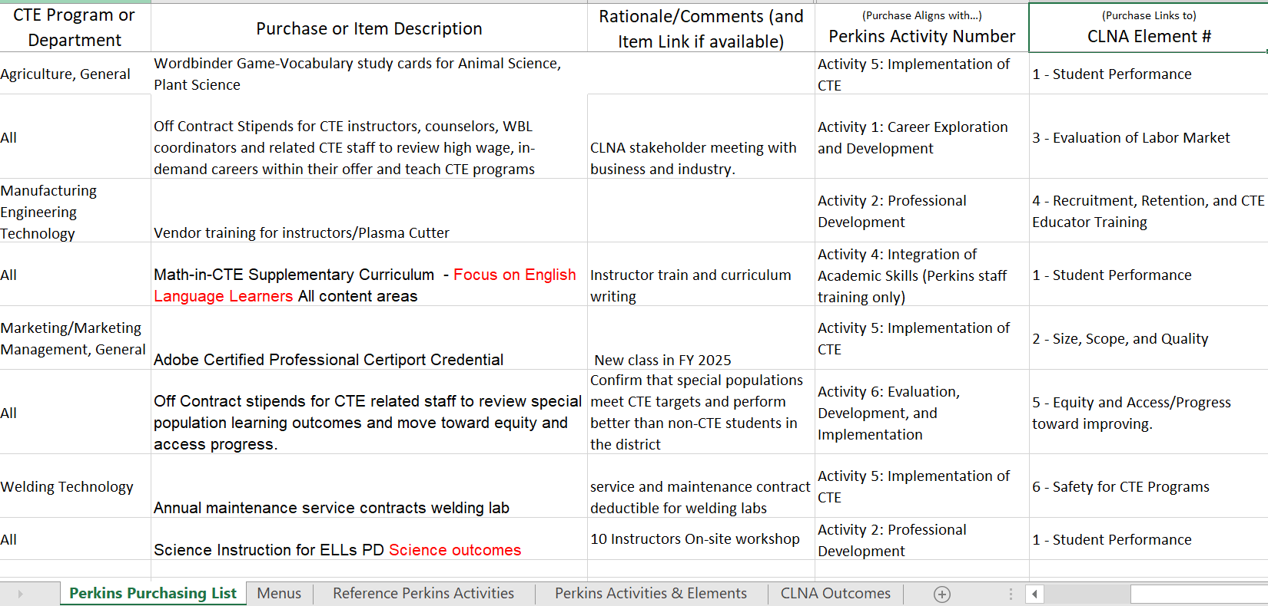
2025 Alignment between Perkins Activities, CLNA Elements, and Purchases
Notes:
Use your CLNA Outcomes Worksheets to Align Content Area, Purchase, Rationale, Perkins Activity Number and CLNA Element Number

Slide 17
Timelines and Due Dates through June 2024
CLNA Elements Aligned with Perkins Activities
FY 2024 Claims
April 15, 2024
July 15, 2024
FY 2025 Perkins Budget (prior approval)
Released March 13, 2024
Negotiated by April 24
Submitted in complete and approved form by May 1
Perkins FY 2025 Perkins V Application
Released on or around May 1, 2024
Due June 30, 2024
Jeff Fletcher 515-321-7309
. FY 2024 CLNA
Released January 17, 2024. TA Recording and Process Landing Page
Cale Hutchings

Slide 18
Perkins Use of Funds
Sec. 135 General Authority and Requirements for Local Uses of Funds
Develop, coordinate, implement, or improve CTE programs to meet the needs identified in the CLNA.
Support CTE programs that are of sufficient size, scope, and quality to be effective.
Six Perkins Activities (37) and Administrative Costs
Career Exploration and Development (6)
Professional Development (9)
CTE Skill Development
Integration of Academic Skills (2)
Support Implementation of CTE (20)
Evaluation of CTE and CLNA activities
Six CLNA Elements
Student Performance
Professional Development
Labor Market
Teacher Training (Recruitment and Retention
Equity and Access (Progress Toward)
Safety in CTE Programs
Notes:
Purchased for non-CTE?
Supplants the district fund for prior years?
Allowable, Reasonable, Prudent, Optics and monitoring

Slide 19
Perkins Use of Funds
Iowa Code
Iowa Code
Federal
EDGAR
Perkins V Statute
UGG
EDGAR Cost Principles
State may be more restrictive than federal.
Local may be more restrictive than state.
Neither may implement less restrictive policies (inventory & reporting).
Factors affecting allowability of Costs Federal → State → Local e.C.F.R. 200.403, More restrictive, not less.
Just because it’s “legal” doesn’t mean the purchase should be made
State
Iowa Code & Rule
Perkins Guidelines
Local
Sec. 135
Board Policies
Perkins Guidelines
National Association for Career & Technical Education Information, Tom Cooley & Tristan Londre, May 13, 2019.
Notes:
Inventory - $5,000, $500, or “easily pilferable” Chapter 258 Program review

Slide 20
Tips for Determining the use of Perkins Funding
Keep Perkins Funding Eligible
Personnel:
Consider the use Perkins first to avoid future supplanting issues.
CTSO Advising positions for newly developed CTSOs
Off-contract stipend or extra duty pay for CLNA development and evaluation
Equipment and Supplies
Are these purchased for non-CTE students, courses, classrooms? If “Yes”, all like purchases are ineligible for reimbursement
Printers, Utility Carts, Computers
Districts may NOT exclude CTE students.
Will the program exist without the purchase?
Is this new or emerging technology that meets or exceeds industry standards?
Considered “reasonable” under a “prudent person” standard? (Gratuities are established at 15%) Transportation away from out of state hotels are ineligible unless no area establishments are available.
Due diligence
Front page/lead story/optics/public perception
Services
Transportation
Insurance

Slide 21
Perkins Allowable Use of Funds
Administrative Costs (up to 5%).
Advertising outreach efforts for the administration of the federal award, including recruitment of CTE instructors and personnel (Do not use “marketing”). Requires prior approval.
Advertising to promote becoming a CTE endorsed instructor.
Advisory committee expenses (meals & snacks ineligible). (Federally ineligible non-regulatory guidance memo)
Career Information and Decision-Making Systems (CIS). - Ineligible (State Mandated)
CASE – All program start-up materials, supplies (consumables with a first-time purchase) eligible if taught by a CASE certified instructor.
Computers -must meet or exceed technological spec used in business and industry; requires faster processing speed, excess memory, graphics cards than computers (CAD, MS Office) that are purchased by district for non-CTE labs.
Conference registration and expenses (no membership dues).
Notes:
Purchased for non-CTE?
Supplants the district fund for prior years?
Allowable, Reasonable, Prudent, Optics and monitoring

Slide 22
Perkins Allowable Use of Funds
Advertising to recruit non-traditional students. Requires Prior Approval
Individuals from their gender comprise less than 25 percent of the individuals employed in the related occupation or field of work.
Advertising to recruit Special populations. Requires Prior Approval
Individuals with disabilities
Individuals from economically disadvantaged families
Individuals preparing for non-traditional fields
Single parents, including single pregnant women
Out-of-workforce individuals
English learners
Homeless individuals
Youth who are in, or have aged out of the foster care system
Youth with a parent who
Is a member of the armed forces
Is on active duty
Notes:
Purchased for non-CTE?
Supplants the district fund for prior years?
Allowable, Reasonable, Prudent, Optics and monitoring

Slide 23
Perkins Allowable Use of Funds
Equipment (all equipment must be inventoried) - More restrictive (easily pilferable, inventory, due diligence)
o $500 threshold for secondary
o $5,000 threshold for postsecondary
Games that allow for simulation and situational learning.
Installation costs required to meet code requirements for equipment purchased
Institutional affiliations, chapter and district memberships and subscriptions.
Individual dues are ineligible for reimbursement.
Maintenance and service contracts on equipment purchased with Perkins.
Middle school CTE- Requires Prior Approval
Notes:
Purchased for non-CTE?
Supplants the district fund for prior years?
Allowable, Reasonable, Prudent, Optics and monitoring

Slide 24
Perkins Allowable Use of Funds
Professional development (staff, no students) (internal) – travel, professional development materials (no food or meals)
Professional development (staff, no students) (external):
In-state and out-of- state mileage, meals, hotel, airfare, baggage, hotel, parking, registration.
Program evaluation development and administration (off contract salaries)
PLTW equipment and supplies, if taught by a CTE PLTW- certified instructor
Rentals and leases (welding tanks, technology contracts)
Repair, service, and necessary maintenance of equipment purchased with Perkins to be kept in an efficient, operating condition.
Substitute pay for CTE personnel attending professional development.
Notes:
Purchased for non-CTE?
Supplants the district fund for prior years?
Allowable, Reasonable, Prudent, Optics and monitoring

Slide 25
Perkins Unallowable Costs
Alcoholic beverages
Capital expenditures
Commencement and convocation costs
Consumable items for classroom operations
Paper, CO2 cartridges, batteries, toner, food, 3D printer cartridges, varnish, wood, shelving, storage, welding gas
Contingency or “petty cash” funds
Fines and penalties
Food and drinks for summer camps or for district professional development advisory meetings.
Notes:
Purchased for non-CTE?
Supplants the district fund for prior years?
Allowable, Reasonable, Prudent, Optics and monitoring

Slide 26
Perkins Unallowable Costs
Furniture
All classroom furnishings are ineligible for reimbursement (supplanting).
District assumes responsibility for:
Tables, chairs (including mobile chairs with casters), desks, ergonomic workspaces, sectionals end-tables, carpet, area rugs.
Mobile whiteboard desks and tables
Storage, bins, totes, shelving and lockers
Furniture will not be approved as “equipment.”
Notes:
Purchased for non-CTE?
Supplants the district fund for prior years?
Allowable, Reasonable, Prudent, Optics and monitoring
Some exceptions apply when purchased by program specific vendors - CAD desks, Webstaurant store, etc.

Slide 27
Perkins Unallowable Costs
Gifts, door prizes, etc.
Individual dues and memberships to professional organizations (ACTE, IACTE)
Insurance
Interest and other financial costs
Item retained by students (uniforms, jump drives, tools)
Meals, banquets, tickets to sporting events, entertainment
Marketing
Notes:
Purchased for non-CTE?
Supplants the district fund for prior years?
Allowable, Reasonable, Prudent, Optics and monitoring

Slide 28
Perkins Unallowable Costs
Professional Development
Individually Marketable Certifications
o CASE Certification
o College credit
o Continuing education units (CEU)
o MOC
o OSHA train-the-trainer
o PLTW certification
Perkins may be used for travel reimbursement in limited cases. Seek prior approval.
Notes:
Purchased for non-CTE?
Supplants the district fund for prior years?
Allowable, Reasonable, Prudent, Optics and monitoring

Slide 29
Perkins Unallowable Costs
Promotional materials, such as t-shirts, pens, cups, key chains, etc.
Student activity costs, clubs
Textbooks for existing courses unless supplemental
Vehicles such as automobiles, trucks, buses, airplanes, boats, golf carts, snowmobiles, motorcycles, helicopters, gators. Electric vehicles Requires Prior Approval
Notes:
Purchased for non-CTE?
Supplants the district fund for prior years?
Allowable, Reasonable, Prudent, Optics and monitoring

Slide 30
Federal Cost Principles
Cost Principles EDGAR
Allowable: Meets the specific purposes of the grant. (Ultrasound equipment for livestock)
Reasonable: Would a prudent person pay this amount for this item or $70 dollar taxi ride for dinner at the end of a conference day? 2 CFR 200, Subpart E. A cost is reasonable if, in its nature and amount, it does not exceed that which would be incurred by a prudent person under the circumstances prevailing at the time the decision was made to incur the cost. 2 CFR 200, Subpart E.
Necessary Would the program exist without the purchase? Can a reasonable argument be made that the program would close without a whiteboard, TV, storage, ultrasound, smartphone, next generation technology?
National Association for Career & Technical Education Information, Tom Cooley & Tristan Londre, May 13, 2019.
Notes:
1986 L.A. Times $285 screwdriver, $469 wrency $437 tape measure $74,165 aluminum ladder, $37 screw

Slide 31
To determine eligibility and due diligence processes:
Would this meet a due diligence standard for monitoring or an OCTAE visit?
Does the district purchase for non-CTE students?
Does it meet or exceed industry standards?
Is this purchased with Perkins and other non-federal funds? (co-mingling) - District and Perkins
Is this adequately inventoried? - Funding Source -Federally owned property location
Do we have a process for adequate monitoring and are at high risk for theft, loss, or damage?
Do we have a process for check-out?
Should we purchase a maintenance or service plan?
Certifications – eligible for students, ineligible for Perkins staff, instructors, advisors.
Notes:
Purchased for non-CTE?
Supplants the district fund for prior years?
Allowable, Reasonable, Prudent, Optics and monitoring

Slide 32
Amy Vybiral MS Ed
Consultant
amy.vybiral@iowa.gov
Bureau of Career and Technical Education
Iowa Department of Education
Rev.3/13-2024
Iowa Department of Education
Bureau of Community Colleges and Postsecondary Readiness
Grimes State Office Building
400 E 14th St
Des Moines, IA 50319-0146

