Slide 1
CCTC Informational Webinar
Oct. 6 2023

Slide 2
Introductions & History
Sheryl Bass, CCTC Linn-Mar, Kirkwood Community College
David Ford, Director, AEA PREP
Erica Woods-Schmitz, Iowa Department of Education, Educational Consultant: Career and Academic Planning
Notes:
Dave

Slide 3
CCTC Initiative in Iowa:
For the 2023-24 school year, there are over 50 CCTCs in the state with over 100 high schools in partnership with all 15 of Iowa’s community colleges
Department of Education began offering start-up grants that run for 3 years using reserve funds
First cycle of positions under Dept. of Education grant begin with the 20-21 school year
Additional funding includes operational sharing and community college partnerships
Notes:
Dave

Slide 4
Career and Technical Education: Perkins V
Iowa’s CCTC Initiative:
Expand College and Career Transition Counselors.
College and Career Transition Counselors work as a liaison between the community college and secondary schools to ensure students are supported in their career exploration and receive proper assistance in transitioning into additional training.
The counselors will support career exploration through a joint effort with district ICAP efforts
The counselors will support ALL postsecondary options as they support students in their postsecondary goals
Ensure consistency in implementation of the model statewide, and allow for tracking and data reporting.

Slide 5
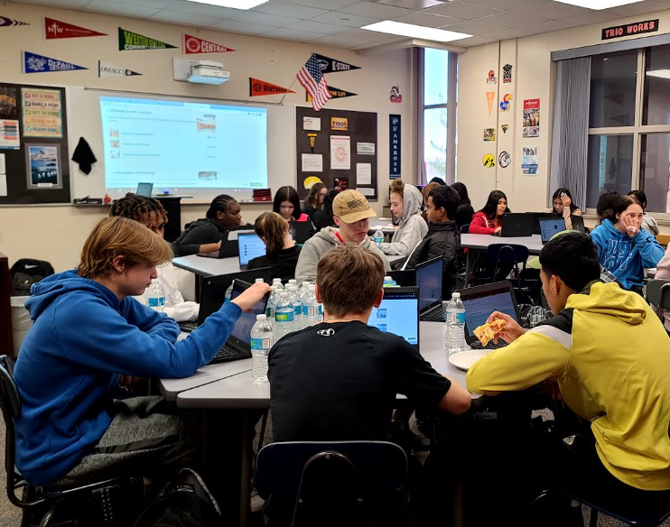
CCTC Role:
The CCTC will work directly through the community college and secondary schools
Support college transition and career exploration through targeted connections with students and families
CCTCs provide additional targeted support to school counseling programs in the college and career domain and work with a variety of stakeholders
CCTCs will work closely with students in grades 11 and 12 in partner high schools, including
Summer after high school graduation; strong connection to FAFSA support
First-year support for students coming out of this program at the coordinating community college
Roster of 300 students including first-year college students
The CCTC Toolkit is available on the Iowa Department of Education Website and includes a sample job description and complete roles and responsibilities document
Notes:
Erica

Slide 6
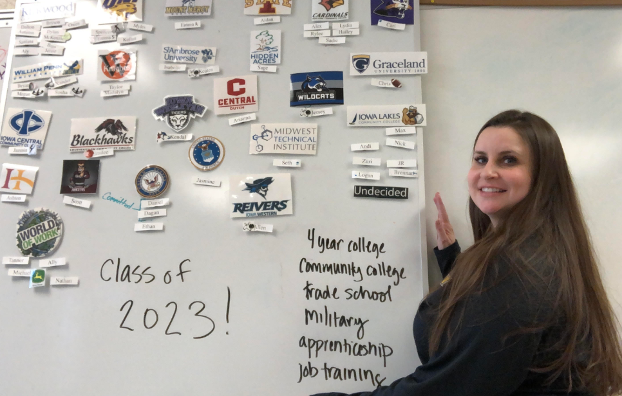
Career Development for All Postsecondary Pathways

Slide 7
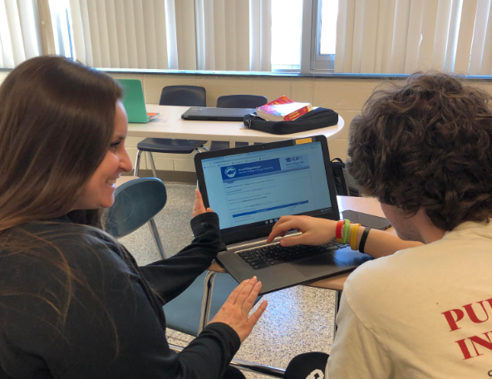
CCTC: What does this look like in the high school?
Career Planning
Review and discuss career assessment results
Research career information including job outlook, salaries, and typical tasks
Job shadow and internship placements
Take students on career tours
Promote apprenticeship opportunities
College Planning
Research college options
Research admissions requirements
Facilitate and provide transportation for campus tours
Financial Aid
Teach students about financial aid options
Support FSA ID and FAFSA applications with students and parents
Assist students with reviewing financial aid award letters
College Decision
Assist with the college application process
Help with next steps for college
Notes:
Sheryl
https://docs.google.com/document/d/1woWlXugGjcQdnqhgJGb0B_46Iax1WyGCgS80UtNOgrY/edit?usp=sharing

Slide 8
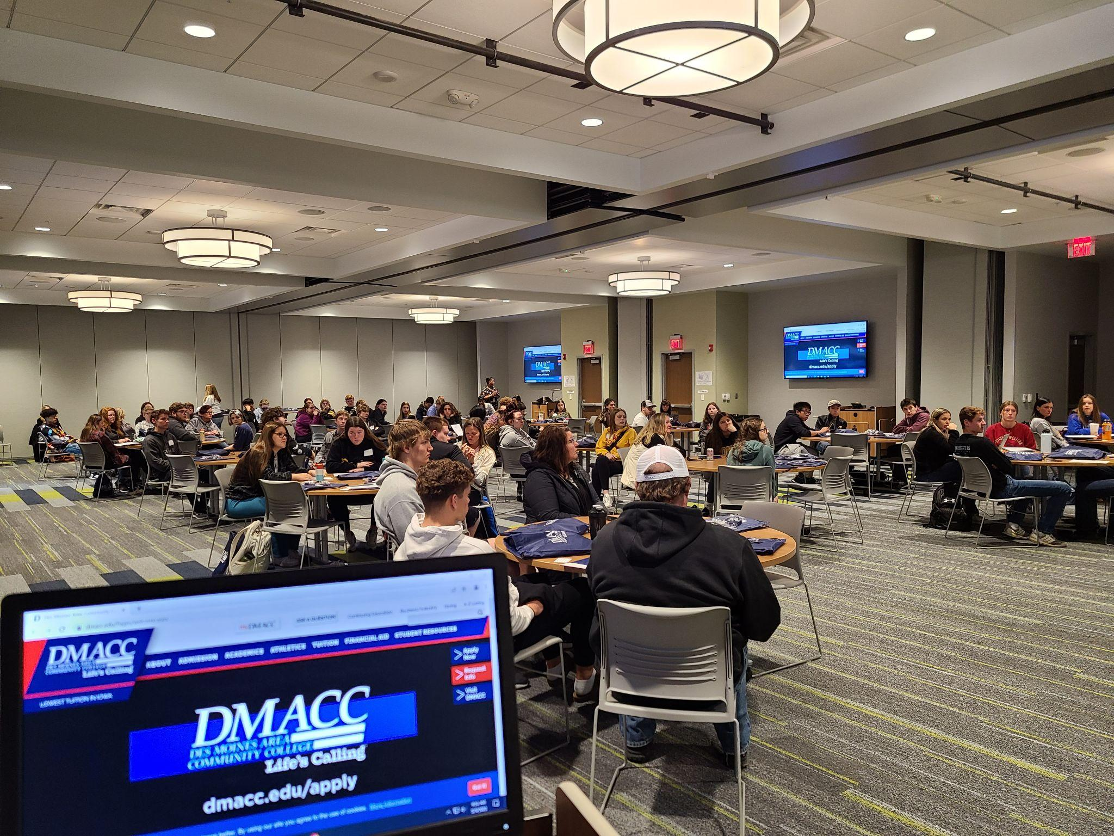
CCTC: Examples of CCTC Work
Meeting with HS Seniors
Creation of and follow up for post-high school plans
Application Day
Organize a community connected event in which all 12th graders had completed an application (military, apprenticeship, world of work, college, scholarship, etc.)
FAFSA
Follow up for students marked as “started and not completed”
Assistance with FAFSA nights
Individual appointments with families after high school hours
Campus Visits
Coordinate visits to colleges or apprenticeship sites
Coordinate with WBL teams at high schools for industry tours
Assisting with ICAP completion for students
College and Career Fairs
Accepted Student Day
Notes:
Pop-up career event in connection with

Slide 9
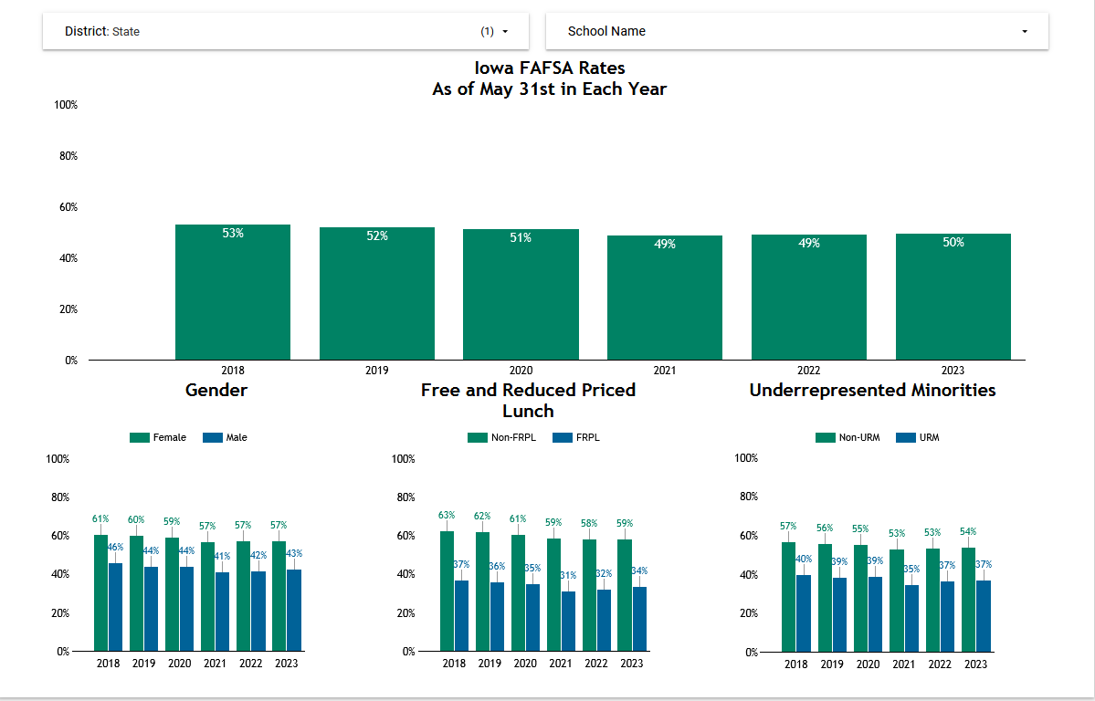
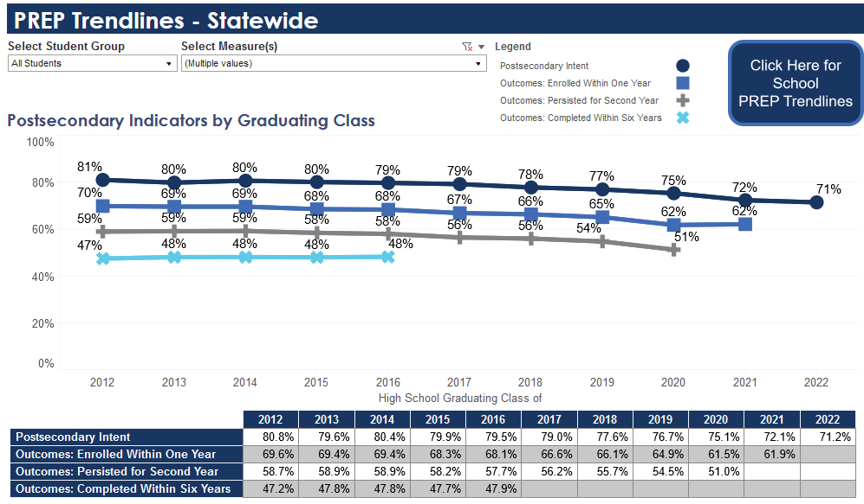
State Trends
FAFSA Completion -
Find your schools’ data at https://iowacollegeaid.gov/Finance
Postsecondary Enrollment-
Iowa Postsecondary Readiness Report - https://reports.educateiowa.gov/PostSecondaryReadiness/home/STATEPREPTrendlines
F
Notes:
Sheryl

Slide 10
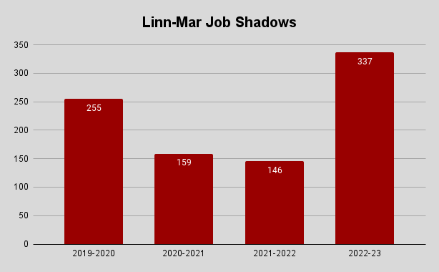
Linn-Mar Data Collection - other indicators
2022-23 School Year
WBL Participation
Dual Credit Coursework (Kirkwood)
Kirkwood Academy Registrations
2021-22: 39 Students/Academies
2022-23: 70 Students/10 Academies – 79.5% increase
Kirkwood LM Onsite Registrations
2021-22 School Year: 584/319 Students
2022-23 School Year: 677 Classes/437 students
16% increase
Kirkwood Alt Concurrent Enrollments
Fall 2021: 93 Classes/68 Students
Fall 2022: 114 Classes/82 Students – 22.5% increase
230% increase!
Notes:
Sheryl

Slide 11
Statewide CCTC Data Highlights
CCTC Schools saw a 17.8% INCREASE in overall FAFSA completion in 2022 compared to 2021.
Interstate 35 and West Liberty led the way with FAFSA Completion up 21% and 19% respectively.
Targeted FRL and URM populations saw an increase in many schools
Johnston increased FAFSA completion for FRL by 13% and URM by over 20%
Knoxville increased FRL completion by 20% and URM completion by 17%
Linn-Mar increased URM completion by 11%
Continued focus on data outcomes
Graduation Rates
FAFSA Completion
Postsecondary Intention (to prevent “summer melt”)
Postsecondary Enrollment
Notes:
Erica

Slide 12
Iowa Department Grant Funding Overview
The grant funding is intended to support and expand the College and Career Transitions Counselors (CCTC) model across the state. School districts may also be able to access operational sharing dollars, institutional resources and federal grant funds to support this position. (5 grant positions)
Timeline:
Year 1 initial Iowa Department of Education grant funding: Perkins incentive support (up to $40,000 per position*). Estimated cost of a shared counselor is $65,000-75,000. *Funding amounts are subject to change.
Year 2 Iowa Department of Education grant funding: Perkins support ($7,500).
Year 3 Iowa Department of Education grant funding: Perkins support ($2,500).
For the round 4 grant through the Department of Education:
Yr1=2024-25 Yr2= 2025-26 Yr3: 2026-27

Slide 13
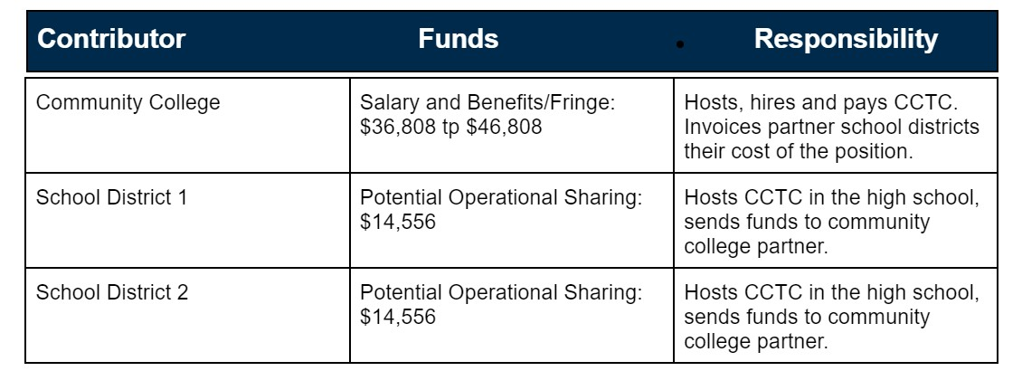
Position Costs Example:
Assumes $50,000-$60,000 salary, $15,000 benefits/fringe (insurance, IPERS, travel, professional development); 195-day contract timeline
Notes:
***Operational Shared weighting for a CCTC is a 3 BUT in HF 257.11(5) there was a temporary reduction in weighting which put counselors and thereby CCTCs at 2 until 2034
The reduced weightings are specified elsewhere in 257.11(5), under paragraph (b). These are temporary and will revert back after the 2024 school year (assuming the Legislature does not extend them). School counselor is a weighting of three, so is reduced to weighting of two per 257.11(5)(b)(2).
Wording: “Notwithstanding paragraph “a” subparagraph (1) each operational function assigned a supplementary weighting of three pupils under paragraph “a” subparagraph (1) shall instead be assigned a supplementary weighting of two pupils for the school budget years beginning July 1, 2022, July 1, 2023 and July 1, 2024

Slide 14
Grant Application:
Community College and at least 1 school district have agreed upon a partnership.
In partnership, develop the following:
Job description
Budget description
Answer 4 questions (see CCTC Toolkit for specific questions)
Impact on students, reduce barriers and expand access, overview of students served and caseload
The community college will act as the fiscal agent for the grant funding.
A community college representative will complete the application in the Iowa Grants system.

Slide 15
Iowa Grants
Select Program Area of Interest as Perkins V
The funding opportunity will be in Perkins V
For help with Iowa Grants, Contact Jeff Fletcher at jeffrey.fletcher@iowa.gov or 515-321-7309

Slide 16
Next Steps, Toolkit and Media
Next steps:
Reach out to your community college
Consider partnerships with area districts
Grant application; grant application will open on Monday, Oct. 10
Submit application; due on December 16, 2023
Notice of award: January 6, 2024
CCTC Toolkit: detailed overview of the CCTC Initiative including:
Grant application requirements
Sample job description
Outlined roles and responsibilities for CCTC, high school/district, community college, etc.
Financial information including operational sharing information, FAQ and supporting data information
CCTC One-Pager: general overview of the CCTC initiative

Slide 17
Questions?
You are welcome to review the CCTC Toolkit and reach out with any questions or unmute and ask your question(s) now. Thank you!

Slide 18
Contact
Sheryl Bass
College/Career Transition Counselor
Kirkwood Community College
Kirkwood CCTC Information
Email: sheryl.bass@kirkwood.edu
David Ford, Director AEA PREP
Iowa’s AEAs
AEA PREP: Link
Email: dford@aeaprep.org

Slide 19
Contact Information
Erica Woods-Schmitz
Educational Consultant, Career and Academic Planning
Bureau of Career and Technical Education
Iowa Department of Education
erica.woods-schmitz@iowa.gov
icap.educateiowa.gov

