Slide 1

How to use the
Certified Annual Report (CAR) – Chart of Account (COA) test site and actual site

Slide 2
Test and actual sites
COA test records site (CAR Year COA Test Records) mirrors the actual collection site (CAR Year Upload and Reports)
  Available year around
  Switches to the current fiscal year’s edits after all the past fiscal year’s CARs have been received and reviewed (April)
  Additional capability of testing individual account codes
Actual collection CAR site is available in August
  All accruals and deferrals should be made prior to upload

Slide 3
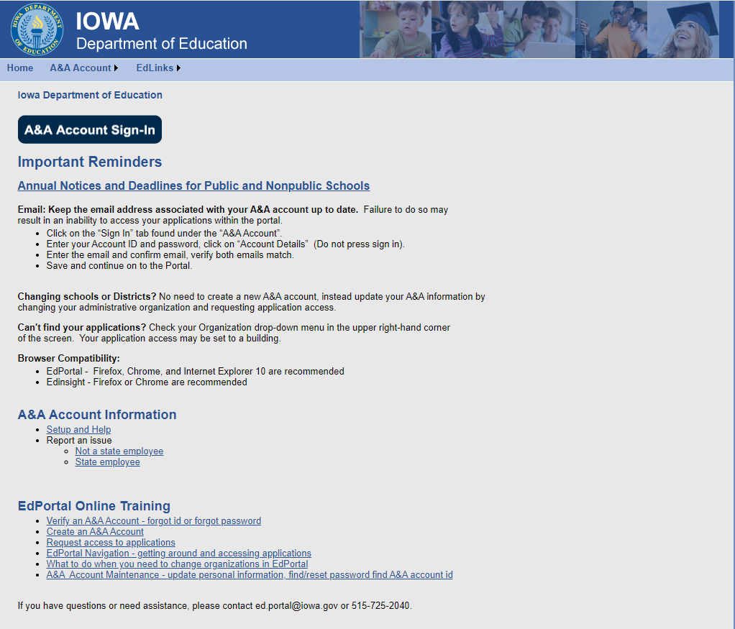
Log in to the Iowa Education Portal:

Slide 4
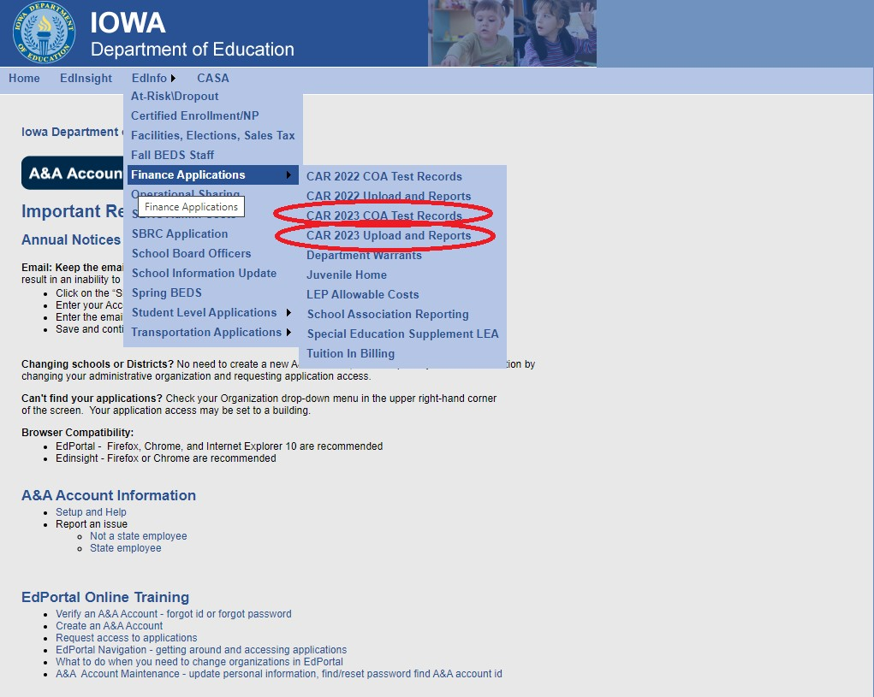
Go into appropriate application

Slide 5

CAR Year COA Test Records site
Test early and test often
Testing gives you the opportunity to clean up incorrect account codes or reconciliations

Slide 6
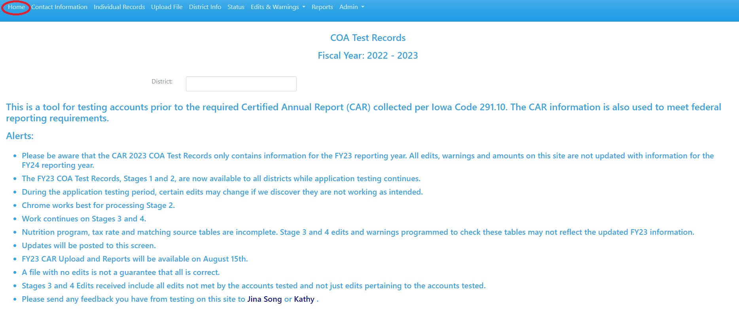
The application opens to the Home Page which includes alerts.

Slide 7
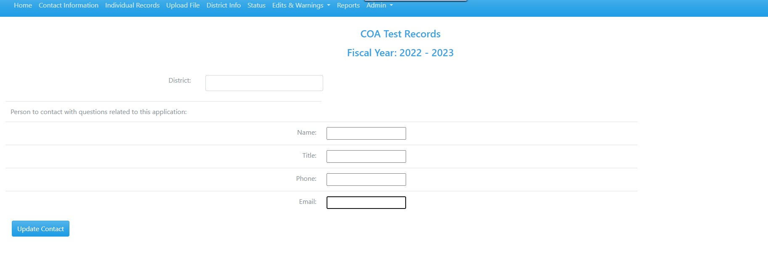
First time through – complete Contact Information

Slide 8
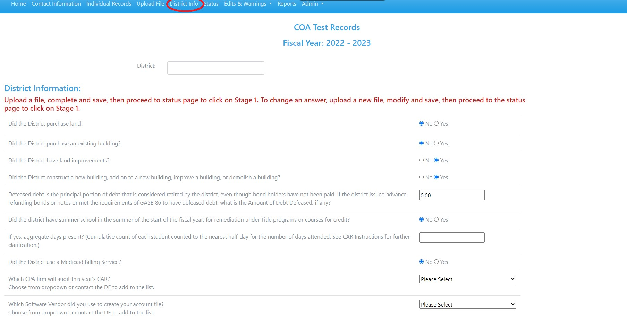
First time through – answer questions on District Info screen after adding Individual Records or Uploading File.
Edits are based on answers.

Slide 9
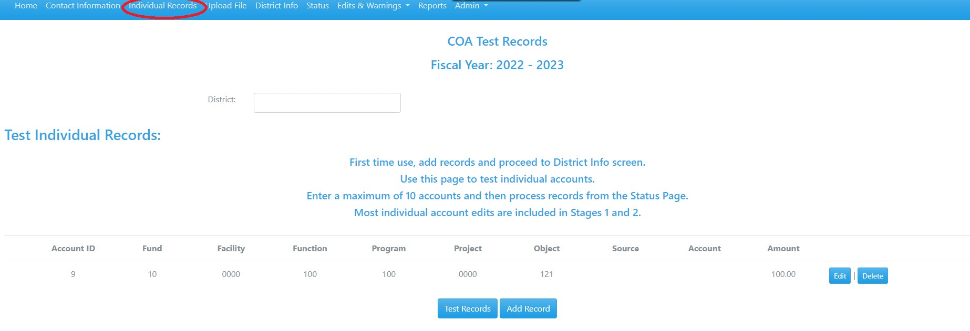
Test Records site – testing individual records
Add up to 10 account numbers & click the Test Records button

Slide 10
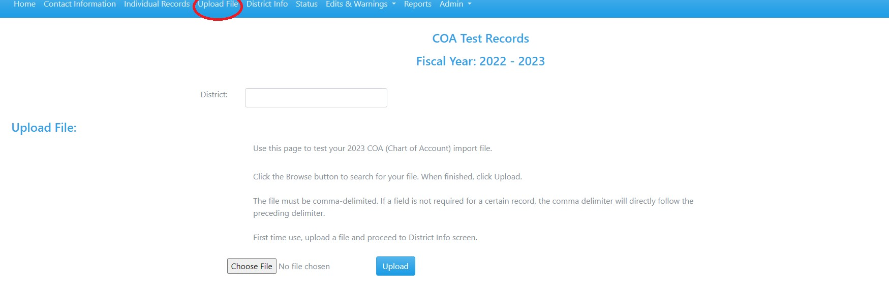
OR… upload entire text file

Slide 11
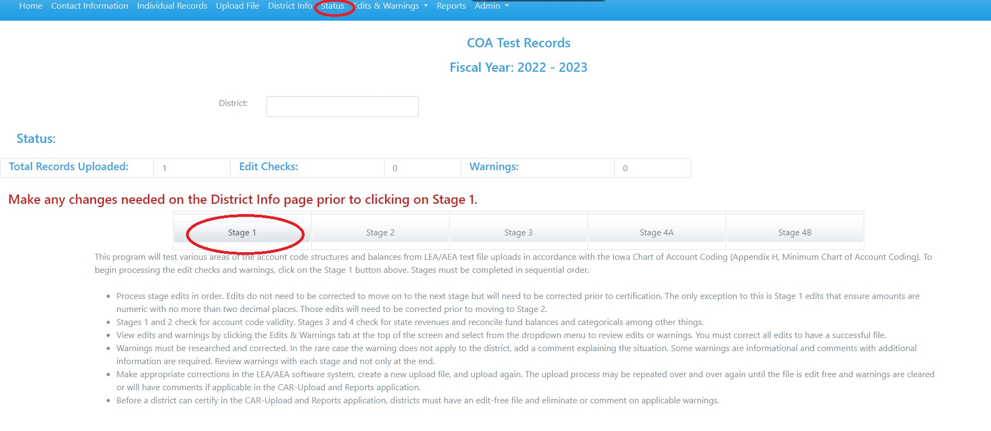
Click on Stage 1 button on the Status Screen

Slide 12
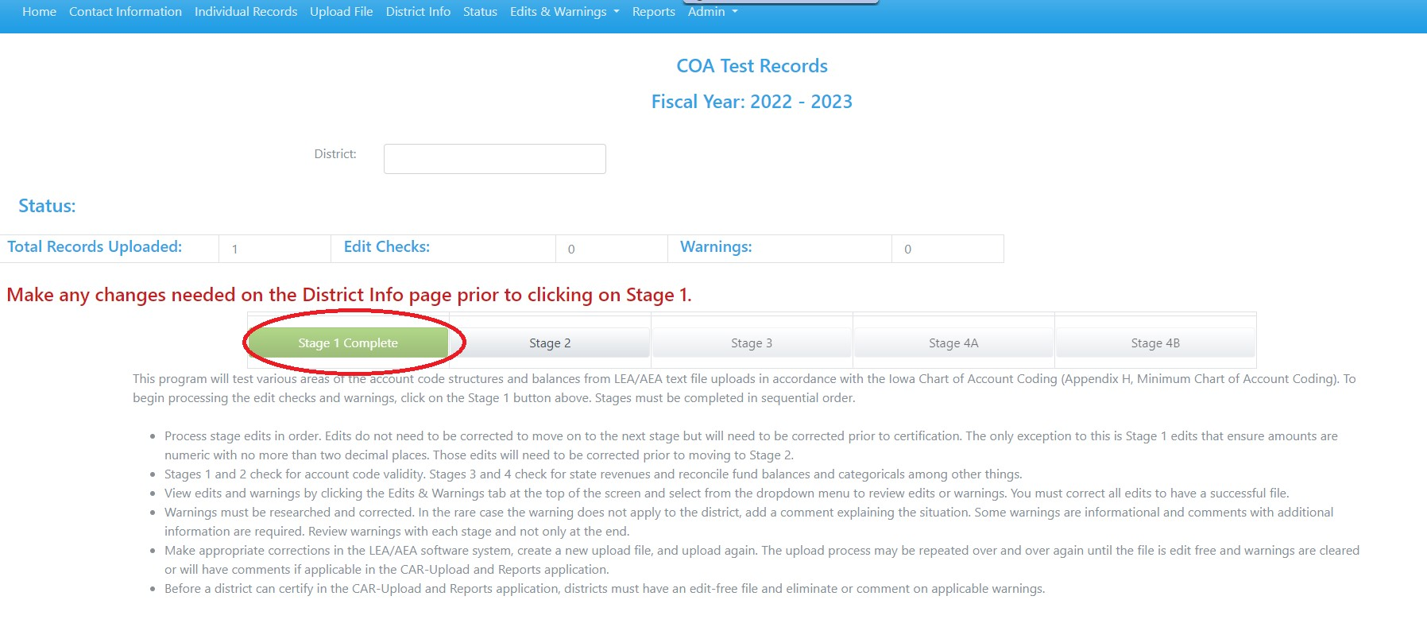
Stage 1 Complete – Green-may proceed through Stage 2.

Slide 13
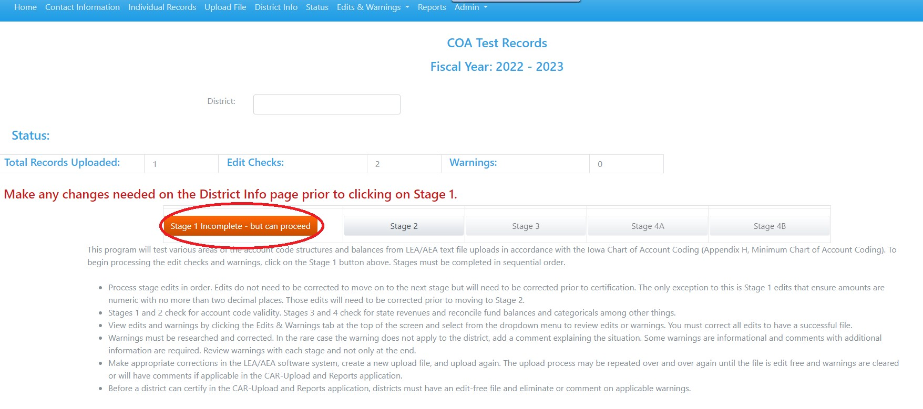
Stage 1 Incomplete-Orange-may proceed to Stage 2. All edits will need to be corrected prior to certification. May proceed through remaining stages.

Slide 14
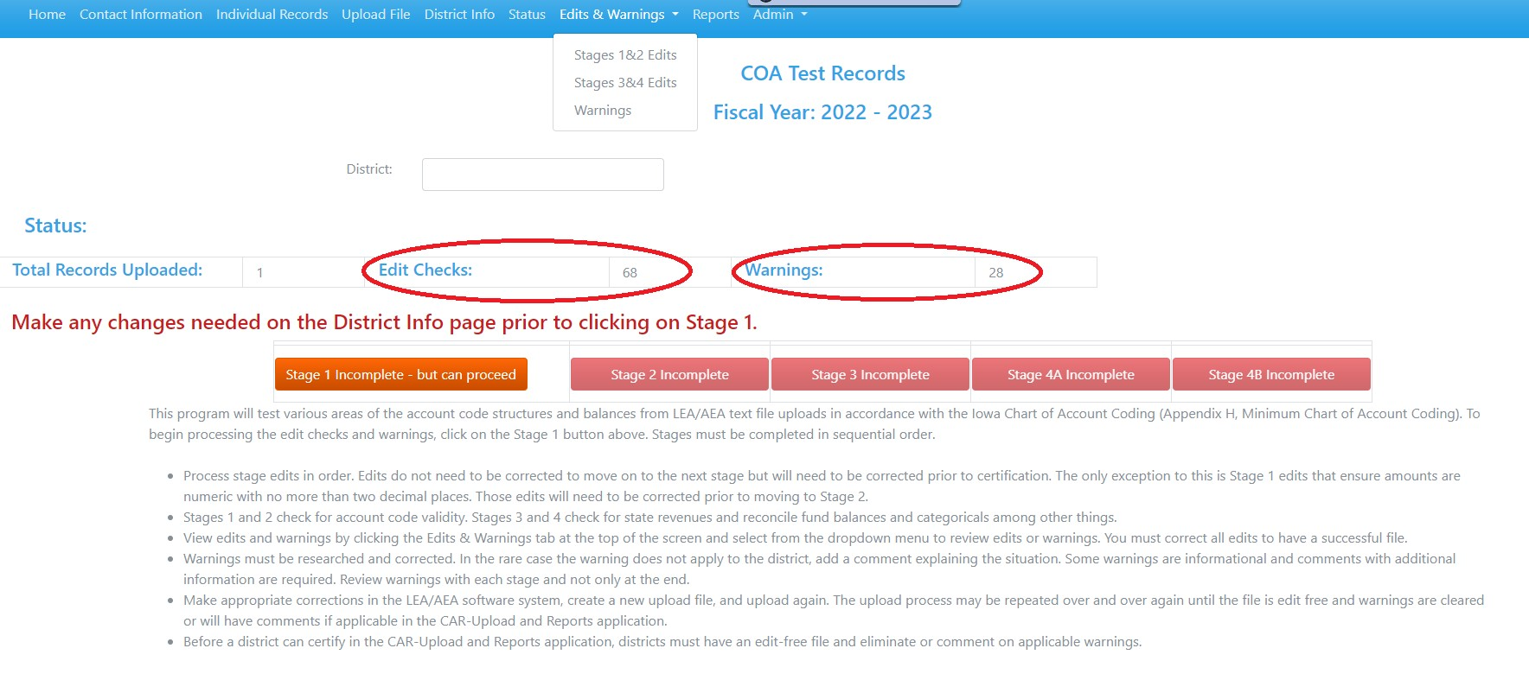
To view edits or warnings – go to Edits & Warnings dropdown

Slide 15
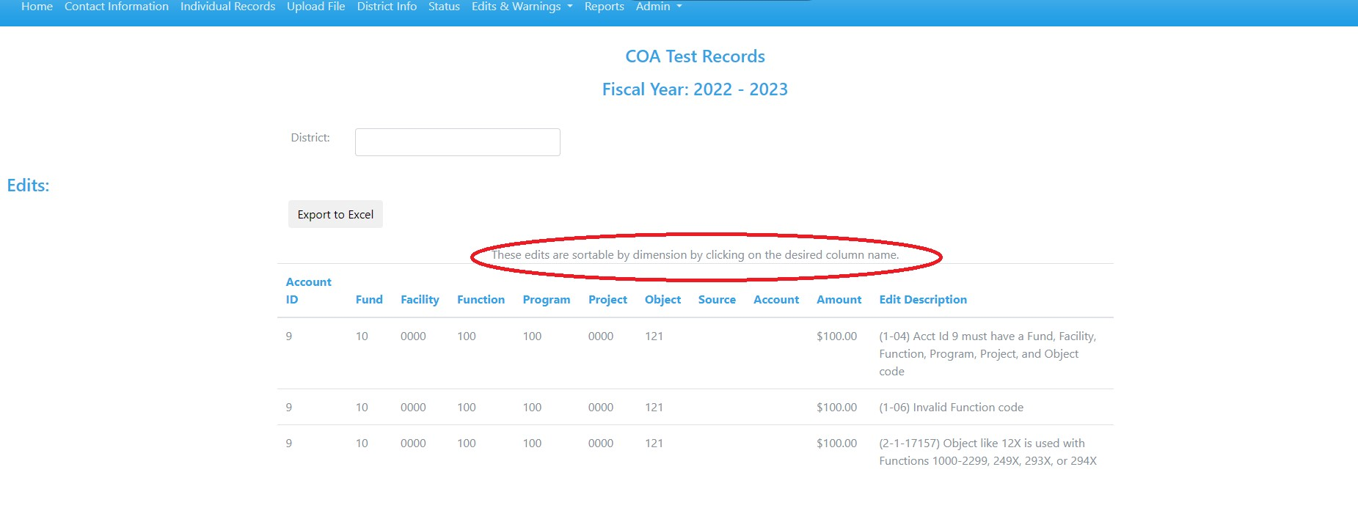
Stages 1 & 2 Edits may be sorted by dimensions

Slide 16
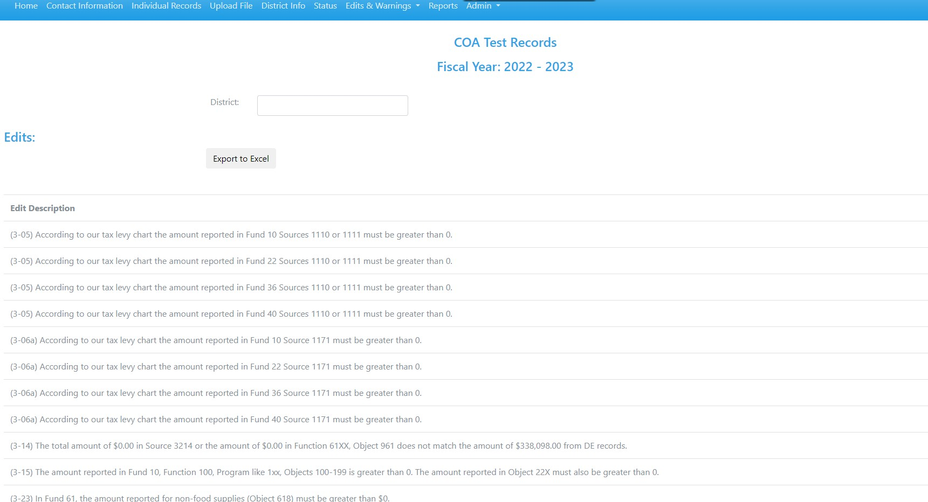
Stages 3 & 4 Edits are grouped as general edits

Slide 17
Edits vs. Warnings
Edits are absolutes for every district and must be corrected and eliminated in order to certify the CAR.
Warnings are not absolutes for every district but apply to most. If a warning applies to the district, it must be corrected and eliminated. If it does not apply, the district must comment as to why it does not apply to the district in order to certify the CAR.

Slide 18
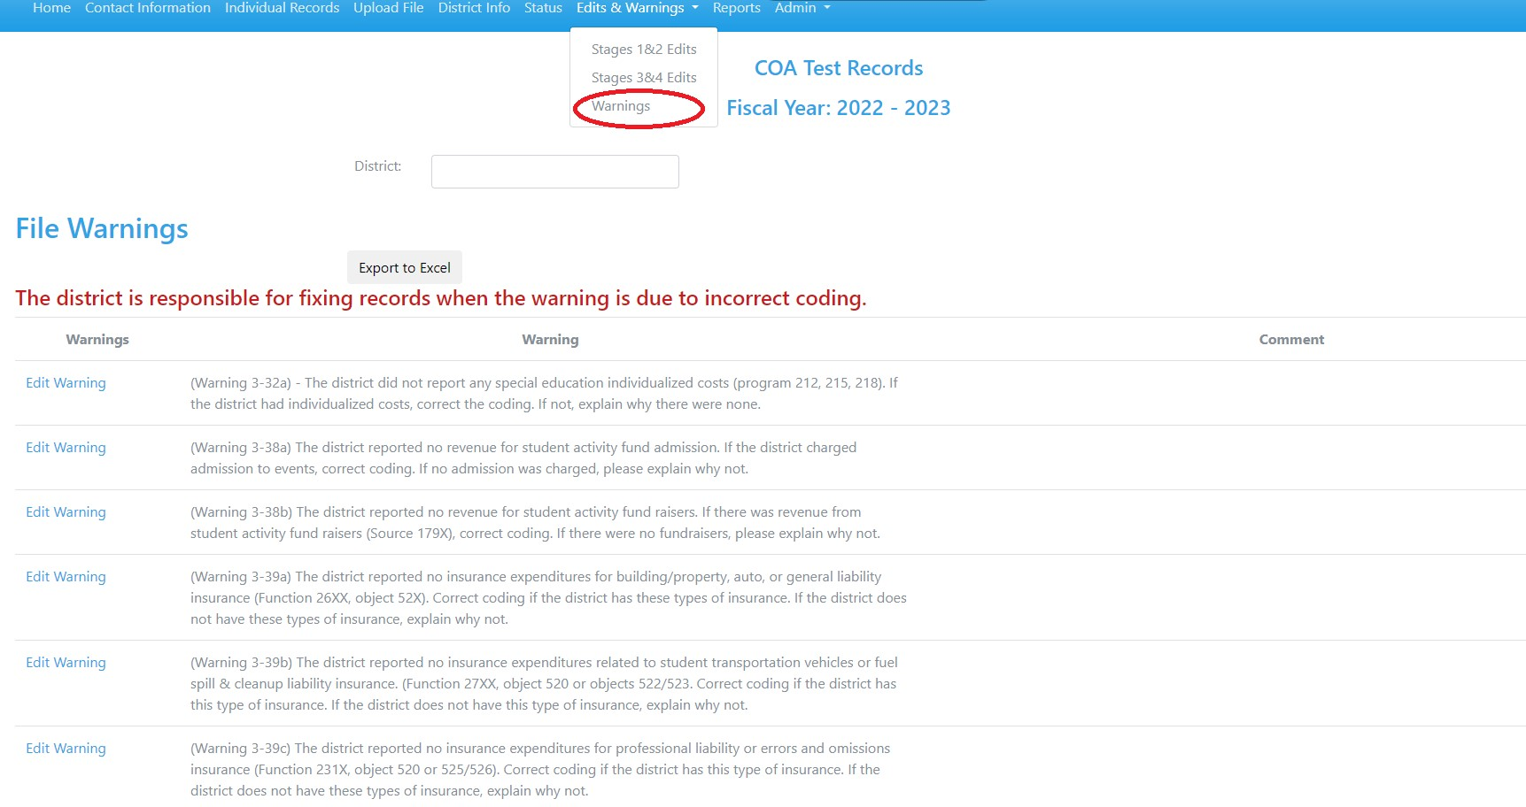
Warnings – Review Warnings

Slide 19
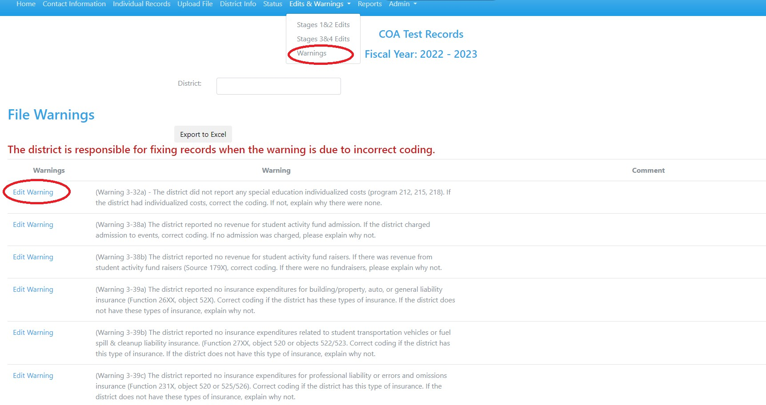
Warnings – Edit Warning to add comment

Slide 20
COA Test Records-Individual account vs. entire file
Individual account codes
  Edit checks in Stages 1 and 2 look at the validity or format of an account code.
  Stages 3 and 4 are comprised of various reconciling edits which will give edit messages that relate to a group of account numbers.
Entire files
  Some edits in Stages 3 and 4 cannot be corrected until all revenues are recorded and accruals/adjustments, deferred inflows and outflows, and end-of-year journal entries are made.

Slide 21
Try, try, and try again!
Individual account codes
  Repeat this process for 1 to 10 account codes at any time
  Completing Stages 1 and 2 determines the validity of the code
Entire files
  Correct edits, applicable warnings and repeat process
  Mirrors the actual upload site which is available in mid-August

Slide 22
Actual CAR upload and reports
Check points
  Bank accounts are reconciled to financials
  Using most updated version of financial software
  One upload file – all accounts from all funds must be included in one comma delimited text file
  Accounting entries have been made (adjustments, accruals, deferred inflows and deferred outflows)
  Opened CAR reports and verified balances to ledger
  Reviewed for accuracy
  Report must be completed & certified by Sept. 15th

Slide 23

Navigation of CAR-COA
Use the buttons across the top of the screen
User must complete contact information before accessing other screens
In completing a report or certification, information is only accepted after hitting UPDATE button

Slide 24
Instructions
Instructions can be found at:
Certified Annual Financial Reports (CAR)
  Or navigate by going to the Iowa Department of Education website, A-Z Index, Certified Annual Financial Reports (CAR)

Slide 25
Resources
  Use the Department of Education website often & bookmark !!!
  Certified Annual Reports (CAR)
    AEA Flowthrough amounts
    Sources for Local Projects
    Commodities
    CAR Information and Instructions
  Uniform Financial Accounting
    Appendix G: Chart of Account Descriptions
    Appendix H: Minimum Chart of Account Quick Reference Guide
    Uniform Financial Accounting Manual for Iowa LEAs and AEAs – 2009 Edition
  Uniform Administrative Procedures for LEAs (AEAs)
  Allocation Summaries
    Spreadsheet of state and selected federal allocations

Slide 26
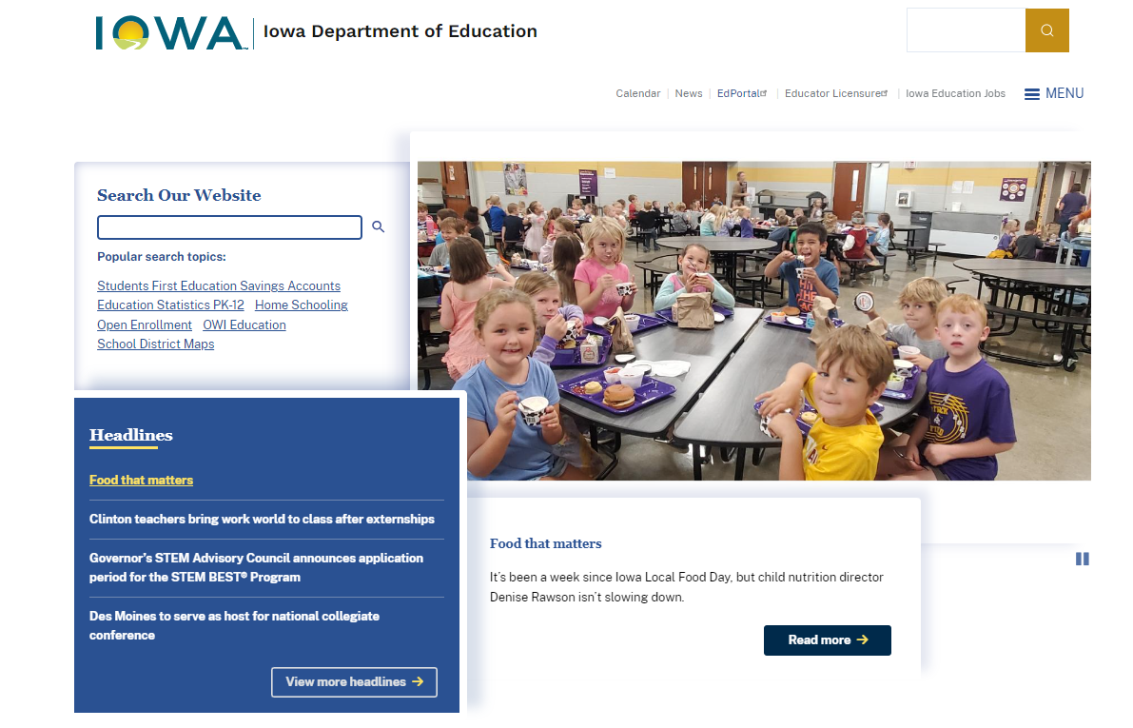
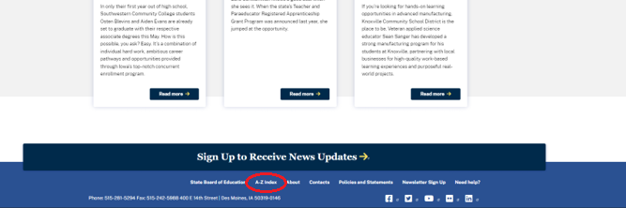
Bookmark! www.educateiowa.gov
Best way to find something.

Slide 27
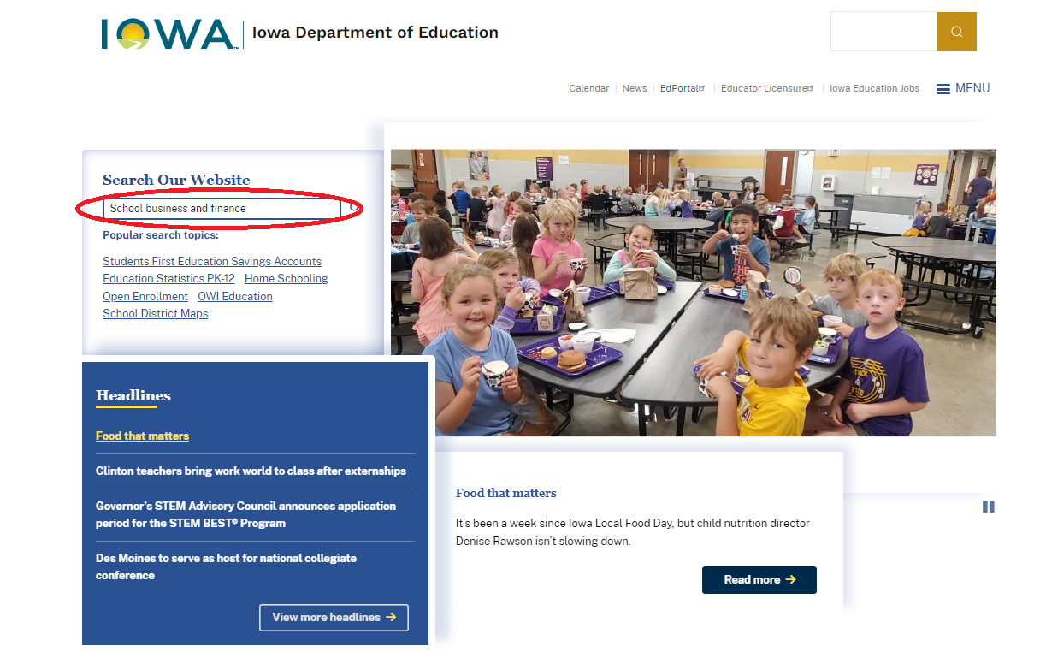
School Business and Finance

Slide 28
Contact Us!!!!
Kathy Bowers, Education Program Consultant kathy.bowers@iowa.gov 515-210-9674
  UFA Chart of Account, COA/CAR Applications, Federal Financial Reports, Indirect Costs
Jina Brincks, Education Program Consultant jina.brincks@iowa.gov 515-313-5942
  UFA Chart of Account, COA/CAR Applications, AEA Budgets and Juvenile Home Claims
Song Luong– Education Program Consultant song.luong1@iowa.gov 515-205-0259
  UFA Chart of Account, COA/CAR Applications, Categorical Funding, Student Activity

