Slide 1
Iowa’s Students First Act
Education Savings Accounts
Parent/Guardian Training

Slide 2
Agenda
Overview | Duration
What is an ESA? | 5 minutes
Iowa’s Students First Act ESA Eligibility Criteria | 5 minutes
Parent/Guardian Timeline | 5 minutes
Introduction to Parent/Guardian Application | 10 minutes
How Odyssey Verifies Eligibility | 5 minutes
How can I use my ESA funds? | 15 minutes
Odyssey Support Team | 5 minutes

Slide 3
What is an ESA?

Slide 4
What is an ESA?
ESA is an acronym for “Education Savings Account.”
An ESA holds funds for an eligible student until they are spent on eligible education expenses.
Each state that offers ESAs has different rules and guidelines, as determined by law.
Applying for enrollment to an Iowa accredited nonpublic school is a separate process from applying for an ESA through the Odyssey platform. Nonpublic school enrollment is unrelated to the Students First ESA application and is strictly between the family and the school.

Slide 5
Iowa’s Students First Act ESA
For Iowa’s Students First Act ESA, funds must first be used to pay accredited nonpublic school tuition and fees.
Any remaining funds can be used to pay other eligible educational expenses.

Slide 6
Iowa’s Students First
ESA Eligibility Criteria

Slide 7
Iowa’s Students First Act ESA Eligibility Criteria
Student is an Iowa resident.
Enrolls in, and attends, an Iowa accredited nonpublic school for the 2024-2025 school year.
A student that attended an Iowa accredited nonpublic school for the 2023-2024 school year and did not receive an ESA is subject to income requirements.
Household income at or below 400% of the 2024 Federal Poverty Guidelines, $124,800 for a family of four.
A student who was approved for and used an ESA in the 2023-2024 school year is not subject to household income requirements for the 2024-2025 school year.

Slide 8
Parent/Guardian Timeline
Parent/Guardian Applications Open
Parent/Guardian Applications Close
Verification (Automated & Manual)
First Day for Approved ESAs to be Funded
April 16, 2024
June 30, 2024
April, May, June and July
July 15, 2024*
*or 30 days after application approval, whichever is later.

Slide 9
Introduction to Parent/Guardian Application

Slide 10
Students Continuing the ESA Program
Annual ESA applications are required for all prospective ESA participants.
A student who was approved for and used an ESA in the 2023-2024 school year is not subject to household income requirements for the 2024-2025 school year.
Parent/Guardian will use the same email address and password to log into their account and complete the 2024-2025 application.

Slide 11
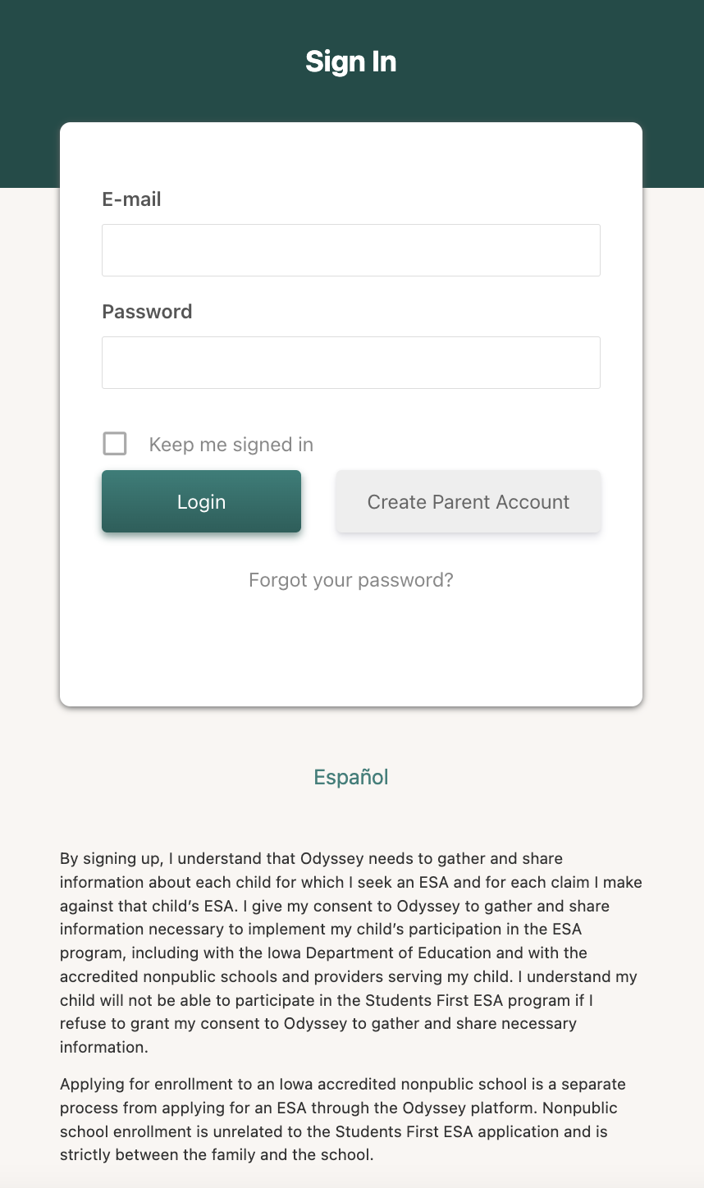
Log-in Screen
Applying for enrollment to an Iowa accredited nonpublic school is a separate process from applying for an ESA through the Odyssey platform.
Nonpublic school enrollment is unrelated to the Students First ESA application and is strictly between the family and the school.
Language below text boxes: “By signing up, I understand that Odyssey needs to gather and share information about each child for which I seek an ESA and for each claim I make against that child’s ESA. I give my consent to Odyssey to gather and share information necessary to implement my child’s participation in the ESA program, including with the Iowa Department of Education and with the accredited nonpublic schools and providers serving my child. I understand my child will not be able to participate in the Students First Act ESA program if I refuse to grant my consent to Odyssey to gather and share necessary information.
Applying for enrollment to an Iowa accredited nonpublic school is a separate process from applying for an ESA through the Odyssey platform. Nonpublic school enrollment is unrelated to the Students First ESA application and is strictly between the family and the school.

Slide 12
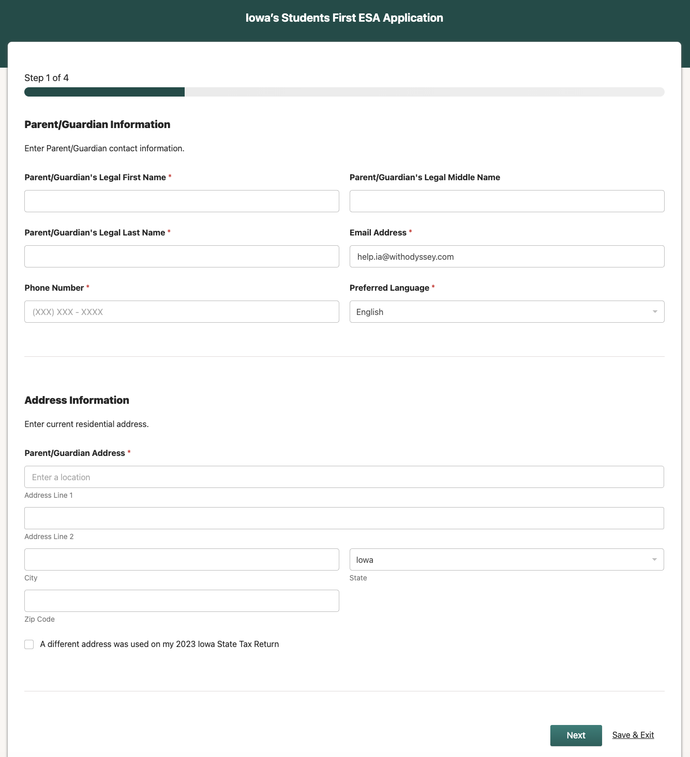
Parent/Guardian Application
Parent/Guardian Information
Parent/Guardian Legal Name
Email Address
Phone Number
Preferred Language
Address Information
Current residential address
If your 2023 Iowa State Tax Return lists a different address, please check the box and input that address.
Save & Exit feature

Slide 13
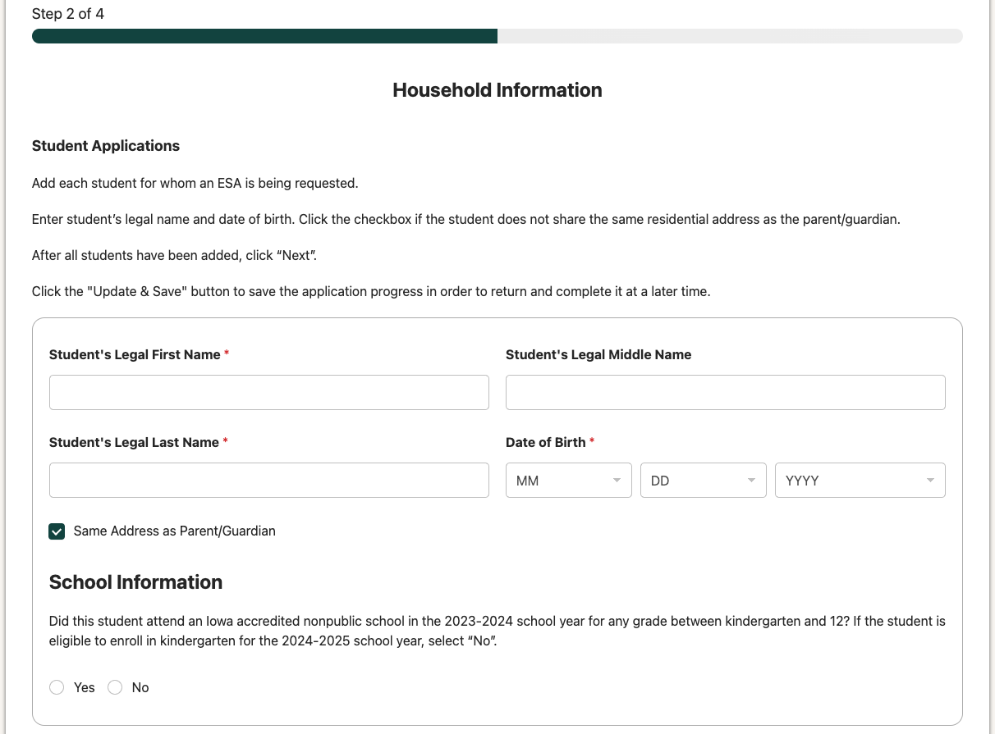
Student Application
Student Legal Name
Student Date of Birth
Student Address
School Information for 2023-2024 school year
Did this student attend an Iowa accredited nonpublic school for the 2023-2024 school year for any grade between kindergarten and 12? If the student is eligible to enroll in kindergarten for the 2024-2025 school year, select “No.”

Slide 14
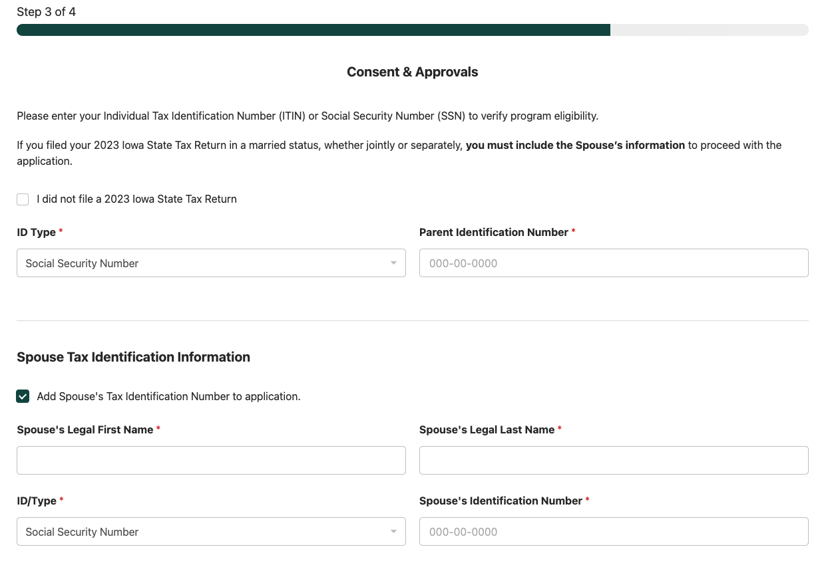
Program Eligibility
Parent/Guardian ID Type and Parent/Guardian Identification Number
Spouse ID type and Spouse Identification Number
This information will be used to verify Iowa residency, and in some cases verify income, with the Iowa Department of Revenue.
If you did not file a 2023 Iowa State Tax Return, please click the checkbox.

Slide 15
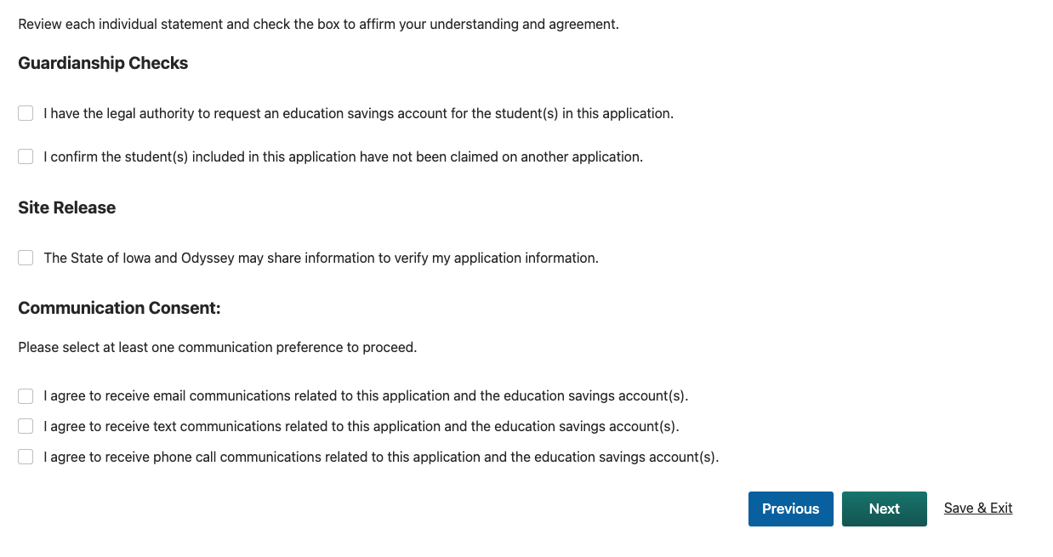
Consent & Approvals
Guardianship Checks
Site Release
Communication Consent

Slide 16
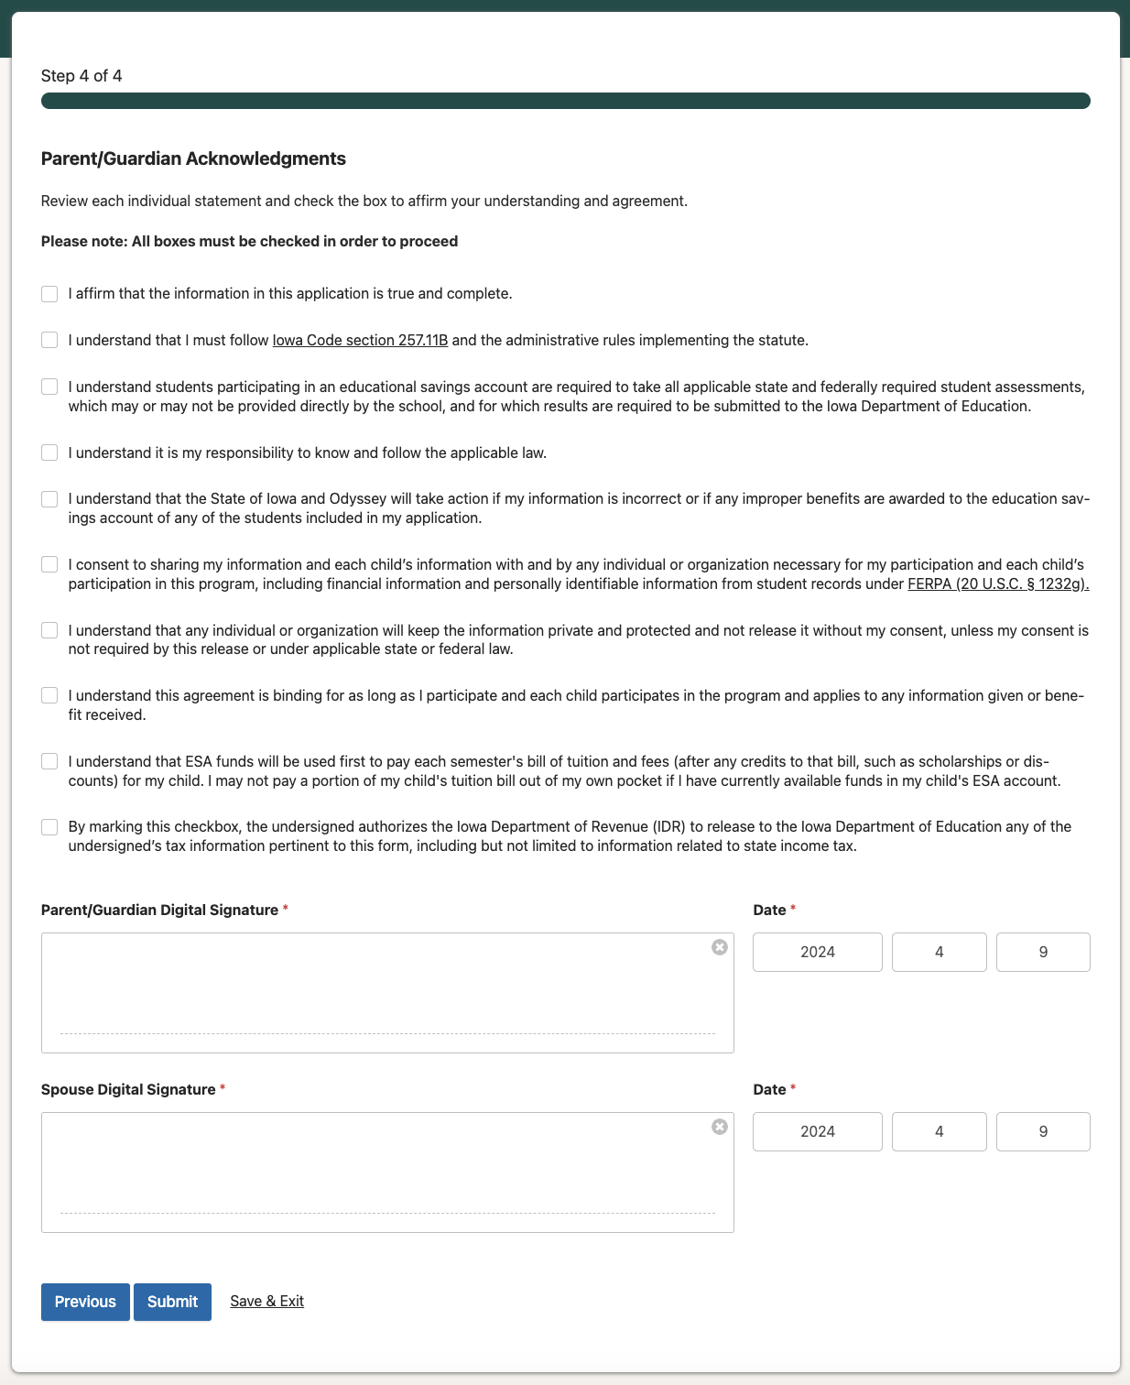
Parent/Guardian Acknowledgements
Review each statement and check the box to affirm your understanding and agreement.
Sign electronically.
Click “Submit” when completed.

Slide 17
Application Status: Final
Approved
Scenario 1:
Student attended nonpublic school in 2023-2024
Student received ESA in 2023-2024
2023 Iowa State Tax Return verified residency
Scenario 2:
Student did not attend an Iowa accredited nonpublic school in 2023-2024
2023 Iowa State Tax Return verified residency
Scenario 3:
Student attended an Iowa accredited nonpublic school in 2023-2024
2023 Iowa State Tax Return verified residency & income eligibility
Not Eligible
Scenario 1:
Student attended an Iowa accredited nonpublic school and did not have an ESA in 2023-2024
2023 Iowa State Tax Return verified residency
2023 Iowa State Tax Return did not verify income eligibility
The majority of applications will be approved through the automatic approval process.
This process will make approvals simple, straightforward, and easy for parents.
Pending
Your application is currently being reviewed. This process can take up to 30 minutes.

Slide 18
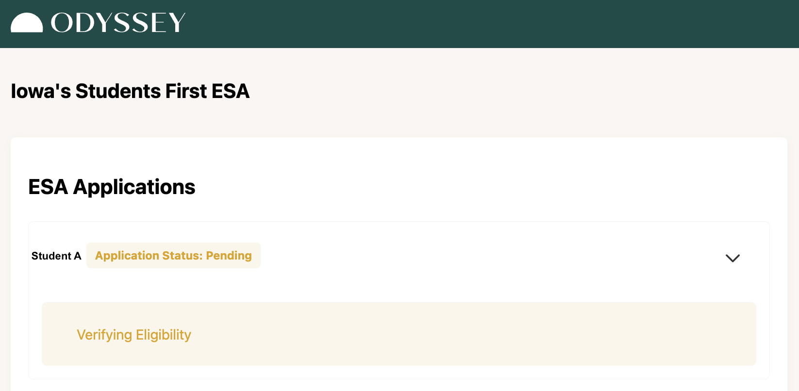
Application Status: Pending
Application is updated with responses typically within seconds of submission.
Income verification will only be completed for students who attended an Iowa accredited nonpublic school and did not receive an ESA in 2023-2024.

Slide 19
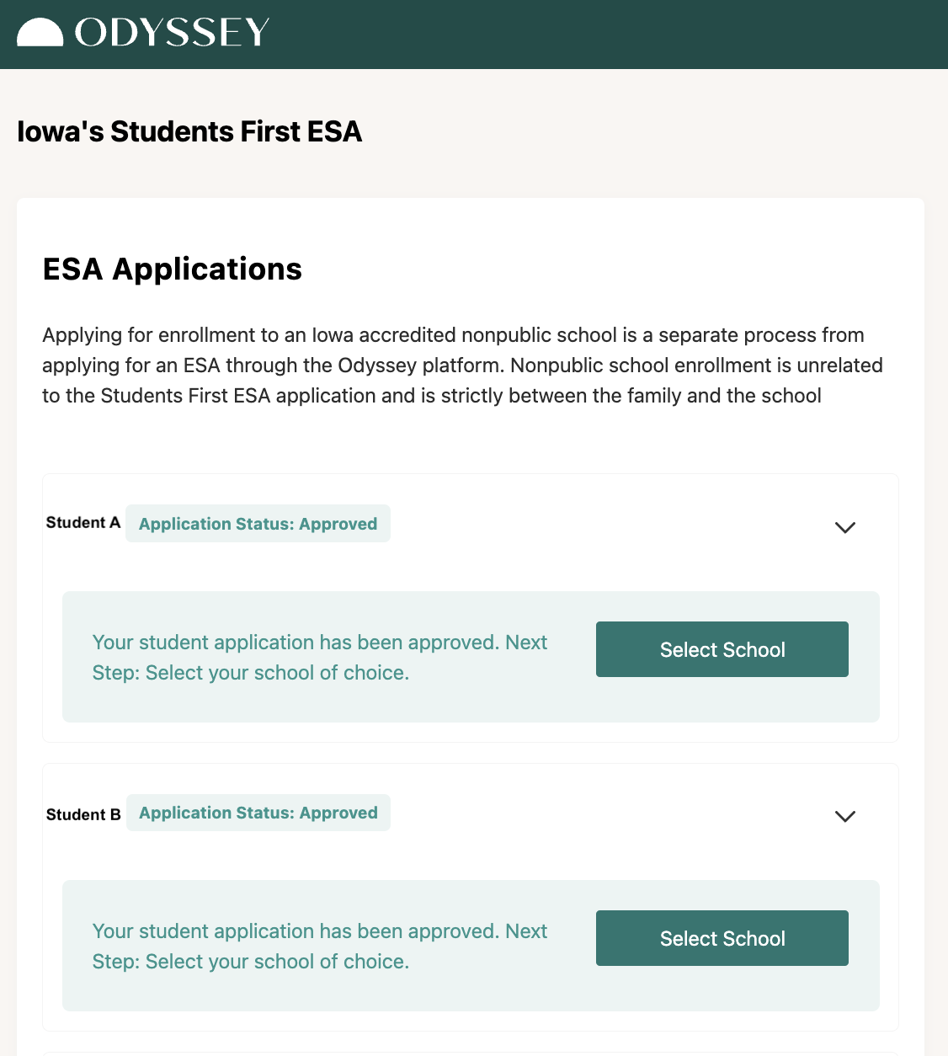
Application Status: Approved
Applying for enrollment to an Iowa accredited nonpublic school is a separate process from applying for an ESA through the Odyssey platform. Nonpublic school enrollment is unrelated to the Students First ESA application and is strictly between the family and the school.
A student’s application status appears behind their name.
Student A, Application Status: Approved
New This Year: As soon as the application status is changed to “Approve”, parents can select the school each student plans to attend for the 2024-2025 school year.

Slide 20
Application Status: Under Review
This status will apply to uncommon scenarios where additional documentation and manual review may be required.
Additional Documentation Required
Parents will be able to upload approved documentation to the Odyssey portal.
Scenario 1: Unable to verify income
Scenario 2: Unable to verify residency
Scenario 3: Unable to verify residency and income
Under Manual Review
Application was not able to be verified automatically.
Verification documentation will be reviewed.

Slide 21
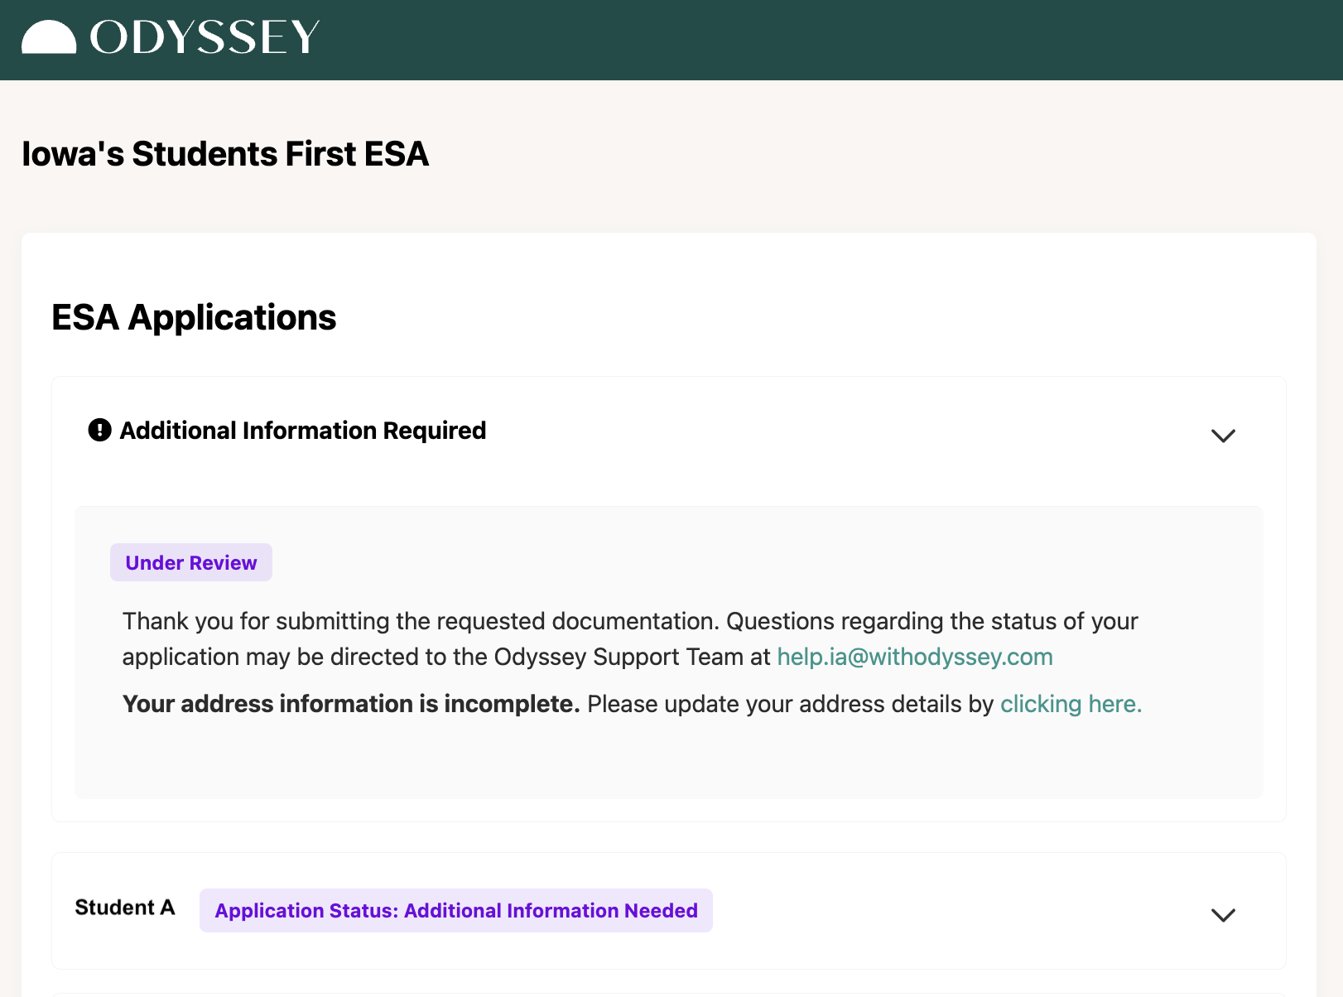
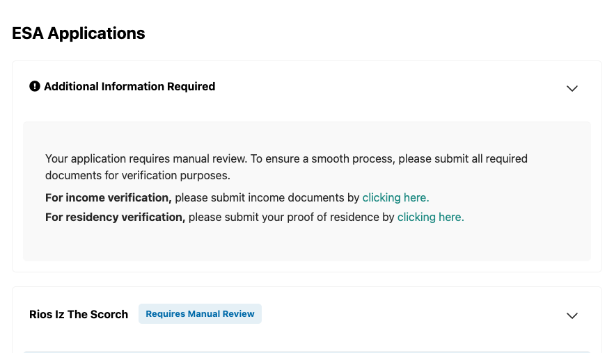
Application Status: Requires Manual Review
If the automated process is unable to confirm eligibility, Odyssey will prompt the parent/guardian to upload additional documents.
Student Name
Student A

Slide 22
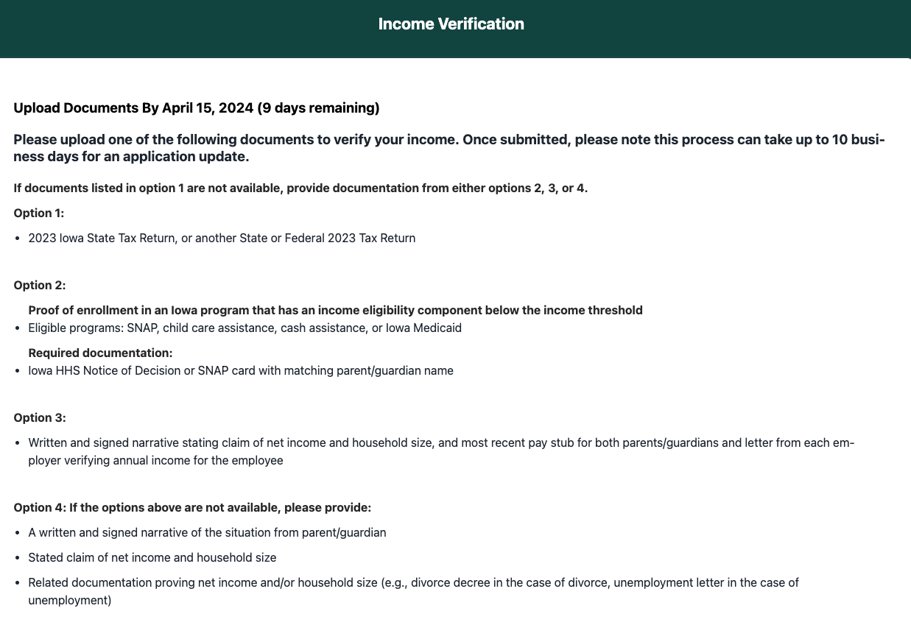
Application Status: Requires Manual Review
Click the link to upload income and residency verification documents.
File types accepted are: png, gif, jpg, pdf, docx, and doc.

Slide 23
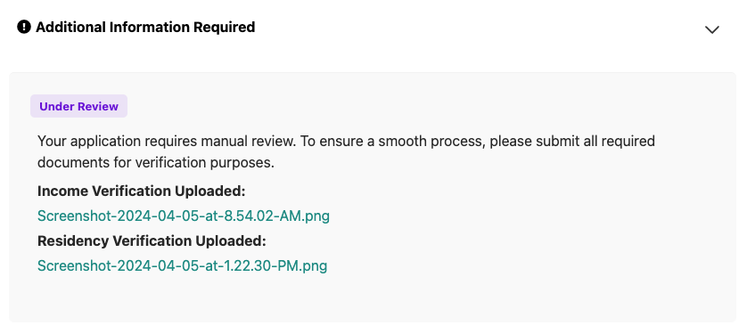
Application Status: Under Review
Once documents have been uploaded, the Odyssey team will manually review.
If additional documentation is required, Odyssey will contact the parent/guardian.

Slide 24
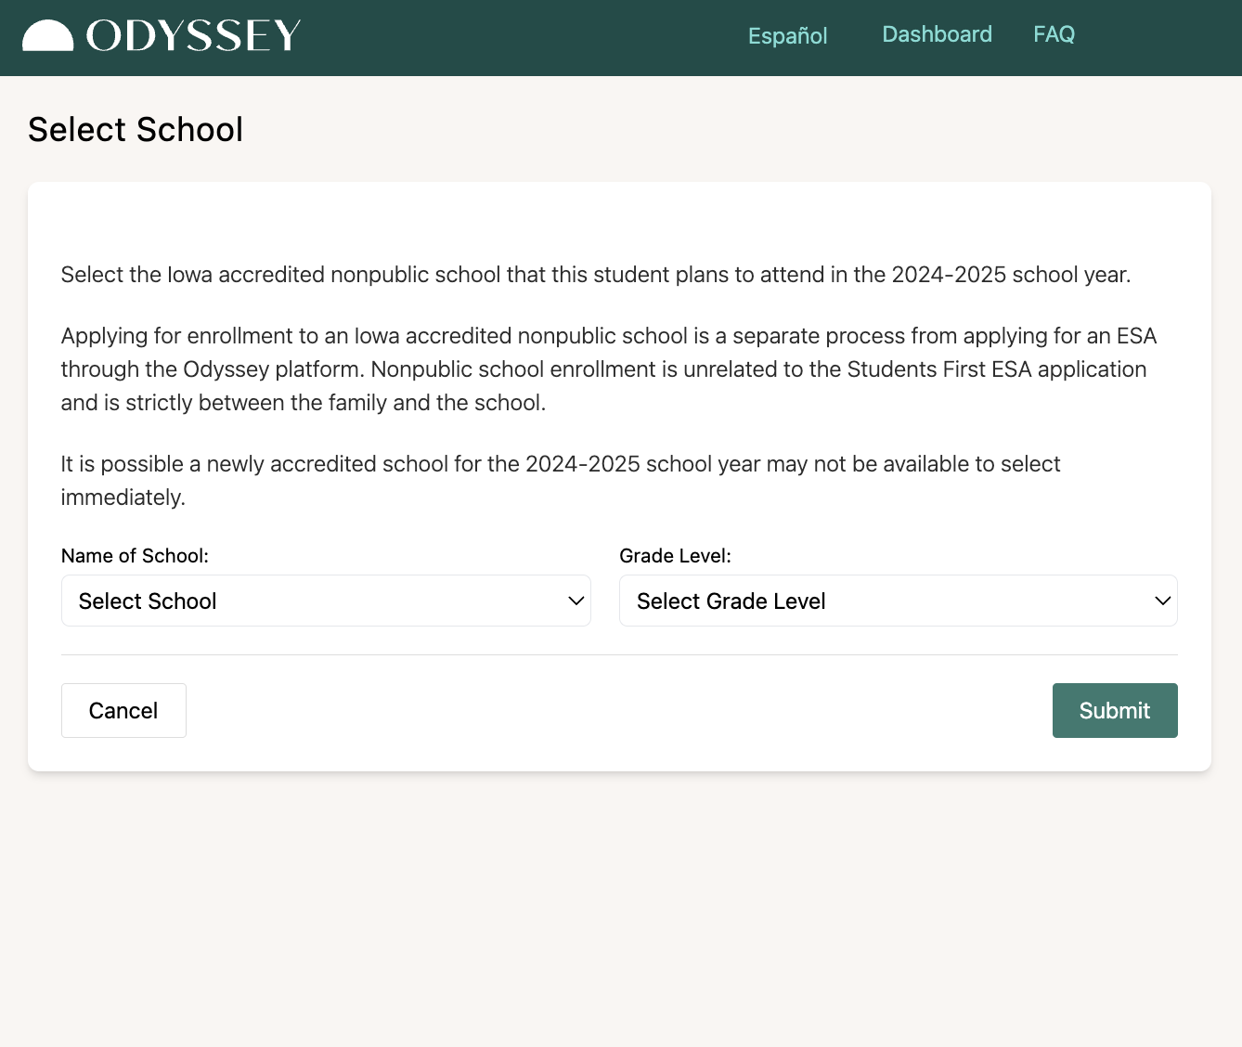
2024-2025 School Information
Applying for enrollment to an Iowa accredited nonpublic school is a separate process from applying for an ESA through the Odyssey platform. Immediately after being approved the Parent/Guardian will select their student’s 2024-2025 school.
Nonpublic school enrollment is unrelated to the Students First ESA application and is strictly between the family and the school.
For each student:
Select school.
Select grade.
Click “Submit” to finish
It is possible a newly accredited school for the 2024-2025 school year may not be available to select immediately.

Slide 25
How Odyssey Verifies Eligibility

Slide 26
How Odyssey Verifies Eligibility
Iowa Department of Revenue System Connection
Odyssey works with the Iowa Department of Revenue to automatically determine Iowa residency, and in some cases, income eligibility, through each applicant’s 2023 Iowa State Tax Return.
This will verify a majority of applicants.
If Additional Verification is Needed
If the automated check fails, the Odyssey system will request a parent/guardian to upload additional verification documents to show Iowa residency and/or income eligibility.

Slide 27
How Odyssey Verifies Eligibility:
Residency
If Additional Residency Verification is Needed
If the automated check for residency is unsuccessful, the Odyssey system will request the parent/guardian to upload additional verification documents.
Option 1:
Current Iowa Driver’s License
Option 2:
Proof of Residence (current mortgage, lease, utility bill)
and one of the following:
Iowa Voter Registration Card.
Claim of Homestead Credit or Military Tax Exemption on a home in Iowa.
Active checking or savings account with an Iowa address.
Other documents and correspondence initiated during tax periods with an Iowa address.
Option 3:
Other written and signed narrative from parent/guardian including a stated claim of Iowa residency, and related documentation reflecting residency.

Slide 28
How Odyssey Verifies Eligibility:
Income
If Additional Income Verification is Needed
If the automated check for income is unsuccessful, the Odyssey system will request the parent/guardian to upload additional verification documents. If documents listed in option 1 are not available, provide documentation from either options 2, 3, or 4.
Option 1:
2023 Iowa State Tax Return, or another State or Federal 2023 Tax Return.
Option 2:
Proof of enrollment in an Iowa program that has income eligibility component below the income threshold.
Eligible programs: SNAP, child care assistance, cash assistance, or Iowa Medicaid.
Required documentation:
Iowa HHS Notice of Decision or SNAP card with matching parent/guardian name,
Option 3:
Written and signed narrative stating claim of net income and household size, and most recent pay stub for both parents/guardians and letter from each employer verifying annual income for the employee.
Option 4: If the information above is not available, please provide:
A written and signed narrative of the situation from parent/guardian.
Stated claim of net income and household size.
Related documentation proving net income and/or household size (e.g., divorce decree in the case of divorce, unemployment letter in the case of employment).

Slide 29
School Attendance
Schools are required to inform Odyssey if an invoice was submitted for a student who did not attend.
Scenario:
Tuition was billed to Odyssey on July 15, school started August 23, but the student did not attend.
Students are NOT eligible for an ESA if they do not attend an Iowa accredited nonpublic school.
ESA funds must be returned by the school for the semester in which the student did NOT attend.
ESA ineligibility does not absolve individuals from financial obligations they have directly entered into with a nonpublic school or any other vendor.

Slide 30
How can I use my ESA funds?

Slide 31
ESA Funds must first be used to pay accredited nonpublic school tuition and fees.

Slide 32
After Tuition and Fees . . .
Remaining ESA funds can be used to pay for other eligible educational expenses.
A list of ESA - Eligible and Ineligible Expenses is available on the Department of Education’s ESA web page.

Slide 33
Eligible Expenses
Beyond tuition and fees, examples of eligible expenses are provided below:
Microsoft Office and Adobe products
Laptops, desktops, and tablets
Textbooks
Tutoring
Course materials
A list of ESA - Eligible and Ineligible Expenses is available on the Department of Education’s ESA web page.

Slide 34
Ineligible Expenses
Examples of ineligible expenses are provided below:
Personal bags (e.g., backpack, laptop bag, purse)
Clothing (e.g., uniforms, hats)
Basic school supplies (e.g., paper, glue, pens, pencils, cleaning supplies)
Childcare (e.g., before and after school care)
Camps (e.g., summer, winter, holiday, athletic)
A list of ESA - Eligible and Ineligible Expenses is available on the Department of Education’s ESA web page.

Slide 35
How do I spend my ESA funds?
Purchases with ESA funds can only be made through the Odyssey Marketplace.
Any purchases made outside of the Odyssey Marketplace are ineligible and will not be reimbursed.

Slide 36
What is the Odyssey Marketplace?
The Odyssey Marketplace is a closed marketplace with eligible vendors, products, and service offerings specifically approved for Iowa’s Students First Act ESA program.
Examples of Odyssey Marketplace vendors include:
Iowa’s accredited nonpublic schools
Bookstores
Computer stores
Educational therapies
Tutoring
Local and national vendors

Slide 37
Odyssey Support Team

Slide 38
Customer Support Availability
Contact Odyssey for technical issues.
We have a fantastic support team that has experience working with parents and vendors to help answer their questions and troubleshoot any issues.
We provide service in both English and Spanish on phone, chat, and email. Our Knowledge Center is available at support.withodyssey.com.
Monday-Friday
7am-9pm CT
Saturday-Sunday
10am-4pm CT

Slide 39
Questions Following Training
If you have questions regarding the application, please contact the Odyssey support team during regular business hours at:
help.ia@withodyssey.com
515-368-9564
This slide deck is available on the Iowa Department of Education’s Students First Act ESA web page.

