Slide 1
Iowa’s Students First Act
Education Savings Accounts
Accredited Nonpublic School Training

Slide 2
Questions During Training
If you have questions during the training, please enter them into the Q&A Zoom Webinar feature.
Frequently asked questions (FAQs) are available on the Department’s Students First Act ESA web page. Questions submitted during the webinar not addressed in the FAQs will be responded to directly via the email address used to sign up for the webinar.

Slide 3
Agenda
Overview | Duration
What is an ESA? | 5 minutes
Iowa’s Students First Act ESA Eligibility Criteria | 5 minutes
Parent/Guardian Timeline | 5 minutes
Introduction to Parent/Guardian Application | 10 minutes
How Odyssey Verifies Eligibility | 5 minutes
School Registration Overview | 10 minutes
Nonpublic School Dashboard: Student Detail | 5 minutes
Odyssey Support Team | 5 minutes

Slide 4
What is an ESA?

Slide 5
What is an ESA?
ESA is an acronym for “Education Savings Account.”
An ESA holds funds for an eligible student until they are spent on eligible education expenses.
Each state that offers ESAs has different rules and guidelines, as determined by law.

Slide 6
Iowa’s Students First Act ESA
For Iowa’s Students First Act ESA, funds must first be used to pay accredited nonpublic school tuition and fees.
Any remaining funds can be used to pay other eligible educational expenses.

Slide 7
Iowa’s Students First Act
ESA Eligibility Criteria

Slide 8
Iowa’s Students First Act ESA Eligibility Criteria
Student is an Iowa resident.
Enrolls in, and attends, an Iowa accredited nonpublic school for the 2023-2024 school year.
If the student attended an Iowa accredited nonpublic school for the 2022-2023 school year, an income check is required.
Household income at or below 300% of the 2023 Federal Poverty Guidelines, $90,000 for a family of four.

Slide 9
Parent/Guardian Timeline
Parent/Guardian Applications Open
Parent/Guardian Applications Close
Verification (Automated & Manual)
First Day for Approved ESAs to be Funded
May 31, 2023
June 30, 2023
May, June and July
July 15, 2023*
*or 30 days after application approval

Slide 10
Introduction to Parent/Guardian Application

Slide 11
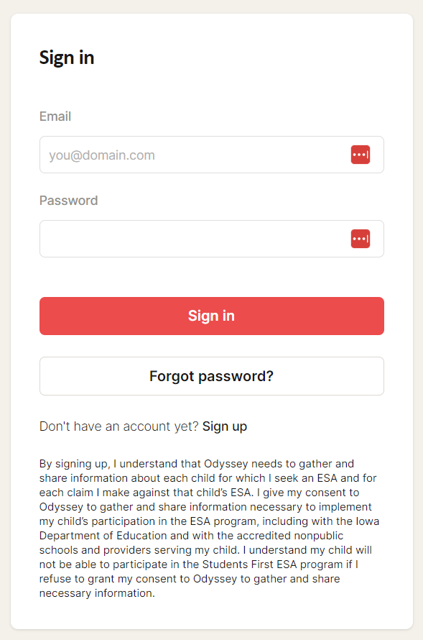
Log-in Screen
Language below text boxes: “By signing up, I understand that Odyssey needs to gather and share information about each child for which I seek an ESA and for each claim I make against that child’s ESA. I give my consent to Odyssey to gather and share information necessary to implement my child’s participation in the ESA program, including with the Iowa Department of Education and with the accredited nonpublic schools and providers serving my child. I understand my child will not be able to participate in the Students First Act ESA program if I refuse to grant my consent to Odyssey to gather and share necessary information.”

Slide 12
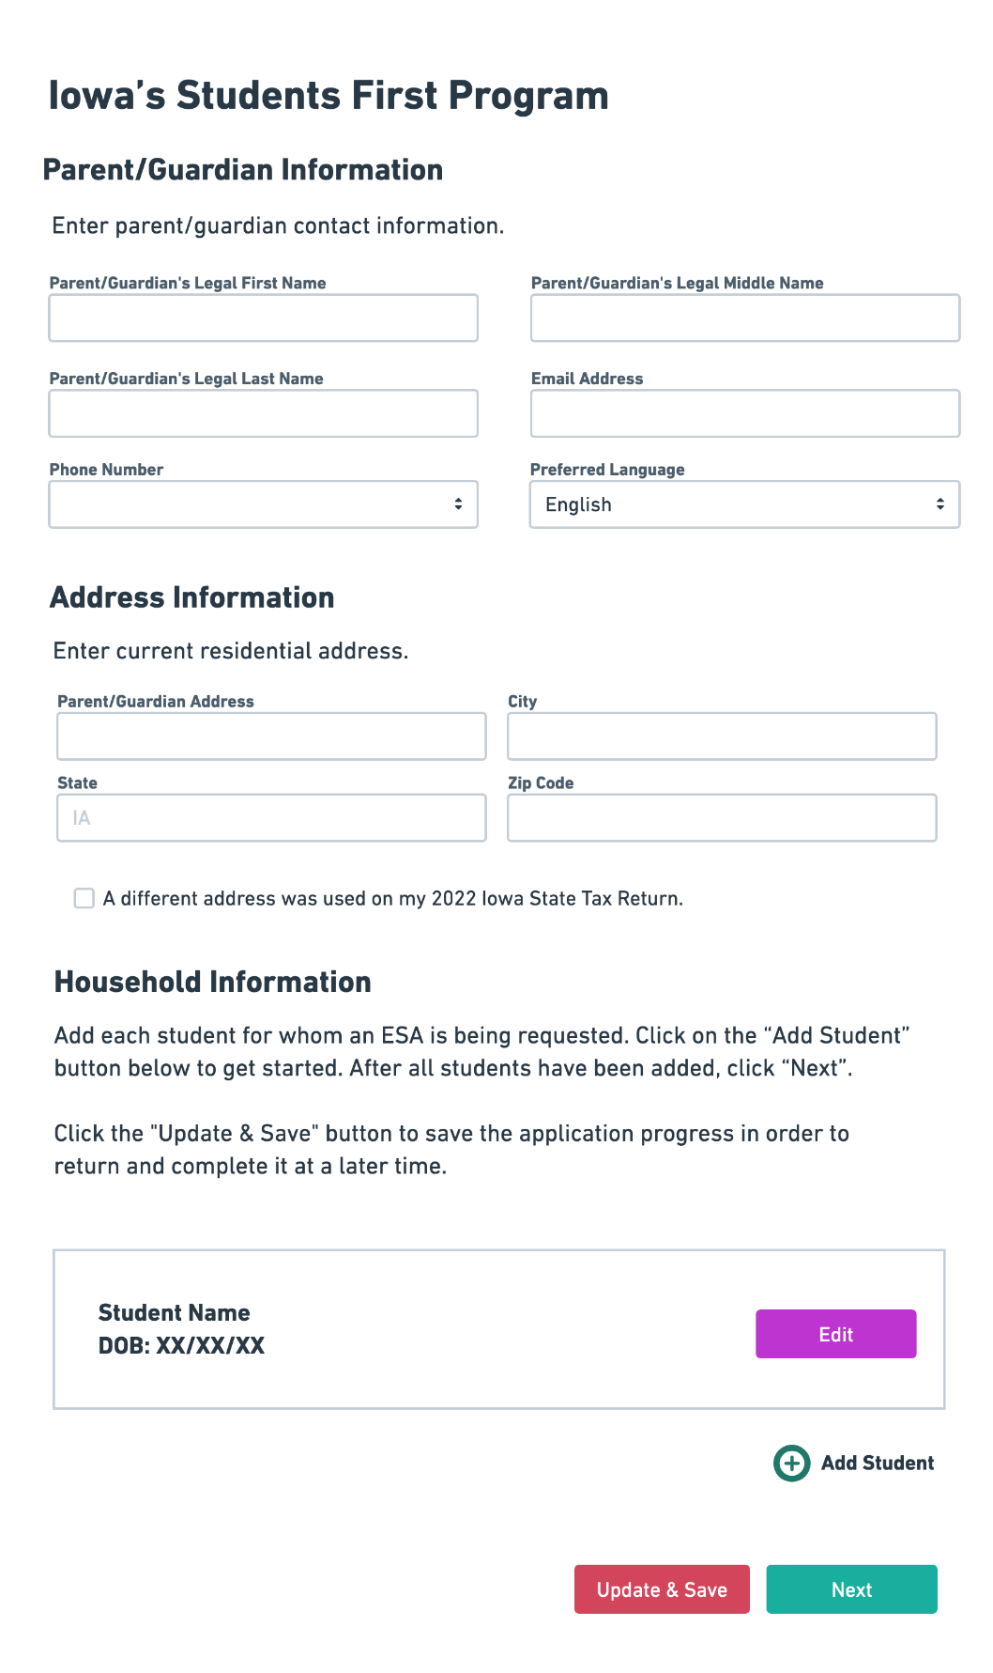
Parent/Guardian Application
Parent/Guardian Information
Parent/Guardian Legal Name
Email Address
Phone Number
Preferred Language
Address Information
Current residential address
If your 2022 Iowa State Tax Return lists a different address, please check the box and input that address.
Household Information
Add Student
Update & Save feature

Slide 13
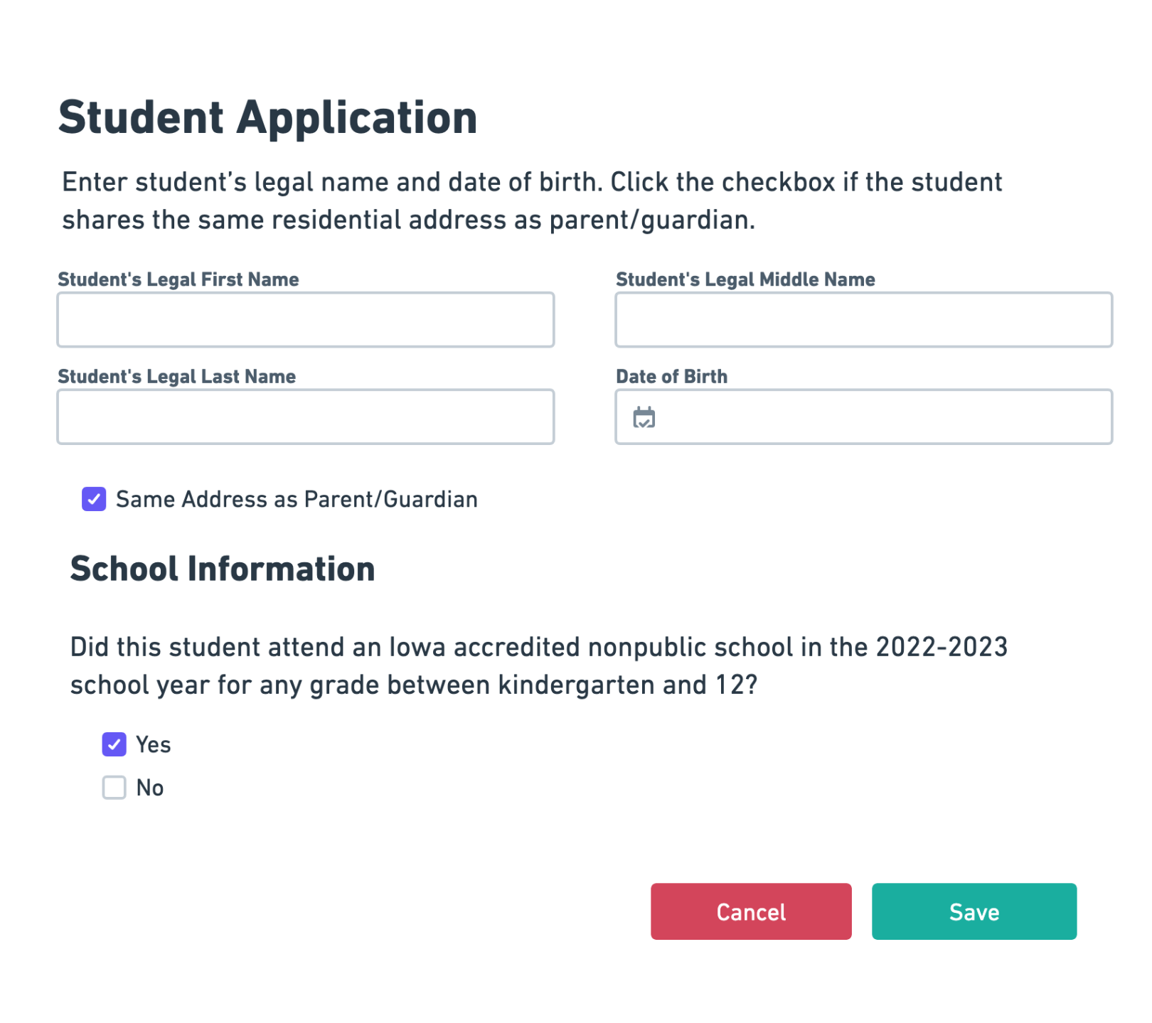
Student Application
Student Legal Name
Student Date of Birth
Student Address
School Information for 2022-2023 school year
Did this student attend an Iowa accredited nonpublic school in the 2022-2023 school year for any grade between kindergarten and 12.

Slide 14
Program Eligibility
Parent/Guardian ID Type and Parent Identification Number
Parent/Spouse ID type and Parent Identification Number
This information will be used to verify Iowa residency, and in some cases verify income, with the Iowa Department of Revenue.

Slide 15
Consent & Approvals
Guardianship Checks
Site Release
Communication Consent
Email
Phone Number

Slide 16
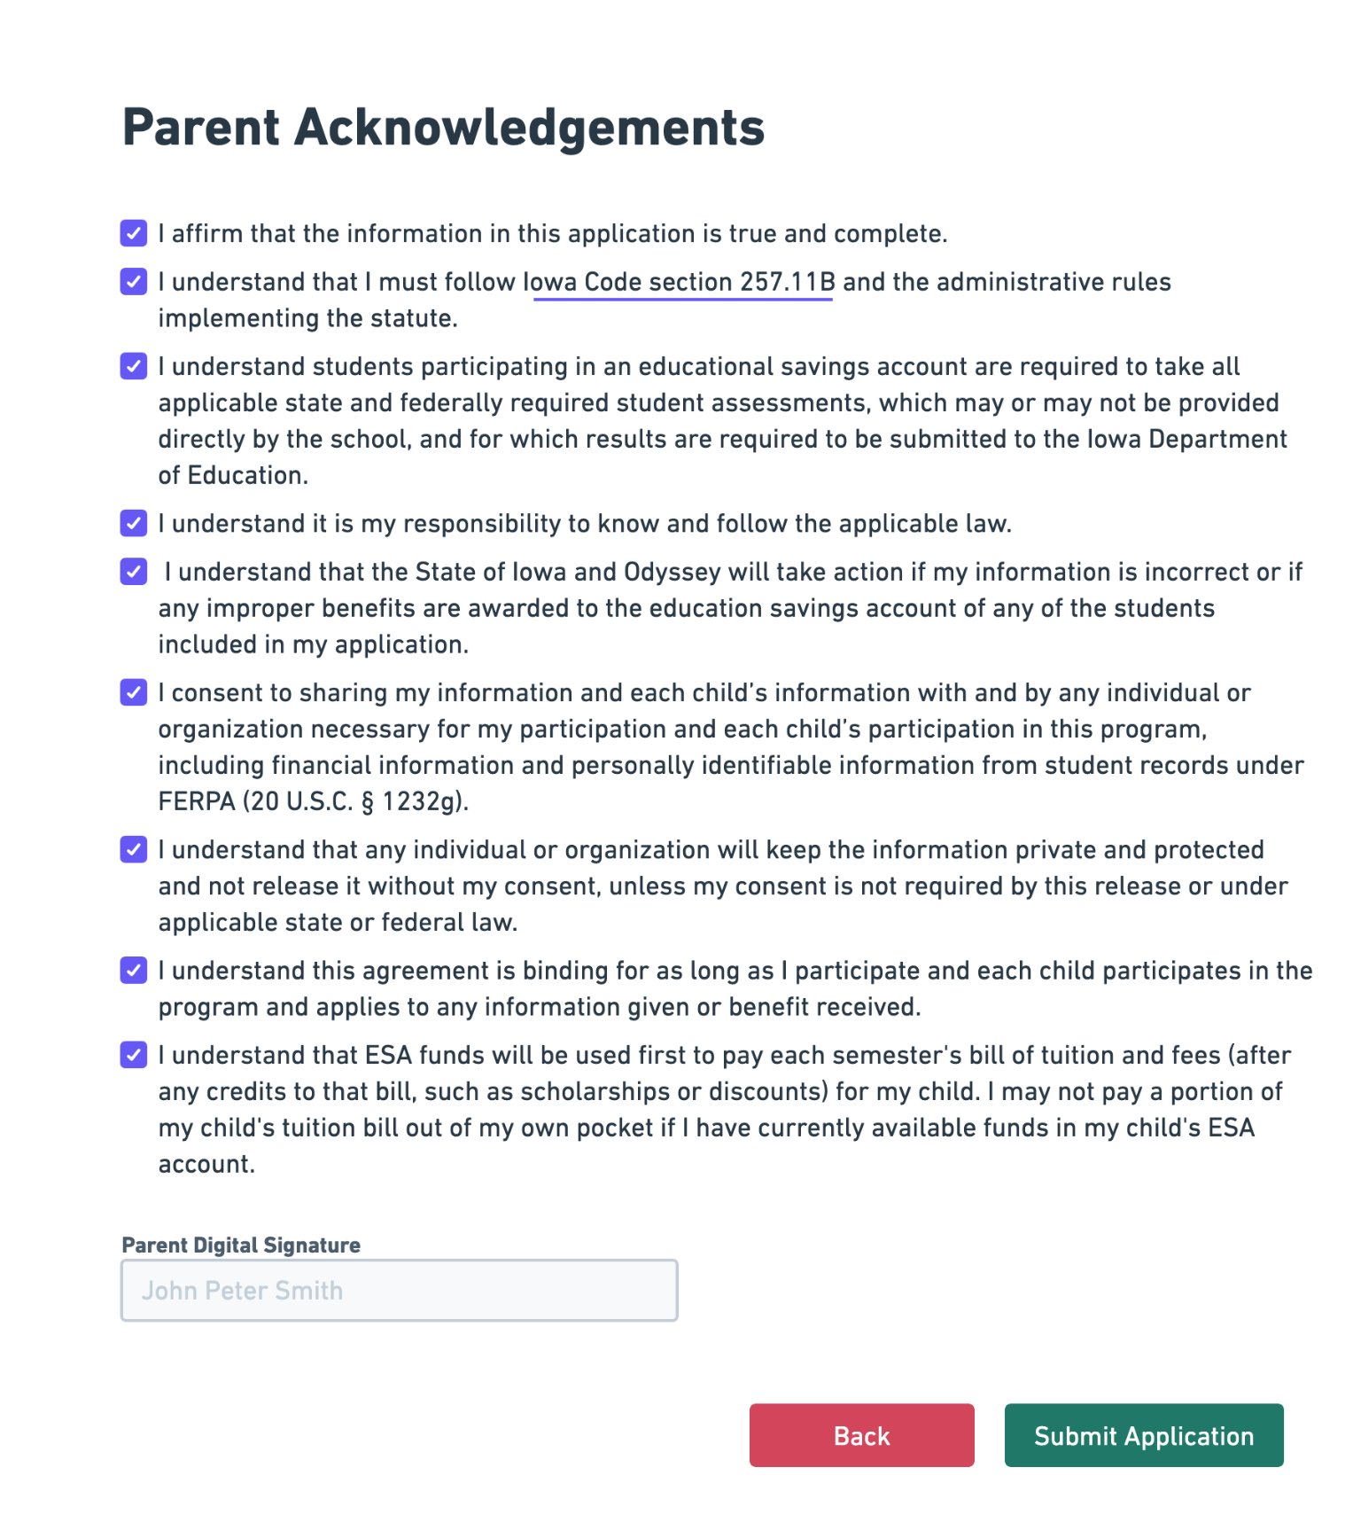
Parent Acknowledgements
Review each individual statement and check the box to affirm your understanding and agreement.
Sign electronically.
Click “Submit Application” when completed.

Slide 17
Application Status: Final
The majority of applications will be approved through the automatic approval process.
This process will make approvals simple, straightforward, and easy for parents.
Submitted
Application has been submitted.
Approved
Scenario 1:
Student attended public school in 2022-2023
2022 Iowa State Tax Return verified residency
Scenario 2:
Student attended an Iowa accredited nonpublic school in 2022-2023
2022 Iowa State Tax Return verified residency and income eligibility
Ineligible
Scenario 1:
Student attended an Iowa accredited nonpublic school in 2022-2023
2022 Iowa State Tax Return verified residency
2022 Iowa State Tax Return did not verify income eligibility

Slide 18
Application Status: In Process
This status will apply to uncommon scenarios where additional documentation and manual review may be required.
Additional Documentation Required
Parents will be able to upload approved documentation to the Odyssey portal.
Scenario 1: 2022 Iowa State Tax Return not filed
Unable to verify income
Unable to verify residency
Under Manual Review
Application was not able to be verified automatically.
Verification documentation will be reviewed.

Slide 19
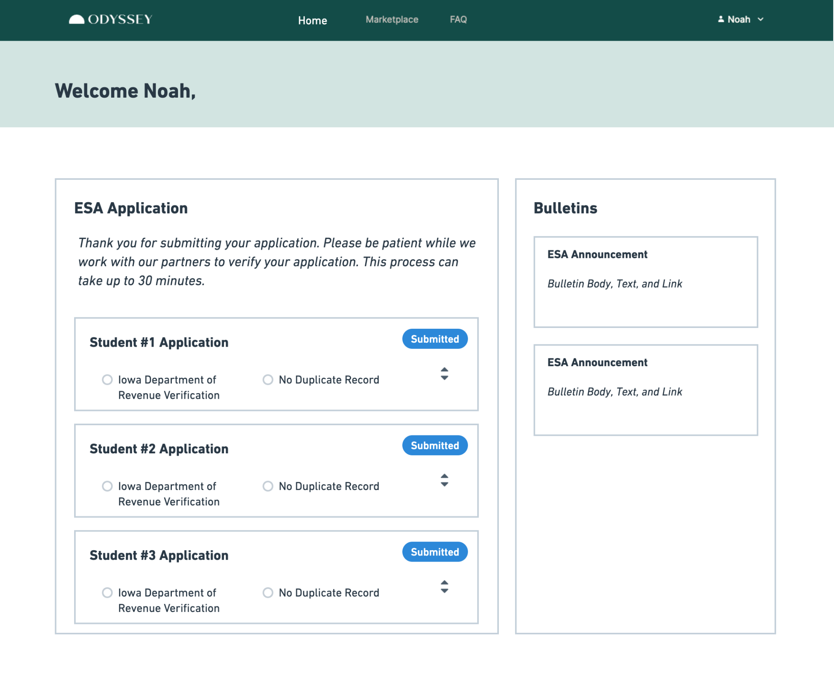
Application Status: Timing
Application is updated with responses within 30 minutes of submission.
Income verification will only be run for households with students who attended an Iowa accredited nonpublic school in 2022-2023.

Slide 20
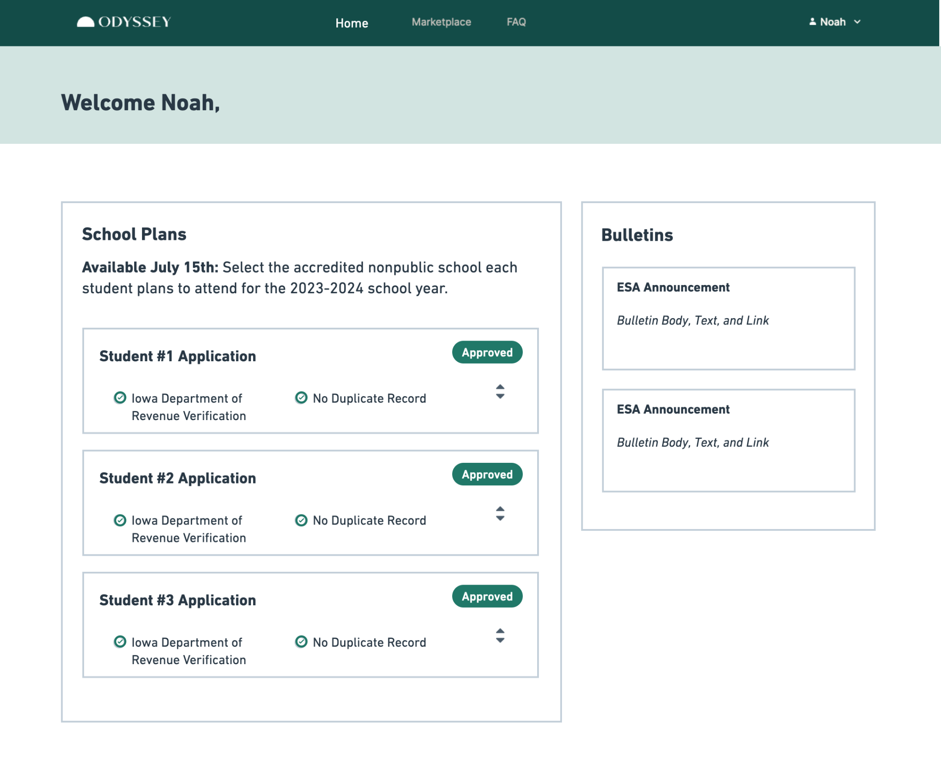
Application Status: Approved
When a student’s eligibility for the ESA has been approved, the status buttons will update to “Approved”.
Parent/Guardian next step:
Available July 15: Parent/Guardian selects the school each student plans to attend for the 2023-2024 school year.

Slide 21
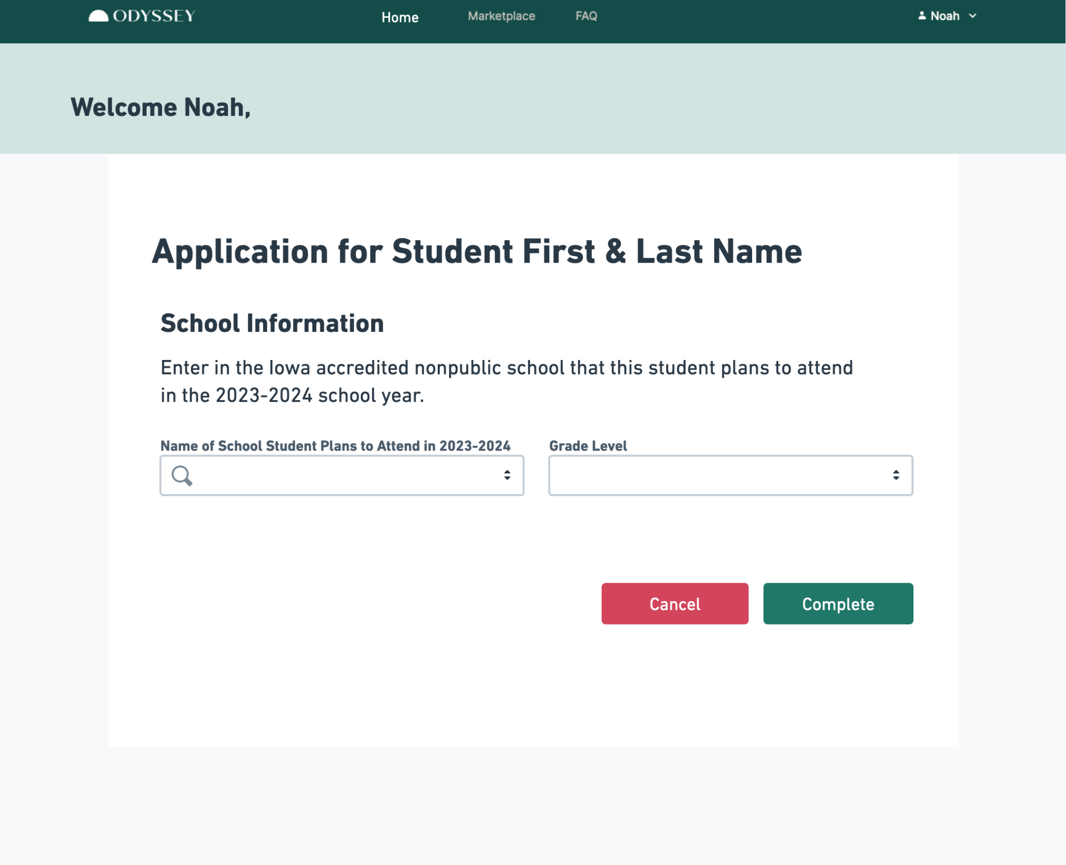
2023-2024 School Information
For each student:
Select school.
Select grade.
Click “Complete” to finish.

Slide 22
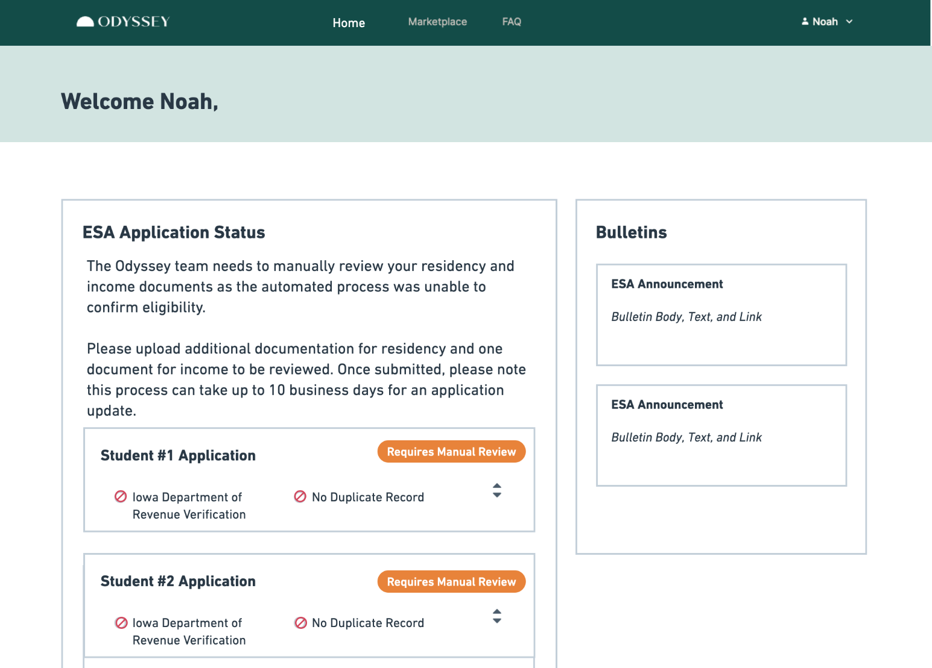
Application Status: Manual Review
If eligibility is unable to be confirmed through the automated process, the Odyssey platform will prompt the parent/guardian to upload additional documents.

Slide 23
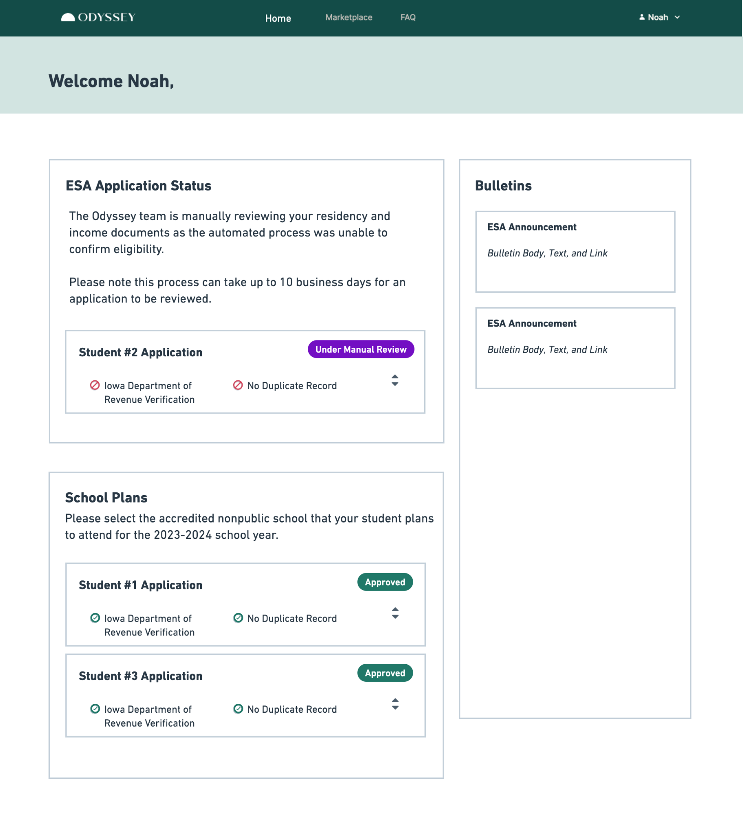
Application Status: Manual Review
Once documents have been uploaded, the Odyssey team will manually review.
If additional documentation is required, Odyssey will contact the parent/guardian.

Slide 24
How Odyssey Verifies Eligibility

Slide 25
How Odyssey Verifies Eligibility
Iowa Department of Revenue System Connection
Odyssey works with the Iowa Department of Revenue to automatically determine Iowa residency, and in some cases, income eligibility, through each applicant’s 2022 Iowa State Tax Return. This will verify a majority of applicants.
If Additional Verification is Needed
If the automated check fails, the Odyssey system will request a parent/guardian to upload additional verification documents to show Iowa residency and/or income eligibility.

Slide 26
How Odyssey Verifies Eligibility:
Residency
If Additional Residency Verification is Needed
If the automated check for residency is unsuccessful, the Odyssey system will request the parent/guardian to upload additional verification documents.
Examples of Residency Verification Documentation:
Current Iowa Driver’s License
Proof of Residence (current mortgage, lease, utility bill) and one of the following:
Iowa Voter Registration Card
Claim of Homestead Credit or Military Tax Exemption on a home in Iowa
Active checking or savings account with an Iowa address
Other documents and correspondence initiated during tax periods with an Iowa address
Written and signed narrative from parent/guardian including a stated claim of Iowa residency, and related documentation reflecting residency.

Slide 27
How Odyssey Verifies Eligibility:
Income
If Additional Income Verification is Needed
If the automated check for income is unsuccessful, the Odyssey system will request the parent/guardian to upload additional verification documents.
Examples of Income Verification Documentation:
Iowa Resident:
Proof of enrollment in an Iowa program that has an income eligibility component below the income threshold.
Eligible programs include SNAP, child care assistance, or cash assistance.
Documentation includes Notice of Decision from Iowa HHS or image of SNAP card with matching parent name.
New Iowa Resident:
2022 tax return from another state
Most recent pay stub for both parents/guardians and a letter from each employer verifying annual income for the employee.
Other:
Written and signed narrative from parent/guardian including a stated claim of net income and household size, and related documentation proving net income and/or household size.

Slide 28
School Registration Overview

Slide 29
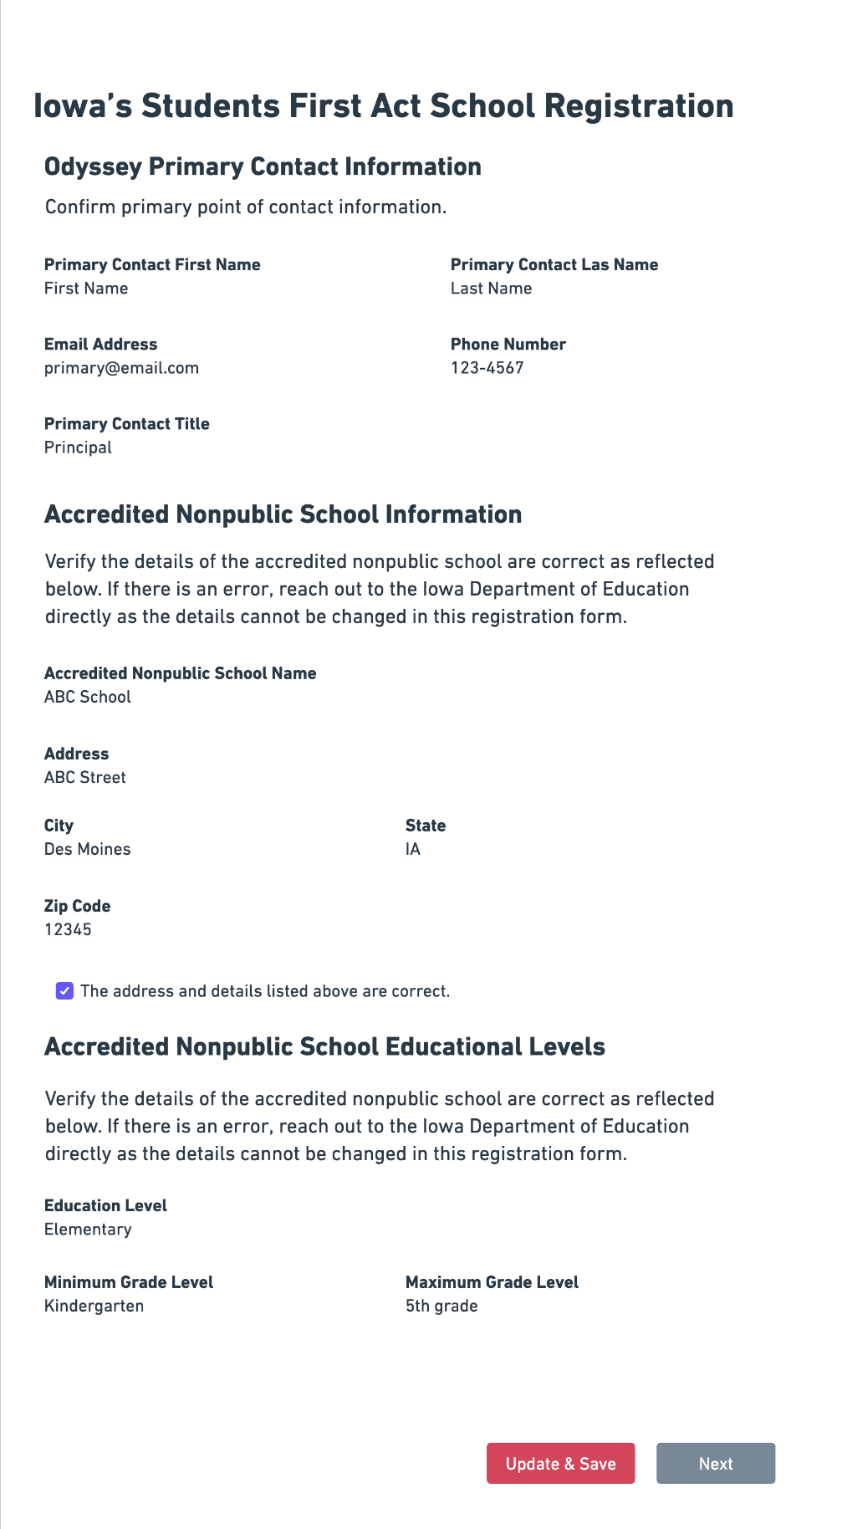
School Registration
The Iowa Department of Education provided Odyssey a list of Iowa accredited nonpublic schools that are eligible to participate in the Students First Act ESA Program.
Each school will be invited to confirm their information and register with Odyssey.
If information is incorrect, changes must be submitted through the Iowa Department of Education.

Slide 30
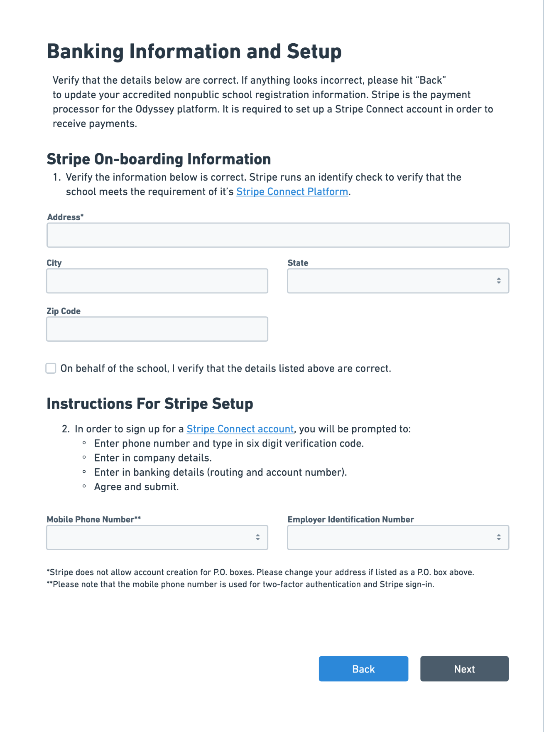
Set Up Banking
Odyssey utilizes Stripe as our secure payment processor.
Each participating school must submit banking information, including routing and account numbers.
The phone number provided must be a mobile phone number in order to utilize two-factor authentication.
Payments to participating schools will be sent via ACH to the bank account provided.

Slide 31
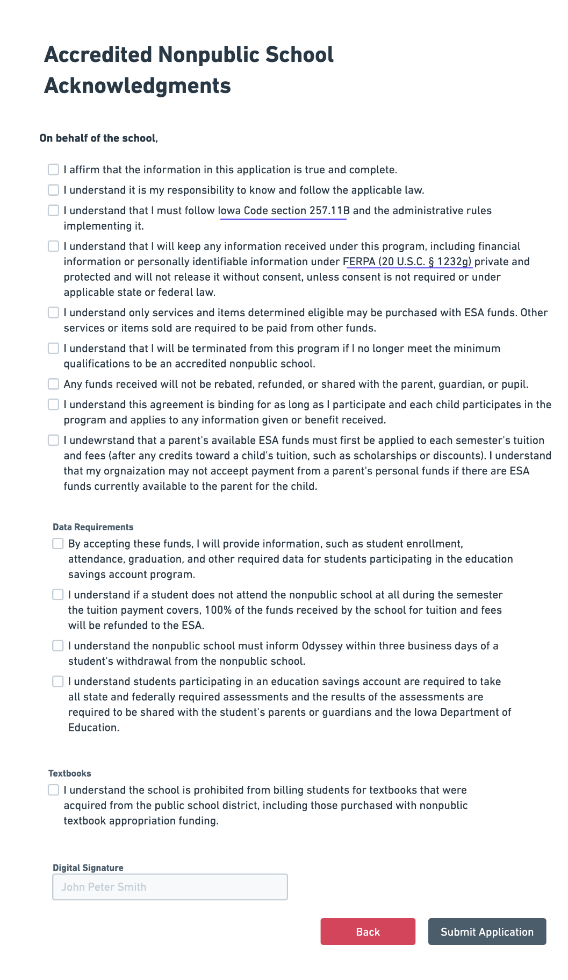
School Acknowledgements
Review each individual statement and check the box to affirm your understanding and agreement.
Sign electronically.
Click “Submit Application” when completed.

Slide 32
Nonpublic School Dashboard: Student Detail

Slide 33
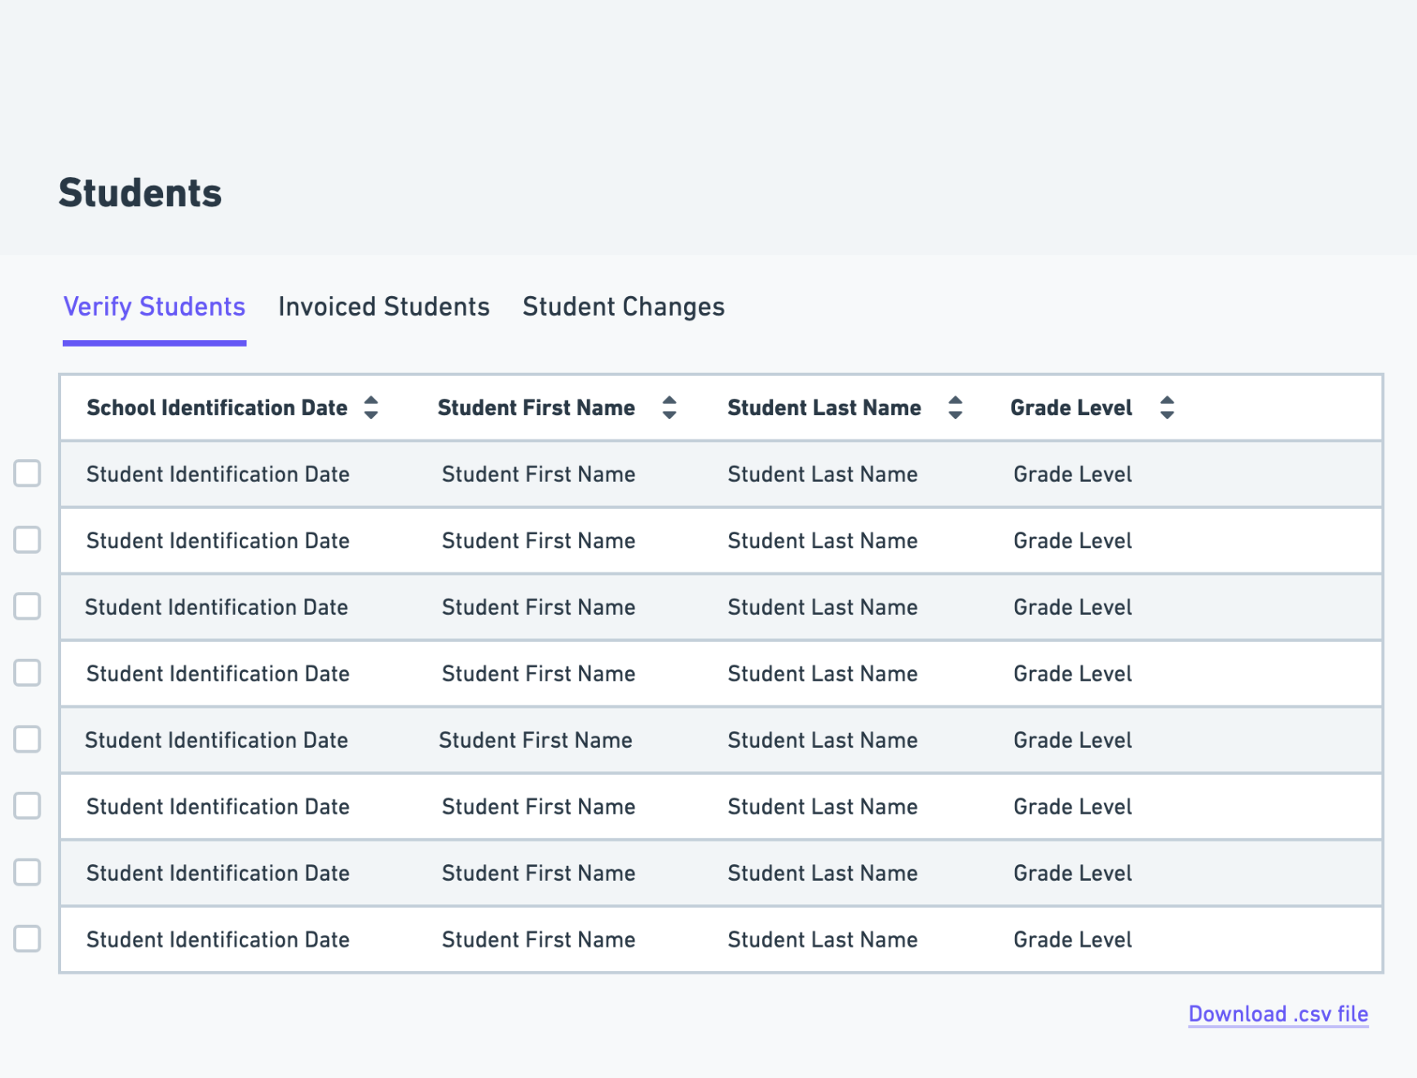
Students Dashboard
Dashboard: View of students with a plan to attend the school, invoiced students, and students who are no longer enrolled at the school.
Verify Students: Confirm each student is enrolled in the nonpublic school for the 2023-2024 school year.
Invoiced Students: List of students with pending or completed payments.
Student Changes: Schools are required to provide notice to Odyssey within 3 business days if a student withdrew.

Slide 34
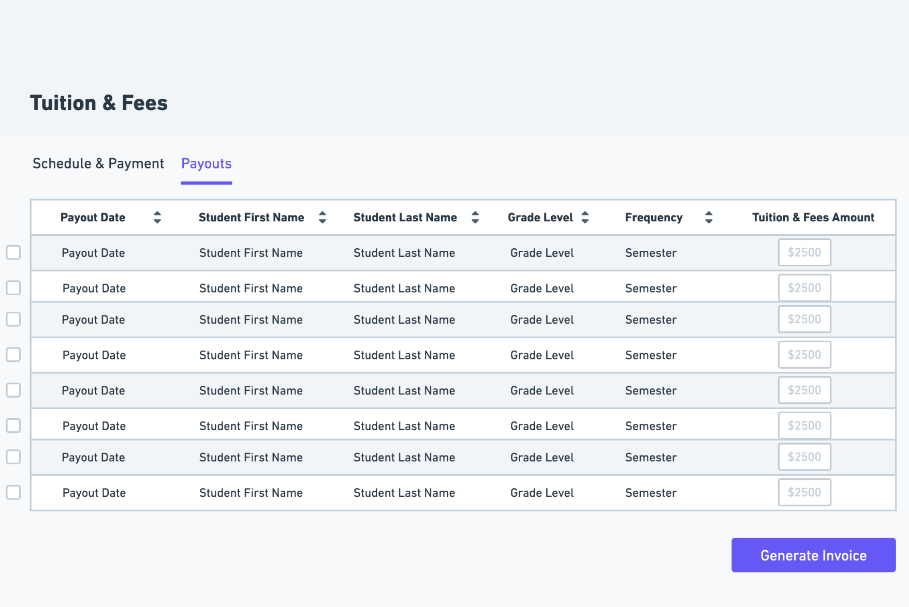
Tuition and Fees: Payouts
School inputs tuition and fee amounts for students.
Tuition and fee amounts are able to be edited.
When input is completed, click “Generate Invoice”.
This invoice will be submitted to the state for review and payment.

Slide 35
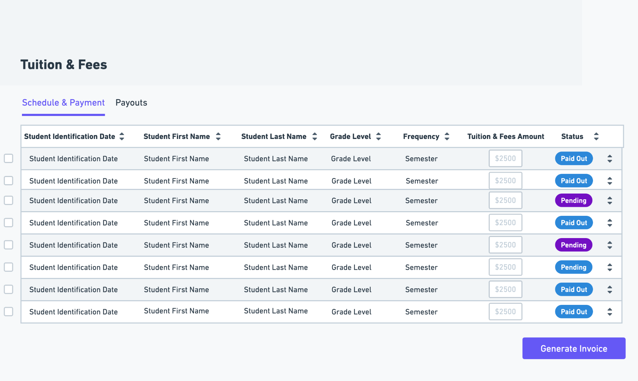
Tuition and Fees: Schedule & Payment
Once the invoice from the state is approved, the funding will be sent to the school.
Funds are sent directly to the bank account submitted as part of the school registration process.

Slide 36
School Attendance and Additional Points of Contact
Schools are required to inform Odyssey if an invoice was submitted for a student who did not end up attending.
Scenario: Tuition was billed to Odyssey on July 15, school started August 23, but the student ended up not attending. Students are NOT eligible for an ESA if they do not attend an Iowa accredited nonpublic school. All ESA funds paid to the school for the semester in which the student did NOT attend, must be returned.
ESA ineligibility does not absolve individuals from financial obligations they may have directly entered into with a school.
Additional Points of Contact:
Schools are able to create additional points of contact for other users to match enrollment, upload tuition, and report enrollment changes.

Slide 37
Odyssey Support Team

Slide 38
Customer Support Availability
Contact Odyssey for technical issues.
We have a fantastic support team that has experience in working with parents and vendors to help answer their questions and troubleshoot any issues.
We provide service in both English and Spanish on phone, chat, and email.
Support will become available on May 31st.
Monday-Friday
7am-9pm CT
Saturday-Sunday
10am-4pm CT

Slide 39
Questions Following Training
If you have questions following the webinar, or need support for process, please contact the Iowa Department of Education at:
studentsfirst@iowa.gov
or
515-954-5652

Slide 40
Thank you for joining.

