Slide 1
Secondary CTE Reporting Application (SCTERA) – 2025 Spring Collection
Dr. Jeffrey Fletcher
Education Program Consultant
Bureau of Career Technical Education &
Postsecondary Readiness
Iowa Department of Education

Slide 2
SRI is used for… Secondary CTE Reporting Application (SCTERA)
The SRI system is the basis for extracting CTE data into the Secondary CTE Reporting Application (SCTERA) system
  A EdInfo Application within the Iowa Education Portal
The data from SCTERA is used for ensuring that school districts comply with state and federal career and technical education requirements
SCTERA is also used to develop the data required for the annual consolidated annual report (CAR) and reporting performance on the Federal Perkins accountability performance indicators
Secondary CTE Reporting Application –
Courses & students from the district SIS upload tagged with a ‘9’
One-way Data Connection
Student Reporting in Iowa (SRI) – Course & student upload from district’s SIS

Slide 3
Secondary CTE Reporting Application (SCTERA)
Important Spring Collection Dates
April 1 – Spring Collection began; Program Student Breakdown Screen
June 15 – Student lists submission due in SCTERA
June 15 – CTE Program updates due in SCTERA
June 15 – Program of Study due in SCTERA
This step "closes the loop" for the 2024-2025 (2025) SCTERA reporting season.
75% of the annual collection (Completed) –
  Already completed adding courses to programs (Winter SRI/SCTERA collection).
25% of the annual collection (In Progress) —
  Reviewing program student lists generated from the work completed in step 1 (Spring SCTERA collection).

Slide 4
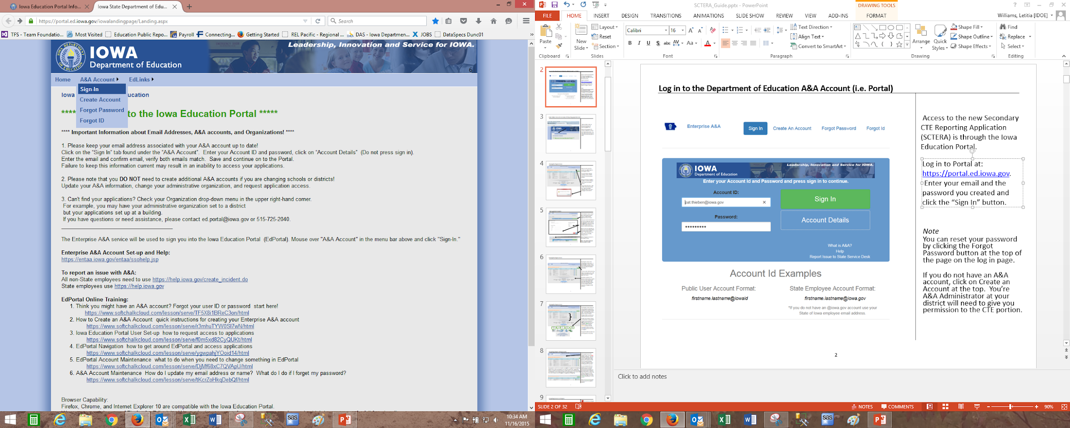
Secondary CTE Reporting Application (SCTERA)
Access to the Secondary CTE Reporting Application (SCTERA) is through the Iowa Education Portal: https://portal.ed.iowa.gov.
Under A&A Account, select “Sign-In” - Enter your e-mail and the password on the sign-in screen

Slide 5
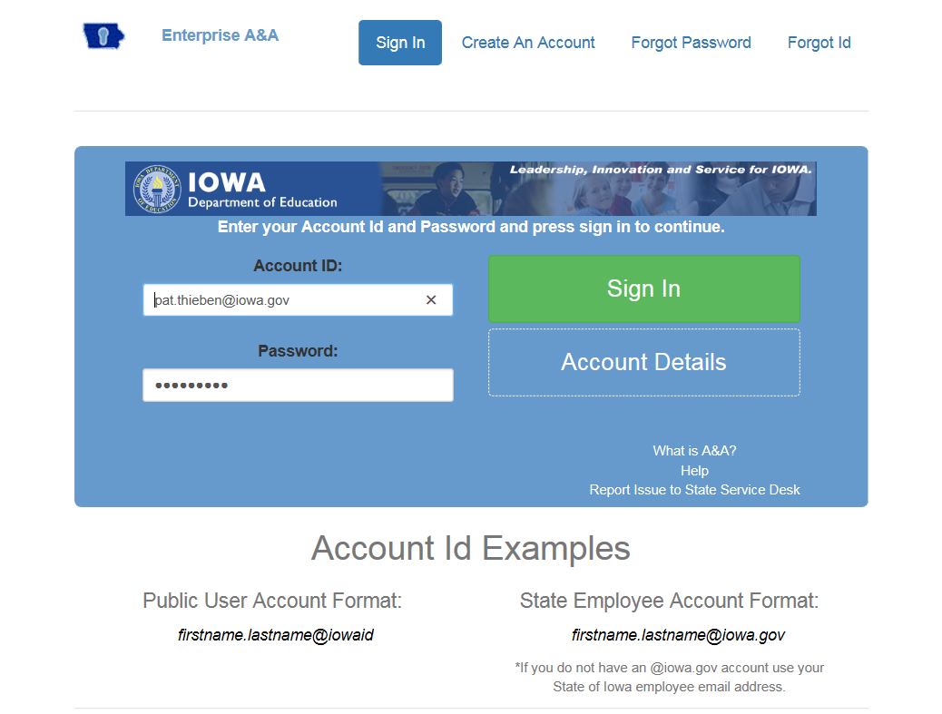
Secondary CTE Reporting Application (SCTERA)
Note: You can reset your password by clicking the Forgot Password button at the top of the page on the login page.
If you do not have an A&A account, click on Create an Account at the top. Your district A&A Administrator will give you permission to the CTE application.

Slide 6
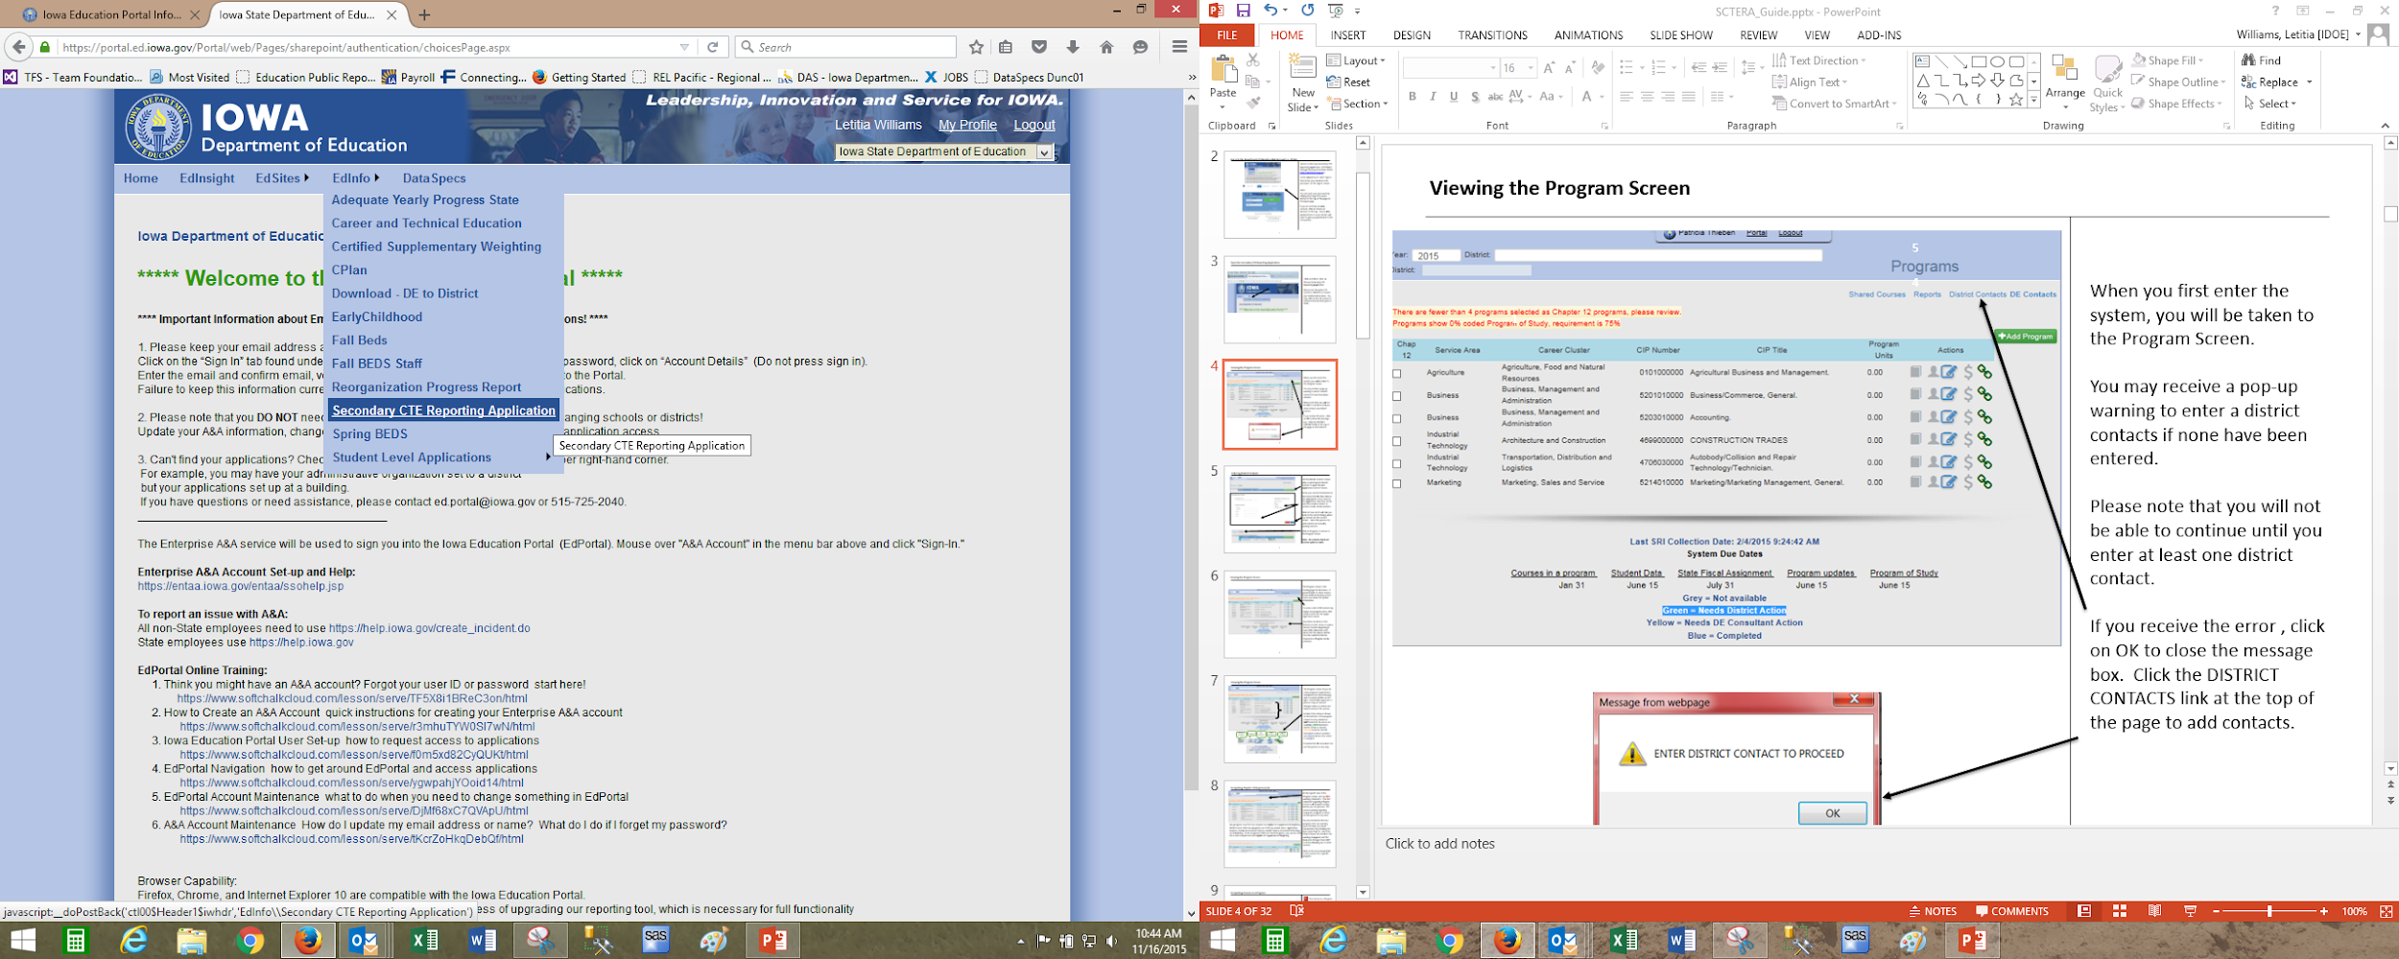
Secondary CTE Reporting Application
Open the Secondary CTE Reporting Application
Click on EdInfo, then choose Secondary CTE Reporting Application

Slide 7
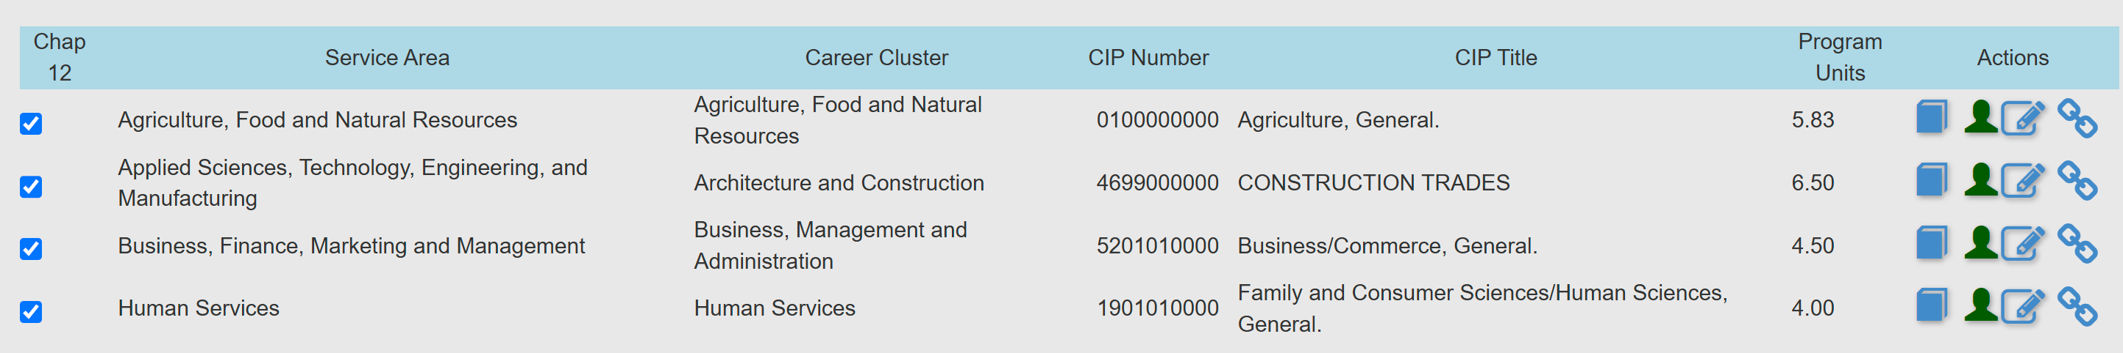
Secondary CTE Reporting Application
Completing Student Data – SPRING COLLECTION - Due June 15
Work to be completed April 1 – June 15 annually
After the DE has approved a program (“blue” book icon), the student data for that program can be entered by clicking on the GREEN student ICON.

Slide 8
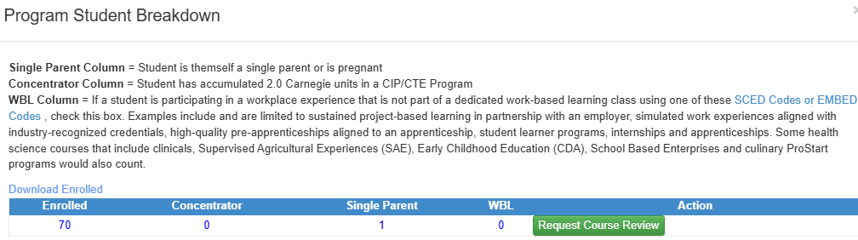
Secondary CTE Reporting Application
The “Program Student Breakdown” screen will open.
The list is downloadable to Excel.
Please note that it will not download if using Safari.
Must use Chrome or Firefox and must use a PC, not Apple, to print student list(s) for your instructors.

Slide 9
Secondary CTE Reporting Application
Concentrator (Column) = Student has accumulated >2.0 units in a CIP/CTE Program.
This column is programmed to calculate accumulated units by StateStudentID based on CTE coursework within a CIP ID/CTE program (CareerED and SRI Databases)
SCTERA queries StateStudentIDs & District IDs
              ‘9’ CTE accreditation courses (with units) & CTE CIP-IDs
Single parent (Column) = Student is a single-parent or is pregnant, not that they live in a single-parent household.
    Indicate that the student is a single parent by clicking on the appropriate check box (District Self-Reports).

Slide 10
Secondary CTE Reporting Application
WBL (Column) = If a student is participating in a workplace experience that is not part of a dedicated work-based learning class using one of these SCED Codes or EMBED Codes , check this box. Examples include and are limited to sustained project-based learning in partnership with an employer, simulated work experiences aligned with industry-recognized credentials, high-quality pre-apprenticeships aligned to an apprenticeship, student learner programs, internships and apprenticeships. Some health science courses that include clinicals, Supervised Agricultural Experiences (SAE), Early Childhood Education (CDA), School Based Enterprises and culinary ProStart programs would also count. (District Self-Reports).
Perkins V Secondary Performance Indicator 5S3: Participated in Work-Based Learning
The percentage (%) of CTE Concentrators graduating from high school having participated in work-based learning. Perkins V Work-Based Learning Defined from Sec. 3 [20 U.S.C. 2302]: Sustained interactions with industry or community professionals in real workplace settings, to the extent practicable, or simulated environments at an educational institution that foster in-depth, firsthand engagement with the tasks required in a given career field, that are aligned to curriculum and instruction.
Work-Based Learning Course Naming and Coding (SCED & Embed Codes)

Slide 11
Secondary CTE Reporting Application
If unsure about whether CTE students should be self-reported in the “Non-Credit WBL” column by program list, please reach out to Jeffrey Fletcher, jeffrey.fletcher@iowa.gov.
If unsure about whether CTE students should be self-reported in the “Single-Parent” column within a program please reach out to Jeffrey Fletcher, jeffrey.fletcher@iowa.gov. *Only reporting mechanism we have for Perkins V reporting at the agency.

Slide 12
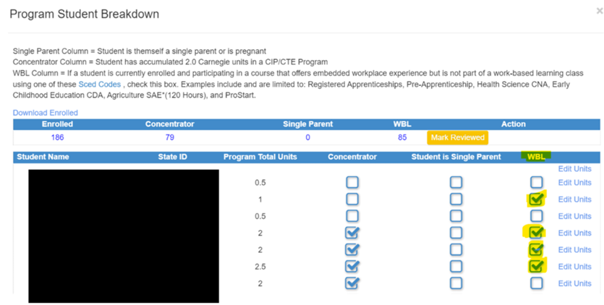
Secondary CTE Reporting Application

Slide 13
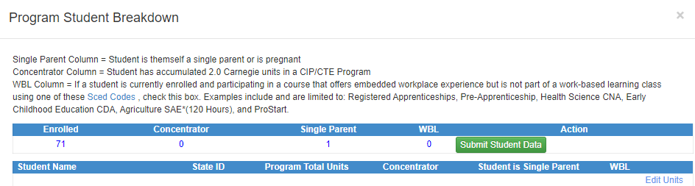
Secondary CTE Reporting Application
VERIFY & VALIDATE
Student units earned & the “concentrator” column
Single-parent column (district selects/checks)
WBL column (district selects/checks) – e.g., Double check with your Ag educator(s) for students completing >=120 Hours of Ag Supervised Agricultural Experience (SAE).
After all student updates (single parent reporting; non-unit WBL) are completed, click on the green Submit Student Data button

Slide 14
Secondary CTE Reporting Application
The submit button will turn yellow indicating the students are submitted and under final review by the DE Consultant. An e-mail will be sent to the district contact with this information. Click on red return to get back to the Program screen. The Student ICON on the Program screen will also turn yellow.
Once the DE Consultant reviews the Student Data, the Student ICON will turn blue. If there are questions, the DE consultant will contact the district either by phone or e-mail. No news is good news!

Slide 15
Secondary CTE Reporting Application
Double-checking/Completing the Program of Study/Linkage Information
Click the Chain Link ICON on the Program screen to open the Program of Study screen. This screen needs to be completed for all programs and can be completed at any time from January 1 – to June 15.
If completed previously, please review it for accuracy or updates.

Slide 16
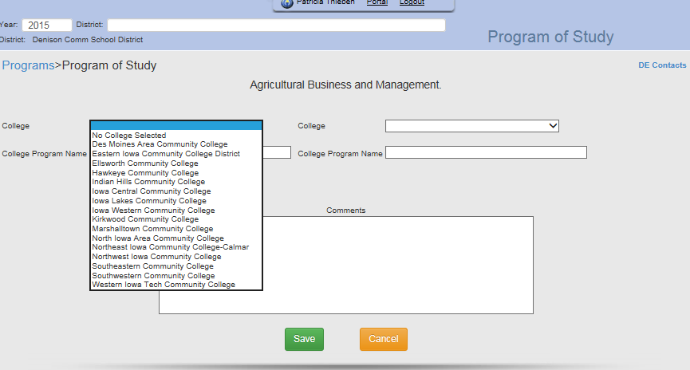
Secondary CTE Reporting Application
Select the college(s) that the program is linked to and enter the college program name (not the department, but the PROGRAM) that the district program is linked to. If none, choose “No College Selected.” The district can also enter any comments regarding the POS. Click the green “Save” button when completed. Programs of Study (POS) are reviewed during the Perkins Monitoring Process and through the Perkins Grant.

Slide 17
Resources
Secondary CTE Reporting Application Directions
Contains screenshots and step-by-step instructions for both the Winter & Spring Collection.
Spring Collection:
SCTERA Spring Collection Webinar Recording. Recorded 4-5-23. Explains the spring SCTERA reporting process and provide a live demonstration of how to access SCTERA. (This PowerPoint).
Winter Collection (complete):
SRI and SCTERA "Connections" Webinar Recording - Recorded 12-18-24. The annual upload for the SCTERA Winter Collection (CTE programs and CTE courses) runs from Jan. 2, 2025, through Jan. 29, 2025. This webinar recording addresses the following key steps: 1. District submits and uploads a 100% complete SRI file. 2. District then completes SCTERA work of adding all CTE courses to program. 3. District then "certifies" SRI file to begin CH.12 accreditation review. 2024-12-18 Webinar PowerPoint
SCTERA Short Takes Video: Shared Courses and "INCLUDE" (3:59)
SCTERA Short Takes Video: Courses NOT Tied to a Program (5:37)

Slide 18
Contact Information
Dr. Jeffrey Fletcher
Jeffrey.Fletcher@iowa.gov
515-321-7309
Bureau of Career Technical Education & Postsecondary Readiness
Division of Higher Education
Iowa Department of Education

