Slide 1
Iowa e-Learning Central Launch Webinar
January 2022
Notes:
Stacie:
[Stacie will have the PPT displayed]

Slide 2
Webinar Purpose
The purpose of today’s webinar is to provide a brief overview of Iowa e-Learning Central and respond to your initial questions.
Agenda
Overview
Resource Library
Course Repository
Student/Course Exchange
Demonstration
Questions and Answers
Notes:
Stacie

Slide 3
Overview
Resource Library, Course Repository, and Student/Course Exchange
Notes:
Stacie:

Slide 4
What is Iowa e-Learning Central?
Iowa e-Learning Central is an online exchange that supports collective efforts to engage in high-quality online learning for Iowa:
Educators,
Students, and
Families.
Iowa e-Learning Central has three primary components:
Resource Library
Course Repository
Student/Course Exchange
Coming this spring
Notes:
Stacie:

Slide 5
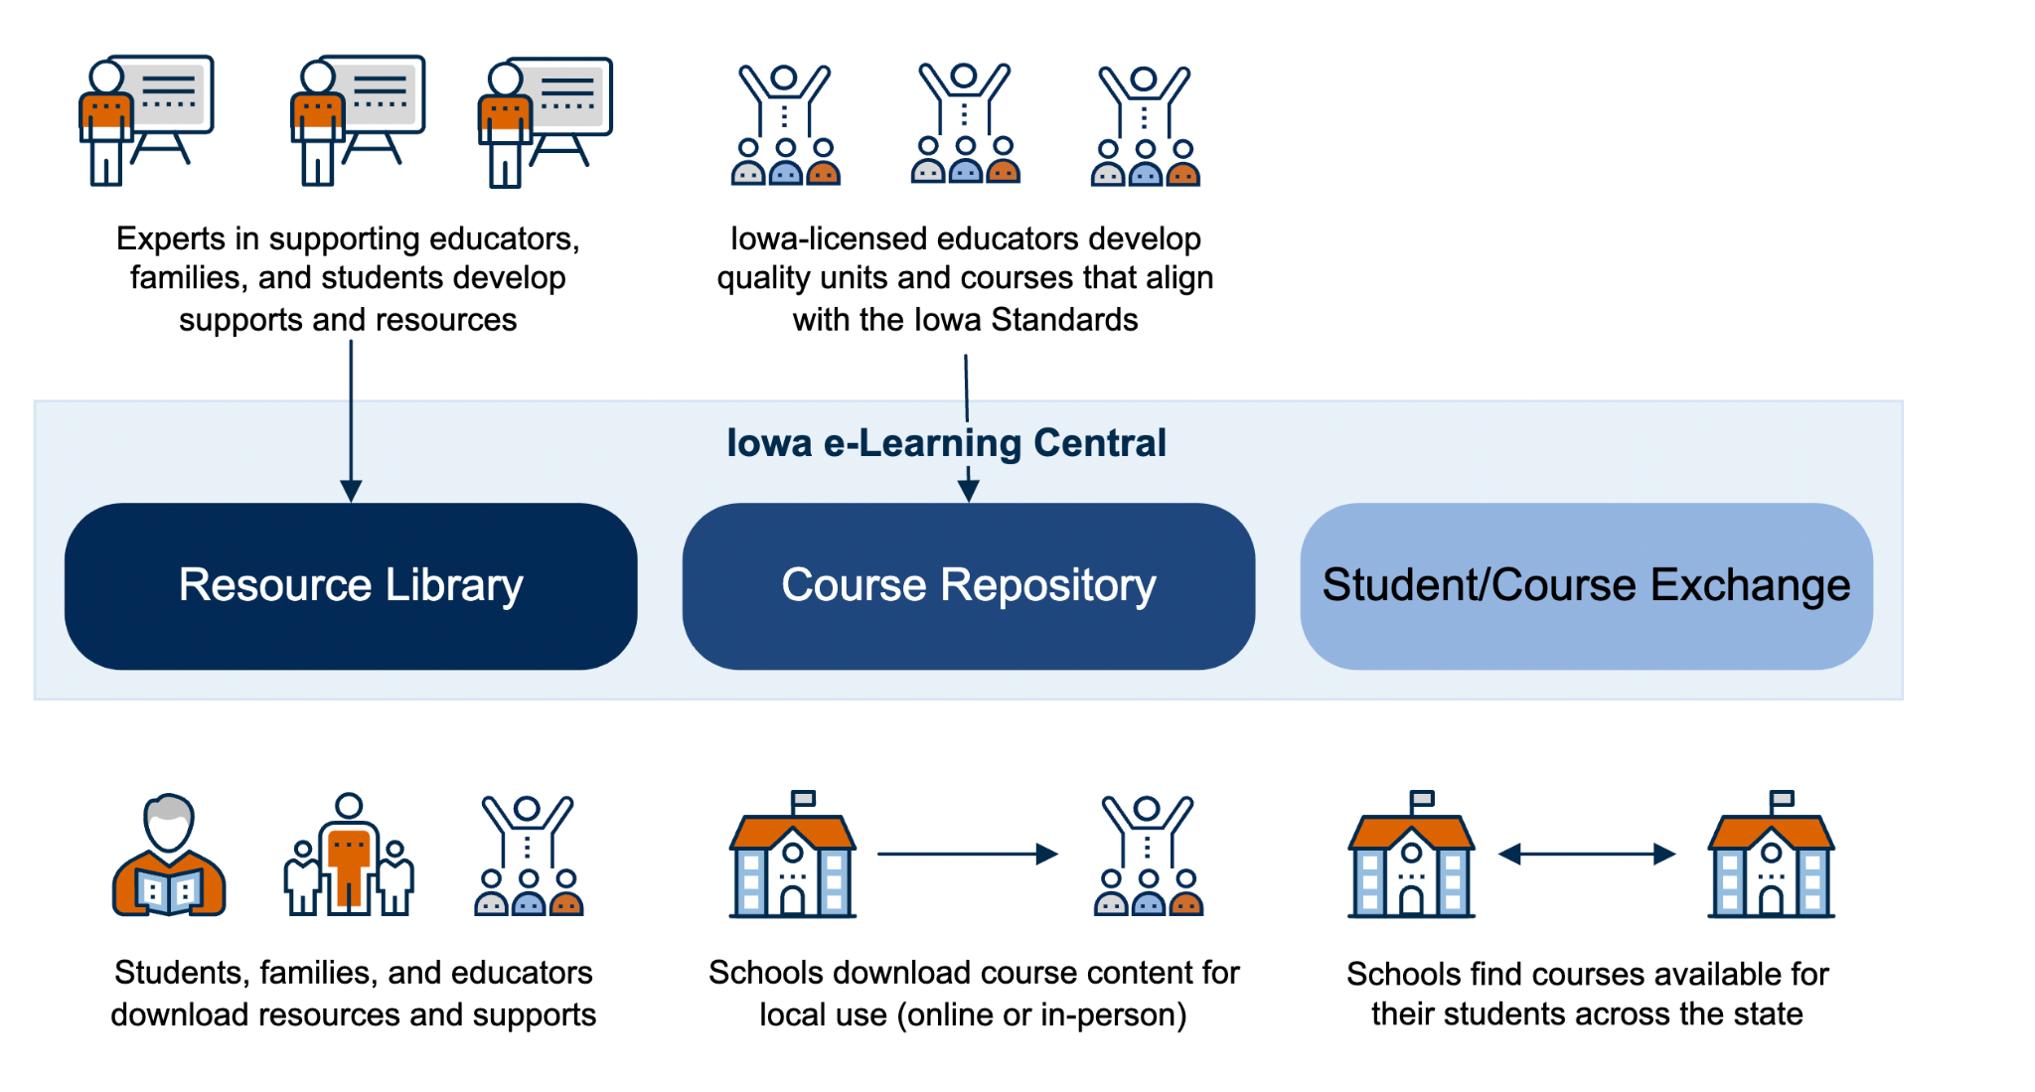
Iowa e-Learning Central
Notes:
Gwen

Slide 6
Resource Library
The Resource Library provides a place for educators, families, and students to access expert-developed resources and supports to help them be successful partners in the online learning process and serves as a mechanism to provide ongoing feedback.
Topics include:
Communication
Collaboration
Mental and Physical Health
Organization
Work Completion
Notes:
Gwen:

Slide 7
Course Repository
The Course Repository serves as a repository to access high-quality course and unit content developed by Iowa-licensed educators for use in classrooms. Its content:
Will expand across all grade levels and disciplines,
Currently only secondary content (6-12th grade)
Can be used online or in the classroom,
Can be adapted to meet local needs or taught as is, and
Is available to any school across the state.
Notes:
Gwen: Focusing on the Course Repository

Slide 8
Student/Course Exchange
The Student/Course Exchange facilitates sharing of online courses so schools can offer their open seats to students in other schools or find seats needed for their students.
This is the next area of development. We anticipate that the Student/Course Exchange will open in the spring.
Notes:
Gwen:

Slide 9
Iowa e-Learning Central
Notes:
Tina and Christi: We will take a few minutes to highlight the course repository

Slide 10
What Courses Are Currently Available?
Secondary Courses
1st Semester of Year-Long Course
Single Semester
Mathematics
6th Grade Mathematics
7th Grade Mathematics
8th Grade Mathematics
Algebra 1
Geometry
Algebra 2
English-Language Arts (ELA)
9th Grade ELA
10th Grade ELA
11th Grade ELA
12th Grade ELA
Science
6th Grade Science
7th Grade Science (delayed)
8th Grade Science
Biology
Computer Science Principles
High School Financial Literacy
Notes:
Christi

Slide 11
What Courses Will Be Available in the Future?
2nd semester of full-year courses listed on previous slide
ELA 6th, 7th, and 8th
World History, US History, and Social Studies 6th, 7th, and 8th
Chemistry and Physics
Spanish 1
Physical education (PE)
High school business
High School family consumer science (FCS)
Elementary
Work will begin in the summer of 2022
Additional middle school courses (e.g., PE, FCS, Health)
Additional courses needed by the field
Notes:
Christi

Slide 12
Developed by Iowa Educators
34
22+
~300
Content Developers
Content Reviewers
Future Needs
Notes:
Tina

Slide 13
Bid Process and Summer Work Timeline
December 2021: Applications for content experts were available (K-5 literacy, mathematics, social studies, and science) Bid closed January 20, 2022
Content experts will apply to guide and support the work of the content developers
Hiring approximately 60
February 2022: Applications for content developers will be available (K-5 literacy, mathematics, social studies, and science)
Content developers will apply to develop units and teacher materials
Hiring approximately 250
April - June 2022: Prep work
Completing instructional design workshops
July 11 - July 13, 2022: Summer Event
Unit development begins
Notes:
Tina

Slide 14
Demonstration
Notes:
Connor:

Slide 15
Questions About Access
Who has access?
Anyone can view the course descriptions and resources without a login.
Educators with permission can download courses.
We recommend that schools and districts identify one or two people to download courses.
Load into a local LMS (e.g., Canvas) to review the course content.
How do we give someone permission?
Users with a portal account can request the ILC district or building role, and the district’s portal security officer can approve or deny access. Directions are here
What is the difference between the district- and building-level roles?
There is no difference for downloading course files
The roles will be meaningful in the course exchange later this year
Check the directions for details
Notes:
Connor:

Slide 16
Questions and Answers
Notes:
Gwen/Stacie:

Slide 17
Questions? Contacts
Iowa e-Learning Central Website
Iowa e-Learning Central Contacts:
General Questions
Gwen Wallace Nagel at gwen.nagel@iowa.gov
Stacie Stokes at stacie.stokes@iowa.gov
Content Development, Bid Process and Summer Work
Tina Wahlert at tina.wahlert@iowa.gov
Christi Donald at christi.donald@iowa.gov
Technical Questions
ILC Help Desk at ilchelp@iowa.gov
Notes:
Gwen:

