Slide 1
Every Student Succeeds Act
in Iowa
Federal Programs Webinar Series: Title I, Part D
March 31, 2021

Slide 2
Federal Programs Webinar Series: Title I, Part D
Introduction to the Title I, Part D (Neglected and Delinquent)
Brief Program Overview
Definition of Terms
Leveraging Title I, Part D For Positive Student Outcomes
Funding
Question and Answer
The purpose of today’s webinar is to provide information pertinent to state agencies and local education agencies regarding Title I, Part D programs serving students living in neglected and delinquent facilities.

Slide 3
Questions?
Please type your questions into the Q&A screen (found at the bottom of your Zoom window)

Slide 4
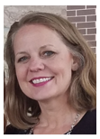
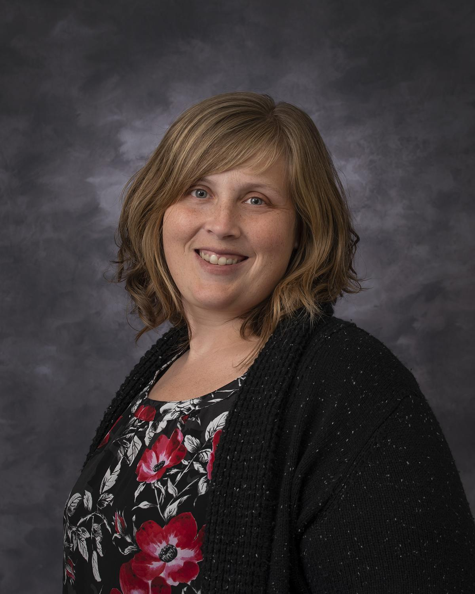
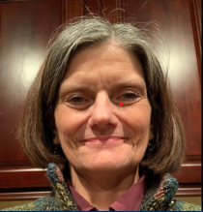
Your Presenters
Iowa Department of Education
Geri McMahon
Administrative Consultant
Emily Teeter
Program Consultant
Susan Walkup
Program Consultant

Slide 5
1. Introduction to the Title I, Part D (Neglected and Delinquent)
Brief Overview and Definition of Terms

Slide 6
Title I, Part D Purpose
Federal Program Purpose
The purpose of Title I, Part D is to:
Carry out high quality education programs to prepare children/youth for secondary school completion, training, employment or further education;
Provide appropriate services to facilitate the transition of youth from residential facilities/institutions to further their education or employment; and
Operate programs in local schools for children/youth returning from placement with a support system to ensure their continued education and involvement of their families and communities.

Slide 7
Title I, Part D: Overview
Federal Program Definition
Title I, Part D, Section 1401:
Prevention and Intervention Programs for Children and Youth Who Are Neglected, Delinquent and At-Risk
Subpart 1
State Agency Programs
Subpart 2
Local Education Agency Programs

Slide 8
Useful Definitions: Title I, Part D Section 1432
Subpart 1: State Agency
Adult Correctional Institutions
Juvenile Corrections
Community Day Program
Subpart 2: Local Education Agency
Locally Operated Correctional Facility (secure)
Delinquent Facility (secure)
Juvenile Detention (secure)
Neglected Facility (non-secure)

Slide 9
Useful Definitions:
A regular program of instruction is an educational program (not beyond grade 12) in a residential facility for children and youth who are neglected or delinquent that consists of classroom instruction in basic school subjects, such as reading, math, vocationally oriented subjects, and that is supported by non-federal funds.
A needs assessment is a process by which state agencies and local education agencies identify and address the needs, or “gaps” between current conditions and desired conditions. A needs assessment should guide the development of a comprehensive program plan and help establish benchmarks for evaluating a program.

Slide 10
2. Leveraging Title I, Part D For Positive Student Outcomes
Continuous Improvement Process, Program Planning and Resources

Slide 11
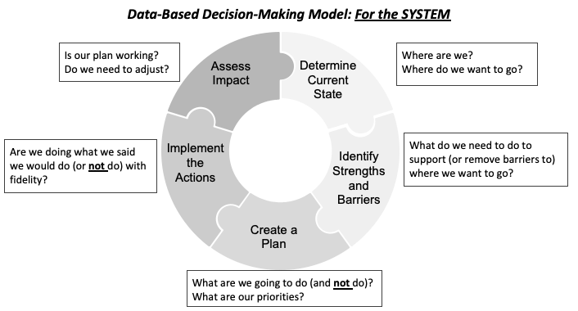
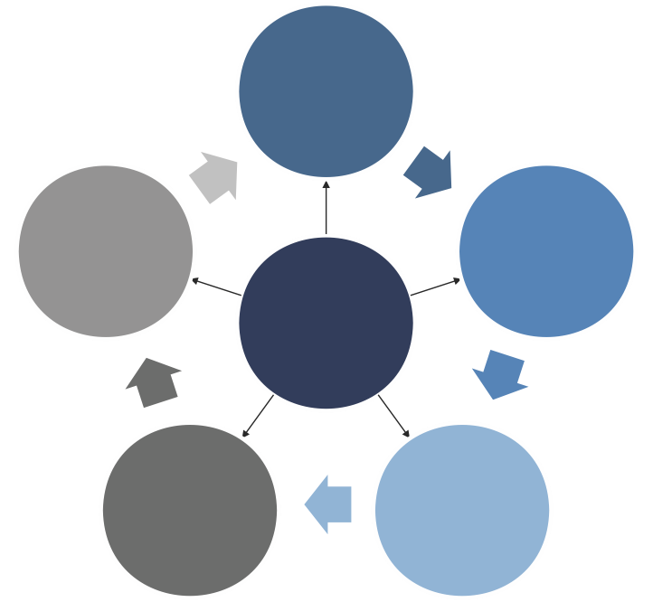
Key Focus Areas
A Focus on
Continuous Improvement
Continuous Improvement Leadership

Slide 12
Determine Current State
Where are we now?
Focus on Educational Stability by Working Together
Review Policies, Procedures & Practices
Interagency Communication & Collaboration
Roles and responsibilities matrix
Work together to improve outcomes
Formalized meeting coordination

Slide 13
Identify What is Needed
What do we do to support where we want to be?
Determine purpose & scope of a needs assessment
Develop your team
Develop questions & data to collect
Analyze data
Identify needs
Set priorities

Slide 14
Create a Plan
What Data is required for Federal and State Monitoring?
Data Collection Review
Review Current Data Collections
CSPR
Pre / Post Testing
Transitions
Intake Planning
Discharge Process Review
Follow-up
Data Analysis

Slide 15
Implement the Plan:
Focus on Transition Planning
The Transition Process
Effective Transitions are
Coordinated
Outcome-oriented process
Successful movement between the facility and the community

Slide 16
Implement the Plan with Fidelity
Transition Stages
Entry
Residence
Discharge Planning/Exit
After Care / Follow-up

Slide 17
Implement the Plan with Fidelity
Participants could include, but are not limited to,
Youth
Education Staff
Parent/Guardian
Referring Worker (DHS/JCS)
Transition Specialist
Mental Health Staff
Academic Advisor
Facility Staff
Community Based Services

Slide 18
Assess the Impact
How Do We Know What We Are Doing is Working?
Is Our Plan Working?
Review objectives used in planning
Analyze data
outcomes
processes
Meet Objectives
Do We Need to Adjust?
Adjust
Next Steps

Slide 19
Assess the Impact
(Program Evaluation)
Subpart 3: Program Evaluation
Determine Scope of Evaluation
determine program impact on participants (credit accrual, graduation, transition)
Determine Evaluation Measures
using multiple data points
Evaluation Results
use results to plan & improve subsequent programs
Title I, Part D Subpart 3 section 1431

Slide 20
Key Focus Areas for Transition Planning
Key Areas to Focus on to Improve Transition Outcomes for Youth Living in Neglected and Delinquent Facilities
Transition Teaming
Efficient Records Transfer
Written Transition Plans
Evidence Based Programs
Academic
Social Emotional Behavioral Health
Family Engagement
Regular Tracking & Monitoring
Professional Development

Slide 21
Resources
Office of Elementary & Secondary Education (OESE)
OESE N & D Resources Webpage
ESSA Definition of Evidence-Based
Iowa ESSA Guidance and Allocations
Iowa ESSA Support Site
Supplement and Not Supplant Guidance
Iowa ESSA Plan - N & D section (p. 97-100)
Transition Toolkit (NDTAC)
Support Success with SEBH Infographic
Professional Development (ESSA Infrastructure)
Enhance Universal Instruction Through Accelerating Learning
SEL Signature Practices

Slide 22
3. Funding
Appropriate Uses of Funds and Submitting Claims

Slide 23
Supplement Not Supplant
As per section 1118(b)(1), Title I funds must be used to supplement (and not supplant) state, local, and other federal funds. Federal funds must be additive and should not take the place of state, local, or other federal funds already required for educational programming provided in neglected or delinquent facilities.
Supplement
Adds to the current revenues and expenses funded by local, state, and/or other federal funds
Supplant
Takes the place of a current expense funded by local, state, and/or other federal funds

Slide 24
Appropriate Uses of Funds
How can Title I, Part D Funds be Used?
Costs should be allowable
Provide benefit to the program
Costs should be reasonable
Costs are necessary to accomplish the program objectives

Slide 25
Appropriate Uses of Funding
Instructional Programs to Meet Unique Academic Needs
Administering Pre-Post testing (e.g., educational staff administer assessments for pre/post requirements of Title 1-Part D Act)
Implement individual interventions based on student with the highest needs. (e.g., purchase supplemental curriculum/materials and/or online programs aligned to support or enhance the regular high school program)
Increase instructional time and/or intensity in areas of need. (e.g., adding paraeducator under supervision of teacher to assist with student needs, identified skill deficit areas).
Implement additional educational supports after school or during the summer. (e.g., providing extended day services, summer programming, tutoring)

Slide 26
Appropriate Uses of Funding
Coordinate Health and Human Services to Improve Likelihood of Completing Their Education
Support a comprehensive system of MTSS for SEBH in the educational setting to represent cultural, philosophical, and practical change. (e.g., social-emotional behavioral health supports, trauma-informed practices, culture-climate, conditions for learning, PBIS, etc.)
Implement targeted and intensive interventions based on MTSS strategies and supports. (e.g., adding teacher FTE or a behavior interventionist to address student needs, etc.)
Focus on mental health supports during transition planning. (e.g., Ensure interagency/intersystem collaboration among all entities involved in the transition process, juvenile justice, workforce development, education, social services, health and mental health services, community-based organizations, and employment service providers)

Slide 27
Appropriate Uses of Funding
Effective Transitions
Allocate, support, and sustain common structures and processes for creating effective transitions. (e.g., pay for additional time so that administrators, teachers and facility staff can work through a roles and responsibilities matrix, work collaboratively to establish policies and procedures that support long term outcomes)
Focus transition planning at entry and sustain effective shared leadership for systems change to support the implementation of effective transitions at all stages. (e.g., designate leadership team members with extra FTE to lead implementation efforts of transition processes, pay for substitutes so that teachers or support staff are able to participate in transition planning and meetings).

Slide 28
Appropriate Uses of Funding
Professional Development & Evaluation
Implement a coaching model aligned to professional learning to focus on evidence-based instructional practices and SEBH Supports. (e.g., provide time and reimbursement for staff to refine practices outside of contract hours, designate staff with extra FTE to lead coaching model efforts).
Design and implement on-going program evaluation to ensure Title 1-Part D Subpart 2 requirements are being met. (e.g., develops the scope, measures and results for program processes and outcomes in accordance with the state plan)

Slide 29
Claims

Slide 30
Submitting Claims: Consolidated Application
Requested claim amounts must match the uploaded general ledger amounts.
Correct program and project coding must be recorded in the uploaded general ledger.
Subpart 1:

Slide 31
Submitting Claims: Consolidated Application
Requested claim amounts must match the uploaded general ledger amounts.
Correct program and project coding must be recorded in the uploaded general ledger.
Subpart 2:

Slide 32
Submitting Claims: General Ledgers
✓ Does the uploaded general ledger include all elements?

Slide 33
4. Question and Answer

Slide 34
Questions?
Please type your questions into the Q&A screen (found at the bottom of your Zoom window)
Contacts
Contacts for questions or concerns are found in the left-hand menu in CASA, which is accessed through the Education Portal.
Questions should be directed to the Title program consultant listed.
Webinar Evaluation
Thanks for completing this webinar evaluation

