Slide 1
Federal Programs Webinar Series: Title IC, Migrant Education Session #3, February 17, 2021

Slide 2
Federal Programs Webinar Series: Title IC, Migrant Education (Session #3)
Introduction to the Migrant Education Program
Brief Program Overview
Definition of Terms
Leveraging Migrant Education for Positive Student Outcomes
Question and Answer
The purpose of today’s webinar is to provide information pertinent to the Migrant Education Program.

Slide 3
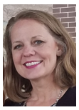
Your Presenter
Geri McMahon
Federal Programs Administrative Consultant
Migrant Education Coordinator
Iowa Department of Education
Geri.McMahon@iowa.gov
515-281-3944

Slide 4
1. Introduction to the Migrant Education Program
Brief Overview and Definition of Terms

Slide 5
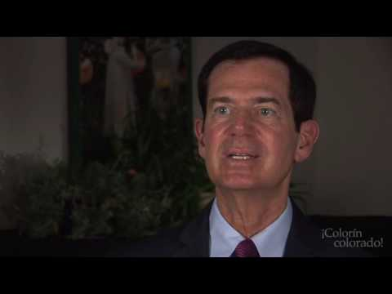
Migrant Education Overview
The Migrant Education Program is designed to provide educational assistance to children whose families make frequent moves in search of agricultural work.
The program helps migrant children master the educational content provided in the local districts by offering services to help reduce the educational disruptions and other problems that can result from these moves.

Slide 6
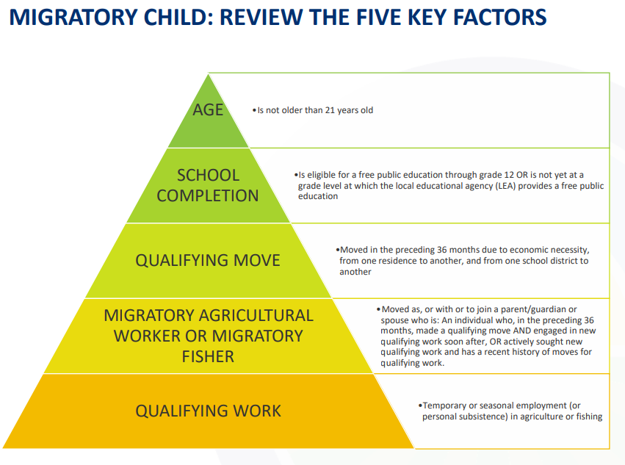
Migrant Definition

Slide 7
The Purpose of the Migrant Education Program
Assist states in supporting high-quality and comprehensive educational programs and services during the school year and, as applicable, during summer or intersession periods, that address the unique educational needs of migratory children
Ensure that migratory children who move among the states are not penalized in any manner by disparities among the states in curriculum, graduation requirements, and challenging state academic standards
Ensure that migratory children receive full and appropriate opportunities to meet the same challenging state academic standards that all children are expected to meet
Help migratory children overcome educational disruption, cultural and language barriers, social isolation, various health-related problems, and other factors that inhibit the ability of such children to succeed in school
Help migratory children benefit from state and local systemic reforms

Slide 8
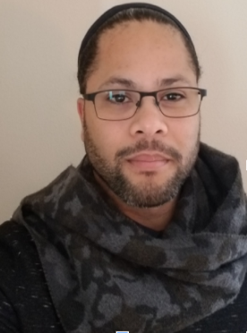
Staff
Alex Johnson
ID&R Coordinator
April Dameron
OSY Coordinator
Colette Stotts
Data Specialist

Slide 9
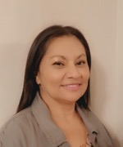
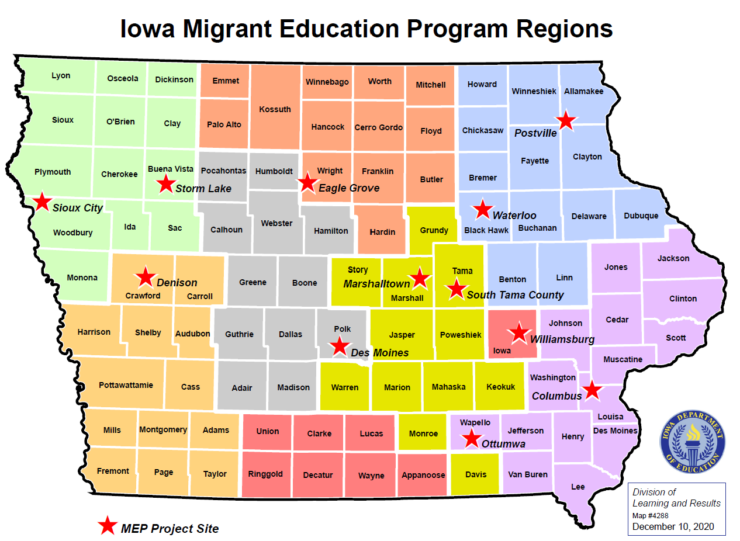
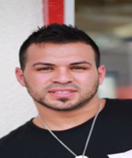
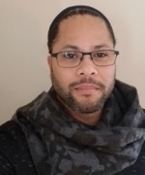
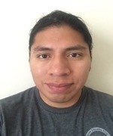
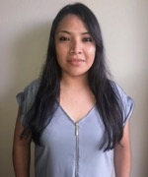
Iowa Migrant Education Sites and Statewide Staff

Slide 10
CASA - Consolidated Application - Title IA
Migrant Liaison
Please enter the contact information for the local area education agency's migrant liaison.
The approved Iowa ESSA Plan requires that a local migrant liaison be assigned to help identify all students who meet the migrant definition and carry out the responsibilities listed below.
Include:
Ensuring the MEP Parent Forms are included on registration packets
Assisting parents in completing the form
Gathering, scanning, and emailing MEP forms to state ID&R coordinator Alex Johnson
Completing the Withdrawal Form when students move out of the district
Does NOT include:
Determining migrant eligibility
Answering questions about services offered by the Migrant Program
Completing a Certificate of Eligibility (COE)

Slide 11
Documenting Migrant Eligibility: National COE
Required form that all States and their local MEPs must use to document the eligibility determinations of migratory children
May be in paper or electronic format
Must be completed based on the known facts at the time of the interview
(see 34 CFR 200.89(c) and National Certificate of Eligibility (COE) Instructions (OMB Control Number 1810- 0662))

Slide 12
Migrant Student Records Exchange (MSIX)
MSIX is the technology that allows states to share educational and health information on migrant children who travel from state to state
SECURE online student information data system
Can only be accessed by approved personnel in the Migrant Education Program
Collects the school data of students in the MEP as they move from town to town, state to state
To set up a MSIX account, contact Colette Stotts at Colette.Stotts@iowa.gov.

Slide 13
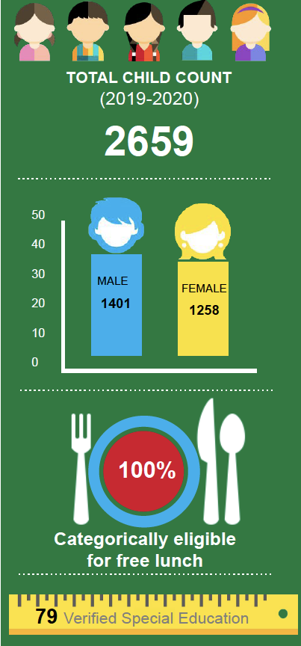
19-20 Data
1099
or 41%
Limited English Proficient
PFS STUDENTS
(Priority for Service)
434
GRADUATION RATE
2018-2019
77.2%

Slide 14
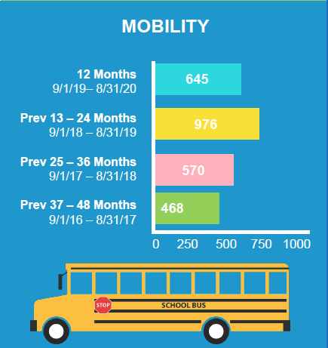
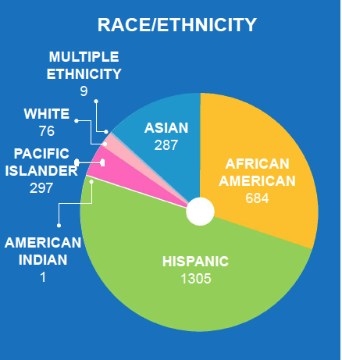
19-20 Data: Mobility and Race/ Ethnicity

Slide 15
2. Leveraging Migrant Education for Positive Student Outcomes
Appropriate Uses of Funding, Services Provided with MEP funds, and Submitting Claims and Resources

Slide 16
Migrant Education Programs
US Department of Education guidance articulates a few general principles for using Title IC, migrant education funds:
Services must be allowable, reasonable and necessary.
MEP funds are to be used for services in addition to, and not in place of, services available to migratory children from other sources
Activities or services that address a need identified in the MEP statewide comprehensive needs assessment (CNA) that are aligned to the strategies in the MEP statewide service delivery plan (SDP).

Slide 17
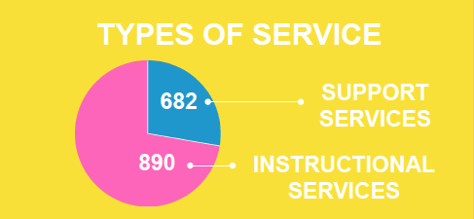
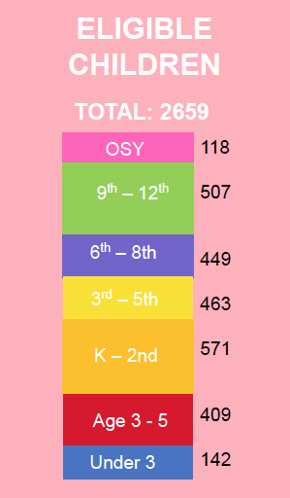
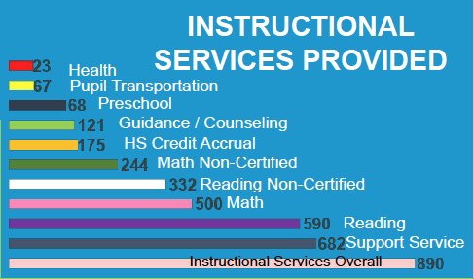
19-20 Data: Types of Service and Eligible Children

Slide 18
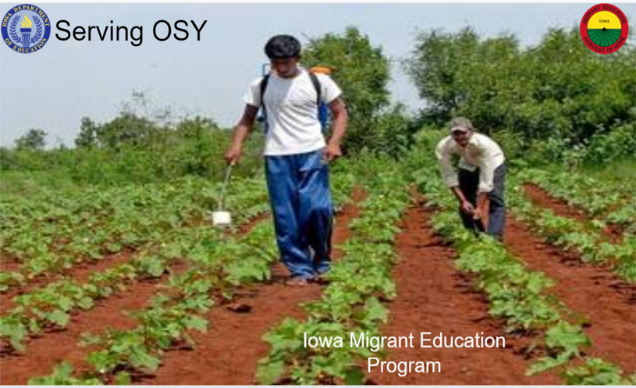
Out of School Youth (OSY)
OSY: A migrant student under 22 without a high school diploma.
Goals:
Increase the graduation rate among migrant youth 16 to 21 years of age
Help youth reach goals by removing barriers to success
Connect youth to education, health, and community services to help meet their needs

Slide 19
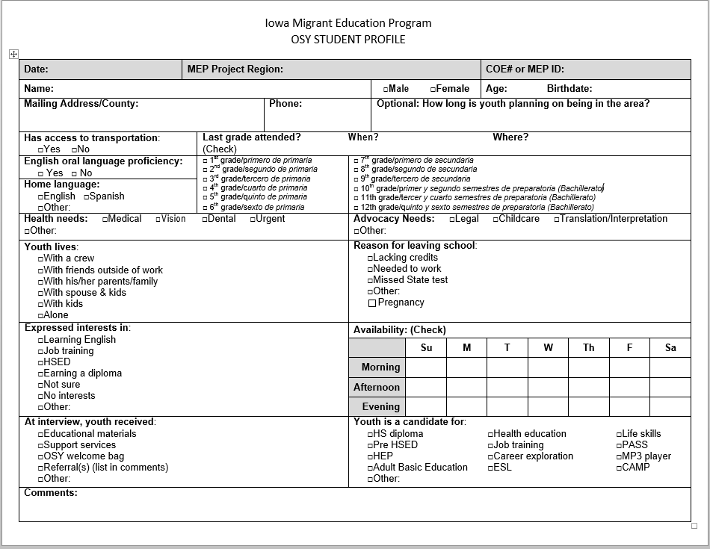
OSY Student Profile
Collecting information in order to provide services
English language and native language
Health/Advocacy Needs
Expressed interests

Slide 20
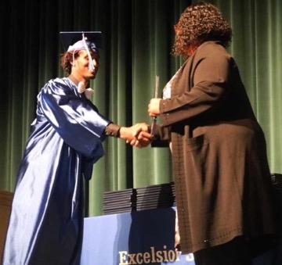
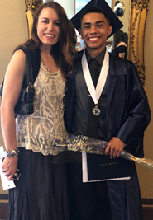
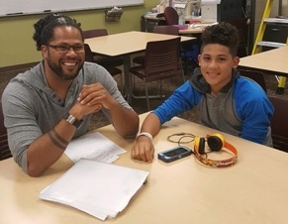
Outcomes
Increasing the Graduation Rate
Supporting youth to finish their diploma
Connecting youth with alternative programs, ELL, and HiSET classes to further their education
Your Future Starts Here
Helping You Reach Goals
Finding job training programs and apprenticeships
Providing Mentorship
Mentor program gave high school and OSY an opportunity to have another adult in their corner helping them to reach goals

Slide 21
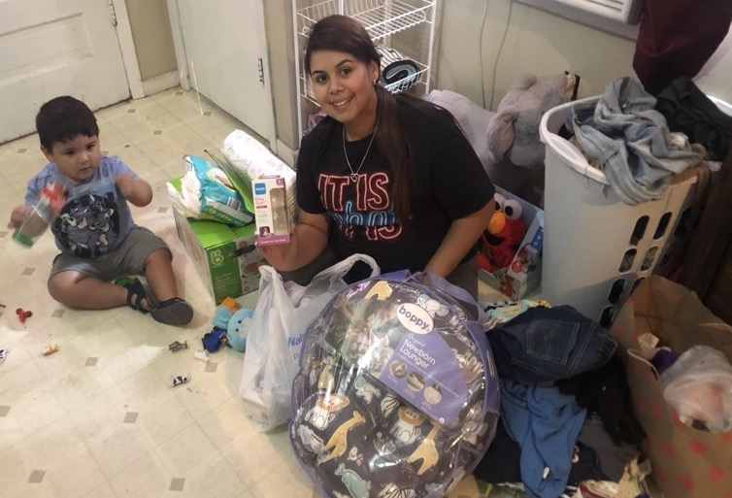
Removing Barriers to Success
This OSY came to Iowa with her mother from Texas. She already had one young son and another on the way.
She had needs to provide for her growing family, and a desire to finish her HSED. She was enrolled in the HiSET program and Proteus was able to provide groceries and formula for her young family.
Donations were given by people in the community and this family was blessed with more than they could imagine!

Slide 22
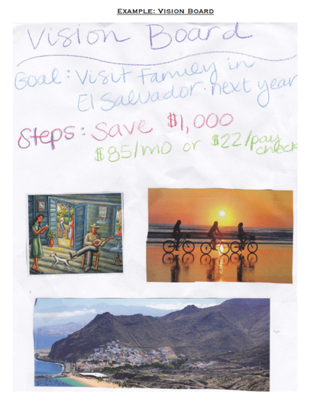
Goal Setting Workshops

Slide 23
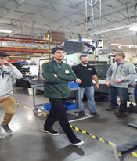
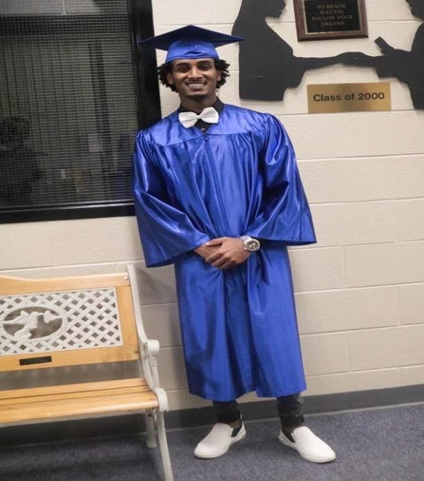
OSY Updates
Left: Former OSY who moved to the US from Peru. He moved quickly through his ELL classes and took his HiSET in Spanish. He enrolled at DMACC with intentions of getting his 2-year degree then transferred to ISU. He is currently looking for a position as a software or web developer.
Right: Former OSY from Ethiopia. He was unsuccessful at completing high school before turning 21. He went to Job Corps and graduated with his HS diploma and a welding diploma, which he used to get a full-time job in Texas.

Slide 24
Helping Youth Reach Goals by Removing Barriers

Slide 25
Services Provided Through Migrant Education Programs

Slide 26
Services Provided Through Migrant Education Programs (continued)

Slide 27
Technology Access

Slide 28
Texas Collaboration

Slide 29
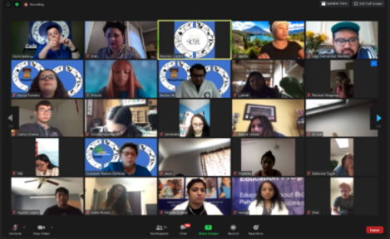
Summer School Services
Virtual Summer Camps for the Migrant Education Program: An Interstate Collaboration (Pennsylvania, Nebraska, Alaska, Arkansas, Colorado, and Iowa
CAMP CONNECT for High School Students with a focus on Science, Technology, Engineering, Arts, and Mathematics (STEAM model) agenda | July 20-23, 2020
Brain STEM (middle school) agenda
Intro – Video of the Camp

Slide 30
Storm Lake

Slide 31
Waterloo’s Migrant Education Program Goals

Slide 32
Create Custom Academic Support Based on Student Profile

Slide 33
BUT WAIT, There’s More: Educational Partners
UNI and Waterloo CSD
Generate possible support projects
Recruit university students
Build team with lead facilitator
Meet determine roles & plan projects
Outcomes/Deliverables
Select resources (book sets) to go home every other week.
Select topics for the Explorers; create learning plan based on the topic
Family letters/information about books and video resources delivered to homes
Support access video content, viewing, citizen scientist type activities
Take home material evaluation or feedback
Generate ideas to extend learning, practice & evaluation

Slide 34
BUT WAIT, There’s More: Waterloo CSD and Embark
Waterloo CSD and Embark (Ethnic Minorities of Burma Advocacy and Resource Center)
In-school/after school in support of academic content and proficiency attainment
Tech support (for virtual learning and online assignments, live streaming activities, parent conferencing etc.)
Delivery of resources (National Geographic/Cengage-literacy backpacks)
Family communication support and translation services

Slide 35
Additional Services Provided Through the MEP: Regular School Year
Free meals
Advocates to ensure migrant students have access to educational services for which they are eligible, including Special Education, Title I, programs for English learners, gifted and talented programs, vocational and technical education, and school nutrition
Preschool Readiness
Medical Agreements / Partnerships
Saturday School
Migrant Advocate for missed bus/late arrivals
High School Advocates
Counseling
State or Local Parent Advisory Committees (PAC)
Food Pantry at school

Slide 36
Finally
Together- we make a great team!
Notes:
Not only do the district MEP sites collaborate with partners to meet the needs of migrant student, the state collaborates with several state agencies in Iowa and with more than 26 other states to break down barriers and meet the needs of our migrant students and families. We have learned that together, we make a great team.

Slide 37
Submitting Claims
Migrant expenses:
Expenses should be reasonable, necessary, and allowable
Exhaust other means of payment prior to using
Title IC funds
For Building and District Expenses:
Budget and quarterly claims are kept and maintained by each district

Slide 38
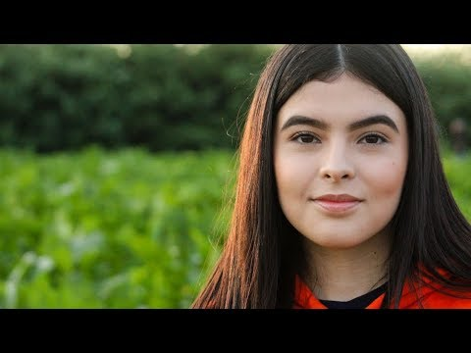
Resources and Closing Thoughts
Office of Elementary and Secondary Education-Migrant Education Program Guidance
Migrant Education Program Result
Instructional Services for Out of School and Secondary Youth (iSOSY)
Identification and Recruitment Consortium (IDRC)

Slide 39
3. Question and Answer

Slide 40
Questions?
Please type your questions into the Q&A screen (found at the bottom of your Zoom window)
Contacts
Contacts for questions or concerns are found in the left-hand menu in CASA, which is accessed through the Education Portal.
Questions should be directed to the Title program consultant listed.
Webinar Evaluation
Thanks for completing this webinar evaluation

