Slide 1
Title I, Section 1003 School Improvement
Stacie Stokes, Education Program Consultant

Slide 2
Overview
Topic
1. Introduction to Title I, Section 1003 School Improvement
A. Grant Purpose
B. Grant Requirements
C. Designations
D. Iowa School Performance Profile (ISSP)
E. Supplement Versus Supplant
F. Evidence-Based Strategies
2. Leveraging Title I, Section 1003 for Positive Student Outcomes
A. Appropriate Use of Funding Based on Needs Assessment
B. Short Term Focus
C. Long Term Focus
D. Submitting Claims
3. Additional Resources

Slide 3
1. Introduction to Title I, Section 1003 School Improvement
Overview and Definition of Terms
Notes:
The Every Student Succeeds Act (ESSA) became law in December 2015, reauthorizing the Elementary and Secondary Education Act of 1965 (ESEA).

Slide 4
Purpose
Purpose of Title I, Section 1003:
Ensure designated schools engage in school improvement efforts that affect significant change in student outcomes;
Provide all children significant opportunity to receive a fair, equitable, and high-quality education; and
Close educational achievement gaps.
Notes:
The purpose of Title I is to provide all children significant opportunity to receive a fair, equitable, and high-quality education and to close educational achievement gaps. Title I, Section 1003 and related section 1111(d) outlines district requirements to support any school within the district identified in need of either comprehensive [extended comprehensive] support and improvement, or targeted [extended targeted] support and improvement, and includes requirements for such identified schools. The goal of school improvement is to ensure identified schools engage in school improvement efforts that effect significant change in student outcomes.
Allocation of funds for this grant are distributed to identified schools. The districts' allocation for each identified school is based on a state determined formula.

Slide 5
Requirements Title I, Section 1003 and Section 111(d)
Districts are required to:
Important Clarifications:
Support designated school(s) within the district to develop and implement improvement plans.
Align resources and modify practices and policies to enable school(s) to effectively implement improvement plans.
Support and monitor designated school(s).
Provide an assurance that appropriate designated school(s) receive the funds as allocated by the State.
Use a rigorous review process to recruit, screen, select, and evaluate outside partners that the district may partner with to provide support to designated schools.
Section 1003 replaces the previous School in Need of Assistance (SINA) and District in Need of Assistance (DINA) process under No Child Left Behind.
Schools are designated; districts are not. The role of the district is to provide ongoing support to identified schools.
Notes:
In order to comply with Title I, Section 1003 and related section 1111(d), districts are required to implement the following actions listed. Keep in mind 2 clarifications: 1) Section 1003 replaced School in Need of Assistance (SINA) 2) Schools are designated; districts are not.
In addition, the district supports each identified school by:
1. Engaging the Building Leadership Team to design, develop, and implement the School Improvement Action Plan.
2. Completing the Consolidated Application to obtain any Title funds.
3. Completing a Needs Assessment to inform the development of the school improvement action plan.
4. Developing and submitting a School Improvement Action Plan within CASA.
5. Engaging in Technical Assistance.

Slide 6
Definition of Terms

Slide 7
Designations
Designation | Criteria
Comprehensive Support and Improvement (CSI) | Schools receive this designation either because: Their overall scores fall within the lowest 5% of Iowa schools receiving federal Title I funding or The high school has a graduation rate below 67.1%.
Extended Comprehensive Support and Improvement (ECSI) | Schools receive the “Extended” designation either because: After an extended amount of time, their overall scores continue to fall within the lowest 5% of Iowa schools receiving federal Title I funding or After an extended amount of time, the high school continues to have a graduation rate below 67.1%.
Targeted Support and Improvement (TSI) | Schools receive this designation if one or more student subgroup scores as low as the lowest 5% of schools in the state.
Extended Targeted Support and Improvement (ETSI) | Schools receive this designation if one or more student subgroup continues to score as low as the lowest 5% of schools in the state over an extended period of time.
Schools designations are based on the ESSA Accountability Index. Designations are available on the Iowa School Performance Profiles webpage.

Slide 8
Iowa School Performance Profile
The Iowa School Performance Profile (ISPP) online tool:
Developed to meet federal and state requirements for publishing online school report cards.
Shows how public schools perform on required measures.

Slide 9
Supplement versus Supplant
(Section 1118(b))
Title I funds must be used to supplement (and not supplant) state, local, and other federal funds.
Federal funds must be additive and should not take the place of state, local, or other federal funds in low-income schools.
Supplement | Supplant
Adds to the current expenses funded by local, state, and/or other federal funds | Takes the place of a current expense funded by local, state, and/or other federal funds
Resource: SUPPLEMENT NOT SUPPLANT UNDER TITLE I, PART A OF THE ELEMENTARY AND SECONDARY EDUCATION ACT OF 1965, AS AMENDED BY THE EVERY STUDENT SUCCEEDS ACT
Notes:
As per requirement 1118(b) Title I funds are to be used to supplement, and not supplant, state and local funds. Federal funds are additive and do not take the place of state and local funds in low-income schools.
[Note: Spending Title I funds on professional development that was previously paid for from general funds is not an allowable use of funds.]

Slide 10
Evidence-Based Strategies
(ESEA § 8101(21)(A))
Evidence-Based Strategies
Found to have a statistically significant effect on improving student outcomes or other relevant outcomes and
Conforms to a set of explicit criteria as defined by the Elementary and Secondary Education Act (ESEA), as amended by the Every Student Succeeds Act (ESSA).
Resource: ESSA Evidence-Based Practices

Slide 11
2. Leveraging Title I, Section 1003 for Positive Student Outcomes
Appropriate uses of funding, short-term focus, long-term focus, and submitting claims

Slide 12
Appropriate Use of Funding
Notes:
Districts may use section 1003 funds to implement interventions aimed at improving the school, such as professional learning. In addition, funds may be used to increase student achievement, such as summer school, tutoring opportunities, supplemental instruction, and family and community engagement.
Alignment is essential; activities supported with section 1003 funds must be consistent with the School Improvement Action Plan.

Slide 13
Appropriate Uses of Funding Based on Needs Assessment
Assess Needs | Example of Allowable Use | Non Example (Supplanting)
Comprehensive balanced assessment system | Develop, support, and sustain a comprehensive balanced assessment system for literacy, mathematics and social-emotional-behavioral-health (SEBH). Purchase reliable and valid assessments aligned to standards. Designate and provide professional learning/coaching to the staff/leadership team with extra FTE to lead efforts in data-based decision making. | Purchase Universal Tier summative assessments.
Class-wide (Tier I) instructional supports | Implement class-wide interventions based on student needs. Purchase intervention curriculum/materials and/or online programs aligned to Tier I (Universal). Provide professional learning/coaching supports with implementation to staff. | Purchase a new reading, math, or SEBH curriculum for Tier I (Universal).
Note: Activities supported with section 1003 funds must be consistent with the School Improvement Action Plan.

Slide 14
Appropriate Uses of Funding Based on Needs Assessment
Assess Needs | Example of Allowable Use | Non Example (Supplanting)
Supplemental (Tier II and III) instructional supports | Implement supplemental evidence-based instructional practices and standards-aligned instructional materials for interventions based on student needs: Purchase supplemental curriculum/materials and/or online programs aligned to Tier I (Universal). Develop professional learning/coaching with implementation. | Purchase (Universal Tier) instructional materials for all students. Purchase electronic devices or other supplies for whole grade levels/classes.
Instructional time and/or intensity | Increase instructional time and/or intensity in areas of need to address student needs: Extend day services. Extend year services. Provide tutoring. Add teacher FTE serving as an interventionist. Add paraeducators under supervision of teacher. | Pay the salary of a current staff member such as a teacher or paraeducator that already supports school improvement work.
Note: Activities supported with section 1003 funds must be consistent with the School Improvement Action Plan.

Slide 15
Appropriate Uses of Funding Based on Needs Assessment
Assess Needs | Example of Allowable Use | Non Example (Supplanting)
Student/family connections | Engage student/family connections by aligning resources and services to family needs: Provide services outside of the normal school hours. Engage in school-community collaborations. Designate and train staff with extra FTE to lead student/family connections/services. | Purchase entertainment for family events.
Shared building leadership | Develop, support, and sustain effective shared building leadership to lead and support the implementation of interventions: Designate and train leadership team members with extra FTE to lead implementation efforts in interventions for students. | Pay the salary of a current teacher or administer that already supports school improvement work.
Note: Activities supported with section 1003 funds must be consistent with the School Improvement Action Plan.

Slide 16
Appropriate Uses of Funding Based on Needs Assessment
Assess Needs | Example of Allowable Use | Non Example (Supplanting)
Common structures and processes | Allocate, support, and sustain common structures and processes for teachers building-wide to: Effectively examine student learning data. Monitor and adjust instructional needs. | Reimburse district-level efforts.
Coaching model | Implement a coaching model aligned to professional learning to focus on evidence-based instructional practices: Provide extra reimbursement for staff to refine practices outside of contract hours. Designate staff with extra FTE to lead coaching model efforts. | Reimburse or cover food and drink expenses for staff.
Note: Activities supported with section 1003 funds must be consistent with the School Improvement Action Plan.

Slide 17
Short Term Focus

Slide 18
Short-Term Focus
What actions can be done in a short amount of time based on assessed student needs that would make the greatest impact?
Action | Resource
Select an evidence-based approach that best meets the school and student needs. | ESSA Evidence-Based Practices
Apply an evidence-based instructional routine right away, as deeper and more extended work of examining universal tier practices, barriers, and needs occur. | Class wide Intervention
Assign, implement, monitor, and evaluate supplemental and intensive interventions. | Supplemental and Intensive Tiers
Select a positive, problem-solving approach to reduce chronic absenteeism. | Advance Student Success by Reducing Chronic Absenteeism

Slide 19
Long Term Focus

Slide 20
Long-Term Focus
What long-term sustained actions based on assessed student and staff needs can be made that would make the greatest student impact?
Action | Resource
Allocate, support, and sustain common structures and processes for teachers building-wide to effectively examine student learning data to monitor and adjust instructional needs. | Best Practices in Assessment in Literacy Instructional Practices in Mathematics
Implement a coaching model aligned to professional learning to focus on evidence-based instructional practices. | Coaching Field Guide

Slide 21
Submitting Claims

Slide 22
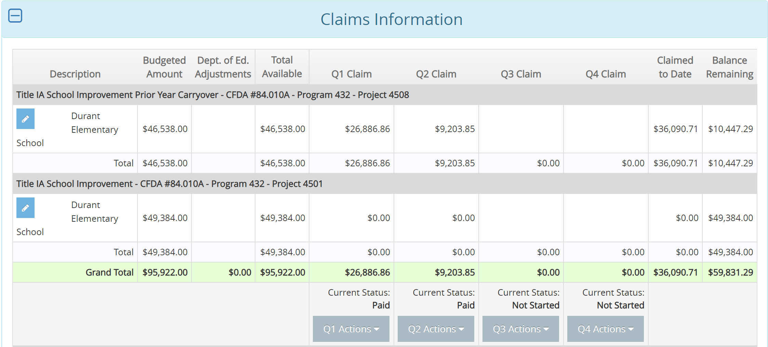
Submitting Claims: Consolidated Application
Claims Checklist:
Claim is submitted by the superintendent/chief administrator or SBO.
Uploaded general ledger is year-to-date.
Correct coding is used: program (432) and project (4508 or 4501).
CASA claim matches the uploaded general ledger amounts.
Claims for each designated (CSI, ECSI, TSI, and ETSI) building is clearly identified within general ledger.
East Elementary
East Elementary

Slide 23
3. Additional Resources

Slide 24
Resources
Item | Description
ESSA Guidance and Allocations | Provides ESSA guidance documents and allocation amounts.
Title I, Section 1003 – School Improvement Application Content | Outlines the content of the Title I, Section 1003, School Improvement application in the Consolidated Accountability and Support Application’s (CASA) Consolidated Application.
ESSA Support Site | Repository of tools and resources to support the work aligned to Iowa's Every Student Succeeds Act (ESSA) Plan.
Using Federal Funds for Professional Development | Provides information on the allowability of using Title program funds to pay school instructional staff for professional development.

Slide 25
Contact
Stacie Stokes
Title I, School Improvement
stacie.stokes@iowa.gov
515-210-5288

