Slide 1
Individuals with Disabilities Education Act:
Differentiated Accountability
(IDEA-DA)
Overview of IDEA-DA Process and Model
November 2022

Slide 2
Topics for this recording, include:
General Supervision and Differentiated Accountability: Background
Implementation Support Rubric
Overview of Accountability Model
Process for Assigning Support Levels

Slide 3
Why Now? What’s Different?

Slide 4
Differentiated Accountability- IDEA Focus
Notes:
Follow the yellow highlights -
Desk Audit - the purpose is to ensure ongoing compliance with federal and state laws that regulate programing, funding, education, etc.
Differentiated Accountability - includes desk audits for:
IDEA Part B (ages 3 - 21) -
Implementation rubric - information on district level performance which allows the DE to provide the levels of needed supports to impact learner outcomes [as required (Results Based Accountability - OSEP)]
Currently have supports in place for Transition (Post Secondary Success)
PPP = Policies, Procedures, Practices
B4 - Suspension & Expulsion rate: % of districts with significant discrepancy by race/ ethnicity
B9 - Disproportionate Representation: % of districts with disproportionate representation of racial / ethnic groups due to inappropriate identification
CEIS Review: Coordinated Early Intervening Services
B13: Secondary Transition: % of youth ages 14+ with measurable, annually updated IEP goals & appropriate transition assessment, services and courses.

Slide 5
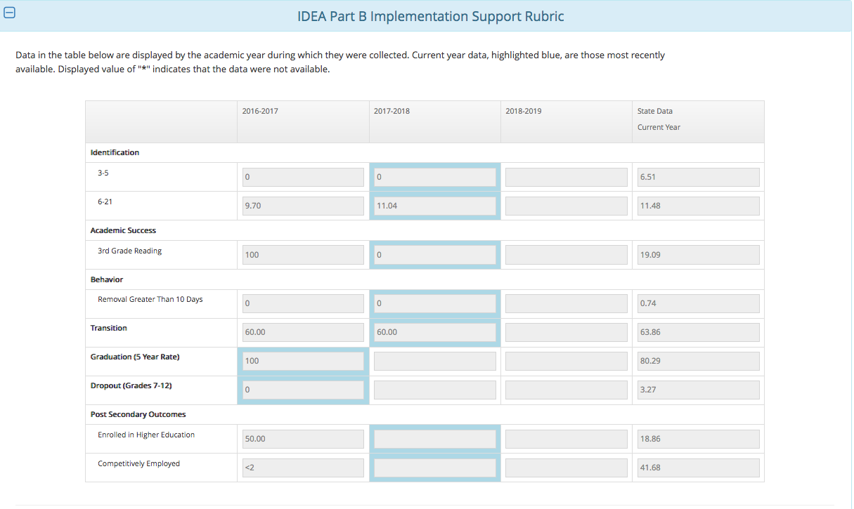
Notes:
CASA = Consolidated Accountability and Support Application

Slide 6
Why Now? What’s Different?
Full Implementation of the Support Rubric!!!!!!
All data elements in the support rubric will be used to identify a district’s support level
Levels of support will be for a 3 year cycle
3 year cycle aligns with ESSA cycle

Slide 7
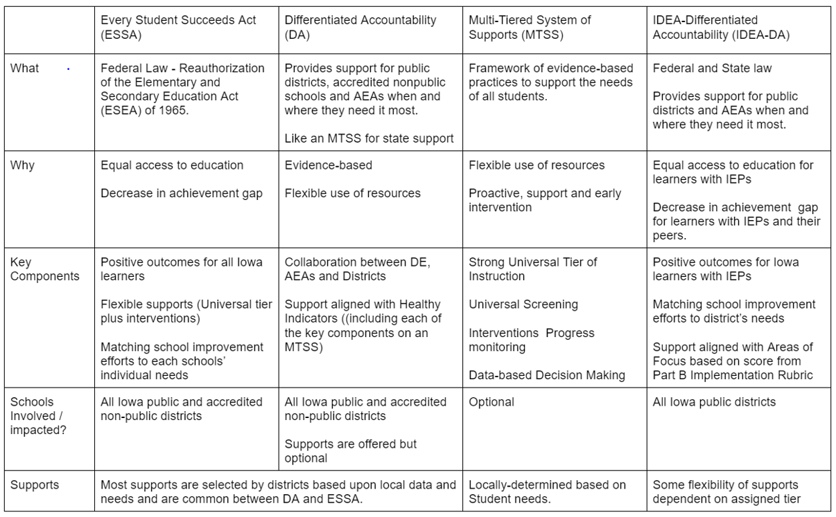
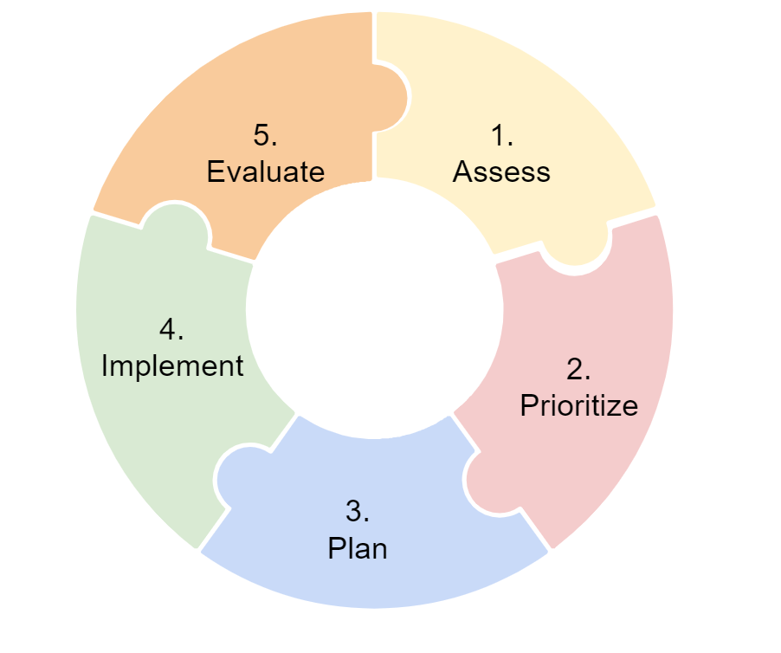
IDEA-DA ~ How it aligns with Iowa’s Current Work
Notes:
Table of Monitoring
This table identifies the alignment between IDEA-DA and ESSA, DA, and MTSS

Slide 8
IDEA Requires General Supervision of IDEA
41.600(2) Primary focus of monitoring activity. The primary focus of the state’s monitoring activities must be on the following:
Improving educational results and functional outcomes for all children with disabilities; and
ensuring that public agencies meet the program requirements under Part B of the Act, with a particular emphasis on those requirements that are most closely related to improving educational results for children with disabilities.
Iowa Administrative Code
Notes:
IDEA requires States to provide general supervision through a number of activities including monitoring. It has always had an emphasis on results (yellow highlighted text)
Duties of General Supervision:
Duty to Inform
Duty to Prevent
Duty to Inspect/Detect
Duty to Correct
These duties are a shared responsibility of the DOE and AEAs

Slide 9
Notes:
This is to illustrate that there are multiple doors to support. These doors could be represented in different ways - we could start with funding stream, or with law, or with a program….in this graphic, we organized things by data.
Red door: Universal desk audit data are those data that districts/schools are accountable to submit annually that help us understand district/school compliance and possible system needs in law or specific programs.
Green door: We also have other data, like complaints or incidents that require immediate action that we must attend to as a state education agency
Any one of these doors could determine that a district or school is in need of support at the T 2 or 3 levels.
Regardless of which data leads us to say supports needed here! - we need to engage in Data Review either within a Directed Team or a System Team….it would be at this point, as we review data, where we would be able to determine what kind of team composition is optimal….for example, if we identify a district as in need of intensive supports based on healthy indicator data, we would also review data across the other DOORS TO SUPPORT so that can identify if there are systemic IDEA needs, program needs, subgroup needs, or early childhood needs - in this way we can ensure we have the optimal team to provide the level of support determined. See below for definitions of Directed and System
Directed. a DIRECTED team works directly with a district or a school for a predetermined purpose. The focus of the purpose is based on on a preponderance of complaints, non-compliance, incidents that require immediate action or otherwise an indication of the need for dedicated and directed support to understand and address critical circumstances. Team membership is exclusively governmental agency personnel.
System. a SYSTEM team works with district and/or school leadership teams on implementing and sustaining continuous improvement practices to improve system and student outcomes. Team membership includes IDOE and AEA personnel, and as the work unfolds, district/school leadership teams in the active implementation of continuous improvement.

Slide 10
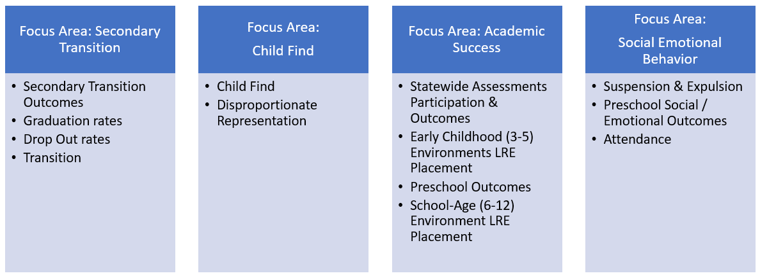
IDEA-DA Focus Areas
Notes:
Our current work toward IDEA-DA is based on the work that was defined by an internal team in 2017. The group listed on the slide worked with Mary to identify data elements that aligned with the promises of IDEA.
This slide depicts the organization of outcomes into focus areas

Slide 11
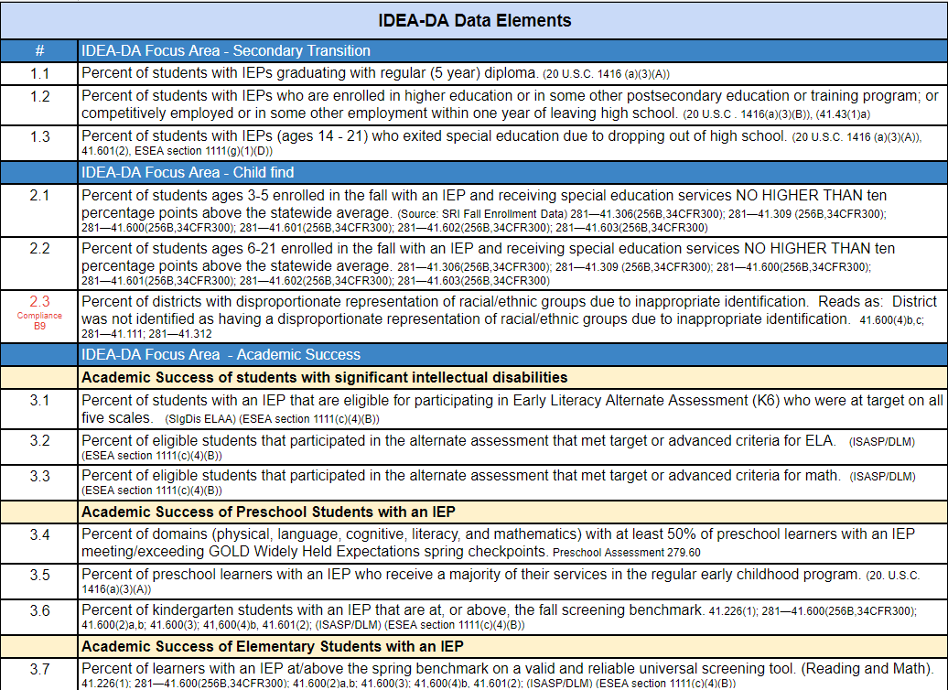
Example of Aligned Data Elements (Link)
Excerpt from IDEA-DA Data Elements
Notes:
Table image updated 9/2/22 to reflect “ST” in place of Post Secondary
The table that you see on this slide took those groupings and moved them into data elements backed by citations and aligned to data sources.
The numbers on the left side of the table help the internal team have a common reference for data elements -
i.e., 1.2 = IDEA-DA focus area 1, second data element.
This is just a snip of the full document.

Slide 12
How does the model work?
Most measures combine the three most recent years of available data; there are exceptions where only the most recent year of data will be used (e.g. Measure 4.2)
A measure will not be used (will be redacted) for a district when there is data for fewer than five students
The model utilizes measure weights
Each of the four focus areas makes up 25% of the total index weight
If a district has other non-redacted measures in the focus area, a redacted measure's weight is spread proportionally among those measure(s); example with Measure 1.2:
If a district has all measures within a focus area redacted, that focus area's weight is spread equally to the other three conceptual areas
If a district does not have enough data for measures making up at least 50% of the total weight, that district will not receive a score

Slide 13
How does the model work?
The model is structured similarly to the school accountability model used to meet Every Student Succeeds Act (ESSA) requirements which is published on the Iowa School Performance Profiles website
Most measures are rates (a numerator divided by a denominator) and will go through the following process (exceptions discussed in two slides):
Standardize each measure, subtracting off the mean of all districts (with N >= 5) and dividing by the standard deviation of all districts (with N >= 5)
Like the ESSA model, set the mean of each measure to 50 and the standard deviation to 10
This puts all measures on a common scale/playing field prior to combining into a total index score
Reverse measures (1.3 & 4.3): change direction at this point so lower values of the measure contribute positively to the district’s score and higher values contribute negatively
Ex. Measure 1.3: Percent of students with IEPs (ages 14 - 21) who exited special education due to dropping out of high school.
Multiply the standard score by the measure’s weight to calculate each measure’s contribution to the district’s overall score

Slide 14
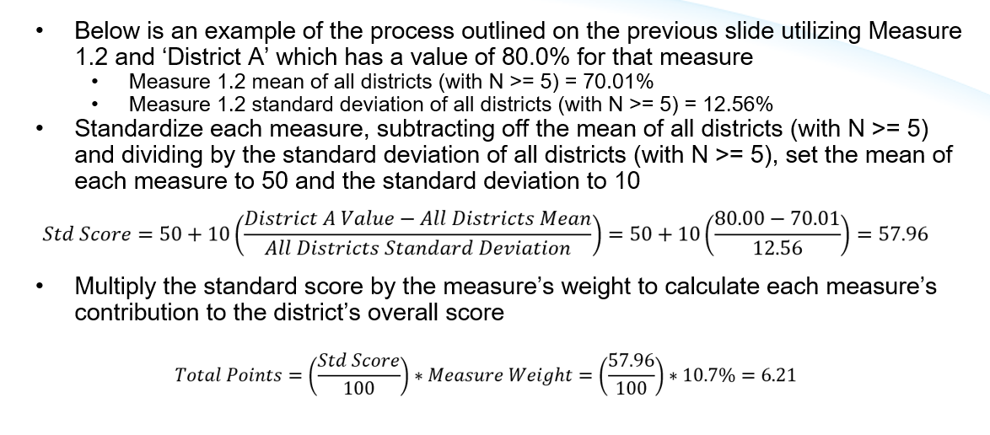
Model: Standard Score Example

Slide 15
Model: Binary Measures
The following measures, rather than using the standard score methodology described on the previous two slides, assign points to a district based upon specific criteria:
2.1, 2.2, 2.3, 3.4, 4.2
Example, Measure 2.1:
Percent of students ages 3-5 enrolled in the fall with an IEP and receiving special education services NO HIGHER THAN ten percentage points above the statewide average.
For each of these, the district receives 100% of the points for the measure (once again, based upon the weights) if they meet the criteria and 0% of the points if they do not meet the criteria

Slide 16
Measure-Level Percentile Ranks
Along with the overall index score calculated for each district, the district’s percentile rank (among districts with N ≥ 5) for each non-binary measure is calculated to provide an idea of how the district performs on each measure relative to all other districts in the state
Ex. If a district has a percentile rank of 73 for a measure, their performance on that measure is at or above 73 percent of districts in the state
The measures for which each district falls in the bottom quartile (bottom 25%) of districts are identified as potential areas of focus
Binary measures where the district is not compliant are also included in the list of measures that are potential areas of focus

Slide 17
Process for Identifying Support Levels
Step 1: Identify Overall District Score (100 total)
District’s overall score comes from adding up the total points from each measure
DE staff will individually review available data for district’s with not enough data for measures making up at least 50% of the total weight will be individually reviewed by DE staff
Step 2: Identify Districts Support Levels
The lowest 10% in the state will be identified to receive Tier 3 Supports
Step 3: Identify Supports for Directed Focus Area
District measures that are in the bottom quartile of all districts will be reviewed
These data will be used to identify a focused area of support

Slide 18
Next Steps
District Notification
Districts will be notified
DE staff will individually review available data for district’s with not enough data for measures making up at least 50% of the total weight will be individually reviewed by DE staff
Step 2: Identify Districts Support Levels
The lowest 10% in the state will be identified to receive Tier 3 Supports
Step 3: Identify Supports for Directed Focus Area
District measures that are in the bottom quartile of all districts will be reviewed
These data will be used to identify a focused area of support

