Slide 1
Student Reporting in Iowa (SRI) and Secondary CTE Reporting Application (SCTERA) Overview
Dr. Jeffrey Fletcher
Education Program Consultant
Iowa Department of Education

Slide 2
Student Reporting in Iowa (SRI)
Student Reporting in Iowa (SRI), an EdInfo application in the Iowa Education Portal, is the Iowa Department of Education’s centralized initiative involving the transfer of individual student records from local districts to the state.
The mission of the project is to reduce data burden and encourage better decision-making by establishing and maintaining a cost effective method of accessing and transferring accurate and timely education information among school districts, postsecondary institutions, and the Iowa Department of Education.
SRI Reporting Tutorials

Slide 3
Student Reporting in Iowa (SRI)
SRI Contacts
Rachel Kruse, Rachel.kruse@iowa.gov, 515-281-4153
Margaret Hanson, Margaret.Hanson@iowa.gov, 515-281-3214
2022-2023 Documentation
2023-2024 Data Dictionary Elements and Codes

Slide 4
Student Reporting in Iowa (SRI)
SCED Coding 101 – Introduces the user to SCED codes for secondary level courses. Examples of SCED codes are given, and the user has the opportunity to practice creating SCED codes.
National Center for Education Statistics – What is SCED?
Understanding the Accreditation Report – Explains the Curriculum Accreditation Report, which is found in Winter SRI. It describes the four main focus areas when checking for accuracy and common mistakes that are made.

Slide 5
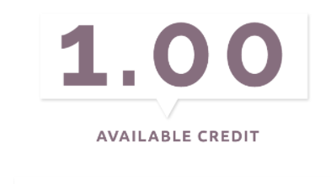
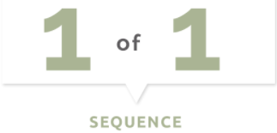
Student Reporting in Iowa (SRI)
Secondary (9-12) SCED Code Structure
Iowa has modified non-secondary in a slightly different style on the non-secondary courses. For non secondary courses, use “000” in place of the Carnegie Units, and the last two digits is the intended grade span instead of sequencing.

Slide 6
Student Reporting in Iowa (SRI)
SCED Course Code
11 alpha numeric characters or a single 0
9-12 courses used as placeholders for no credit, such as study hall or lunch, may contain a single ‘0’
All 9-12 courses should be assigned a course code generated from the coding manual, Secondary School Course
Classification System: School Codes for the Exchange of Data (SCED) from the National Center for Educational Statistics, SCED
School Courses for the Exchange of Data (SCED) v11as modified by the Iowa Department of Education and found on the State Reporting (SRI) website
The 9-12 SCED course codes are 11 characters in length and have four components:
a. Course Description consisting of a two digit Subject Area and three digit Course Identifier
b. Course Level consisting of one alphabetic character in UPPERCASE
c. Carnegie Units expressed as a three digit number excluding the decimal point (e.g. 0.50 = 050)
d. A two digit sequence representing a count of the number of times you re-use the first 5 digits for courses with different content or used to indicate 1st term/2nd term of a year-long course

Slide 7
WBL SCED CODING – Student Reporting in Iowa (SRI)
SCED Codes for Work-Based Learning Indicator
This document is organized to identify a list of SCED codes used to collect data on the courses used for the work-based learning secondary indicator for Perkins V through the SRI & SCTERA collection process.
For more information on the references made to course naming and coding, please review the SCED Codes for Work-Based Learning Indicator
Work-Based Learning Toolkits - Provides tools, and recommendations to address barriers to increasing opportunities for high school students, while also providing a wide range of real-world examples from across the state that can be modeled and replicated within local communities.
For more information, or questions, please contact

Slide 8
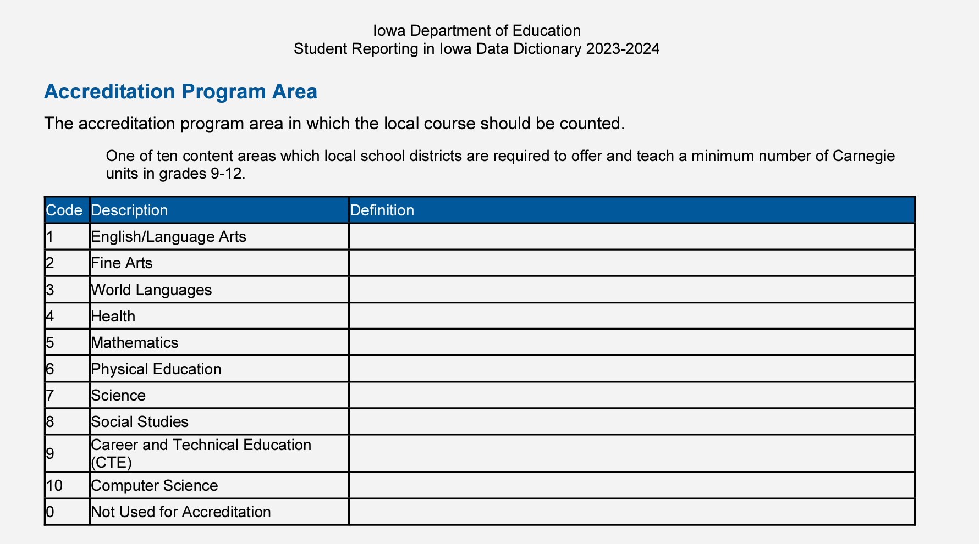
Student Reporting in Iowa (SRI)
CRITICAL!!! Accreditation Program Area, Code = ‘9’ for each SCED that is Career & Technical Education (CTE); a critical step for information to “flow” into the IDE’s Secondary CTE Reporting Application (SCTERA) (SRI HANDBOOK, P. 105)

Slide 9
Student Reporting in Iowa
Dates to Remember
December 1 – Cedar Connect and SRI open for Winter collection (public and nonpublic)
December 1 – Dropout Verification Report opens (public and nonpublic having grades 7-12)
December 15 – Dropout Verification certification deadline (public and nonpublic having grades 7-12)
January 2 – Secondary CTE Reporting Application goes “live”
January 26– Courses in a program due in SCTERA → Winter SRI certification deadline

Slide 10
SRI is the foundation for… Secondary CTE Reporting Application (SCTERA)
The SRI system is the basis for extracting CTE data into the Secondary CTE Reporting Application (SCTERA) system (another EdInfo Application)
A EdInfo Application within the Iowa Education Portal
The information from SCTERA is used for ensuring that school districts comply with state and federal career and technical education requirements.
SCTERA information is also used to develop data required for the annual consolidated annual report (CAR) and reporting performance on the Federal Perkins accountability performance indicators.
Secondary CTE Reporting Application
One-way Data Connection
Student Reporting in Iowa (SRI)

Slide 11
Secondary CTE Reporting Application (SCTERA)
Log in to the Iowa Department of Education Portal
IDE recommends using the Google Chrome web browser
Access to the Secondary CTE Reporting Application (SCTERA) is through the Iowa Education Portal: https://portal.ed.iowa.gov.
Under A&A Account, select “Sign-In” - Enter your e-mail and the password on the sign-in screen.

Slide 12
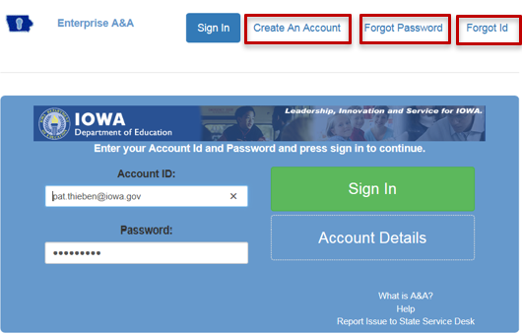
Secondary CTE Reporting Application (SCTERA)
You can reset your password by clicking the Forgot Password button at the top of the page on the log in page.
If you do not have an A&A account, click on Create an Account at the top. Your district A&A Administrator will give you permission to the CTE application.

Slide 13
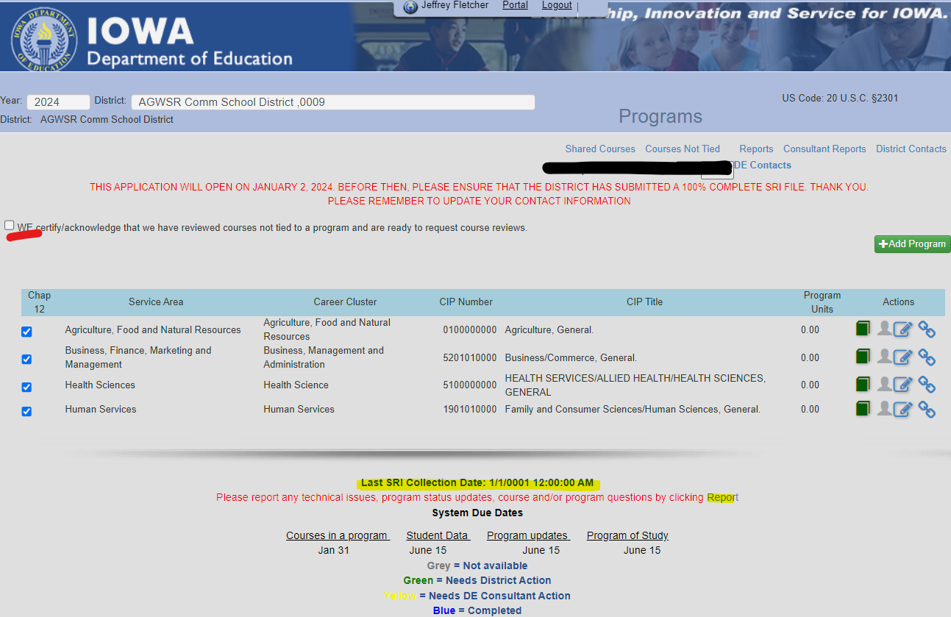
Secondary CTE Reporting Application (SCTERA)
Notes:
Check to make sure SRI is uploaded, timestamp is circled in RED in screenshot — nothing can be completed until school districts SRI file is uploaded/submitted AND 100% complete.
If the school district needs to re-upload/re-submit, it is important to be very cognizant of what the changes were so they can re-do/update a CTE program if CTE data changed.
Check (4) programs under the Chapter 12 column; the check-marks are about compliance for offer and teach accreditation; not that these are the only ones that will be documented.
Pick programs with 3.0 or more units of school district classes - unless they are a district that has under 600 students, then they can use CC classes in ONE program (if they have at least 5 students in the course or courses) and they would not lose supplemental weighting.

Slide 14
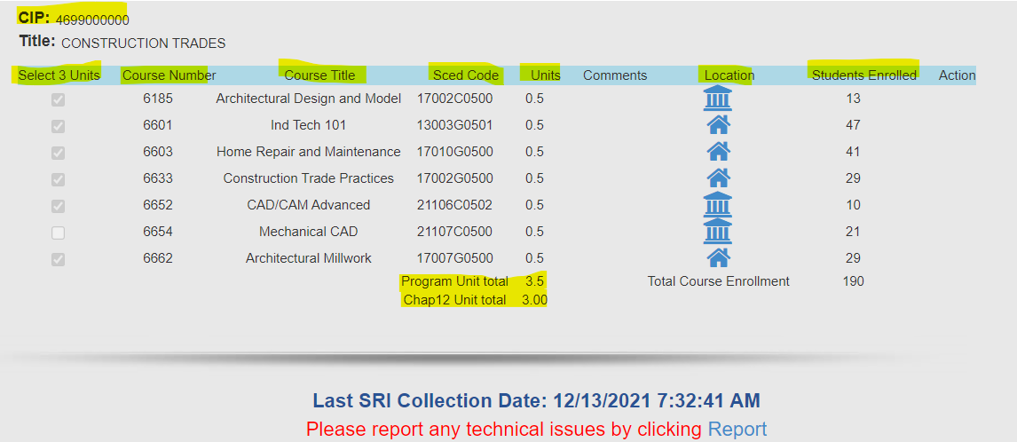
Secondary CTE Reporting Application (SCTERA)
Notes:
Be sure to include ALL Community College CTE courses associated with a CIP/CTE Program. We also need to count all CTE students. It can make a difference.
If there is more than (1) CIP/CTE Program within a Service Area, ensure that the courses are unique/specific to each CIP.
If CIP/CTE Program was checked for Chapter 12 – boxes for each course will be available; select courses until reaching 3.0 units. Note: If supplemental weighted courses are checked for the offer and teach requirement, the supplemental weighting is lost. Try to check local courses when and if possible. Any course(s) not marked as meeting the Offer and Teach requirement is/are eligible for supplemental weighting.

Slide 15
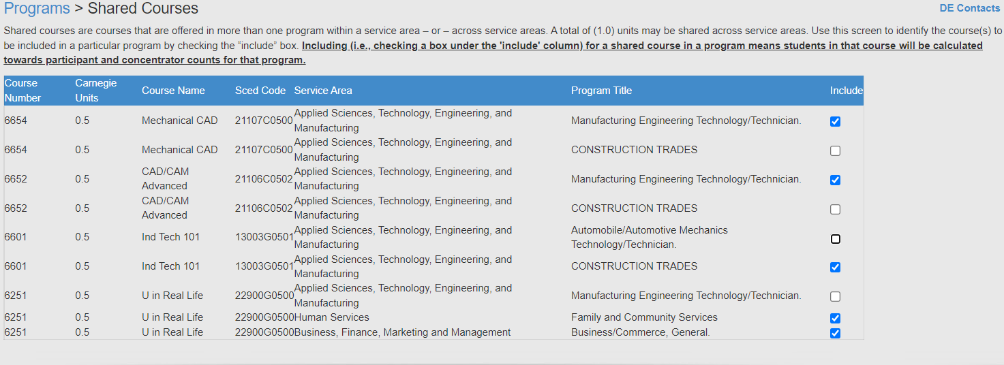
Shared Courses
Once all programs are completed, click on the “Shared Courses” link at the top of the Program screen.
SCTERA Short Takes Video: Shared Courses and "INCLUDE" (3:59)
Notes:
Shared courses are courses that are offered in more than one program within a service area or across service areas.
A TOTAL of 1.0 units may be shared across service areas.
There is no limit on sharing units within the same service area, however, the courses should relate to the CIP/CTE Program and show how the programs are unique. If needed, discuss with a service area DE consultant.
For shared courses – for each course, check the box if it should be counted in the program’s student counts.

Slide 16
Course NOT Tied to a Program
This is a frequent action item that comes up in a DE review and can result in additional attention and actions required by the district.
SCTERA Short Takes Video: Courses NOT Tied to a Program (5:37)
INSTRUCTIONS: Please review the list of "courses not tied" to a program: a) Whether a secondary or concurrent enrollment course, does it fit into an existing program? b) Whether secondary or concurrent enrollment courses - are there 3.0 units of sequential courses to create a new program? Please contact a service area consultant. c) If scenario A or B is not applicable, then the course may remain in in "course not tied" list.
Notes:
Courses Not Tied To A Program Report – It is possible or plausible to have an additional program if less than 2.0 units but shared with another course tied to a program. There are scenarios where a district may or may not want to consider. It is advised to speak with a Service Area DE Consultant.

Slide 17
Secondary CTE Reporting Application (SCTERA)
After adding courses to all programs is complete, click on green “student head icon” and then click “Request Course Review” button.
Repeat step 1 for each program.
Congratulations, 2024 Winter SCTERA Collection is complete!
Certify SRI file in EdInfo SRI application.

Slide 18
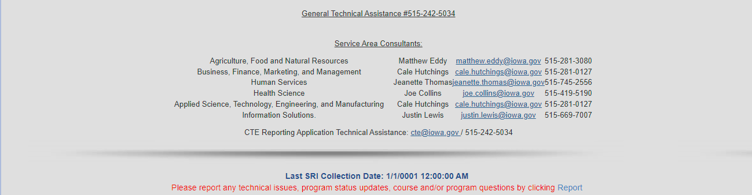
Secondary CTE Reporting Application (SCTERA)
Questions about SRI data? SCED Codes? Sequencing? Other? – Rachel Kruse (Rachel.Kruse@iowa.gov)
Questions about SCTERA application? Complete a Google Form ticket via home screen.
For questions about courses & programs, please reference contact list below (or click on “DE Contacts):

Slide 19
Secondary CTE Reporting Application (SCTERA)
IDE-IT recommends using the Google Chrome web browser
REMINDERS:
1) District submits and uploads a 100% complete SRI file
2) District then completes SCTERA
3) District then “certifies” SRI file to begin CH.12 accreditation review.
Drop-in office hours are scheduled for assistance and Q & A:
Matt Eddy will host drop-in office hours for Q&As and assistance that will be held at the following dates and times.
Please mark your calendars.
Drop-in office hours are scheduled for assistance and Q&A.
Please contact Matthew Eddy or 515-720-8863; CTE Hunt Line 515-242-5034 with any questions.
January 3, 7:30 a.m. – 8:20 a.m. SCTERA Help Desk 1/3/24
January 11, 3:00 p.m. – 3:50 p.m. SCTERA Help Desk 1/11/24
January 18, 7:30 a.m. – 8:20 a.m. SCTERA Help Desk 1/18/24
January 26, 7:30 a.m. – 8:20 a.m. SCTERA Help Desk 1/26/24

Slide 20
Dr. Jeffrey Fletcher
Education Program Consultant
Jeffrey.Fletcher@iowa.gov
515-321-7309
Bureau of Community Colleges & Postsecondary Readiness
Division of Community Colleges and Workforce Preparation
Iowa Department of Education

Slide 21
Appendix
Hyperlinks
SRI 2023-2024 Data Dictionary
Career Academy Minutes and SCED Codes (9-39-23)
Complete List of Non-Secondary Course Codes (8-24-21)
SCED v11 (7-13-23)
SCED Codes and Contact Minutes for Community College Courses (8-2022)
SCED Code Handout Updates (High School Level) (4-1-13)
Concurrent Enrollment vs PSEO Courses (1-9-23)
SCTERA APPLICATION HANDBOOK (12-12-23)
SCTERA Webinar FAQs (12-30-21)
SCTERA Short Takes Video: Shared Courses and "INCLUDE" (3:59)
SCTERA Short Takes Video: Courses NOT Tied to a Program (5:37)
Iowa Approved CTE CIP Codes (10-6-21)
SCED Codes for Perkins V: Work-Based Learning (12-20-23)
Work-Based Learning Course Naming and Coding Guidance (9-1-22)

Slide 22
Appendix
According to Ch. 46 Career and Technical Education, ALL secondary CTE programs are required to be approved by the Director of the Department of Education. This is done through the self-study process as outlined in Ch. 46. The Department tracks operational programs subject to approval through the state CTE reporting system (SCTERA). Therefore, if a district wishes to offer a CTE program, it must be reported annually through the CTE reporting system.

