Slide 1
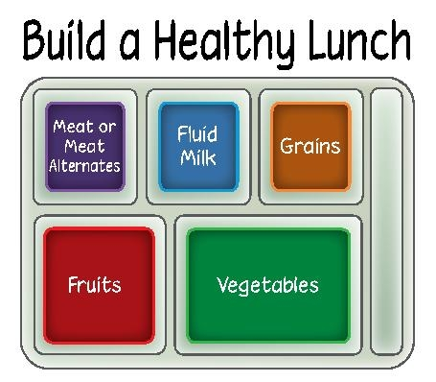
ABC Community School District Nutrition Program
The Nutrition Department is focused on fueling student bodies & minds with highly nutritious foods and running an efficient food service operation in which food safety is our culture. These high standards meet federal and state guidelines.
Notes:
Update the presentation with your school nutrition program information. Remove red, italic text and all photos showcasing your school meals!

Slide 2
Menus Planned
Update to reflect your school nutrition program. Insert pictures of your school meals!
Elementary
3-week cycle, 2 entrée choices
Middle School
3-week cycle, 3 entrée choices and a salad bar
High School
5-week cycle, 5 entrée choices and a salad bar

Slide 3
There’s an App for That!
If an app based menu is utilized highlight it as a resource for families.
Nutritional information
Food item photos
Customer feedback

Slide 4
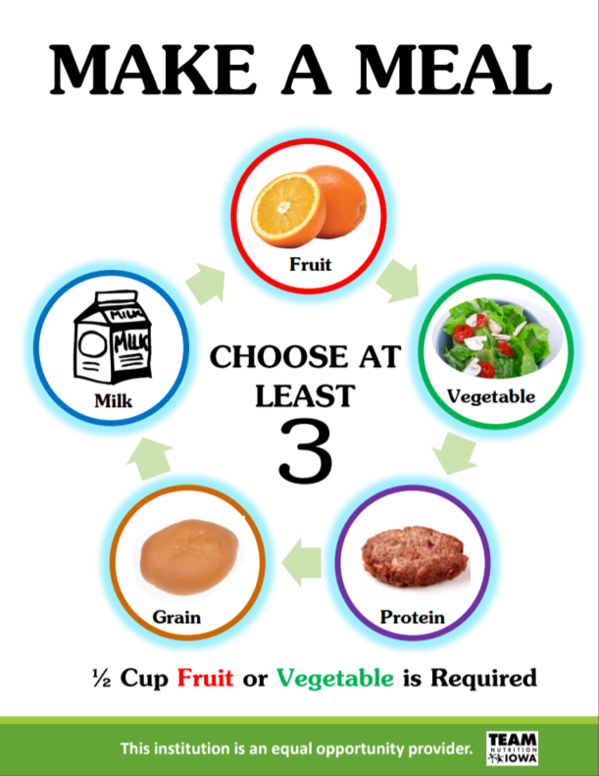
Make a Meal
Provide copies of What is a Reimbursable Meal Handout.
Notes:
What’s in a School Lunch?
Meat/Meat Alternate: Minimum of 1 serving daily with 8-10 by the end of the week
Grains: Minimum of 1 serving daily with 9 by the end of the week; must be whole grain
Fruits: At least ½ cup daily
Milk: 1 cup daily, fat free flavored milk or 1% white
Vegetables: ¾ cup daily PLUS weekly subgroups:
Dark Green
Red/Orange
Beans/Legumes
Starchy
Other

Slide 5
Breakfast Meals Served
Share number of meals served for the past 3 FY for each building. Highlight successes for increases in participation and challenges if there were decreases.
Building | FY15 | FY16 | FY17
ABC | 10,000 | 12,000 | 11,500
DEF | 8,000 | 10,000 | 12,200
GHI | 2,100 | 2,200 | 2,300
Total
Average Daily Participation in Breakfast: XX%

Slide 6
Lunch Meals Served
Share number of meals served for the past 3 FY for each building. Highlight successes for increases in participation and challenges if there were decreases.
Building | FY15 | FY16 | FY17
ABC | 10,000 | 12,000 | 11,500
DEF | 8,000 | 10,000 | 12,200
GHI | 2,100 | 2,200 | 2,300
Total
Average Daily Participation in Lunch: XX%

Slide 7
Ala Carte Sales
Share a la carte sales for each building and give examples of offerings at each of the buildings and the Smart Snack nutrition requirements.
Building | FY15 | FY16 | FY17
ABC | 10,000 | 12,000 | 11,500
DEF | 8,000 | 10,000 | 12,200
GHI | 2,100 | 2,200 | 2,300
Total

Slide 8
Free and Reduced Meals
Provide an update on free and reduced meals eligibility. Has there been an increase or decrease the last few year?

Slide 9
Meal Prices
Provide a reminder of current meal prices and future plans to adjust prices.

Slide 10
Administrative Review
If a School Nutrition Administrative Review recently took place, provide an update if there were any findings/corrective action and plans to correct moving forward.

Slide 11
Special Diets
Provide an update on the number of special diets and accommodations the school nutrition program provides.
21 Gluten Free
1 Soy Free Dairy Free
8 Egg Free
Carbohydrate counts for diabetic students
Additional Allergies
Peanut, tree nut, milk, dairy, soy, fish, shellfish, cinnamon, stone fruit, citrus fruit

Slide 12
Summer Food Program
If a Summer Food Service Program sponsor, update them on participation, serving sites, successes, and challenges. Share promotional materials and photos.

Slide 13
Additional Services
Highlight other areas the school nutrition receives revenue from.
Catering for staff events and meetings
Classroom snacks & birthday parties
After school activity snacks

Slide 14
Local Foods
If incorporating local foods into your school nutrition program, taste testing, or participating in local food day (Oct 11th) provide an update.

Slide 15
What’s Next?
Highlight future plans for school nutrition…. New menu offerings, partnerships with student groups or other school departments, expansion of breakfast programs, summer food service program, local foods, sharing tables, etc.

Slide 16
Thank You!
Include a picture of the school nutrition team.

