Slide 1
Perkins V
Claim Submission Process
FY 2027
Wednesday, October 14 10:00 to 11:00
Perkins Resources

Slide 2
Unallowable Cost Updates - FY 2027
Update from Cale Hutchings RE: Drone Purchases
Under the American Security Drone Act of 2023, federal funds provided through a grant, cooperative agreement, or other federal award generally may not be used to procure or operate a “FASC-prohibited unmanned aircraft system” on or after December 22, 2025. A FASC-prohibited UAS is a drone or unmanned aircraft system manufactured or assembled by an entity identified as an American Security Drone Act-covered foreign entity. Related federal acquisition requirements are implemented through FAR Part 40.
This is not a blanket prohibition on all drones manufactured outside the United States. The restriction turns on whether the drone was manufactured or assembled by a covered foreign entity. Certain exemptions, exceptions, and waivers may apply.
Purchasing drones from the Blue UAS Cleared List
The Blue UAS Cleared List identifies specific drone systems that have undergone federal security and compliance reviews. Selecting a listed system can help purchasers identify vetted options. Approval applies to the listed system and configuration, rather than every drone sold by that manufacturer.

Slide 3
Agenda
Housekeeping
Update - FBLA and FCCLA Student Travel
Links to October 7 Updated Powerpoint and Recording
Claim Template Instructions
  Claim 001 use 2026 - Claim 002 - Amy will send the final. Formula updates
Iowa Grants Claim Instructions
  Never withdraw a claim. Contact Amy Vybiral or Jeff Fletcher with editing or correcting assistance.

Slide 4
Housekeeping
Claim Webinar Schedule will remain on the 2nd Wednesday at 10:00.
November 11 Holiday - Webinar moved to November 12

Slide 5
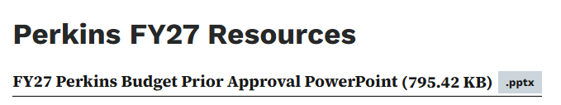
Webinar Questions/Clarifications
1. CTSO Student Travel Expenses - Submit on the October 16 Claim - Example to follow in this meeting.
FBLA June 29 – July 2, 2026
Airfare and Registration expensed to the Perkins FY 2026 allocation
June 29 and 30 expensed to the Perkins FY 2026 allocation: baggage, hotel, meals, parking, ground transportation, mileage.
    July 1 and 2 expensed to the Perkins FY 2027 allocation: baggage, hotel, meals, parking, ground transportation, mileage. Claim on October 15, 2026.
FCCLA July 6 - 10, 2026
Airfare and Registration expensed to the Perkins FY 2026 allocation
    July 6 - 10 expensed to the Perkins FY 2027 allocation: baggage, hotel, meals, parking, ground transportation, mileage. Claim on October 15, 2026.
FY 2027, CTSO student eligible costs after July 10, 2026 are limited to competitor registrations. Student attendee costs are ineligible
October 7 Slide Deck
October 7 Recording

Slide 6
Claim Due Dates FY 2027
Quarter | Date of Purchase, Service, or Activity | Claims Due | Warrant/Paid Date
1 | July 1 - September 30 | October 16 | November 3, 2026
2 | October 1 - December 13 | January 15 | February 2, 2027
3 | January 1 - March 31 | April 16 | May 4, 2027
4 | April 1 - June 30 | July 16 | August 3, 2027

Slide 7
Claim Submission Sequence
Create the Perkins Claim Template.
  Scan CTSO affiliated invoices to pdf and save (when applicable). CTSO invoices are the only documentation required for inclusion with submitted claims.
Create the claim in Iowa Grants .
Submit the claim for review and approval.
  Note: Never withdraw a claim. Contact Amy Vybiral or Jeff Fletcher with editing or correcting assistance.
  Always use a claim in “Editing” or “Correcting” status instead of creating a new claim.

Slide 8
Claim Templates
Perkins Resources - All FY 2027 Documents and Recordings
Tip - Share the inventory form with all colleagues receiving Perkins items. Enter purchases onto the inventory form the day that items are received (instructors, business managers)-
Secondary/Consortium & Community College templates
  Download the claim template
  Scan the CTSO invoices to pdf
Travel worksheet (No CTSO expenditures)
  This is for all levels of CTE staff and related Perkins content professional development.
CTSO Staff and Students Worksheet
  Enter Fiscal Agent (or Community College
  Enter School District (or Campus location)
  Insert Affiliation Membership invoices (when applicable).
  Insert first FCCLA invoice (Insert→object→create from file→browse and select→display as icon→OK)
  Insert secondary FCCLA Invoice
    Ineligible invoices - removed, template revised, Iowa Grants reduced, approved.
    Recipient notified.
    May submit an Iowa eligible CTSO invoice on a stand-alone claim or with on the next due date.
    Institutions may change between individual student memberships (district funded) and affiliated (Perkins funded) memberships from year to year with no supplanting issues.

Slide 9
Claim Templates
Salaries, Benefits & Sub Pay
  Keep it simple
  Last names only
  Job title
  Percentage - Ensure that the percentages for permanent positions are at the same percentage or less than the prior year to avoid supplanting.
  Substitute pay - use the last name of the substitute instructor.
Sec. 135 - Local Uses of Funds -Secondary and Community Colleges
  E6, E7, & E8 (Travel, Salaries, and CTSO Expenses) Auto populate - Do not duplicate
  Entity Description (Column A)
    Fiscal agent or community college name
    School district or college campus location

Slide 10
Claim Templates
Sec. 135 - Local Uses of Funds -Secondary and Community Colleges
  Perkins Activity (Column B)
    Activity
      1 - Career
      2 - Professional Development
      4 a - Secondary Academic Integration
      4 b - Postsecondary Academic Integration
      5 - Everything else (equipment, supplies, WBL CBE, IRCs, staff recruitment, blended & distance ed, IWD collaboration, community partnerships, business engagement).
      6 - Evaluation related to the comprehensive local needs assessment (CLNA).
  Extended Description (Column C) - default or your selection.
  Item Purchased - Keep it simple. (Only enough so anyone can determine eligibility. Drill, AET subscription, CNC router, real care babies, DJI Air 3 Drone) “FASC-prohibited unmanned aircraft system”
  Admin
    Costs associated with the administration of the grant.
    Budget code “Salaries and Benefits”
    Zoom trainings, claim submissions, reimbursement disbursements, grant writing, CLNA, data review, ordering, inventory list, checking allowable costs (ineligible drones).
  Assurances
    Federal requirements
    Read and provide professional development for all administrators and CTE staff (counselors, administrators, instructors, staff, tutors, etc.)

Slide 11
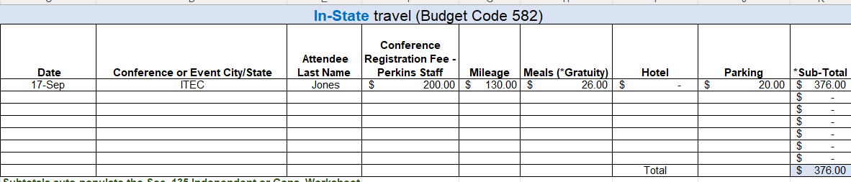
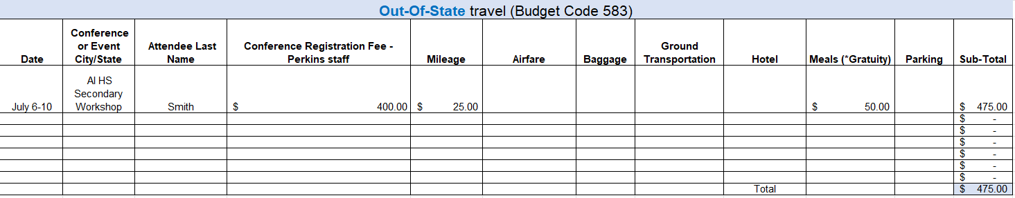
Additional Worksheet and Travel
CTSO dedicated worksheet and updated Assurances - Do not use the FY 2026 template. The claim will be returned.

Slide 12
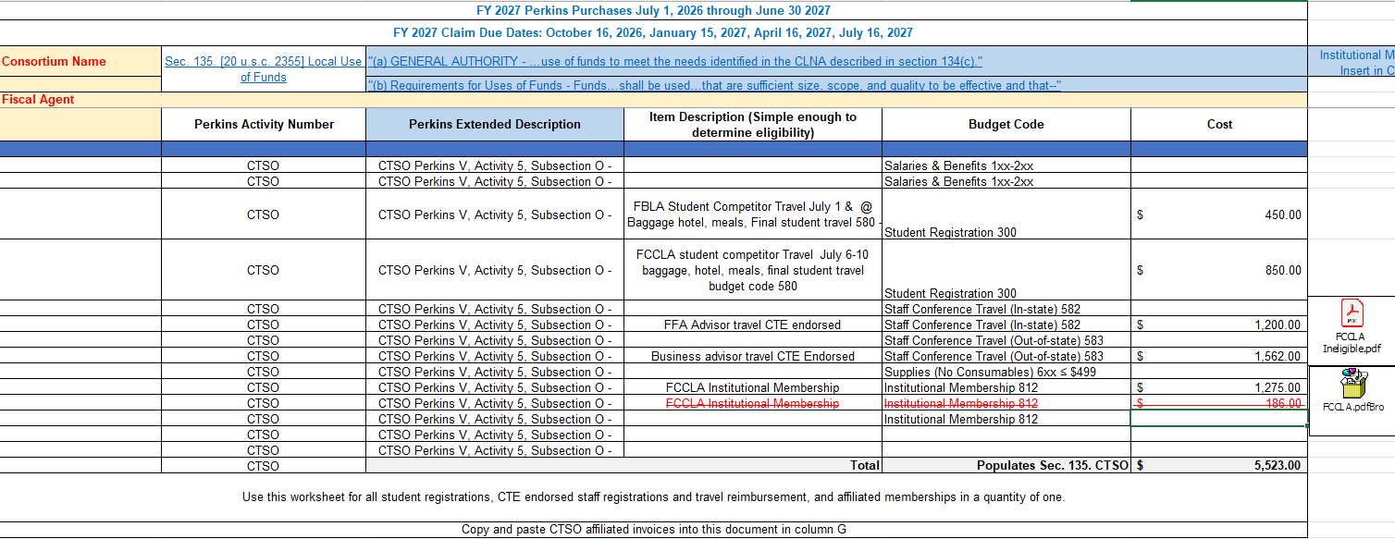
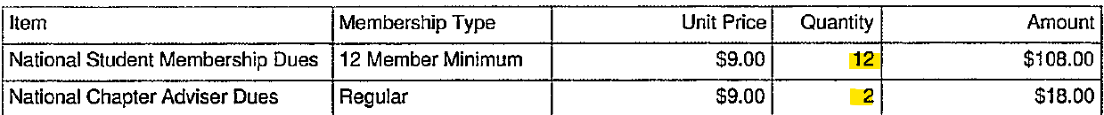
CTSO Staff & Students
Quantities of more than one are ineligible for reimbursement.

Slide 13
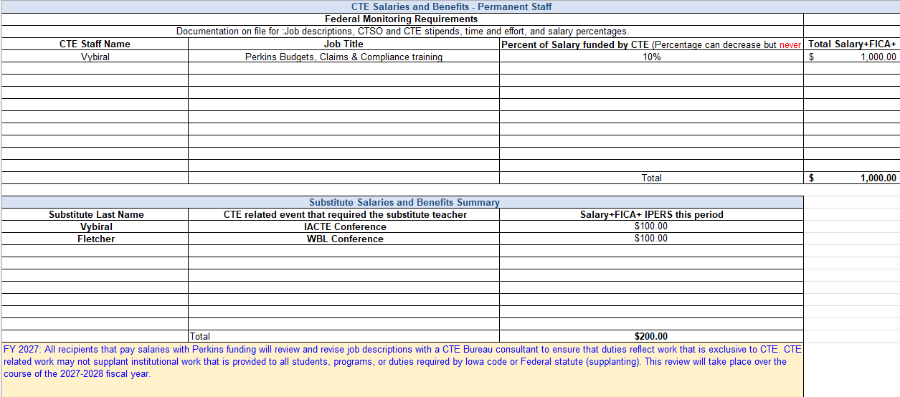
Salaries & Benefits

Slide 14
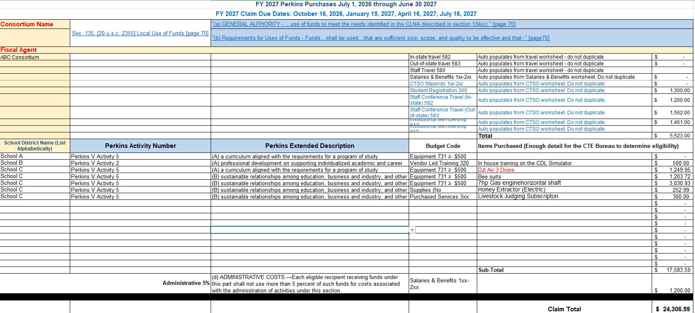
Sec. 135. Use Of Funds
Ineligible FCCLA invoice removed, total reduced, updated template will be emailed to all Perkins contacts listed on the application and claim form.

Slide 15
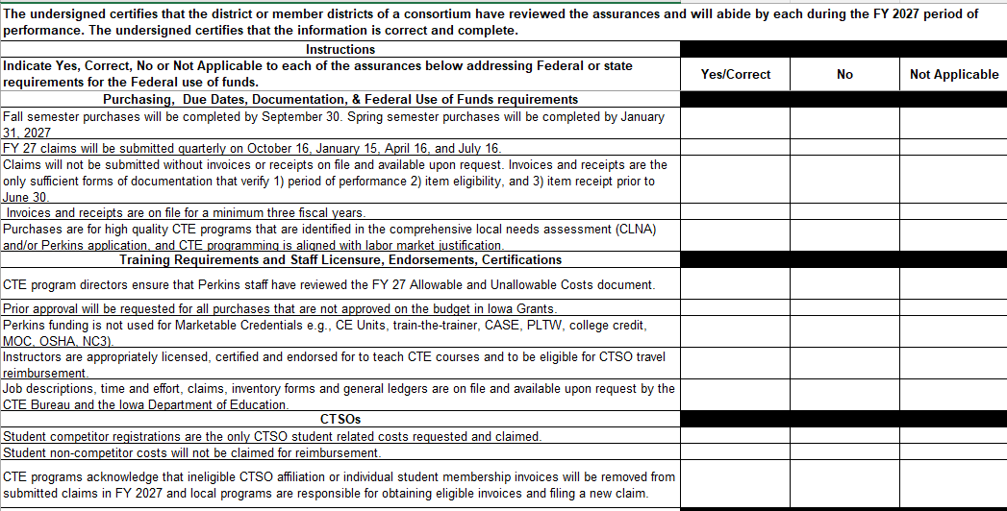
Assurances

Slide 16
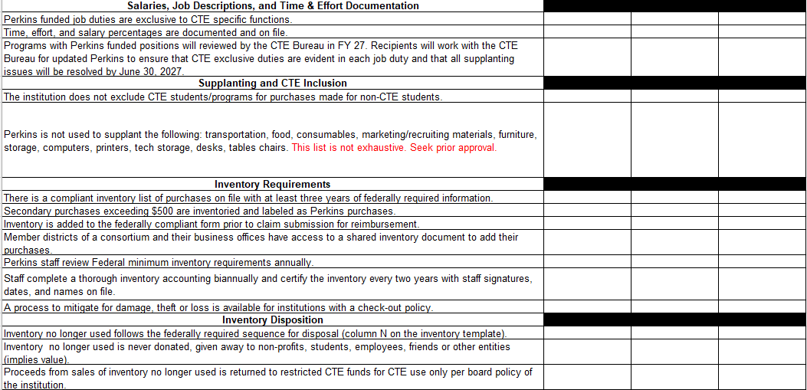
Assurances
Community College -Includes PRWORA. Review only.

Slide 17
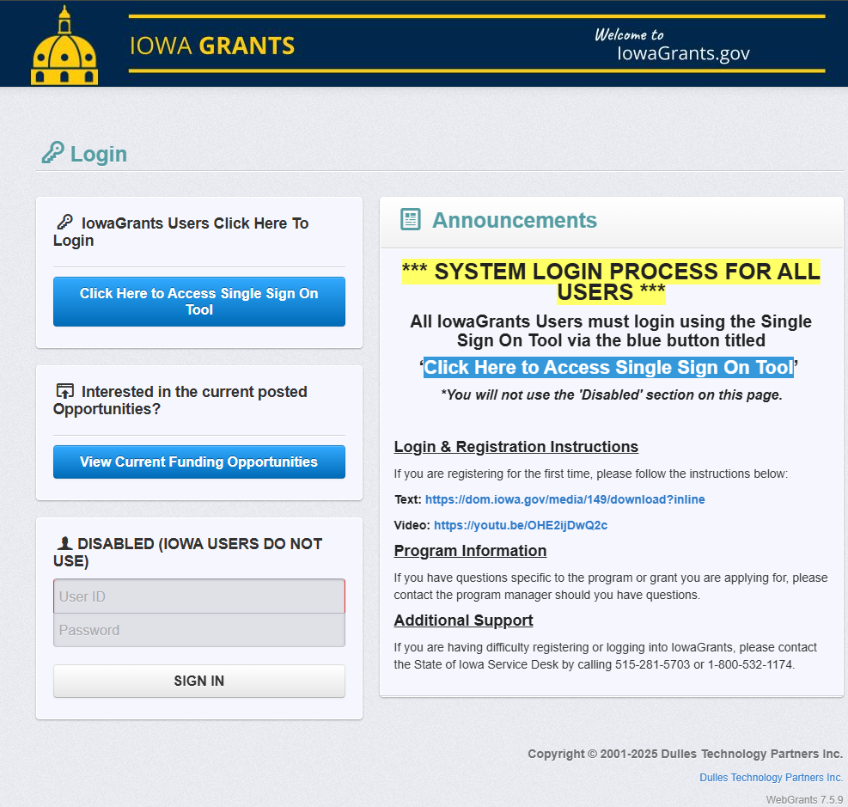
Create the claim in Iowa Grants

Slide 18
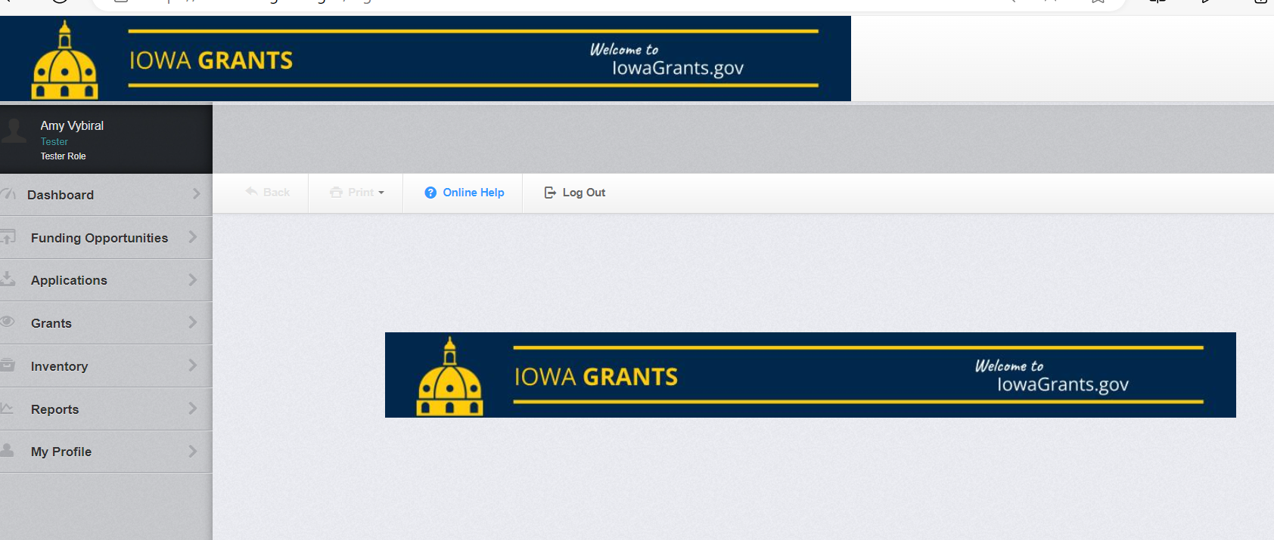
Create the claim in Iowa Grants
Select “Grants”

Slide 19
Create the claim in Iowa Grants
Select the application
Remember to select 2027 - 2026 might not be closed yet.

Slide 20
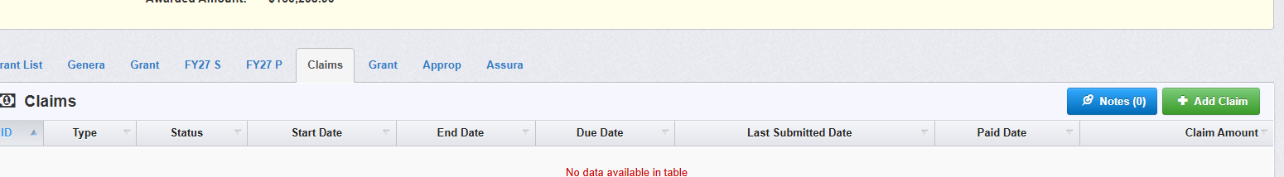
Create the claim in Iowa Grants
Select Claims
Add a claim
Do not withdraw claims. Contact amy.vybiral@iowa.gov for assistance. Always use claims in editing and correcting status before opening a new claim.

Slide 21
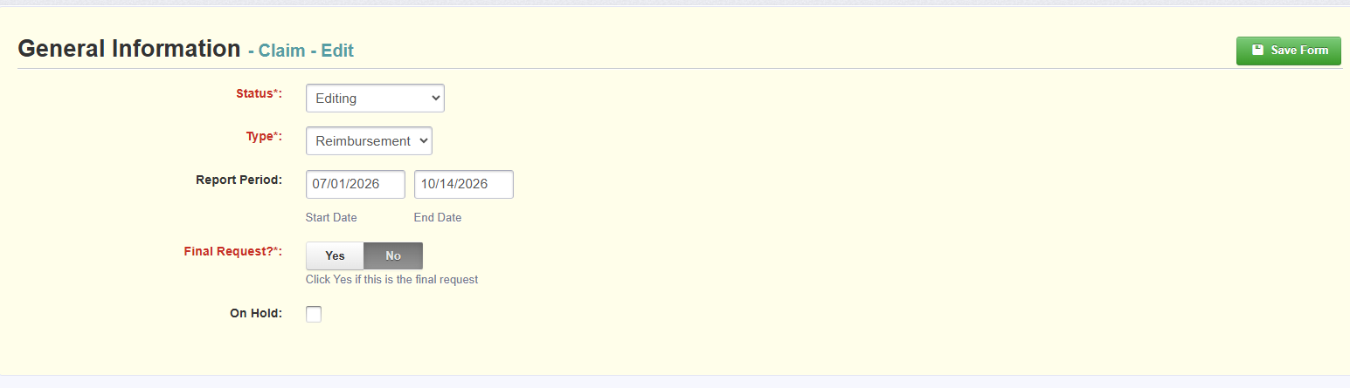
Create the claim in Iowa Grants

Slide 22
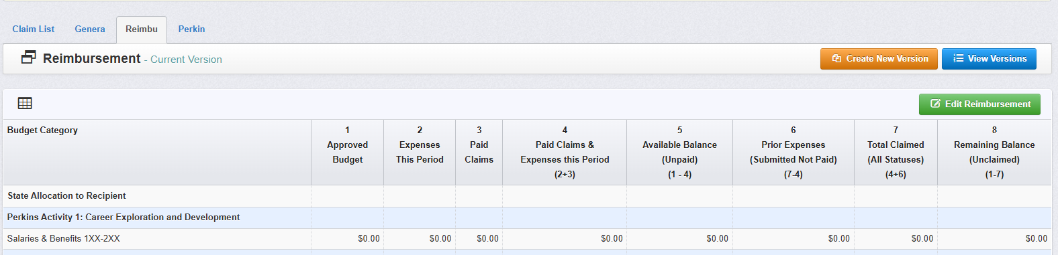
Create the claim in Iowa Grants

Slide 23
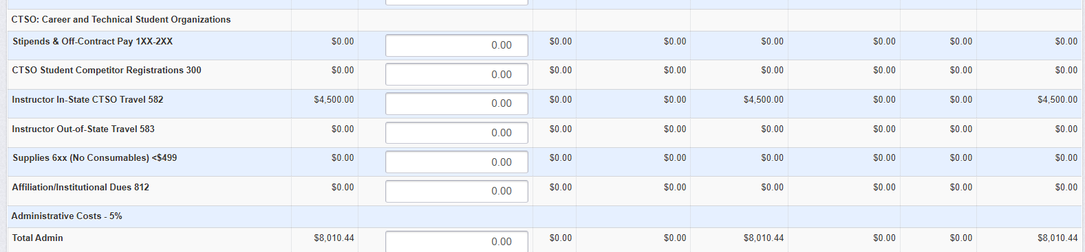
Calculate totals for all activities before entering budget

Slide 24
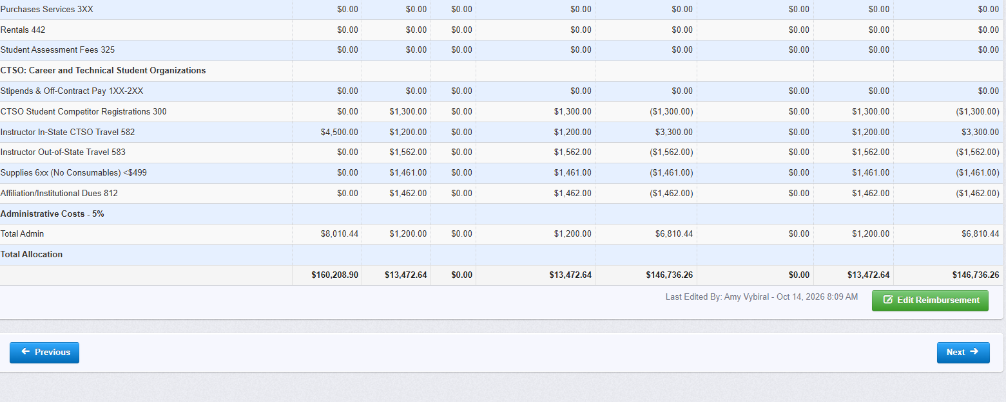
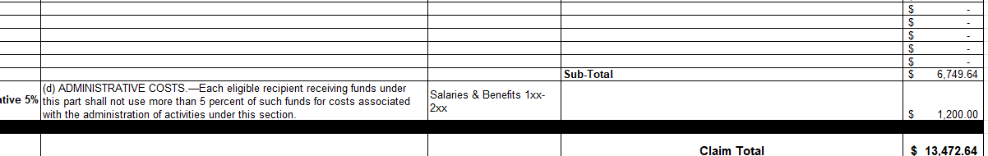
Iowa Grant and Claim Template totals must align when the claim is submitted.

Slide 25
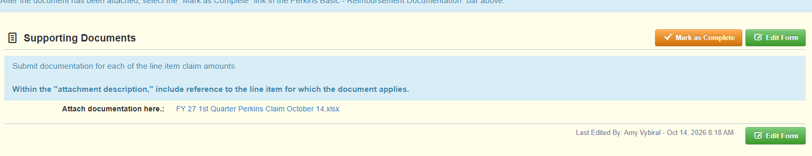
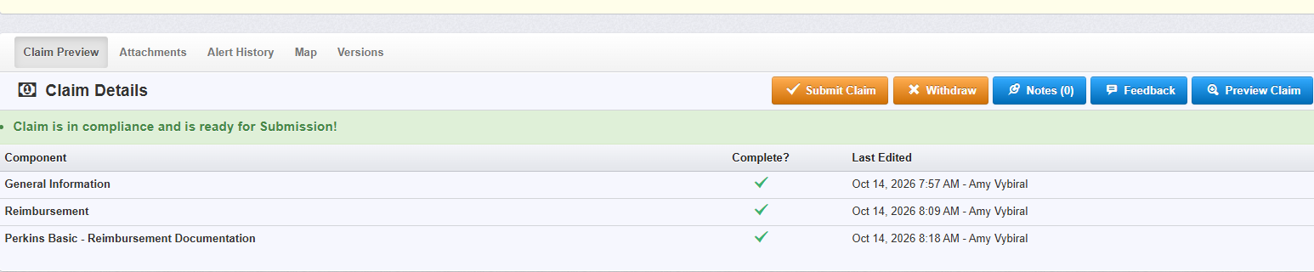
Upload documentation and submit claim
Upload claim template and mark as complete. Final step - Submit claim.

Slide 26

Amy Vybiral, MS Ed
Education Program Consultant - Perkins Budgets, Claims and Monitoring Processes
Bureau of Career Technical Education & Postsecondary Readiness
Iowa Department of Education
Grimes State Office Building
400 East 14th Street
Des Moines, Iowa 50319-0146
Cell: (515) 339-4520
amy.vybiral@iowa.gov

