Slide 1

Special Education Policy and Practice Webinar Series
IEP Team Member Roles and Responsibilities

Slide 2

Welcome
Questions?
  Please submit questions using the webinar Q & A
Slide note catcher will be shared in chat at the beginning of each webinar
Slides will be posted on the DE website after the webinar
Policy & Practice Webinar Series & Recordings | Department of Education

Slide 3
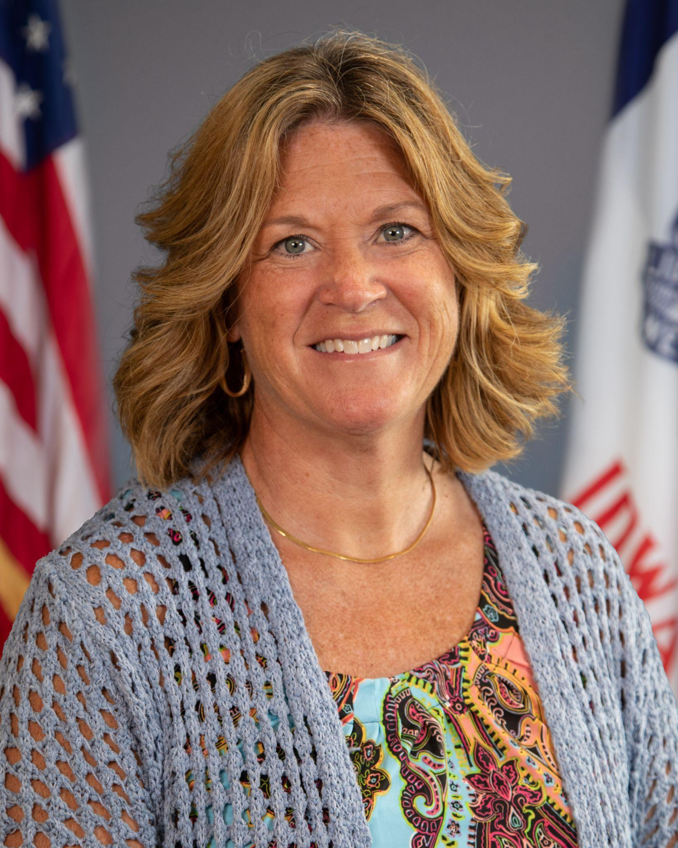
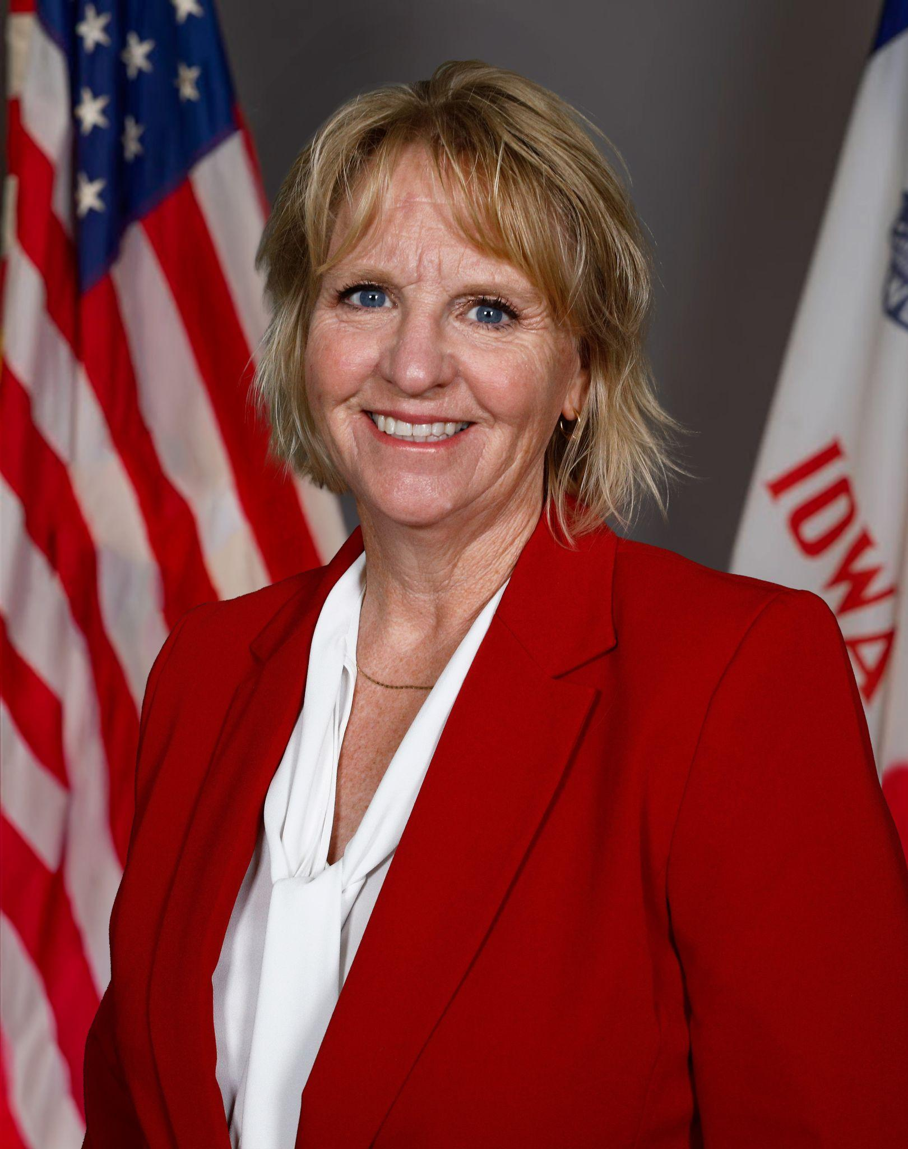
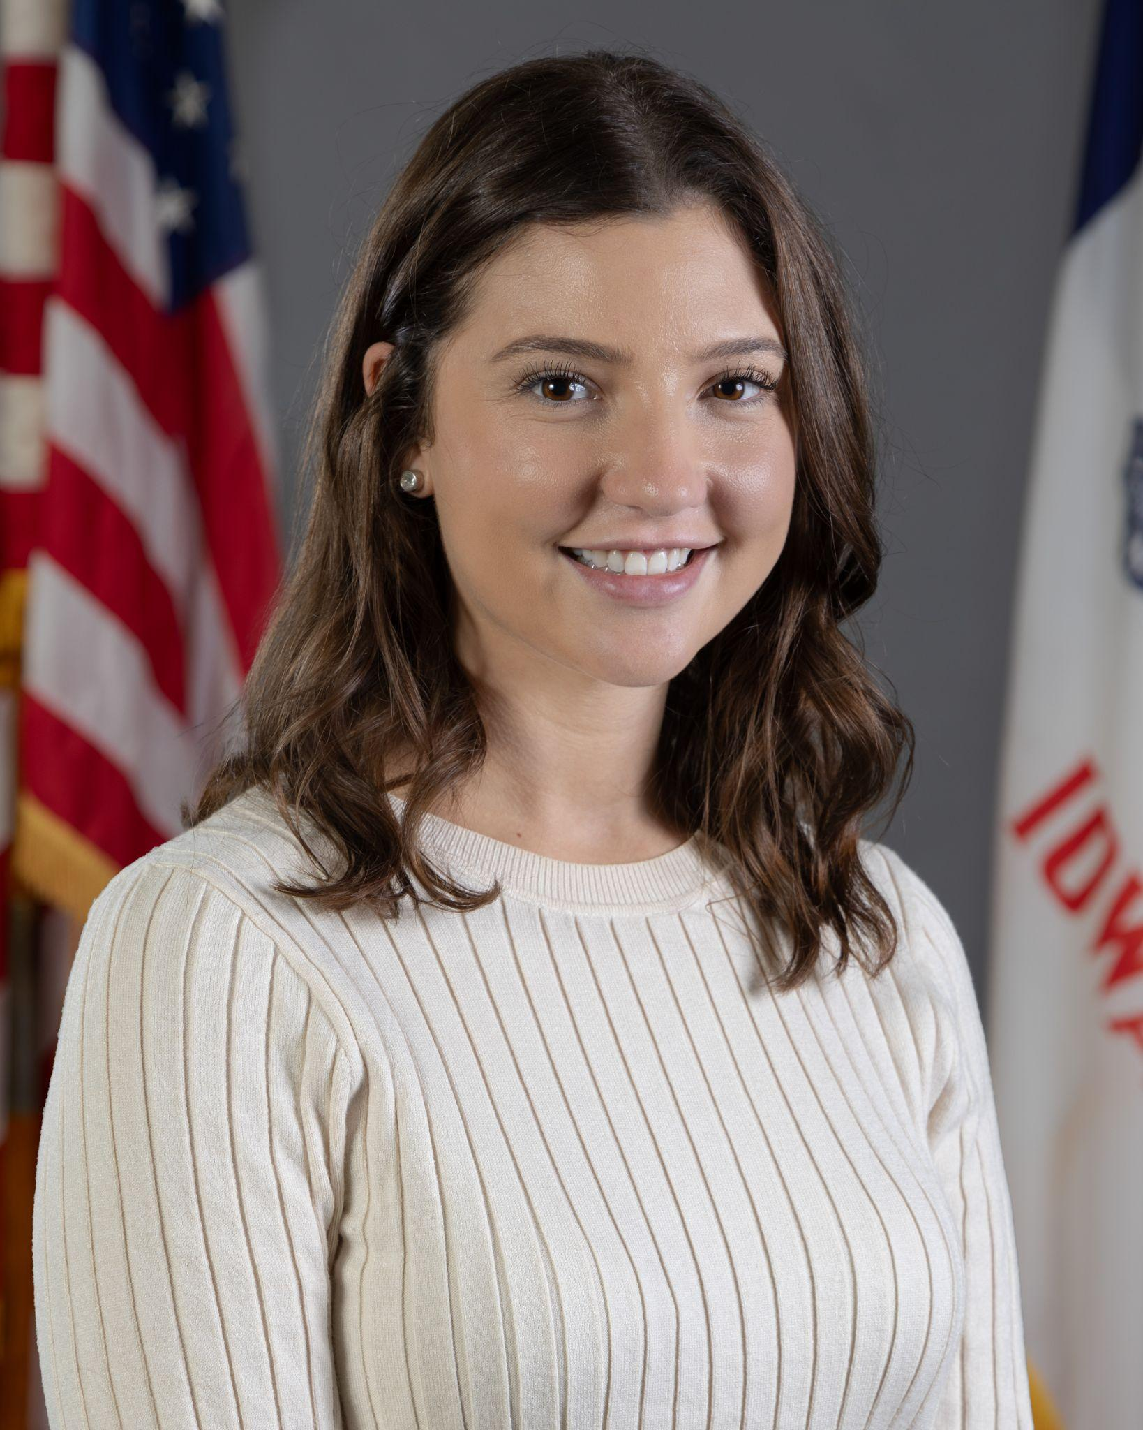
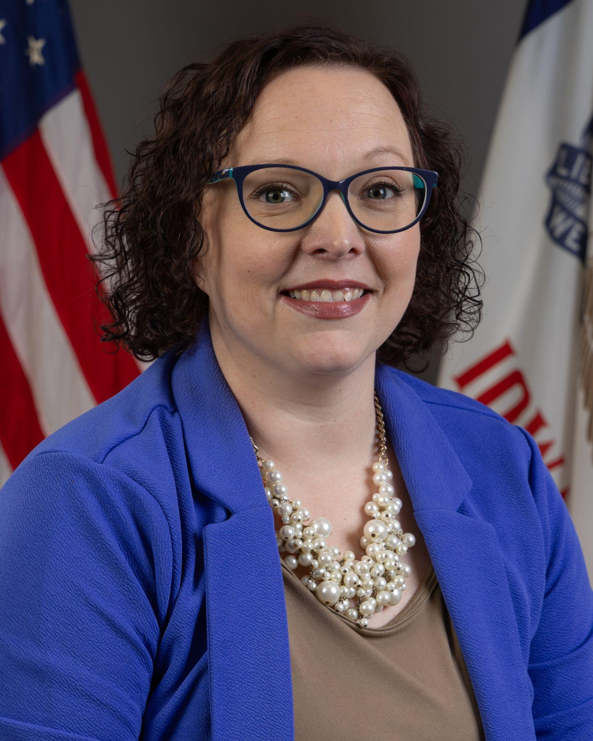
Today’s Presenters
Name: Molly Elston
Title: Regional Special Education Director-Prairie Lakes,
Division of Special Education
Name: Michelle Havenstrite
Title: Regional Special Education Director-Northwest,
Division of Special Education
Name: Rachel Bosovich
Title: Attorney II
Division of Special Education
Name: Shannon Grundmeier
Title: Education Program Consultant, ACHIEVE
Division of Special Education
Education Program Consultants that contributed to today’s session: Andrea Raber

Slide 4
Participants will:
Understand those who are required and discretionary IEP team members
Understand when written documentation is required, how attendance is documented, and when an IEP team member can be excused
Determine who can fill the role of parent and how this is documented
Understand how an IEP team functions to make collaborative decisions for the purpose of providing a FAPE

Slide 5
IEP Team Participants

Slide 6
Required Participants
Parent(s)
General Education Teacher
Special Education Teacher
Representative of the Public Agency
Individual who can interpret evaluation results
*Student-when appropriate
*Students aged 13-21 must be invited to their IEP meeting when the purpose is consideration of needed transition services

Slide 7
Meeting Attendance and Agreement to Excuse
All required IEP team members are expected to attend the entire IEP meeting.
IEP team members who would fill required roles must be excused if unable to attend.
There are two ways that an IEP team member can be excused:
An IEP team member’s attendance is not necessary. This means that the team member's area of expertise is not being discussed.
The IEP team member’s area of expertise will be discussed and their input will be provided in writing.
Both require written Agreement to Excuse

Slide 8
Discretionary Participants
It may be appropriate for IEP teams to invite other individuals who have knowledge or special expertise regarding the child.
These individuals may include but are not limited to:
Licensed Health Professionals
School Counselor
School Social Worker
Special Education Consultant
Educational Interpreter
Employers
Private Counselor
Discretionary Participants need to be included on the Meeting Notice

Slide 9
Senate File 2428
Paraeducators
At least one paraeducator or other district employee who assists a teacher in providing classroom instruction to a student who has an IEP or 504 plan must attend all meetings related to the student's IEP or 504 plan.
This requirement applies only when the students receives paraeducator services
Additional attendees at the IEP meeting following the first removal
If practical, the removing teacher, other teachers who instruct the student, and district employees without a BOEE license directly involved in the conduct
If unable to attend: review the minutes/summary and provide written acknowledgment.
Attendance required under state law ≠ required IEP team member under IDEA

Slide 10
IDEA Parent

Slide 11
“Parent” under the IDEA
Biological or adoptive parent
Authorized guardian
generally authorized to act as the parent, or authorized to make educational decisions
An individual acting in place of a biological/adoptive parent
including a grandparent, stepparent, or other relative with whom the child lives or an individual who is legally responsible for the child's welfare;
Appointed Surrogate
may include a foster parent, appointed under 281-41.519 or 20 U.S.C. 1439(a)(5).
Iowa Admin. Code 281- 41.30.

Slide 12
“Parent” Under IDEA
Biological or adoptive - parent presumption
The biological or adoptive parent must be presumed to be the parent for purposes of IDEA unless the parent does not have legal authority to make educational decisions for the child.
Court orders
If a judicial decree or order identifies a person to act as the parent or make educational decisions, then that person shall be the parent for purposes of IDEA.
Agencies & official personnel are excluded
Public or private agencies involved in the child’s education or care, and their employees/contractors acting in their official capacity, do not qualify as the IDEA parent.

Slide 13
Surrogate Parent
When to consider whether a surrogate is needed:
No IDEA parent can be identified
A parent cannot be located after reasonable efforts
The child is a ward of the state
The child is an unaccompanied homeless youth
Two appointment routes:
AEA Appointment - when no parent can be identified or reasonably located
  The AEA selects the surrogate, or
  HHS designates the foster parent, who completes the same appointment process
Court Appointment - when the child is a ward of the state
  The judge may not appoint an employee of an agency involved in the care or education of the child, including an HHS caseworker.
Special rule for unaccompanied homeless youth: appropriate staff of emergency shelters, independent living centers, transitional shelters, and street outreach programs may serve temporarily as a surrogate until a fully qualified surrogate parent is appointed. This applies to Part B only.

Slide 14
Divorced / Separated Parents
Physical Custody vs Legal Custody
Legal Custody relates to decision-making rights
Physical Custody relates to physical care, such as a child’s home and routine care
Presume joint legal custody (equal decision making rights) unless an order/decree provides otherwise
Protective Orders
When both parents retain relevant rights, arrange lawful participation consistent with the order.
IEP Meetings
One IEP team and one coordinated process.
Do not hold different meetings.
Step Parents
Marriage to a parent alone does not qualify an individual as the IDEA parent

Slide 15
Consent / Revocation of Consent
Divorced/ Separated Parents
“If a parent who has legal authority to make decisions about the child’s education revokes consent, services must cease even if the other parent disagrees .” Letter to Cox, OSEP
Special rule: Initial Evaluations ONLY (Part B) If the child is a ward of the state and is not residing with the child’s parent, the public agency is not required to obtain consent from the parent if:
  Despite reasonable efforts, the public agency cannot locate the parent
    Document reasonable efforts
  Parental rights have been terminated
  The rights of the parent to make educational decisions have been subrogated by a judge and consent for an initial evaluation has been given by an individual appointed by the judge to represent the child
HF644 & consent to services
The language providing HHS with the ability consent to services conflicts with IDEA and therefore should not be implemented. Federal law controls under the Supremacy Clause.

Slide 16
ACHIEVE
Notes:
.

Slide 17
Identifying Parents in ACHIEVE
In Federal Statute/State Code, “Parent” means: | In ACHIEVE, “IDEA Parent” relationship type means:
Biological or adoptive parent | Parent (Biological or Adoptive) Upon age of majority/date of rights transfer prior to 18: Learner Power of Attorney
A guardian authorized to act as parent or make educational decisions | Legal Guardian of Minor Upon age of majority: Legal Guardian of Protected Person
An individual acting in the place of a biological or adoptive parent with whom the child lives or individual who is legally responsible for the child’s welfare | Relative Acting as Parent (IDEA)
A surrogate parent appointed in accordance with 41.519 | Court Designee (Court-Appointed) Surrogate (Appointed by AEA)

Slide 18
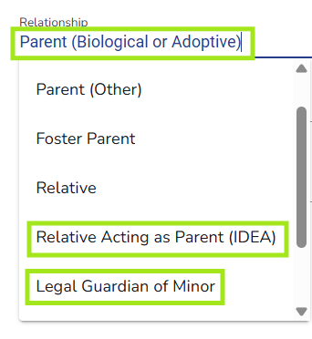
Assigning IDEA Parent Roles: Family Contact Stepper
Roles Assigned by Case Owner:
Parent (Biological or Adoptive)
Relative Acting as Parent (IDEA)
Legal Guardian of Minor
Court Designee* (will be replaced by Court-Appointed Surrogate)
Roles Assigned by ACHIEVE Users with Permission to add Surrogates:
Surrogate (Regionally appointed by AEA)
Court-Appointed Surrogate* (will replace Court Designee soon)
Role Automatically Assigned by ACHIEVE:
Learner (18th birthday or upon transfer of rights prior to age 18)

Slide 19
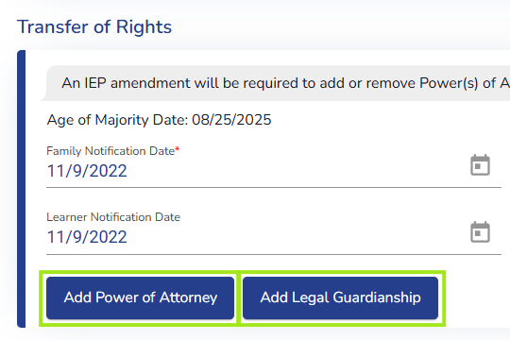
Assigning IDEA Parent Roles in ACHIEVE: PLAAFP
Roles Assigned via Case Owner on PLAAFP section of IEP after learner reaches Age of Majority:
Legal Guardian of Protected Person
Power of Attorney

Slide 20
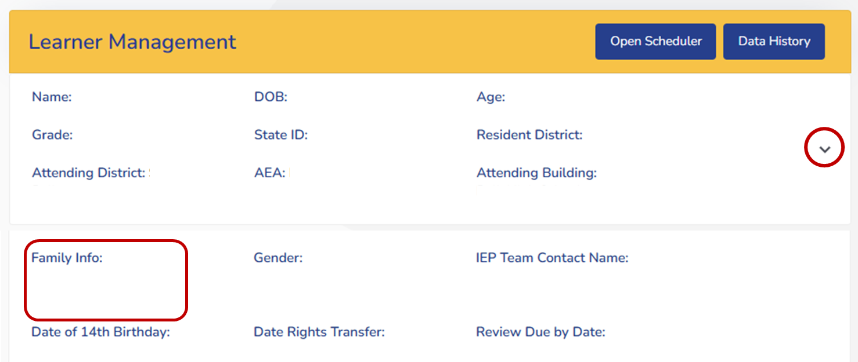
IDEA Parent(s) at a Glance: Learner Management
Family contacts who meet IDEA Parent criteria are displayed on Learner Management
Select the Expand accordion icon to review IDEA Parents in the Family Info section

Slide 21
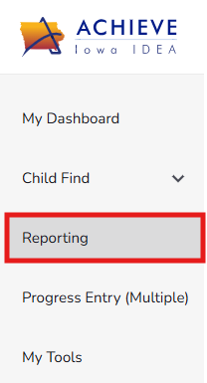
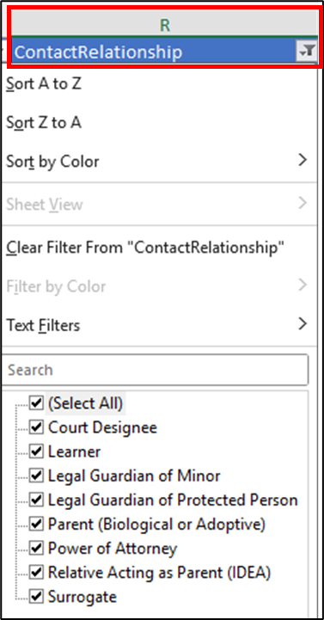
IDEA Parent(s) Details: Family Contact Validation Report
Review family contacts with an IDEA Parent relationship type in the Family Contact Validation Report
EA - Family Contact Validation Report
SE - Family Contact Validation Report
Column R in both reports displays Contact Relationship details

Slide 22
Making Collaborative IEP Decisions

Slide 23
Effective collaboration begins before the meeting
Create a shared understanding of who is on the IEP team
  Invite participants by role and name
  Inform about why they were invited (contributions/perspective/expertise)
Establish a mutually agreed-upon time and location
Clarify the purpose of the meeting
Create conditions for meaningful participation
Begin with the shared goal: Meeting the needs of the student and providing FAPE

Slide 24
Team Decision-Making
The goal isn’t simply agreement
It’s a well-informed team decision focused on the learner.
Share
Information
Consider
Needs
Discuss
Options
Make
Decisions
Provide FAPE

Slide 25
Responsibility for FAPE
LEA is ultimately responsible for ensuring FAPE
Team members contribute to the decision-making process
LEA must ensure that the IEP:
Addresses the learner’s identified needs
Includes appropriate services and supports
Is implemented as written
Provides the learner with FAPE

Slide 26
Documentation supports the collaborative process
Consider: What decisions were discussed? What information was considered? What did the team agree upon?
Use the Prior Written Notice (PWN) to restate what is in the IEP so everyone has a clear understanding of:
What was discussed?
What data was used to make the decision?
What was agreed upon or decided including what services/supports will be provided?

Slide 27
AEA and LEA Working Together
One Learner. One Plan. One Team.
AEA and LEA team members bring different perspectives, expertise and responsibilities
Related services are part of the IEP team’s collaborative process and should not be made in isolation
Effective collaboration means:
Clearly understanding each person’s role
Sharing relevant information
Planning together
Coordinating services and supports
Making decisions as a team

Slide 28
Reminder: Keep Resident District Connected
When a learner receives services through a different attending district and/or a nonpublic school:
Consider how the resident district is included in communication and decision making
Ask:
Who is responsible for each part of the process?
Who needs to be at the table?
How will information be shared?
How will services be coordinated?
How will responsibility for FAPE be monitored?

Slide 29
Collaborative Decisions Recap
Collaboration begins before the meeting
Invite the right people
Clarify roles and contributions
Share information and expertise
Make decisions as a team
Document what was decided
Coordinate services and implementation
Ensure FAPE

Slide 30
Questions from the field
Please add your questions in the Q & A.

Slide 31
Future Policy and Practice Webinars
Upcoming Topics and Dates (9:00 am - 10:00 am)
November 18, 2026: Appropriate Duties of Paraeducators
December 9, 2026: Accessible Educational Materials
January 13, 2027: A Deeper Dive into Secondary Transition

Slide 32
Thank You!

