Slide 1
Dispute Resolution: Resolving Conflict, Mediation, State Complaints and Due Process
Iowa Students with Disabilities Parentally Placed in Accredited Nonpublic Schools

Slide 2
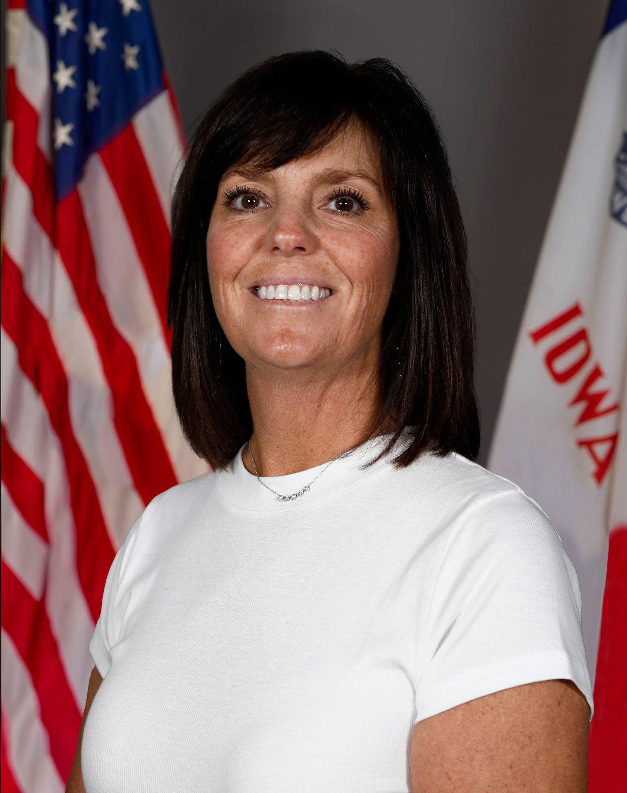
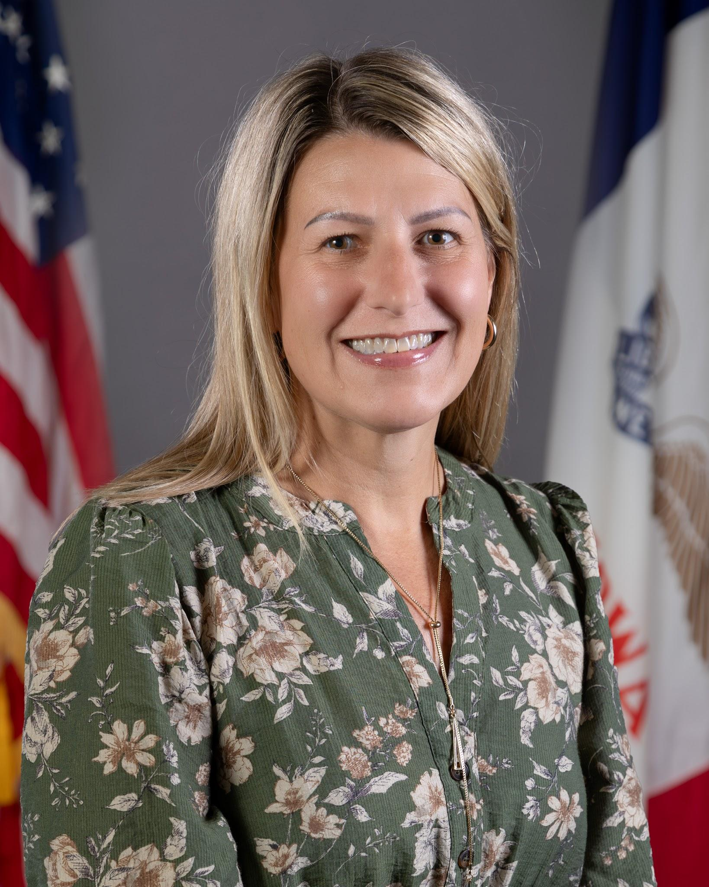
Today’s Presenters
Janelle Danner
Nonpublic School Liaison
Jennifer Cira
Dispute Resolution Coordinator

Slide 3
Overview of Today’s Content
Building strong systems
Understand why conflict occurs
Explore strategies that strengthen collaboration
Identify characteristics of effective written systems
Develop processes for addressing concerns
Understanding dispute resolution
Mediation
State Complaints
Due Process
Our Goal: Create written systems that support collaboration, communication, transparency, and trust that address conflict before it escalates

Slide 4
Building Strong Systems

Slide 5

Conflict Is Inevitable in Complex Systems
Conflict often emerges from:
Communication breakdowns
Misunderstandings
Differing expectations
System limitations
Implementation challenges
"The single biggest problem in communication is the illusion that it has taken place." -George Bernard Shaw

Slide 6


Strong Sustainable Systems
Clear written documentation and detailed structured systems act as a blueprint for cooperation and collaboration. When roles, processes, and agreements are written down, they remove assumptions and prevent friction before it can even start.

Slide 7
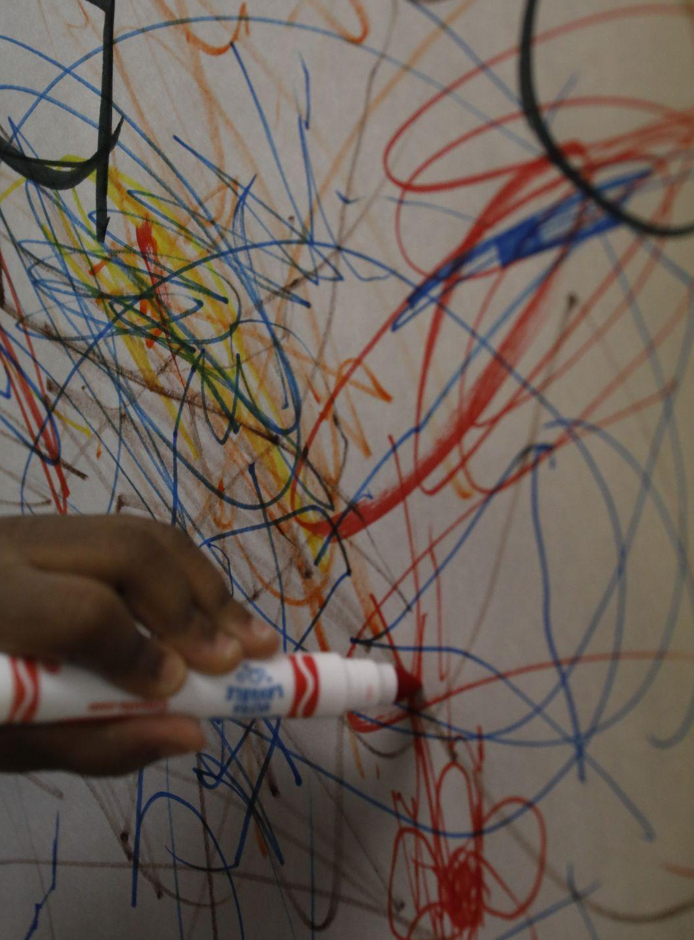

Preventing Conflict Through Strategic System Design
Cross-School Special Education Delivery

Slide 8
Pillars of Collaboratively Written Systems
Unclear Roles
Clear Roles and Commitments
Misaligned Goals
Aligned Goals
Unclear Decision Rights
Clear Decision Rights
Openness, Shared Understanding, and Trust
Competing Priorities
Effective Communication
Poor Communication
Culture of Continuous Improvement
Siloed Teams

Slide 9
When Conflict Does Arise
Have a process for addressing concerns early
Be willing to reconsider your own understanding
Seek to understand the concern in the context of student needs, IDEA, and the local system
Review systems
Keep communicating
Use a neutral third party as another tool within the process
Use formal dispute resolution when the concern cannot be resolved

Slide 10
Supporting Parents and Families
Build trust before a problem occurs
Families are the experts on their children
Listen to understand, not to respond
Understand from the family’s perspective
Educate teams about the grief associated with having a child with a disability
Take time to help parents understand the multiple systems in place that support special education when it is provided in an accredited nonpublic school

Slide 11
Formal Dispute Resolutions
Mediation | State Complaint | Due Process

Slide 12
State Mediation
Voluntary
Confidential
Impartial mediator assigned by the Department
Mediator facilitates the parties' efforts to reach an agreement
Mutually agreeable resolution
Written agreement is legally binding if reached

Slide 13
State Complaints
Formal written complaint
Investigates alleged IDEA violations
Investigated by the Department
Any individual or organization may file
State complaint investigator makes the final decision
Corrective action required if a violation is found

Slide 14
Due Process
Formal legal process
Addresses disputes about identification, evaluation, placement, or FAPE
Parent or school/public agency may file
Administrative law judge conducts the hearing
Parties present information and arguments
Administrative Law Judge makes the final decision

Slide 15
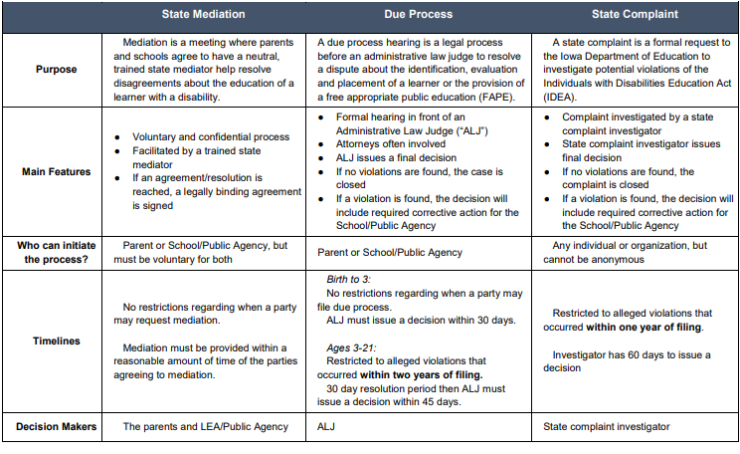
IDEA Dispute Resolution Comparison Table

Slide 16
Wrap Up

Slide 17
Wrap-Up/Key Takeaways
Conflict is inevitable. How we respond to it is part of the system.
        Build intentionally.
    Communicate clearly.
    Document shared understandings in writing.
    Address concerns early.
    Keep working toward resolution.
    Know the formal options: Mediation, State Complaint, Due Process.
Strong written systems help schools and families navigate complexity while keeping students at the center.

Slide 18
Resources and References
Policy and Practice Webinar Series Recordings - May 13th, 2026: Dispute Resolution webinar
IDEA Dispute Resolution Comparison Table
Dispute Resolution Summary
Procedural Safeguards Manual- Rights of Students with Disabilities Ages 3-21
Iowa Department of Education- Dispute Resolution -contains guides for families, request forms, agreement to hold resolution meeting form, and detailed information about all 3 dispute resolution options

Slide 19
Q&A

Slide 20
DEPARTMENT OF EDUCATION
SPECIAL EDUCATION
ACCREDITED NONPUBLIC SCHOOLS

Slide 21
Next Webinar- NOVEMBER
Special Education Funding and Contracts For Services
Tuesday, November 3, 2026
9:00-10:00 am
Same Zoom link
Zoom using passcode 431127
Foundations of special education funding as it relates to students enrolled in accredited nonpublic schools, and contracting arrangements for the provision of services, including the continuing responsibilities of public schools for fiscal oversight, accountability and compliance.

Slide 22
Thank You!!
janelle.danner@iowa.gov

