Slide 1
Class Size Reduction
Title II, Part A—Supporting Effective Instruction
Bureau of ESEA Programs
Amy Hensley

Slide 2
Overview
The purpose of today’s webinar is:
Provide school districts with information on the allowable activity, class size reduction, in Title II, Part A - Supporting Effective Instruction.
Ensure federal programs are effectively implemented according to federal guidance.

Slide 3
Purpose
The purpose of Title II, Part A is to
Increase student achievement consistent with the challenging State academic standards;
Improve the quality and effectiveness of teachers, principals, and other school leaders;
Increase the number of teachers, principals, and other school leaders who are effective in improving student academic achievement in schools; and
Provide low-income and minority students greater access to effective teachers, principals, and other school leaders. (Section 2001 of the ESEA).

Slide 4
Class Size Reduction
Reduce class sizes through hiring additional effective teachers, based on evidence of improved student achievement - 2103(b)(3)(D)

Slide 5
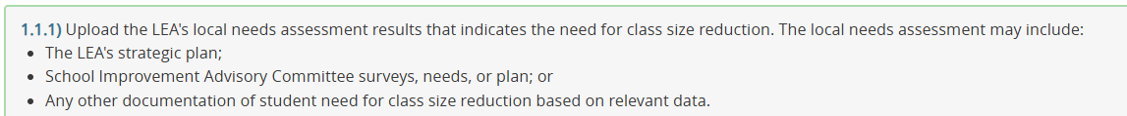
Needs Assessment
Data
  Enrollment numbers
  Assessment results
  School improvement report
Clearly outline the LEA’s need
Evidence based size to increase student achievement
Upload to CASA

Slide 6
District Policy
Title II, Part A allocations may only be used to supplement State and Local programs (ESEA § 2301)
Local Policy
  Review to determine potential allowability
  May reduce below the local student to teacher ratio

Slide 7
Highly Effective Teachers: Class Size Reduction
Identify the teacher(s) and grade level | Grades K-3 only One CSR teacher per grade per building Must hold a Standard or Master Teacher license. Initial and substitute licenses are not eligible.
LEA confirmation | LEAs must confirm that the teacher listed in the application is highly effective

Slide 8
Allowable Activities: Class Size Reduction
Class Size Reduction (LEA only)
Reduce class sizes through hiring additional effective teachers, based on evidence of improved student achievement 2103(b)(3)(D) | Title IIA funds may be used to reduce class size if the initiative meets all the following criteria, which have been established by scientifically-based research and have been based upon a needs assessment. The impact on student achievement must be measurable. Based on local needs assessment; and Must reduce class size to a reasonable, evidence-based level, to further student achievement; and In grades kindergarten through third grade (K-3); and In classes taught by highly-qualified and highly-effective teachers who adjust instructional strategies to fit reduced class size. | K-3 teachers

Slide 9
Contact Information
Amy Hensley
Education Program Consultant
amy.hensley@iowa.gov
515-689-9749

