Slide 1
Perkins V Accountability
Understanding and completing your Perkins V performance plan.

Slide 2
Thank you for joining us
The webinar will be recorded
The slide deck will be shared
We will have limited time for questions at the end
You may also ask your questions in chat, our team will be providing answers in either real time or via follow up email
Please be mindful of your mic
Please consider having your Perkins performance email letter accessible on another screen or device.

Slide 3
Perkins V Performance Plans
A prompt to look closer-NOT a red alert
The goal is to understand the result, choose reasonable actions, and monitor improvement

Slide 4

Today’s Webinar
Understanding Perkins accountability and state determined levels of performance
Read a performance letter without getting lost in the codes
Know when a plan is required
Build a useful improvement plan
Special topic 4S1
Leave knowing where to get help
We will hold time for questions, examples, and local “what do I do next?” discussion.

Slide 5
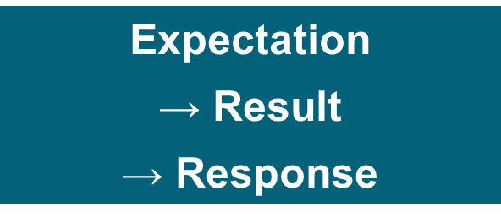
Performance Levels
Iowa has approved performance levels for Perkins indicators.
Recipients receive annual results and compare performance to the applicable threshold.
When a result falls below the 90% threshold, the recipient completes a performance improvement plan.
The plan documents what you will look at, what you will do, who is responsible, and how you will know whether the work is helping.

Slide 6
Who is Counted?
Secondary
Postsecondary
CTE participant
0.5 or more units within a CTE program
CTE participant
1.0 or more credits within a CTE program
CTE concentrator
2.0 or more units within a CTE program
CTE concentrator
12.0 or more credits in a CTE program,
or completed a CTE program, if fewer than 12 credits.
The indicators in the performance letter focus on CTE concentrators.

Slide 7
Indicator Codes
Secondary
Postsecondary
1S1
Four-year graduation rate
1P1
Post-program placement
2S1
Reading/language arts
2P1
Earned recognized postsecondary credential
2S2
Mathematics
3P1
Nontraditional concentration
2S3
Science
3S1
Post-program placement
4S1
Nontraditional concentration
5S1
Recognized postsecondary credential
5S3
Work-based learning
Notes:
Timing: 4 minutes. This is for recognition, not memorization. Point participants to the indicator reference linked in the performance letter for precise numerator, denominator, and student population definitions.

Slide 8
The 90% Threshold
90% of the approved target = the plan threshold
Indicator | Target | 90% threshold | Actual | Met? | Plain-language read
2S1 ELA | 69.38% | 62.44% | 65.39% | YES | Below the full target, but above the 90% threshold
2S3 Science | 65.86% | 59.27% | 56.87% | NO | Below the 90% threshold; plan required
4S1 Nontraditional | 27.19% | 24.47% | 24.36% | NO | Below the 90% threshold; plan required
It is not a requirement that every actual result be 90%.
Notes:
Timing: 5 minutes. Slow down here. Emphasize that 90 percent threshold means 90 percent of the approved target, not a student outcome of 90 percent. Use the ELA example to show that a result can be below the full target but still meet the threshold.

Slide 9
Secondary SDPLs: Where the Targets Are Going
State Determined Performance Levels
Iowa’s approved secondary SDPLs show the expected trajectory across the Perkins plan—not just a single-year number.
current year
Indicator
PY 2024–25
PY 2025–26
PY 2026–27
PY 2027–28
PY 2028–29
1S1 Four-year Graduation Rate
94.00%
95.00%
96.00%
97.00%
98.00%
2S1 Reading/Language Arts
69.38%
70.38%
71.38%
72.38%
73.38%
2S2 Mathematics
66.19%
69.57%
70.57%
71.57%
72.57%
2S3 Science
65.86%
66.86%
67.86%
68.86%
69.86%
3S1 Post-Program Placement
90.03%
91.03%
92.03%
93.03%
94.03%
4S1 Nontraditional Concentration
27.19%
27.20%
27.30%
27.40%
27.50%
5S1 Recognized Postsecondary Credential
4.00%
15.00%
20.00%
25.00%
30.00%
5S3 Work-Based Learning
26.73%
45.00%
48.00%
51.00%
54.00%
The SDPL is the target. 90% of the applicable SDPL is the threshold that determines whether a performance plan is required.
Source: FY25–FY29 Secondary Perkins V Indicator Reference, uploaded draft.

Slide 10
Postsecondary SDPLs: Where the Targets Are Going
State Determined Performance Levels
Postsecondary accountability uses three indicators. The SDPLs move steadily across the plan years, creating a clear trajectory.
current year
Indicator
PY 2024–25
PY 2025–26
PY 2026–27
PY 2027–28
PY 2028–29
1P1 Post-Program Placement
78.49%
79.49%
80.49%
81.49%
82.49%
2P1 Earned Recognized Postsecondary Credential
61.41%
62.41%
63.41%
64.41%
65.41%
3P1 Nontraditional Program Concentration
17.30%
17.40%
17.50%
17.60%
17.70%
These levels are annual targets for CTE concentrators.
They help recipients see both the current expectation and the direction of travel.
The SDPL is the target. 90% of the applicable SDPL is the threshold that determines whether a performance plan is required.
Source: FY25–FY29 Postsecondary Perkins V Indicator Reference, uploaded draft.

Slide 11
Completing your Performance Plan
An eight step process

Slide 12
STEP 1 | Start with Your Performance Letter
Read both pages and confirm:
Recipient name and academic year
The plan requirement is based on the eligible recipient’s overall indicator result
Use disaggregated data to understand and address performance gaps
Plan implementation period: November 1, 2026 - October 31, 2027
Need help interpreting an indicator?
Secondary indicator reference
Postsecondary indicator reference
Example: AEA Consortium Four’s letter reflects consortium-level AY 2024–2025 results, not individual member-district results.

Slide 13
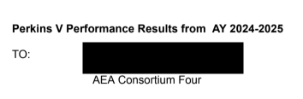
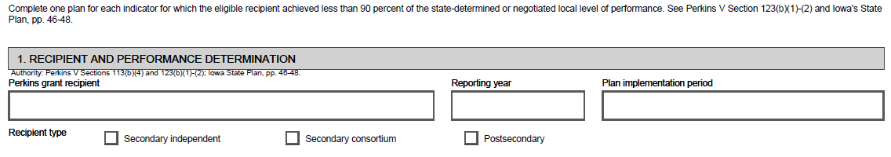
STEP 1 | Start with Your Performance Letter
Plan implementation period: November 1, 2026 - October 31, 2027

Slide 14
STEP 2 | Identify Indicators Requiring a Plan
Compare AY 2024–2025 Performance with the 90% Threshold and confirm the Met (Y/N) determination.
Important: The threshold is 90% of the approved target—not a requirement that actual performance equal 90%.
Indicator of Performance | AY 2024–2025 Target | AY 2024–2025 90% Threshold | AY 2024–2025 Performance | Met? (Y/N)
2S1: Academic Proficiency in ELA | 69.38% | 62.44% | 65.39% | YES*
2S3: Academic Proficiency in Science | 65.86% | 59.27% | 56.87% | NO
4S1: Non-traditional Program Concentration | 27.19% | 24.47% | 24.36% | NO
2S1 ELA: Below the full target, but above the 90% threshold → No plan
2S3 Science and 4S1 Non-traditional Concentration: Below the threshold → Plan required

Slide 15
STEP 3 | Complete One Form for Each “NO”
AEA Consortium Four would complete two forms:
• 2S3: Academic Proficiency in Science
• 4S1: Non-traditional Program Concentration
In Section 1, enter:
Recipient information
• Recipient • Reporting year • Implementation period • Recipient type
Performance information
• Indicator • AY 2024–2025 target • 90% threshold • Actual performance
Copy the performance values directly from the letter.
Keep the evaluation year separate from the period when improvement activities will occur.

Slide 16
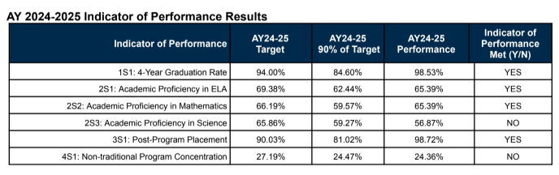

STEP 2 | Identify Indicators Requiring a Plan

Slide 17
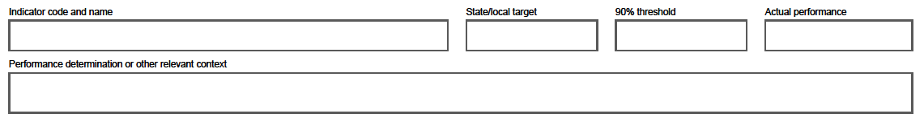
STEP 3 | Complete One Form for Each “NO”
Performance Improvement Plan
If a performance indicator listed in this report did not meet at least 90% of the target, please submit one plan
form for each unmet indicator target to jeffreyfletcher@iowa.gov. The deadline to return is October 31, 2026.

Slide 18
STEP 4 | Analyze the Overall Result
1. Use the dashboard and public-results spreadsheet linked in the letter.
2. Review AY 2024–2025 results by:
• Participating district
• Student population
• CTE program and/or program area
3. Summarize the key findings in Section 2.
For consortia:
Start with the consortium-level determination, then use member-district data to identify where action is needed.

Slide 19
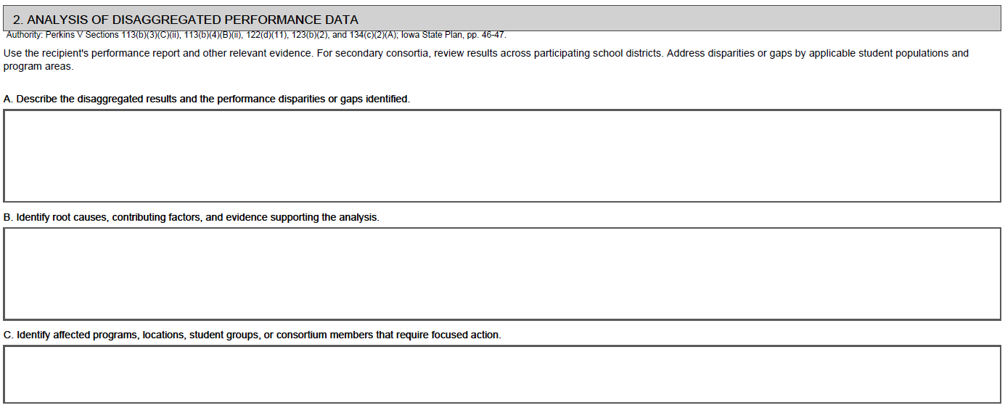
STEP 4 | Analyze the Overall Result
For secondary consortiums (and independent recipients) not achieving 90% on a performance indicator target, please review the disaggregated performance data across each participating school district, including student population groups, by navigating to the www.iowastudentoutcomes.com dashboards.
For this data in spreadsheet form, please click on the following Public District-Level: 2024-2025AY Accountability Results hyperlink for the public-facing Google sheet file for viewing and download only.

Slide 20
STEP 5 | Identify Likely Contributing Factors
The letter identifies what needs improvement—not why.
Engage relevant staff and stakeholders.
Use local evidence, student feedback, and the CLNA.
Distinguish confirmed findings from issues requiring further investigation.
Record contributing factors in Section 2 and stakeholder involvement in Section 4.

Slide 21
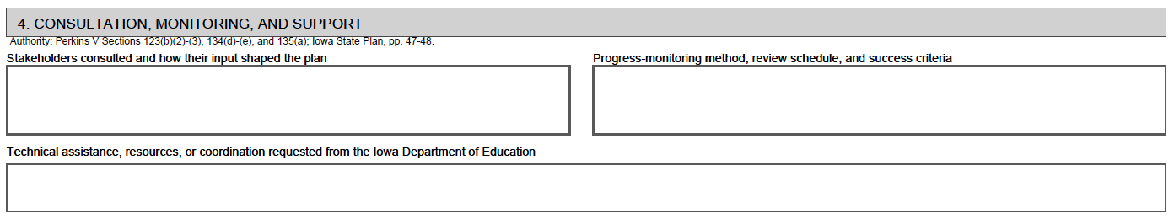
STEP 5 | Identify Likely Contributing Factors

Slide 22
STEP 6 | Identify Actions and Assign Responsibility
In Section 3, choose actions that:
• Address the contributing factors identified; and
• Align with the CLNA and local planning.
“Improve science performance” is a goal—not an action.
For each action, specify:
• What will we do?
• Who is responsible?
• When will it happen?
• What evidence will show progress?

Slide 23
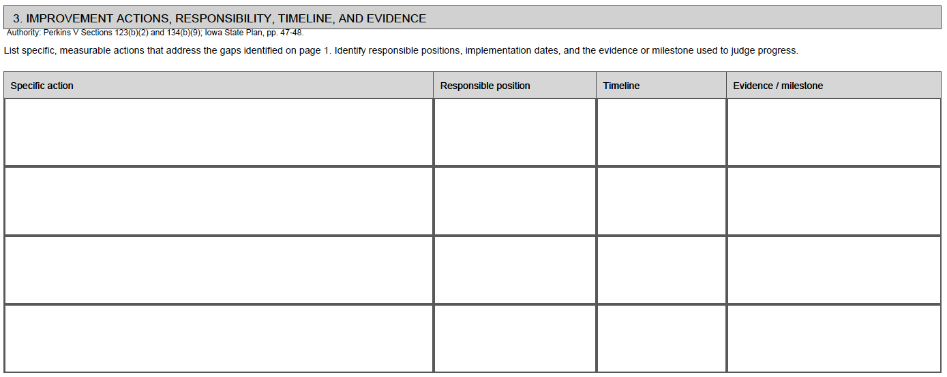
STEP 6 | Identify Actions and Assign Responsibility

Slide 24

STEP 7 | Monitor Progress and Identify Support Needs
In Section 4:
Define how often progress will be reviewed, what evidence will be examined, and what success will look like.
Monitor both activity completion and learner outcomes.
Document stakeholder input and any Iowa Department of Education technical assistance needed or pursued.

Slide 25
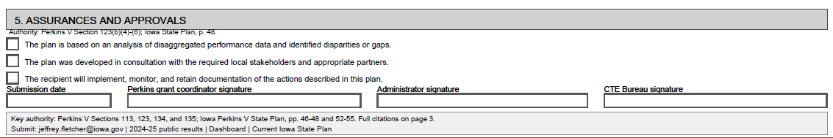
STEP 8 | Finalize, Submit, and Implement
Before submitting
Complete the assurances.
Obtain Perkins coordinator and administrator signatures; electronic signatures are acceptable.
Leave the CTE Bureau signature blank for Department review.
Page 3 contains references only—no response is required.
Submit
Due: October 31, 2026
Send completed plans and accountability questions to:
jeffrey.fletcher@iowa.gov | cale.hutchings@iowa.gov
After submitting
Keep a local copy.
Follow the implementation and progress-review schedule documented in the plan.

Slide 26
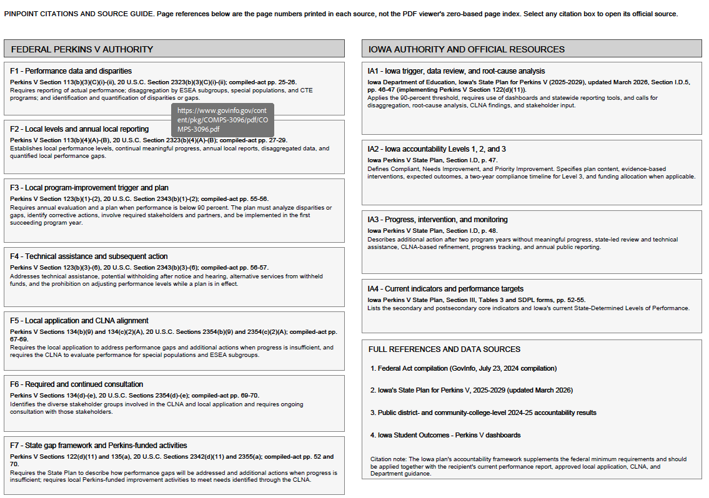
Citations & Source Guide
Select and left-click on any citation box to open its official source.

Slide 27
Special Topic
4S1 Nontraditional Program Concentration

Slide 28
4S1 Nontraditional Program Concentration
4S1 Nontraditional Program Concentration
PY 2026–27 Iowa SDPL
27.30%
This indicator looks at CTE concentrators in programs that lead to nontraditional fields.
FEDERAL MEASURE
WHAT MAKES A FIELD “NONTRADITIONAL”?
“The percentage of CTE concentrators in career and technical education programs and programs of study that lead to non-traditional fields.”
less than
25%
A nontraditional field is an occupation or field of work where individuals from one sex make up less than 25% of the people employed in that occupation or field.
Perkins V §113(b)(2)(A)(v)
Perkins V §3(33)
4S1 is a signal to look at student access, recruitment, concentration, and support in programs connected to nontraditional career fields.
The number tells us where to ask better questions: Which programs are driving the result? Which student groups are represented? Where might a local barrier, message, or support need attention?
Source: Perkins V §113(b)(2)(A)(v) and §3(33); FY25–FY29 Secondary Perkins V Indicator Reference.

Slide 29
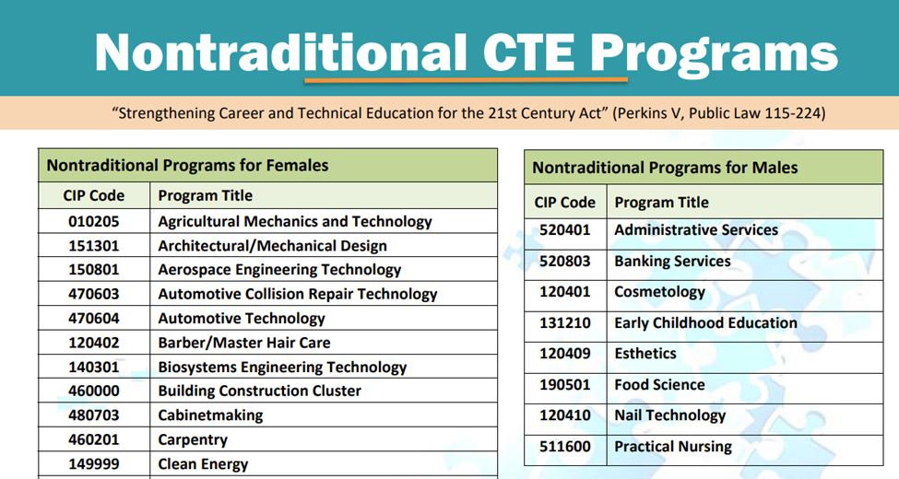
Nontraditional Careers Crosswalk
Nontraditional Careers Crosswalk

Slide 30

Strategies to Improve Nontraditional Program Concentration
Consider making equipment and environmental adjustments
Invest in appropriately-sized equipment (e.g., smaller welding helmets).
Cultivate diverse faculty and employer networks. Seek out instructional staff and industry partners who represent non-traditional demographics to serve as visible, successful role models.
Implement professional development related to gender stereotypes.
Sources:
Advance CTE - careertech.org
Association for Career and Technical Education - acteonline.org

Slide 31
NTO Strategies to Consider
Designated NTO Staff
Outreach to Middle and High School Students
Student Supports and Program Review
Supportive NTO Role Models
Affinity Groups/Peer Support Systems
Business and Industry Trends

Slide 32
Strategies to Improve Nontraditional Program Concentration
Provide early exposure and guidance
Implement introductory courses that rotate incoming students through various CTE pathways (e.g., a short rotation through all industrial tech programs) before they commit to a specific track.
During program open houses or exploration days, have current non-traditional students (like male nursing students or female welding students) lead the technical demonstrations.
Provide advising staff with labor market data and training to ensure they are actively encouraging students toward high-wage, high-demand fields regardless of traditional norms.
Sources:
Advance CTE - careertech.org
Association for Career and Technical Education - acteonline.org

Slide 33

Strategies to Improve Nontraditional Program Concentration
Focus on targeted recruitment
Ensure brochures, websites, and social media campaigns feature non-traditional learners.
Utilize program graduates who are currently working in non-traditional fields to provide direct mentoring and networking opportunities for prospective students.
Actively recruit by collaborating with local groups and student organizations that represent underrepresented populations.
Sources:
Advance CTE - careertech.org
Association for Career and Technical Education - acteonline.org

Slide 34
Strategies to Improve Nontraditional Program Concentration
Provide structural and wraparound supports
Designate specific staff members to serve as dedicated points of contact and support for non-traditional learners navigating the high school and college systems
Provide wraparound services like tutoring, transportation assistance, and flexible scheduling to ensure students can participate in extended opportunities like work-based learning
If participating in Career and Technical Student Organizations (CTSOs), combine any historically gender-separated events into single, inclusive skill-based competitions
Sources:
Advance CTE - careertech.org
Association for Career and Technical Education - acteonline.org

Slide 35
NTO Resources Links and Technical Assistance
Explore Nontraditional Careers
· Camps
· Industry Tours
· CTSOs
· Professional Organizations
Nontraditional Career Preparation
NTO Root Causes and Strategies
Strategies to Increase the Concentration of Students in Nontraditional Occupations
Nontraditional Occupation (NTO) Programs: Scale of Adoption Assessment

Slide 36

Strategies to Improve Nontraditional Program Concentration
Focus on data analysis and program review
Try to identify root causes for non-traditional participation.
Cross-reference specific CIP codes with disaggregated demographic data to pinpoint the pathways with the widest gaps.
Track how non-traditional participation impacts overall program outcomes, postsecondary earnings, and Perkins V performance indicators.
Sources:
Advance CTE - careertech.org
Association for Career and Technical Education - acteonline.org

Slide 37
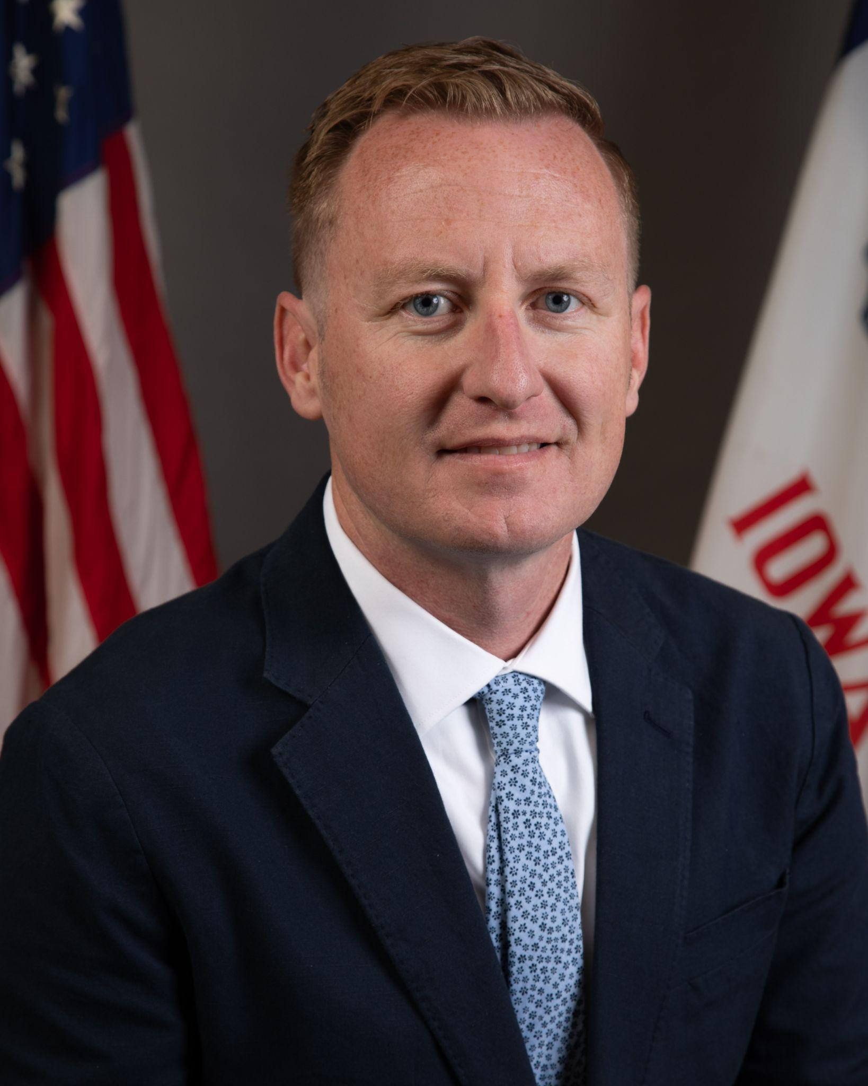
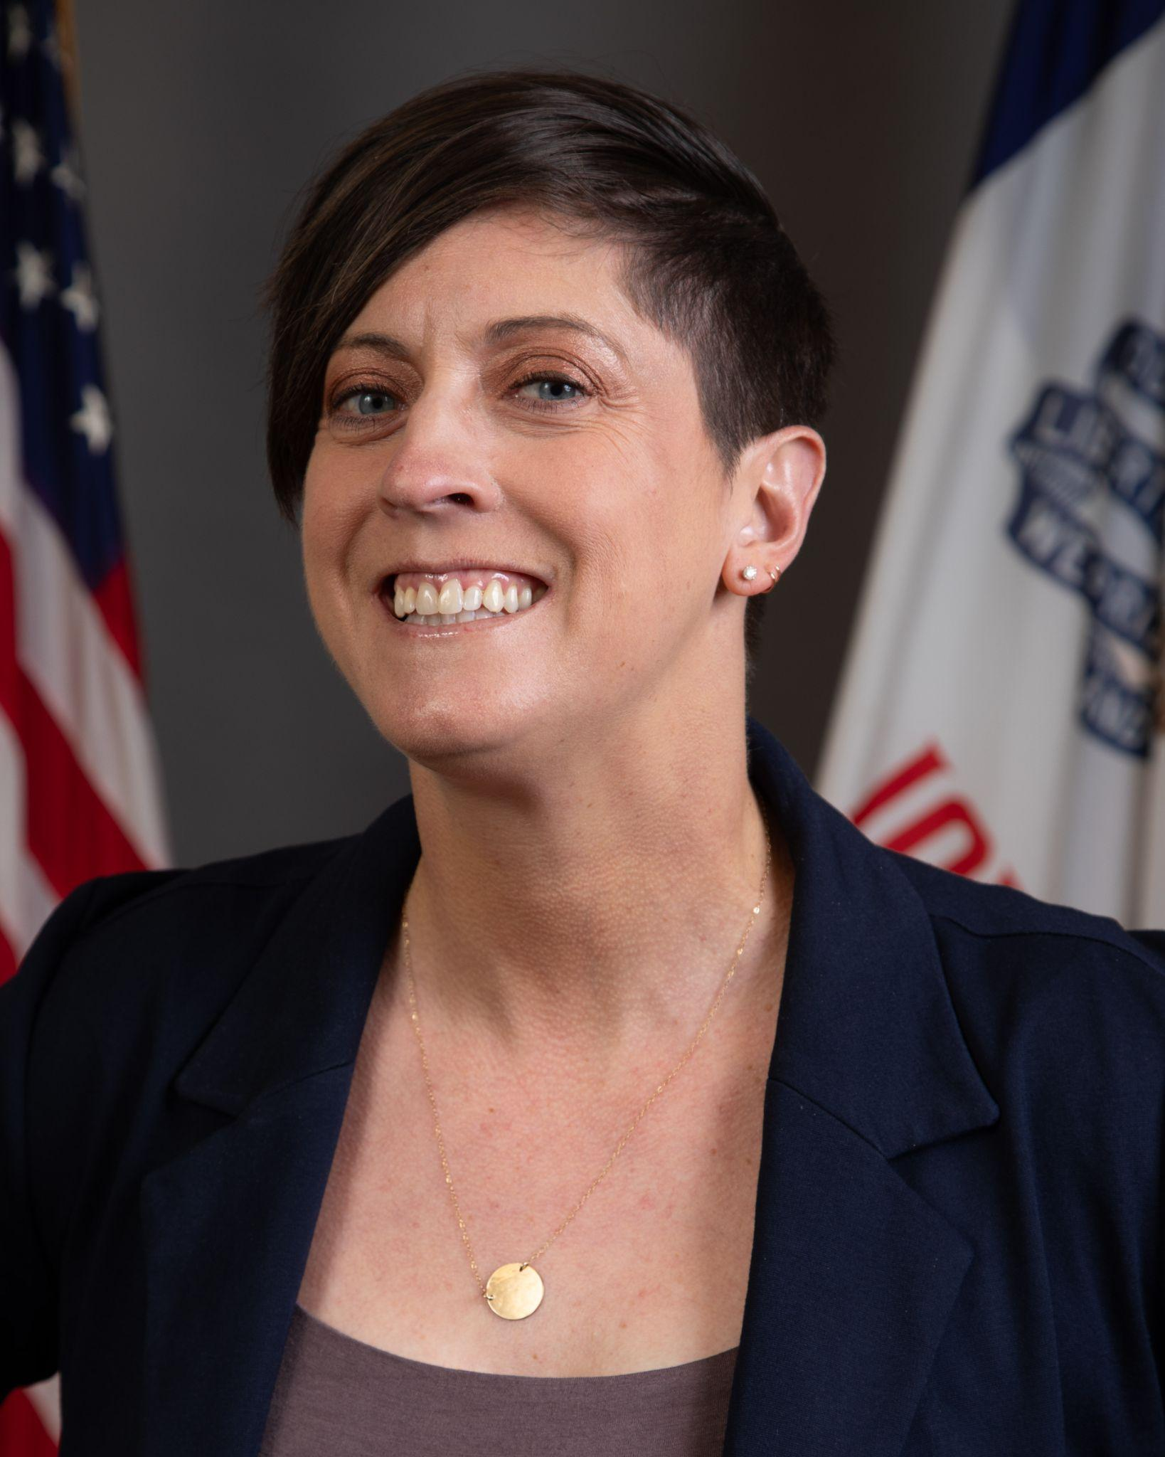
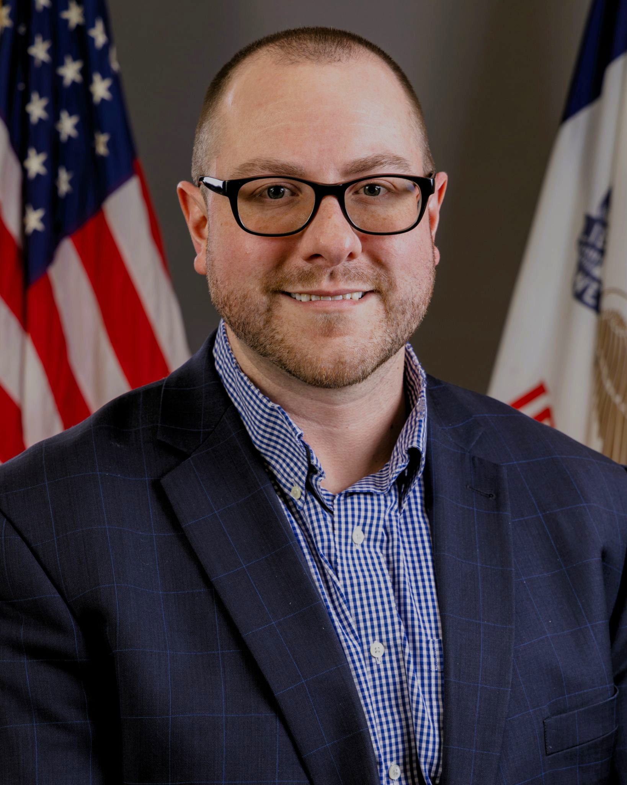
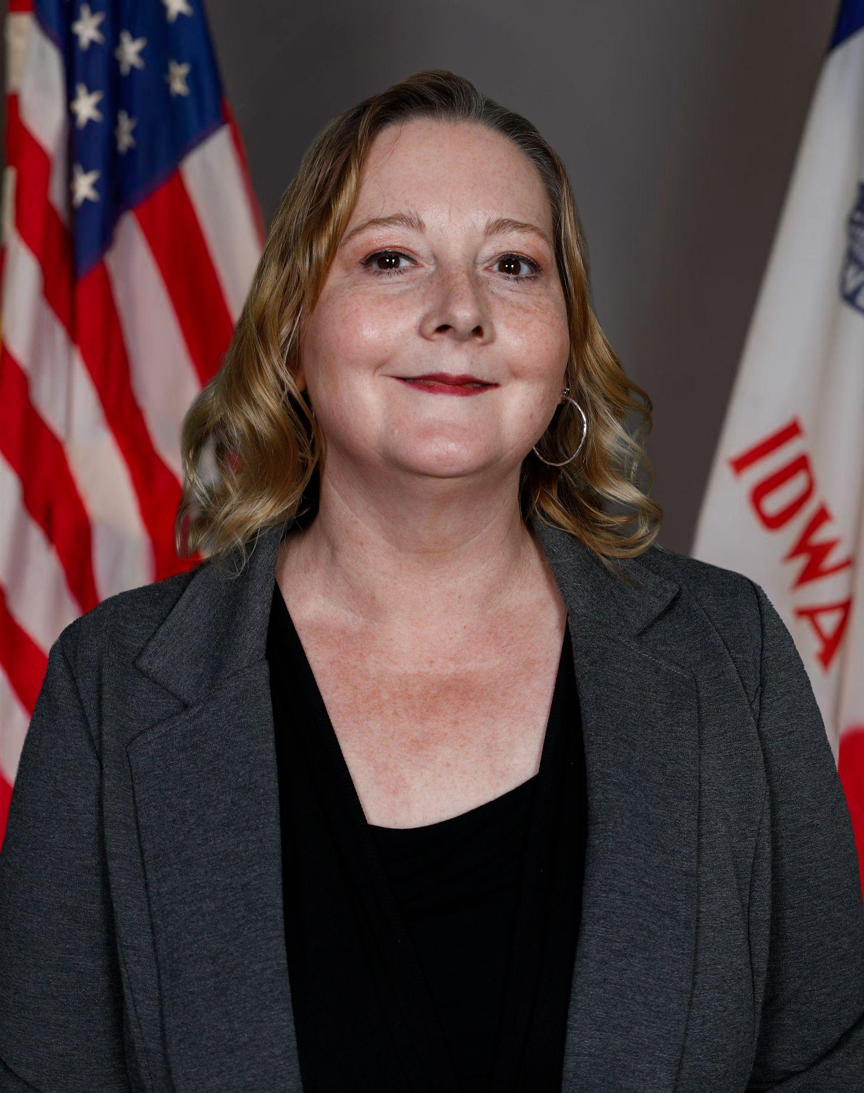
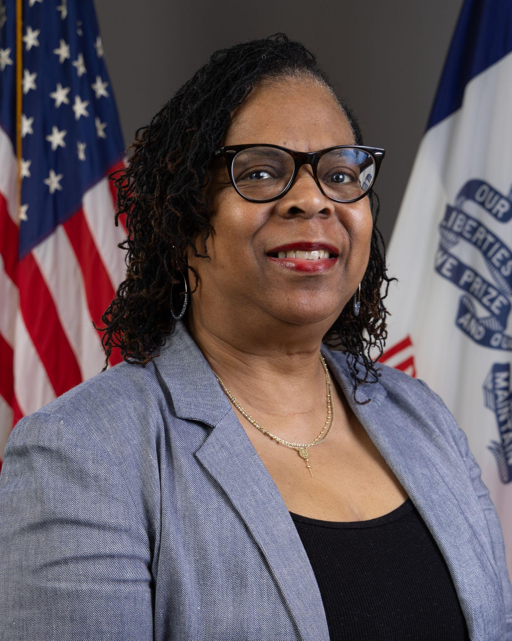
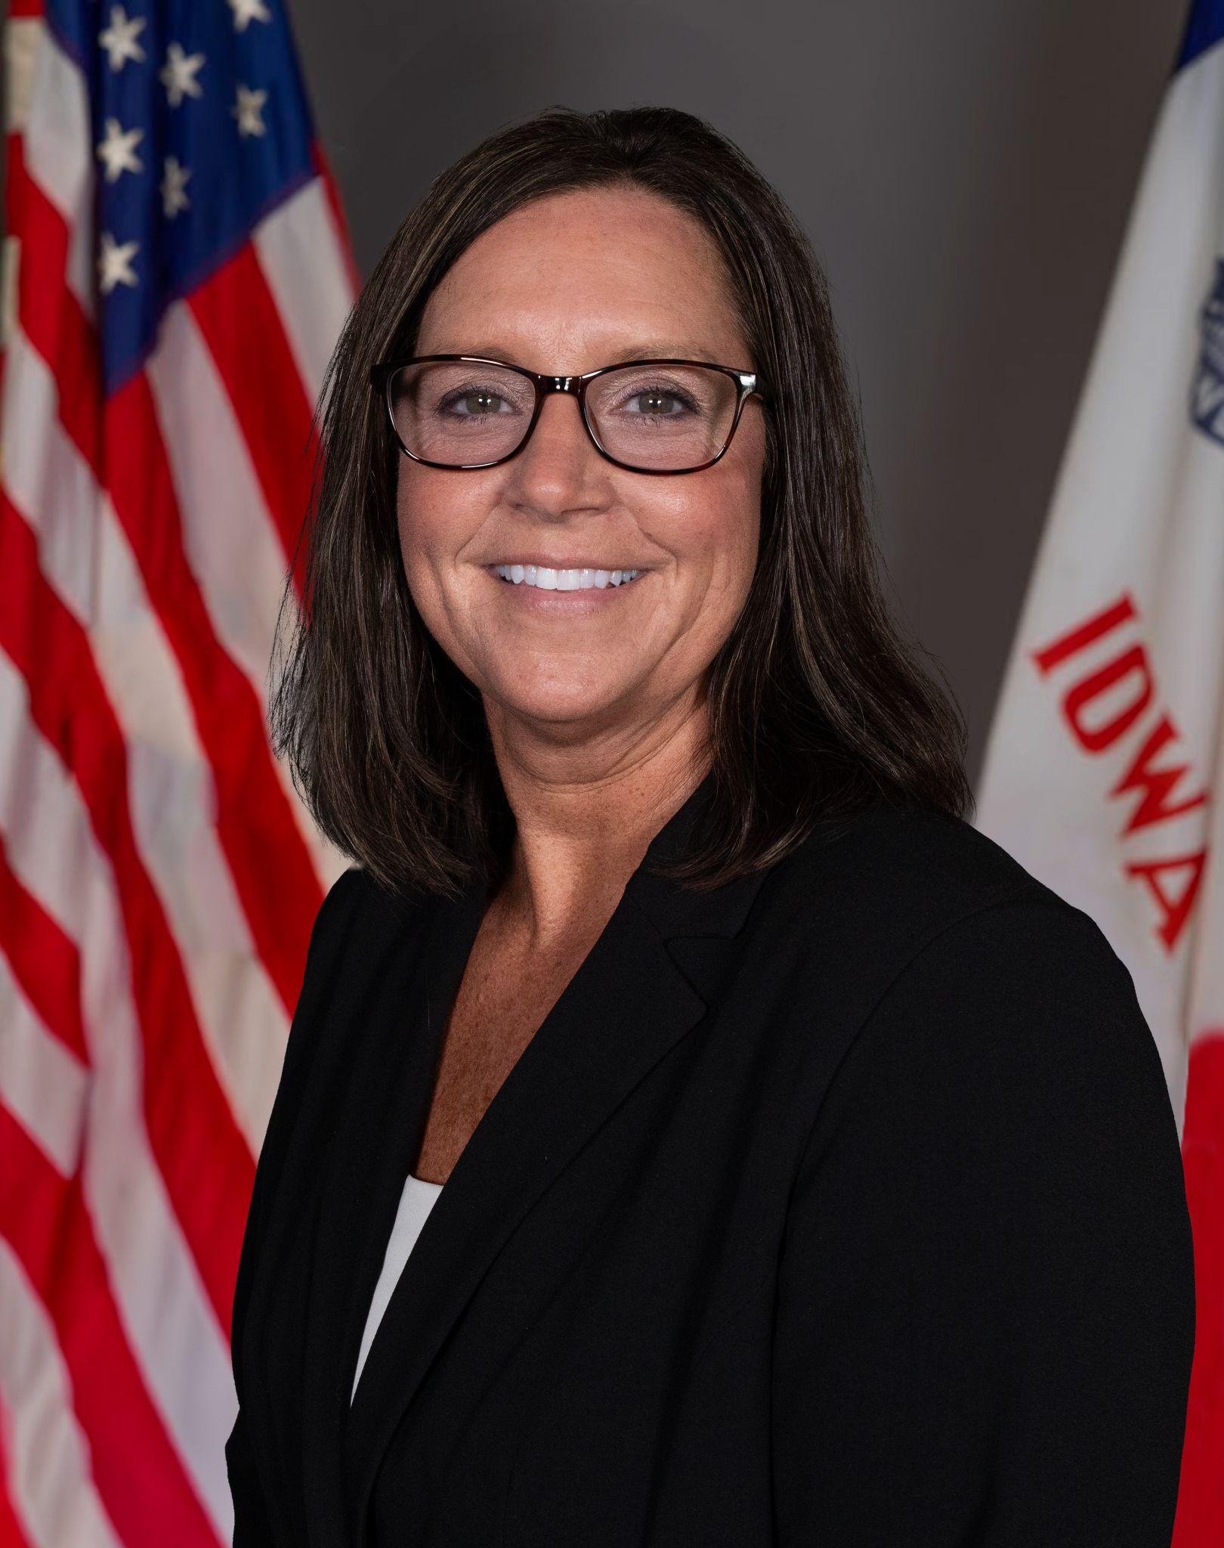
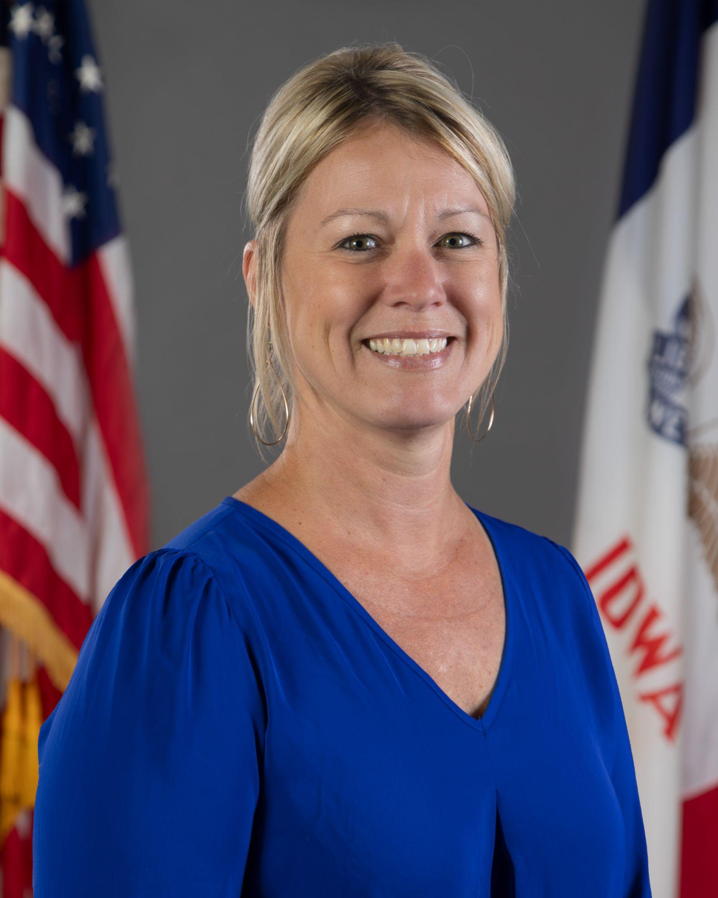
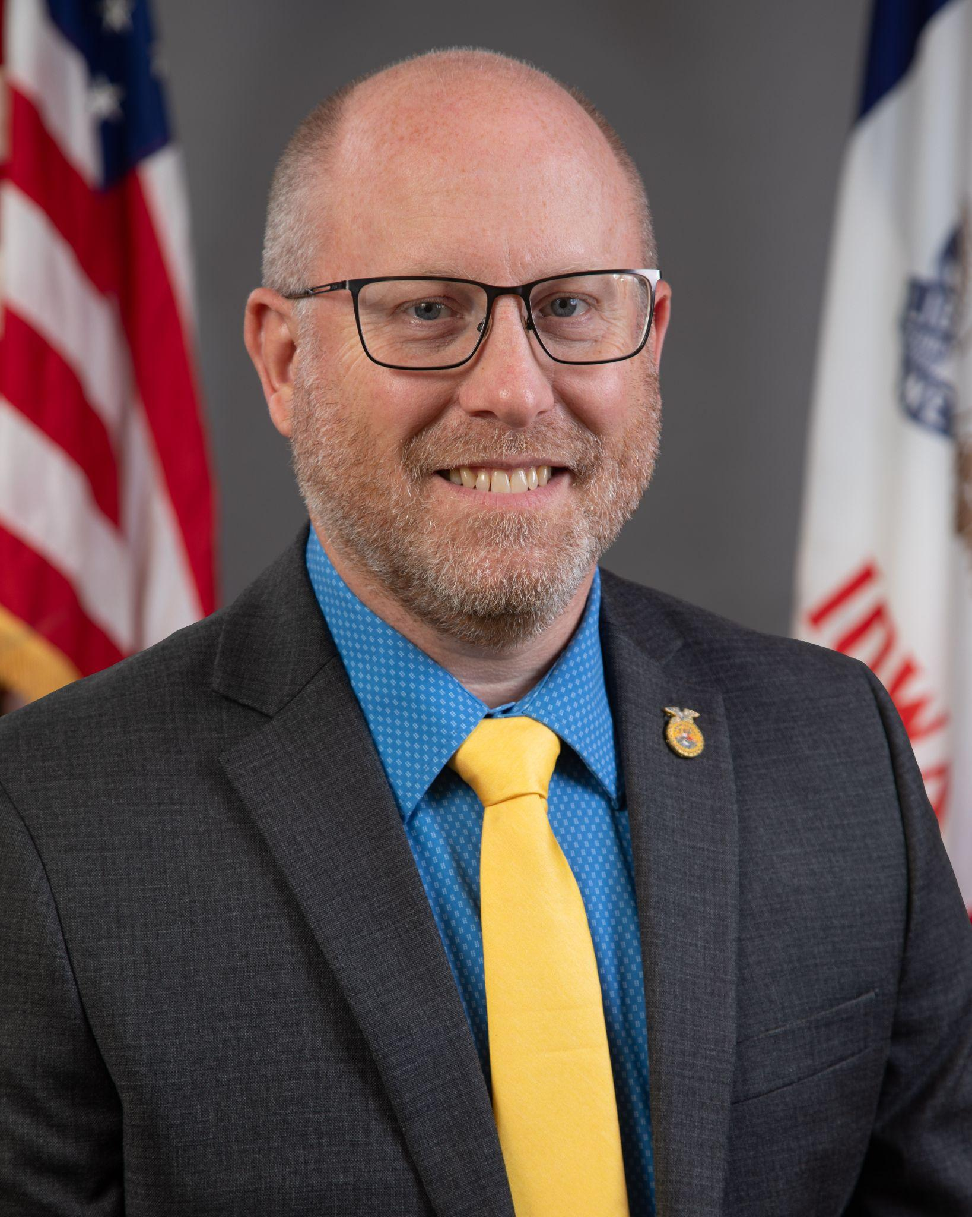
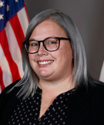
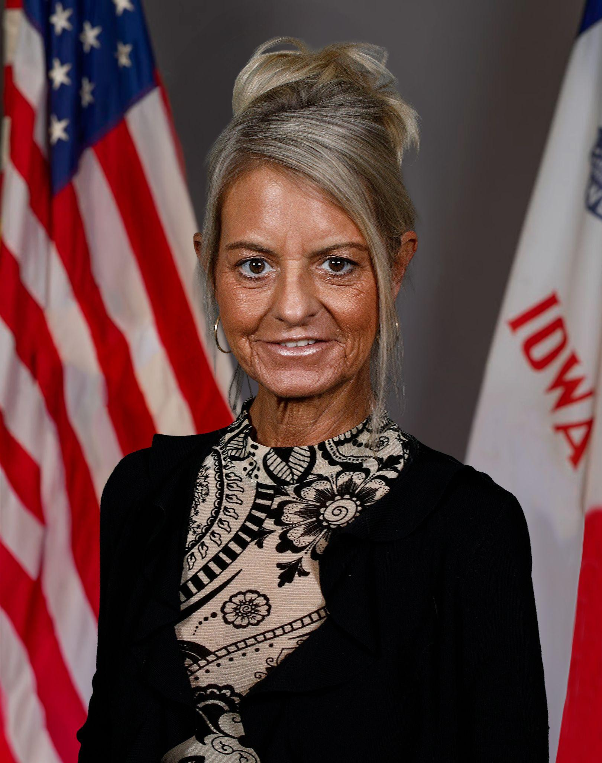
CTE Bureau Team
Cale Hutchings
Bureau Chief
CTE & Postsecondary Readiness
cale.hutchings@iowa.gov
Heather Meissen
Administrative Consultant
CTE and Health Sciences
heather.meissen@iowa.gov
Jeffrey Fletcher
Education Program Consultant
Perkins, IowaGrants
jeffrey.fletcher@iowa.gov
Michelle Meier
Education Program Consultant
Information Systems
michelle.meier@iowa.gov
Jeanette Thomas
Education Program Consultant
Student Access and FCS
jeanette.thomas@iowa.gov
Shelly Duwa
Education Program Consultant
Business and CTSOs
shelly.duwa@iowa.gov
Karey Hawkins
Education Program Consultant
Career and Academic Planning
karey.hawkins@iowa.gov
Alan Spencer
Education Program Consultant
Agriculture
alan.spencer@iowa.gov
Jodie Smith
Education Program Consultant
WBL & IRCs
jodie.smith@iowa.gov
Amy Vybiral
Education Program Consultant
Perkins Budgets and Claims
amy.vybiral@iowa.gov

