Slide 1
1

Slide 2
Learning Objectives
Participants will be able to:
Identify PWN changes that apply to Early ACCESS, Special Education or both.
Navigate the updated PWN workflow in ACHIEVE.
Create and manage multiple draft PWNs.
Complete and manage PWNs using updated system features.
Identify changes to PWN notifications, output and reporting.

Slide 3
Changes Across PWN Types
Both Early ACCESS and Special Education
Link PWN to
Other Essential Information
PWN buttons and draft management
Contact Person
Multiple PWNs
Draft PWN tracking
Family Portal notification
Output updates
Unfinalized PWN Report
Early ACCESS Only
Transition option
Date Decision Reached
Action date documentation updates
Special Education Only
Individual proposed/refused action
Action-specific decision-making information
Proposed/refused action accordions

Slide 4
Removal of PWN Completion and Notice Date
The following data fields are removed:
“Parents were provided notice of action on”
“Prior Written Notice completed on”
Instead:
Select Complete → ACHIEVE stores the completion date → Completion date populates Notice Date on the PWN output
Applies to: Early ACCESS and Special Education

Slide 5
Link PWN To Field

Slide 6
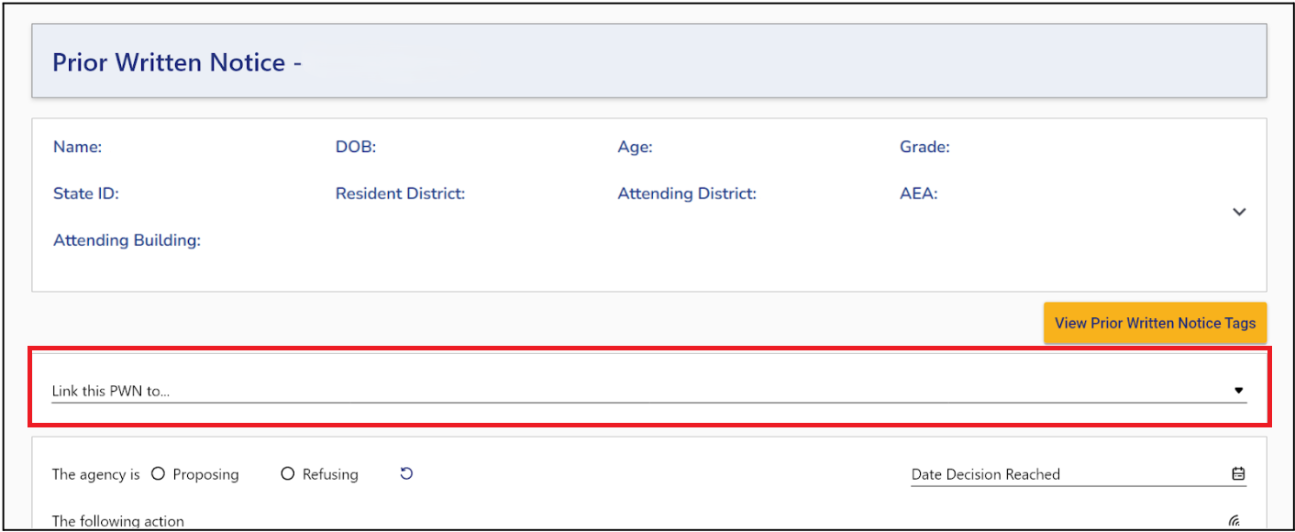
Link PWN to Drop-down Menu
Located at the top of the PWN
Always displayed
Required
Identifies the process associated with the PWN
Includes an Other option
Applies to: Early ACCESS and Special Education

Slide 7
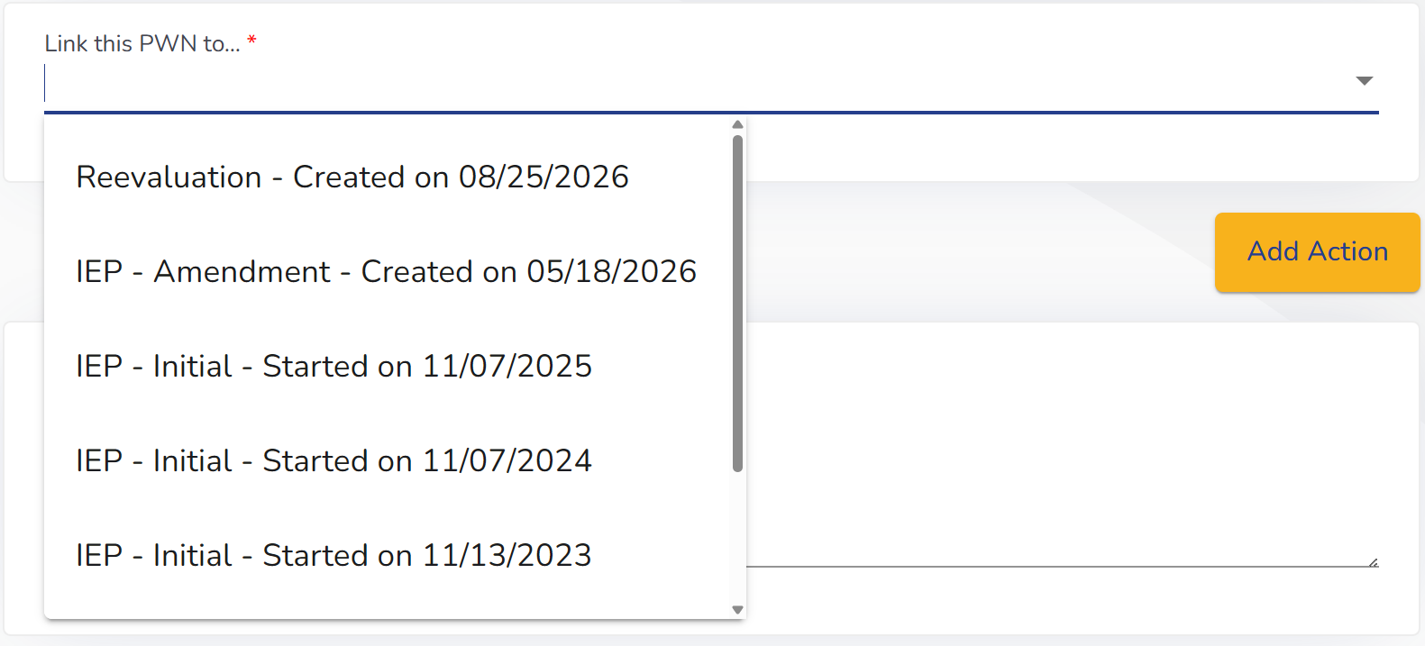
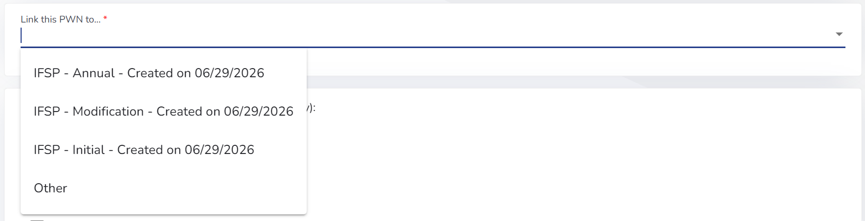
Link PWN to Drop-down Menu Options

Slide 8
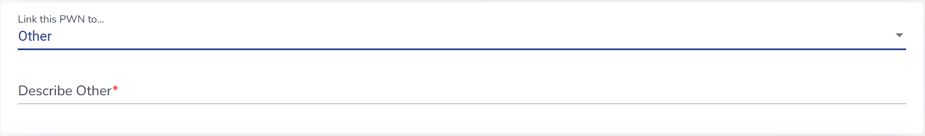
Link PWN to “Other” Option
When Other is selected:
Describe Other appears
Describe Other is required
The field is only displayed when Other is selected
Applies to: Early ACCESS and Special Education

Slide 9
Incomplete Data Report (IDR) Logic
Incomplete Data Report Process | Required Link PWN To Option
Initial IFSP | IFSP - Initial
Modification IFSP | IFSP - Modification
Annual IFSP | IFSP - Annual
Initial IEP | IEP - Initial
Interim IEP | IEP - Interim
Amendment IEP | IEP - Amendment
Reevaluation | Reevaluation

Slide 10
Resolve Button with No Draft PWN
When Resolve is selected for an applicable IDR item:
Resolve
ACHIEVE creates a new PWN
Link PWN to defaults to the corresponding process
Applies to: Early ACCESS and Special Education

Slide 11
Resolve Button with Existing Draft PWN(s)
When Resolve button is selected:
If exactly one draft PWN linked to the corresponding process → ACHIEVE opens that existing PWN
If multiple draft PWNs OR one draft linked to a different process → ACHIEVE displays the Prior Written Notice modal
From the modal, the user can:
Select Create New → Link PWN To defaults to the corresponding process
Select an existing PWN by its date hyperlink → the existing Link PWN To selection does not change

Slide 12
PWN Buttons and Actions
Changes to how draft PWNs are viewed, shared and deleted

Slide 13
View Draft Button
Preview is renamed View Draft
Allows user to view the PWN while it is still in draft
Selecting the View Draft button allows the team to review a draft copy of the PWN output without adding a copy to the draft PWN to the Documentation section of ACHIEVE or the ACHIEVE Family Portal
Applies to: Early ACCESS & Special Education

Slide 14
Push to Portal Button
Sends the draft PWN to the Family Portal
Allows the family to review the PWN before it is finalized
Does not finalize the PWN
Adds the PWN to Documents as Incomplete

Slide 15
Delete PWN Button
Delete PWN is available for a draft PWN
Selecting it begins the deletion process
A confirmation message appears before the PWN is deleted
The PWN is not deleted until the user confirms
Delete PWN is available to:
The user who created the PWN
Data Leads based on location
Super Admins

Slide 16
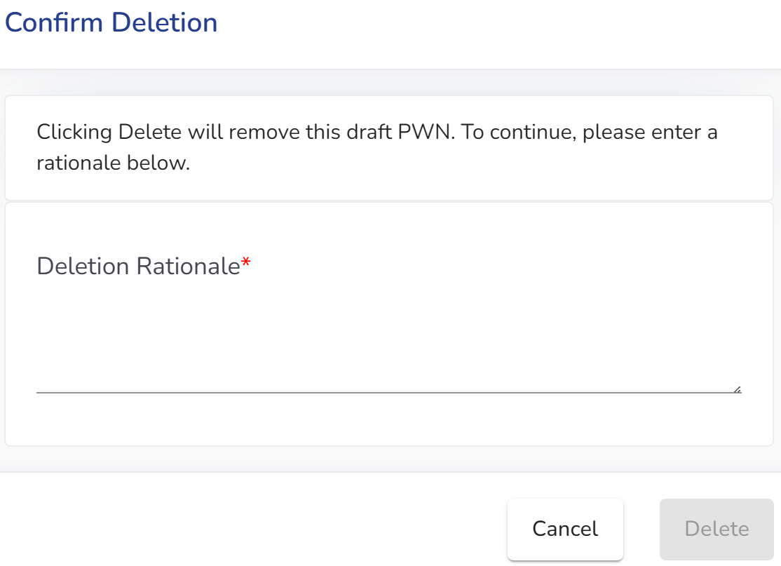
Confirming Deletion
Select Delete PWN to begin the deletion process
A rationale is required when deleting a draft PWN
Confirm the deletion to remove the draft

Slide 17
Contact Person Changes
Identifying who families can contact about the PWN

Slide 18
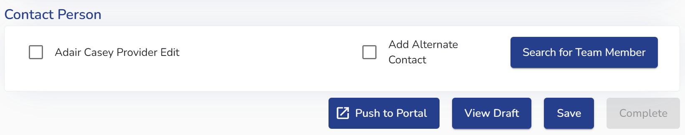
Selecting a Contact Person
Updated Contact Person functionality applies to both Early ACCESS and Special Education PWNs.
Users may identify a contact person by:
Selecting checkbox next to the name of the PWN creator
Adding an Alternate Contact
Selecting Search for Team Member
Multiple contact persons may be selected.

Slide 19
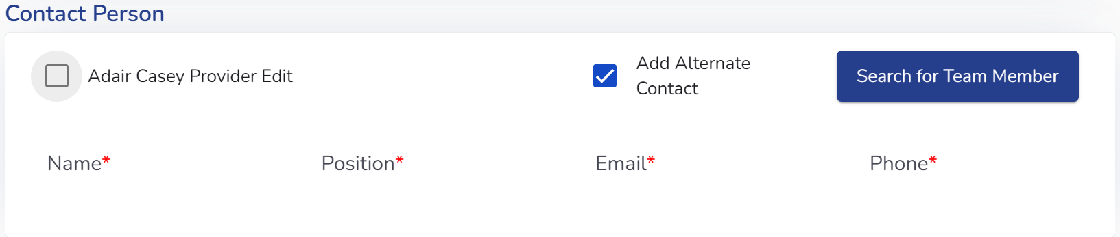
Adding an Alternate Contact
Use Add Alternate Contact to manually enter a contact person
Enter the contact person’s
Name
Phone number
Email address
An alternate contact may be used along with other selected contact persons.

Slide 20
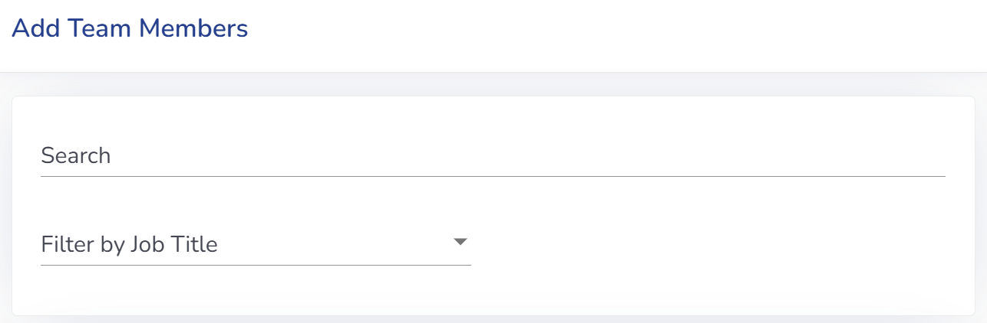
Search for Team Member
Select Search for Team Member to identify another ACHIEVE user as a contact.
Enter at least three characters of the person’s name
ACHIEVE displays matching team members
Select the appropriate individual
The selected person is added as a Contact Person
More than one team member may be selected.

Slide 21
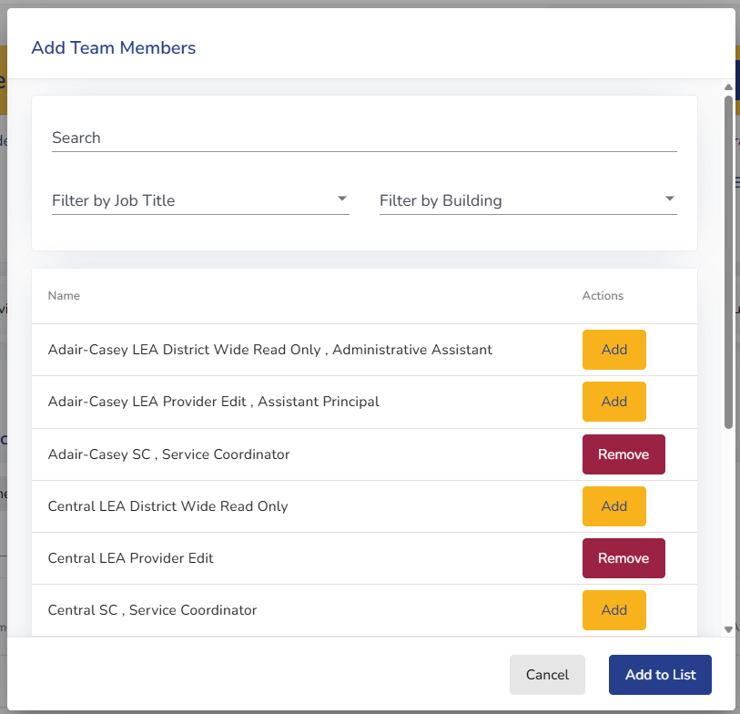
Managing Selected Contact Persons
Once selected, each contact person displays with:
Name
Phone number
Email address
Remove option
Contact information is populated from the individual’s ACHIEVE profile.
Removing a contact person requires confirmation.

Slide 22
Early ACCESS

Slide 23
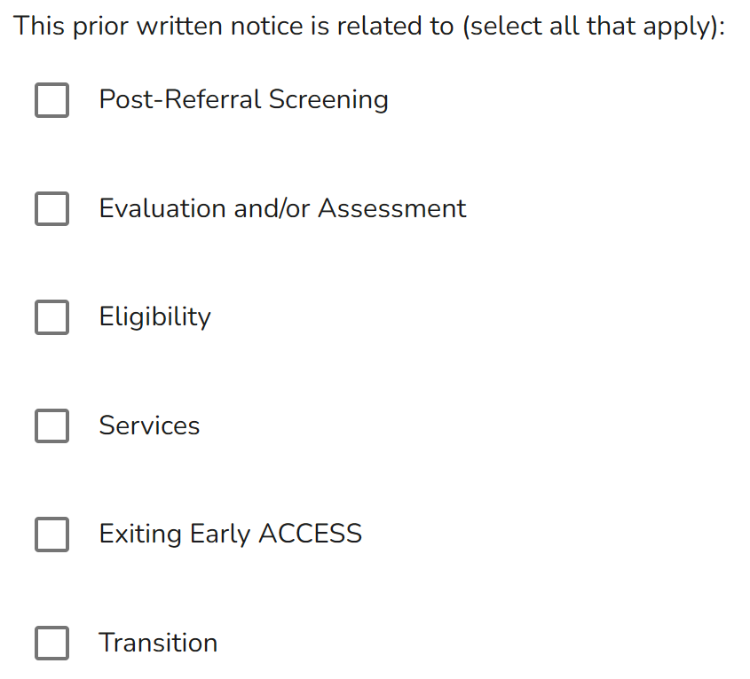
Early ACCESS: Transition Option
A new Transition option is available under:
“The prior written notice is related to (select all that apply)”
Specific to Early ACCESS PWNs
  May be selected with other applicable options

Slide 24
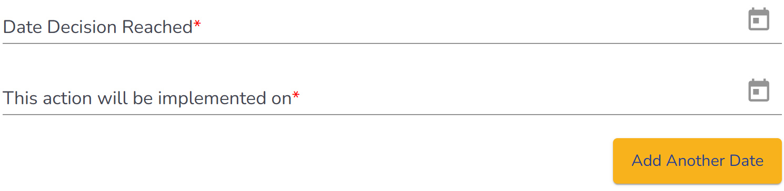
Early ACCESS: Date Decision Reached
New required field on Early ACCESS PWNs
Documents when the decision was reached
Cannot be a future date
Key Point: The decision date and implementation date serve different purposes.

Slide 25
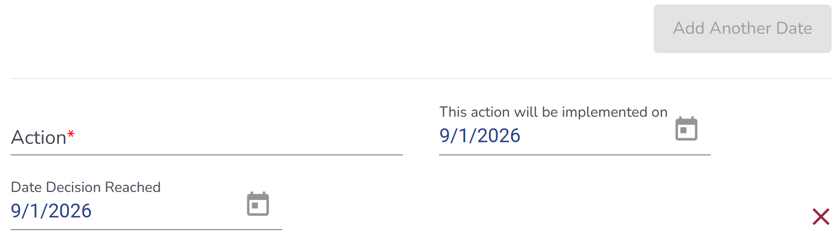
Early ACCESS: Adding Another Date
When Add Another Date is selected, a removable action-date section includes:
Action
This action will be implemented on
Date Decision Reached
How it works
Each added section has a red X for removal
Add Another Date is disabled until all required fields in the newest section are completed

Slide 26
Proposed and Refused Actions
Special Education PWN

Slide 27
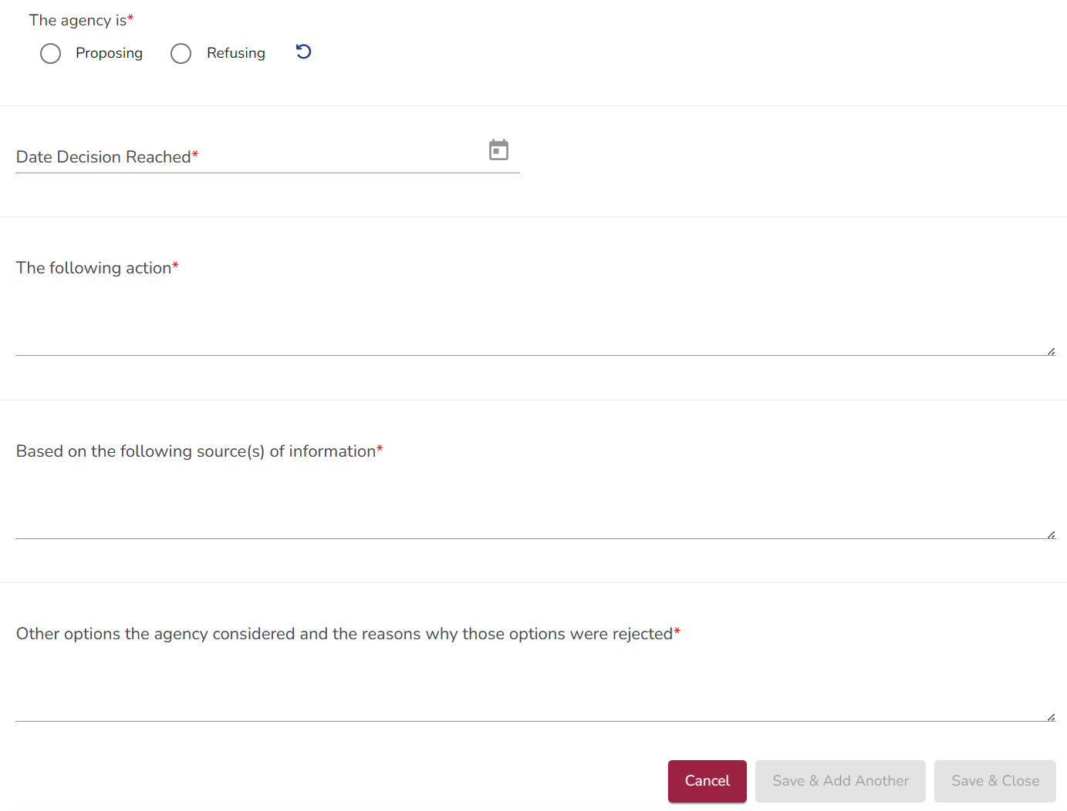
Document Each Action Individually
What is changing?
Each proposed or refused action is documented separately
Decision-making information is connected to the specific action
Action-specific dates replace Document Action Dates in Special Education PWNs
At least one action must be saved before the PWN can be completed

Slide 28

Proposing or Refusing
Start by identifying the agency’s action
The agency is:
Proposing
Refusing
Also required for every action:
Date Decision Reached
The following action
Sources of information
Other options considered and why they were rejected
When Proposing is selected:
This action will be implemented on

Slide 29
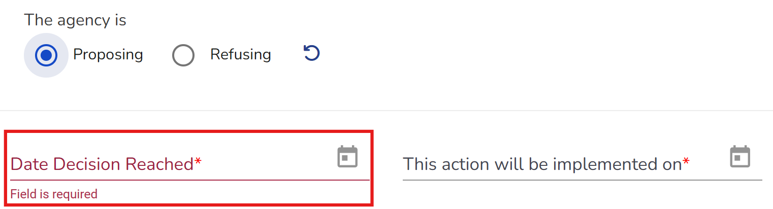
Date Decision Reached
Date Decision Reached
Required for every proposed or refused action
Cannot be a future date
Documents when the decision was reached

Slide 30
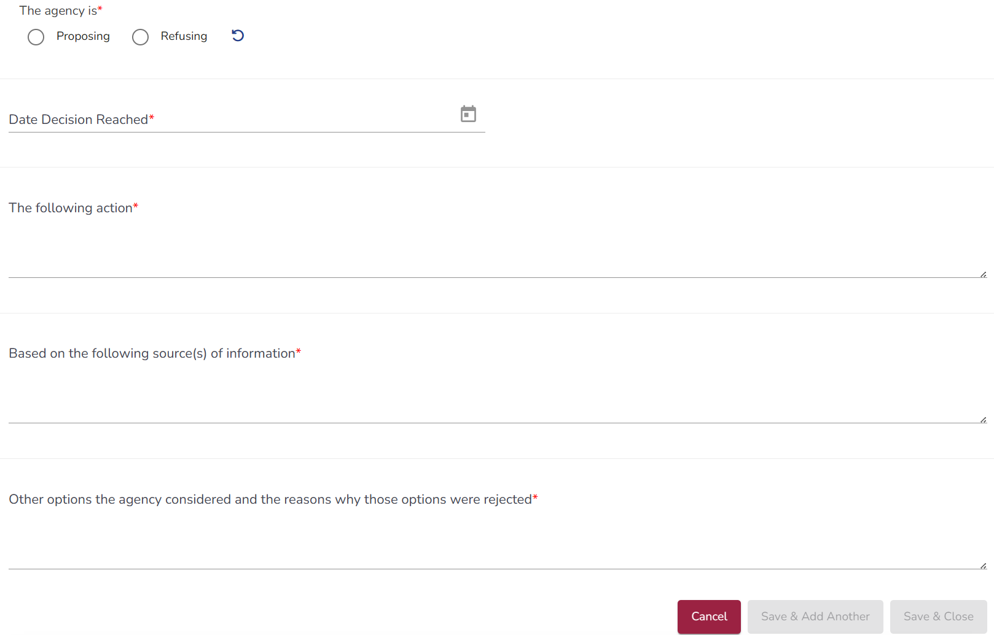
Documenting the Decision
For each action, document:
The following action
Based on the following source(s) of information
Other options the agency considered and the reasons why those options were rejected
Key Point: The documentation should explain the decision for each specific action.

Slide 31

Other Relevant Factors
Are there other relevant factors?
ACHIEVE asks whether other factors are relevant to the:
Proposed action, or
Refused action
If Yes is selected, a required Description of the relevant factors field appears.

Slide 32
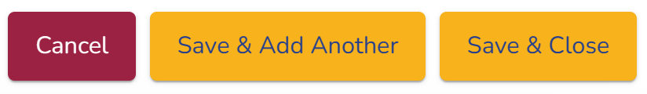
Saving an Action
Cancel
Exits without saving changes
Save and Add Another
Saves the action
Opens a new action entry
Save and Close
Saves the action
Returns to the action list
Required fields must be complete before an action can be saved.

Slide 33
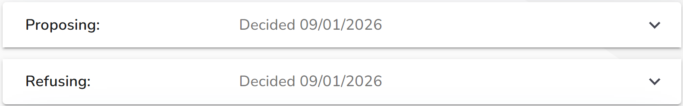
One PWN, Multiple Actions
A PWN may include more than one action.
For example, the agency may:
Propose one action
And
Refuse another action
Each action is documented and saved separately within the same PWN.

Slide 34
PWN Accordions and Essential Information

Slide 35
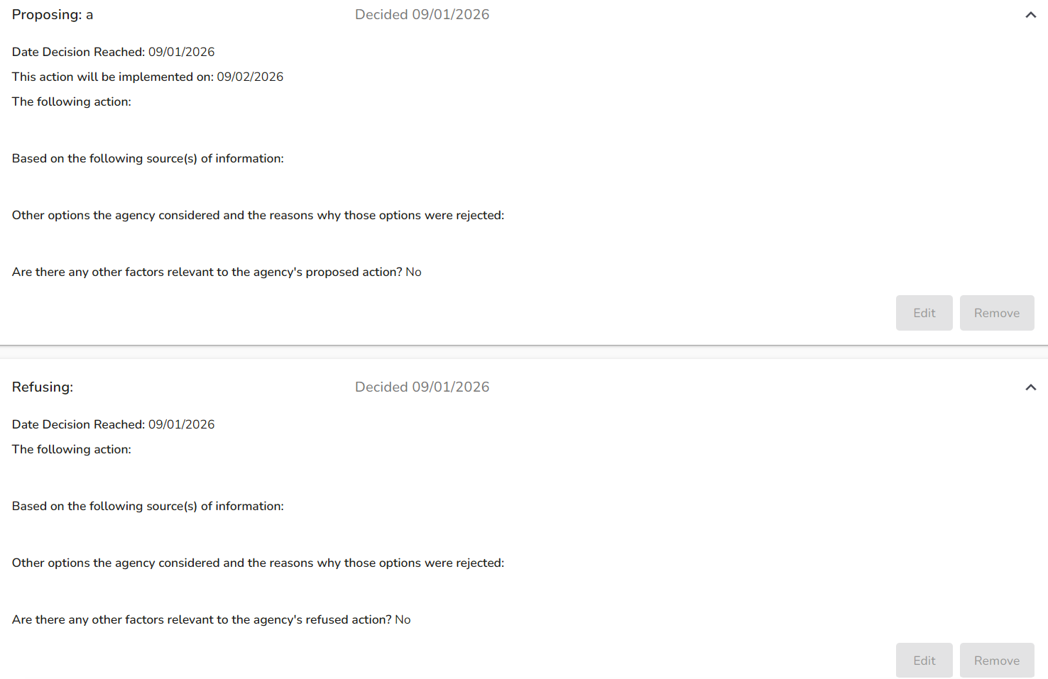
Saved Action
Each saved action:
Appears in its own accordion;
Is collapsed by default;
Is identified as Proposing or Refusing; and
Can be expanded to review, revise, or remove information for that action.

Slide 36
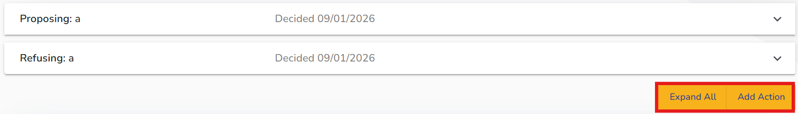
Managing Action Accordions
Expand All: Opens all saved action accordions.
Collapse All: Closes all saved action accordions.
Add Action: Opens the field to document another proposed or refused action.

Slide 37
Reviewing and Editing an Action
When an accordion is expanded:
Saved action information is displayed for review
Select Edit to make changes to the action
Users with edit permissions for the learner can edit the action

Slide 38
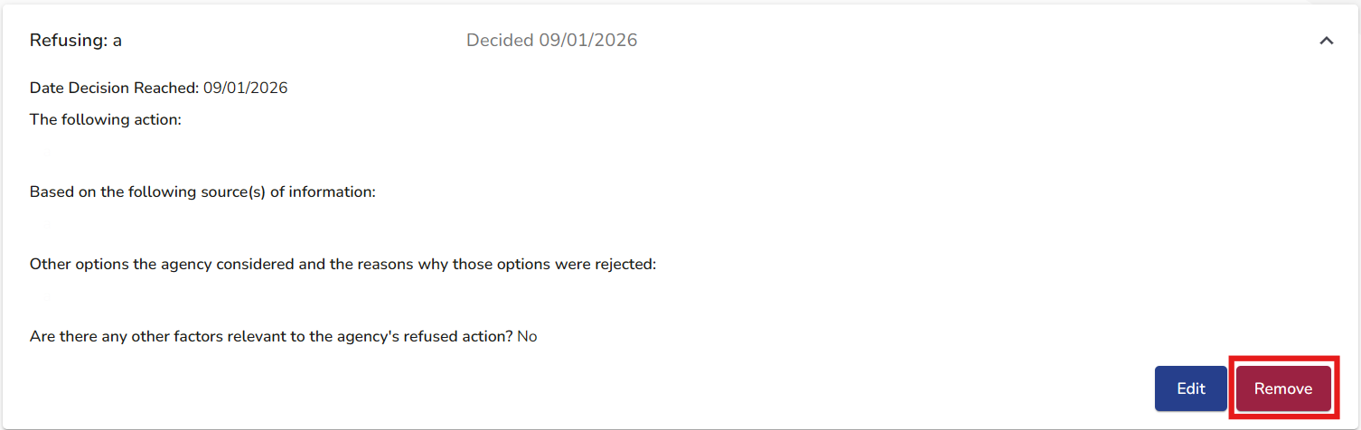
Removing an Action
Remove is available to:
The user who created the PWN
Super Admin users
Location-based Data Leads
ACHIEVE requires confirmation before the action is removed.

Slide 39
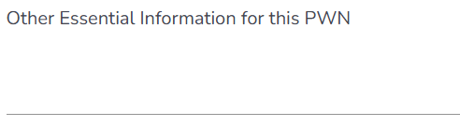
Other Essential Information
Other Essential Information for this PWN
New optional text field
Located below the action entry area and saved action accordions
Provides a separate location for additional information related to the PWN

Slide 40
Multiple PWNs

Slide 41
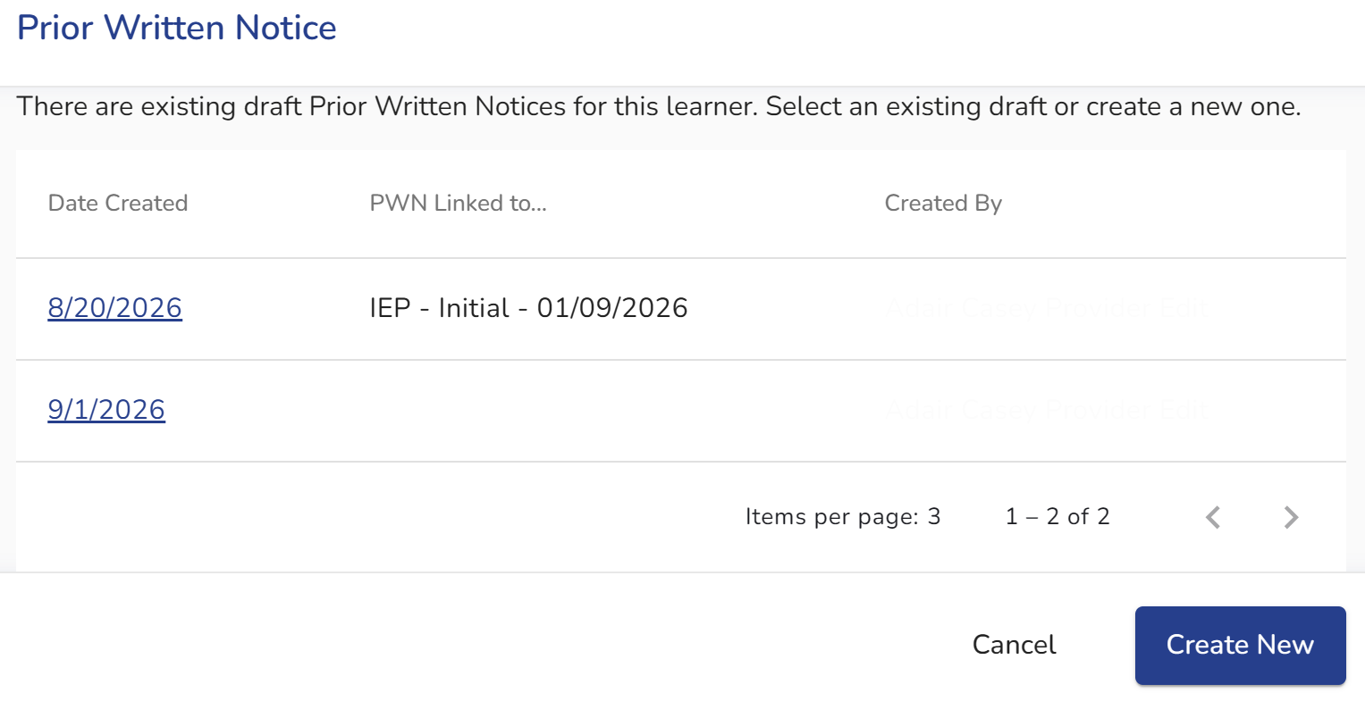
When a Draft PWN Already Exists
When a learner already has a draft PWN, ACHIEVE now displays a Prior Written Notice pop-up modal.
Review existing drafts:
Date Created: select date to open the draft
PWN Linked to: identifies the associated “Link PWN to” process
Created By: identifies who created the draft

Slide 42
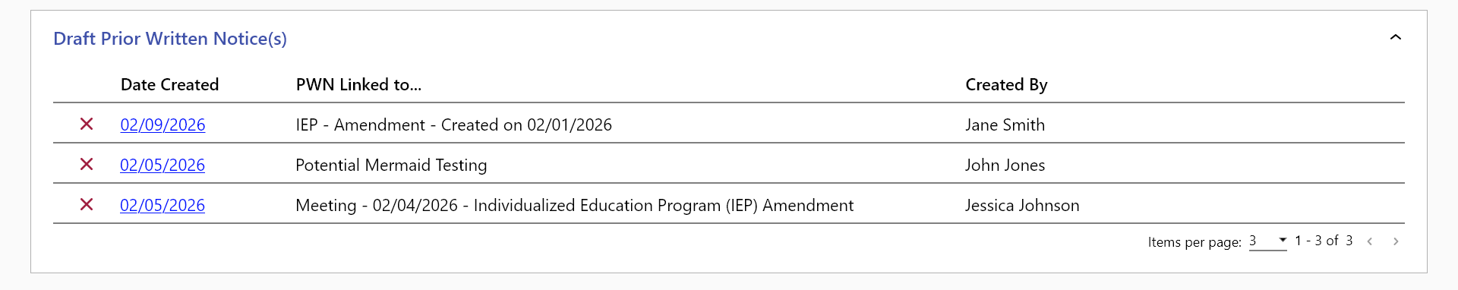
Draft Prior Written Notice(s)
When a learner has a PWN in progress, a new Draft Prior Written Notice(s) accordion appears on the Documentation stepper.

Slide 43
Deleting a Draft from Documentation
Authorized users can select the X to delete a draft:
User who created the PWN
Super Admin users
Location-based Data Leads
Selecting the X opens the Confirm Deletion window.

Slide 44
Finalizing Draft PWNs

Slide 45
New To Do for Draft PWNs
When a PWN remains unfinished for 5 or more days, ACHIEVE generates a To Do for the user who created the PWN.
To Do begins with: Finalize Draft PWN

Slide 46
Finalize Draft PWN To Do
Finalize Draft PWN
The To Do identifies the draft using:
PWN Linked to…
Date Created
Due Date: 9 days after the PWN was created

Slide 47
Resolving the To Do
Resolving the To Do
Select Resolve to open the PWN in progress.
The To Do ends when the:
PWN is finalized or completed
Draft PWN is deleted
Learner exits

Slide 48
Family Portal Notifications
Notification when a PWN is finalized

Slide 49
What the Family Receives
When a PWN is finalized, eligible family contacts receive an email notification.
Subject: New Document is Available in Your Portal Account to Review
The email:
Lets the family know a new document is available
Directs the family to log in to the portal to access it

Slide 50
PWN Output Changes
How PWN changes are reflected in the final document

Slide 51
Updated PWN Documents
ACHIEVE PWN outputs are being updated to align with the revised PWN process.
Updated outputs include:
Early ACCESS Prior Written Notice
Special Education Prior Written Notice

Slide 52
Unfinalized PWN Report
Supporting timely completion of Prior Written Notice

Slide 53
Identifying PWNs That Remain Unfinalized
ACHIEVE will include a new canned report:
Unfinalized PWN Report
The report identifies:
Learners with an unfinalized PWN that has been open for 10 or more days

Slide 54
Supporting Timely PWN Completion
Finalize Draft PWN
To Do | Unfinalized PWN Report
Appears at 5+ days | Identifies PWNs open 10+ days
Assigned to the PWN creator | New canned report
Opens the in-progress PWN | Identifies learners with an unfinalized PWN
These tools increase visibility of PWNs that have not yet been finalized.

Slide 55
Thank You

