Slide 1

Special Education Policy and Practice Webinar Series
Prior Written Notice

Slide 2

Welcome
Questions?
  Please submit questions using the webinar Q & A
Slide note catcher will be shared in chat at the beginning of each webinar
Slides will be posted on the DE website after the webinar
Policy & Practice Webinar Series & Recordings | Department of Education

Slide 3

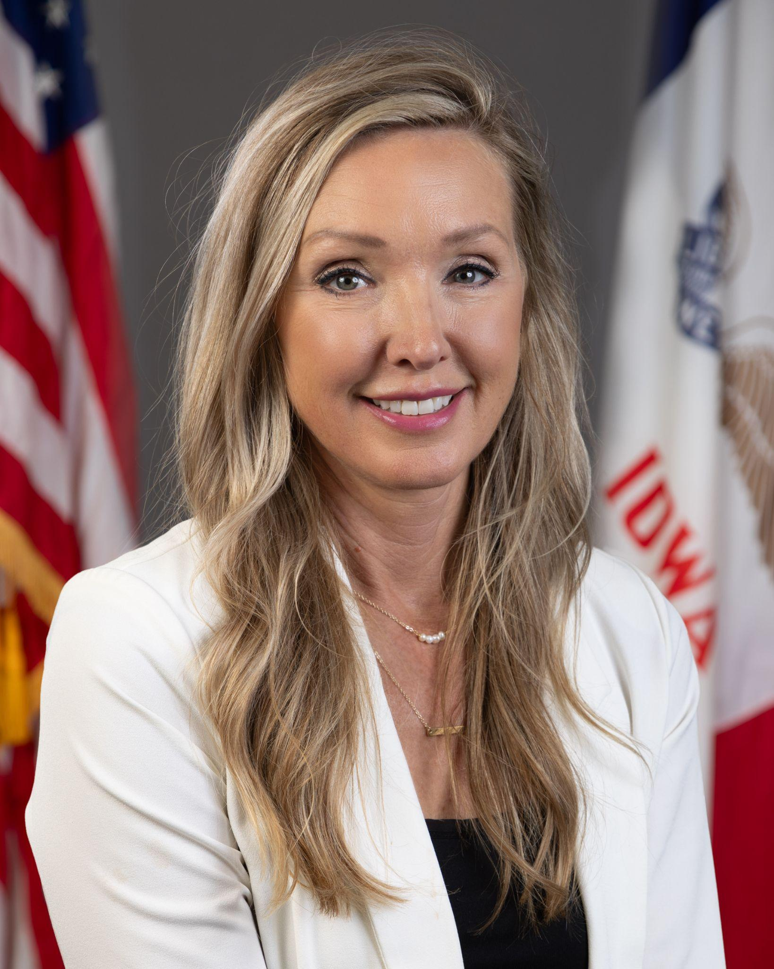

Today’s Presenters
Name: Molly Elston
Title: Regional Special Education Director-Prairie Lakes,
Division of Special Education
Name: Amy Thoms-Starr
Title: Regional Special Education Director-Central Rivers,
Division of Special Education
Name: Betsy Lin
Title: Bureau Chief
Division of Special Education, Bureau of Student Evaluation, Instruction, and Services
Education Program Consultants that contributed to today’s session: Laura Ramaekers, Katherine Hall, Jessica Hernandez, Amanda Juhl, Shannon Grundmeier

Slide 4
Participants will:
Policy
Understand the legal requirements of a Prior Written Notice (PWN)
Identify when a PWN is required or recommended
Know how to determine and document appropriate content in a PWN
Learn the current areas of concern and lack of understanding in development and delivery of PWNs
Practice
Understand the importance of parent voice and user friendliness in a PWN
Learn how to engage in General Supervision with PWNs
Learn PWN updates in ACHIEVE (releasing Mid-September ‘26)

Slide 5
Policy

Slide 6
Iowa Administrative Code:
Prior Notice by the Public Agency
Written notice must be given to the parents of a child with a disability within a reasonable time before the public agency proposes or refuses to initiate or change:
  The identification
  Evaluation
  Educational placement of the child; or
  The provision of FAPE to the child
Iowa Administrative Code rule 281– 41.503

Slide 7
When is a PWN Required?
Proposing/Refusing an action, decision, consideration requested by the parent
(Re)Evaluations
Change in placement
  Initial eligibility
  Consider disciplinary actions beyond 10 days
  Change in LRE
  Exiting special education services - ALL reasons
Change in service provision and current needs for FAPE
  IEP team designs a new plan for a learner
    Amendments (with and without a meeting)
  Extended School Year Services (ESYS) determination
If in doubt, use a PWN. It is an equal protection for districts and family.

Slide 8
When is a PWN Not Required?
Change in material or methodology
Change of qualified service provider
Change in location of service not controlled by school agency
  Court or HHS ordered placement
Change in location of service which does not change service or placement
  Classroom, Building, Teacher
If in doubt, use a PWN. It is an equal protection for districts and family.

Slide 9
Required Contents of a PWN
Description of the action proposed or refused by the agency
Explanation of why the agency proposes or refuses to take the action
Description of each evaluation procedure, assessment, record, or report the agency used as a basis for the proposed or refused action
Statement of the procedural safeguards and parent supports
Sources for parents to contact to obtain assistance in understanding the provisions of these laws/rules
Description of other options the IEP team considered and reasons why those options were rejected
Description of other factors relevant to the agency’s proposal or refusal
281 IAC-41.503

Slide 10
Parent’s Procedural Safeguards: Notice in Understandable Language
Notice must be in language understandable to the general public
Must be provided in the native language of the parent or other mode of communication
  Unless it is clearly not feasible
If the language/mode of communication is not a written language, the public agency must take steps to ensure:
  The notice is translated orally or by other means to the parent in the parent’s native language or other mode of communication
  The parent understands the content of the notice
  There is written evidence that the requirements have been met
281 IAC -41.503

Slide 11
Creating a Clear Record
PWN requirements exist for a purpose
  Provides a record of decisions
  Ensures parents are fully informed and able to meaningfully participate
In Union School District v. Smith (9th cir. 1994)
  “This formal requirement has an important purpose that is not merely technical, and we therefore believe it should be enforced rigorously.”
Absence of, or misleading, PWN creates confusion
  Decisions must be clear and understandable to all parties
Notes:
.

Slide 12
State Complaints in Iowa
Misleading PWN (2026)
Timely notice of PWN (2026)
  Caution when multiple meetings are held
  Even if all decisions are not made in one meeting, PWN required when proposals or refusals occur
Blank PWN and no PWN provided after an amendment (2025)
Insufficient information, not providing PWN for qualifying requests made by email (2026)
Delay in issuing PWN, even after one was requested by parents, and insufficient information (2026)
In several cases, PWN violations resulted in denial of meaningful parent participation (2025, 2026)

Slide 13
Case Law
PWNs must accurately reflect what occurred (123 LRP 14125, SEA OH 2023)
PWN needs to be provided with “enough time to fully consider the change and respond to the action before it is implemented” (OSEP, April 2012)
  Providing notice before meeting could suggest predetermination
PWNs must adequately explain the team decisions (123 LRP 17953, SEA WA, 2023)
Information in PWN is that which is always necessary regardless of the circumstances surrounding the proposal
  Does the information provided in the PWN provide sufficient content (as required) around the proposals/refusals? (116 LRP 11536, SEA OH 2016)

Slide 14
Practice

Slide 15
Beyond a Form
A legally compliant PWN is more than a complete form
A PWN must support parent(s) understanding and foster active participation.
Clearly communicates the team’s decision
Explains the rationale for the decision
Reflects meaningful parent participation
Is understandable to families

Slide 16
Reflecting Parent Voice
Parent voice is reflected when the PWN:
Documents parent concerns accurately
Includes information shared by the family
Explains how parent input was considered
Connects parent input to the team's discussion

Slide 17
Reader-friendly PWN
Minimizes educational jargon
Explains technical terms when needed
Connects data to the team’s decision
Focuses on clarity rather than complexity

Slide 18
Review and Reflection
Reviewing the PWN:
Reflect parent voice
Explain the team’s rationale
Use language families can understand
Accurately reflect the discussion
Support parent understanding
Have a reasonable “implementation date”
Reflection Questions for Administrators:
Could a parent identify the concern that prompted the discussion?
Could a parent understand this section without additional explanation?
Does it explain the data the team used to make the decision?
Does it communicate the team's thinking or simply document the final decision?

Slide 19
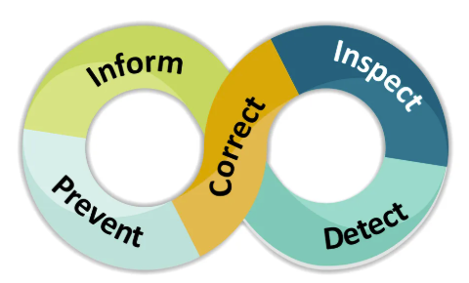
General Supervision
Prevent
  Review PWNs for accuracy and comprehensiveness prior to being sent to families
Inform
  Ensure staff have adequate training and knowledge of the requirements of PWNs
Detect
  Run an “Open PWN” report
Inspect
  Are there patterns in PWN noncompliance?
Correct
  Have staff revise draft PWN or issue new PWN

Slide 20
PWN Updates to ACHIEVE
Coming Mid-September 2026

Slide 21
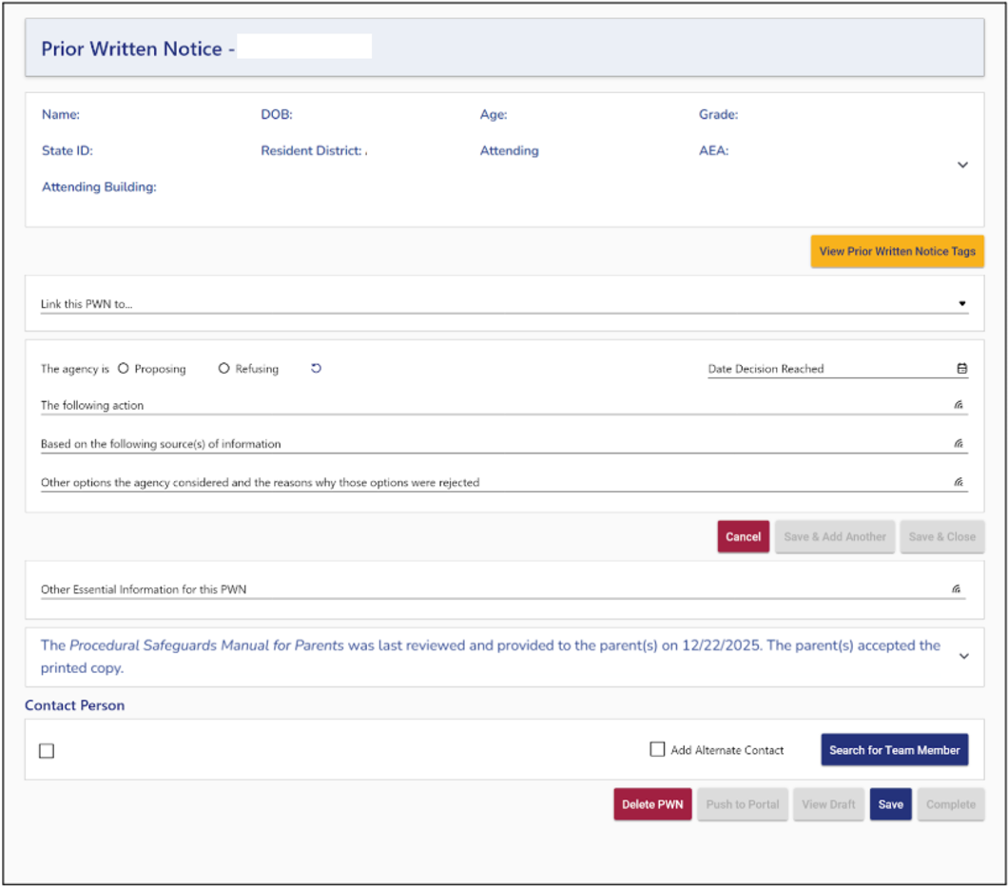
Prior Written Notice: Key Changes
Manage multiple drafts - More than one draft PWN may be in progress for a learner
Locate unfinished PWNs - Drafts are accessible from the Documentation stepper
Link the PWN to a process - Required
Document actions individually - Proposed or refused action is entered separately
Identify contact persons- Select the PWN creator and/or search for team members

Slide 22
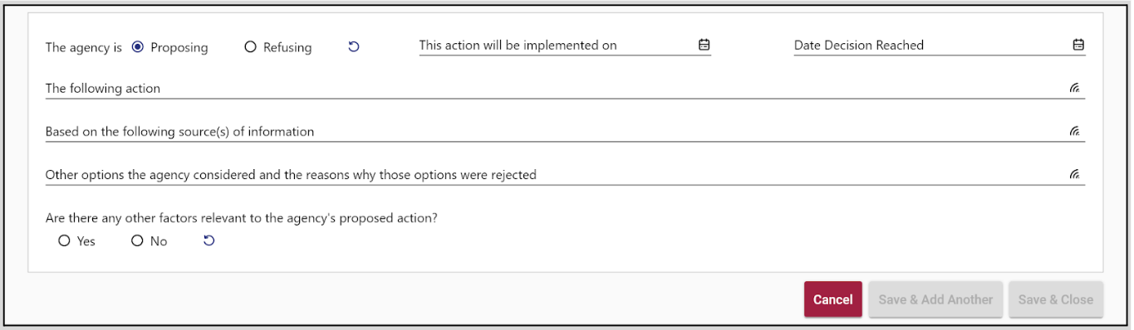
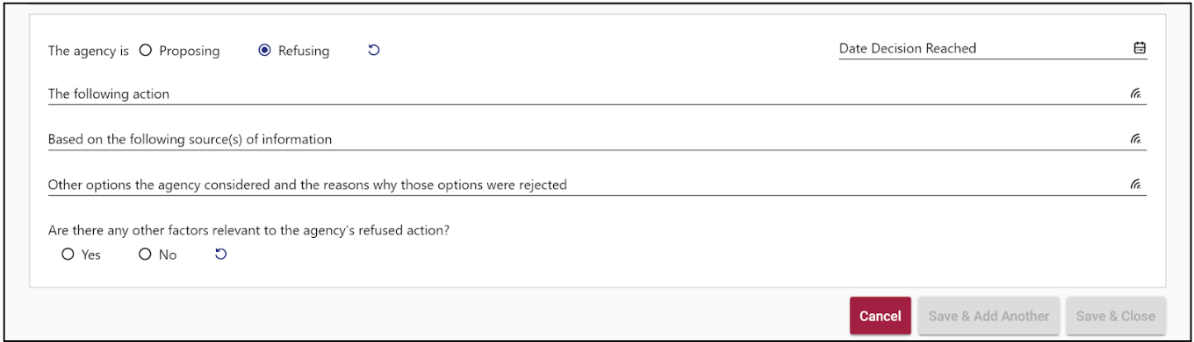
Documenting Proposed and Refuse Actions
Each action is documented separately, including:
Proposing or Refusing
Date Decision Reached
Action
Sources of Information
Other options considered and reason rejected
Relevant factors, when applicable
Implementation date, when proposing
At least one proposed or refused action must be saved before the PWN can be completed.

Slide 23
Managing Draft PWNs
Multiple Drafts
More than one PWN may be in progress for a learner
Open an existing draft or create a new PWN
Finding Drafts
Draft PWNs appear in the Documentation stepper
Select the Date Created to reopen a draft
Unfinished Drafts
After 5 days, an unfinished qualifying PWN generates a To Do for the PWN creator
An Unfinalized PWN Report identifies PWNs open 10 or more days
Delete a Draft
A draft created in error can be deleted by the person who created it
Find further information about ACHIEVE Changes on the Iowa Department of Education website

Slide 24
Upcoming Policy and Practice

Slide 25
Future Policy and Practice Webinars
Upcoming Topics and Dates (9:00 am - 10:00 am)
October 14, 2026: IEP Team Member Roles and Responsibilities
November 18th, 2026: Appropriate duties of paraeducators
December 9, 2026: Accessible Educational Materials

Slide 26
Questions from the field
Please add your questions in the Q & A.

Slide 27
Thank You!

