Slide 1

Special Education Policy and Practice Webinar Series
Regulations and Considerations for Preschool Administrators

Slide 2

Welcome
Questions?
  Please submit questions using the webinar Q & A
Slide note catcher will be shared in chat at the beginning of each webinar
Slides will be posted on the DE website after the webinar
Policy & Practice Webinar Series & Recordings | Department of Education

Slide 3
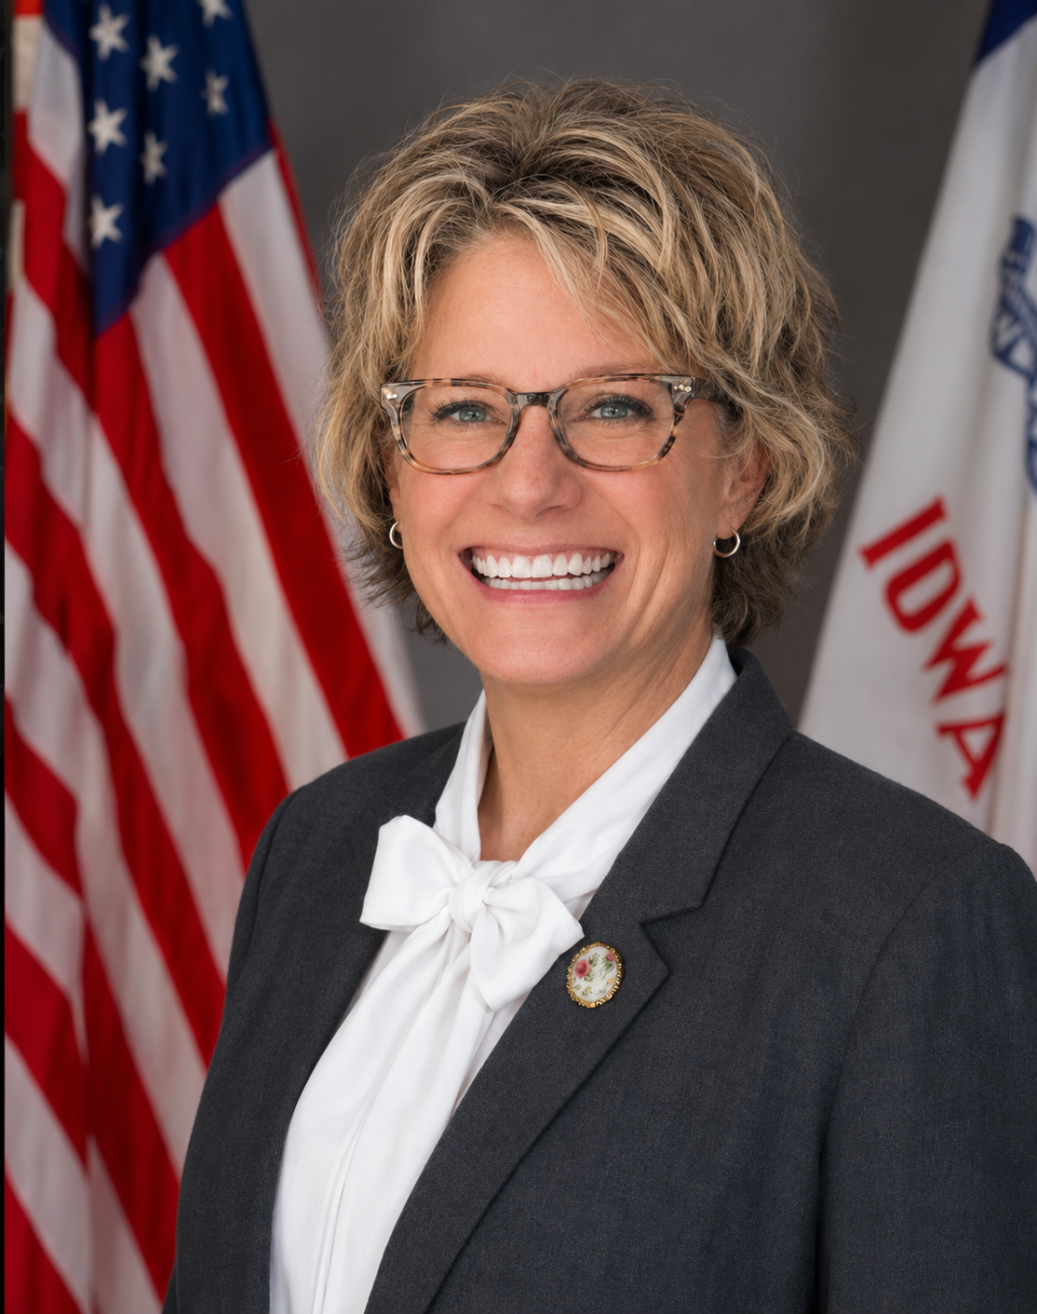
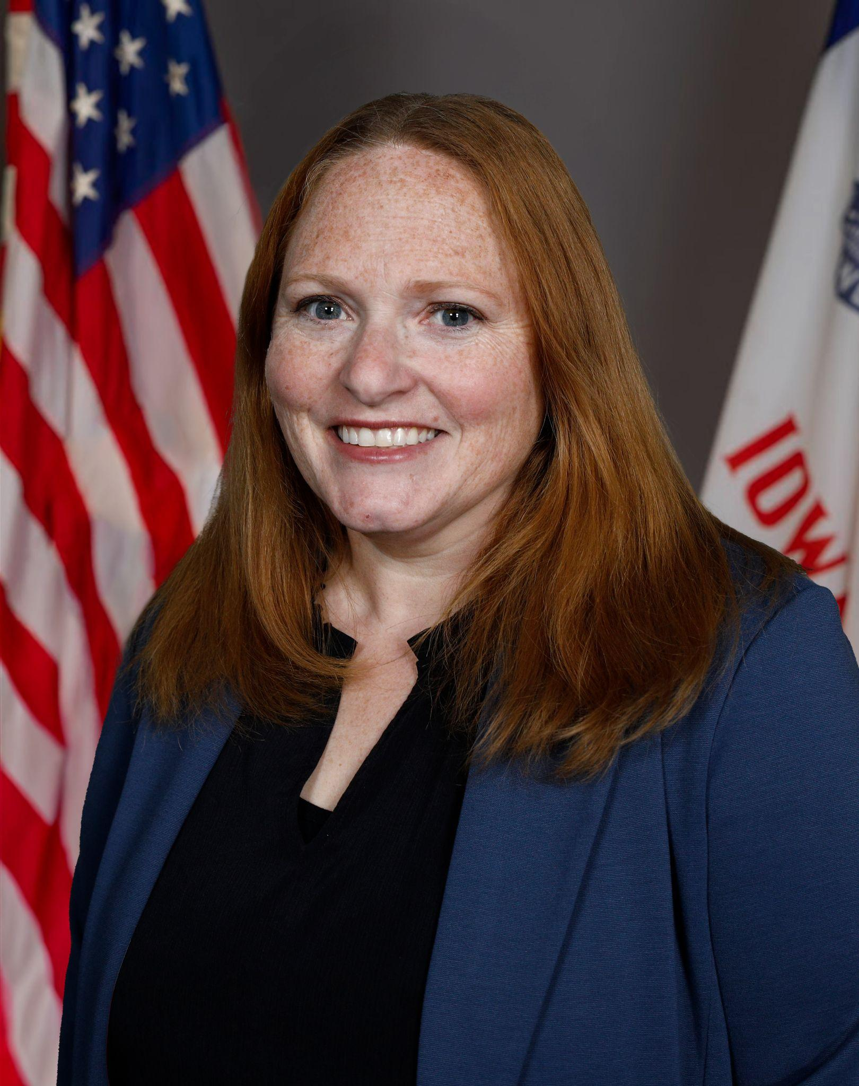

Today’s Presenters
Other Department staff who contributed to today’s session:
Denise Kepner, Tiffanie Nederhoff, Melissa McGuire, Kristi Duhn, Mary Breyfogle
Kimberly Villotti
Bureau Chief
Bureau of Early Childhood
Celeste Mortvedt
Administrative Consultant
Bureau of Early Childhood

Slide 4

Today’s Topics
Assurances and Program Standards
Regulations and considerations related to:
  Free Appropriate Public Education (FAPE)
  Least Restrictive Environment (LRE)
  Transition
Connections to Preschool Practice
  Program requirements
  IEP similarities and differences
  RECP/ACHIEVE

Slide 5

Why Preschool Leadership Matters
High Quality Preschool
Inclusive Opportunities
IDEA Implementation
Better Child Outcomes

Slide 6
State and Federal Regulations
Chapter 12
IDEA
K-12
Assurances & Program Standards
IDEA
Preschool

Slide 7
Program Standards: High Quality General Education Settings
Relationships | Family and Community Connections | Curricula
Teaching Practices | Assessment | Learning Environments
Health and Safety | Professionalism | Leadership and Management

Slide 8

Program Assurances
Program Operations and Accountability | Family and Community Engagement
Professionalism | Teaching & Learning

Slide 9

An Interconnected System
IDEA
Program
Assurances
Program
Standards

Slide 10

FAPE

Slide 11

FAPE in Regulations
281—41.51(8) General education environment. “General education environment” includes, but is not limited to, the classes, classrooms, services, and nonacademic and extracurricular services and activities made available by an agency to all students. For preschool children who require special education, the general education environment is the environment where appropriate activities occur for children of similar age without disabilities.
281—41.17(256B,34CFR300)
Free appropriate public education. “Free appropriate public education” or “FAPE” means special education and related services that are provided at public expense, under public supervision and direction, and without charge; that meet the standards of the SEA, including the requirements of this chapter; that include an appropriate preschool, elementary school, or secondary school education; and that are provided in conformity with an individualized education program (IEP) that meets the requirements of rules 281—41.320(256B,34CFR300) to 281—41.324(256B,34CFR300).
281—41.160(256B,34CFR300) Participation in assessments. 41.160(1) General. The state must ensure that all children with disabilities are included in all general state and districtwide assessment programs, including assessments described under Section 1111 of the ESEA, 20 U.S.C. Section 6311, with appropriate accommodations and alternate assessments, if necessary, as indicated in their respective IEPs.
No cost to families
Individualized through the IEP
District responsibility
General AND Special Education Services

Slide 12

FAPE Considerations
Timely services
IEP implementation
SDI
Qualified staff
Family Partnerships
Enrollment possibilities
FAPE answers what districts must provide
while LRE answers where it is provided.

Slide 13

LRE

Slide 14
LRE in Regulations
281 41.115(1) General. Each public agency must ensure that a continuum of alternative services and placements is available to meet the needs of children with disabilities for special education and related services.
281 41.116(1) General. In determining the educational placement of a child with a disability, including a preschool child with a disability, each public agency must ensure the following: a. The placement decision shall be made: (1) By a group of persons, including the parents and other persons knowledgeable about the child, the meaning of the evaluation data, and the placement options; and (2) In conformity with the LRE provisions of this chapter, including rules 281—41.114(256B,34CFR300) to 281—41.118(256B,34CFR300); b. The child’s placement shall be: (1) Determined at least annually; IAC 12/10/25 Education[281] Ch 41, p.17 (2) Based on the child’s IEP; and (3) Located as close as possible to the child’s home; c. Unless the IEP of a child with a disability requires some other arrangement, the child shall be educated in the school that he or she would attend if nondisabled; d. In selecting the LRE, the agency shall consider any potential harmful effect on the child or on the quality of services that he or she needs; and e. A child with a disability shall not be removed from education in age-appropriate regular classrooms solely because of needed modifications in the general education curriculum.

Slide 15

LRE in Regulations, continued…
IDEA Regulations. 34 CFR § 300.114(a)(2)
"Each public agency must ensure that— i) To the maximum extent appropriate, children with disabilities, including children in public or private institutions or other care facilities, are educated with children who are nondisabled; and ii) Special classes, separate schooling, or other removal of children with disabilities from the regular educational environment occurs only if the nature or severity of the disability is such that education in regular classes with the use of supplementary aids and services cannot be achieved satisfactorily."
Children should receive services alongside peers without disabilities to the maximum extent possible.

Slide 16
Additional Points From the OSEP Dear Colleague Letter on Preschool LRE
Requirements apply when determining placement options for a child with a disability who already participates in a regular public preschool program, including a community-based regular public preschool program operated by a public agency other than the LEA.
Unless the child’s IEP requires some other arrangement, the child is educated in the school that he or she would attend if nondisabled. (34 CFR §300.116(c))
The placement team, which includes the child’s parent and may include the child’s current teacher, must consider any potential harmful effect on the child and on the quality of services that he or she needs before removing the child from the current regular public preschool setting to another more restrictive setting. (34 CFR §300.116(d))

Slide 17
LRE Considerations
Build inclusive opportunities
Maintain a continuum of placement options
Support staff with accommodations and services
Placement is an IEP team decision
Placement is based on the child’s IEP
ECTA Center: Making Sound Preschool LRE Decisions
Requirements of classrooms providing services for children with IEPs:
Follow one of the approved sets of program standards
  NAEYC, Head Start, IQPPS
Use of SmartTeach GOLD Assessment

Slide 18
Myths and Facts - Placement Decisions
Myths | Facts
Learners with IEPs do not count towards class ratio | ALL learners count towards the 1:10 ratio and group size. Non-weighted IEPs count toward the special education ratio
The program cannot serve the child because it is full | Programs are required to provide services to children who are eligible for early childhood special education
3-year-olds have to be placed with other 3-year-olds | Mixed-age classrooms are a viable and appropriate consideration
3-year-olds attend less frequently than 4-year-olds | FAPE and SDI should be based on individual learner needs*
3-year-old classrooms do not need to follow program standards | Classrooms serving learners with IEPs enrolled must follow program standards

Slide 19

Transition

Slide 20

Transition in Regulations
281—41.124(256B,34CFR300) Transition of children from the Part C program to preschool programs. Each public agency shall comply with the state’s policies concerning the transition of infants and toddlers from programs under Part C to programs under Part B of the Act and shall ensure the following regarding such transition: 41.124(1) Smooth transition. Children participating in early intervention programs assisted under Part C of the Act, and who will participate in preschool programs assisted under Part B of the Act, experience a smooth and effective transition to those preschool programs in a manner consistent with Section 637(a)(9) of the Act; 41.124(2) IEP developed. By the third birthday of a child described in subrule 41.124(1), an IEP has been developed and is being implemented for the child consistent with subrule 41.101(2); and 41.124(3) Participating agencies. Each affected LEA will participate in transition planning conferences arranged by the designated lead agency under Section 635(a)(10) of the Act.
Transition is
a process
NOT
a meeting

Slide 21

Transition Considerations
Process for communication with Early ACCESS teams and families
Transition plans in place and understanding of timelines for both Part C to Part B and Pre-K to K
Making placement decisions as a team
Prioritizing family supports and communication
The transition process is continually reviewed and improved
  Initial contact
  Meetings
  Documentation/paperwork
  Family involvement
  Child supports
  First day follow-up

Slide 22

Connections to Preschool Practice

Slide 23
Programming Requirements
Every Child Receives | Every Classroom Includes | Every District Considers
FAPE Specially Designed Instruction (SDI) LRE GOLD Assessment | Inclusive opportunities Family communication Approved program standards Qualified staff Evidence-based practices | Continuum of services Family communication Classroom capacity Staffing Year-round enrollment

Slide 24

IEP Similarities: K-12 and Preschool
All children are general education student FIRST and entitled to FAPE
Parental rights
Parents are active members of the IEP team
Placement conversations with consideration of LRE
Children receive specially designed instruction (SDI)
Progress monitoring is required
Open enrollment

Slide 25

IEP Differences in Early Childhood
Early Childhood Outcomes (ECO)
Special education funding
Full time (20+ hrs) /half time (less than 20 hrs)
Transition to ECSE services from Early ACCESS at three years of age
Eligibility/exclusionary factors
Kindergarten transition has a unique documentation process in ACHIEVE

Slide 26
One more unique difference
Regular Early Childhood Program (RECP)
For IDEA reporting purposes, data collection guidance specifies:
"A Regular Early Childhood Program (RECP) for the purpose of OSEP required data collection is defined as a program that includes a majority (at least 50 percent) of nondisabled children (i.e., children not on IEPs).”
Does the child attend any Regular Early Childhood Programs (RECP) and for how long?
Once the IEP is written, where will the special education services be provided?
Accurate entry of the RECP for both weighted
and non-weighted IEPs is essential to correct setting codes
being generated for reporting purposes.

Slide 27

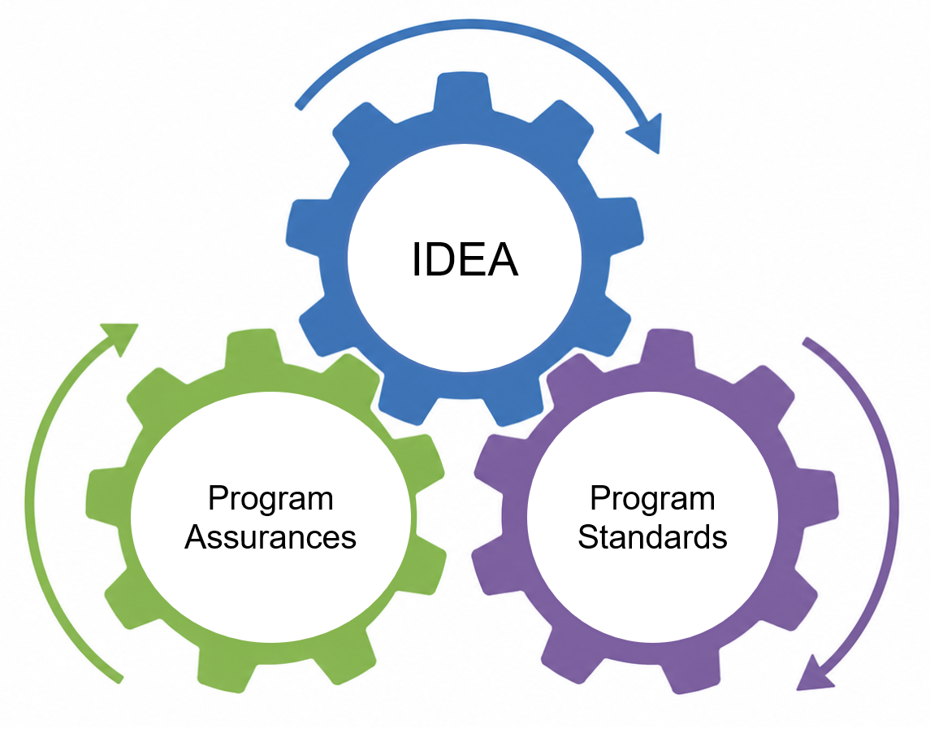
System Level Questions to Consider
How are decisions made about where and when to provide special education services to preschool learners in your district? What is in your district’s District Developed Service Delivery Plan (DDSDP)?
Do you have processes to support decisions surrounding:
  FAPE
  Placement
  LRE
  Transition

Slide 28

Stay Up To Date
Subscribe to the monthly Early Childhood Newsletter

Slide 29
Future Policy and Practice Webinars
Upcoming Topics and Dates (9:00 am - 10:00 am)
September 9, 2026: Prior Written Notice
October 14, 2026: IEP Team Member Roles and Responsibilities

Slide 30
Questions from the field
Please add your questions in the Q & A.

Slide 31
Supporting Resources
https://ectacenter.org/topics/inclusion/indicators.asp- ECTA indicators for high quality inclusion
https://ectacenter.org/topics/iep/iep-reference.asp- ECTA preschool LRE reference points and discussion prompts
ECTA Center: Making Sound Preschool LRE Decisions
Making Sound Placement Decisions for Children with Disabilities, Ages 3-5
  (1 hour, ECTA, presented to CT State Department of Education, January 2021)
https://sites.ed.gov/idea/files/policy_speced_guid_idea_memosdcltrs_preschool-lre-dcl-1-10-17.pdf

Slide 32
Thank You!

