Slide 1

Pathway to Statewide Voluntary Preschool Program Participation for Community-Based Providers
July 2026

Slide 2
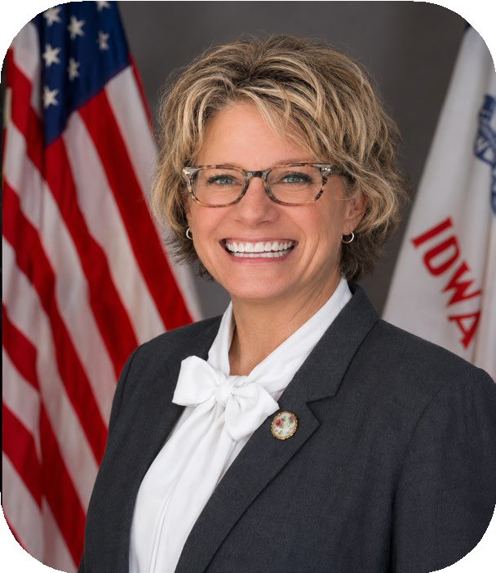
Welcome!
In accordance with HF2754
District Program: a public school district approved to provide the SWVPP within district or community partner locations. The district is responsible for ensuring that any community partner sites have access to required training opportunities and implement all applicable SWVPP program assurances outlined below.
  Community Partner: an approved program partnering with their local school district to provide a SWVPP. The district monitors all partner locations.
Kimberly Villotti Early Childhood Bureau
Chief
Community-Based Provider (CBP): a provider approved to directly participate in the SWVPP. CBPs operate independently from school districts and are not a part of an approved local district program.

Slide 3
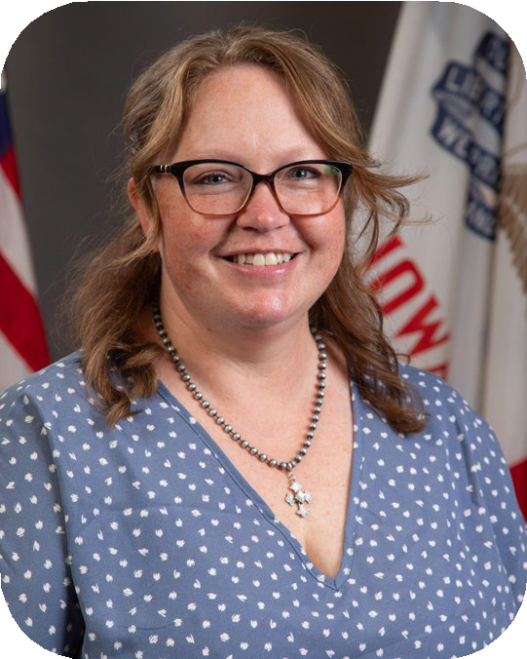
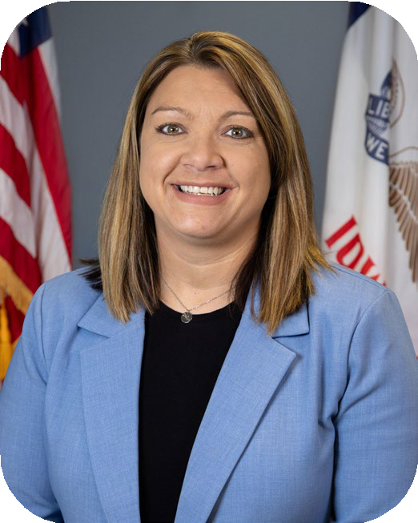

Meet the SWVPP Team
Amy Stegeman Early Childhood Consultant Bureau of Early Childhood
Marcie Lentsch Early Childhood Consultant Bureau of Early Childhood

Slide 4

Agenda
Pathway to SWVPP CBP Participation
Phase 1: Explore
Phase 2: Plan and Apply
Phase 3: Implement and Sustain
Time for Questions

Slide 5
Three Phases To Become A SWVPP CBP in Iowa
Phase 3: Implement and Sustain
Phase 1: Explore
Phase 2: Plan and Apply
❏ Program is able to meet the four foundational requirements of SWVPP:
❏ Teacher Licensure
❏ Location
❏ GOLD® Subscription
❏ Student Information System
❏ Review CBP application timeline and approval process
❏ Design and refine preschool program to align with selected program standards
❏ Select a set of program standards & curricula
❏ Update systems and procedures to ensure reporting requirements will be met
❏ Complete and submit CBP application via IowaGrants by Friday, August 21, 2026
❏ Review materials on SWVPP webpage and IowaGrants.

Slide 6

Four Foundational Requirements of a SWVPP
Phase 1: Explore
Licensed Teacher
Location
SmartTeach GOLD® Assessment
Student Information System

Slide 7

Teacher Licensure
Valid practitioner license issued by the State of Iowa - Board of Educational Examiners
Appropriate teaching endorsements are:
  Teacher Endorsement #100 -- Prekindergarten through grade three, including special education
  Teacher Endorsement #103 – Prekindergarten through kindergarten
  Teacher Endorsement #106 – Prekindergarten through grade three
  Teacher Endorsement #1001 – Birth through grade three inclusive settings

Slide 8

Location
Maximum group size of 20 children in a classroom with adequate space available (a minimum of 35 square feet of usable space per child).
Teaching staff-child ratio is identified as 1 teacher per 10 students for SWVPPs.
A minimum of one appropriately licensed teacher and one staff member must be present when 11 to 20 four-year-old children are present.
Programs should refer to their locally selected preschool program standards for further guidance pertaining to outdoor space requirements.

Slide 9
Assessment
All SWVPP classrooms are required to assess all students using the SmartTeach GOLD® online assessment system.
As a subscriber under the State of Iowa GOLD® agreement, the program administrator/director will ensure the assessment is implemented across all classrooms, including at a minimum the completion of the spring checkpoint.
Programs are encouraged to complete three checkpoints: fall, winter and spring in order to implement a systematic ongoing procedure for obtaining assessment information.
Teaching Strategies GOLD® Assessment SmartTeach GOLD Setup Logistics
Iowa GOLD Initial Application Form Iowa GOLD® Assessment Procedures
GOLD® Getting Started Checklist for New Administrators
Note: Iowa Code section 279.60 requires the administration of the SmartTeach GOLD® assessment to all prekindergarten children enrolled.

Slide 10


Student Information System
All SWVPPs will utilize a Student Information System (SIS)
4 approved vendors
  JMC
  Infinite Campus
  PowerSchool
  Alma
Student information data is used in multiple reporting processes:
For Assistance Contact: Rachel Kruse
515-281-4153
rachel.kruse@iowa.gov
Student Reporting in Iowa (SRI)
Certified Enrollment
  Funding

Slide 11

SWVPP Funding
Children age-eligible for SWVPP funding in 2026-2027 must be 4 years of age on or before September 15th
SWVPP age-eligible children generate .50 of per pupil state funding (FY27 SPPF - $8,148; $4074)
Funding for children receiving special education services will vary
If space is available, children younger or older may participate in a SWVPP classroom. Younger/older children will NOT generate SWVPP funding and may require an alternate funding source. Enrollment of four-year-old children should be prioritized.

Slide 12
SWVPP CBP Funding
Initial Student Enrollment Count: Preliminary number of children/students being served
Certified Enrollment: October 1
Reconciliation Process: Occurs to determine accurate funding based on certified enrollment
Payments: Processed monthly
Subsequent Years: Funding based on enrollment count of the prior year

Slide 13
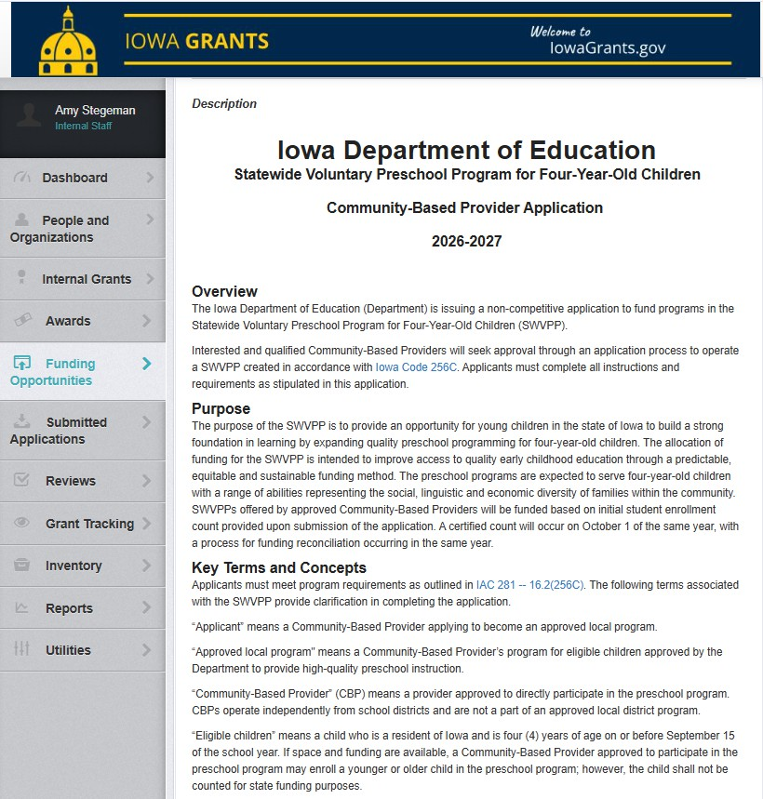

Review materials on SWVPP webpage.
Phase 1 Tools

Slide 14
Phase 2:
Plan and Apply
Review application timeline
Select one of the three program standards & an evidence-based and research-based curricula
Complete and submit CBP application by 4:30 PM on Friday, August 21

Slide 15
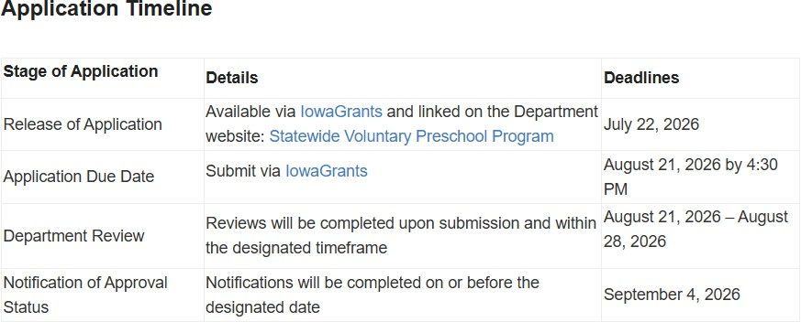
CBP Application Timeline and Approval Process

Slide 16

SWVPP Program Standards
The three Iowa approved preschool program standards that meet the characteristics of quality early childhood programs:
2026 Iowa Quality Preschool Program Standards (IQPPS)
Head Start Program Performance Standards (HSPPS)
National Association for the Education of Young Children (NAEYC Accreditation+)

Slide 17

Curricula
SWVPPs must adopt a research-based or evidenced-based curriculum aligned to all areas within the Iowa Early Learning Standards.
Resources for selecting curricula can be found on the SWVPP webpage.

Slide 18
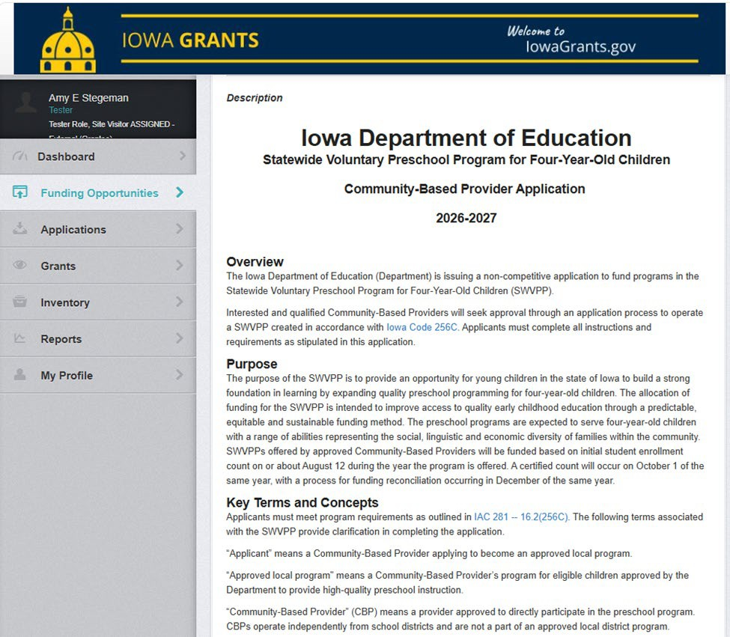
SWVPP Community-Based Provider Application
A completed application includes:
Cover Page
Assurances
Collaboration with Community Stakeholders
Program Plan to Provide Quality Preschool
Preschool Budget Plan
Submit by 4:30 PM on August 21, 2026

Slide 19
Phase 3:
Implement and Sustain
Design and refine the preschool program to align with selected program standards.
Update systems and procedures to ensure reporting requirements will be met according to the respective timeline.
Data collection efforts are completed throughout the school year:
Preschool Desk Audit (CASA): Part 1 - September 15
Program Assurances and Requirements (CASA)
Certified Enrollment Report (SIS): October 1

Slide 20

Resources and Contact Information
Statewide Voluntary Preschool Program web page:
  Recommended Year At A Glance Timeline Resource
  Coming Soon: CBP webinar recording and FAQs
  Coming soon: Program Requirements and Assurances Tool
Early Childhood Standards web page
Teaching Strategies in Iowa
Questions regarding the application process may be directed to Marcie Lentsch at marcie.lentsch@iowa.gov.
Questions regarding IowaGrants may be directed to Amy Stegeman at amy.stegeman@iowa.gov.

Slide 21


Questions?
All questions will be recorded and posted to a common FAQ document and posted to Statewide Voluntary Program webpage following the live webinar.

