Slide 1
Special Education
Lessons Learned &
Allowable Uses
June 30, 2026

Slide 2
Department Team
Q/A Facilitators
Presenters
Presenters
Special Education – Central Division:
Leisa Breitfelder, Division Administrator
Office of the Director:
Thomas Mayes,
General Counsel
Bureau of School Business Operations: Dr. Kassandra Cline, Bureau Chief
Bureau of School Business Operations: Stephanie Edler, Administrative Consultant
Sarah Sheeder, Education Program Consultant

Slide 3
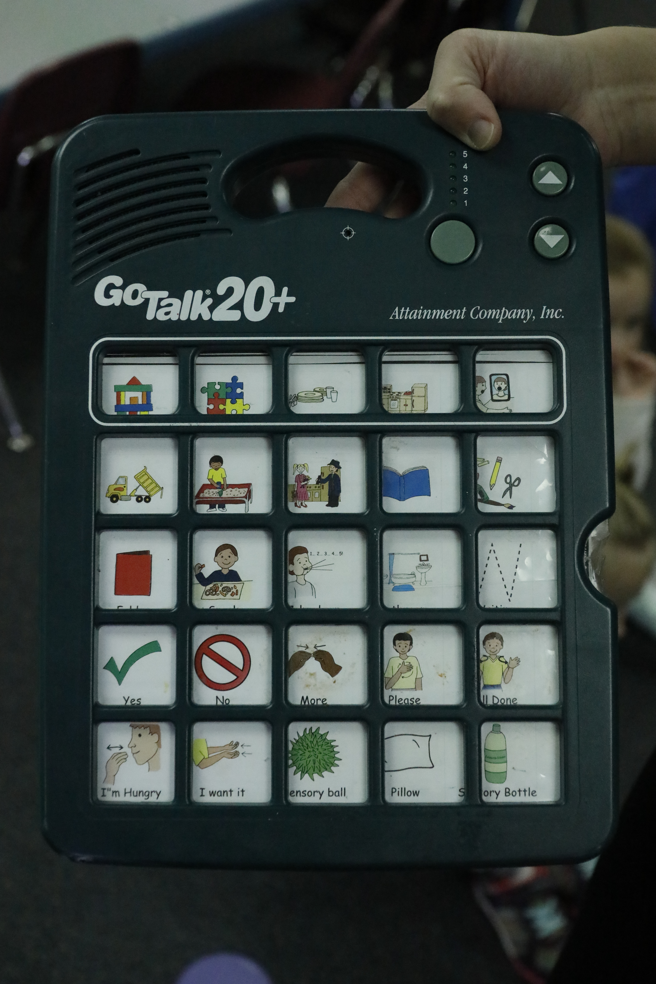
Fiscal Monitoring
General supervision
OSEP Report
SBRC

Slide 4



General Supervision
Ensure appropriate use of local, state, and federal funds
Iowa Code section 256.1
1. The department of education is established to act in a policymaking and advisory capacity and to exercise general supervision over the state system of education…
Expenditures regularly exceed funding; special education deficit grows annually.
Special education is a $1B program.

Slide 5
Department & IDEA
Part B of the Individuals with Disabilities Education Act (IDEA 34 C.F.R. §§ 300.149 and 300.600)
Individuals with Disabilities Education Act (IDEA)
Department is grantee and pass-through agency and requires subrecipient monitoring to ensure compliance with both fiscal and programmatic requirements.
34 C.F.R. § 76 of the Education Department General Administrative Regulations (EDGAR)
2 C.F.R. § 200, Uniform Administrative Requirements, Cost Principles, and Audit Requirements for Federal Awards (Uniform Guidance)

Slide 6
Department Findings & Actions
Required Action: Increase and strengthen subrecipient fiscal monitoring
Office of Special Education Programs (OSEP)
Issued findings to the Department in July, 2025 based on fiscal monitoring practices.
Proactive monitoring: Implement IDEA PBC Application- includes proactive proof of IDEA fund use prior to issuance of reimbursements
Subsequent monitoring: Implement cycle of monitoring program costs – includes a deeper dive into actual finance and fiscal practices

Slide 7
SBRC
Annual Actions
Reviews special education weightings (Iowa Code § 256B.9)
School Budget Review Committee (SBRC)
Annual actions relating to special education weightings and balances, including deficit and excess amounts.
Authorizes modified supplemental amount (MSA) for deficit special education balances (Iowa Code § 257.31(14))
Reverts excess balances (Iowa Code §§ 257.31(14) and 257.36)
Directs the Department to analyze costs on a comparable basis and to conduct desk reviews and on-site reviews for districts identified as outliers in the analysis.

Slide 8
Decision Point: Determining Allowable Uses

Slide 9

Students
Every student is a general education student first.
Every student generates regular program state aid (i.e., 1.0 monies).

Slide 10
Decision Question & Answer
Cost for SE Student
SE Cost
GE Cost
Is every cost related to a special education student a cost to the special education program?
Answer: No.

Slide 11
Decision Question & Answer
Cost for SE Student
SE Cost
GE Cost
X
Question: Is every cost related to a special education student a cost to the special education program?
Answer: No.
Statutory Authority: Iowa Code section 256B.9(1) …“above the costs of instruction of pupils in a regular curriculum”.
Cost for Student
GE Cost
Starting Point
Everything is a GE cost, until it isn’t.

Slide 12
FY27 Fiscal Monitoring Process

Slide 13
FY27 Fiscal Monitoring
Like FY25, FY26 special education program expenditures will be reviewed.
Examples
Additional
Criteria
Initial Selection
Additional Selections
5-year cycle
20% of all districts will be reviewed each year
Any district can be selected any year, and can be more than once each five years
Risk assessment
SE deficit
SE costs

Slide 14
FY27 Fiscal Monitoring
Incorrect expenditures will be identified and required to be reported to auditor
Incorrectly coded expenditures may result in multiple consequences.
Negative MSA may be awarded
Account coding corrections may be required
Develop and implement corrective action plan

Slide 15
Observations and Lessons Learned

Slide 16
Observations from Review in FY26
FY23-FY25 expenditures were reviewed for select districts.
Overall
Transaction Line Review
Staff
Similar incorrect determinations
Tangible & non-tangible purchases
Salaries
Training
Other reimbursables

Slide 17
Lessons Learned
General office and instructional supplies
The Department identified many district needs during this review, most importantly was the type of technical assistance that is needed in the field for appropriate determinations of whether or not a cost is allowable to the special education program.
Transportation costs, furniture, technology
Staff costs

Slide 18
Lessons Learned
Recall, all students are general education students first. All students and staff are entitled to the same supplies.
Examples of unallowable costs
Folders
Tape
Paper
Binder
Cost: General office supplies
Allowability: No

Slide 19
Lessons Learned
Decision matrix – Is this how you are told you determine if a cost is appropriate to the SE program? This is not the way!
SE Student
SE Cost
Cost: Instructional supplies
Allowability: It Depends!

Slide 20
Lessons Learned
Example: Calculator
Decision matrix
Cost
Instructional Supply
Same as GE class
Pursuant to an IEP
Allowable to GE
Same as GE class
Allowable to GE
Specialized / Adaptive
Allowable to SE
Example: Writing supports on a computer
Cost: Instructional supplies
Allowability: It Depends!
Curriculum translated to braille

Slide 21
Lessons Learned
Instructional supplies should regularly be considered a cost to the general education classroom.
An instructional supply is only a cost to the special education program if it is
Different from what is provided in the general education classroom
Provided pursuant to an IEP
Specialized / adaptive
Cost: Instructional supplies
Allowability: It depends!

Slide 22
Lessons Learned
Examples of instructional supplies
Books
  Story books
    All classrooms can be equipped with storybooks. Just because the books will be housed, for example, in the SE classroom does not make them an SE cost.
  Social-emotional learning books
    Even if these books are purchased to help students regulate emotions pursuant to an IEP, if they are the same books used by the guidance counselor who provides this instruction to all students, it is not an SE cost.
Curriculum
  All students are entitled to curriculum.
  Just because it is for an SE student does not make it an SE cost.
  It still has to be modified in some way for SDI.
  Same curriculum = GE cost.
Games
  Games are a regular purchase for many classrooms.
  Just because the game is for the SE classroom does not make it an SE cost.
Cost: Instructional supplies
Allowability: It depends!

Slide 23
Lessons Learned
All students and staff are equally entitled to
Desks
Whiteboards
Technology
Chairs
These costs are generally only a GE cost since these are basic functions and furnishing of a classroom. These items are non-adaptive, non-specialized, and appropriate for any GE classroom. SE costs are only those that are beyond a GE classroom pursuant to an IEP and specialized / adaptive.
Desks
  Allowable example: Adaptive desk for student in a wheelchair
Whiteboards
  Allowable example: Individual, ergonomic / slant whiteboard for student with fine motor skill deficiency
Technology
  Allowable example: Extra large display for student with visual impairment
Chairs
  Allowable example: Hi-lo chair for student unable to exit the chair without assistance on a regular basis
Cost: Equipping a classroom
Allowability: It depends!

Slide 24
Lessons Learned
Purchased Transportation Services
Must be used only for the transportation of SE students with specialized transportation services in their IEP.
Staff
Only staff costs for those who drive a vehicle other than a yellow school bus can be charged to the SE program.
Time is eligible only when providing specialized transportation to eligible students.
Time is not eligible when transporting mixed groups of students.
Vehicle Maintenance and Repair
Do not charge costs to maintain vehicles to the SE program.
Vehicle maintenance / parts / fuel charged to SE is included in mileage rate for cars, vans, and buses.
  Calculated in Annual Transportation Report (ATR)
  Brought from ATR to Special Education Supplement (SES)
Cost: Transportation
Allowability: It depends!
Note: Transportation that is not specialized is a GE cost, even if students with IEPs are being transported.

Slide 25
Lessons Learned
Providing cash and cash equivalents are not an appropriate cost from any public funds, including special education.
Audit and Allow
  Iowa Code section 279.29
  Requires costs to be “audited” by the board before they are “allowed” to be paid
  If cash or cash equivalents are provided, there is not a way for the board to audit how the funds were spent before allowing the cost; therefore the cost shall not be allowed.
Public Purpose
  Article III, Section 31 of the Constitution of the State of Iowa
  Requires public funds be spent for a public purpose
  If cash or cash equivalents are provided, the district cannot determine if the cost met a public purpose.
Cost: Cash / Cash equivalents
Allowability: No

Slide 26
Lessons Learned
Incentives are allowable for any student in any service environment from GE sources.
Districts may have other specific sources that provide incentives, such as PBIS.
Costs for incentives for a behavior intervention plan (BIP) are allowable from GE sources.
Just because a student has a BIP does not make the behavior incentive an SE cost.
Costs for incentives in a BIP must be identified in an IEP to be allowable to the SE program.
  A student can have a BIP and not also have an IEP.
Cost: Incentives
Allowability: It depends!

Slide 27
Lessons Learned
Staff costs must be attributable to the SE program.
Staff costs should be prorated if they do not spend all of their time engaged in eligible SE program work.
Instructional staff are allowable from the SE program.
Support staff and SE directors are allowable from GE sources or special education support services (SESS) funding.
Internal Controls
Verify initial assignments when setting up account coding.
Make incremental checks throughout the year.
Conduct year-end test to ensure account coding is purposeful and accurate.
SESS Funding Reminders
Eligible for any SE instructional or support services cost
The 90% portion shall be fully expended each year pursuant to the AEA contract.
If a balance remains in the 10% retained
  It will create a restricted balance and be carried forward to the next year.
  The amount will be deducted from any MSA request related to an SE deficit balance.
Cost: Salary / Benefits
Allowability: It depends!

Slide 28
FY26 Action and FY27 Preparation: Challenges to the Field

Slide 29
FY26 Challenge
Check expenditure outliers (by function, object code combinations).
Engage in these activities prior to closing FY26 to mitigate identification of instances of noncompliance during the SE fiscal review of FY26.
Verify eligible staff were charged for the appropriate time to the program. Prorate where applicable.
Challenge: Review each line item expenditure for appropriateness to the program.

Slide 30
FY27 Challenge
Ensure proactive, incremental, and year-end review of program expenditures (TIP: SE and other programs).
Use what you learn from the FY26 expenditure review to identify potential areas of opportunity to strengthen practices and procedures to support the district’s success in FY27.
Page 1/2
Ensure properly trained staff are proactively utilized to determine whether a cost is allowable to SE before costs are approved.
Ensure the description in the accounting software is sufficient for each involved in the process to determine eligible expenditures. (TIP: Add SSID for individualized costs.)

Slide 31
FY27 Challenge
Document business procedures so all staff involved in the process are following the same procedures.
Use what you learn from the FY26 expenditure review to identify potential areas of opportunity to strengthen practices and procedures to support the district’s success in FY27.
Page 2/2
Provide staff training for anyone coding SE expenditures to reiterate expectations and business processes. Even seasoned staff can benefit from a refresher.
Identify necessary lines of communication between the business office and program staff.

Slide 32
Special Education Finance Resources

Slide 33
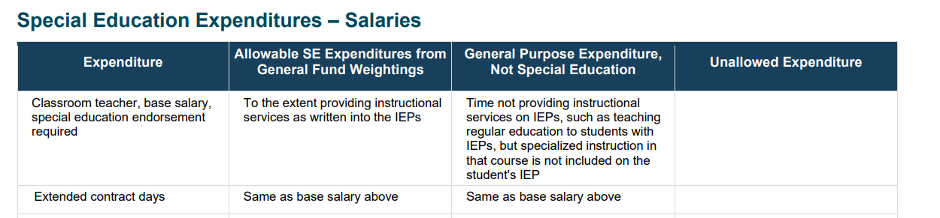
Department Resources
Chart of Allowable Special Education Costs
Salaries & Benefits
Purchased Services
Supplies
Equipment & Other Property
Available on the Department’s Special Education Finance web page

Slide 34
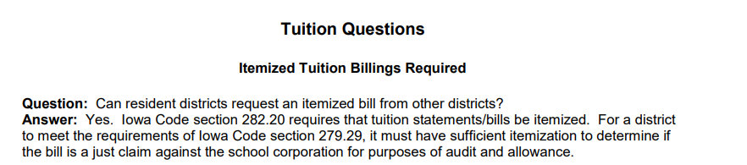
Department Resources
FAQ Permissive and Nonpermissive Uses of Special Education Funds
Billable Costs
Districts, AEAs, Private Facilities, Private Service Providers
Available on the Department’s Special Education Finance web page

Slide 35
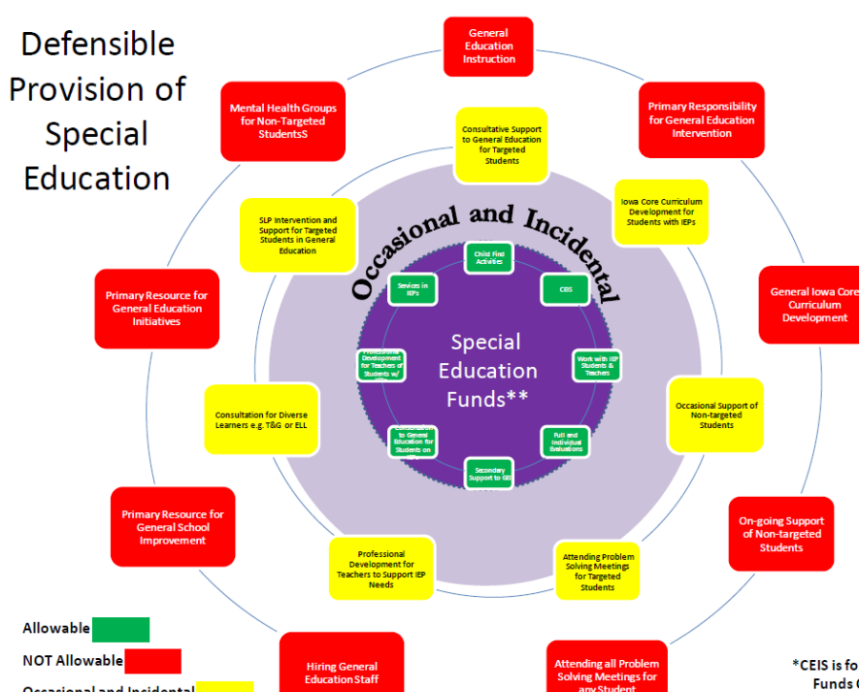
Department Resources
Use of Special Education Funds, Explanatory Chart
Green, Yellow, Red
Defensible Provision of Special Education
Uses
Determining Appropriateness of AEA / LEA Staff
Available on the Department’s Special Education Finance web page

Slide 36
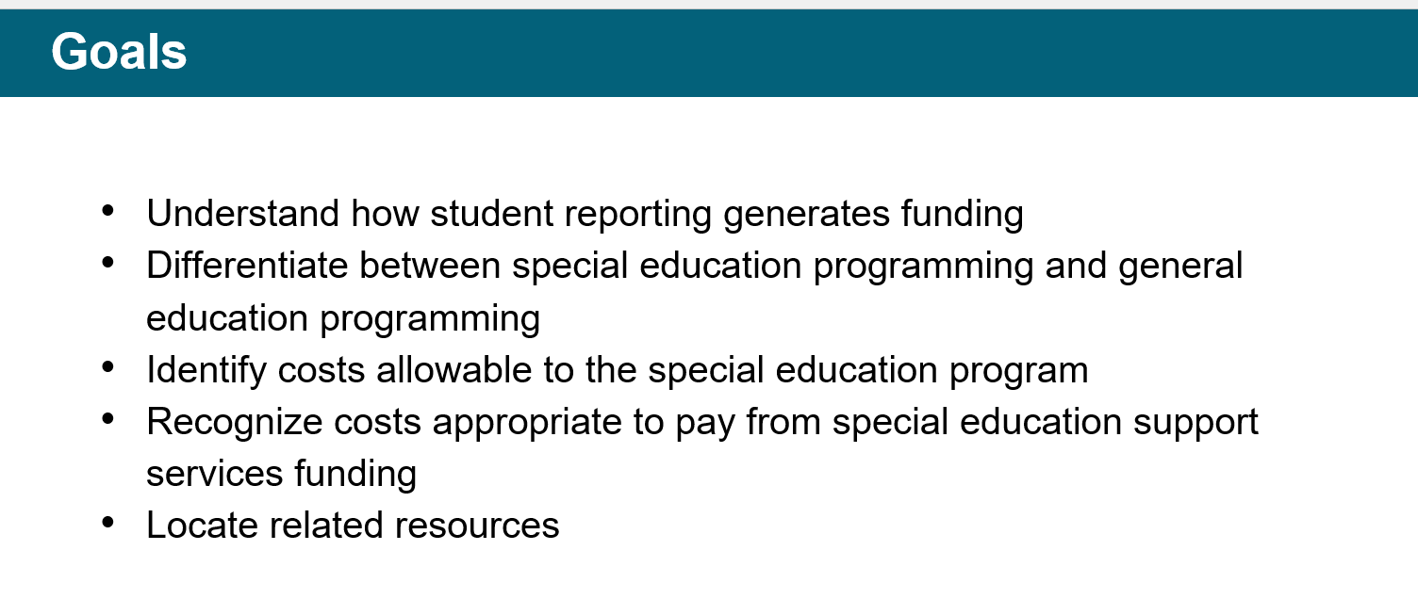
Department Resources
Allowable Uses of Special Education Funds Webinar, recorded 8/13/25
Available on the Department’s Special Education Finance web page

Slide 37
Questions

