Slide 1
REEVALUATIONS
Changes to ACHIEVE
July 2026
Notes:
Welcome, and thank you for accessing this presentation on the updates to the reevaluation process within the ACHIEVE system.
On/after July 2nd, I recommend opening up your ACHIEVE sandbox and navigating the changes while following along with this presentation.

Slide 2
Agenda
Starting the Reevaluation process
Creating an Agreement, Notice or Consent
Completing Team Members Stepper
Completing Reevaluation Data Stepper
Completing Exclusionary Factors (formerly Additional Information)
Determining Eligibility
Notes:
Today I’ll review navigating the changes to the Reevaluation Process in ACHIEVE. I’ll begin with how to start the process, creating a notice, consent, or the new agreement, then I’ll discuss the team members, reevaluation data, and exclusionary factors steppers, and lastly I’ll discuss the changes to determining eligibility.

Slide 3

Updates Include
Evaluation Table to align to FBA table
Notice/Consent Form (PWN)
  Addition of an Agreement a Reevaluation is Unnecessary
Team Members
Reevaluation Details
Assessment Methods
Eligibility Determination
Notes:
There were numerous changes made as part of this Reevaluation update, some very minor and others will take some time to navigate.
The main change, and reason for starting the process of revamping our Reevaluation Process in ACHIEVE, was the addition of an Agreement a Reevaluation is Unnecessary.
Other changes include having the table with current and past evaluations align to the format of the FBA table on the Evaluation stepper, as well as altering the Reevaluation Details page, the Team members stepper, moving the Assessment Methods section, and aligning the Eligibility Determination with the EER.

Slide 4
Starting the Reevaluation Process:
Evaluation Stepper and
Overview Stepper
Notes:
We’ll begin by going over the the changes to the Evaluation Stepper, and the Overview Stepper once a Reevaluation has been opened.

Slide 5
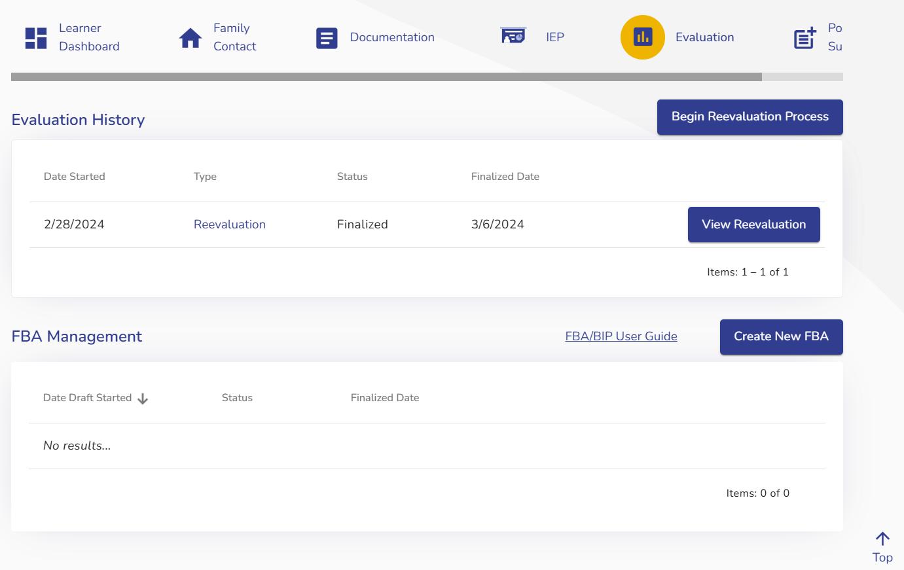
Evaluation Stepper
Notes:
Since the appearance of the evaluation stepper was recently redesigned to house FBAs, to help maintain the same flow and information, updates were made to the Evaluation/Reevaluation History as well.
Similar to the FBA Management, users will see a history of past evaluations, the date it was started, the current status, and the date it was finalized. You’ll be able to View past evaluations by clicking View EER or View Reevaluation. If there was an Agreement a Reevaluation was Unnecessary in the past, you’ll have the option to “View Agreement”
There will be a blue “Begin Reevaluation Process” button that replaces “Begin Reevaluation” and this button is now located in the same line as Evaluation History to help differentiate between the Evaluations table and the FBA table.
Clicking this button is the first step, even if the team has determined that a reevaluation is unnecessary.
Once the reevaluation has been opened, there will be button options to either View Draft or Edit Draft.

Slide 6
Overview Stepper
Once the Reevaluation is open, users will be taken to the Overview Stepper
The Prior Written Notice/Consent is now housed on the Overview Stepper, along with the new “Agreement”
All Steppers will not automatically display as before
  If choosing an Agreement, they will never display
  Once the team has selected a Reevaluation is occurring, Team Members and Reevaluation Data Steppers will appear.
Notes:
Once the Reevaluation is open, users will be taken to the Overview Stepper
The Prior Written Notice/Consent is now housed on the Overview Stepper, along with the new “Agreement”
All Steppers will not automatically display as before
If choosing an Agreement, they will never display
Once the team has selected a Reevaluation is occurring, Team Members and Reevaluation Data Steppers will appear.
Something to note here is the full name of the Agreement is Prior Written Notice of Agreement a Reevaluation of Special Education is Unnecessary. However, throughout this training and on Achieve buttons, it’ll be referred to as Agreement. Therefore, the new Overview page is essentially the Notice/Consent/Agreement page.
We will touch more on when the Exclusionary Factors and Eligibility Determination Steppers will appear in a few more slides.

Slide 7
Purpose of Reevaluation
Purpose of Reevaluation will now be static text instead of multiselect checkboxes
This is now 4 items instead of 3, to align with IDEA/Iowa Administrative Code
  Whether the learner continues to have a disability and the educational needs of the learner
  The present levels of academic achievement and related developmental needs of the learner
  Whether the learner continues to need special education and related services
  Whether additions or modifications to the special education and related services are needed to enable the learner to meet the measurable annual goals and to participate in general education curriculum
Notes:
The “purpose of reevaluation” previously was multiselect boxes, but it will now be static text with no requirement for a selection. This was also changed from three points to four in order to align with code.
The four points for the Purpose of reevaluation are:
Whether the learner continues to have a disability and the educational needs of the learner
The present levels of academic achievement and related developmental needs of the learner
Whether the learner continues to need special education and related services
Whether additions or modifications to the special education and related services are needed to enable the learner to meet the measurable annual goals and to participate in general education curriculum

Slide 8
Reevaluation Initiated
Teams will still select why the Reevaluation is being initiated
  One must occur every three years
  The IEP Team determined that the educational or related services needs, including academic achievement and functional performance of your learner, warrant a reevaluation.
  A Parent or Teacher requested a reevaluation
  Other
Notes:
Next, teams will continue to select why the Reevaluation is being initiated, and these items have not changed. What has changed are the prompts that will occur after teams have made a selection.
If option 1 is selected, teams will be asked the following question “is the team considering an Agreement that the reevaluation is not needed?”
If options 2, 3, or other are chosen, teams will be guided to the Additional Assessment question, same as before.
Also, I want to note an update that you may not notice for a while- ACHIEVE is programmed to know if the last reevaluation was determined unnecessary, so in a few years once the next eval is coming due, ACHIEVE will not display this question if the previous reevaluation had an Agreement. This is because the Department has determined teams should not skip two reevaluations in a row.

Slide 9
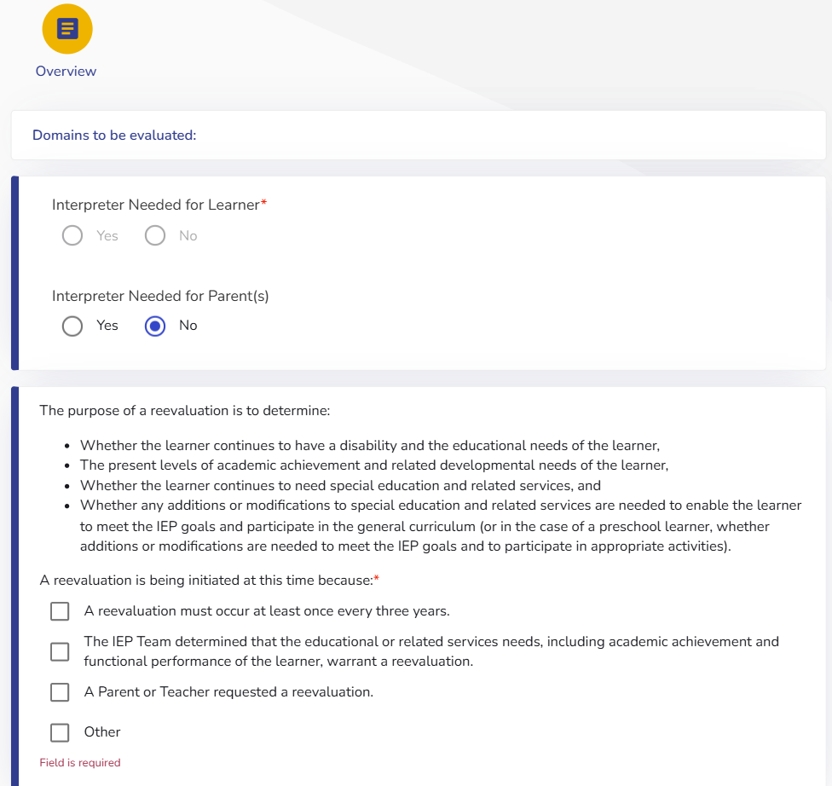
Overview
Notes:
Here is a screenshot of how this will look, with the Consent/Notice now occupying the Overview Stepper

Slide 10
Agreement Reevaluation is Unnecessary

Slide 11
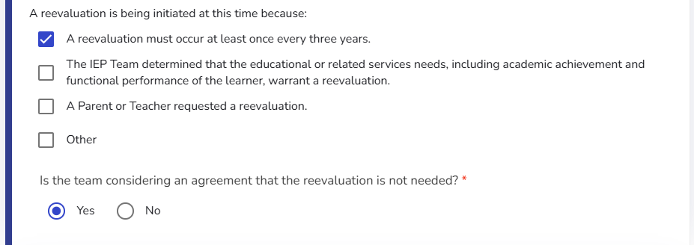
Select Reason for Reevaluation
Notes:
This is how the “Agreement” question will appear. Reminder, it will appear if ONLY the first box is checked, and no other box is checked.

Slide 12
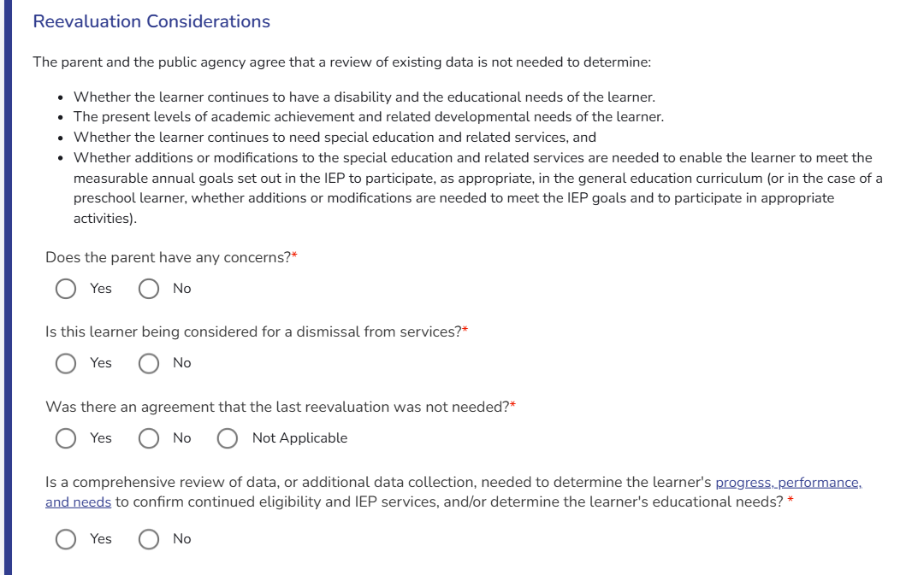
Agreement that a Reevaluation is Unnecessary
If the team selected “Reevaluation is not needed” staff will be guided through a series of questions to determine whether a Reevaluation is truly not needed.
Notes:
Once the team selected a reevaluation is not needed, the “Reevaluation Considerations” will display. It will remind staff that the parent and public agency agree a review of existing data is not needed to determine the “purpose of reevaluation” points. When we say you agree that a review of existing data is not needed, we mean a comprehensive review of existing data. We will describe what a comprehensive review of data is later in this presentation.
Then, there are four questions the team must answer:
Does the parent have any concerns
Is the learner being considered for a dismissal of services
Was there an agreement the last reevaluation was not needed,
Is a comprehensive review of data, or additional data collection, needed to determine the learner’s progress, performance, and needs to confirm continued eligibility and IEP services, and/or determine the learner’s educational needs?

Slide 13
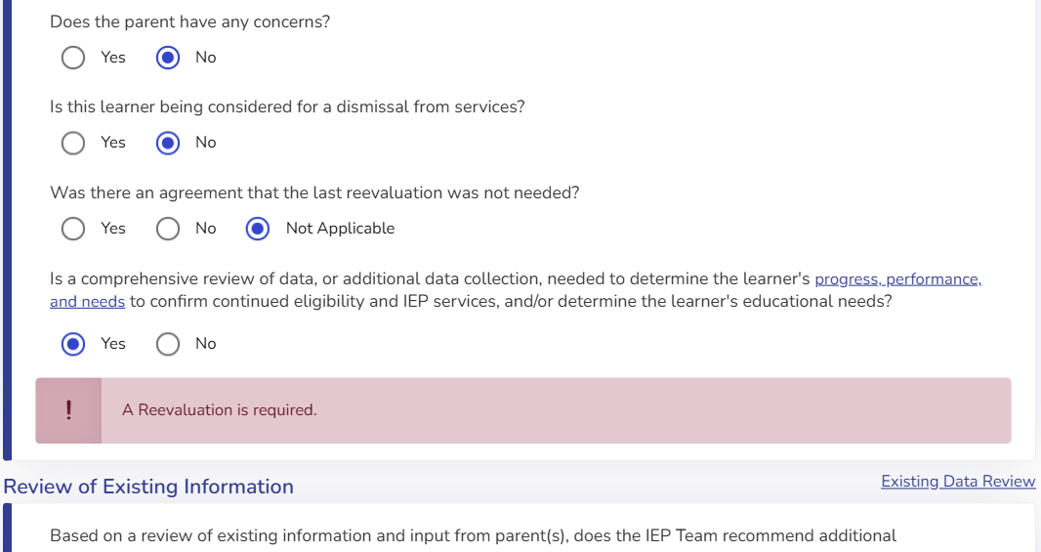
Reevaluation Considerations
If teams answered any of the Consideration questions as ‘Yes,’ ACHIEVE will prompt that a Reevaluation is required
Notes:
If any of these questions are answered Yes, then the system will prompt a reevaluation is required. This is a reminder to teams that attempting to say a reevaluation is not needed would be inappropriate in these situations. Parents are required to agree the reevaluation is not needed, therefore if they say they have concerns in regard to their child, then it would be inappropriate to not complete the evaluation. Next, reevaluations are required by law prior to determining a learner is no longer eligible.
Additionally, the department has determined that foregoing two reevaluations in a row would be inappropriate, as a student could then potentially never have a reevaluation in their school career. It’s important to remember that reevaluations are more than just determining eligibility, and a reevaluation is a prime opportunity to review past progress and thoroughly evaluate where a student has been and where they need to go.
Lastly, as eligibility decisions come down to progress, performance, and needs, if the team needs to complete a comprehensive review any data to make decisions around these three prongs, then a reevaluation is going to be needed.

Slide 14
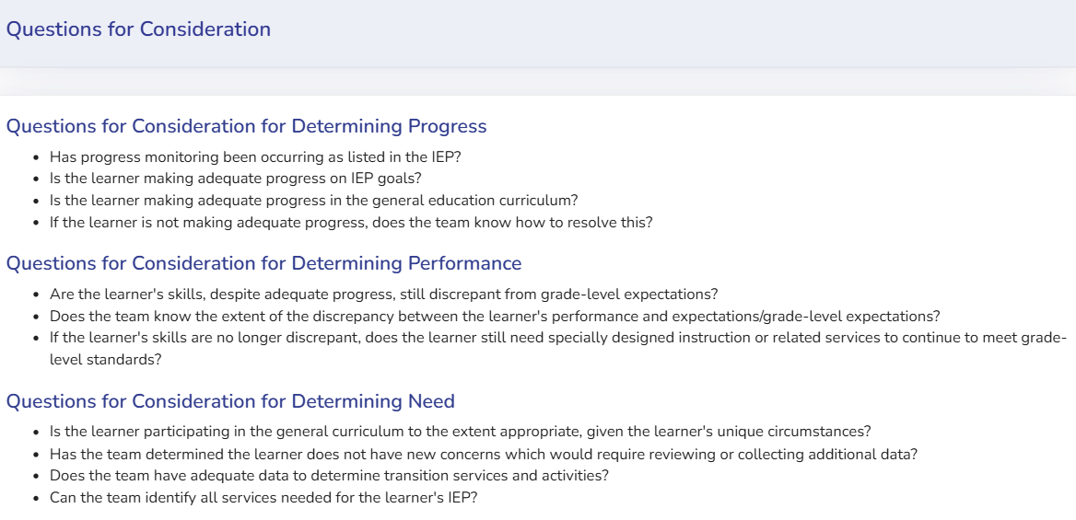
Helper Text: Progress, Performance, Need
Notes:
You may have noticed in the last two slides, that the last question about progress, performance (aka discrepancy), and need have a hyperlink. Clicking the link will provide teams with Helper Text to further support in determining if a review of existing data, or collection of additional data, is required.
If the team is unable to answer the questions in the helper text without a comprehensive review of data (or collection of additional data), a reevaluation is necessary. However, if the team is confident a comprehensive review of data is not needed, then it would be appropriate to not complete the reevaluation process.

Slide 15
Comprehensive Review of Existing Data
Does not mean:
  Standard data reviews that occur as part of ongoing collaboration or consultation to guide instructional decisions
  Standard review of progress monitoring to inform instructional changes
  Brief review of a learner’s data for purposes other than eligibility decisions
Does mean:
  Thorough review of learner’s data is needed to inform eligibility decision and/or determine the nature and extent of the learner’s educational needs
Notes:
While the purpose of this webinar is to just explain the changes occurring to the process/system in ACHIEVE, we wanted to make a quick note around the last question in the Reevaluation Considerations.
When we say a comprehensive review of data, we do not mean the regular review of data that can occur as part of typical AEA responsibilities. What this question is getting at, is if the team needs to dive deep into data because they aren’t able to quickly/easily identify continued eligibility or determine what their student’s programming needs to look like, then the team should be completing a reevaluation.
The Department wants to remind teams that not completing a three-year reevaluation should be rare.

Slide 16
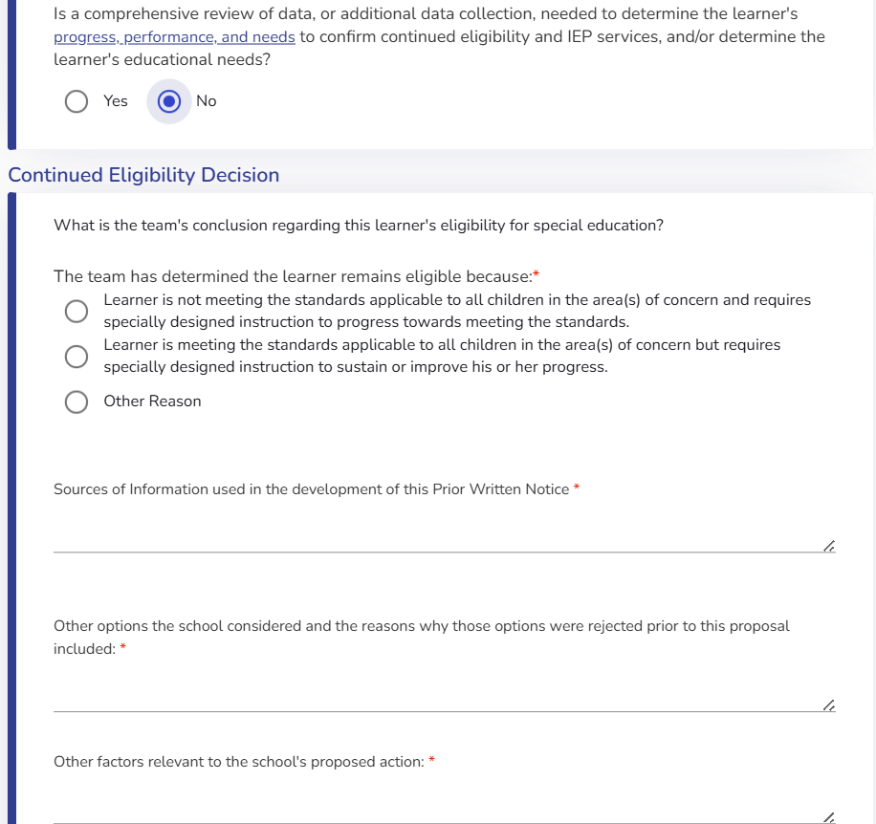
Reeval Not Needed: Eligibility Determination
If it is determined that a reevaluation is unnecessary, staff will document the reason for continued eligibility
Notes:
Once teams have appropriately answered the Reevaluation Considerations, teams will be navigated to documenting an eligibility determination.
The learner is not meeting standards and needs SDI
Or the learner is meeting standards, but needs SDI
An Other option continues to be available, in case teams would like to provide more details or feel their reasoning doesn’t fit in either of the other two choices.

Slide 17
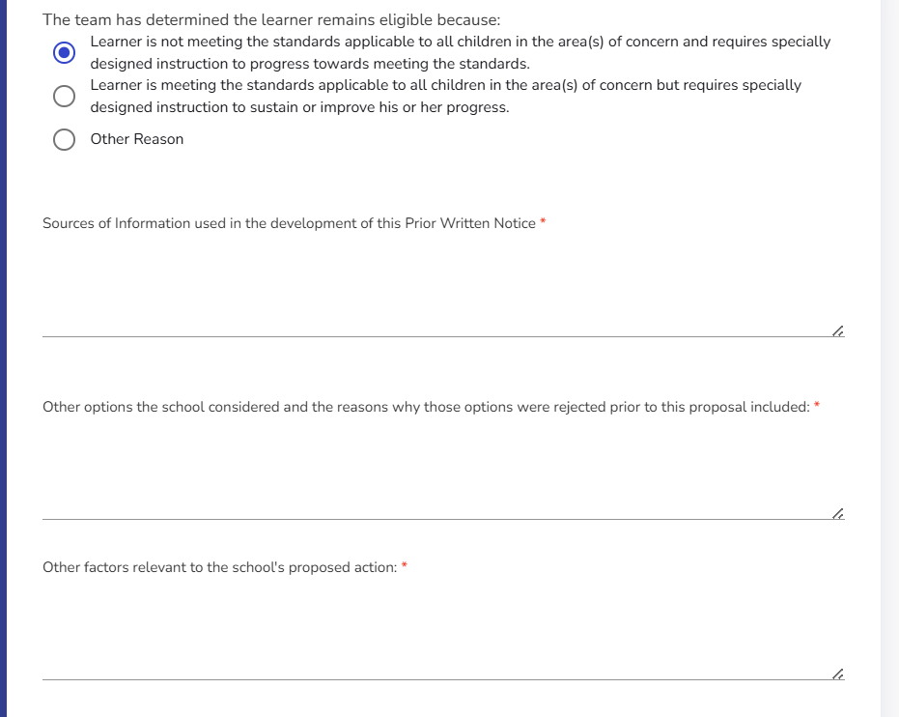
“Finalizing” the Agreement
Other options and Other factors remain as this is still considered a Prior Written Notice to the Agreement
Added Sources
Notes:
Some key points when it comes to finalizing the agreement, this document is also a Prior Written Notice, so teams will continue to provide the Other Options and Other Factors answers.
One change here is that teams will now be required to enter their own Sources of data used to make the decision. Previously, the Notice/Consent provided automatic text in regard to data that was reviewed. However, there was no guarantee that teams were actually reviewing all the sources provided in that list. Therefore, this has been updated to ensure accurate information.
For other options- you’ll want to note why the team believes completing a reevaluation was unnecessary- ie. what facts do you know about the student that leads the team to not question eligibility or needs?
For other factors- It’s recommended that parent input/response to the agreement is entered here so that their response is documented

Slide 18
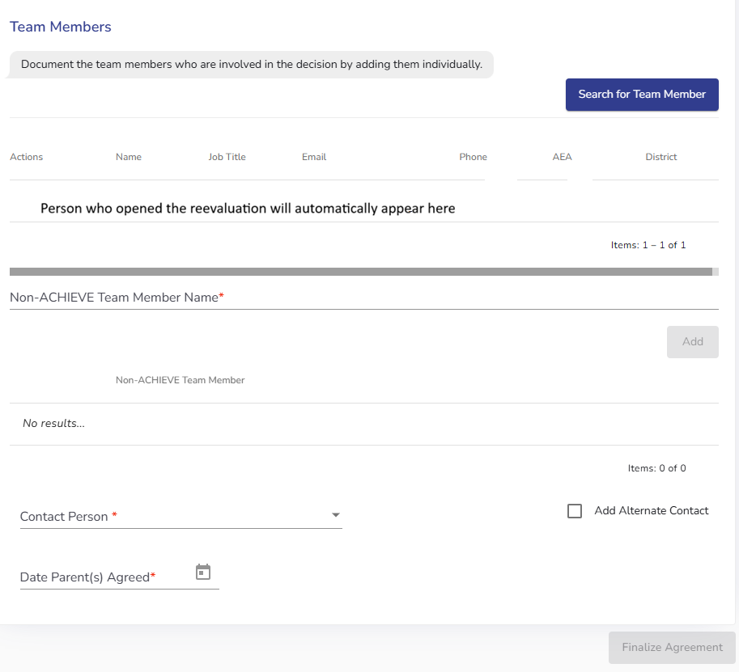
Finalizing the Agreement, Continued
Team members who were part of the decision will need to be selected
Since parents MUST agree that a reevaluation is unnecessary, staff will document the date parents agreed to the decision
Notes:
Team members who were part of the decision will need to be selected
Since parents MUST agree that a reevaluation is unnecessary, staff will document the date parents agreed to the decision.

Slide 19
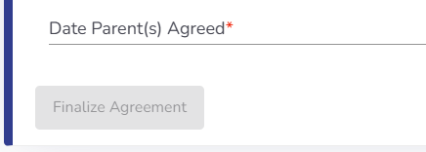
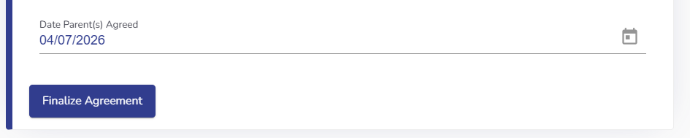
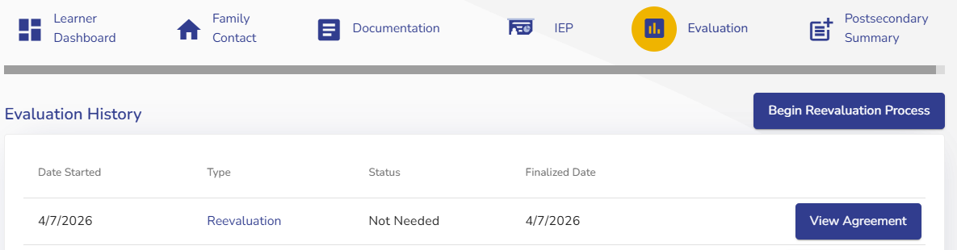
Finalizing the Agreement, Last Step
Finalize Agreement Button
  Appears when all required components are completed
  Clicking will generate PDF of the Agreement, which must be provided to parents within a timely manner
Next reevaluation due date is set
Notes:
Once all the required components have been completed, the blue Finalize Agreement button will now be accessible. Clicking this will generate the PDF of the Prior Written Notice of Agreement that Reevaluation of Special Education is Unnecessary. This PWN/Agreement will need to be provided to families within a timely manner.
You’ll be navigated back to the Evaluation stepper and will be able to click the View Agreement button later if needed. Also, you’ll see another Begin Reevaluation Process button, so that if it’s decided a reevaluation is needed at a later date, you can easily open a new reevaluation.
The next reevaluation due date will be reset, and the bottom of the Agreement PDF will provide the next due date.

Slide 20
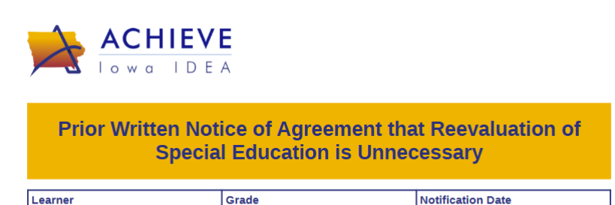
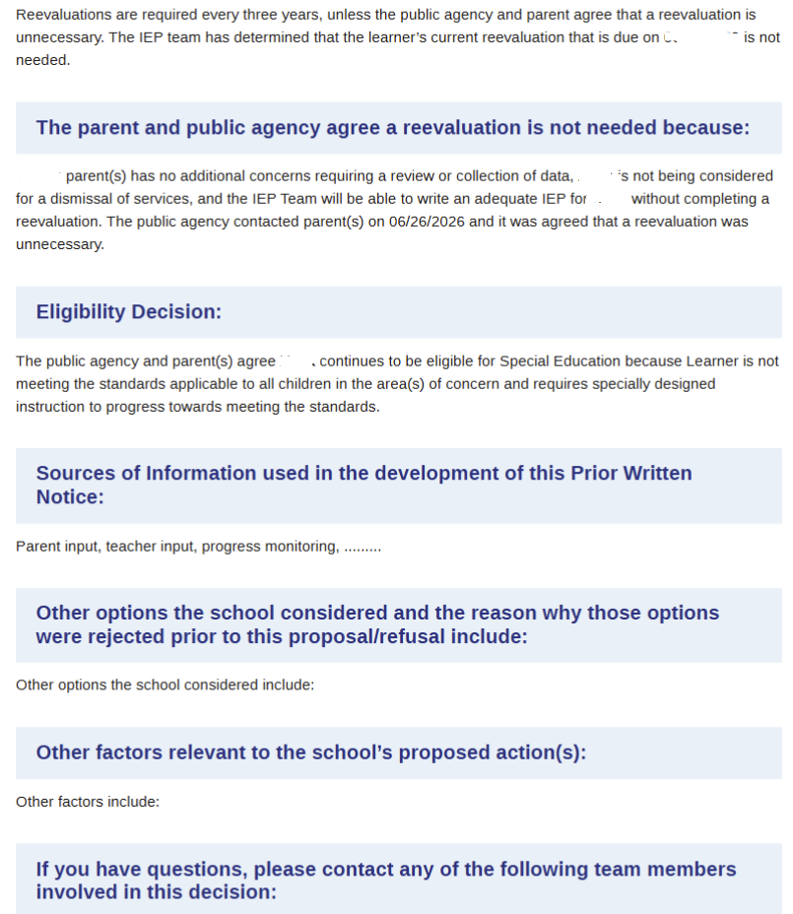
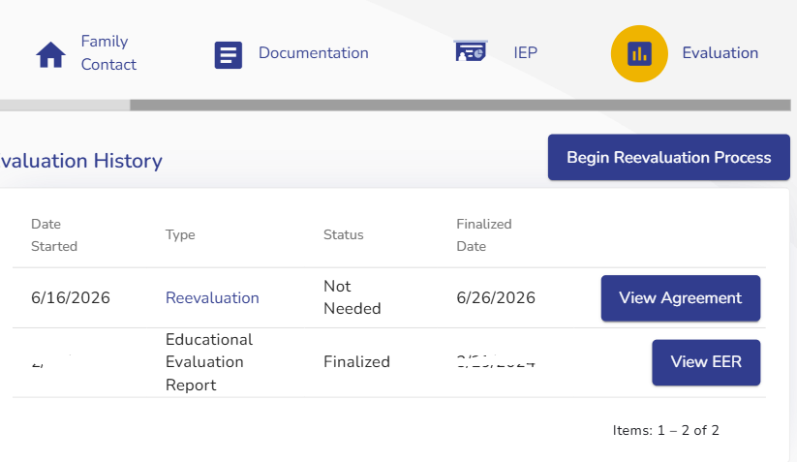
PDF of Agreement
Notes:
And here are some pieces of what the Agreement printout will look like. The learner information and procedural safeguards sections remain the same, as well as the PWN components.
Also, this shows what the Evaluation Stepper will look like once the Agreement has been finalized

Slide 21
Reevaluation is Needed
(Consent/Notice)

Slide 22
Notice vs. Consent
Additional Data Question - remains the same
New - Required for both Notice/Consent
  Date parents were contacted
  Identify domains to be reviewed (student’s current goals/ services)
    Domains selected here will transfer to “Domains to be evaluated” banner
  Consent- of the above domains, which will have additional data collected
PWN components remain
Notes:
Now, we will move on to review completing the Notice or Consent form. We are still on the Overview Stepper
For the Notice/Consent, the process remains largely unchanged. Teams will continue to determine if additional data is needed, and depending on that choice will determine if a Consent is generated, or a Notice.
What’s new in this section is that teams will be required to document the date parents were contacted in regard to the discussion of additional assessments. The previous form only asked for a date parents were provided the Notice/Consent when additional assessments were being collected.
Additionally, the Notice and Consent will both ask teams to identify the domains that will be reviewed, and includes helper text that teams should review the learner’s IEP to determine the domains to be addressed. The domains selected on the Overview will transfer to the Domains to be Evaluated banner that appears at the top of each stepper. Previously, in order for Domains to appear in that banner, they had to be selected in the Team Assignments.
As noted when reviewing the Agreement PWN process, the previous PWN for Notice/Consent had the Sources of Information box pre-filled with text of all the data that should be reviewed prior to making decisions on the evaluation plan. Teams will now have to enter the sources of information they reviewed in making their decision, same as you do for regular PWNs.

Slide 23
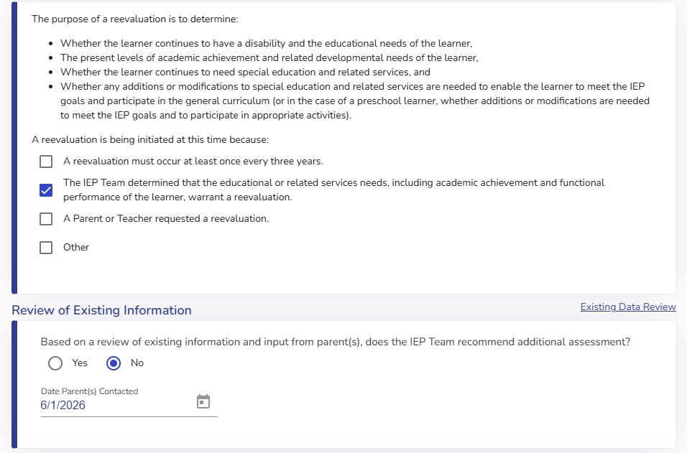
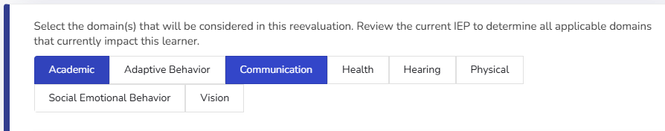
Navigating the Form - Notice
Notes:
Here is a screenshot of the components for the the Notice.
An additional note here: The Department has requested that the domain selection comes just after selecting the date. This is a function that may not be live with the July 1 roll out, and should appear sometime in late July.

Slide 24
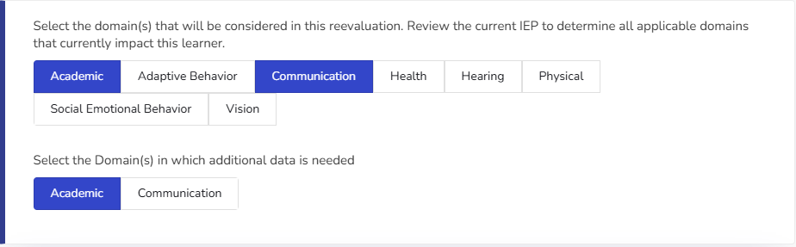
Navigating the Form - Consent
Notes:
And if the team instead selected Yes for additional assessments, another row will appear to display which domains will be tested.
You’ll notice that only the domains selected to be considered are the only domains a team can then choose additional assessments for.
The selection of the Domains on the Overview is important because it will then display in the steppers and on the printout of the report what domains were evaluated.

Slide 25
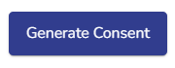

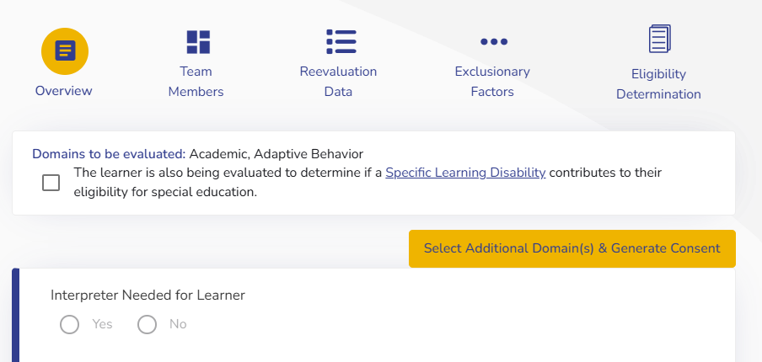
Finalizing Notice/Consent
When all components are completed, Generate button will be clickable
PDF of Notice pops up
Consent found on Documentation Stepper- under Family Consent
Exclusionary Factors and Eligibility Determination Steppers will appear
Notes:
Similar as before, and to the Agreement, once all the required components have been filled out, users will be able to click Generate Consent or Generate Notice. This will pop up the PDF of the selected form, and components of the Overview page will no longer be editable. Finalizing this will also display the Exclusionary Factors and Eligibility Determination Steppers.
Another change is the PDF that is generated will have a title of either Prior Written Notice of Reevaluation or Consent for and Prior Written Notice of Reevaluation.
Also, one new feature is that you can create a new Consent form after the original Notice or Consent has been finalized. So if you determined part way through the reevaluation that you do need additional data, which requires Consent, you can create a new form.
Teams just have to navigate back to the Overview page, and click the Select Additional Domain(s) and Generate Consent button at the top of the Overview Stepper. This will open a new form to click the additional domains being added, along with the remaining PWN components. If there was a previous Consent, which has not yet been signed (approved/uploaded), all of the domains on the former Consents will automatically generate in the new form.

Slide 26
After Consent/Notice is “Finalized”
Consent:
Continue to have option to sign electronically
Learner Facilitator remains the person who can change the “Consent Status”
Consent Approved or Declined
  Once approved “test” will become a data method option
Notice/Consent
Option to “Select Additional Domains”
Notes:
Consent is still able to be signed electronically and the main facilitator is still the person who can change the consent status. Once the Consent is approved, the Test option for data methods will become available (and we’ll touch on this more in the Reevaluation Data section). If Consent is declined, or revoked at a later time, the test option will no longer be available.
Lastly, once a notice or consent is finalized, there is an option to add additional domains and generate a new Consent, or identify additional domains to be addressed. This option was added since the Domains to be evaluated is linked to domains selected in the Overview.
A quick note here is that at the time of this recording, there’s a bug with the test component. It is currently still allowing users to select test and enter data without approved Consent. This is in the process of being fixed.

Slide 27
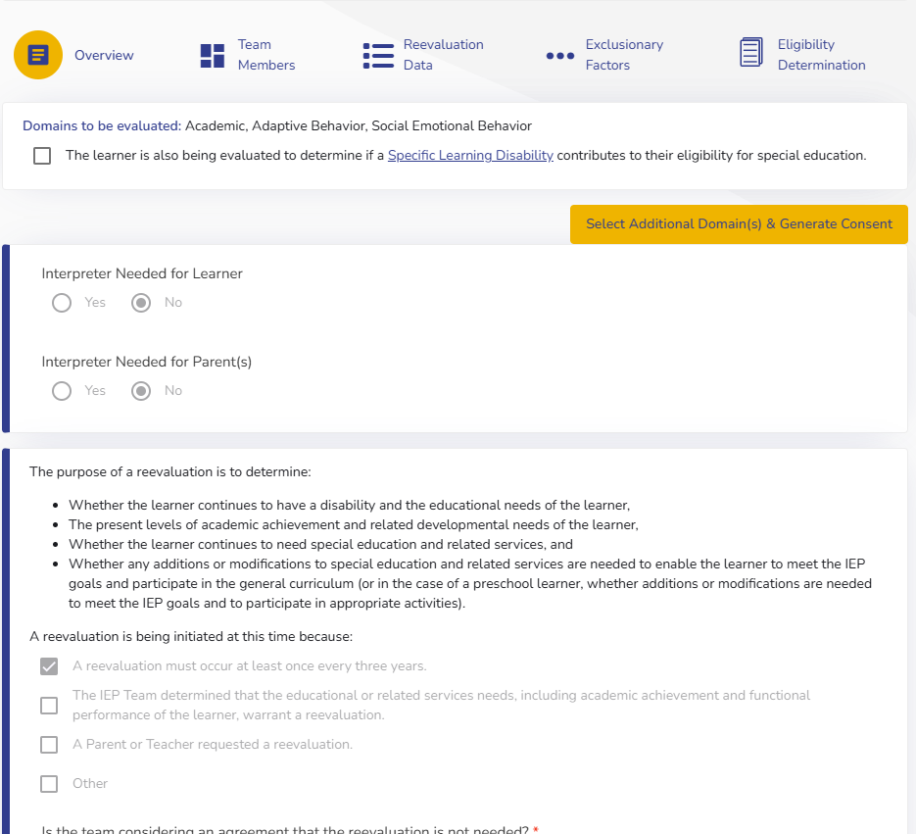
Select Additional Domains
Notes:
As you can see, this learner’s Overview page has been greyed out, meaning nothing on the page can be edited as the final document had been generated.
At all times, the orange Select Additional Domains button will be available for teams to add any domains for either review or for additional testing that requires consent.
[Will need to replace screenshot when updates go through- as it should just say select additional domains]

Slide 28
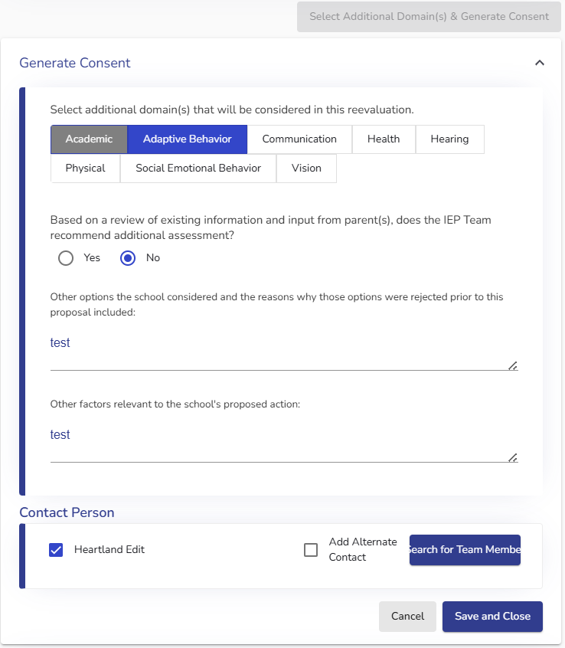
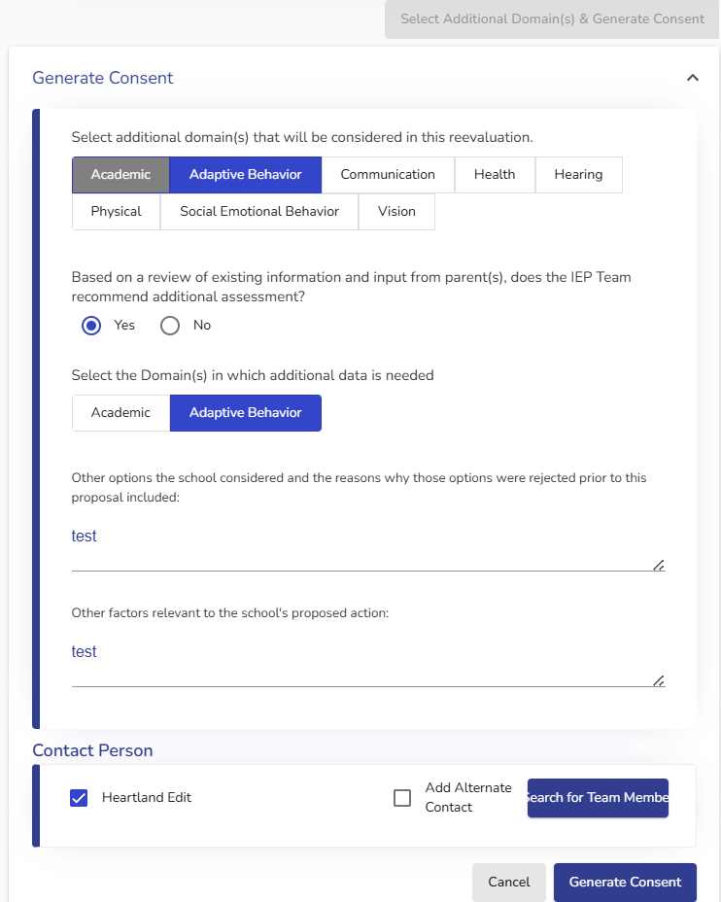
Select Additional Domains and
Generate Consent / Notice
Notes:
[Once bugs/issues fixed, replace screenshot on the left]
After clicking to Select additional, a new dropdown will appear with the option to select additional domains to be considered. You’ll notice the Academic domain is greyed out- this is because this domain had already been selected on the original notice.
If you click no to additional assessments, then you fill out the PWN components, select the contact person, and hit “save and close”. Once it’s saved, the additional domain will be added to the “domains to be evaluated” banner at the top. Also, a new dropdown will appear that currently says “consent generated” and the date. This does not mean it’s a new Consent, and there are fixes happening to not cause confusion.
If additional assessments are needed, then click yes, choose the domains, fill out the PWN components, team member, and then generate. As with any consent, the new Consent will appear on the Documentation stepper, under Family Consent. The previous Consent form will become inactive and the new consent will need signed and approved.

Slide 29
Team Members Stepper
Notes:
Now we’ll discuss the changes and navigation of the Team Members Stepper

Slide 30
Team Members- Formerly Overview
Remains the same:
  Evaluation Facilitator
  Evaluation Team
Changes - Evaluation Assignments
  Domains identified in Overview (Notice/Consent) will be reflected here
  A specific team member will not be required
Notes:
As the Overview Stepper contains the Notice/Consent/Agreement, the Team Members and Assignments selection is now on it’s own stepper.
The process will remain the same, where the evaluation facilitator is automatically the person who opened the evaluation, but this can still be changed to whomever will take on this role (which will usually be the AEA rep).
Then you add the additional team members so they display on the pdf of the report, and will continue to be able to add Non-ACHIEVE team members.
A new change involves the Evaluation Assignments. Previously, it was option to add Domains via the Assignments, and doing so would display in the Domains to be Evaluated header that appeared on each stepper. A new feature will automatically add the Domains being evaluated in the Evaluation Assignments area based on what was selected in the Notice/Consent, however at the time of this recording this is a bug that is still being worked on
You won’t be required to select a Team Member for the Assignment, which is how it stands now in the EER and Reevaluation, but selecting a person may be helpful when you have multiple staff and each person is focusing on a specific domain.

Slide 31
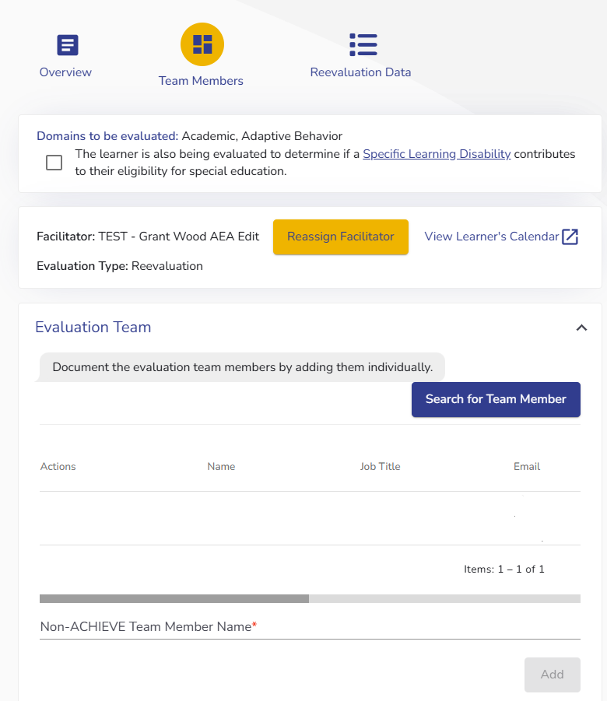
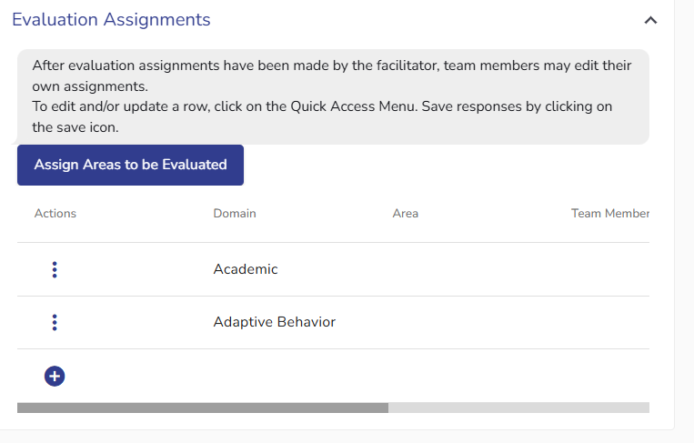
How it looks in ACHIEVE
Notes:
Here’s what this looks like in ACHIEVE. The screenshot on the left shows selection of the eval team. You can also see that the Domains to be Evaluated is noted at the very top, underneath the steppers.
The eval assignments, on the right, shows the Domains. By clicking the three dots on the left for to edit or delete the row. By editing, you are able to choose a member from the Eval Team to be assigned to a domain.

Slide 32
Reevaluation Data Stepper
Notes:
The most significant changes are found within how the data is compiled into the report. This next section will review these changes.

Slide 33
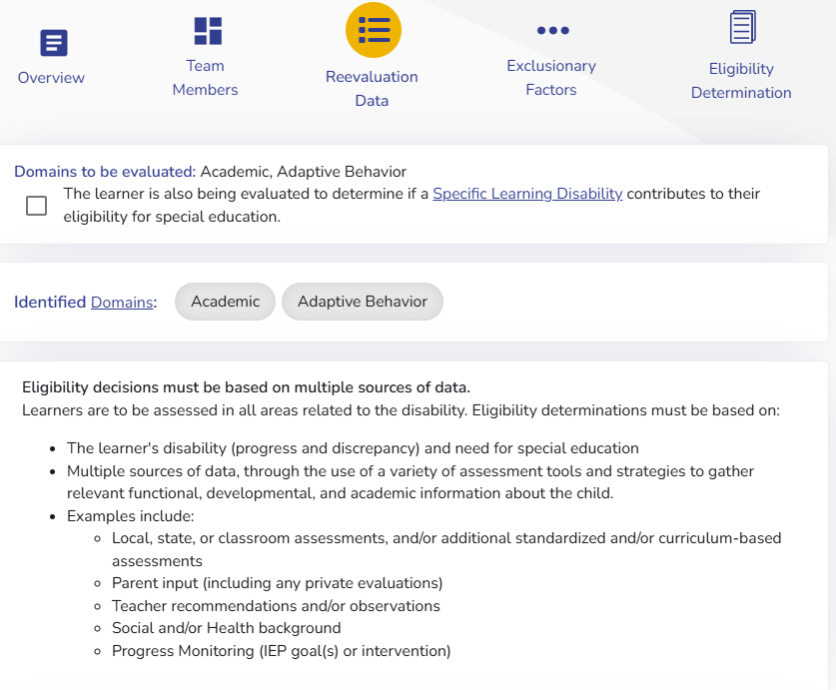
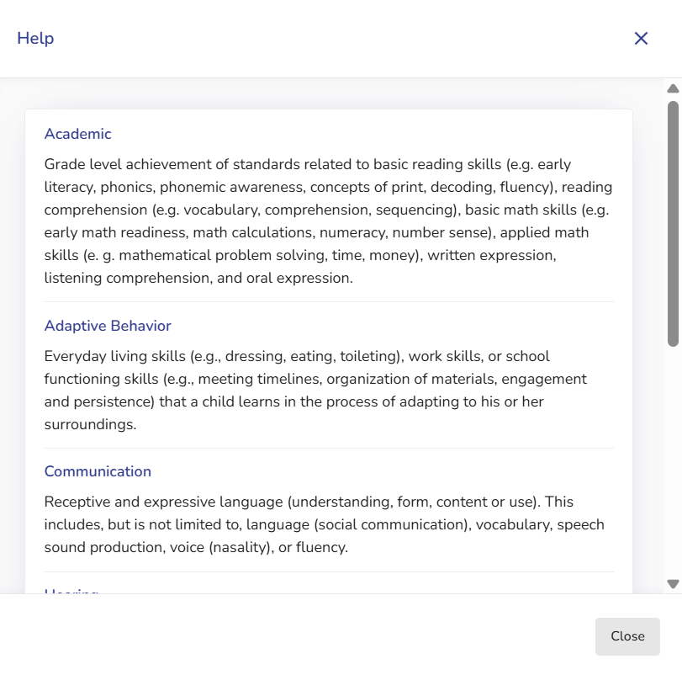
Reevaluation Data
Helper text of information needed
Helper text for Domains
Notes:
The Reevaluation Details Stepper has been renamed to Reevaluation Data, and has been modified for more clarity in the type of data and organization. The first change users will notice is the Helper Text around the requirements of reevaluations and what eligibility determinations must be based on.
In the Identified Domains heading section, Domains is a hyperlink which takes you to a summary of what is included in each Domain area.

Slide 34
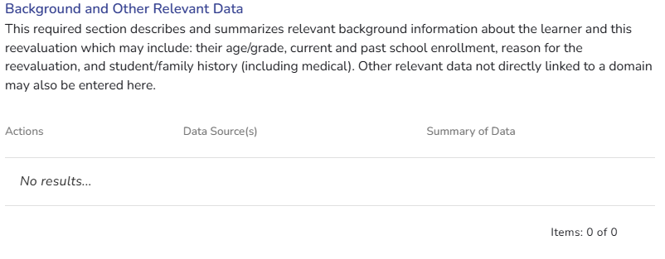
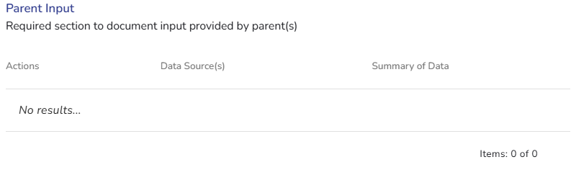
Background and Parent Input
Background and Other Relevant Data
  Helper text similar to EER of information to be entered
Parent Input
Notes:
The Data Entry will be separated into 3 categories; background and other relevant data, parent input, and domains.
The background/relevant data box will be required and it will have helper text of what information could be entered. This section aligns to the Background Information section of the Initial EER.
This will be a space to enter information like the student’s grade, current goals/services, how long they’ve had an IEP, why the reevaluation is being completed, and/or family history (including medical).
You can also enter information that doesn’t fit perfectly into a domain, such as student strengths, interests, and preferences, attendance, Transition information, extracurricular activities, and so on.
As parent input is a required component of all evaluations, a box was also added for teams to enter any information, feedback, or concerns the parent expresses either at the start of the reevaluation process, and/or what they share in the reevaluation meeting.

Slide 35
Domains
Methods (RIOT) and Data Source dropdown menus
  This has been moved from the Assessment Methods section on the Additional Factors page
Domains sorted similar to EER
  If multiple domains selected, they will be in their own category
Test will not be available to enter information until Signed Consent has been received.
Notes:
Lastly, we have made it easier to group data by domains, and the Assessment Methods have been moved, so when you begin your data entry, you will select one (or more) domains, then the Method used (either Review, Interview, Observe, or Test), and then from the dropdown, select the Source of the Data.
Examples of this will be shown on the next slides
*Reminder that at the time of this recording/delivery of ppt to AEAs, the Test function has a bug that is being worked on

Slide 36
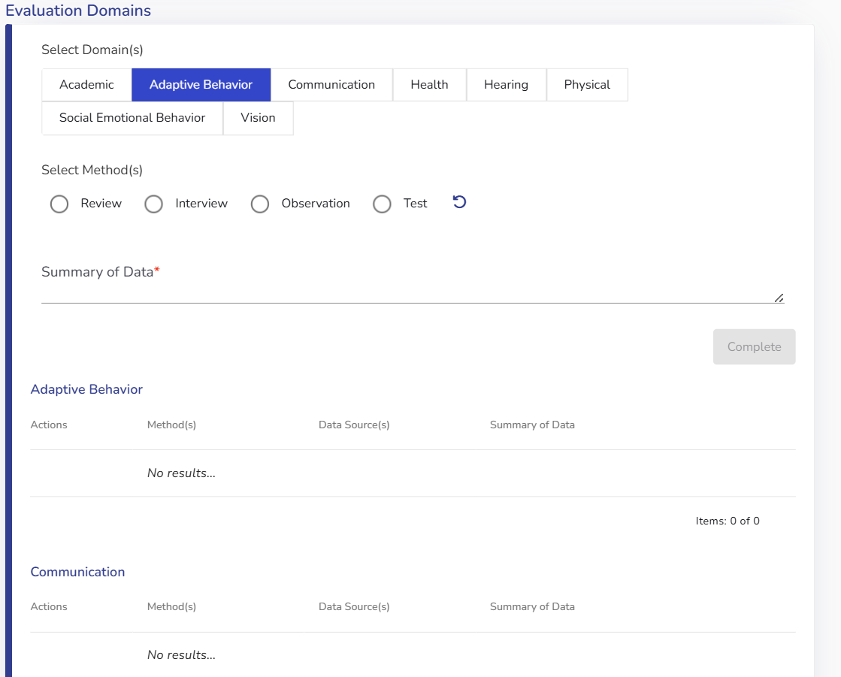
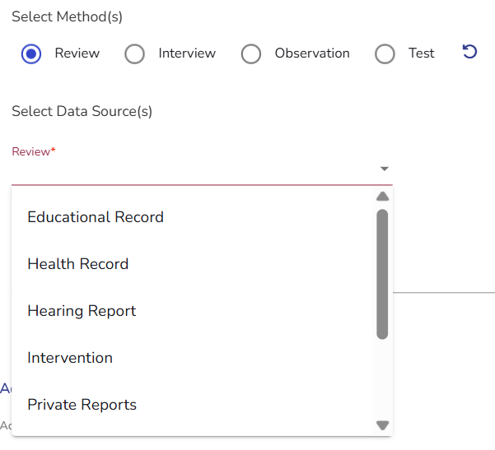
Navigating the Data Entry - Domains
Notes:
This is what it’ll look like to enter Domain information, as well as the options that can be selected when clicking on the Review method.

Slide 37
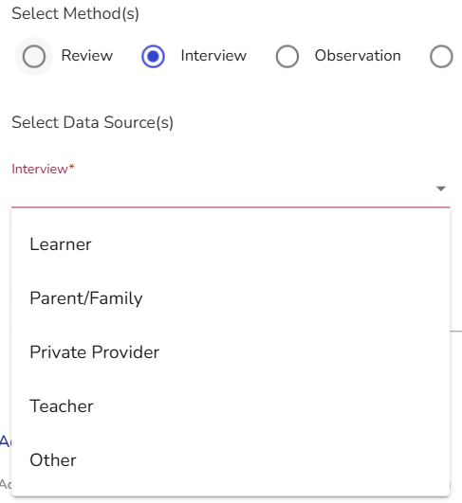
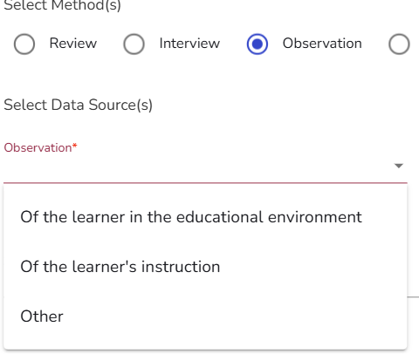
Domains - Sources of Data
Notes:
And this shows the dropdown options for Interviews and observations. You’ll notice the sources for Review, Interview, and Observation are the same as on the previous assessment methods section.

Slide 38
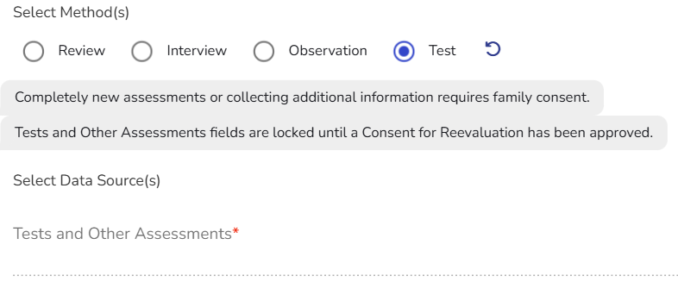
Domains - Test as Data Source
Notes:
A new feature will add Consent Approval requirements in order to utilize Test as the Data Source. This is because completing new assessments requires parent consent. This may also help consistency in the field, as sometimes ISASP or district assessments are entered as Tests. However, this new feature is differentiating between Tests/Assessments reviewed and Tests that are administered as part of the Reevaluation whereby the parent provided signed Consent.

Slide 39
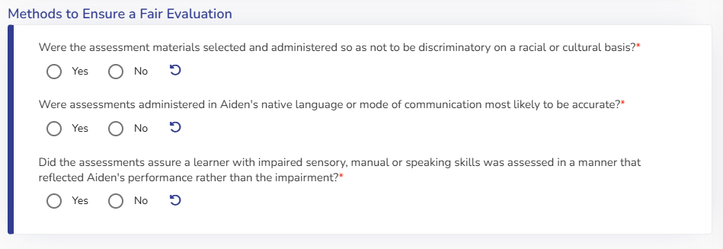
Methods to Ensure Fair Evaluation
Same questions as on the EER
Appears if Consent was approved and Test was completed.
Notes:
One addition to the Data Entry process if additional assessments were completed is answering the Fair Evaluation questions. These are the same questions asked on the Initial EER.

Slide 40
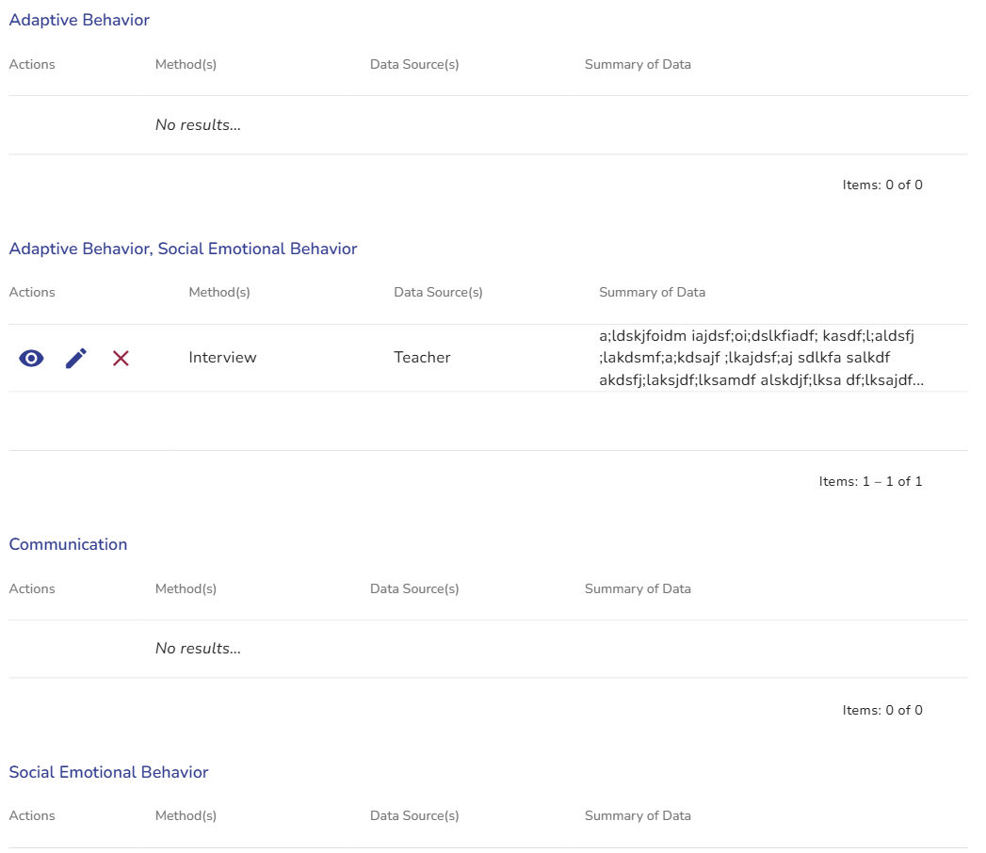
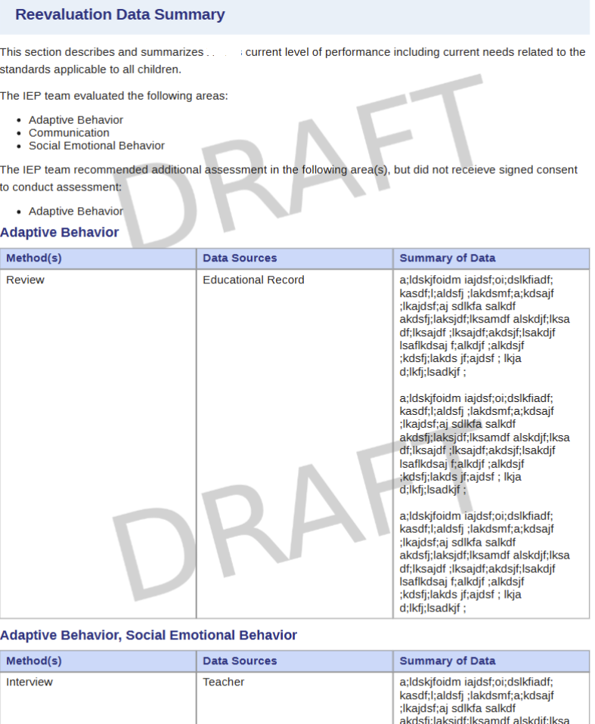
Multi-Select Domains and PDF
Notes:
As noted, similar to the EER, evaluators will be able to select multiple domains if a source/method of data is the same.
The screenshot on the left gives an example of what the data looks like once entered for multiple domains.
The screenshot on the right shows how this will be organized in the printout of the report. You’ll notice that under Reevaluation Data Summary, it provides a list of the domains that were evaluated. Then, if Consent was requested, those domains will appear under a statement that the team had recommended additional assessments. If consent is not “approved” then this is what will show. Once consent has been approved, the sentence will change to say “The IEP team recommended and conducted additional assessment data in the following area(s):”
Another note here: as of this recording and delivery to the AEAs, the tables are not supposed to be standard, and are to change in size based on the amount of data entered. This is something that is currently in progress of being changed.

Slide 41
Exclusionary Factors

Slide 42
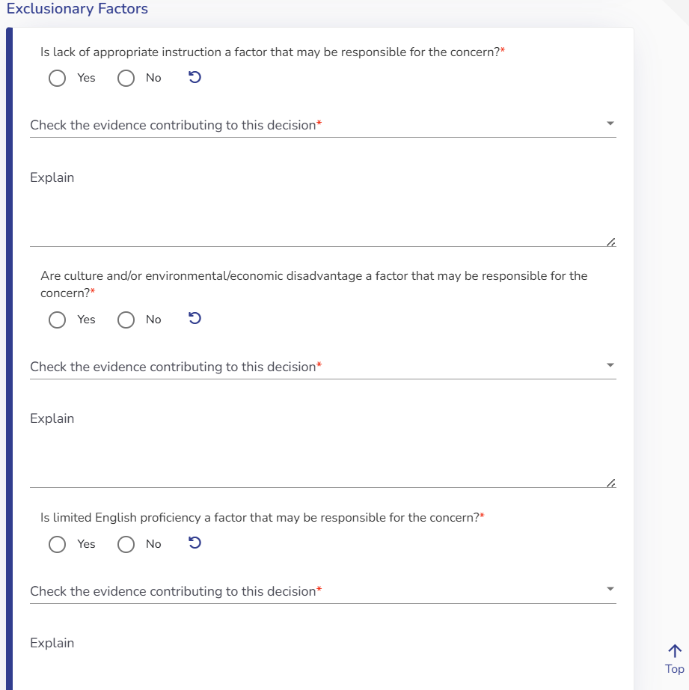
Navigating the Form - Exclusionary Factors
Formerly - Additional Factors Stepper
Data entry remains the same
Notes:
Exclusionary Factors are now on their own stepper, since the Assessment Methods has become part of the Reevaluation Data entry. There are no changes to this section, however something teams may notice is a fix to the Draft PDF.

Slide 43
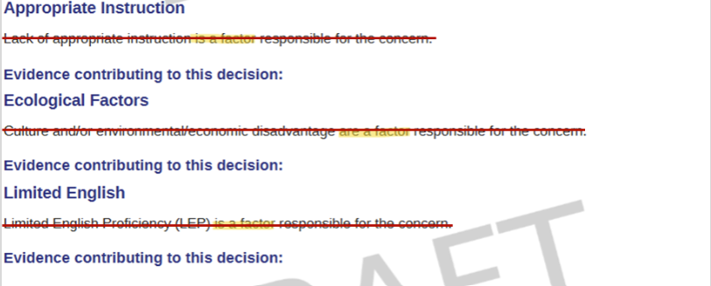
Exclusionary Factors Stepper
Draft PDF has an error fixed
Will now have empty fields if this section has not been completed
Notes:
Previously, if nothing was selected for each Exclusionary Factor, the draft output would display that IT IS a factor responsible for the concern. Moving forward, these fields will remain empty until a selection has been made.

Slide 44
Eligibility Determination Stepper
Notes:
Formerly the Summary Stepper, this has been renamed to match the decisions being made on this stepper.
The Incomplete Data Report will still display here.

Slide 45
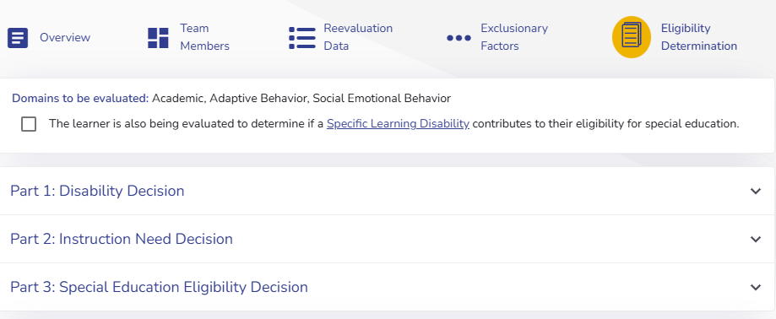
Eligibility Determination
Changed to match EER
  Comments will now be required
Will still need to answer the additional questions
Questions will not display until Roll Call
IDR remains on this page
Notes:
The Eligibility documentation has been changed to align with the EER and make it easier for teams to discuss the eligibility decision with the team. This change also includes the same helper text that appears on the EER. However, the Comments under each question will be required. This is a place for teams to document a summary of why they are answering yes or no for the respective question.
Also new to the reeval is that teams will have to complete the meeting roll call before they can select an eligibility decision, which also matches the EER and ensures teams are not making predeterminations. If the meeting has not yet been scheduled, the IDR will state “Continued Eligibility for Special Education Services meeting has not been scheduled yet”
Lastly, if requested by parents or someone on the team, there is still the option to select SLD determinations and that process has not changed. If SLD is being considered, the Academic Domain will need to be selected for the SLD “button” to appear. We will not dive into this in this training, but the differences and requirements for SLD decisions starts at 41.307 in the Iowa Administrative Code.
Additionally, there is information on i3 and in Standard 6 of the Eligibility and Evaluation Standards in regards to SLD evaluations.

Slide 46
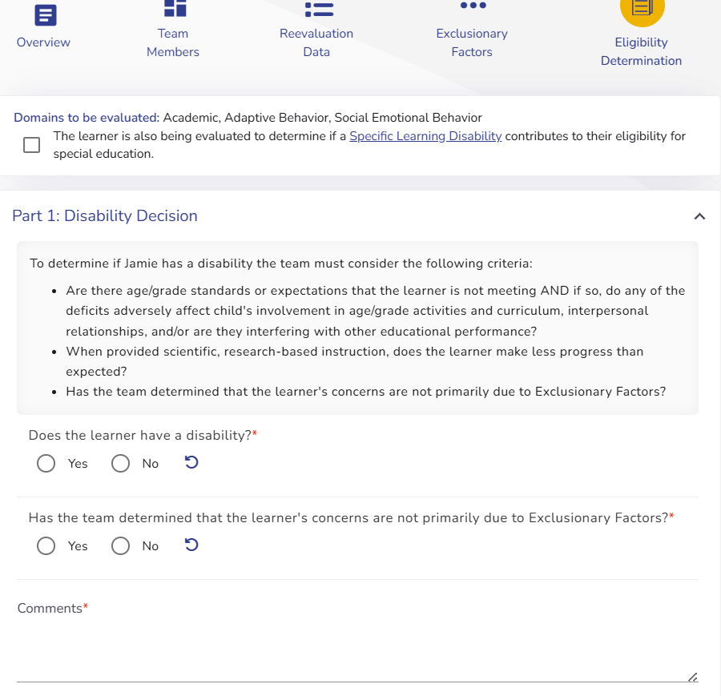
Eligibility Determination: Part 1
Notes:
For Part 1, this will appear the same as on the EER, including the same first two bullet points of helper text. One difference is an update to the language of the third bullet around Exclusionary Factors. This was reworded to provide clarity around what the question is asking. It will now say "Has the team determined that the learner's concerns are not primarily due to Exclusionary Factors?" In addition, teams will need to select whether the concerns are due to Exclusionary factors

Slide 47
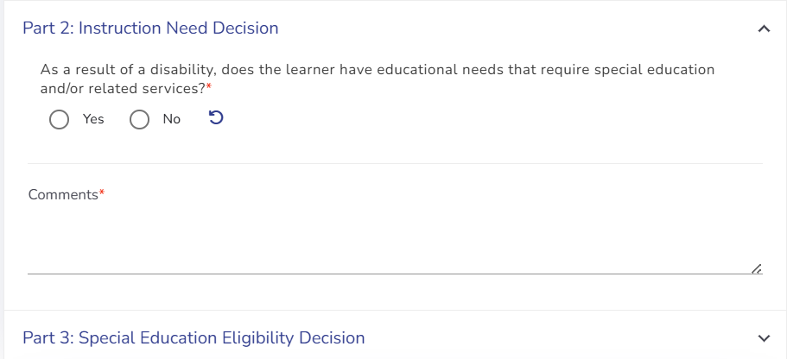
Eligibility Determination: Part 2
Notes:
For Part two, this still applies to determining a need for specially designed instruction, however the question is being rephrased for clarity. It will now say “As a result of a disability, does the learner have educational needs that require special education and/or related services?"

Slide 48
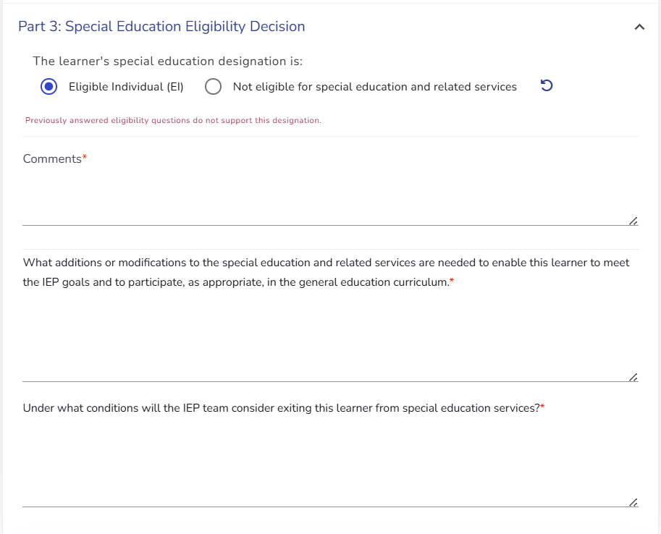
Eligibility Determination: Part 3
Notes:
Part 3, the team answers whether or not the student is eligible for special education and/or related services. If the student continues to be eligible, teams will continue to address what changes may need to be made to the student’s services/programming and when the team will consider exiting the student from services.
Also, you’ll notice the red text within this screenshot states “previously answered eligibility questions do not support this designation” If either of the first two questions are blank, or answered no, this text will display.

Slide 49
Meeting Notice

Slide 50
Scheduling Reevaluation Meeting
Purpose of Meeting Changes
  Previously: Eligibility for Special Education
    Now: Initial Eligibility or Continued Eligibility*
  Previously: Evaluation Information
    Now: Initial Evaluation
  Reevaluation Information* remains the same
*Continued Eligibility and Reevaluation Info meeting purpose is only available once a Reevaluation has been started
Meeting Roll Call required before Eligibility Determination
Reminder - Cancel Event/Reschedule Event buttons
Notes:
Previously, when creating a meeting notice, you were to select Reevaluation Information and Eligibility for Special Education Services. Reevaluation Information was required for the IDR on the Reevaluation, and when you completed the Roll Call, the Eligibility tag on the Meeting Notice is what reset the next evaluation due date.
Now, the system will be set up so that you cannot select Continued Eligibility for Special Education or Reevaluation Information without opening the Reevaluation. This is because teams had been selecting these as purposes of a meeting without actually opening a reevaluation. Then, once the meeting roll call was completed, the reevaluation date would be reset even though an evaluation and new eligibility decision hadn’t been completed.
When you schedule your Continued Eligibility/Reevaluation Information meeting, the meeting date must be on/after the day you clicked “begin reevaluation process” otherwise this will not connect in the IDR.
In most cases, Teams will select both Continued Eligibility and Reevaluation Information, and then teams can also select IEP Meeting if the plan is to review the IEP if the student remains eligible, and teams should also select Secondary Transition if the student is 14 or older. If the team plans to only review reevaluation information, but perhaps won’t be making an eligibility decision, then they could only select the former. However, teams must select the Continued Eligibility option in order for the reevaluation due date to reset.
Similar to an Initial, a Meeting Roll call will be required before teams can make an eligibility decision. This is to ensure that eligibility is a team discussion and determination, and is not decided prior to the meeting occurring.
Because of the way the coding will work for resetting dates and other meeting purpose requirements, I want to say a quick reminder that teams should be using the Cancel or Reschedule buttons if the meeting will no longer take place when originally scheduled. Roll calls should not be completed for a meeting that did not happen at the time scheduled on that Notice/Activity.
When you are on the Learner Dashboard, and scroll down to the bottom of the page, under Activity, click on the scheduled meeting. Once the drop down opens, you’ll see buttons along the bottom.

Slide 51
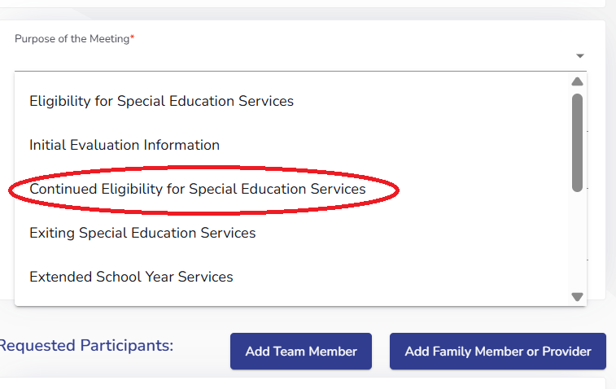
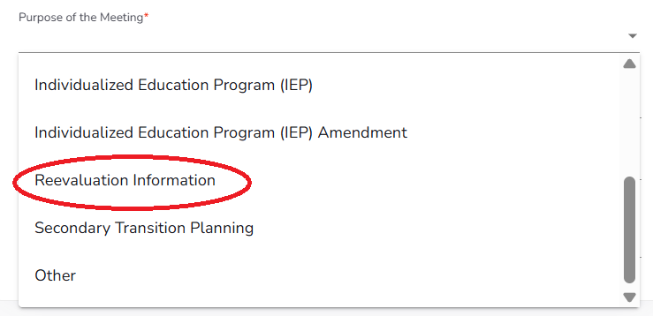
Reevaluation Meeting Purposes

Slide 52
Incomplete Data Report

Slide 53
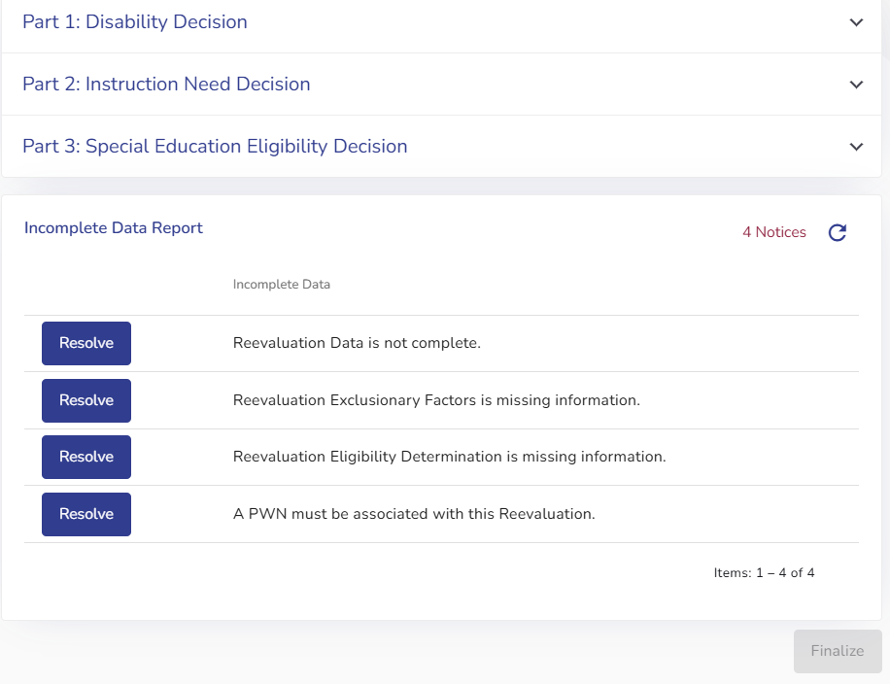
Incomplete Data Report (IDR)
Located at the bottom of the Eligibility Determination stepper (formerly the Summary Stepper)
Will continue to function the same
Will note Reevaluation Data is missing if Parent input or background information is blank
Notes:
The IDR will now be located under the Eligibility Determination section, as there is no longer a Summary Stepper. It will continue to function the same as it has, but as background information and parent input are required, it’ll notify you that the reevaluation data section needs completed if either of those have been left blank. It will also notify you if you don’t have at least one box for each domain that was selected as being evaluated.

Slide 54
Thank you!
Open Office Hours:
Thursday July 2nd
  8:30-9:30 am
  11 am-12 pm
Wednesday Aug. 5th and 19th
  8:30-9:30 am and 3-4 pm
Fridays in August
  11:30 am-12:30 pm
Additional Reevaluation Training and Resources:
Coming soon!
Contact your Regional Special Education Director
ACHIEVE webpage
Notes:
Thank you for sitting through this recorded webinar on the changes to Reevaluations in ACHIEVE. If you haven’t already, I recommend opening your sandbox in ACHIEVE and practice working through the changes.
Starting in the August, I’ll be hosting office hours to answer any questions in regard to how to navigate the changes. You can find the zoom link by going to the ACHIEVE webpage on the Department’s website, and scrolling down to Training and Resources.
More detailed trainings on reevaluations and their requirements will be available soon from the Department and can be accessed by contacting your Regional Special Education Director (RSED).

