Slide 1
Equitable Services
Use of Third-Party Providers and Carryover Guidelines
Elementary and Secondary Education Act (ESEA) of 1965, as amended by the Every Student Succeeds Act (ESSA) of 2015
Luke Markway - ESEA Programs Ombudsman
Notes:
Isbelia

Slide 2
Overview
Purpose
Third-Party Providers
  Requirements for All Third-Party Providers
  State-Vetted Provider
    Implementation
    Guidelines
Nonpublic Schools Carryover Share For Supplemental Equitable Services
  General Guidelines
Nonpublic Consultation Agreement Updates
  CASA
Resources

Slide 3
Purpose
This webinar will provide guidelines on the use of third-party providers, and the process to opt-in to receive supplemental services by Iowa’s vetted third-party provider.
Attendees will also learn about the equitable share for services carryover for nonpublic schools.
Notes:
Read the slide

Slide 4
Third-Party Providers

Slide 5
Requirements
During the consultation process the nonpublic and public school can determine who best meets the needs of the students and teachers to provide the services.
  AEA
  Public School
  Third-Party Provider
Through consultation it may be determined that there may be a variety of providers needed to provide the supplemental services across programs.
All service providers must be independent of the nonpublic school.

Slide 6
Requirements (cont.)
The LEA remains responsible for oversight of all ESEA programs.
The third-party provider must be independent of the nonpublic school.
  All supplemental services must be secular, neutral, and non ideological.
The LEA must adhere to the Uniform Administrative requirements, Cost Principals, and Audit Requirements for Federal Awards (2 CFR 200).
The control of funds including any title to material, equipment, and property purchased remain with the LEA (ESEA section 1117(d)(1)).

Slide 7
Third-Party Provider
Master Services Agreement

Slide 8
Third-Party Provider Master Services Agreement
The LEA may opt in to use the Department’s master services agreement with Catapult Learning to provide supplemental services and the provider may also help manage the consultation process with the LEA and nonpublic school.
The LEA will hold a contract with the provider which provides the details of the services that are needed to support the nonpublic students and teacher.
The provider may be able to provide services for one program or the provider could meet the needs across all programs.

Slide 9
Supplemental Service Categories
Service Categories | Examples
Student Supports | Math and reading interventions Counseling services Summer enrichment
Professional Development | In-person workshops Virtual workshops Leadership of instructional coaching
Family Engagement Services | In-person or virtual family workshops Take-home learning resources and activities Flexible topics related to family needs

Slide 10
Supplemental Service Categories (cont.)
Service Categories | Examples
Assessment Support | Data analysis and reporting Progress monitoring and reporting Comprehensive needs assessment and school improvement planning
Assistance with Management of Equitable Services | Assistance with the consultation process Administrative costs may be used to pay for this activity

Slide 11
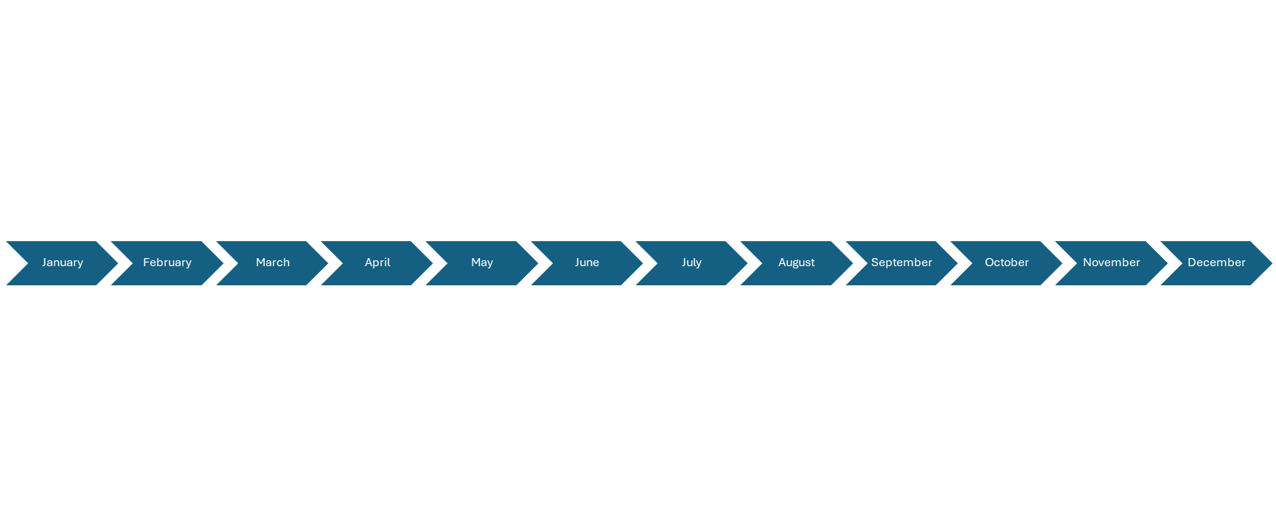
Nonpublic Consultation Agreement Timeline
*August 7 The list of schools who opted in will be sent to the vendor
October 15 Program Applications Due
January 31 Q2 Claims Due
April 30 Q3 Claims Due
July 15 Q4 Claims Due
November 30 Q1 Claims Due
Ongoing Consultation
January 15 Nonpublic Consultation Agreement Opens
March 15 Initial Consultation Agreement Due
*August 3 Third-party Vendor Opt-in Due
October 15 Final Nonpublic Consultation Due
* The August 3 opt-in due date is for 2026-27 only. Moving forward it will be due at the same time of the initial consultation agreement on March 15th.

Slide 12
Implementation of the State Vetted Third-Party Provider
Opting in: During the consultation process, if the LEA and the nonpublic school reach agreement, the LEA may elect to opt in to the use of a third-party provider as outlined in the consultation agreement.
Timely, Meaningful, and Ongoing Consultation: The third-party provider may assist the LEA in facilitating timely, meaningful, and ongoing consultation; however, the LEA remains responsible for ensuring all consultation requirements are met.
Budget Amendment: If the needs have changed and there needs to be an amendment, the third-party provider will ensure allowability of the change, and may work with the LEA to submit a budget amendment request to the SEA for approval within CASA.

Slide 13
Implementation of the State Vetted Third-Party Provider (cont.)
Data Collection: It is the responsibility of the LEA to evaluate the programs. The third-party provider may assist in collecting data based on the needs for all programs.
Invoicing: The LEA will pay the third-party provider and will follow the claims process to request reimbursement from the State during the claims period. Invoices should be clear and itemized and should align with the approved program budget and application.
Program monitoring:The LEA is required to submit evidence of equitable service programs to the Department. The third-party provider may not complete the monitoring task for the LEA. The provider may serve as a liaison for collecting the required paperwork, data, and ensure the procedures are followed.

Slide 14
Nonpublic Schools Carryover Share For Supplemental Equitable Services

Slide 15
Guidelines
Funds allocated to an LEA for educational services must be obligated in the fiscal year for which they are received ((ESEA section 8501(a)(4)(B); 34 C.F.R. § 299.7(a)(3)).
There generally should not be any or significant carryover; however, the ESEA does not prohibit carryover for equitable services.
The Department is making adjustments within CASA to align with the guidance. The nonpublic school must have a plan to use the equitable shares in the next year.

Slide 16
Eligible ESEA Programs
Reason for Carryover | Use of Carryover
Services for eligible children in one or more private schools are delayed (e.g., based on a natural disaster, delayed consultation, inability to employ qualified personnel, or unexpected procurement challenges). As a result, the LEA is unable to fully provide required services, and some funds are unobligated at the end of the Fiscal Year. | The LEA must use the funds to provide equitable services to eligible children in the affected private schools the following year.
An LEA uses a third-party contractor to provide equitable services, and the invoiced amount for services in one of the private schools is $1,000 less than anticipated. Because this occurs late in the summer, the LEA is unable to responsibly obligate the funds prior to the end of the Fiscal Year. | The LEA, in consultation with the private school officials, must use these funds the following year to provide equitable services to students in the affected private school.

Slide 17
Specific ESEA Programs
Title I, Part A | Title VIII, Part F
If, after consultation, those private school officials decline such services, the LEA must add funds to the proportional share available for equitable services to other participating private schools. If there are no other participating private schools, the funds may be used to provide services in the public schools | Any carryover funds become part of the general pool of funds available for expenditures for programs for public schools and participating private school children and educators for the next year.

Slide 18
Title I, Part A Carryover Limitation
The 15% carryover limitation in ESEA section 1127(a) is based on the LEA’s total Title I, Part A allocation, including the equitable share for services.
If the LEA exceeds the carryover limitation, the Department will reduce the allocation, however, the reduction may not come from the portion used to provide equitable services.
An exception would be if the nonpublic school would decline services for the following year and there were no other participating nonpublic schools.

Slide 19
Nonpublic Consultation Agreement Updates

Slide 20
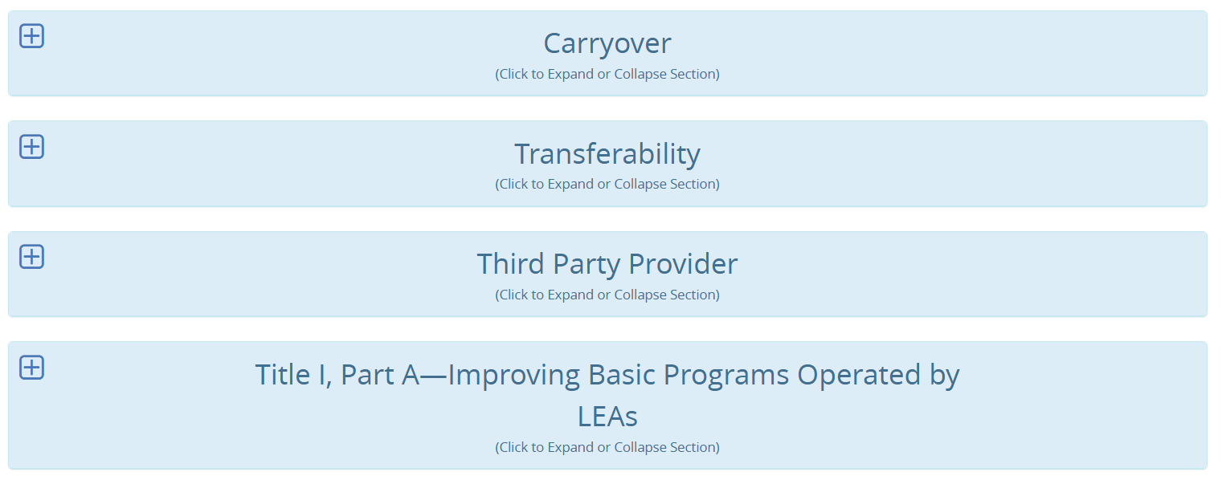
Home Screen

Slide 21
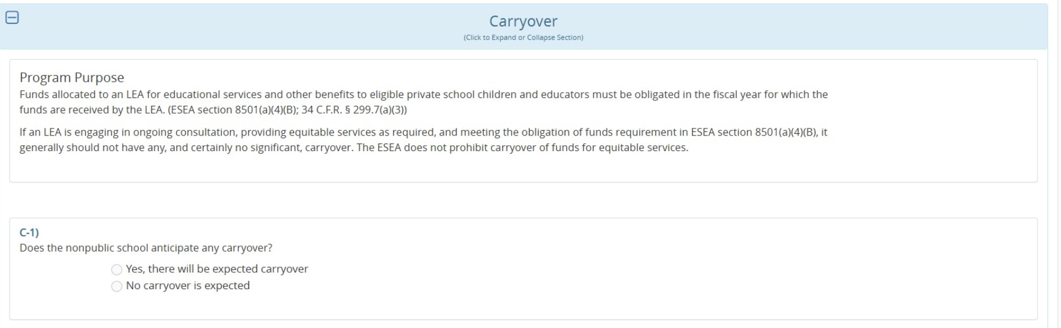
Carryover Process

Slide 22
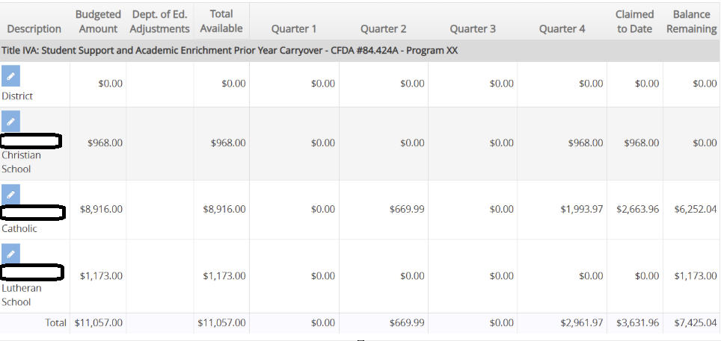
Carryover within CASA

Slide 23
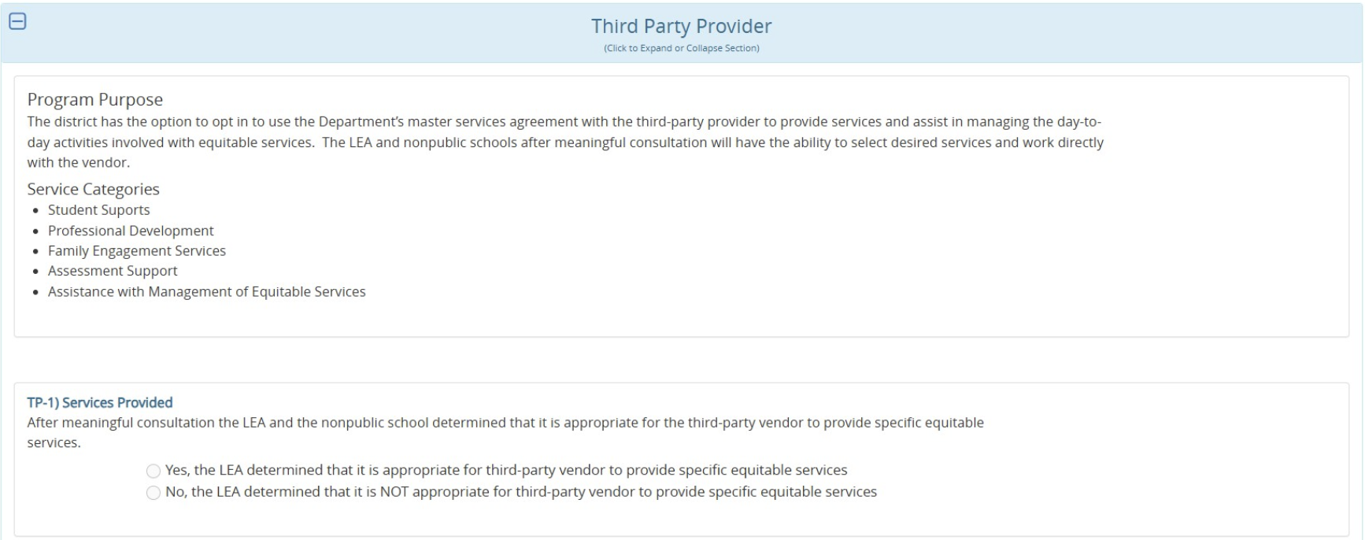
Third-Party Opt-in

Slide 24
Resources
Title I, Part A Non-Regulatory Guidance
Title VIII, Part F Non-Regulatory Guidance
ESSA Guidance and Allocation Page
Iowa Chart of Accounts
ESEA Ombudsman Contact Information

