Slide 1
Operating a Title I, Part A
Schoolwide Program
Bureau of ESEA Programs

Slide 2
Overview
Purpose
General Information
  Schoolwide vs Targeted
Operating Schoolwide Programs
  Eligibility
  Plan
  Benefits
  Required Elements
  Supplement Not Supplant
  Strategies
  Examples
Application
  Selection of Schools
  Schoolwide Waiver Application
Resources

Slide 3
Purpose
To provide guidelines on how operating a schoolwide program under Title I, Part A may be beneficial to schools as they explore how to most effectively leverage their local, State, and Federal funds in order to raise student achievement.

Slide 4
General Information

Slide 5
General Information (cont.)
Title I, Part A Schoolwide Programs remain a key tool to improve academic achievement and enable a school to more effectively leverage ESEA funds to upgrade its entire educational program.
A local educational agency may consolidate Title I, Part A funds with other federal, state, and local funds to upgrade the entire educational program of certain schools. In general, schools must meet the poverty threshold rate in order to operate a Schoolwide Program (ESEA Section 1114(a)(1)(A)).

Slide 6
Schoolwide vs Targeted
Schoolwide
Targeted
A school may use Title I, Part A funds to upgrade the entire educational program of a school to provide services to any eligible student who needs support.
In a targeted assistance program, ESEA Section 1115 limits the use of funds to Title I, Part A identified students only
Schools that are eligible and receive Title I, Part A funds must design and implement programs to support eligible students through a schoolwide or targeted assistance model.

Slide 7
Operating a Schoolwide Program

Slide 8
Eligibility
In order for a school to operate a Title I, Part A Schoolwide Program -
It must first establish eligibility to be served with Title I, Part A funds.
It has submitted a waiver application in CASA (ESEA sections 1114(a)(1)(B) and Section 1114(b)(6))
It has been granted the flexibility by the Department
It receives a waiver from the Department to operate a schoolwide program without meeting the poverty threshold.
Once approved, it may operate a Schoolwide Program.

Slide 9
Schoolwide Assistance Plan
An eligible Title I, Part A school may implement a schoolwide program if it is below the poverty threshold. Title I schools below the poverty threshold must apply for a waiver from the Department.
Schoolwide program funds are used to upgrade the entire educational program in a school, and all students may benefit from the use of Title I funds.
Activities must be part of the schoolwide plan and support an identified academic need through the school’s comprehensive needs assessment (ESEA § 1114).

Slide 10
Benefits
A school that operates a schoolwide program is able to take advantage of numerous benefits, including:
Serving all students
  A school operating a schoolwide program does not need to identify particular students as eligible to participate (ESEA section 1114(a)(2)(A)(i)).
Consolidating federal, state, and local funds
  A school operating a schoolwide program may consolidate Federal, State, and local education funds to better address the needs of students in the school (ESEA section 1114(a)(1)(3)).

Slide 11
Required Elements
There are three steps to implementing a compliant and effective schoolwide program (ESEA §1114(b)(1)(A)):
Conducting a comprehensive needs assessment
Preparing a comprehensive schoolwide plan
Annually evaluating the schoolwide plan

Slide 12
Supplement Not Supplant
"Supplement, not supplant" - Title I, Part A funds are not used to provide services that would, in the absence of those Title I dollars, be supported with state or local resources (ESEA Section 1118 (b)(1)).
The methodology used is Title I, Part A-neutral (ESEA Section 1118(b)(2)).
Title I, Part A funds must be used to supplement the amount of funds allocated from non federal sources for the school in the absence of Title I, Part A funds (ESEA Section 1114(a)(2)(B)).

Slide 13
Strategies
A school operating a Schoolwide Program must implement strategies that:
Provide opportunities for all children to meet challenging state academic standards;
Use methods and instructional strategies that strengthen the academic program in the school, increase the amount and quality of learning time, and help provide an enriched and accelerated curriculum; and
Address the needs of all students, but particularly those at risk of not meeting challenging state academic standards.

Slide 14
Examples
Transition from early learning to elementary education programs.
Recruitment and retention of effective teachers
Instructional coaches
Increased learning time
Evidence-based strategies to accelerate the acquisition of content knowledge for English learners.
Activities designed to increase access to advanced coursework
Career and technical education programs
Counseling, school-based mental health programs, mentoring services
School climate interventions
School-level high-quality instructional materials (HQIM) upgrades, and more

Slide 15
Title I, Part A – Application
Selection of Schools

Slide 16
Eligible School Buildings
Low Income Family Count
ESSA Permitted Methods
Title I, Part A
Eligibility Determination
Free and Reduced Price school lunch
Free Lunch Only
Direct Certification and household surveys
Direct Certification Only
Other- data collection tools following the USDA Food Nutrition Service Annual Income Eligibility Guidelines
All Title I buildings must be served in rank order of poverty – serving the highest poverty buildings first, either by grade-span groupings or by rank order
Schools with poverty rates at or above 75% must be served
Schools at or above 35% poverty may be served
Schools at or above the district-wide poverty percentage, if less than 35% poverty
If a district has only one building in a grade span, the building may be served regardless of the district-wide poverty percentage
Special exception for 1 year – Grandfather year
Rank and serve does not apply to districts with enrollment less than 1,000 (ESEA Section 1113(a)(6))
Only qualifying schools are eligible to use Title I funds and operate Title I programs

Slide 17
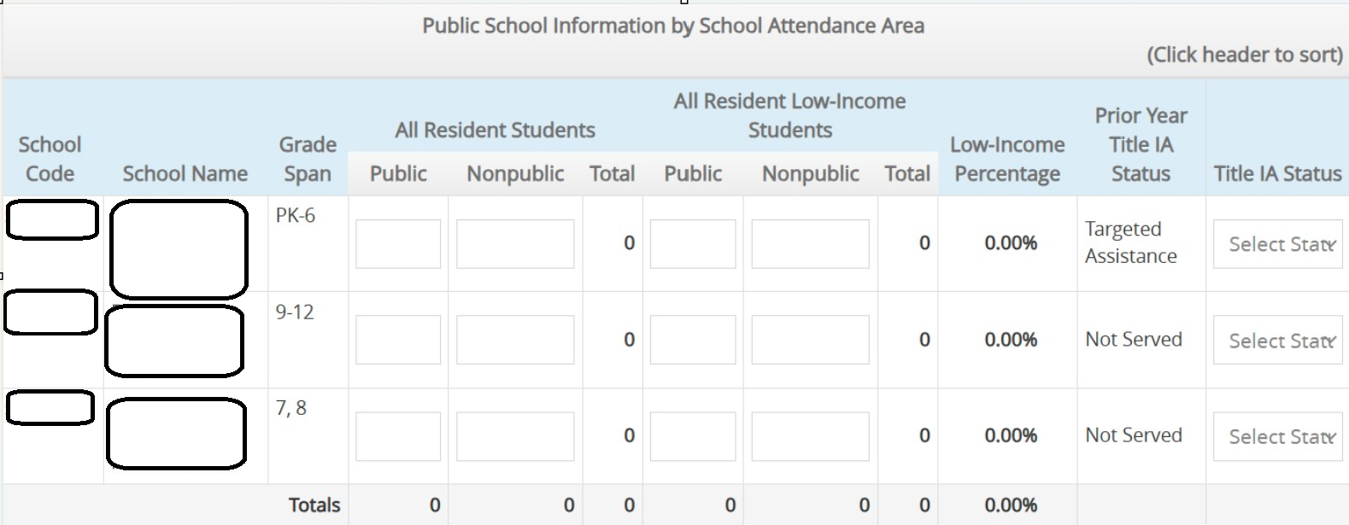
Title I, Part A Selection of Schools in CASA

Slide 18
Schoolwide Waiver Application

Slide 19
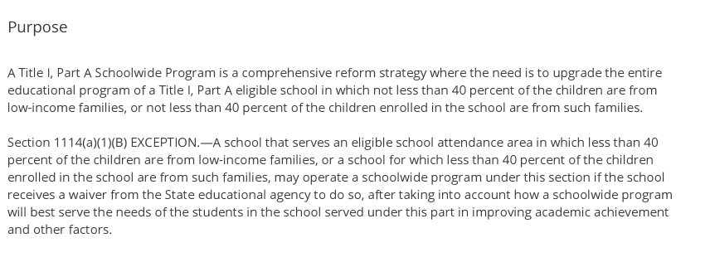

Schoolwide Waiver Application - Purpose

Slide 20
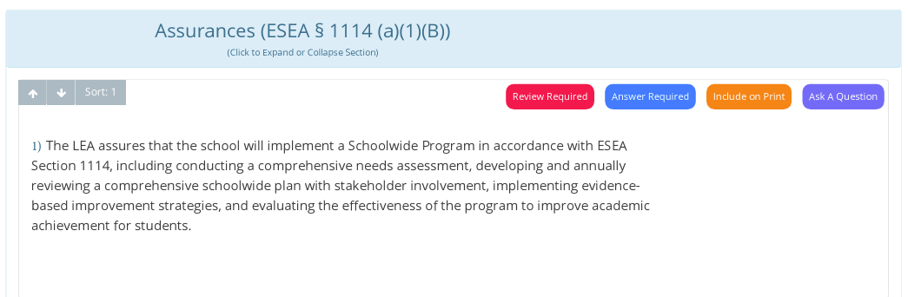
Schoolwide Waiver Application - Assurances

Slide 21
Resources
ESEA Programs
Title I, Part A
Contact Information
Supporting School Reform by Leveraging Federal Funds in a Schoolwide Program

Slide 22
Questions

