Slide 1
ACHIEVE:
Individualized Education Program (IEP) Enhancements
Released: June 18, 2026
Notes:
Welcome, and thank you for joining today’s overview of the upcoming ACHIEVE Individualized Education Program, or IEP enhancements.
This release represents a significant set of updates to Iowa’s statewide special education system designed to improve clarity, consistency, usability, and documentation practices within the IEP process. These enhancements were developed through extensive review of current workflows and are aligned to the functional specifications outlined for ACHIEVE’s IEP changes.
Throughout this training, we will review enhancements related to meeting processes, learner dashboard updates, PLAAFP special factors, secondary transition, goals, accommodations, services, and Least Restrictive Environment updated for preschool learners.
As we move through the training our focus will be on understanding both the purpose behind the changes and how they function within ACHIEVE. By the end of the session, participants should feel more confident navigating these updates and applying them accurately within the IEP process.

Slide 2
Purpose of Enhancements
Stronger alignment between student needs, goals and services
More consistent documentation across teams and districts
Improved data quality for instructional decision-making
Streamlined workflows that reduce duplicate entry
Greater transparency for families and educators
Notes:
These enhancements are intended to improve both the functionality of ACHIEVE and the quality of IEP documentation statewide. The updates strengthen clarity and compliance by improving alignment across IEP components and reducing incomplete or disconnected documentation. They also support stronger data-driven decision making by requiring clearer connections between learner needs and the services, supports, and goals being provided. In addition, several updates improve usability for teams by streamlining workflows and simplifying navigation within the system.
Ultimately, these changes are designed to support greater statewide consistency, improve family understanding, and help teams create stronger, more individualized IEPs for students.

Slide 3
What’s Included in this Release
Enhancements include:
Learner Dashboard Activity Section
Meeting Notices
Family Portal Registration
IEP Content
  PLAAFP: Special Factors Enhancements
  Secondary Transition Improvements
  Goal Updates
  Least Restrictive Environment (LRE) PK Updates
  Incomplete Data Report Changes
Notes:
This release includes targeted enhancements across several areas of the IEP portion of ACHIEVE. This presentation will review updates to the Learner Dashboard Activity Section, meeting notices and revisions and a new Family Portal registration feature. The Family Portal enhancement adds a button that generates a registration flyer containing information families need to create a Family Portal account, including the last four digits of the student’s State Student ID. The presentation will also touch base on updates to PLAAFP special factors, secondary transition, goals, and preschool Least Restrictive Environment requirements. Finally, the slides will review changes to the Incomplete Data Report, or IDR, which introduce alignment and documentation accuracy. As the presentation moves through each section, we will review both the technical functionality within ACHIEVE and the practical impact these changes may have on IEP teams and documentation practices statewide.

Slide 4
Learner Dashboard
Activity Section Changes
Notes:
We are now moving into updates related to the Learner Dashboard Activity Section. Several enhancements were made to improve organization, meeting tracking and documentation visibility within ACHIEVE. These updates separate pending meetings from past meetings, improve how meetings are displayed to users, and add additional documentation requirements for meetings that are canceled or not held. The overall goal of these changes is to create a clearer workflow for teams while improving transparency and historical tracking of meeting activity.

Slide 5
Additional ACHIEVE Enhancements
Learner Dashboard Updates
Activity section structure
Display format (accordion→Table/pagination)
Notes:
One of the first dashboard enhancements users will notice is the updated structure of the Activity section. Previously, this area displayed a limited number of meeting accordions. With this release, the Activity section is reorganized to improve readability and provide easier access to meeting information. The display format is also changing from a limited accordion view to a more structured format that supports expanded visibility and improved organization of meeting information. These updates help users more efficiently track pending meetings, review historical meeting activity, and locate documentation connected to meetings.

Slide 6
Activity Section
Activity section of the Learner Dashboard
  Pending Meetings
    The “Cancel Meeting” button will appear on meetings that have not yet occurred and will require the user to enter rationale for the cancellation.
  Past Meetings
    If Meeting Date is in the Past, a new ‘Meeting Not Held” button will display
Notes:
The updated Activity section will now be divided into two categories: Pending Meetings and Past Meetings. Pending Meetings will display meetings that have not yet had a completed roll call and are still active within the system. Past Meetings will include meetings that were held, canceled, or marked as not held. Another important enhancement is the addition of the ‘Meeting Not Held’ button. If a meeting date has passed and the meeting did not occur, users can now document that directly within ACHIEVE. Additionally, the Cancel Meeting process now requires documentation of a rationale for cancellation, which strengthens meeting documentation and improves transparency within the system.

Slide 7
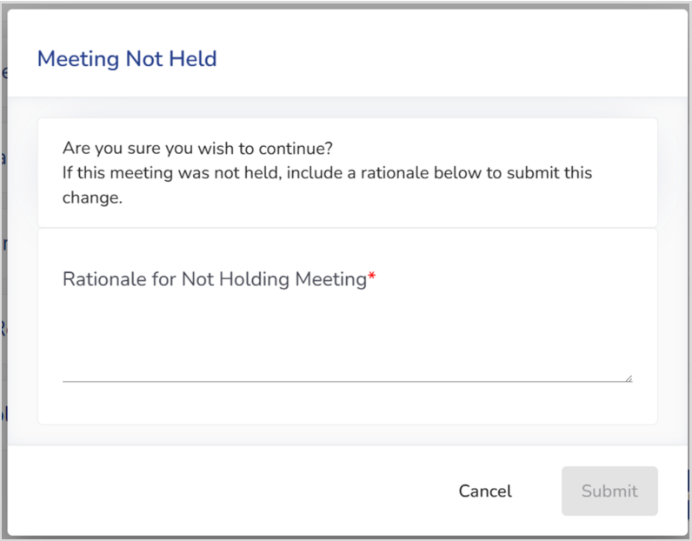
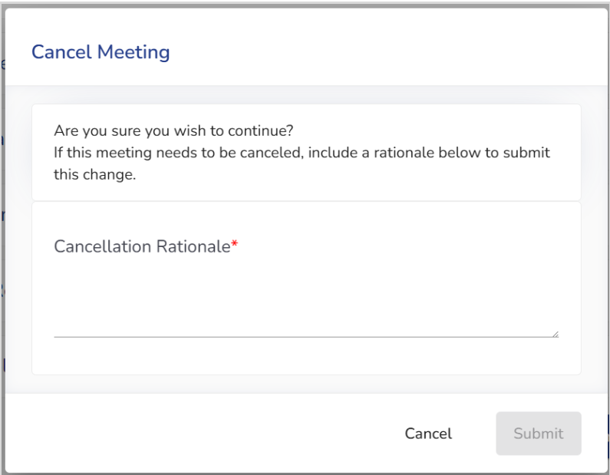
Meeting Not Held/Cancel Meeting
Notes:
The update also introduces new documentation requirements when meetings are canceled or not held. If a scheduled meeting does not occur, users will now complete a ‘Meeting Not Held’ process directly within ACHIEVE. Similarly, canceled meetings will require documentation explaining why the meeting was canceled.
In both situations, users must enter a rationale before submitting the change. As a result, teams can quickly identify which meetings still require action and which have already been completed or resolved.

Slide 8
Meeting Notice
Notes:
Next, we will move into updates related to Meeting Notices. Several enhancements were made to simplify the meeting revision process, improve communication with families, and strengthen documentation of meeting changes within ACHIEVE. These updates include changes to meeting revision workflows, revised meeting notices, updated meeting purpose logic, and additional system guardrails related to scheduling and documentation.

Slide 9
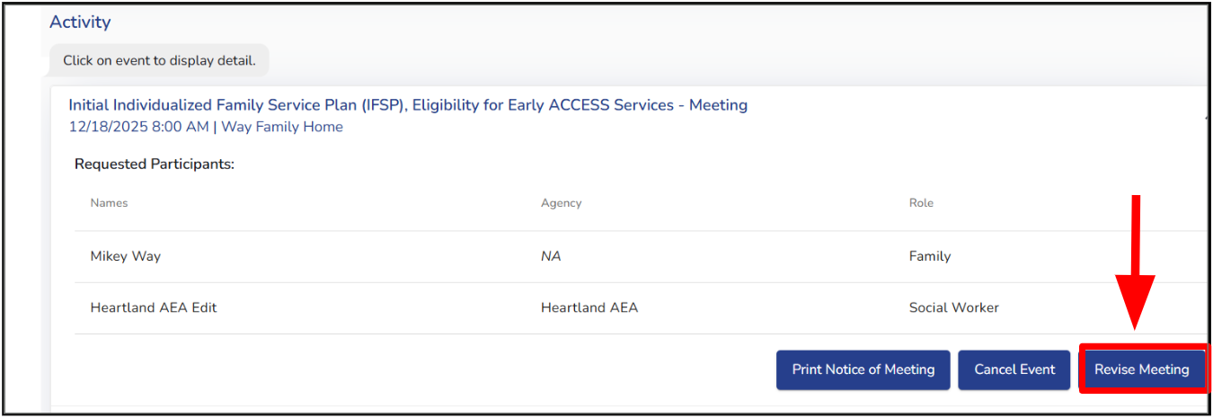
Meeting Notice Updates - Overview
What’s changing with Meeting Notices?
Streamlined meeting actions
New “Revised Meeting” functionality
Improved documentation of changes
Updated meeting notices process
Improved roll call completion and meeting decision tracking
Notes:
Several important updates were made to the Meeting Notice process within ACHIEVE. These enhancements are intended to streamline meeting actions, improve documentation, and simplify how teams make revisions to existing meetings. One major change is the introduction of the new ‘Revise Meeting’ functionality, which replaces several previous meeting actions and creates a more centralized revision process. Overall, these updates improve clarity for teams, strengthen communication with families, and create more consistent documentation practice across the system.

Slide 10
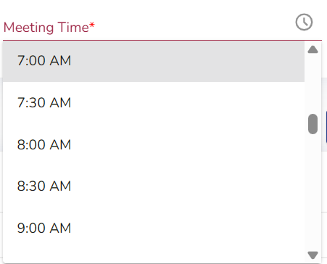
Scheduling a meeting time
Time Picker Standardization
Time picker will default to 7:00 AM start instead of 12:00 AM
Notes:
One small but important usability enhancement involves the time picker within ACHIEVE. Previously, the time picker defaulted to midnight, or 12:00 AM, which often required users to scroll extensively to locate typical meeting times. With this update, the time picker will now default to a 7:00 AM starting point. This change standardizes the scheduling experience across ACHIEVE and improves efficiency when scheduling meetings.

Slide 11
Revise Meeting: Key Functionality
“Revise Meeting” button:
Opens a dedicated revision window
Allows additional meeting purposes to be added
Allows updates to date, time, or location
Maintains original meeting details for reference
Requires confirmation before applying updates
Generates a revised meeting notice
Notes:
When a user selects a ‘Revise Meeting’ button, ACHIEVE opens a dedicated revision window for the existing meeting notice. Within this window, users can add additional meeting purposes, revise the meeting date, time, or location and add additional participants when appropriate. One important feature is that the original meeting information remains visible for reference.
Teams no longer need to cancel and recreate meetings simply to update logistics, reducing duplicate work and preserving meeting history.

Slide 12
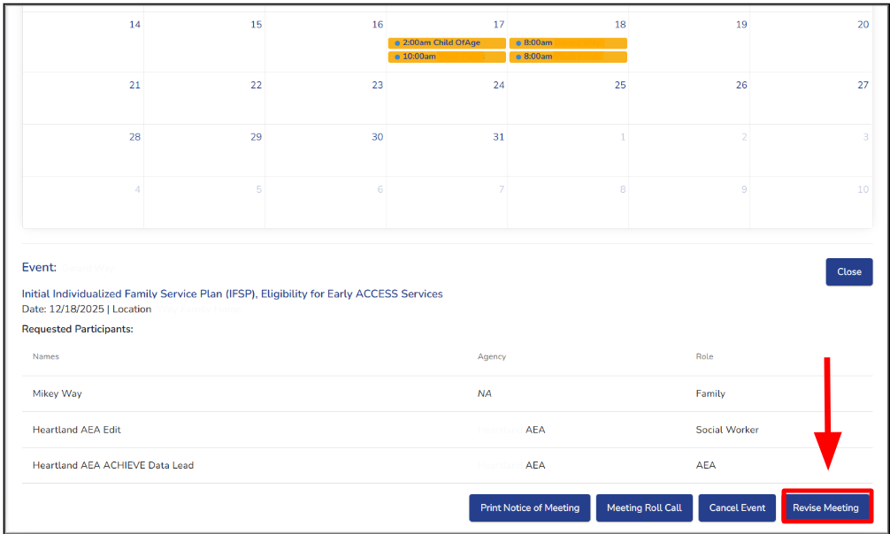
Where is this found?
Notes:
The new ‘Revise Meeting’ button can be found within the ACHIEVE calendar area on My Dashboard. This button replaces previous options such as reschedule event and add participants. Selecting ‘Revise Meeting’ opens the updated meeting revision workflow and allows users to make approved revisions to an existing meeting notice while maintaining documentation of the original meeting information. After the meeting date, or once roll call has been completed the Revise Meeting button will no longer appear directly on the dashboard. However, users can still access the functionality through the Roll Call modal while editing roll call information. This allows teams to continue making necessary revisions when appropriate while still maintaining system controls around finalized meeting documentation.

Slide 13
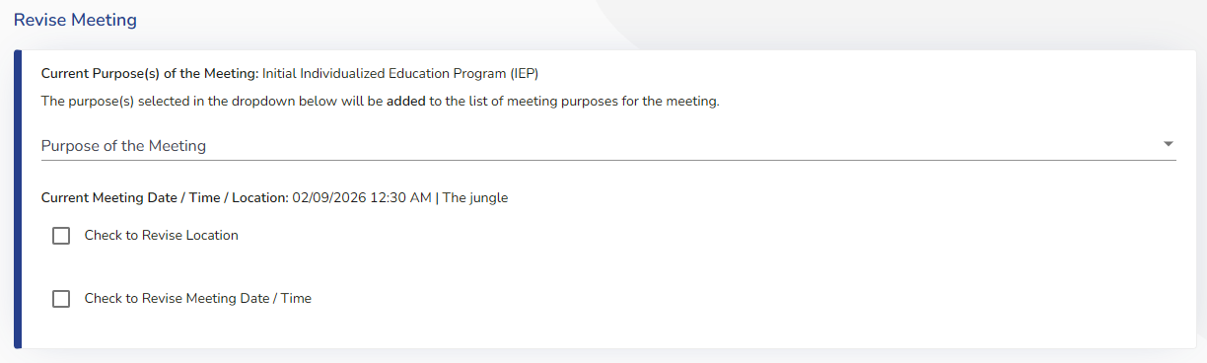
Purpose of the Meeting
Add additional Meeting purposes
Cannot delete previous meeting purposes
Notes:
The Revise Meeting process also updates how meeting purposes are managed within ACHIEVE. Users may now add additional meeting purposes to an existing meeting notice; however, previously selected meeting purposes cannot be removed during the revision process. The system will only display meeting purposes that have not already been selected for that meeting. Additionally, if the learner has both an active EA and Special Education Case, the available meeting purposes will align to the program associated with the original meeting notice. This enhancement helps preserve documentation integrity while still allowing teams flexibility when meeting needs change.

Slide 14
Purpose of Meeting - Updates
Changes Include:
New Meeting Options
  Interim Individualized Education Program (IEP)
  Initial Individualized Education Program (IEP)
  Annual Individualized Education Program (IEP)
Important:
Meeting purpose will be required for each annual IEP
Why this matters:
Aligns meeting purpose with IEP process
Reduces errors in scheduling
Notes:
Another enhancement within ACHIEVE involved updates to the Purpose of the Meeting options. New meeting types have been added, including Interim Individualized Education Program or Interim IEP, Initial Individualized Education Program and Annual Individualized Education Program or Annual IEP. In addition, the meeting purpose will be required for each annual IEP.
These updates are important because the selected meeting purpose now directly connects to system logic and workflow requirements within ACHIEVE. The system will use the meeting purpose to help drive timelines, required actions, and portions of Incomplete Data Report (IDR).
Overall, this enhancement helps better align the meeting notice process with the actual type of IEP being developed. This improves consistency, reduces scheduling errors and supports more accurate documentation across the system.

Slide 15
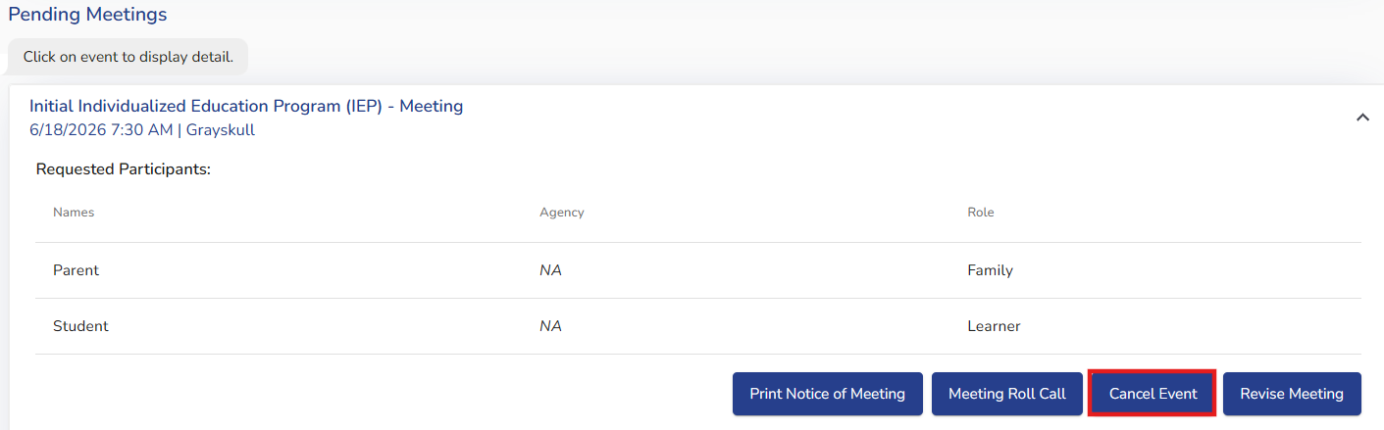
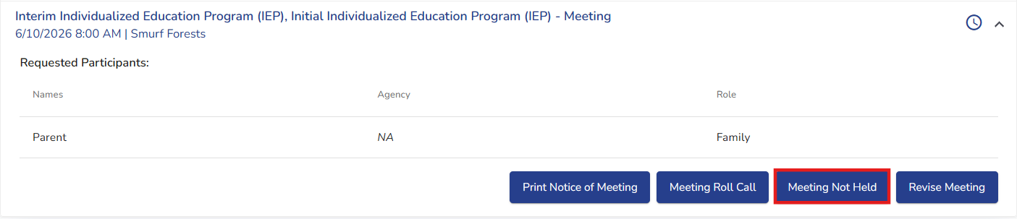
Canceling a Scheduled Meeting
Notes:
There may be situations where a meeting is scheduled but no longer needs to occur. In those situations, teams should use the Cancel Event option rather than revising the meeting. Canceling a meeting removes the scheduled event and documents that the meeting will not take place. This is the appropriate action when the purpose of the meeting is no longer needed and it is prior to the meeting date. If the meeting date has already passed, the Cancel Event button will disappear and the Meeting Not Held button will appear. A rationale is needed for both a cancel event or meeting not held.
Remember that previously selected meeting purposes cannot be removed through the Revise Meeting workflow. If a meeting purpose was added in error or is no longer needed, the meeting should be canceled and a new meeting created with the appropriate purpose.
Using the correct workflow helps ensure meeting records remain accurate and provides a clear historical record within ACHIEVE.

Slide 16
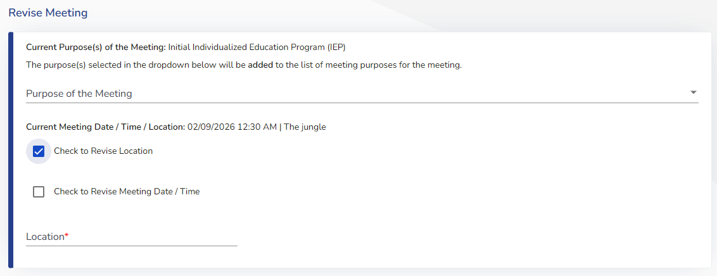
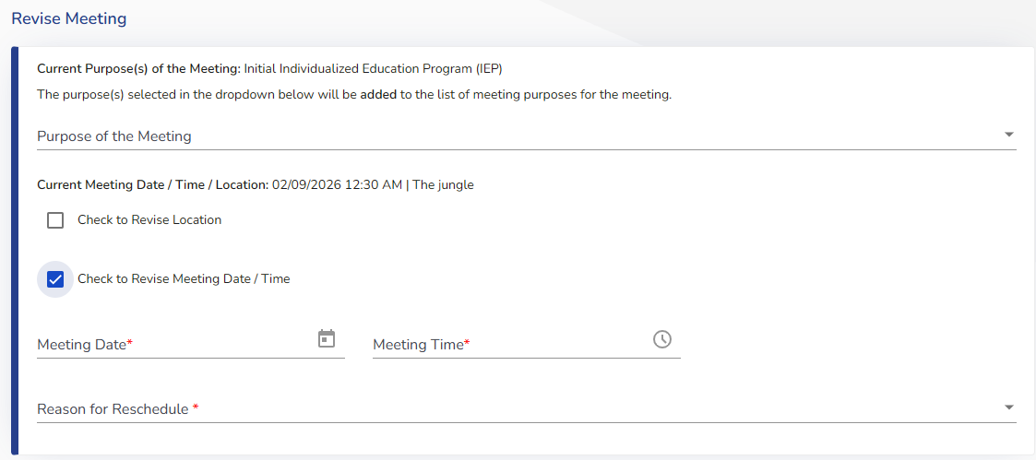
Revise Meeting Location, Date and Time
Notes:
There may be situations where a meeting remains necessary, but the location, date, or time must be adjusted. In these situations teams can use the Revise Meeting functionality rather than creating a new meeting notice. Within the Revise meeting window, users can select whether they want to update the meeting location, revise the meeting date and time, or revise both. When a date or time change is made, ACHIEVE requires users to enter the updated meeting information and document the reason for the reschedule.
Once the revisions are completed, ACHIEVE generates a revised meeting notice that documents the updated information while maintaining a record of the original meeting details. This helps ensure families and team members have access to the most current meeting information while preserving a clear history of changes. Using the Revise Meeting process allows teams to make necessary scheduling updates efficiently while maintaining accurate documentation and communication throughout the IEP process.

Slide 17
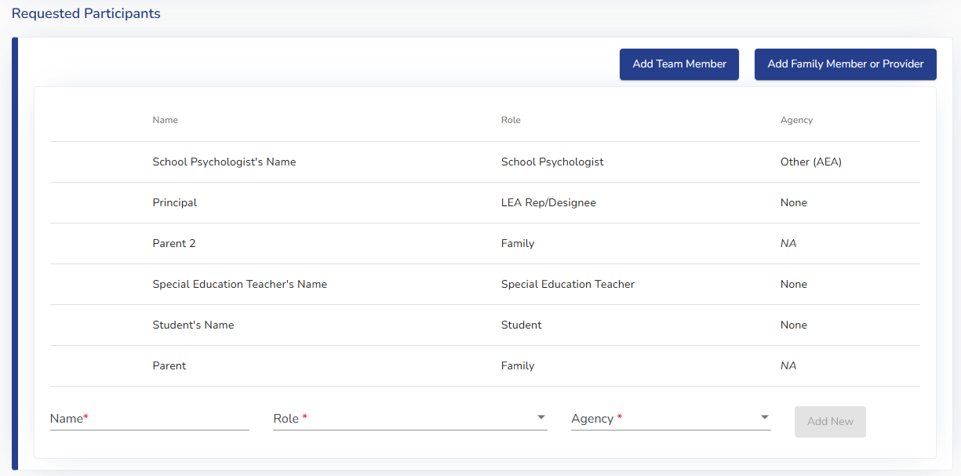
Requested Participants - Changes
Participation section:
Functions like the scheduler
Existing participants cannot be edited or removed
To change previously selected participants→ cancel current meeting and schedule a new one
Why this matters
Protects integrity of original notice
Prevents undocumented changes to required members
Notes:
This slide highlights changes related to Requested Participants within the revised meeting process. Functionally, the participant section will continue to work similarly to the scheduler; however, there is one major difference. Existing participants who were already included on the original meeting notice can no longer be edited or removed during a revision. If a team determines that participant changes are needed beyond simply adding additional individuals, a new meeting notice must be scheduled. This change was intentionally designed to protect the integrity of the original meeting notice and preserve documentation related to required team members and parent notification requirements.
Teams may still add additional participants if needed, but ACHIEVE is now placing stronger guardrails around revising existing meeting membership after the notice has already been generated. The original notice remains intact, ensuring teams can accurately demonstrate who was invited and when the invitation occurred.

Slide 18
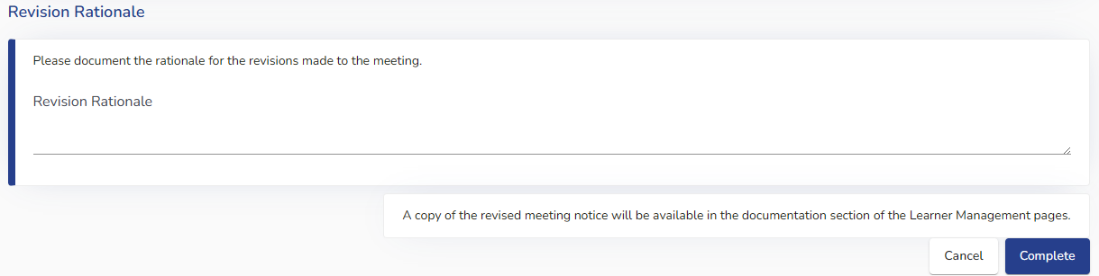
Revision Rationale - New Requirement
New addition:
Text field to document why changes were made
Why this matters
Supports transparency
Strengthens documentation
Helps teams document rationale
Notes:
This enhancement introduces a new Revision Rationale box within the Revise meeting process. When a team makes changes to an existing meeting notice, ACHIEVE will now provide a dedicated area for documenting why those revisions were made.
As shown in the screenshot, the Revision Rationale section appears toward the bottom of the Revise Meeting pop-up window. Teams can enter a written explanation describing the reason for the revision, such as a scheduling conflict, updated participant availability, or another meeting-related change.
While the rationale field itself is not required to complete the revision process, documenting the reason for changes is considered a best practice. This enhancement supports greater transparency and creates a clearer historical record for decision-making within ACHIEVE.
This also strengthens communication across team members and with families by ensuring there is documentation explaining why revisions occurred after the original meeting notice was created. The Revision Rationale box creates a record of why meeting changes occurred, making it easier for teams to understand revisions when reviewing meeting history later.

Slide 19
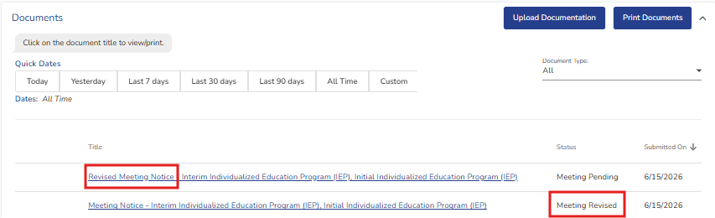
Revised Meeting Notice
When “Complete” is selected:
Revised meeting notice is generated
Stored in Documentation
Available in Family Portal
Status updated to “Revised”
Displays summary of meeting notice changes
Notes:
Once the Revise Meeting process is completed, ACHIEVE will automatically generate a Revised Meeting Notice. As shown in the screenshot, users will first receive a confirmation pop-up asking them to verify that they want to proceed with sending the revised meeting notice. After selecting ‘Yes,’ the system saves the changes, updates the meeting status to ‘Revised,’ and creates the updated meeting notice. The revised notice is then stored within the Documentation section of Learner Management and is also made available through the Family Portal.
This enhancement helps ensure families and team members have access to the most current meeting information while maintaining documentation of revisions within the system. It also supports clearer communication and reduced confusion when meeting details change after the original notice has already been sent.
An important reminder for teams is that after revising a meeting notice, updated information should still be communicated to families as appropriate. The system enhancement improves access and documentation, but strong communication practices remain essential throughout the IEP process.

Slide 20
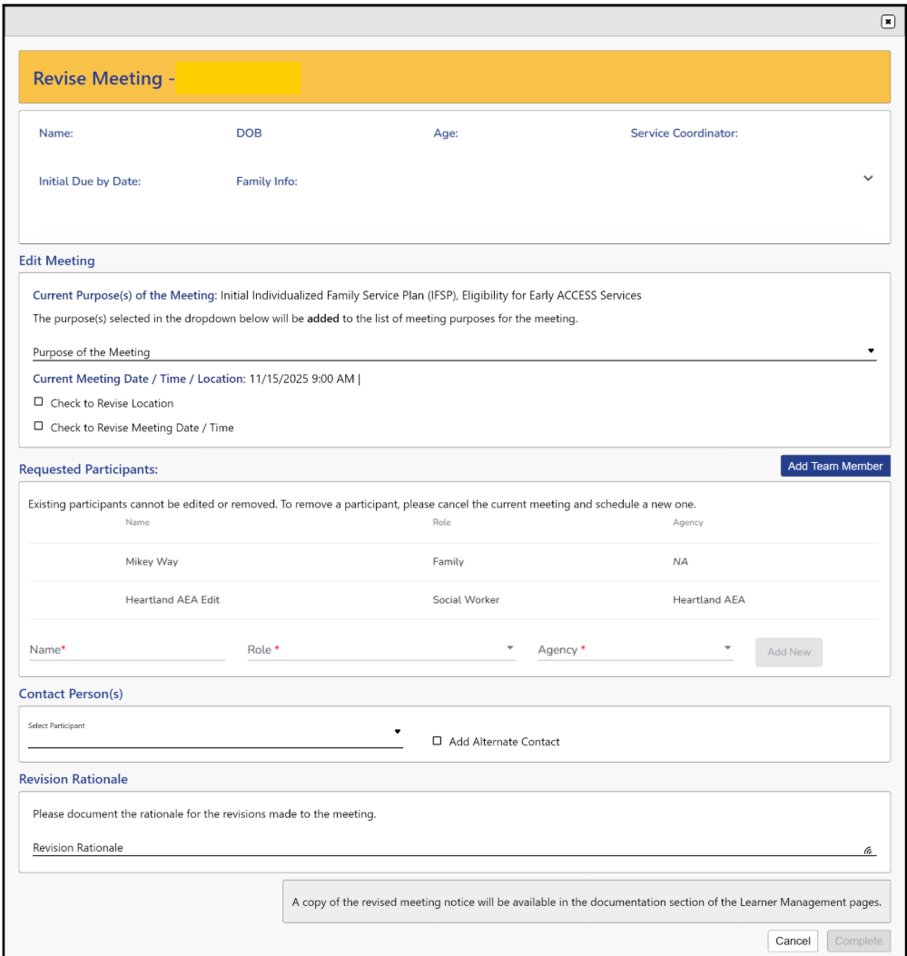
Revise Meeting Screen
Notes:
This slide provides a full view of the new Revise Meeting pop-up window and brings together the enhancements discussed throughout the previous slides. As shown in the screenshot, the pop-up is organized into several sections that guide users through the revision process in a more structured and transparent way.
At the top of the window, users can view the learner demographic information and the current purpose of the meeting. If additional meeting purposes need to be added, users can select them from the dropdown menu. Importantly, the original meeting purposes remain attached to the meeting notice and are not removed during the revision process.
Below that, users can review the current meeting date, time, and location. If revisions are needed, users can select whether they want to revise the location, revise the meeting date and time, or both. When date and time changes are selected, additional required fields will appear, including the updated meeting information and the reason for the reschedule.
The Requested Participants section is also visible within the screenshot. Existing participants from the original notice cannot be edited or removed; however, users can add additional participants if needed. This helps preserve the integrity of the original meeting notice while still allowing flexibility for additional team involvement.
Finally, at the bottom of the window, users will see the Revision Rationale field. This area allows teams to document why the meeting revisions were made, helping strengthen transparency and supporting clearer documentation practice within ACHIEVE.
Overall, this redesign creates a more centralized and structured revision workflow that improves usability, communication and documentation consistency across the IEP process.

Slide 21
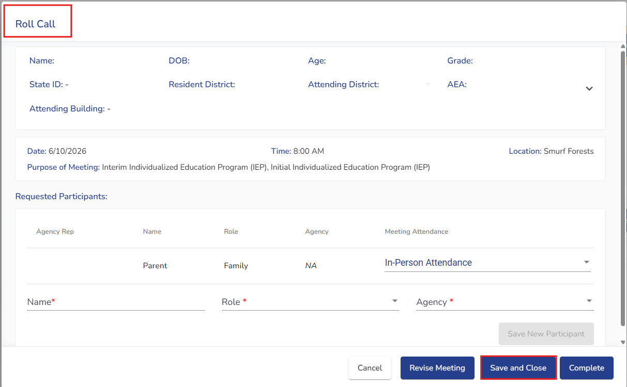
Meeting Status and Roll Call Completion
Why Roll Call Completion Matters
Meeting Status now clearly reflects whether a meeting has been completed and all roll call actions have been finalized
Meetings with unresolved roll calls can be found in Pending Meetings
Finalizing roll calls helps ensure accurate documentation and timely completion of meeting activities
Notes:
Meeting status within ACHIEVE now provides a clearer picture of where a meeting stands in the process. A meeting is not considered fully complete until all required roll call actions have been finalized. Meetings with unresolved roll call items will continue to appear within the Pending Meeting section. This helps teams quickly identify meetings that require follow-up actions before documentation is finalized.
Completing roll call is an important step because it documents attendance, confirms participation and helps ensure meeting record accurately reflect what occurred. Finalizing roll call also supports accurate meeting status updates and helps prevent incomplete meeting activities from remaining open within the system.
Before moving on from a meeting, teams should verify that roll call has been completed and that all required meeting actions have been finalized. Doing so helps maintain accurate records and ensures the meeting process is fully documented within ACHIEVE.

Slide 22
Family Portal Registration
Notes:
This enhancement introduces new functionality to support family access to the ACHIEVE Family Portal. The following slides will demonstrate where the new Family Portal feature is located and how it can be used to provide registration information directly to families.

Slide 23
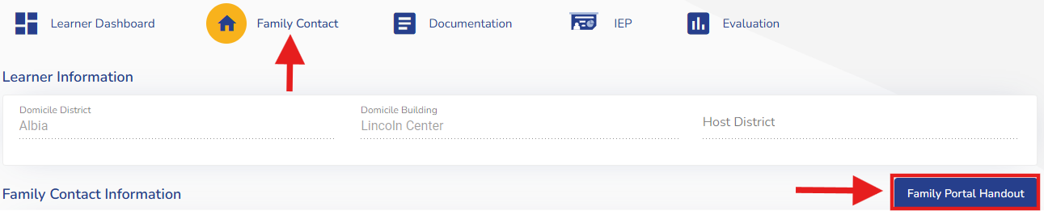
New Family Portal Registration Access
What is new?
A new Family Portal button has been added to the Family Contact section
A handout provides families with information needed to register for and access the ACHIEVE Family Portal
The handout includes the learner’s last four digits of the State ID required during registration
Notes:
A new Family Portal Handout button has been added within the Family Contact section of ACHIEVE. This enhancement provides users with a quick way to generate a handout that can be shared directly with families. The handout includes registration information as well as the last four digits of the learner’s State ID, which families will use during the account setup process. The IEP team will need to continue to select the Invite to Portal button for families to register for the Family Portal.

Slide 24
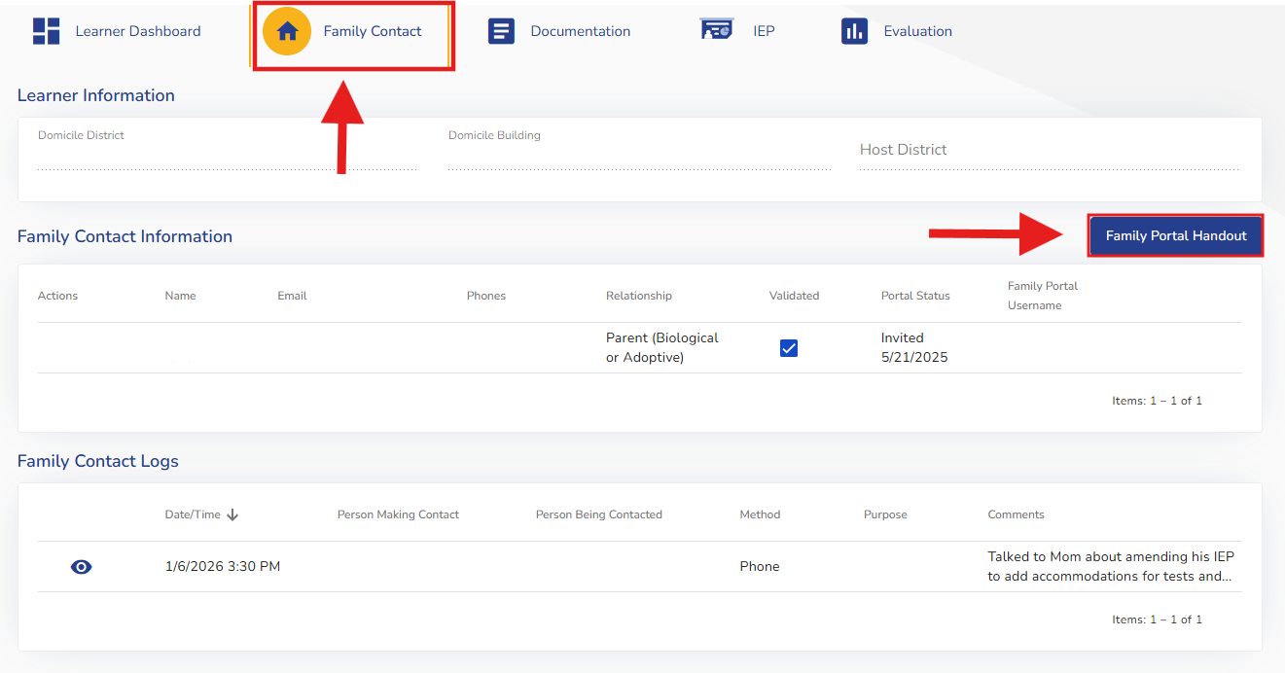
Family Portal Button
How it Works
Navigate to the Family Contact tab
Select Family Portal button.
ACHIEVE generates a Family Portal handout.
Families can use the information to register for and access the Family Portal.
Notes:
To generate the handout, navigate to the learner’s Family Contact tab and select the Family Portal Handout button. ACHIEVE will automatically create a handout that can be provided to the family. This allows staff to provide families with registration information immediately rather than manually locating student information needed for account creation.

Slide 25
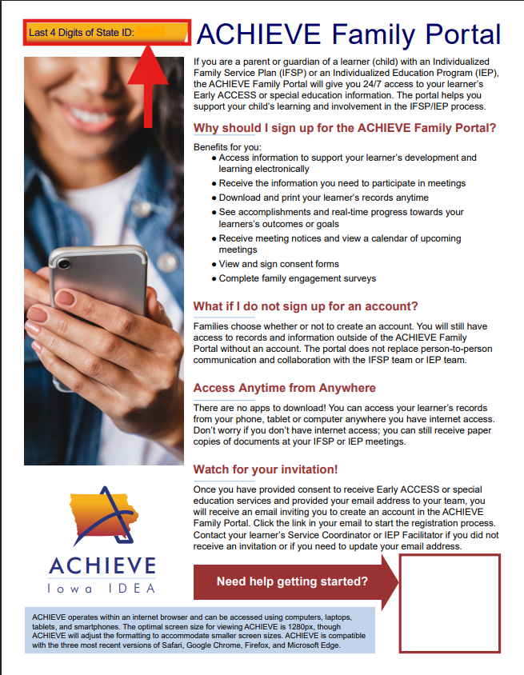
Family Portal Flyer
Handout Includes
Last four digits of the learner’s State ID
Family Portal registration information
Overview of Family Portal benefits
Instructions for getting started
OQ Code and support resources
Family Portal Features
Access IEP and IFSP records electronically
View meeting notices and upcoming meetings
Monitor learner progress
Review and sign consent forms
Notes:
Selecting the Family Portal handout button generates a flyer that can be shared with families. The flyer contains the last four digits of the learner’s State ID, registration information and resources to help families get started. It also highlights the benefits of the Family Portal, including electronic access to records, meeting notices, learner progress information, and electronic consent forms. This enhancement supports increased family engagement and provides a consistent statewide process for sharing Family Portal access information.

Slide 26
Reminder of Family Portal Invitation Requirements
To Receive a Family Portal Invitation
Each IDEA parent must have a unique, valid email address entered in ACHIEVE.
Family Portal invitations are sent to the email address stored in ACHIEVE.
Families use the invitation email and learner information to establish a Family Portal Account
Notes:
In addition to the new Family Portal Handout, it is important to understand the requirements for Family Portal invitations. Each IDEA parent must have a unique, valid email address entered in ACHIEVE. The invitation is sent to the email address stored within the system and is used to begin the Family Portal registration process. The new flyer does not allow families to register; however, it provides them with more information regarding the Family Portal. The IEP team should continue to select the Invite to Portal button after they review a family contact's email address and validate the contact record.

Slide 27
PLAAFP: Special Factors Enhancement
Notes:
The next section introduces one of the largest updates within the IEP enhancements release: changes to the PLAAFP Considerations of Special Factors process. The goal of these updates is to strengthen intentional decision-making, improve alignment across IEP components, and increase documentation consistency statewide.

Slide 28
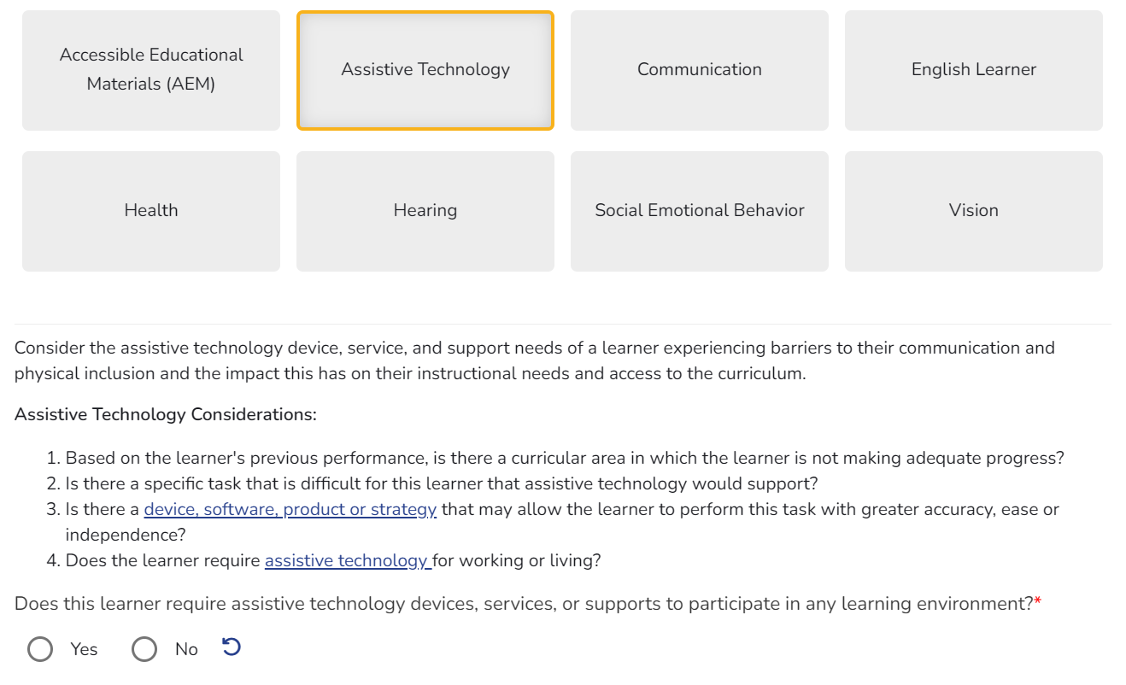
PLAAFP Key Changes: Special Factors
Each special factor must be addressed individually
No more “all considered” checkbox
Requires explicit Yes/No decision for each factor
Notes:
This slide highlights the core structural changes to how Special Factors are addressed within the PLAAFP section of ACHIEVE. Under the updated process, each special factor must now be reviewed and addressed individually by the IEP team. The previous option allowing teams to broadly indicate that all factors were considered has been removed.
As a result, teams are now required to make an explicit Yes or No decision for every individual special factor. Along with the Yes/No decision, the guiding questions were updated to help with these decisions. This creates a more intentional and transparent process for documenting student needs and determining whether those needs must be addressed within the IEP.
The screenshot on the slide demonstrates how the system now presents each factor as its own interactive selection area rather than part of a single generalized checklist. This redesign helps guide teams through a more individualized review process and visually reinforces which factors still require action or responses.
Teams must now make a deliberate decision for each factor rather than simply indicating that all factors were considered.

Slide 29
What this means for IEP Teams
Must review each factor intentionally
Must document decision for each factor
Cannot skip or broadly generalize
Updated guiding questions are available for many Special Factors to support team decision-making.
Notes:
This enhancement significantly changes how teams interact with Special Factors during IEP development. As shown on the slide, teams can no longer broadly review or generalize Special Factor as a group. Instead, each factor must be intentionally reviewed and individually documented within ACHIEVE.
This means teams must actively determine whether each Special Factor applies to the learner and whether it needs to be addressed through goals, services, or other IEP components. Each decision now requires more intentional discussion and documentation rather than relying on a single overall checkbox or generalized statement.
Teams are guided through each factor separately, helping ensure that decisions are clearly documented and not unintentionally skipped. Many of the Special Factors now include updated guided questions. These questions are designed to support team discussion and help ensure decisions are thoughtful, individualized and clearly documented within the IEP process.
Teams are guided through each factor separately, helping ensure that decisions are clearly documented and not unintentionally skipped. Many of the Special Factors now include updated guiding questions to support team discussion and decision-making. Rather than replying on a single checkbox teams now work through each factor individually, creating a more deliberate review process that focuses on the learner’s specific needs.

Slide 30
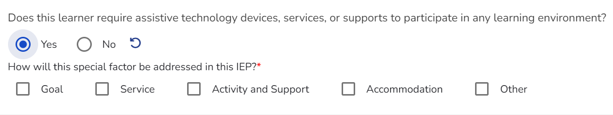
New Structure in ACHIEVE
Each factor includes:
  Initial Yes/No question
  Follow-up questions if “Yes”
Visual indicators show completion status
Notes:
This slide introduces the new structure teams will see within ACHIEVE when working through Special Factors. Each Special Factor now includes an initial Yes or No question that serves as the decision point for whether that factor will be addressed within the IEP.
As shown in the screenshot, if a team selects “Yes,” additional follow-up questions and required selection appear beneath that factor. ACHIEVE also uses visual indicators, including warning icons, and color changes to help teams quickly identify whether required responses have been completed or whether additional action is still needed.
For example, factors that are being addressed display differently than those marked ‘No,’ and incomplete follow-up requirements will trigger warning indicators until the necessary information is entered. This creates a more guided workflow and helps teams identify incomplete documentation earlier in the process.
ACHIEVE uses visuals indicators and follow-up questions to guide teams through the review process. These built-in prompts help users to identify missing information before moving to other sections of the IEP and make it easier to determine which factors still require action.

Slide 31
If “No” is Selected
Factor is not addressed in the IEP
No additional action required
Must be an informed decision
Notes:
As shown in the screenshot, selecting ‘No’ indicates that the Special Factor is not being addressed within the learner’s IEP.
When ‘No’ is selected, no additional follow-up action or required fields appear for that factor. The system visually changes the factor to reflect that decision, helping teams clearly distinguish between factors that are being addressed and those that are not.
Although additional documentation is not required when ‘No’ is selected, the decision should still represent an intentional team determination based on the learner’s data, needs, and educational access. The absence of additional requirements does not mean the factor was skipped; rather, it indicates the team determined the factor does not require supports or services within the IEP at the time. This enhancement helps improve clarity within the documentation process while also reinforcing that each Special Factor requires active consideration and individualized team decision-making.

Slide 32
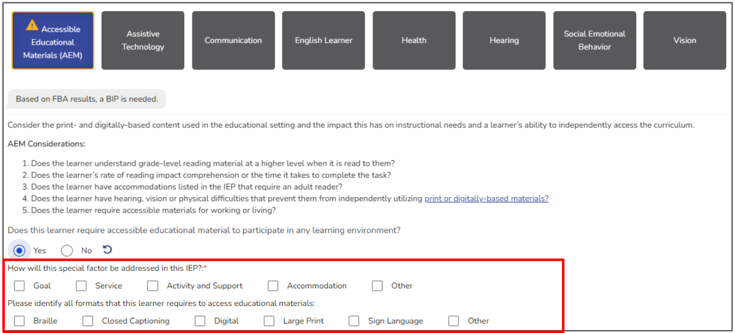
If “Yes” is Selected
Must identify how the factor is addressed in the IEP
Requires additional selections
System will flag incomplete responses
Notes:
Choosing ‘Yes’ indicates that the factor will be addressed somewhere within the learner’s IEP and triggers additional required actions within ACHIEVE. As shown in the screenshot, once ‘Yes’ is selected, the system expands to display follow-up options requiring teams to identify how the Special Factor will be addressed. This may include connections to goals, services, accommodations, activities and supports, or other IEP components. ACHIEVE also provides visual warning indicators if required responses are incomplete. For example, warning icons remain visible until teams complete the required selection tied to that Special Factor. This helps guide users through the process and reduces the likelihood of incomplete documentation.
This enhancement reinforces that identifying a Special Factor within the PLAAFP should lead to intentional planning elsewhere within the IEP. Selecting “Yes” now requires teams to move beyond identification and document the actual supports that will address the learner’s needs.

Slide 33
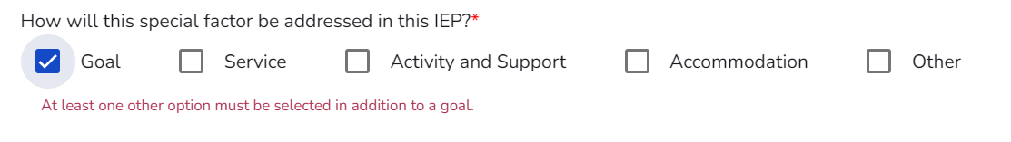
Alignment Requirement
Special factor identified in PLAAFP must connect to:
  Goal
  Services
  Activities/Supports
  Accommodations
Notes:
The enhancement introduces a stronger alignment requirement across IEP components. It does not prescribe how the need must be addressed; rather, it requires teams to identify where the support is documented within the IEP. When a Special Factor is identified in the PLAAFP, ACHIEVE now requires teams to document how that factor is addressed elsewhere within the IEP. As shown on the slide, identified Special Factors should connect to one or more IEP components, including goals, services, activities and supports, or accommodations. These connections help demonstrate how the team is addressing the learner’s identified needs through the IEP. ACHIEVE uses tagging and alignment indicators to support the process. If a Special Factor is identified but not connected elsewhere in the IEP, the system may generate warning messages or Incomplete Data Report items to alert the team that additional review may be needed.
You will also notice the Other option. This option is available when a Special Factor is being addressed within the IEP but does not fit neatly within a goal, service, activity and support, or accommodation. When Other is selected, ACHIEVE provides a text field for the team to describe how the factor is being addressed. This allows teams to document unique situations while still maintaining alignment across the IEP. While the system allows the use of Other, teams should first consider whether the identified need is already addressed through a goal, service, activity and support, or accommodations before selecting that option.
It is important to remember that not every identified Special Factor will result in a goal. Teams should determine the most appropriate method for addressing the learner’s needs and then identify where that support is documented within the IEP.
Ultimately, these enhancements help move teams away from isolated PLAAFP statements and toward a more connected, data-informed IEP where identified needs, supports, services, and accommodations work together to support the learner.

Slide 34
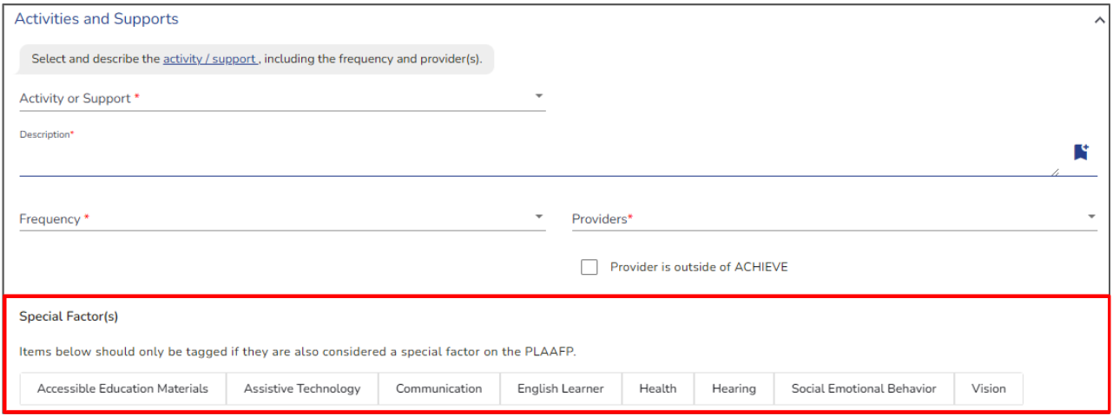
New Tagging System
Special factors can be tagged in:
  Goals
  Services
  Activities and Supports
  Accommodations
Tags must match PLAAFP decisions
Notes:
On this slide you can see the new tagging system connected to Special Factors throughout ACHIEVE. As shown in the screenshot, teams can now apply Special Factor tags directly within goals, services, activities and supports, and accommodations.
The tagging system is designed to help visually connect IEP components back to the learner’s identified Special Factors within the PLAAFP. Rather than relying only on narrative descriptions, teams can now explicitly tag which parts of the IEP are addressing areas such as Assistive Technology, Communication, Health, Social-Emotional Behavior, Vision, or other identified factors.
The screenshot demonstrates the multi-select format users will use within ACHIEVE.
The tags provide a visual connection between the need identified in the PLAAFP and the support documented elsewhere in the IEP.

Slide 35
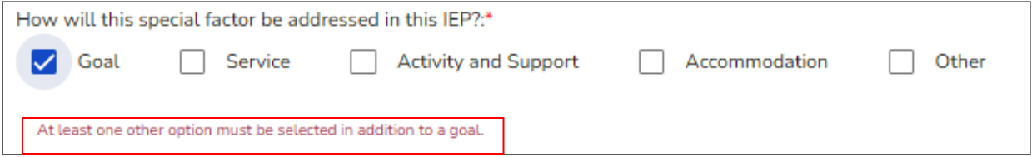
System Guardrails
ACHIEVE generates a warning when:
  Factor marked “Yes” but not addressed elsewhere
  Tagged items do not align with PLAAFP
  Missing alignment across components
Notes:
As shown on this screenshot, ACHIEVE now generates warning messages when information across the IEP does not align correctly. For example, the system may generate a warning if a Special Factor is marked ‘Yes’ within the PLAAFP but is not connected to goals, services, accommodations, or supports elsewhere in the IEP. It can also flag situations where tags applied in other sections do not align with the team’s PLAAFP decisions.
The screenshot demonstrates how these warnings appear directly within the workflow to alert users to potential inconsistencies before finalizing the IEP. These alerts are intended to guide teams toward stronger internal alignment and reduce the likelihood of incomplete or contradictory documentation.
These warnings serve as checkpoints throughout the IEP development process. They help teams identify potential omissions or inconsistencies before the IEP is finalized, allowing corrections to be made while the team is still actively working in the document.

Slide 36
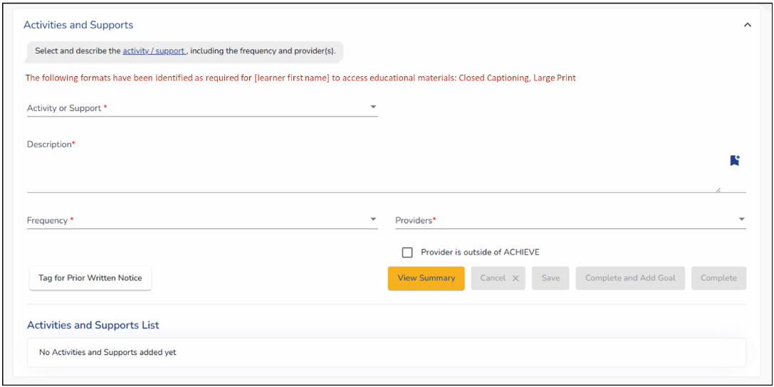
Continued ACHIEVE Enhancements
Accessible Materials Display
If accessible formats are selected, the system will display a list of required formats in Activities and Support
Notes:
This enhancement focuses on improving visibility and alignment for Accessible Educational Materials, or AEM, within ACHIEVE.
The screenshot demonstrates how the system will surface these identified formats directly within the workflow rather than requiring teams to remember or manually cross-reference information from another section on the IEP-see the red text in the screenshot. This creates a clearer connection between identified accessibility needs and the supports documented for implementation. It is important to note that the system is not automatically creating an Activity or Support. Rather, ACHIEVE is displaying the accessible format that was selected in the Special Factors section as a reminder and reference for the team. For example, if a team identifies Braille, large print, audio, or another accessible format as an AEM need, they would select AEM in the Activities and Support drop down and then describe within the description how those materials will be provided to the student and implemented in practice
Overall, this change strengthens documentation clarity while helping teams ensure that accessibility considerations remain visible throughout the IEP development process.

Slide 37
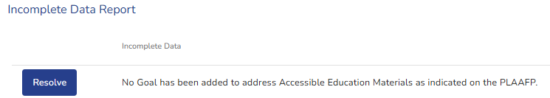
Incomplete Data Report Updates
If factor = “Yes”, system checks for:
Goal
Service
Activity/Support
Accommodation
Missing components generate Incomplete Data Report (IDR) items
Notes:
This slide focuses on updates to the Incomplete Data Report (IDR), process connected to Special Factors. Under the new logic, when a team identifies that a Special Factor will be addressed within the IEP, ACHIEVE will automatically check for alignment across related IEP components.
As shown on the slide, the system now reviews whether there is at least one related goal, service, activity, and support, or accommodation connected to the identified Special Factor. If one of those expected components is missing, ACHIEVE generates an IDR item notifying the team of the missing alignment.
The screenshot demonstrates how these system-generated IDR items function as a prompt for teams to review incomplete areas before finalizing the IEP. ACHIEVE also includes a direct resolve button that routes users to the appropriate section needing attention, helping streamline corrections within the workflow. It is important to note that if the team selects “other” in how the Special Factor will be addressed, ACHIEVE does not check for that item or generates an IDR as a reminder. The automatic checks and IDR only apply to Goal, Service, Activity/Support and Accommodation.
Rather than discovering missing connections during a review, teams receive immediate feedback while developing the IEP.

Slide 38
Secondary Transition Improvements
Notes:
We are now moving into the Secondary Transition enhancements. This section introduces updates designed to strengthen how Postsecondary Expectations are documented and connected across IEP components.
The upcoming slides will walk through new transition tagging features, updated system alerts, and how these enhancements support stronger alignment between transition planning and the overall IEP process.

Slide 39
Key Changes to Transition
Post Secondary Expectations Field tags
Secondary Transition Alert
Notes:
The first update is the addition of Postsecondary Expectations field tags, which allow teams to identify whether transition planning is connected to Learning, Living and/or Working. The second update is a new Secondary Transition alert within the system. This alert helps prevent users from unintentionally opening Postsecondary Transition requirements for learners when transition documentation may not yet be appropriate. Together, these enhancements help strengthen consistency in transition documentation and improve alignment between Postsecondary Expectations and other IEP components throughout ACHIEVE.

Slide 40
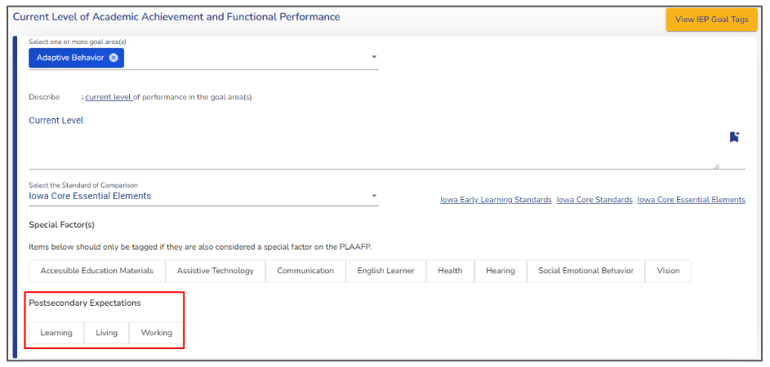
Postsecondary Expectations Field Tags
Multi-select button which identifies which areas are being addressed (e.g., Living, Learning and Working)
Not required
Connects transition needs across IEP components
Notes:
As shown on the slide, teams can now identify which transition domains are being addressed within the IEP by selecting tags related to Learning, Living, and Working. The screenshot demonstrates the new multi-select button structure teams will use when documenting Postsecondary Expectations. These tags are optional, meaning teams only select the areas that are relevant to the learner’s individualized transition planning.
This enhancement helps strengthen the connection between transition planning and other IEP components by making Postsecondary Expectations more visible throughout the system. Rather than transition information existing only within one isolated section, the tags help support clearer alignment across goals, services, activities and supports, and accommodations.
The enhancement applies specifically to Secondary Transition IEPs. As shown on the slide, the Postsecondary Expectations field tags only appear when the learner is participating in a Secondary Transition IEP workflow. The screenshot reinforces that these transition-specific fields are not visible for non-transition IEPs. This helps reduce unnecessary clutter within the system and ensures users only see transition-related documentation requirements when they are applicable to the learner.
Teams can quickly identify which transition domains are addressed without searching through multiple sections of the IEP.

Slide 41
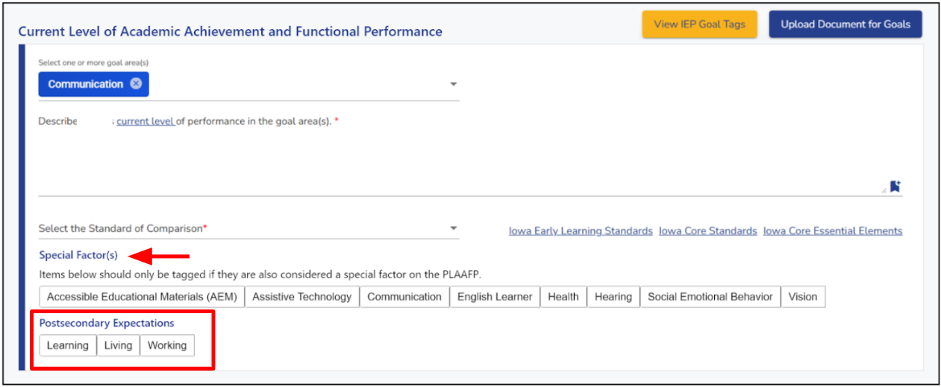
Location of Secondary Transition tags
Appears directly below Special Factor tags
Available in:
  Goals
  Services
  Activities and Supports
  Accommodations
Notes:
Postsecondary Expectations tags are now available within multiple areas of the IEP workflow within ACHIEVE. In the screenshot, you can see these tags appear directly below the Special Factor tags, helping teams connect transition planning throughout the system rather than documenting it in isolation.
Teams will be able to apply these tags within goals, services, activities, and supports, and accommodations. This creates a more visible connection between Postsecondary planning and the actual support and instruction documented within the IEP. The overall goal is to help teams build stronger alignment between transition needs and implementation across the learner’s educational program

Slide 42
Integration with Existing Components
Works alongside:
  Special Factor tags
Applies the same tagging logic:
  Multi-select
  Optional
  Cross-component visibility
Notes:
Rather than creating an entirely separate transition workflow, ACHIEVE integrates Postsecondary Expectations into the same structure already used for Special Factors. The screenshot demonstrates how the Postsecondary tags follow the same multi-select and tagging logic teams are already familiar with throughout the IEP process.
This creates a more consistent user experience and helps teams navigate transition documentation more efficiently. Because the tags function similarly across components, teams can focus more on meaningful transition planning rather than learning an entirely new process within the system.
These updates also strengthen visibility across the IEP by making Postsecondary planning easier to connect to goals, services, supports and accommodations already being documented for the learner.

Slide 43
Secondary Transition Alert
When Secondary Transition is selected for a learner 12 years or younger, a warning message prompts the user to verify that transition planning is needed.
Notes:
To help reduce accidental transition documentation, ACHIEVE now includes a Secondary Transition alert within the workflow. If Secondary Transition is selected for a learner age 12 or younger, the system will display a warning message asking the user to confirm that they want to continue. The purpose of this alert is not to block teams from moving forward but rather to provide an additional checkpoint before Postsecondary documentation requirements are triggered within the IEP.
The screenshot demonstrates how ACHIEVE uses a confirmation-style warning to help users pause and verify that Secondary Transition was intentionally selected. This supports more accurate documentation and helps prevent teams from unintentionally opening transition requirements when they are not needed. Teams may still proceed when transition planning is appropriate for the learner.

Slide 44
Goal Updates
Notes:
We are now moving into the Goal Updates section of the ACHIEVE enhancements. These changes focus on improving document uploads, warning logic, and how goal-related documentations is connected and displayed within the system. The next few slides will walk through those workflows and usability improvements in more detail.

Slide 45
Key Change Overview
Document upload reminder
System-generated warnings
Goal document integration
Notes:
This section focuses on three primary updates related to goals within ACHIEVE: document upload behavior, system-generated warning messages, and goal document integration. Together, these enhancements are intended to improve organization, streamline workflow, and create clearer connections between goals and supporting documentation within the IEP process.

Slide 46
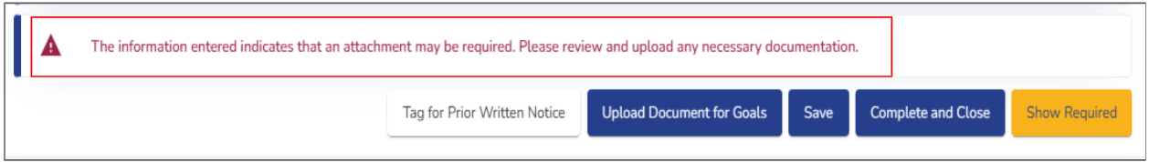
New System Warning (Keyword Detection)
System scans goal fields for keywords such as “Attach”
If detected, a warning message appears
Does not block “Complete and Close”
  User can still complete and close
  Upload is not required
Notes:
ACHIEVE now includes a keyword detection feature within the Goals section. As shown in the screenshot, the system scans several goal-related text fields for the word ‘attach.’ If the keyword is detected, ACHIEVE automatically displays a warning message reminding the user to review whether supporting documentation may need to be uploaded. The screenshot demonstrates how the warning appears directly above the goal action buttons during the workflow. This serves as a prompt for users without interrupting the goal completion process.
Importantly, this warning does not create a hard stop. Users may still select ‘Complete and Close,’ and uploads are not required in order to finalize the goal.
The purpose of this enhancement is simply to provide additional guidance and help reduce situations where documentation may have been referenced in the goal but unintentionally not uploaded into ACHIEVE.

Slide 47
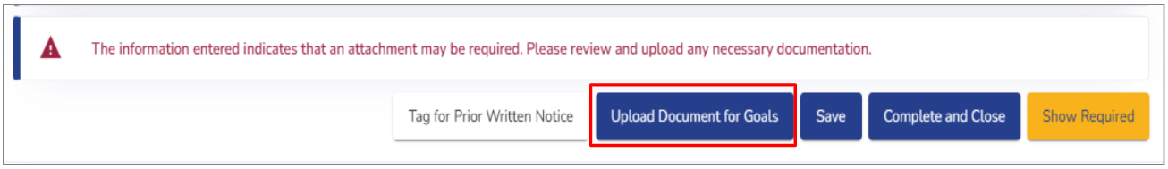
Change to Document Upload
Upload Document for goals button moved
  Removed from the top of the page
  Moved to the bottom of goal entry
Now located near Save/Complete buttons
Notes:
Document upload functionality within the Goals section has also been reorganized to improve workflow and usability. Previously, the ‘Upload Document for Goals’ button appeared at the top of the Goals stepper. With this enhancement, the upload button has been moved directly next to the Save and Complete buttons at the bottom of the individual goal entry.
The screenshot highlights this updated placement within the workflow. Positioning the upload option closer to the final goal actions creates a more intuitive process by allowing users to upload supporting documentation at the point where they are actively finalizing or reviewing the goal. Placing the upload button next to the completion action makes it easier to attach supporting documents at the point they are most likely to be needed.

Slide 48
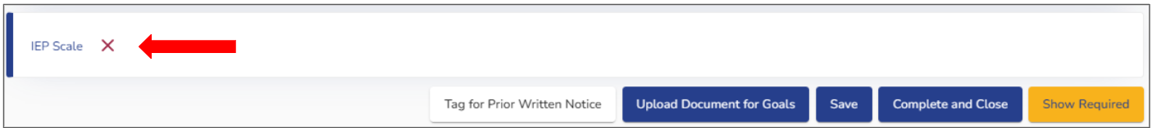
Documents Linked to Goals
Uploaded documents are now attached to specific goals
In the “Documentation” tab the Goal Nickname - Document Title will display
Available in the “Documentation” section after the IEP has been submitted
Notes:
One of the workflow improvements in this release is that uploaded documents are now directly associated with specific goals. Documents uploaded during goal development will display alongside the related goal rather than existing separately without context. Within the Documentation section, ACHIEVE will now display the Goal Nickname followed by the document title. This creates a clearer connection between supporting documentation and the specific goal it relates to.
The screenshot also demonstrates how users can manage these linked documents directly within the workflow, including opening, downloading or removing uploaded files when appropriate.
Overall, this enhancement improves organization, strengthens traceability of documentation, and helps teams more easily identify which supporting documents align to specific learner goals within the IEP.

Slide 49
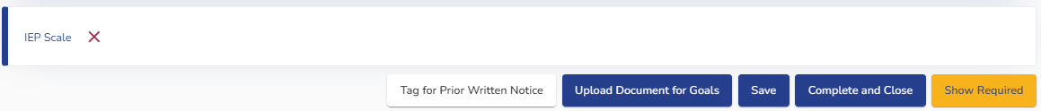
Where Attached Goal Documents Appear
Accessible in:
  Goal entry view
  Documentation stepper, after the IEP is submitted
Users can:
  Open/download
  Remove while in draft/amendment (via “X”: icon)
Notes:
Once documents are uploaded and connected to a goal, ACHIEVE now makes those files accessible in multiple locations throughout the workflow. Users can view attached documents directly within the goal entry area as well as later within the Documentation stepper after the IEP has been submitted.
The screenshot also demonstrates the additional management options now available to users. Documents can be opened or downloaded directly from the interface, and users may remove uploaded files using the red ‘X’ icon when appropriate. These updates improve accessibility to supporting documentation and help teams more easily track which files are connected to specific learner goals throughout the IEP process.

Slide 50
Least Restrictive Environment (LRE)
PK updates
Notes:
We are now moving into the Preschool Least Restrictive Environment, or PK LRE, updates within ACHIEVE. These enhancements focus on strengthening the connection between Regular Early Childhood Program data and LRE decision-making within the preschool workflow. The next slides will walk through the new system checks, warning messages and workflow requirements tied to RECP information.

Slide 51
Where this Applies: Scope of Change
Applies to Preschool (PK) LRE only
No changes to School-age LRE
Notes:
These updates apply specifically to Preschool, or PK, Least Restrictive Environment workflows within ACHIEVE. As shown on the slide, there are no changes being made to school-age LRE processes as part of this enhancement release. The purpose of this clarification is to help teams understand that the new RECP-related logic, warning messages, and workflow requirements are limited to preschool LRE documentation only. This targeted approach allows ACHIEVE to strengthen PK-specific compliance and documentation practices while maintaining the existing workflow for school-age learners.

Slide 52
Key Changes to LRE (PK)
LRE section now depends on Regular Early Childhood Program (RECP)
System checks data before allowing LRE completion
  If RECP data is missing, the LRE field becomes read-only and users cannot edit LRE decision
The system check causes a hard stop until data is complete
Notes:
For Preschool LRE workflows, ACHIEVE now introduces stronger system checks tied directly to Regular Early Childhood Program, or RECP, information. As shown on the slide, the LRE section now depends on completed RECP attendance data before teams can finalize portions of the preschool LRE process. The screenshot demonstrates how the system can temporarily make portions of the LRE section read-only when required RECP information is missing. Specifically, if responses related to whether the learner will attend a RECP after the IEP meeting have not been completed, users will be prevented from editing the LRE decision until that information is entered. The enhancement strengthens alignment between RECP attendance information and preschool LRE determination while helping ensure required data is completed before finalizing the workflow.

Slide 53
System Warning Message
System displays “There are RECP programs listed without a response entered…”
Prompts user to update RECP data before proceeding
Notes:
When required RECP information is missing, ACHIEVE now displays a system-generated warning message to alert the user. As shown in the screenshot, the warning notifies teams that there are RECP programs listed without a completed response entered. The warning also directs users to either update the RECP information directly or return to the Learner Dashboard to complete the missing response before proceeding. This enhancement helps teams quickly identify incomplete preschool LRE data and provides clearer guidance regarding what must be resolved before the workflow can continue. The goal is to improve data integrity and strengthen consistency between RECP documentation and PK LRE decisions within ACHIEVE.

Slide 54
Required User Action
How to resolve:
User must enter response for “Will attend RECP after IEP meeting”
Then the LRE field becomes fully editable
Notes:
When the RECP warning appears, ACHIEVE also provides clear guidance regarding what actions must be taken to resolve the issue. As shown on the slide, users must enter a response to the question asking whether the learner will attend a Regular Early Childhood Program after the IEP meeting. The screenshot demonstrates how completion of that required response unlocks the Preschool LRE section and allows the field to become fully editable again. This enhancement helps ensure that required RECP attendance information is completed before final Preschool LRE decisions are finalized within ACHIEVE>

Slide 55
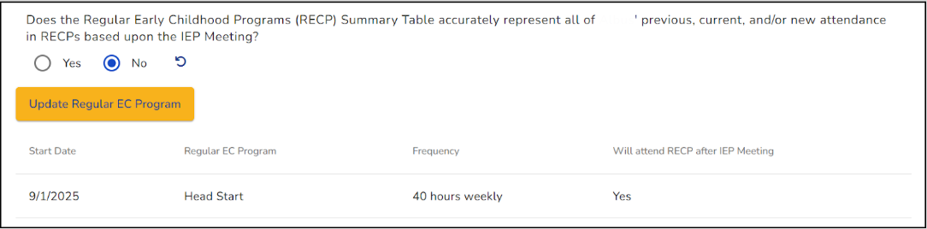
Revise RECP data
If Response is No:
Update Regular Early Childhood Program (EC Program) button appears
Allows user to revise RECP data on the Learner Dashboard
This maintains connection between LRE and RECP data
Notes:
If teams determine that the RECP information is not accurate, ACHIEVE now provides a direct pathway for revising the information within the workflow. As shown in the screenshot, selecting ‘No’ for the RECP summary accuracy question causes the ‘Update Regular EC Program’ button to appear. This allows users to return and revise the underlying RECP data connected to the Preschool LRE determination. Rather than forcing teams to leave the workflow entirely, ACHIEVE creates a more connected process for reviewing and correcting the information. These updates help maintain stronger alignment between RECP attendance documentation and Preschool LRE decision-making while improving usability within the PK workflow.

Slide 56
Key Takeaways
These updates support:
Consistency
Clarity
Data integrity
Provider efficiency
Family Understanding
Accurate monitoring
Notes:
As we close, these enhancements are all centered around improving consistency, clarify and alignment across the IEP process within ACHIEVE. The updates strengthen data integrity by reducing inconsistencies and improving how information connects across components. They also improve usability for providers through clearer workflows, stronger system guidance, and more intentional organization of information. At the same time, many of these enhancements support better family understanding by improving transparency, documentation, accuracy, and access to updated information throughout the IEP process. Ultimately, the goal of these changes is not simply system modernization, but supporting more accurate documentation, stronger implementation practices, and a more aligned experience for both teams and families.

Slide 57

Thank You
Notes:
Thank you for taking the time to review these ACHIEVE IEP enhancements. As we have discussed throughout this session, these updates are intended to strengthen workflows, improve consistency across the state, and support more accurate and meaningful documentation. As ACHIEVE continues to evolve, these enhancements are designed to better support providers, improve usability, and strengthen alignment between documentation, implementation, and student needs.
Thank you again for your continued work supporting learners, families and IEP teams across Iowa.

