Slide 1

Special Education Policy and Practice Webinar Series
Continuous Improvement in Special Education -
End of Year Program Review

Slide 2

Welcome
Please post your questions in the Q&A
Slides will be posted on the DE website after the webinar
Policy & Practice Webinar Series & Recordings | Department of Education

Slide 3
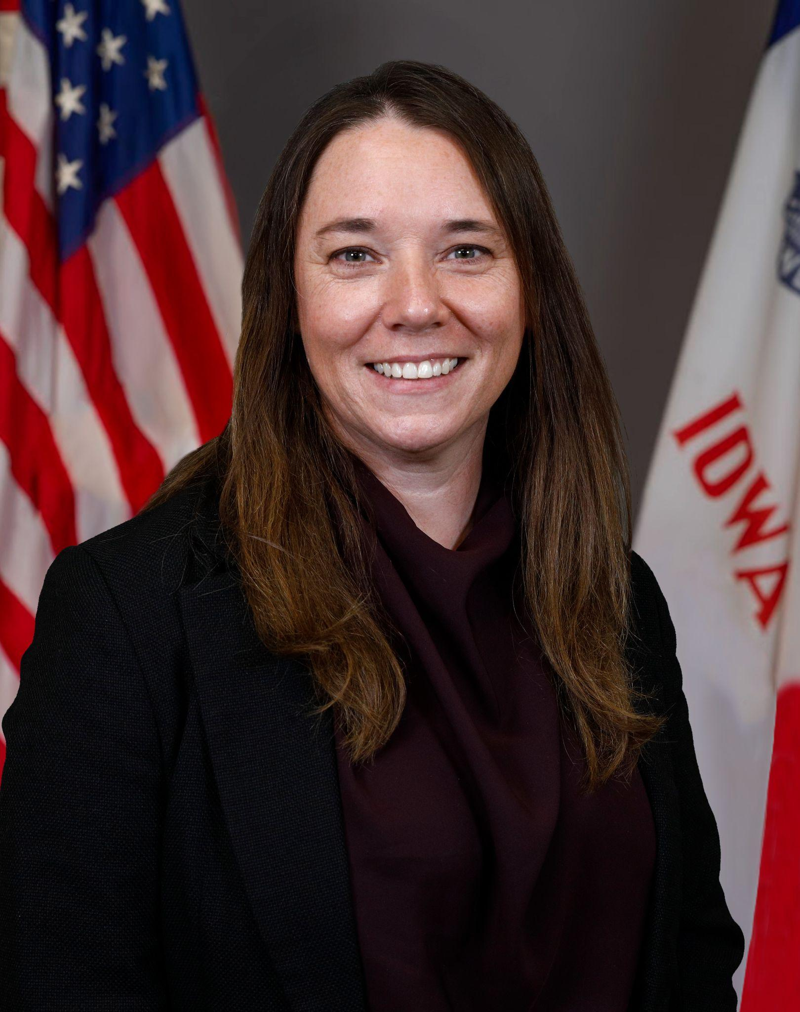
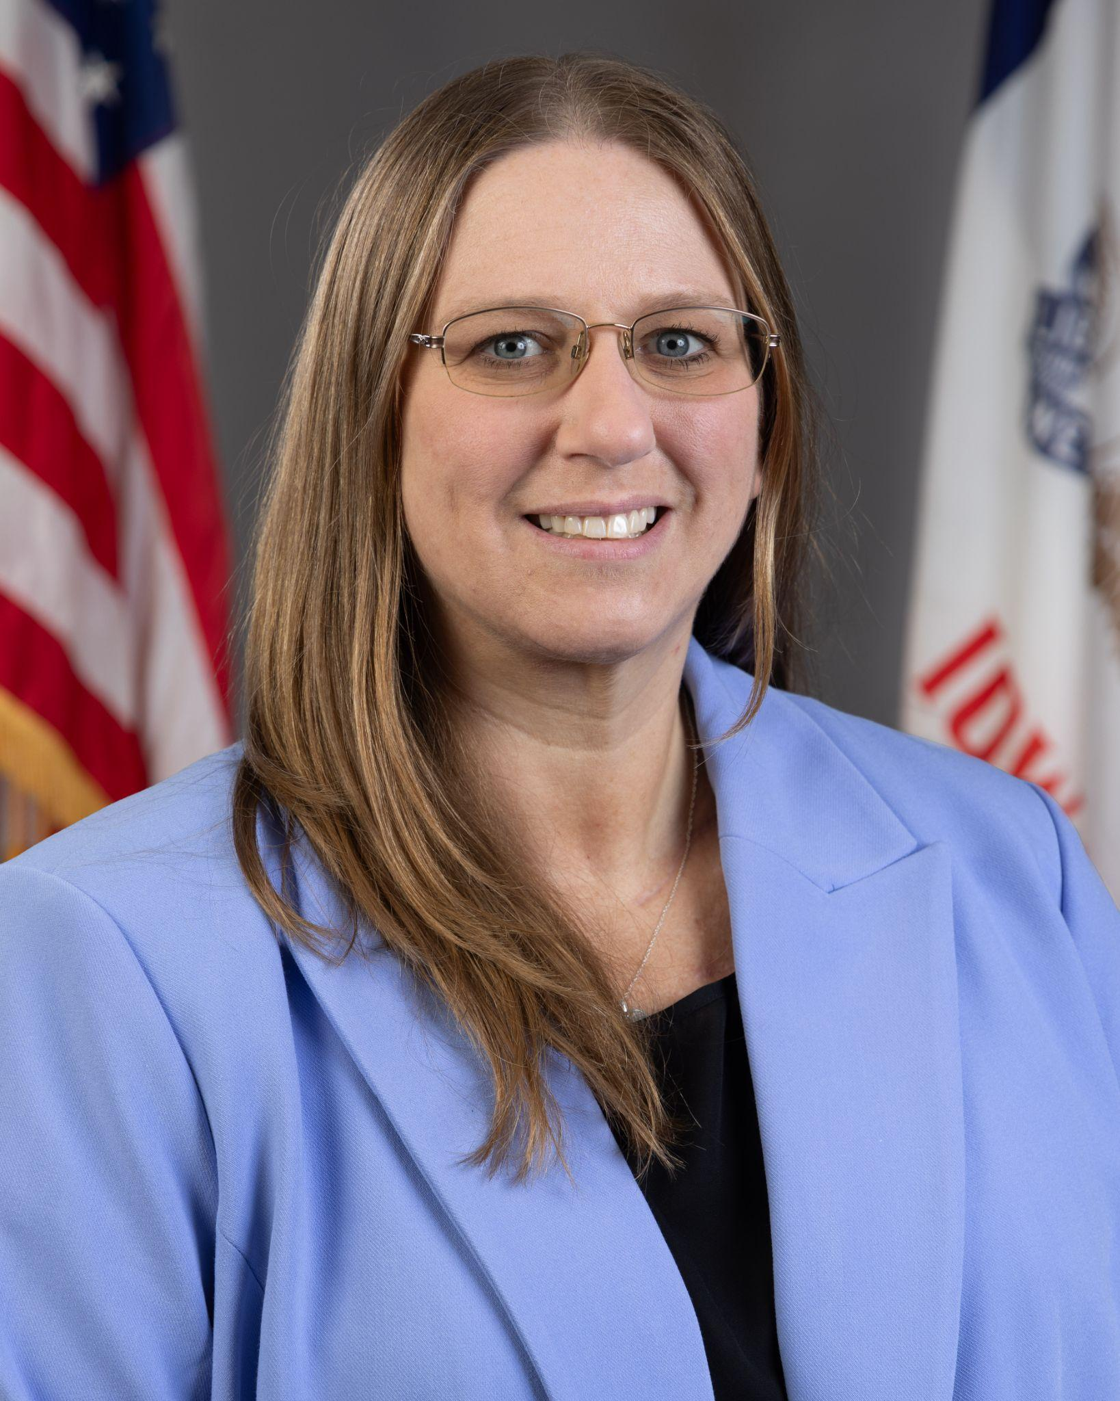
Today’s Presenters
Name: Leisa Breitfelder
Title: Division Administrator
Division of Special Education
Name: Angelisa Fynaardt
Title: Division Administrator for Special Education Continuous Improvement & Compliance;
Regional Special Education Director-Great Prairie
Division of Special Education

Slide 4
Participants will understand:
General supervision considerations for end-of-year review
End-of-year system and building level questions associated with the duties to inform, detect, inspect, correct and prevent
Iowa’s Continuous Improvement Process as it aligns with end-of-year program review
Red flags and missteps related to general supervision

Slide 5
Policy

Slide 6
IDEA and IAC Reference to General Supervision
Division VIII:
Monitoring, Enforcement, Confidentiality and Program Information
281—41.600(256B,34CFR300) State monitoring and enforcement.
41.600(1) General. The state must monitor the implementation of Part B of the Act and this chapter, enforce this chapter in accordance with rule 281—41.604(256B,34CFR300), and annually report on performance under Part B of the Act and this chapter
Iowa Administrative Code

Slide 7
Primary Focus of Monitoring Activities (IDEA)
41.600(2) Primary focus of monitoring activity. The primary focus of the state’s monitoring activities must be on the following:
Improving educational results and functional outcomes for all children with disabilities; and
ensuring that public agencies meet the program requirements under Part B of the Act, with a particular emphasis on those requirements that are most closely related to improving educational results for children with disabilities.
Iowa Administrative Code

Slide 8
District Responsibilities in Monitoring Activities (IDEA)
District leadership is responsible for:
holding ultimate responsibility for ensuring FAPE is provided to every eligible resident district learner through IEPs that are developed, implemented and monitored with fidelity.
monitoring their own policies, procedures and practices, ensuring alignment with federal and state regulations.
using internal and external data to identify delays or implementation concerns, and take prompt action to self-correct.
participating in needs assessments and continuous improvement processes.
regularly reviewing district special education procedures, special education data, and identifying areas for continuous improvement.

Slide 9
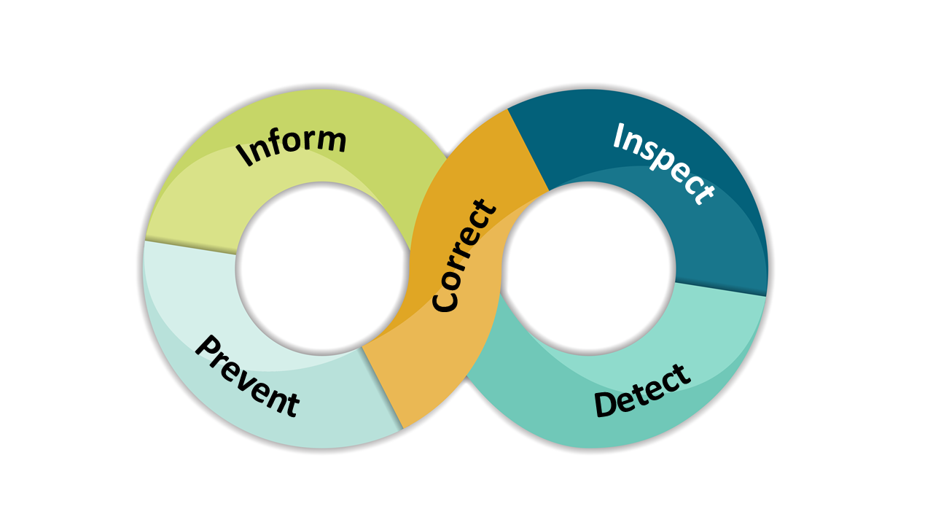
Iowa’s Duties of General Supervision

Slide 10
Practice

Slide 11
General Supervision
Considerations for End-of-Year Review

Slide 12

Inform
The duty to inform means ensuring teachers, providers, and any staff member who works with learners with disabilities and their families are aware of and understand the requirements of IDEA.
Outcome: Increased knowledge and common understanding of special education policy, procedures, and evidence-based practices.

Slide 13
End of Year Questions: Duty to Inform
Systems Level
Building Level
Is there a structure in place in the district to share information and updates on special education with administrators?
Is there professional learning around special education policy and procedures for administrators?
Is the school board updated on relevant special education changes to inform their work?
Is there a process for staff to communicate concerns or achievements related to special education to the superintendent?
Is there a structure in place to share information and updates on special education with all teachers and staff who support students with IEPs, including general education teachers?
Is there professional learning around special education policy and procedures for all teachers and staff who support students with IEPs, including general education teachers?
Is there a process for staff to communicate concerns or achievements related to special education to the building administrator or special education director?

Slide 14

Detect
The duty to detect includes processes for regularly analyzing data, coordinating intake of concerns, and using information from the other duties to screen for potential issues.
Outcome: Potential issues are identified early and on a regular basis so that concerns do not continue unaddressed or become systemic.

Slide 15
End-of-Year Questions: Duty to Detect
Systems Level
Building Level
Is ACHIEVE, or other data platforms, used to look at continuous improvement focus areas for the district and to pull year end reports such as Exits by Code, Shortened School Day, or Seclusion and Restraint data?
Do the results from that data guide system improvement?
Do all building administrators know how to monitor special education implementation?
Is there a process at the district level to detect issues or concerns related to special education?
Is Special Education integrated into building-level MTSS and continuous improvement efforts?
Is there a system to support monitoring IEPs for quality and compliance?
Is there a cadence of reviewing student outcome data and fidelity data at the building level?
What professional development did staff participate in throughout the year? Who and How many?
What barriers did you encounter with regards to professional development?
What do you have planned for professional learning next year?

Slide 16
Inspect
The duty to inspect includes problem analysis and in-depth investigations to verify the existence of an issue or issues, determine their underlying causes, and assess the extent of the problem (e.g., whether it is specific to a student, classroom, building, etc.)
Outcome: Analysis results may establish confirmation of issues arising from detect, including the likely causes and identification of next steps.

Slide 17
End of Year Questions: Duty to Inspect
Systems Level
Building Level
Is there an established process for the review of specific IEP’s based on reports pulled in ACHIEVE to identify patterns or problems?
Are there established times for conversations among administrators in the district to assess the extent of patterns or problems regarding special education?
Are supports in place to address these patterns or problems?
What are the barriers to special education in your building and how do you know?
What process is used at the building level to investigate problems specific to a student, classroom or building?
Are all staff aware of this process?
Are supports in place to address these barriers or issues?

Slide 18

Correct
The duty to correct includes actions taken to address issues that are verified through inspect. The actions may be the result of a formal Corrective Action Plan (CAP), IDEA-DA continuous improvement or other reasons.
Outcome: The issue is corrected and improvements are made for both individual and systemic issues, with an emphasis on learner outcomes.

Slide 19
End-of-Year Questions: Duty to Correct
Systems Level
Building Level
If a formal CAP has been initiated, are the corrections being prioritized and resolved?
Has your district considered dates for scheduling IDEA-DA continuous improvement requirements (systems coaching, practice coaching, SDI package professional learning)?
Has your IDEA-DA leadership team identified time to meet and review the district IDEA-DA Implementation Plan, action steps and relevant data sets?
If a formal CAP has been initiated, are building level corrections being prioritized and resolved?
Does your building have representation in the IDEA-DA systems level work?
Are learner outcomes the focus of this corrective work at both the building level and systems level?

Slide 20

Prevent
The duty to prevent includes creating systems and structures that guide implementation of the general supervision processes. These include actions that the State, AEA and LEA take to prevent noncompliance or concerns with IDEA implementation now and in the future.
Outcome: Results that indicate a low number of noncompliance and an increase in achievement of learners receiving special education services and supports.

Slide 21
End-of-Year Questions: Duty to Prevent
Systems Level
Building Level
Is there a process for administrators to express ideas to prevent noncompliance and increase achievement of learners receiving special education services and supports?
Is the district engaged in professional learning from the Department of Education (Policy & Practice webinars, Communities of Practice, guidance documents, newsletters) to prevent issues of noncompliance?
Is there a process in place for the review of staff schedules to ensure a match with what is documented in an IEP for instruction and related services?
Do administrators partake in a review of paraeducator schedules to ensure a match with what is documented in an IEP?
Is there a process for building staff to express ideas to increase achievement for learners receiving special education services and supports?

Slide 22
Example of all 5 Duties Together through the lens of SSD
4. Correct overidentification for shortened school day with specific teacher
3. Inspect specific IEP’s related to shortened school day
1. Watch & share webinar information
5. Professional learning for all sped staff on shortened school day
2. Pull reports in ACHIEVE & look for patterns

Slide 23

Iowa’s Continuous Improvement Model
Step 5. Evaluate
Step 1. Assess
Step 4. Implement
Step 2. Prioritize
Step 3. Plan

Slide 24
Iowa’s Continuous Improvement Process: Assess & Prioritize
CIP Process | General Supervision Duty | Reflection Questions | Examples
1. Assess: Helps teams understand the problem before jumping to solutions | Detect Identify patterns Determine root causes Decide where deeper analysis needed | What does our current data tell us about learner outcomes? Is there a gap between current outcomes and our shared expectations for all learners? | Concerns revealed through data: Average LRE for students with IEPs is less than 80% as reflected in SE-Activity Roster report in ACHIEVE (Column T). Root causes: The majority of students receiving special education services get SDI in a pull out setting. Preschool students’ LRE is not accurately documented.
2. Prioritize: What patterns, risks, gaps, strengths and emerging needs are becoming visible? | Prevent Determine which barriers will have the greatest impact Put system in place to consistently review data | What evidence-based strategies or system wide interventions, services and supports will address the identified areas? What do we need to do to support/remove barriers for this work? | Prioritize concern(s) to address root cause(s): The district will focus on increasing the amount of time students are in the general education setting and with their grade level peers. Barriers: Majority of students receive SDI in pull out settings. General education teachers’ understanding of accommodations and modifications.

Slide 25
Iowa’s Continuous Improvement Process: Plan & Implement
CIP Process | General Supervision Duty | Reflection Questions | Examples
3. Plan: Prioritize needs with evidence-based interventions and SDI | Inform Ensure understanding of requirements and procedures Share effective practices and data use guidance | What is our plan to address the priority area(s) of need? What, when, how, where? How will we know that we are making progress on our plan? | Action steps: Clear communication around the District’s Developed Service Delivery Plan (DDSDP) with all staff. Professional learning for all general education and special education teachers on Iowa’s SDI framework.
4.Implement: Ongoing monitoring ensuring consistency | Correct Address issues or noncompliance Implement corrective actions and evidence-based practices | Are we implementing strategies, services, interventions with fidelity? If not, why not? | Implementation: Expectations are communicated around professional learning and clearly defined responsibilities. New learning implemented with fidelity Ongoing practice coaching and feedback around Iowa’s SDI Framework and teacher SDI action planning.

Slide 26
Iowa’s Continuous Improvement Process: Evaluate
CIP Process | General Supervision Duty | Reflection Questions | Examples
5. Evaluate: Review outcomes and adjust strategies | Inspect Review data, practices and outcomes Determine compliance and effectiveness of supports | Did our plan work to help address the identified priority areas? | Evaluate effectiveness of plan: Compare current and prior data from SE-Activity Roster report in ACHIEVE (Column T) Walk-throughs - observe where students are receiving their SDI. Reflect upon the completion of action steps within the teacher SDI action plan. What growth can be observed?
Notes:
Script:
This slide focuses on the final phase of Iowa’s Continuous Improvement Process - evaluate.
During this phase, teams review data, practices, and outcomes to determine whether the action plan is making a positive impact on the identified priority area. The goal is to evaluate both compliance and the effectiveness of supports and interventions.
In the example, the team is reviewing ACHIEVE reports pertaining to special education activity and LRE data, conducting classroom walk-throughs to observe the location and implementation of Specially Designed Instruction (SDI) and the application of professional learning, and monitoring the completion of action steps within the teacher SDI action plans.
Continuous improvement is ongoing. Teams use evaluation data to determine what is working, what may need adjustment, and how to continue improving outcomes for students. If the data collected is not resulting in growth, the next step would be to revisit the data and start the process again.

Slide 27
Example of Continuous Improvement - Exit Report
Step 1. Assess / Detect
Gather and review exit data to identify patterns, strengths, concerns and possible root causes.
Step 5. Evaluate / Inspect Determine whether changes improve outcomes. Pull ACHIEVE report to compare data.
Step 4. Implement / Correct Action steps outline new practices; Review IEPs and provide feedback to teachers around postsecondary transition planning.
Step 2. Prioritize / Prevent Determine which problems affect the largest number of learners and/or which root causes are the most actionable?
Step 3. Plan / Inform
What professional learning is needed around exiting students?

Slide 28
Red Flags & Missteps

Slide 29
Case Law: General Supervision
DL v. District of Columbia, 860 F.3d 713 (D.C. Cir. 2017)
(Filed in 2005 - Ongoing)
Allegations: Systemic failure to ensure-
Identification of preschool-aged children in need of special education and related services
Timely initial evaluations for preschool-aged children
A smooth and effective transition for children moving from Part C to Part B

Slide 30
Case Law: General Supervision
Court Analysis
Court’s Analysis: The “trial focused mainly on the structure and design of the District’s policies and practices themselves.” And further, the Court “examin[ed] the District’s self-reported data to evaluate the actual results that the District’s policies produced.”
Are there policies and procedures in place to ensure legal requirements are met?
How is implementation of these policies and practices monitored and/or ensured?
What are the outcomes and effectiveness of implementing these policies and procedures?
“While the District’s policies, procedures, and practices are important, the outcomes of those policies, procedures, and practices is even more critical”
Are the data and statistical conclusions used to support the development, monitoring and outcomes of these policies and practices accurate and reliable? Are actions taken if data identifies a concern?

Slide 31
Case Law: General Supervision
Findings / Order
Findings:
Failing to identify approx. 98-515 (2%) children a month;
Failing to provide “smooth and effective transition” to almost 30%;
Missing deadline for determining eligibility approx. 20% of the time
Order:
Injunctive relief
8.5% enrollment target, with a minimum 0.5% annual increase
Timely evaluations and determinations at 95% compliance
95% compliance for transition services
Implementation of various "programmatic" systems designed to improve the identification and tracking of children, including establishing databases and disseminating information to parents and stakeholders
  Detailed and specific record keeping requirements
Annual and biannual reports required to Plaintiffs and Court
Attorney Fees
  Nearly 10 million dollar request
  “First half of 2024”, $126,500
“The Court today makes clear that the implementation and outcomes of the District’s policies are paramount. The District will comply with its statutory obligations when it actually locates and identifies children to provide them with a FAPE [free appropriate public education], timely evaluates them, timely determines their eligibility, and smoothly and effectively transitions them—not when they establish policies that, if properly implemented, would achieve these goals. If the [District] fails to abide by the order...the District will earn far more significant court involvement and oversight than is ordered today.”

Slide 32
Questions from the Field

Slide 33
2026-2027 Policy and Practice Webinar Topics
2026 | Topic | 2027 | Topic
August | Preschool | January | Behavior & Discipline - Part 1
September | Prior Written Notice | February | Behavior & Discipline - Part 2
October | IEP Team Member Roles and Responsibilities | March | Continuum of Services
November | Appropriate Duties of Paraeducators | April | Secondary Transition - A Deeper Dive
December | Accessible Educational Materials | May | General Supervision for Learners Outside of the District
 |  | June | Lessons Learned from the Field

Slide 34
Thank You!

