Slide 1
Elementary and Secondary Education Act
Claims Process

Slide 2
Overview
Purpose
Overview of the Consolidated Application in the CASA
Reimbursement Claim Process in the Consolidated Application
Carryover Limitations
Transferability
Resources

Slide 3
Purpose
To provide ESEA Programs subgrantees with information on how to submit required claims in the Consolidated Application, which is located in the Consolidated Accountability and Support Application (CASA).

Slide 4
Overview of the CASA

Slide 5
The Consolidated Application - ESEA Programs 1
Simplifies and seeks to reduce burden by unifying:
  Most program application due dates
  All reimbursement claim periods and payments
  Requirements for general ledgers
Consistency in the review claims across programs
Nonpublic Consultation Agreements
Transferability
Annual Program Applications
Quarterly Reimbursement Claims
End-of-Year Reports
Federal Programs Compliance Review and Monitoring Plan
Applicable Waivers

Slide 6
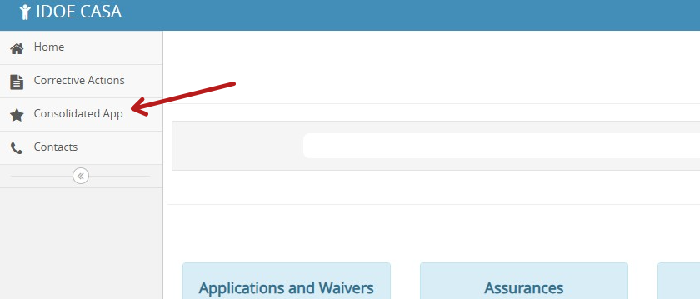
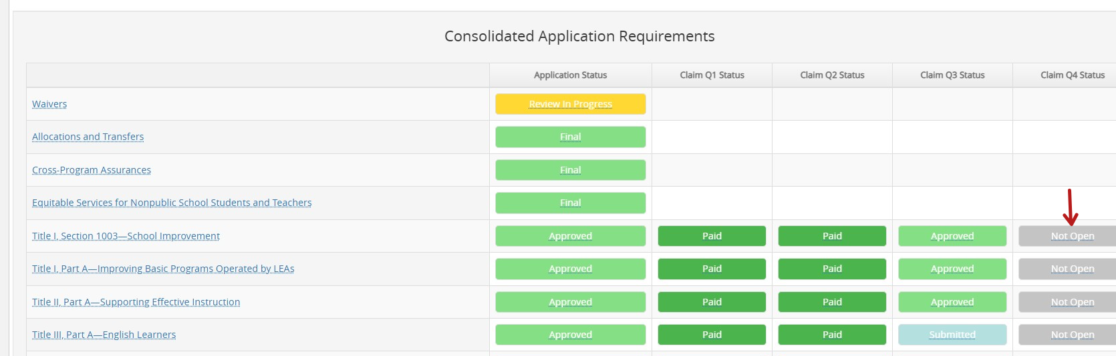
The Consolidated Application - ESEA Programs 2
After logging into CASA
  Select Consolidated App on the left toolbar
Once loaded, scroll to the bottom of the next page
ESEA Title programs
  Program Application Status
  Claims Status Tile by quarter

Slide 7



Help in CASA
Links to the ESSA Guidance and Allocations page for relevant guidance and resources
Found at the top right-hand corner of the screen
Content Questions -
Allows the user to communicate with the relevant Department consultant
Found in each program application component
All these questions are summarized in the Communication Summary on the program’s dashboard
Technical Issues -
Allows the user to indicate they are experiencing a technical issue with the system and submit a trouble ticket
Found at the top right-hand corner of the screen

Slide 8
ESEA programs
Title I, Part A (Title IA) – Basic Programs
Title I, Section 1003 – School Improvement
Title I, Part C (Title IC) – Education of Migratory Children
Title I, Part D, Subpart 1 (Title ID1) – Neglected, Delinquent, & At-Risk State Agency Programs
Title I, Part D, Subpart 2 (Title ID2) – Neglected, Delinquent, & At-Risk Local Agency Programs
Title II, Part A (Title IIA) – Supporting Effective Instruction
Title III, Part A (Title IIIA) – English Learners
Title III, Part A (Title IIIA) – Immigrant Students
Title IV, Part A (Title IVA) – Student Support & Academic Enrichment
Title IV, Part B (Title IVB) – 21st Century Community Learning Centers
Title V, Part B, Subpart 2 (Title VB2) – Rural & Low-Income Schools
McKinney-Vento Homeless Education

Slide 9
Reimbursement Claim Process in the Consolidated Application

Slide 10
Claim Timelines
Claim Period | Last Day to Submit “Not Started” and “In Progress” Claims | Date that the Dept. will move unsubmitted claims to “Failed to Submit” | Last Day to Submit Corrections to "Action Required" Claims (Cut-Off Date) | Date that the Dept. will move unsubmitted “Action Required” claims to “Failed to Submit”
Q1: Nov. 1-30 | Nov. 30 | Dec. 1 | Dec. 10 | Dec. 11
Q2: Jan. 1-31 | Jan. 31 | Feb. 1 | Feb. 10 | Feb. 11
Q3: April 1-30 | April 30 | May 1 | May 10 | May 11
Q4: June 1-July 15 (expenses MUST occur by June 30th) | July 15 | July 16 | July 25 | July 26
*If the deadline falls on a weekend, the subgrantee has until the next business day

Slide 11
Claim Process
The public agency’s staff enters in all of the required information and uploads one year-to-date general ledger for each funding source that meets all of the requirements.
The public agency’s head administrator or school business official submits the claim by the last day of the reimbursement period.
The Department reviews claims for allowability, appropriate coding, and whether it meets all of the claim requirements.
The Department processes all approved claims for reimbursement.

Slide 12
Claim Process, cont.
Claim funds in the following order until they are fully expended:
  Expiring Funds or Reallocated Funds
  Prior year carryover
  Any funds “transferred in” from Title IIA and/or Title IVA
  Current year allocation. Users cannot enter a dollar amount other than zero in the current year allocation section until the carryover and transferred-in amounts have been exhausted
Within the “Claims Information” table, input a value for all rows. All cells must have a value. Allowed to enter $0, if appropriate

Slide 13
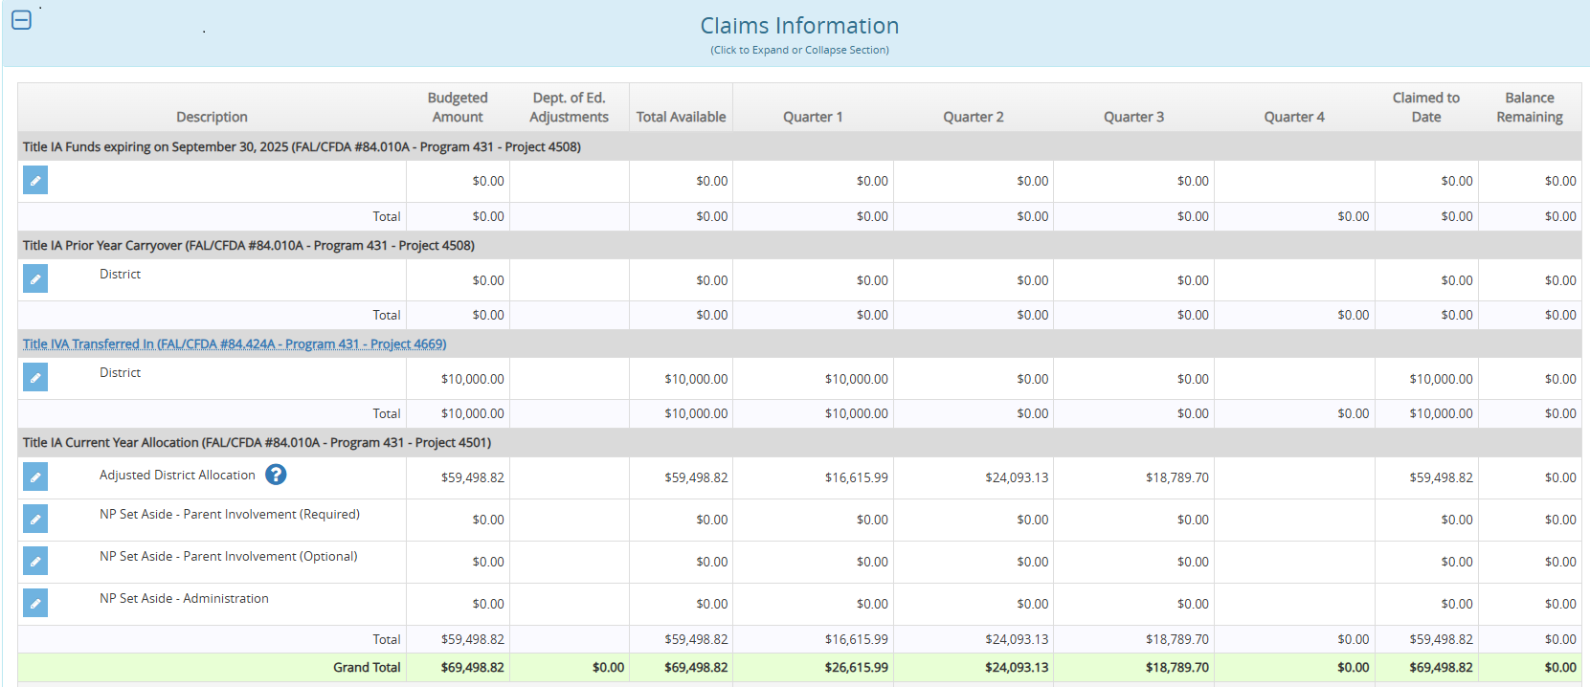
CASA

Slide 14
Claim Requirements
A detailed general ledger is required to be uploaded and must include the following:
Include only one project code (e.g., 4501 ledger, 4508 ledger, 4669 ledger) — which is appropriately coded to the original funding source in the case of transfers;
Contain all revenues and expenditures year to date;
Exclude encumbrances;
Comply with the state’s Uniform Financial Accounting guidelines;

Slide 15
Claim Requirements, cont.
Include only allowable program expenditures and be consistent with the approved program application; and
Be in an appropriate format and include all the required elements.
*Transferred funds: The money was not actually moved from one project code to another. Therefore, expenditures will remain coded to the original funding source. Please note that transferred in funds must be expended/claimed first.

Slide 16
General Ledger Requirements
An appropriate ESEA program ledger contains all of the following.
Public agency’s name
Date range of July 1, 20XX, to June 30, 20XX
Appropriate account codes for revenues and expenditures (see the following Account Codes section)
  Project code (must match the project code in the program claims information table);
  Program code (must match the program code in the claims information table); and
  Object code (see the Iowa Chart of Account Descriptions for appropriate coding)

Slide 17
General Ledger Requirements, cont.
Purchase information
  Vendor name;
  Purchase date; and
  Expenditure amount
Salary and wage information
  Employee’s name and job classification
Travel reimbursement information
  Expenditure description;
  Name of individual the expenditure was for

Slide 18
Account Codes
Dimensions | Format | Revenue & other sources of funds | Expenditures & other uses of funds
Fund | XX | Required | Required
Facility (combination of operational unit & instructional level) | XXXX | Recommended | Required
Function | XXXX | Optional | Required
Program | XXX | Required | Required
Project | XXXX | Required | Required
Object | XXX | Not applicable | Required
Source | XXXX | Required | Optional

Slide 19
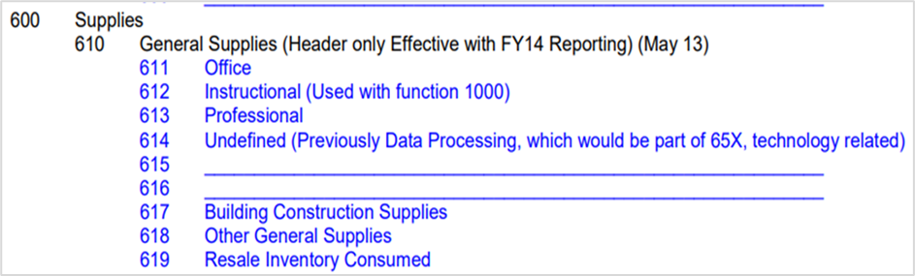
Object Codes
Make sure the object code is allowable for the program. The Department consultants use these codes to determine allowability of the program’s activities.
Example of allowable & unallowable Object Code for Title II, Part A
Allowable: 613 - Professional
Unallowable: 612 – Instructional

Slide 20
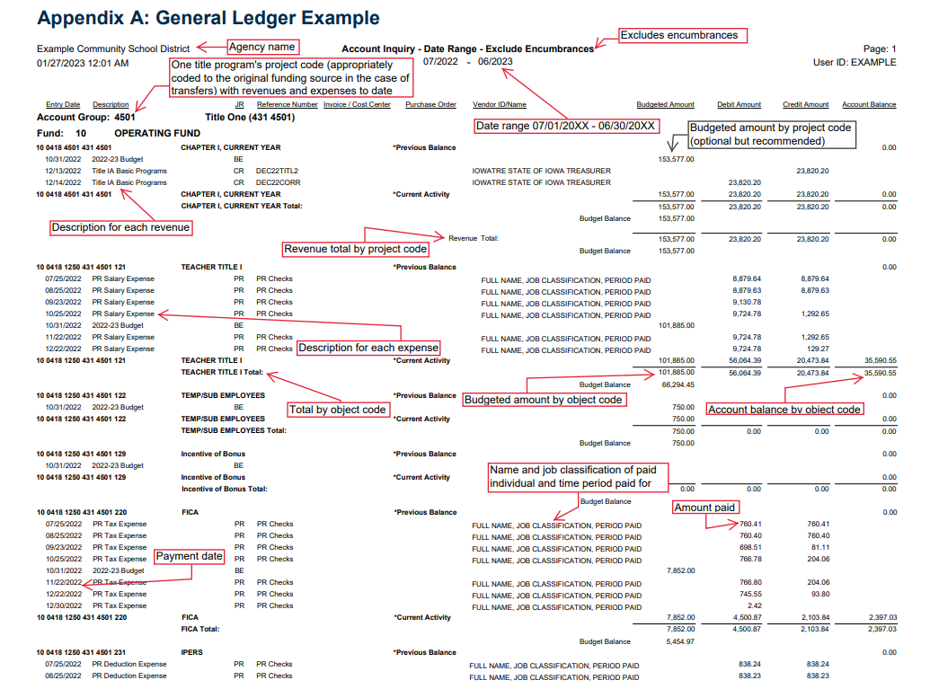
Example of General Ledger Type 1

Slide 21
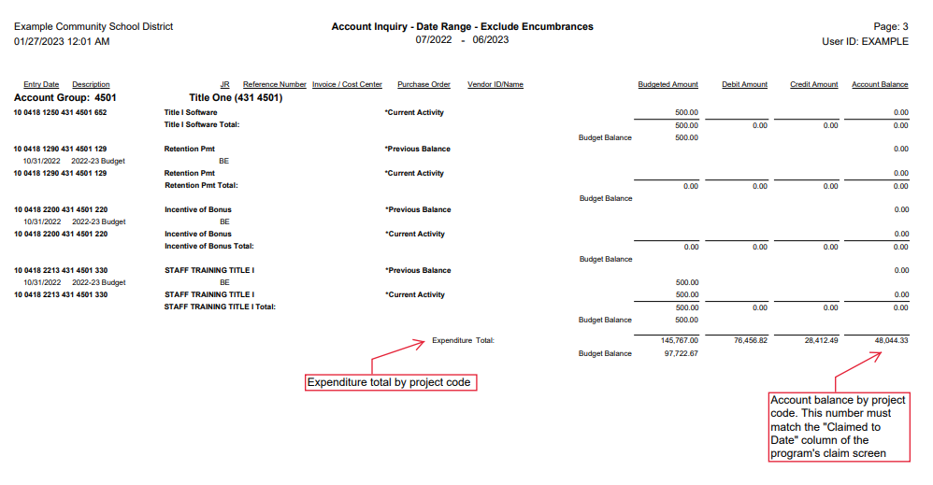
Example of General Ledger Type 2

Slide 22
Carryover Limitations

Slide 23
Examples of Carryover Limitations
ESEA Title Program | Carryover Allowed?*
Title I, Section 1003 | Yes
Title IA | Yes, but districts with a current year allocation of $50,000 or more cannot carry forward more than 15% of its allocation without an approved waiver from the Department.
Title IC | No, funds are reallocated to eligible subgrantees
Title ID1 | Yes
Title ID2 | Yes
Title IIA | Yes
Title IIIA – EL | Yes
Title IIIA – Immigrant | Yes
Title IVA | Yes
Title IVB | Yes
Title VB2 | Yes
McKinney-Vento | Yes

Slide 24
Transferability

Slide 25
Transferability Explained
The LEA may transfer all or a portion of funds from Title II, Part A and Title IV, Part A to any of the following Title programs if it has a current year allocation for the program:
Title I, Part A
Title I, Part C
Title I, Part D
Title II, Part A
Title III, Part A
Title IV, Part A
Title IV, Part B (Only SRSA-Eligible LEAs)
Title V, Part B
Equitable services must be provided to eligible nonpublic school children, teachers and other educational personnel, and families in the following programs if the public agency is receiving an allocation in each:
Title I, Part A
Title I, Part C
Title II, Part A
Title III, Part A
Title IV, Part A or
Title IV, Part B

Slide 26
Reminders 1
All “Not Started “ and “In Progress” claims must be submitted by the last day of the claims period.
All “Action Required” claims must be resubmitted within 5 calendar days or before the cut-off date, whichever comes first.
Failure to meet any of these deadlines will result in the claim being moved to “Failed to Submit an Approvable Claim,” which impacts the ESEA Programs’ risk assessment and may result in additional monitoring requirements.

Slide 27

Reminders 2
Deadline extensions are rarely available because they delay the entire reimbursement process for all agencies.
Budget amendment requests may be considered under specific circumstances.
The “Funds Exhausted” status

Slide 28
Resources
ESEA Programs Webpage
CASA Webpage
Chart of Accounts
Contact Information

