Slide 1
2026 Spring Collection
Secondary CTE Reporting Application (SCTERA)
Dr. Jeffrey Fletcher
Education Program Consultant
Bureau of Career Technical Education & Postsecondary Readiness
Iowa Department of Education

Slide 2
SRI is used for… Secondary CTE Reporting Application (SCTERA)
The SRI system is the basis for extracting CTE data into the Secondary CTE Reporting Application (SCTERA) system.
  A EdInfo Application within the Iowa Education Portal
The data from SCTERA is used for ensuring that school districts comply with state and federal career and technical education requirements.
SCTERA is also used to develop the data required for the annual consolidated annual report (CAR) and reporting performance on the Federal Perkins accountability performance indicators.
Secondary CTE Reporting Application (SCTERA) –
Courses & students from the district SIS upload tagged with a ‘9’, ‘11’, or ‘12’
One-way Data Connection
Student Reporting in Iowa (SRI) – Course & student upload from district’s SIS

Slide 3
Secondary CTE Reporting Application (SCTERA) – Spring Collection Dates
Important Spring Collection Dates
June 15 – Student lists submission due in SCTERA
  This step "closes the loop" for the 2024-2025 (2025) SCTERA reporting season
June 15 – Program of Study due in SCTERA
75% of the annual collection (COMPLETE)
  Districts have already completed adding courses to programs!
  Winter SRI ← → SCTERA collection
25% of the annual collection (IN PROGRESS)
  Districts review program student lists generated from the work completed in step 1
  Spring SCTERA collection

Slide 4
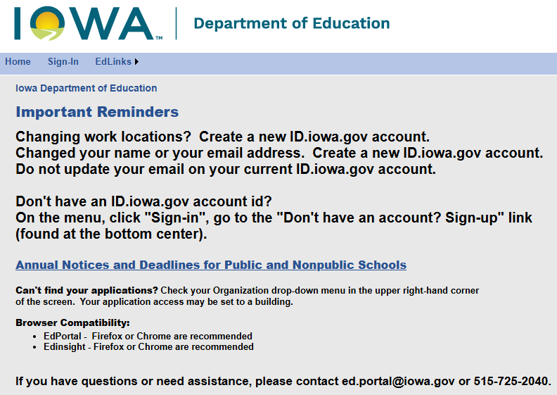
Secondary CTE Reporting Application (SCTERA) – Logging into the Ed Portal
Access to the Secondary CTE Reporting Application (SCTERA) is through the Iowa Education Portal: https://portal.ed.iowa.gov
Changing work locations? Create a new ID.iowa.gov account.
Changed your name or your email address? Create a new ID.iowa.gov account.
Do not update your email on your current ID.iowa.gov account.
Don't have an ID.iowa.gov account id?
On the menu, click "Sign-in", go to the "Don't have an account? Sign-up" link (found at the bottom center).
Annual Notices and Deadlines for Public and Nonpublic Schools
Can't find your applications? Check your Organization drop-down menu in the upper right-hand corner
of the screen. Your application access may be set to a building.
Browser Compatibility:
  EdPortal - Firefox or Chrome are recommended
  Edinsight - Firefox or Chrome are recommended
If you have questions or need assistance, please contact ed.portal@iowa.gov or 515-725-2040.

Slide 5
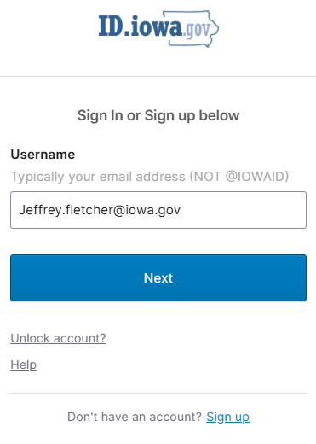
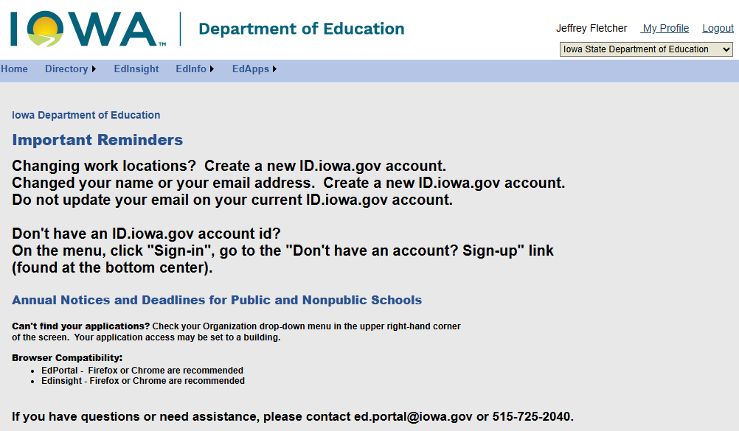
Secondary CTE Reporting Application (SCTERA) – Okta & IowaGrants

Slide 6
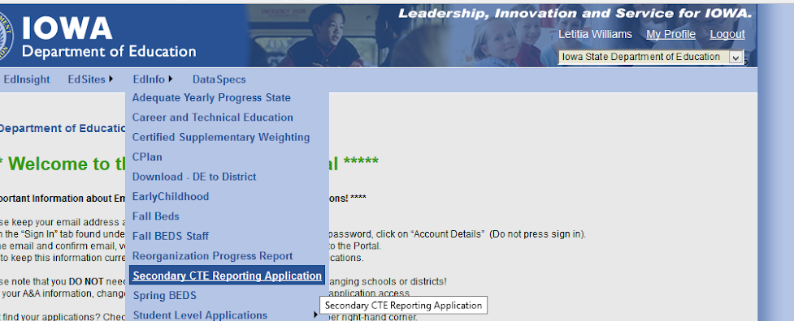
Secondary CTE Reporting Application (SCTERA) – Is an EdInfo Application
Open the Secondary CTE Reporting Application
Click on EdInfo, then choose Secondary CTE Reporting Application

Slide 7
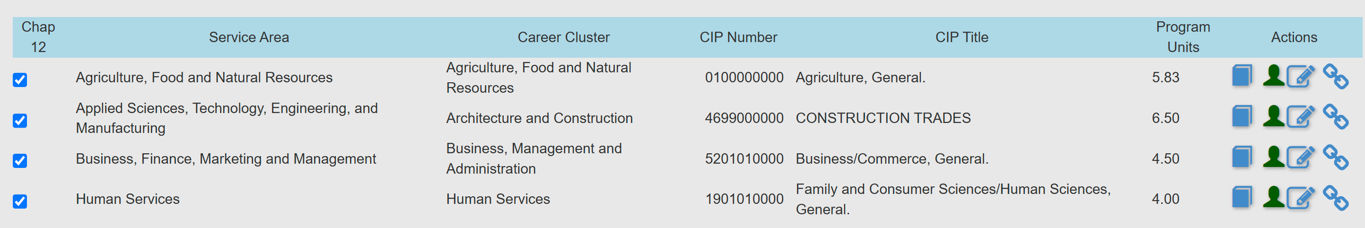
Secondary CTE Reporting Application (SCTERA) – Annual Spring Collection Season Dates
Completing Student Data – SPRING COLLECTION - Due June 15
Work to be completed April 1 – June 15 annually
After the DE has approved a program (“blue” book icon), the student data for that program can be entered by clicking on the GREEN student ICON.

Slide 8
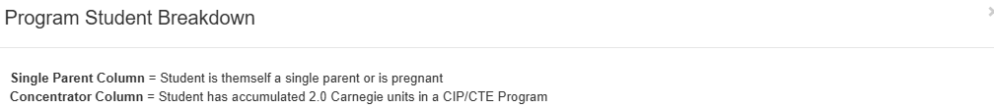
Secondary CTE Reporting Application (SCTERA) – Program Student Breakdown Screen Definitions
The “Program Student Breakdown” screen will open.
The list is downloadable to Excel.
Please note that it will not download if using Safari.
Must use Chrome or Firefox and must use a PC, not Apple, to print student list(s) for your instructors.

Slide 9
Secondary CTE Reporting Application (SCTERA) – Concentrator & Student is Single Parent Column Details
Concentrator (Column) = Student has accumulated >2.0 units in a CIP/CTE Program.
This column is programmed to calculate accumulated units by StateStudentID based on CTE coursework within a CIP ID/CTE program (CareerED and SRI Databases)
SCTERA queries StateStudentID & District ID
              ‘9’, ‘11’, & ‘12’ CTE accreditation courses (including course units) & CTE CIP IDs
Single parent (Column) = Student is a single-parent or is pregnant, not that they live in a single-parent household.
    Indicate that the student is a single parent by clicking on the appropriate check box – the district self-reports/populates this column of information.
    If unsure about whether or not CTE students can (or should be) self-reported in the “Student is Single Parent (or pregnant)” column within a program please reach out to Jeffrey Fletcher, jeffrey.fletcher@iowa.gov. This is the only reporting mechanism we have for Perkins V reporting at the agency.
Example Query: District-level CTE course record query
District ID | District Name | CIP ID | CIP NAME | Course SCED | Accreditation ID | Embed WBL ID | Local Course # | Local Course Name | CC Number | CC Region | Carnegie Units
1350 | Collins-Maxwell CSD | 5201010000 | Business/Commerce, General. | 12051C05000 | 9 | 99 | DMACC 510S1 | BUS 102 | BUS102 | 11 | 0.5

Slide 10
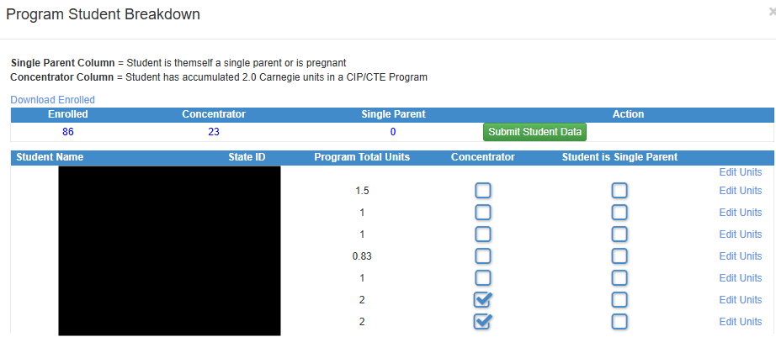
Secondary CTE Reporting Application

Slide 11
Secondary CTE Reporting Application
VERIFY & VALIDATE
After all student updates (single parent reporting) student program total units earned/accumulated column
Verify auto-programmed concentrator column is “auto-checking” based on ‘program-units.’ E.g., Yes >= 2.0 units (trimester-students >= 1.98 units)
Student is single-parent (or is pregnant) column (district selects/checks)
e completed, click on the green Submit Student Data button.

Slide 12
Secondary CTE Reporting Application
The submit button will turn yellow indicating the students are submitted and under final review by the DE Consultant. An e-mail will be sent to the district contact with this information. Click on red return to get back to the Program screen. The Student ICON on the Program screen will also turn yellow.
Once the DE Consultant reviews the Student Data, the Student ICON will turn blue. If there are questions, the DE consultant will contact the district either by phone or e-mail. No news is good news!

Slide 13
Secondary CTE Reporting Application
Double-checking/Completing the Program of Study/Linkage Information
If completed previously, please click the Chain Link ICON on the Program screen to open the Program of Study screen. This screen needs to be completed for all programs and can be completed at any time from January 1 – to June 15. Please review it for accuracy or updates.

Slide 14
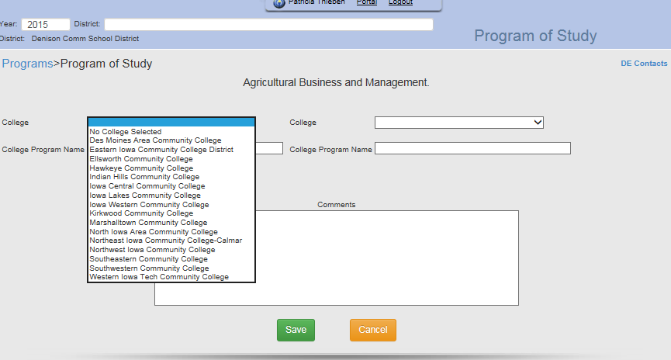
Secondary CTE Reporting Application
Select the college(s) that the program is linked to and enter the college program name (not the department, but the PROGRAM) that the district program is linked to. If none, choose “No College Selected.” The district can also enter any comments regarding the POS. Click the green “Save” button when completed. Programs of Study (POS) are reviewed during the Perkins Monitoring Process and through the Perkins Grant.

Slide 15
Resources
Secondary CTE Reporting Application Directions
Contains screenshots and step-by-step instructions for both the Winter & Spring Collection.
Winter Collection (completed):
Annual Upload for Secondary Career and Technical Reporting Application (SCTERA) - Recorded 12-17-25. Provides an overview of the Winter SRI and SCTERA data collection and reporting process for Chapter 12 State Accreditation, due on Jan. 29, 2026. It covers the Chapter 12 Offer and Teach accreditation requirements for CTE programs and courses, explains how course and student data move from district student information systems (SIS) into the SRI and SCTERA databases, and shows how the Information Analysis Bureau uses these databases for state and federal reporting, including ESSA/ESEA and Perkins V.
SCTERA Short Takes Video: Shared Courses and "INCLUDE" (3:59)
SCTERA Short Takes Video: Courses NOT Tied to a Program (5:37)

Slide 16
Contact Information
Dr. Jeffrey Fletcher
Jeffrey.Fletcher@iowa.gov
515-321-7309
Bureau of Career Technical Education & Postsecondary Readiness
Division of Higher Education
Iowa Department of Education

