Slide 1
Student Reporting in Iowa (SRI) and Secondary CTE Reporting Application (SCTERA) “Connections” Webinar
Topic:
Annual Upload for Secondary Career and Technical Reporting Application (SCTERA)
Description:
The annual upload for the Secondary Career and Technical Reporting Application (SCTERA) courses in a program begins Monday, January 5, 2026, and is to be completed by 5:00 PM on Thursday, January 29, 2026.
Iowa Department of Education
Zoom/webinar format
10:00 - 11:00 AM
12/17/2026

Slide 2
Opening Remarks
This webinar is about the Winter SRI & SCTERA Data Collection/Reporting (I.e., ‘Secondary CTE Reporting’) for Ch. 12 State Accreditation due January 29, 2025.
Ch. 12 Offer & Teach Accreditation Requirements around CTE programs & CTE courses.
Extracting course/student data from district student information system (SIS) to SRI & SCTERA department databases.
SRI and SCTERA databases are utilized by the Performance and Analytics Bureau, Bureau of CTE, & Iowa Department of Education for programmatic data processing for state and federal reporting (e.g., ESSA/ESEA, Perkins V, and more).
More accurate/complete data collection leads to… More accurate/complete data processing & reporting down-the-road!

Slide 3
Student Reporting in Iowa (SRI) Team
SRI Contacts
  Rachel Kruse, Rachel.kruse@iowa.gov, 515-281-4153
  Kerri Ladehoff, Kerri.ladehoff@iowa.gov, 515-281-3805
  Lynette Foster, Lynette.foster@iowa.gov, 515-281-3214
2025-2026 SRI Documentation
  Student Reporting in Iowa Data Dictionary

Slide 4
Student Reporting in Iowa (SRI)
Dates to Remember
December 2 – Cedar Connect and SRI open for Winter collection
December 8 – Dropout Verification site opens
December 19 – Dropout Verification certification deadline
January 5 – Secondary CTE Reporting Application goes “live” – Winter SRI certification window opens
January 29 – Courses in a program due in SCTERA & Winter SRI certification window closes
KEY STEPS:
District submits and uploads a 100% complete Winter SRI Course file
District completes “Winter SCTERA work” of adding all CTE courses to each program (January 29).
District “certifies” to begin CH.12 accreditation review (January 29).

Slide 5
Student Reporting in Iowa (SRI)
Student Reporting in Iowa (SRI), an EdInfo application in the Iowa Education Portal, is the Iowa Department of Education’s centralized initiative involving the transfer of individual student records from local districts to the state.
The mission of the project is to reduce data burden and encourage better decision-making by establishing and maintaining a cost effective method of accessing and transferring accurate and timely education information among school districts, postsecondary institutions, and the Iowa Department of Education.
Student Reporting in Iowa Tutorials

Slide 6
Student Reporting in Iowa (SRI) - SCED codes -
SCED Coding 101 – Introduces the user to SCED codes for secondary level courses. Examples of SCED codes are given, and the user has the opportunity to practice creating SCED codes. National Center for Education Statistics – What is SCED?
9-12 courses used as placeholders for no credit, such as study hall or lunch, may contain a single ‘0’ for the SCED
All 9-12 courses should be assigned a course code generated from the coding manual, Secondary School Course Classification System: School Codes for the Exchange of Data (SCED) from the National Center for Educational Statistics, School Courses for the Exchange of Data (SCED) v12 as modified by the Iowa Department of Education and found on the State Reporting (SRI) website.
The 9-12 SCED course codes are 11 characters in length and have four components:
  Course Description consisting of a two digit Subject Area and three digit Course Identifier
  Course Level consisting of one alphabetic character in UPPERCASE
  Carnegie Units expressed as a three digit number excluding the decimal point (e.g. 0.50 = 050)
  A two digit sequence representing a count of the number of times you re-use the first 5 digits for courses with different content or used to indicate 1st term/2nd term of a year-long course
Understanding the Accreditation Report – Explains the Curriculum Accreditation Report, which is found in Winter SRI. It describes the four main focus areas when checking for accuracy and common mistakes that are made.
SCED Codes for Non-secondary Courses - Teaches how to create a SCED code for a non-secondary level course.

Slide 7
SRI is the foundation for… Secondary CTE Reporting Application (SCTERA)
The SRI system is the basis for extracting CTE data into the Secondary CTE Reporting Application (SCTERA) system (another EdInfo Application)
A EdInfo Application within the Iowa Education Portal
The information from SCTERA is used for ensuring that school districts comply with state and federal career and technical education requirements.
SCTERA information is also used to develop data required for the annual consolidated annual report (CAR) and reporting performance on the Federal Perkins accountability performance indicators.
Secondary CTE Reporting Application (SCTERA)
One-way Data Connection
Student Reporting in Iowa (SRI)

Slide 8
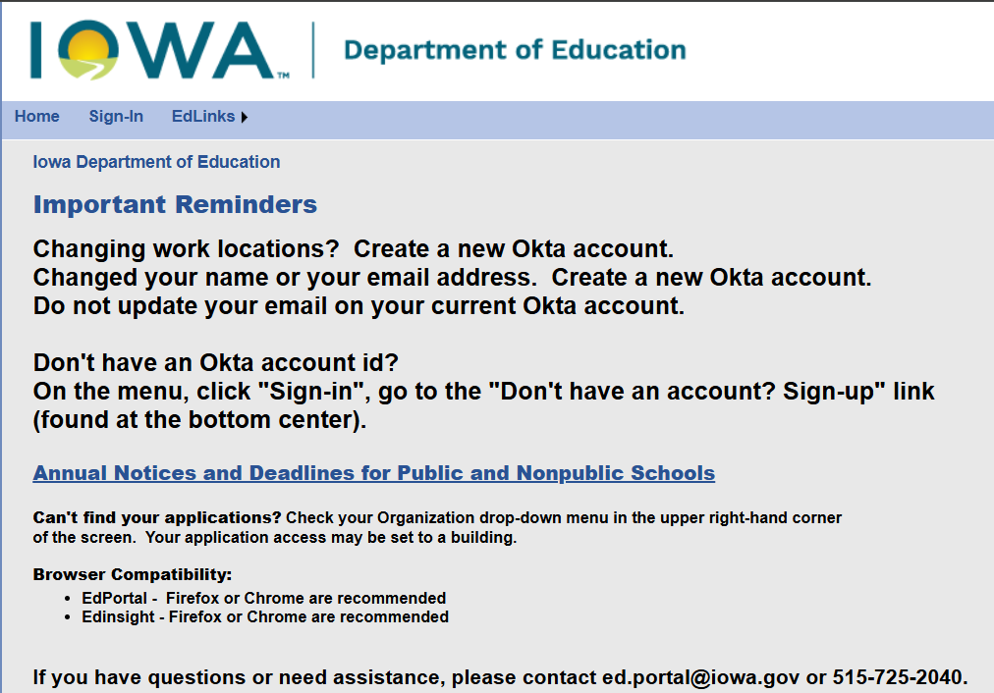
Secondary CTE Reporting Application (SCTERA)
Log in to the Iowa Department of Education Portal
IDE recommends using the Google Chrome web browser
Access to the Secondary CTE Reporting Application (SCTERA) is through the Iowa Education Portal: https://portal.ed.iowa.gov

Slide 9
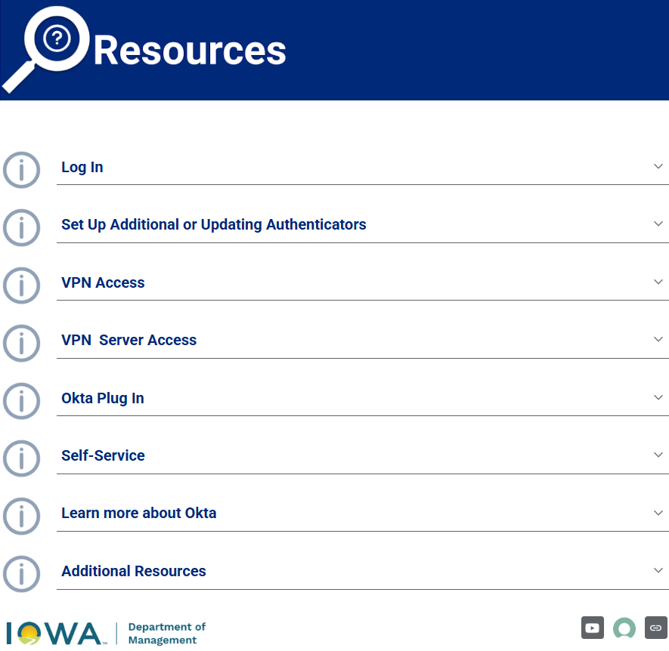
Secondary CTE Reporting Application (SCTERA)
Experiencing difficulty with the State of Iowa’s Okta double-authentication security log-in tool?
Try starting with some self-help resources: Okta.iowa.gov - Resources

Slide 10
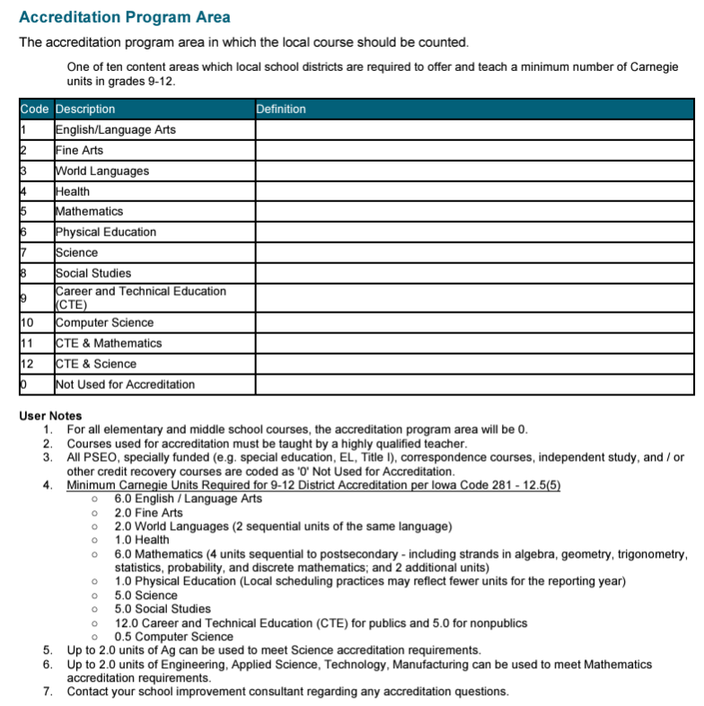
CRITICAL!!!
Accreditation Program Area, Code = ‘9’ or ’11*’ or ’12*’ for each Course that is Career & Technical Education (CTE)
*Caution should be given when assigning a course an accreditation area of ‘11’ or ‘12’
  Courses flagged with accreditation program area codes ’11’ or ’12’ will also “flow” into SCTERA.
  ‘11’ = Applied STEM for Math (up to 2.0 units)
  ‘12’ = Agricultural for Science (up to 2.0 units)
A critical step for information to “flow” into the IDE’s Secondary CTE Reporting Application (SCTERA) (SRI HANDBOOK, P. 109)
Reporting Assistance for HF 2465
(about new accreditation areas ’11’ & ‘12’)
Applied STEM for Math
Agricultural for Science

Slide 11
Student Reporting in Iowa & Secondary CTE Reporting
Reporting Assistance for HF 2465
Accreditation program area code ’11’ – CTE (ASTEM) & Mathematics ; ‘12’ – CTE (AG) & Science
  An Act modifying provisions related to the curriculum provided to students enrolled in grades 9-12 by allowing instruction related to agriculture to meet a portion of the unit requirements related to science, and
  Allowing instruction related to ASTEM to meet a portion of the unit requirements related to mathematics.
Selecting Accreditation Area in Student Reporting in Iowa (SRI)
Districts opting to use a course with an Agriculture SCED code to also meet accreditation requirements in science, should set the Accreditation Program Area to '12' Career and Technical Education (CTE) and Science on the course in their Student Information System (SIS).
Districts opting to use a course with an Applied Science SCED code to also meet accreditation requirements for mathematics should set the Accreditation Program Area to '11' CTE and Mathematics on the course in their SIS.
Courses with the Accreditation Program Area of '11' or '12' will show in the district's curriculum accreditation report found in winter SRI in both CTE and either math or science accreditation areas.
  As mentioned earlier, these courses will also “flow” into SCTERA and populate the courses lists to as options to add to programs.
For more information or questions, please contact Cale Hutchings at cale.hutchings@iowa.gov

Slide 12
WBL SCED CODING – Student Reporting in Iowa (SRI)
Coding & Reporting Work-Based Learning Experiences
Beginning with the 2024-25 academic year, work-based learning reporting will reflect the new state definition referenced above for Iowa’s new, unified Every Student Succeeds Act (ESSA) school accountability system, which includes work-based learning experiences attained in the Postsecondary Readiness Indicator, and Iowa’s Perkins Secondary Career and Technical Education 5S3 work-based learning measure (Senate File 2411, 2024).
Schools will leverage existing SCED codes and embedded work-based learning codes to report these activities to the Iowa Department of Education.
FAQ & Guidance
Work-Based Learning Definition and Reporting
Work-Based Learning Course Naming and Coding
For more information or questions, please contact Jodie Smith at jodie.smith@iowa.gov

Slide 13
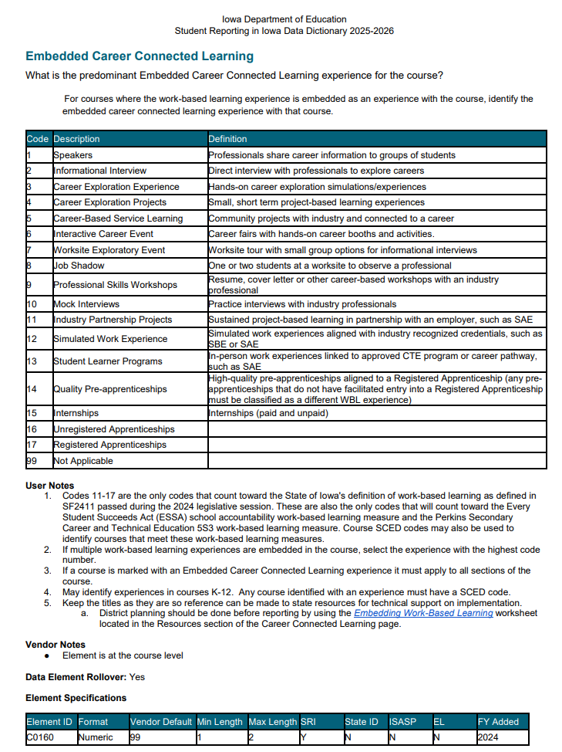
Embedded Career Connected Learning Coding – SRI
Embedded Career Connected Learning Coding Indicator was added to SRI and district SIS systems beginning with the 2023-2024 reporting cycle for use in reporting work-based learning happening in courses that may not be a dedicated WBL course.
Embedded Career Connect Learning codes are outlined in the Student Reporting in Iowa (SRI) data dictionary (p. 115).
“User Notes” indicates which embed codes count toward the state’s new work-based learning definition and which do not, etc.
It is desired ALL courses include this code, even dedicated WBL courses, since it adds a layer of specificity that does not exist with SCED codes.

Slide 14
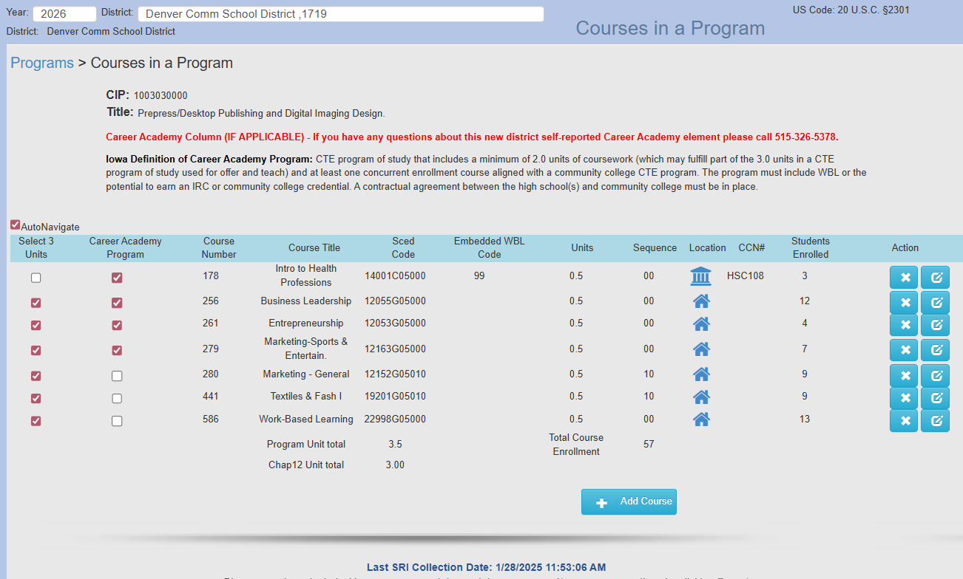
NEW Enhancement: Self-Report CA Program Courses
Career Academy Program
District “identifies/selects” Career Academy Program Courses ONLY (when/if) applicable.
If you have any questions about this new district ‘self-reported’ data element please call Heather Meissen @ 515-326-5378.
Iowa Definition of Career Academy Program:
CTE program of study that
includes a minimum of 2.0 units of coursework (which may fulfill part of the 3.0 units in a CTE program of study used for offer and teach)
and at least one concurrent enrollment course aligned with a community college CTE program.
  The program must include WBL or the potential to earn an IRC or community college credential.
  A contractual agreement between the high school(s) and community college must be in place.
For more information or questions, please contact Heather Meissen at heather.meissen@iowa.gov

Slide 15
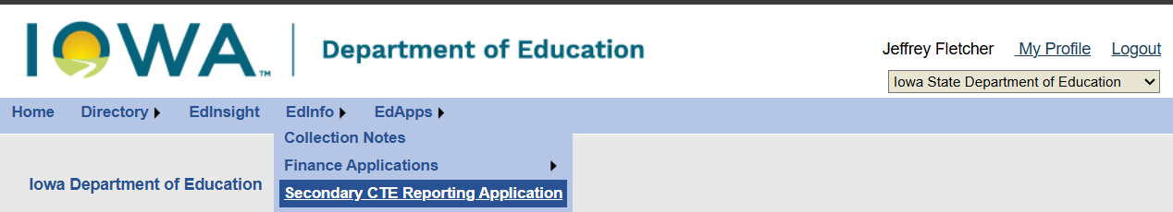
Secondary CTE Reporting Application (SCTERA)
After successfully logging into the Iowa Education Portal –
Navigate to the dropdown menus in blue
Click on “EdInfo”
Select/click “Secondary CTE Reporting Application”
Need assistance with the Iowa Education Portal?
Need assistance with access to SRI and/or SCTERA applications?
If you have questions or need assistance,
please contact ed.portal@iowa.gov or 515-725-2040.

Slide 16
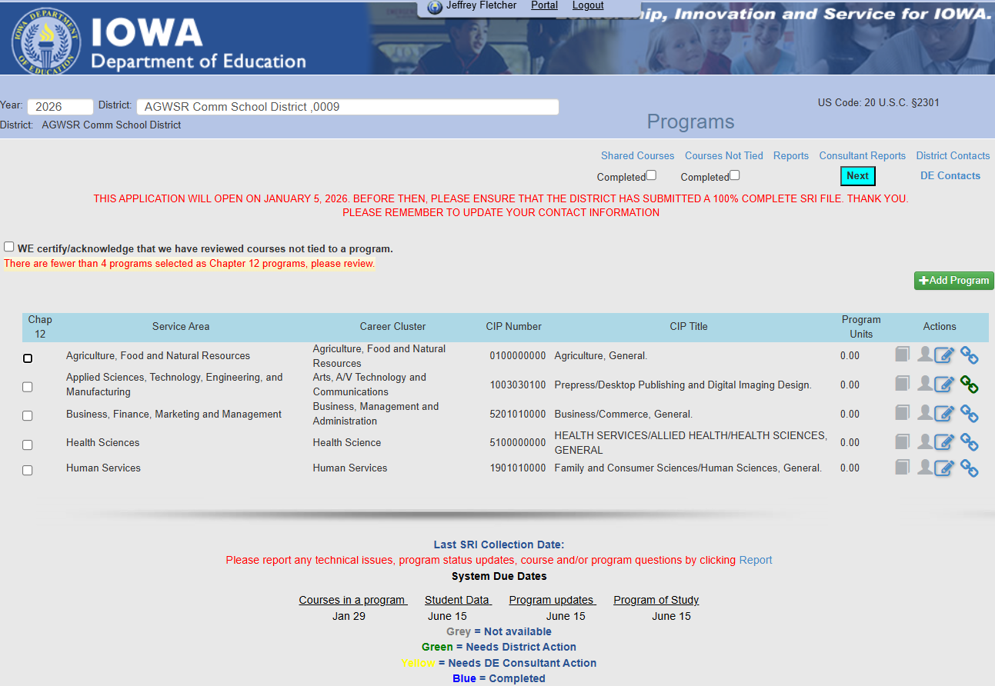
District’s Program Screen - SCTERA
Notes:
Check to make sure SRI is uploaded, timestamp is circled in RED in screenshot — nothing can be completed until school districts SRI file is uploaded/submitted AND 100% complete.
If the school district needs to re-upload/re-submit, it is important to be very cognizant of what the changes were so they can re-do/update a CTE program if CTE data changed.
Check (4) programs under the Chapter 12 column; the check-marks are about compliance for offer and teach accreditation; not that these are the only ones that will be documented.
Pick programs with 3.0 or more units of school district classes - unless they are a district that has under 600 students, then they can use CC classes in ONE program (if they have at least 5 students in the course or courses) and they would not lose supplemental weighting.

Slide 17
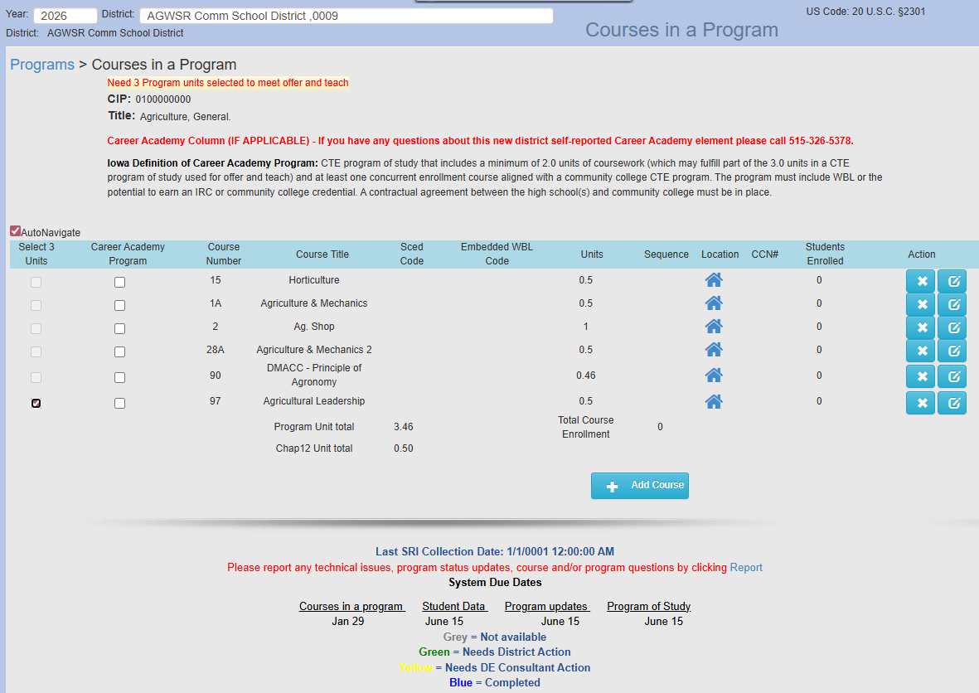
Courses in a Program Screen - SCTERA
*Screenshot is from the “staging/testing” environment; does not show all information/functionality.*
Notes:
Be sure to include ALL Community College CTE courses associated with a CIP/CTE Program. We also need to count all CTE students. It can make a difference.
If there is more than (1) CIP/CTE Program within a Service Area, ensure that the courses are unique/specific to each CIP.
If CIP/CTE Program was checked for Chapter 12 – boxes for each course will be available; select courses until reaching 3.0 units. Note: If supplemental weighted courses are checked for the offer and teach requirement, the supplemental weighting is lost. Try to check local courses when and if possible. Any course(s) not marked as meeting the Offer and Teach requirement is/are eligible for supplemental weighting.

Slide 18
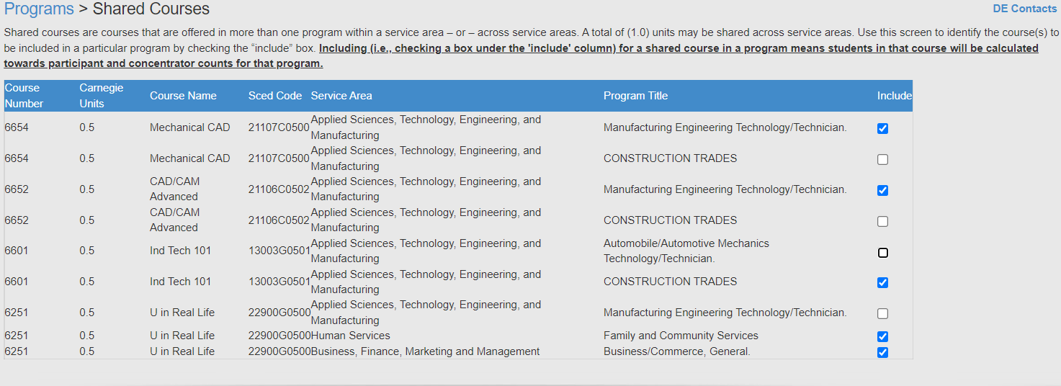
Shared Courses Screen - Secondary CTE Reporting Application (SCTERA)
Once all programs are completed, click on the “Shared Courses” link at the top of the Program screen.
SCTERA Short Takes Video: Shared Courses and "INCLUDE" (3:59)
Notes:
Shared courses are courses that are offered in more than one program within a service area or across service areas.
A TOTAL of 1.0 units may be shared across service areas.
There is no limit on sharing units within the same service area, however, the courses should relate to the CIP/CTE Program and show how the programs are unique. If needed, discuss with a service area DE consultant.
For shared courses – for each course, check the box if it should be counted in the program’s student counts.

Slide 19
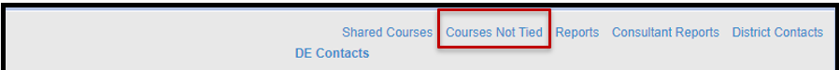
Course NOT Tied to a Program Screen - SCTERA
This is a frequent action item that comes up in a DE review and can result in additional attention and actions required by the district.
SCTERA Short Takes Video: Courses NOT Tied to a Program (5:37)
INSTRUCTIONS: Please review the list of "courses not tied" to a program:
a) Whether a secondary or concurrent enrollment course, does it fit into an existing program?
b) Whether secondary or concurrent enrollment courses - are there 3.0 units of sequential courses to create a new program? Please contact a service area consultant.
c) If scenario A or B is not applicable, then the course may remain in in "course not tied" list.
Notes:
Courses Not Tied To A Program Report – It is possible or plausible to have an additional program if less than 2.0 units but shared with another course tied to a program. There are scenarios where a district may or may not want to consider. It is advised to speak with a Service Area DE Consultant.

Slide 20
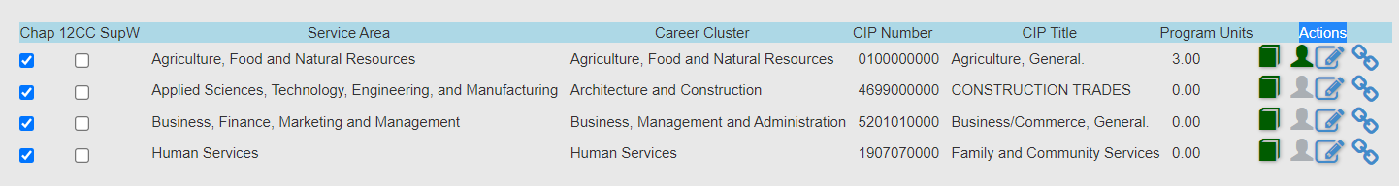
Secondary CTE Reporting Application (SCTERA)
After adding courses to 1st/(one) program is complete, click on green “student head icon” and then click “Request Course Review” button.
Repeat step 1 for each program.
Congratulations, 2026 Winter Course SCTERA Collection is complete!
Navigate back to EdInfo SRI application to Certify SRI file.

Slide 21
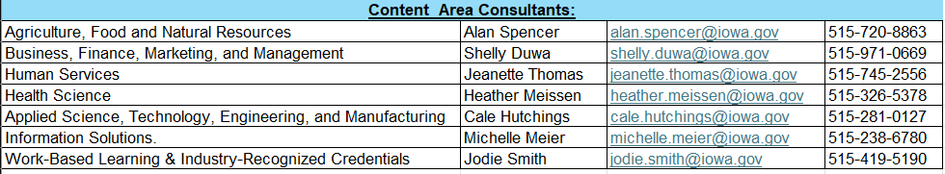
Closing Remarks - End of Webinar
Jeffrey Fletcher, PhD, MPA
Jeffrey.Fletcher@iowa.gov | 515-321-7309
Bureau of Career and Technical Education & Postsecondary Readiness
Division of Higher Education
Iowa Department of Education
For SCTERA assistance, there are multiple options available for your convenience:
The SCTERA scheduling tool.
Questions about SRI data? SCED Codes? Sequencing? Other? – Please contact the SRI team.
Questions about SCTERA application? Complete a Google Form "Report" ticket via the district home screen.
Career Academy Column (IF APPLICABLE) - If you have any questions about this new district self-reported Career Academy element please call Heather Meissen @ 515-326-5378.
For questions about courses & programs, please reference contact list below (or click on “DE Contacts” in SCTERA application):

Slide 22
Appendix – Compiled Resources
SRI 2025-2026 Data Dictionary
Reporting Assistance for HF 2465
                Accreditation program area code ’11’ – CTE (ASTEM) & Mathematics
              Accreditation program area code ‘12’ – CTE (AG) & Science
Student Reporting in Iowa Tutorials
Framework of SCED for Secondary Level Courses (12-2024)
Career Academy Minutes and SCED Codes
Complete List of Non-Secondary Course Codes (8-24-21)
SCED v12
SCED Codes and Contact Minutes for Community College Courses
Compare PSEO and Contracted Courses
SCTERA APPLICATION HANDBOOK
SCTERA Webinar FAQs
SCTERA Short Takes Video: Shared Courses and "INCLUDE" (3:59)
SCTERA Short Takes Video: Courses NOT Tied to a Program (5:37)
Iowa Approved CTE CIP Codes
Coding & Reporting Work-Based Learning Experiences
Notes:
POWERPOINT ENDS.

Slide 23
Appendix – Compiled Resources
According to Ch. 46 Career and Technical Education, ALL secondary CTE programs are required to be approved by the Director of the Department of Education. This is done through the self-study process as outlined in Ch. 46. The Department tracks operational programs subject to approval through the state CTE reporting system (SCTERA). Therefore, if a district wishes to offer a CTE program, it must be reported annually through the CTE reporting system.

Slide 24
Appendix – Compiled Resources

Slide 25
Work-Based Learning (WBL) Coding and Reporting Support Webinar
January 13, 2025
Notes:
Heather

Slide 26
Outline
Defining Career-Connected Learning (CCL)
Recommendations for Coding and Expanding Work-Based Learning (WBL)
Reporting WBL in the Student Information Systems (SIS) for SRI Reporting
Additional Resources to Consider
If you have any questions, please ask them in the chat. We will provide an FAQ after the meeting with answers to your questions.
This webinar is being recorded and will be shared after the webinar. It will also be posted to the Career-Connected Learning webpage at educate.iowa.gov/ccl.
Notes:
Heather

Slide 27
Terminology Changes
The passage of Senate File 2411 in May 2024 solidified the definition of “work-based learning” as being only those activities that involve direct interactions between industry and education stakeholders as:
sustained project-based learning in partnership with an employer
simulated work experiences aligned with industry-recognized credentials
high-quality pre-apprenticeships aligned to an apprenticeship
student learner programs
internships
apprenticeships
Most of these experiences will occur in a physical work environment, but some may be provided in a simulated or virtual environment in class or on campus.
Refer to the new Work-Based Learning Course Naming & Coding resource available at educate.iowa.gov/ccl for information on definitions and coding.
Notes:
Joe

Slide 28
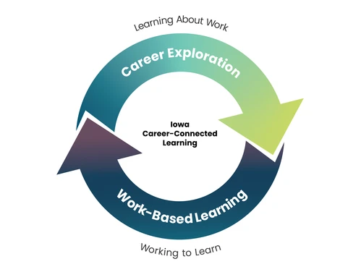
Career-Connected Learning
Career-Connected Learning = Career Exploration + Work-Based Learning
Career Exploration - activities that help students in learning about work
Work-Based Learning (WBL) - supports students in working to learn the knowledge and skills they need to succeed in the workplace and beyond
Career-Connected Learning Website
(educate.iowa.gov/ccl)
Notes:
Joe

Slide 29

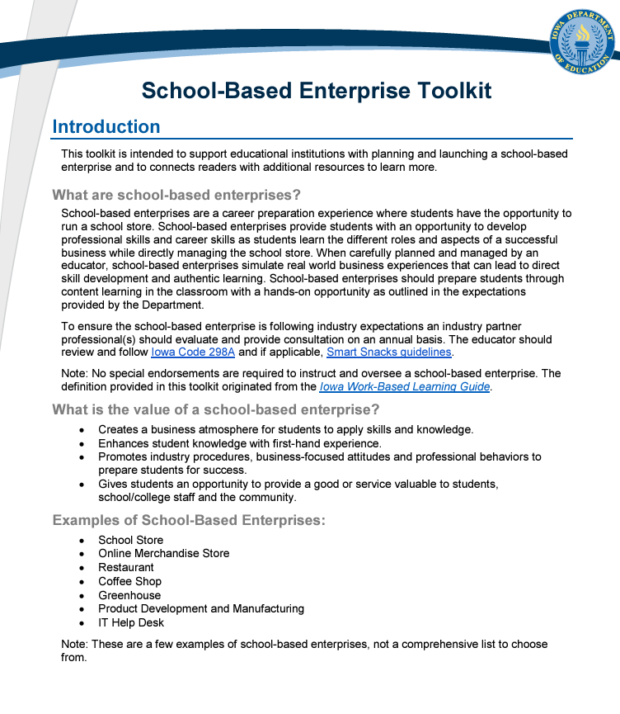
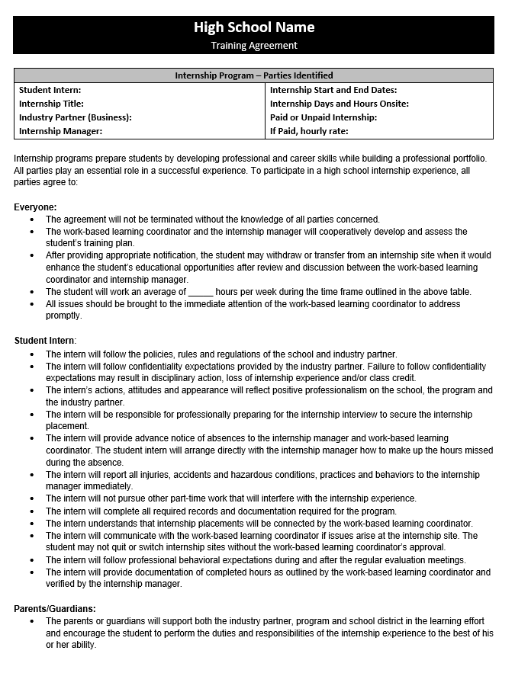
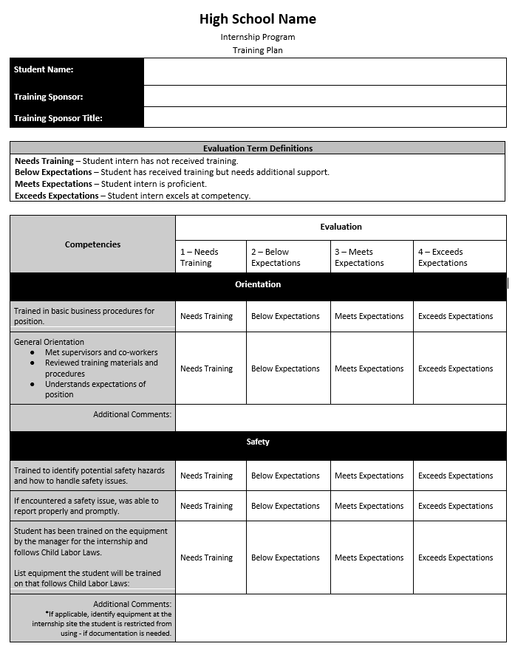
Overview of WBL Resources
Check out the guides, toolkits, templates and other resources available at educate.iowa.gov/ccl
Career Exploration
Authentic Project Experiences Toolkit - Informational Interview Toolkit
Career Immersion Experience Toolkit - Interactive Career Event Toolkit
Career-Based Service Learning Toolkit - Job Shadow Toolkit
Classroom Speaker Toolkit - Mock Interview Toolkit
Developing Professional Skills in CTE Toolkit - Professional Skills Workshop Toolkit
Entrepreneurship Toolkit - Worksite Exploratory Event Toolkit
Work-Based Learning
Internship Toolkit
School-Based Enterprise Toolkit
Sample Internship Training Plan
Sample Internship Training Agreement
WBL Self Assessment Tool
Expanding WBL for Schools
Notes:
Joe

Slide 30
Quick WBL Verification Check
While districts have flexibility on how they classify experiences, there are some specific considerations to keep in mind to ensure it should be considered “Work-Based Learning” and not “Career Exploration”. Note: CTE courses do not automatically count as WBL!
Are students actively working, not passively observing?
  Students must be completing actual work duties that provide value to employers in a real or simulated environment. Some examples of roles played by students would include:
    Project-Based Learning = Consultants
    Simulated Work Experience = Worker for School Based Enterprise, completing work clinicals or practicum requirements, etc…
    Internships, Student Learner Programs, Pre-Apprenticeships & Apprenticeships = Worker
Are employer partners directly involved and engaging with students?
  Employer partners need to be directly involved and engaging with students to be considered WBL, not simply providing consultation on advisory councils, CTSOs, competitions, etc…
    Projects, lab work or experiences that have been designed by or approved/vetted by employers or advisory councils do not automatically qualify.
  Schools/districts, family businesses, entrepreneurs and others may qualify as “employers”.
Notes:
Joe

Slide 31
Three tips for counting/expanding WBL experiences #1
Tip #1: Embedded experiences count the same as dedicated WBL courses
Work-based learning activities or experiences that are part of a course (otherwise known as "embedding") are counted the same as dedicated WBL courses (e.g. internships or work-study) for the Iowa School Performance Profiles and other measures.
The staff, time and other resources necessary to offer dedicated WBL programs and courses can be a barrier for many schools, so consider embedding experiences into your current course offerings before building out larger scale programs and changes.
Some examples would be a student-led coffee shop that is part of a business course, internships that are part of an agriculture course or project-based learning activities as part of a construction course.
Notes:
Joe

Slide 32
Three tips for counting/expanding WBL experiences #2
Tip #2: All courses can qualify as work-based learning
There is no requirement that WBL must occur as part of a designated career and technical education (CTE) course or program of study. Every course can be counted as including WBL as long as it meets one of the state definitions.
A few examples might be project-based learning as part of a math class, a school-based enterprise as part of a science class or a student learner program as part of a government/social studies class.
Similar to the previous tip, expanding or implement quality CTE programs can be time and resource intensive, so consider adapting all of your current course offerings to be included as WBL in different ways.
Reminder: CTE courses, even those taught at a career academy or regional center, do not automatically count as WBL.
Notes:
Joe

Slide 33
Three tips for counting/expanding WBL experiences #3
Tip #3: Create an inventory of courses and survey staff for ideas or opportunities
Districts should consider building out an inventory of all courses and surveying staff to determine if qualifying WBL is already taking place or if some minor tweaks might be needed to be able to do so in some capacity.
Questions to consider might be:
Do you involve business and industry partners in your course/program?
  If not, are you interested in doing so in the future?
Do you include project-based learning in your course/program?
  If yes, are local business and industry partners involved?
    If not, are you interested in doing so in the future?
Do your students conduct clinicals, practicum or other required work experience for your course/program or related credentials/licensure?
  If no, has this interest been expressed by students or industry partners?
Do your students work towards an industry-recognized credential (IRC) as part of your course/program?
  If no, has this interest been expressed by students or industry partners?
Are you interested in learning more about incorporating career exploration or work-based learning activities and experiences in your course/program?
Notes:
Joe

Slide 34

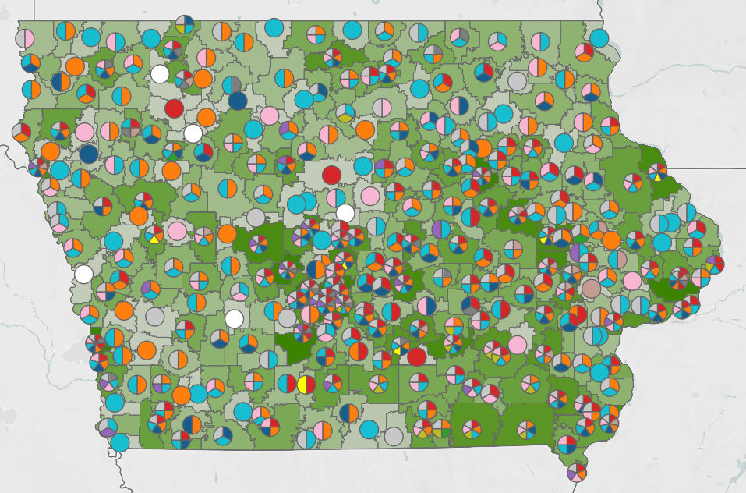
Iowa Student Outcomes WBL Dashboard
The interactive WBL dashboard at
www.iowastudentoutcomes.com/work-based-learning
showcases WBL participation at the district level and
has recently been updated to reflect 2023-2024 AY
data for the new state definition of the new definition of WBL.
District staff are encouraged to check the updated
information and conduct a thorough review of all
identified courses, as well as any that may be missing
or seemingly incorrect due to coding or reporting issues.
A new feedback form has also been added to the site to
request corrections, clarifications or other information. This is
being done to help ensure courses are being adequately
coded within district Student Information Systems (SIS) before
the transmission of Winter Student Reporting in Iowa (SRI)
data files by the end of this month (January 29th).
Notes:
Joe

Slide 35
WBL Data Collection Points
The WBL data will be collected in the Winter SRI data files that are due between December and January of each year (Deadline: January 29, 2025)
Although not required, consider using all three of the below data points in combination with one another to ensure accuracy:
School Courses for the Exchange of Data (SCED) Codes
  Course Names (keywords; only used for map/internal DE use)
Embedded Work-Based Learning Indicator Codes
Secondary Career & Technical Education Reporting Application (SCTERA)
  Student-level, only for “CTE concentrators” (earned 2.0 credits in specific CTE area)
Refer to current resources at educate.iowa.gov/ccl for updated guidance.
Course/ Content Area | Keyword(s) to Include in Course Title | SCED Code | Embedded Work-Based Learning Indicator
Internship for All Career Paths | “Internship” or “Intern” | 22998 | 15
Notes:
Joe

Slide 36
ESSA Postsecondary Readiness Indicator
Prior Indicators
Outcome Based
Phased in Indicators
ACT or SAT participation
ACT or SAT success
College-level coursework
CTE concentrators
% students that obtain college credit while in high school
% of students in a work-based learning (updated definition) experience
% students who obtain an industry recognized credential (IRC)
ESSA State Plan Information (pg. 47); General student reporting information
Notes:
Jason takes over

Slide 37
Postsecondary Readiness: Work-Based Learning
Reported in Fall 2024: Seniors from the 2022-23 school year who were in Iowa public schools for the four years leading up to that year
Work-Based Learning
  Enrolled in a course in the Winter Student Reporting in Iowa (SRI) data collection that has a work-based learning School Courses for the Exchange of Data (SCED) course code
  Enrolled in a course in the Winter SRI data collection that is tagged with an Embedded Work-Based Learning code on the approved list
  Identified within the Secondary Career and Technical Education Reporting Application (SCTERA) as having participated in work-based learning at student-level
A school receives points toward its accountability index score proportional to the percentage of students participating in work-based learning; for example, if the school has 25% of students participating in work-based learning, it receives 25% * 50 possible points = 12.5 total points.
Notes:
Jason

Slide 38
Student Reporting in Iowa (SRI)
Student level data collection which includes all scheduled courses for a student.
Uses data from a district’s Student Information System (SIS)
Three times per year: Fall, Winter, and Spring
Winter collection is considered the ‘Curriculum’ collection
  Winter SRI includes all scheduled courses for the year
  Winter SRI should not be certified until courses for the entire year have been verified.
First Semester/First Trimester
Scheduled Course Enrollments
Winter SRI Data
2024-2025 Academic Year
Second Semester/ Second and Third Trimester
Scheduled Course Enrollments
Notes:
Rachel takes over

Slide 39
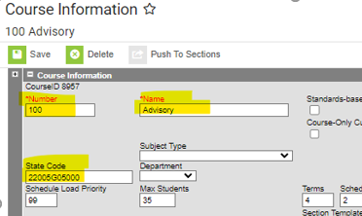
SCED Codes in Infinite Campus
Main Menu > Scheduling & Courses > Course Information (if no course is selected, you will need to Open Course Search and search for the course, hitting return will list all courses/sections)
Notes:
Rachel

Slide 40

SCED Codes in JMC
Schedules > Course > Edit Course Data > State Specific Course tab
Notes:
Rachel

Slide 41
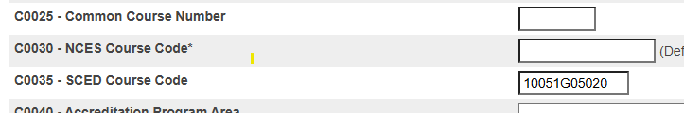
SCED Codes in PowerSchool
School Management > Courses & Programs > Courses
Select a course
Under the Iowa State Report Information
Notes:
Rachel

Slide 42

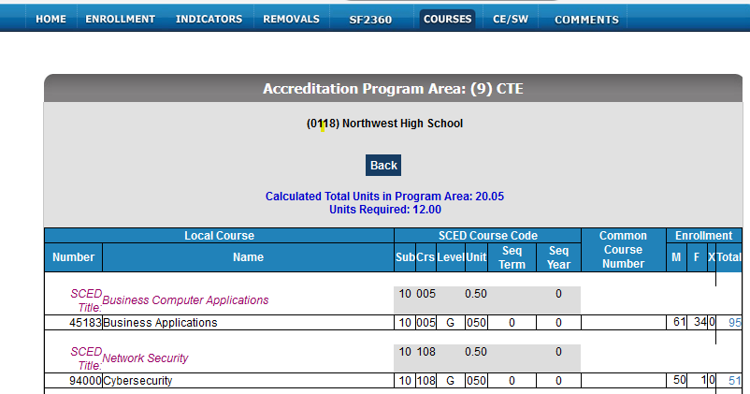
Curriculum Reports in Winter SRI for SCED Codes
Notes:
Rachel

Slide 43
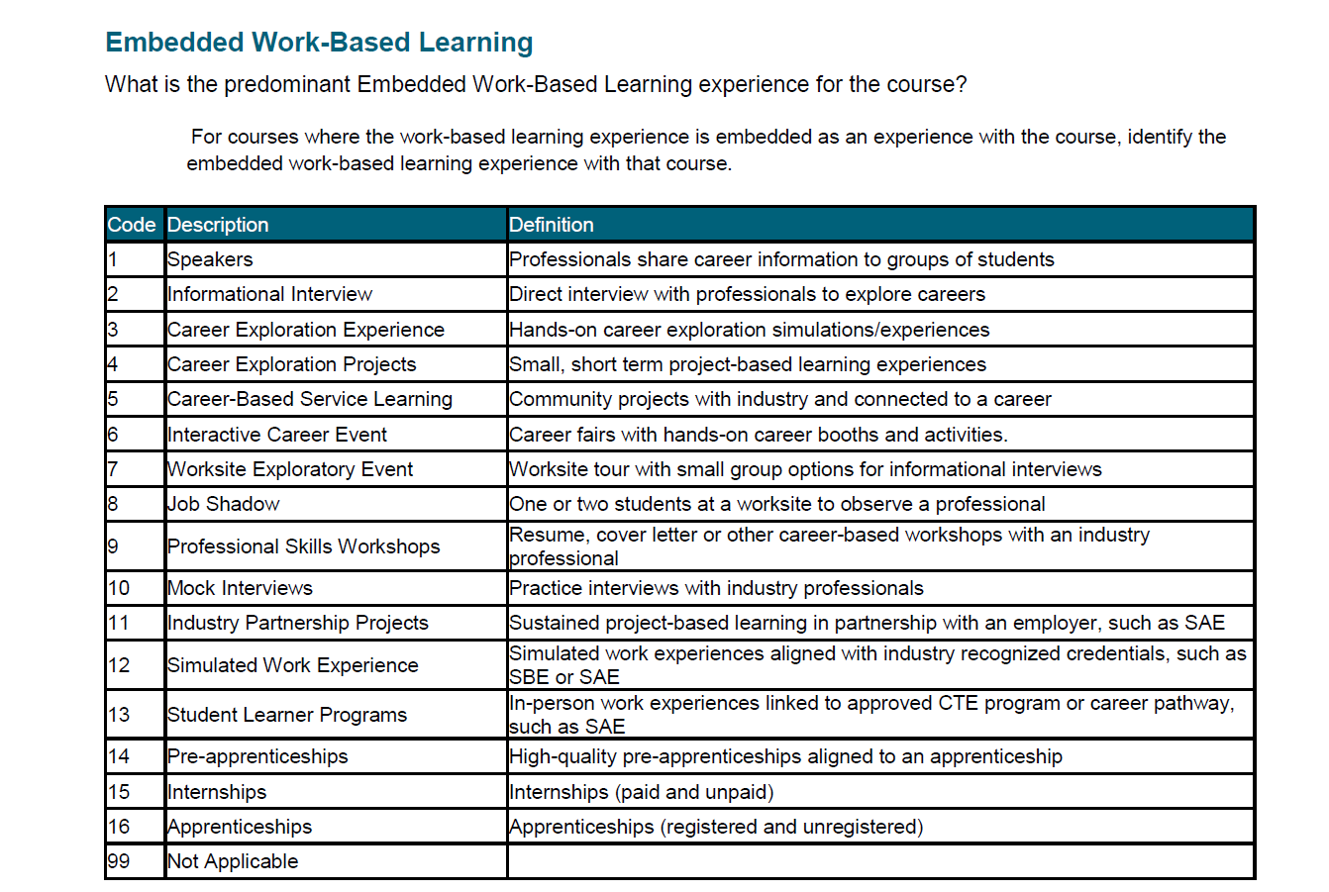
Embedded Career Connected Learning Indicator
Data Dictionary page 115
WBL
Notes:
Rachel

Slide 44
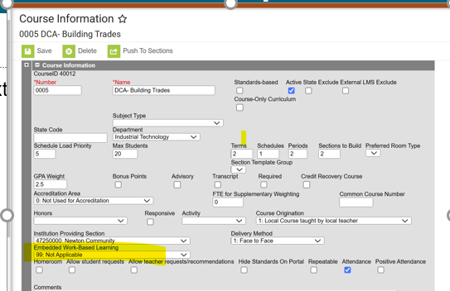
Embedded WBL – Infinite Campus
Search by Course/Section
Select Course
Course Information
Notes:
Rachel

Slide 45
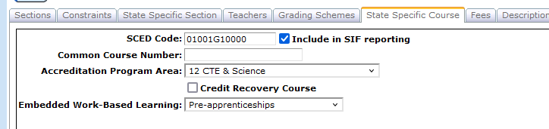
Embedded WBL - JMC
Schedules > Course > Edit Course Data
State Specific Course tab
Notes:
Rachel

Slide 46
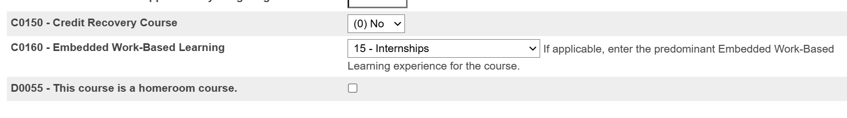
Embedded WBL - PowerSchool
School Management > Courses and Programs > Courses
  Under the Iowa State Report Information section
Notes:
Rachel

Slide 47
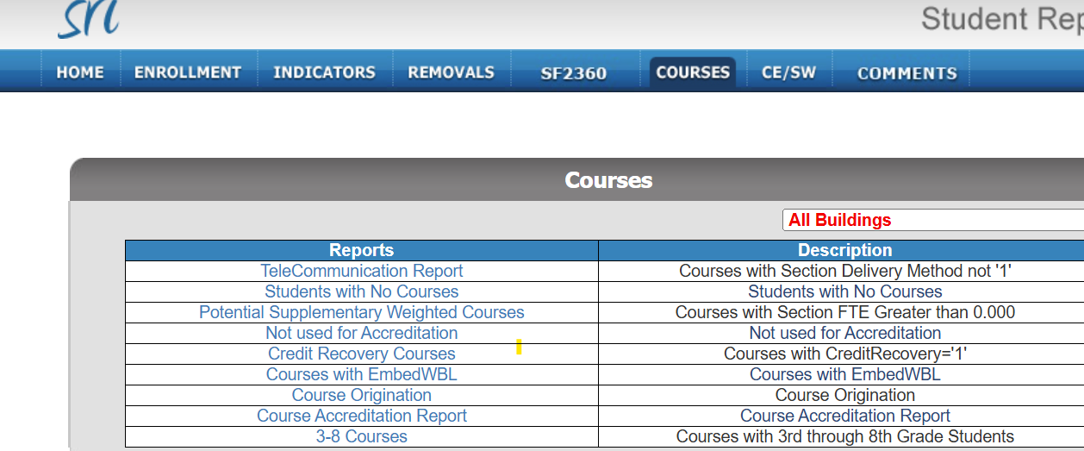
Report in Winter SRI Showing Courses with Embedded WBL
Notes:
Rachel

Slide 48
Stay in the Loop
Sign up for the following monthly newsletters to stay updated on important education news, trends and initiatives. Archived copies are also available on each site.
Work-Based Learning Coordinators
educate.iowa.gov/ccl
Superintendent & Education Leader Updates
educate.iowa.gov/pk-12/accreditation-program-approval/school-improvement/superintendent-education-leader-update
Notes:
Heather

Slide 49


Partner Spotlight: Iowa Workforce Development/Iowa Office of Apprenticeship
Our colleagues at Iowa Workforce Development have some great information and resources to consider at https://workforce.iowa.gov/opportunities/work-based-learning.
Schools and districts can fill out a WBL Interest Form to schedule a cross-agency meeting to review strategies and resources available to help with the planning, expansion, improvement or implementation of quality WBL programs or opportunities.
They also recently opened the Iowa Office of Apprenticeship with dedicated statewide teams that can help with pre-apprenticeship and apprenticeship program needs at https://workforce.iowa.gov/apprenticeship.
Notes:
Heather

Slide 50
Iowa Work-Based Learning Webinar Series
The Iowa Department of Education and Iowa Workforce Development are continuing a collaborative and informative series of webinars aimed at showcasing the many ways that Iowa schools and employers are building the workforce pipeline across our state. Special guests also include strategic partners like the Iowa Work-Based Learning Coordinators Association, Iowa Business Council and the Iowa Governor's STEM Advisory Council. Learn more, view previous session recordings and register for future sessions at https://workforce.iowa.gov/wbl-series.
Past Sessions:
10/01 - Work-Based Learning: Essential Tool for Preparing Students for Careers
10/21 - Jump-Start Careers: Apprenticeship, Pre-Apprenticeship and Industry-Recognized Credentials
11/19 - Iowa Business Council’s ‘Top Four' List of Professional Proficiencies
12/03 - Where to Find Funding and Other Resources for Work-Based Learning
Upcoming Sessions:
01/21 - A Deeper Dive into Starting and Expanding Work-Based Learning
02/11 - Using Labor Market Information to Drive Work-Based Learning Decisions
03/04 - Pre-Employment Transition Services (Pre-ETS) Work-Based Learning for Students with Disabilities
04/08 - Linking Perkins, CTSOs and Other Programs for Sustained Work-Based Learning
Notes:
Heather

Slide 51
Appendix – Compiled Resources

Slide 52
Individual Work Based Learning- How to code in SRI

Slide 53
Individual Work Based Learning
When a student completes a Work – Based learning experience that is not embedded in a course. Example = A student completed an internship over the summer working for the DNR that was not part of a course offering. These should be coded at the student level.
The first two digits represent the SCED Subject area of the experience and the last two digits represent the type of WBL experience.
The Student Reporting in Iowa 2025-26 Data Dictionary provides the list of codes on page 46.
    https://educate.iowa.gov/pk-12/data/data-collections/student-reporting

Slide 54
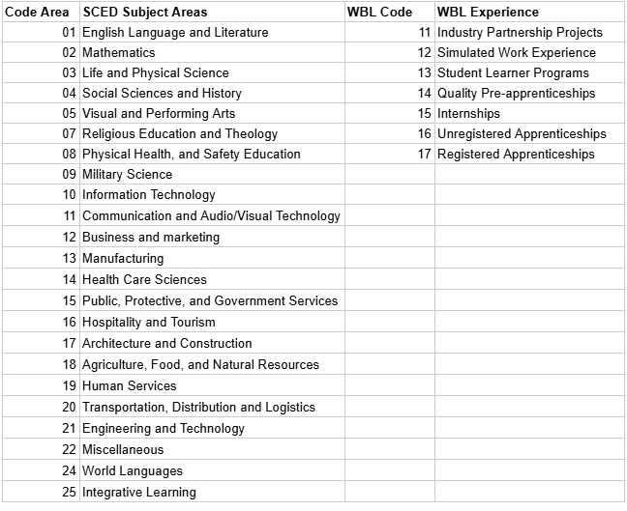
Individual Work Based Learning
4 digit code
A student participating in a summer marketing internship would be 12 for the SCED Subject Area and 15 for the WBL experience.

Slide 55
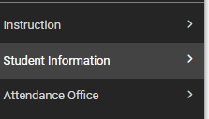
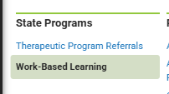
Coding a Student in your SIS
Infinite Campus
1. Search/pull up the Student First
  Then go to Student Information
    Scroll Down to State Programs
    And Select Work – Based Learning

Slide 56
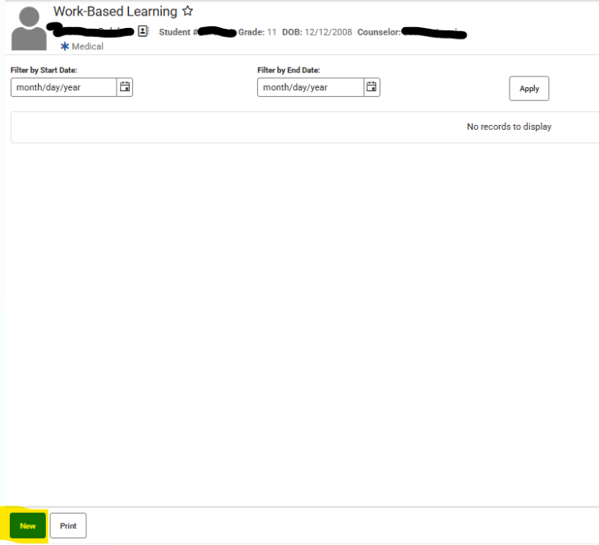
Infinite Campus Coding
Click New on the bottom left of the screen

Slide 57
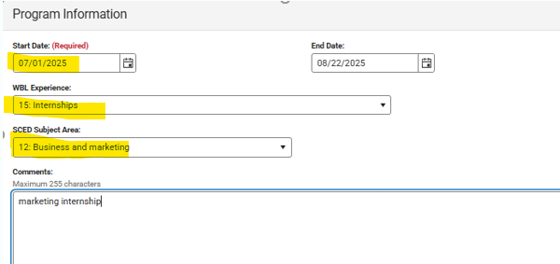
Infinite Campus Coding
Complete the fields on the Screen.
You do not have to put in a comment – but this is a good place to document where/what job/learning they performed.
Click Save in the bottom left hand corner!

Slide 58
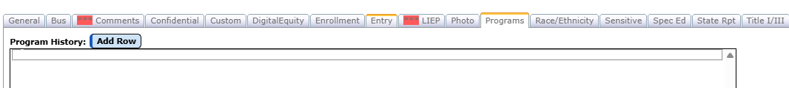

JMC Individual Based Learning
JMC
Find/ select your student
Click the Programs tab on that student
Click Add Row
Click Edit

Slide 59
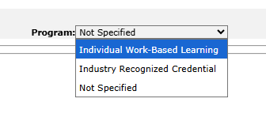
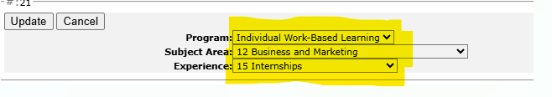


JMC Individual Based Learning
Select Individual Based Learning in your Program drop down
Select the Subject Area and Experience in each of the drop downs
Click UPDATE
****Click UPDATE before Save!!
Then Click Save

Slide 60
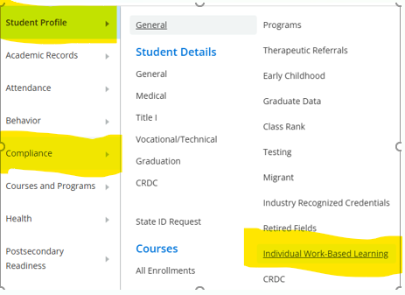
Power School Individual Based Learning
Work-Based Learning Tab under Student>Compliance with SCED Subject Areas and WBL Experience drop downs
Search for your Student- Click Compliance- Individual Work Based Learning

Slide 61
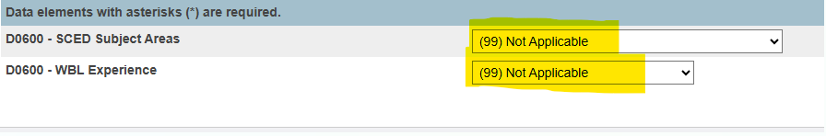
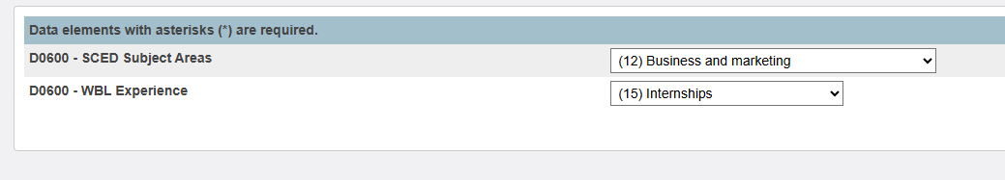
PowerSchool
Then complete the two areas for the IWBL- each has a drop down to choose:
A business or marketing intern- would be coded this way:
And then click SUBMIT on the right hand side.

Slide 62
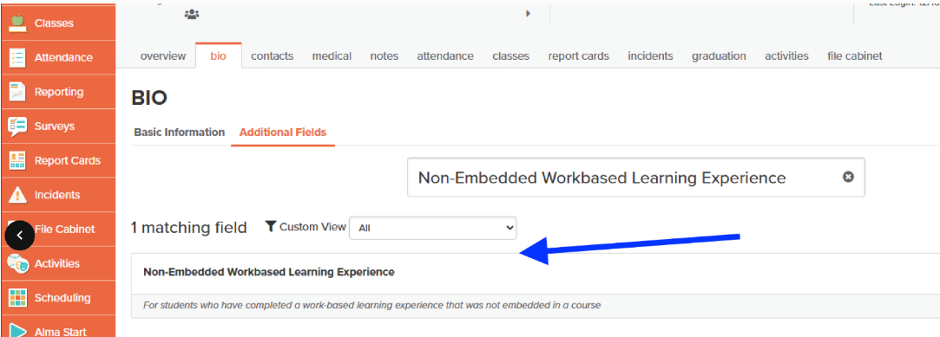
ALMA coding
IndWBL- Student > Bio > Additional Fields > Non-Embedded Workbased Learning Experience

Slide 63
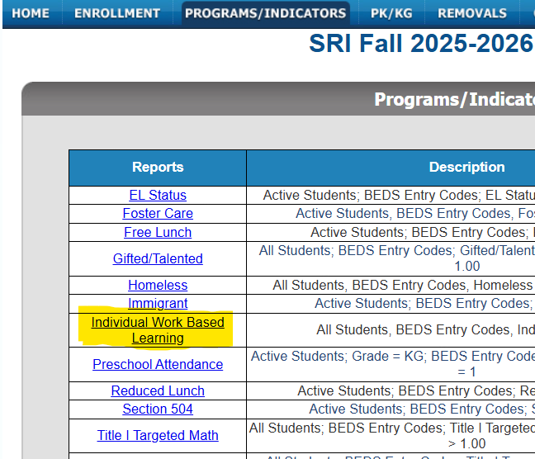
Reporting In SRI
Students coded for Individual Work Based Learning in their Student Information System will show here in SRI:
Edportal- EdInfo- Student Level Applications- Student Reporting Iowa
  Programs/Indicators
  Click the Wording ‘Individual Work Based Learning’ to see the students coded

