Slide 1
Discipline, Behavior and Manifestation Determinations
Iowa Students with Disabilities Parentally Placed in Accredited Nonpublic Schools

Slide 2
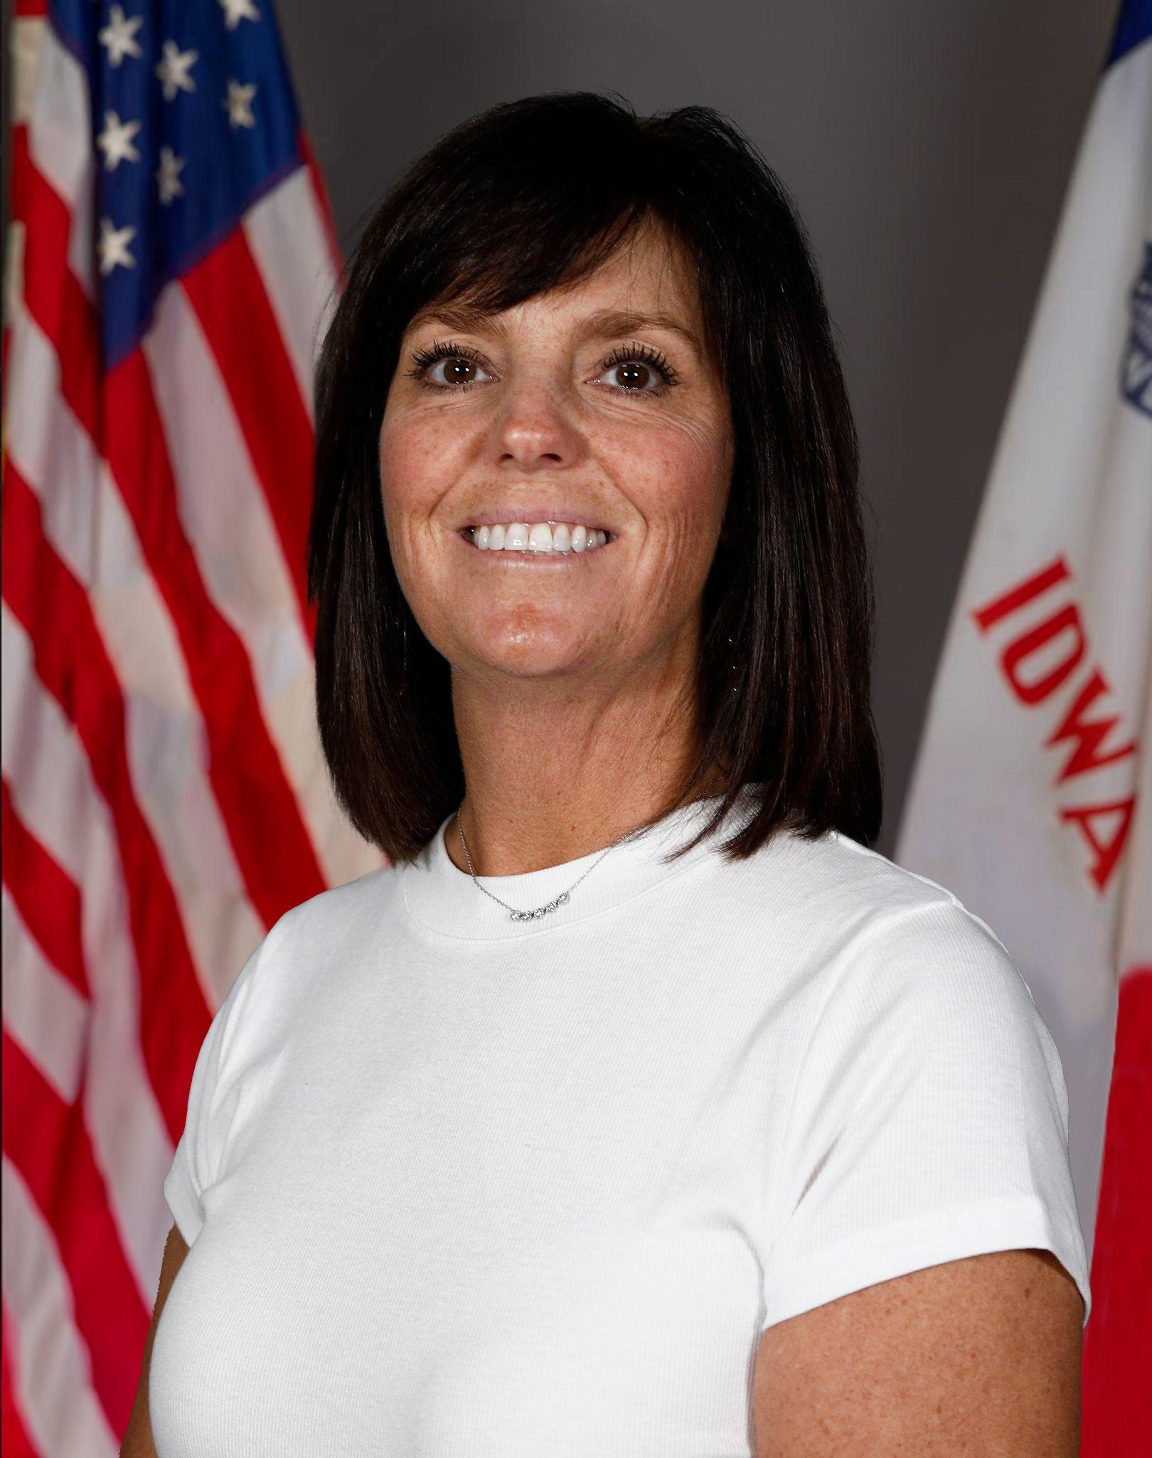
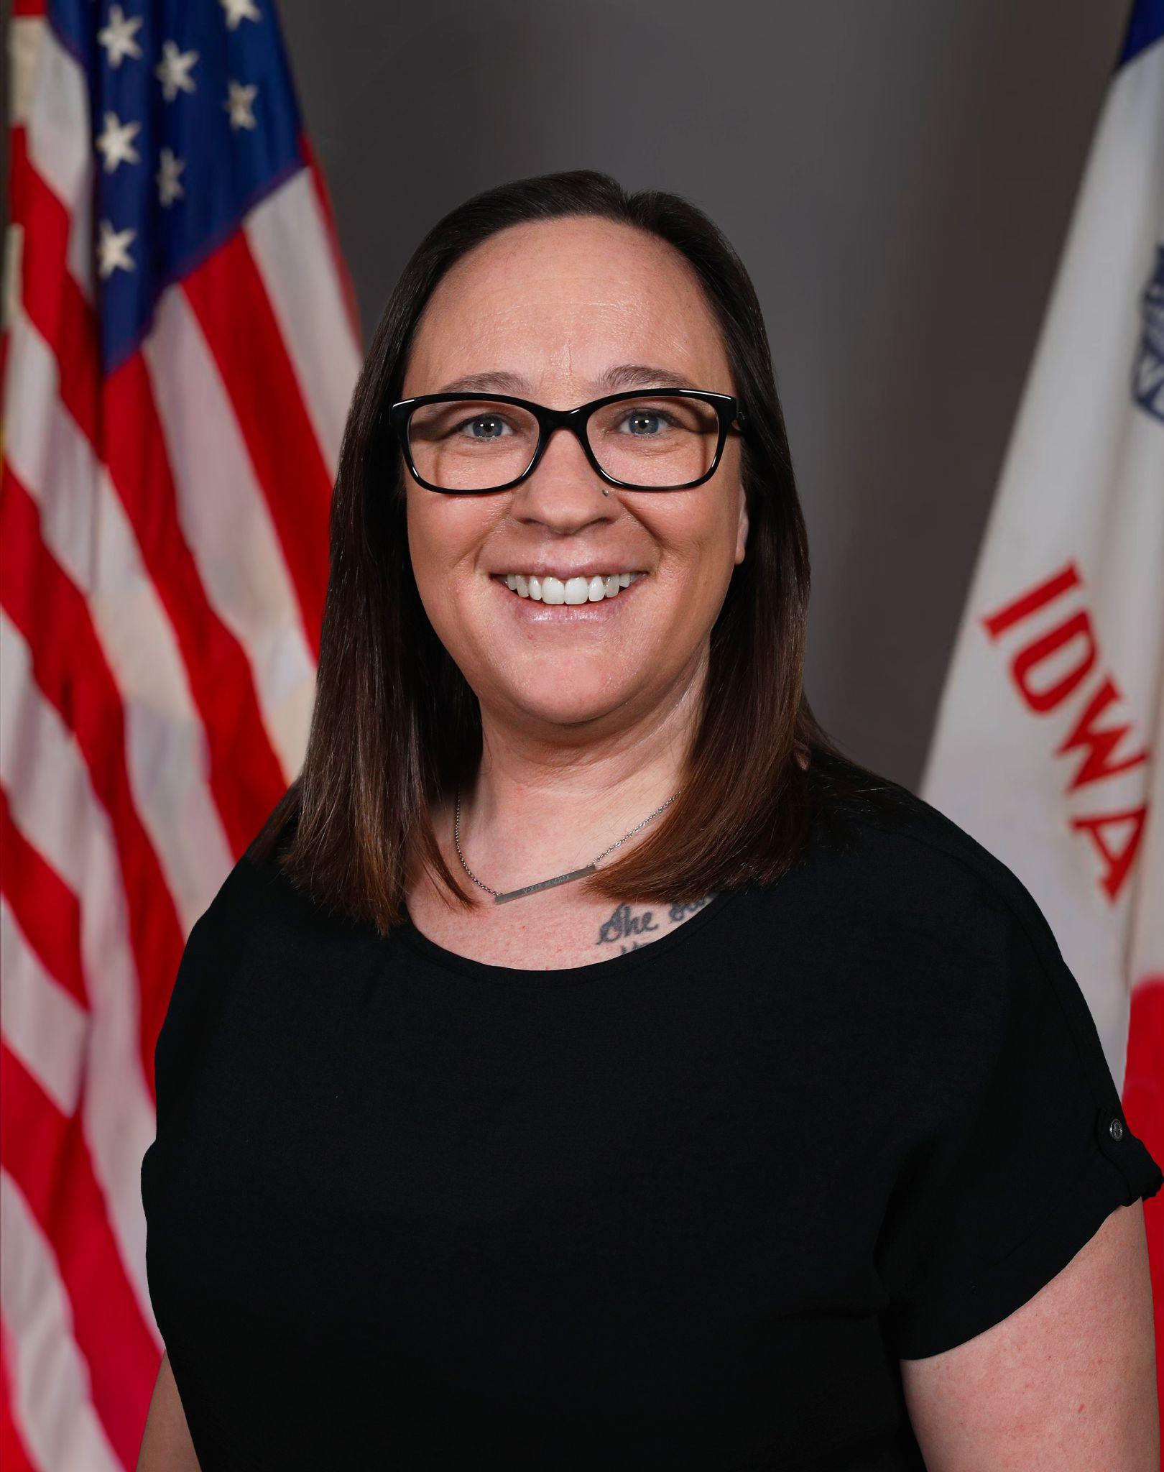
Today’s Presenters
Janelle Danner
Nonpublic School Liaison
Rose Cartee
EPC: Behavior and Autism

Slide 3
Overview of Today’s Content
Understanding behavior as part of learning
When behavior becomes a special education consideration
Functional Behavior Assessments (FBA)
Behavior Intervention Plans (BIP)
Roles of public school and accredited nonpublic school
Removals and access to instruction
Manifestation determination and student rights
Communication and partnership

Slide 4
Understanding Behavior
Behavior is:
  functional
  a form of communication
  reflects a need or skill gap
Understanding behavior starts with asking “why”
Focus on what the student is trying to communicate

Slide 5
Behavior as Part of Learning
Students may need instruction in:
Self-regulation
Communication
Problem-solving
Support includes:
Before, preparation
During, coaching
After, reflection

Slide 6
Behavior, Instruction and Adult Response
Adults play a key role by:
Identifying patterns and possible triggers
Identifying skill gaps and providing instruction
Adjusting responses to support positive behavior
Monitoring and documenting:
  When and where behavior occurs
  What happens before and after
  Adult responses
  Outcomes over time

Slide 7
Child Find- Behavior Related to a Disability
Child Find may be triggered when:
Behavior concerns continue despite supports
A student requires unusually intensive support to function successfully
Concerns substantially interfere with educational access or progress
There is other information that might suggest a disability
Concerns should be supported with data, including:
Any interventions attempted and student response
Frequency, intensity, duration, and impact of behaviors

Slide 8
Behavior Related to a Disability (IEP Special Factors)
IEP teams consider behavior as a Special Factor
Interferes with learning
Results in loss of access to other opportunities
Results in loss of instructional time for the student or others
Creates safety concerns for the student or others
Occurs across settings or routines
Continues despite documented, data-informed interventions
Reflects the impact of extenuating life circumstances
When reviewing Special Factors, teams consider:
Impact on learning and participation
Connection to the student’s disability
Need for specialized instruction, supports, or services

Slide 9
FBA - Functional Behavior Assessment

Slide 10
Functional Behavior Assessment (FBA)
A process used to understand the whole student
Looks across settings to identify patterns in:
  When and where challenging and successful behaviors occur
  What happens before and after behavior
  Differences across environments, tasks, and people
Considers influences beyond the classroom
Uses input from multiple perspectives to build a complete picture
Determines the function (why the behavior is happening)
  Avoiding work, getting attention, access to preferred item or activity, sensory needs

Slide 11
The FBA Process
Clearly defines behaviors in observable, measurable terms
Includes examples, non-examples, and patterns over time
Gathers information through:
  Review of existing data
  Interviews with key individuals
  Observations across settings
  Additional assessment or testing as needed
Led by trained public school or AEA personnel
Uses data to identify patterns and contributing factors

Slide 12
Accredited Nonpublic School Role
Provides daily insight into student behavior across the school day
Contributes observations of both challenging and successful behaviors
Documents patterns, triggers, and responses through consistent data collection
Shares information about routines, instruction, and environmental factors
Participates in collaborative discussions to build a complete understanding of the student

Slide 13
BIP - Behavior Intervention Plan

Slide 14
Behavior Intervention Plan (BIP)
A plan developed from FBA information or other relevant sources to support student behavior
Identifies target behaviors and replacement skills to be taught
Outlines strategies to prevent, teach, and respond to behavior
Includes supports and interventions used consistently across settings
Guides how adults respond to help reduce challenging behavior and build positive skills
Designed to be carried out collaboratively as part of the IEP

Slide 15
Developing a BIP
Developed by the IEP team, including family participation
Based on FBA results, if one has been completed
Aligned to the function of behavior
Identifies replacement behaviors that serve the same purpose as the targeted behavior
Includes prevention, teaching, and response strategies
May include safety or reintegration planning if needed
Establishes goals and how progress and implementation will be monitored

Slide 16
Partnership in BIP Implementation
The BIP is implemented through shared commitment within the IEP team
Clear understanding of roles across all settings is essential for consistency
Implementation depends on staff being prepared, supported, and confident in using strategies
Ongoing collaboration supports consistent and effective implementation
Focus remains on consistency, communication, and student success across the school day

Slide 17
Discipline

Slide 18
Key Discipline Terms for Students with IEPs
Removal: Any time a student is not able to participate in their usual learning setting due to behavior, including partial day changes or being separated from peers
Suspension: Removal from school due to behavior, regardless of the label used
Manifestation Determination: Required team meeting when removals constitute a pattern or reach legal thresholds
Change in Enrollment/Placement: Ending enrollment or transferring the student to another setting requires coordination

Slide 19
Removals from the Educational Setting (Behavior-Based)
Removals include any time a student is removed from regular instruction due to behavior
Includes both formal and informal removals, such as:
  In-school suspension (ISS) or out-of-school suspension (OSS)
  Sent to the office or another supervised location
  Removed to a resource room, special education room, or alternate space
  Exclusion from class activities, transitions, or portions of the school day
Removals must be tracked when they result from behavior
Patterns of removal may impact educational access and trigger required team decisions

Slide 20
IEP Written Behavior Supports
IEP-implemented supports are not considered disciplinary removals
Examples may include planned:
Breaks or sensory time
De-escalation space
Brief removal with staff support
Supports must be:
Included in the IEP
Used as intended by the team
Monitor:
Time away from instruction
Impact on access to learning

Slide 21
Manifestation Determinations
Required when disciplinary removals reach legal thresholds (e.g., 10-day rule, patterns)
Determines whether behavior is a result of the student’s disability
Conducted by the IEP team using current data and information
Ensures students with disabilities receive appropriate protections under IDEA
Guides next steps in discipline and continued provision of services

Slide 22
Special Circumstances
Carries/possesses a weapon
Possesses, uses, sells or solicits the sale of a controlled substance or illegal drugs (Alcohol and tobacco violations of a school’s code of conduct are not “special circumstances.”)
Inflicted serious bodily injury upon another person

Slide 23
Accredited Nonpublic School Role in MD
Provides timely, detailed information about removals and behavior incidents
Commits to consistent communication so the public school can make timely decisions within required processes
Shares how supports, including the BIP, are being implemented in daily practice
Participates in IEP team discussions as a collaborative partner

Slide 24
Partnership in Practice
Shared commitment to supporting the student across the full school day
Clearly defined roles supported by ongoing collaboration
Established communication systems that are consistent and reliable
Proactive planning and problem-solving, not just reactive responses
Mutual participation in implementing and supporting IEPs and BIPs

Slide 25
Wrap Up

Slide 26
Bringing It All Together
Behavior is communication and can be taught and supported
Data, not assumptions, drives decisions
Some behaviors may be linked to a disability and require specialized support
FBAs and BIPs provide structure for understanding and intervention
Removals and discipline processes carry additional protections
Partnership, communication, and commitment support consistent implementation

Slide 27
Q&A
A FAQ document will be posted on the website soon

Slide 28
DEPARTMENT OF EDUCATION
SPECIAL EDUCATION
ACCREDITED NONPUBLIC SCHOOLS
Accredited Nonpublic Schools and Special Education

Slide 29
Thank You
Janelle.Danner@iowa.gov

Slide 30
Thank You!!

Slide 31
Resources and References
DOE
Special Education Parent Information (DOE)
Policy and Practice Webinar- Behavior and Discipline in Special Education Webinar (DOE)
Designing Behavior Instruction and Supports for Learners with Disabilities Webinar (DOE)
Iowa IDEA Information (i3)
Iowa IDEA Information, Social Emotional Behavior in an IEP
Iowa IDEA Information, Discipline in an IEP
Iowa IDEA Information Special Education Discipline: Step-by-Step Guide to Suspension/Expulsion
Iowa IDEA Information What is the Family's Role in the FBA?
Iowa IDEA Information Frequently Asked Questions
ASK Resource Center
Behavior Intervention Plan (BIP) Guide and Checklist
Behavior Intervention Plan Guide
Functional Behavior Assessment (FBA) Guide and Checklist
The ABC's of Challenging Behavior

