Slide 1

Webinar Series
Dispute Resolution

Slide 2

Welcome
Please post your questions in the Q&A
Slides will be posted on the DE website after the webinar
Policy & Practice Webinar Series & Recordings | Department of Education

Slide 3
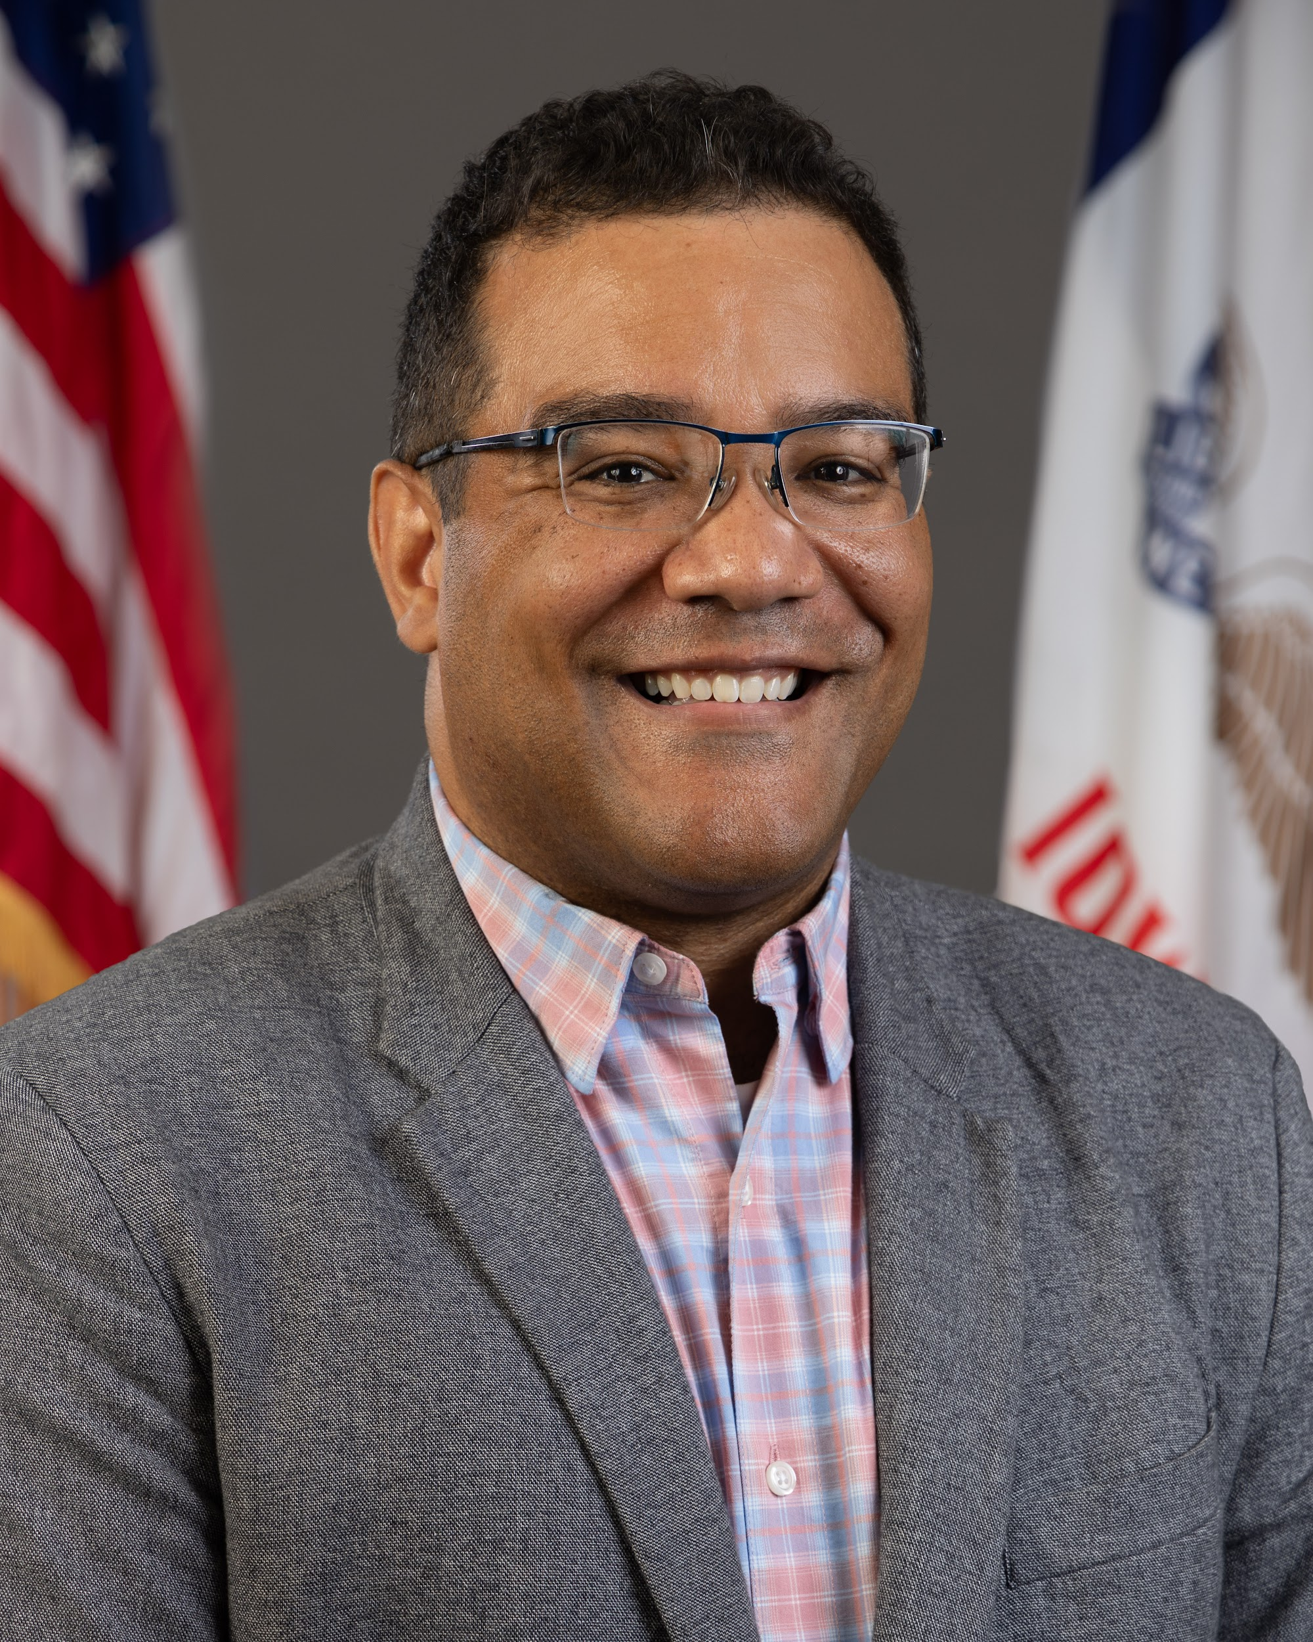
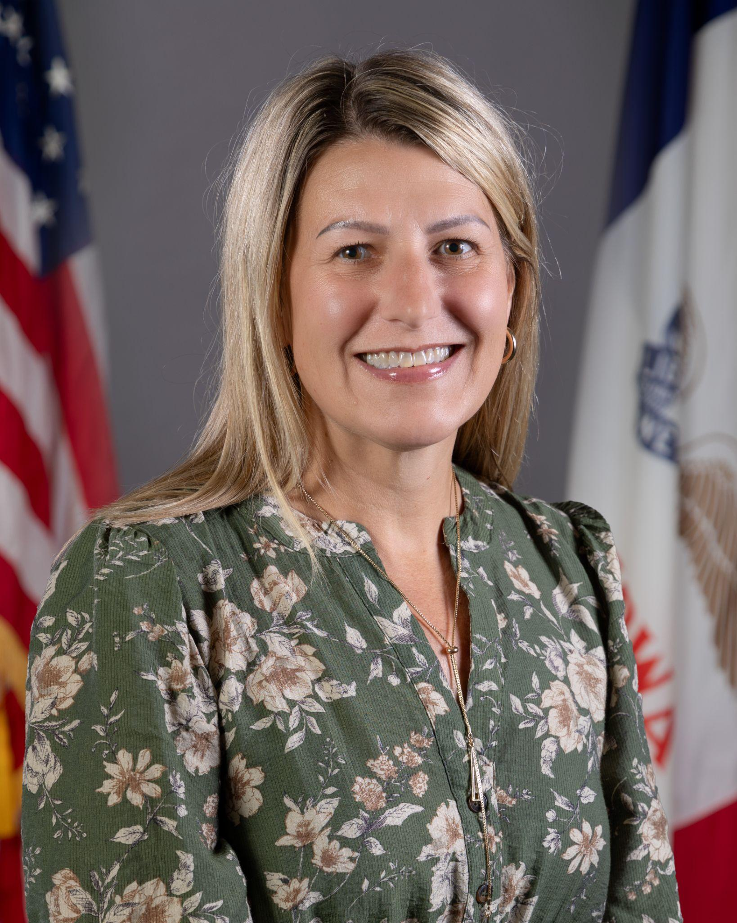
Today’s Presenters
Name: Ivan Gentry
Title: Regional Special Education Director
(Green Hills AEA Region)
Division of Special Education
Name: Jennifer Cira
Title: Dispute Resolution Coordinator
Division of Special Education

Slide 4
Participants will understand:
Key features of the dispute resolution processes of mediation, state complaints and due process
Timelines and learner placement during each process
Current trends and themes in dispute resolution
Systematic preventative practices that reduce the likelihood of dispute resolution

Slide 5
Policy

Slide 6
Iowa Administrative Code: Procedural Safeguards
Iowa Administrative Code chapter 281-41.504 - Procedural Safeguards
Contents. The procedural safeguards notice must include a full explanation of all the procedural safeguards available under this chapter relating to the following:
  opportunity to present and resolve complaints through the due process complaint and state complaint procedures, and must explain:
the time period in which to file a complaint;
the opportunity for the agency to resolve the complaint; and
the difference between the due process complaint and the state complaint procedures, including the jurisdiction of each procedure, what issues may be raised, filing and decisional timelines, and relevant procedures
f) the availability of mediation;
g) the child’s placement during the pendency of any due process complaint;
j) hearing on due process complaints, including requirements for disclosure of evaluation results and recommendations

Slide 7
IDEA Dispute Resolution
State Mediation
State Complaint
Due Process
Mediation is a meeting where parents and schools agree to have a neutral, trained state mediator help resolve disagreements about the education of a learner with a disability.
A state complaint is a formal request to the Iowa Department of Education to investigate potential violations of the Individuals with Disabilities Education Act (IDEA).
A due process hearing is a legal process before an administrative law judge to resolve a dispute about the identification, evaluation and placement of a learner or the provision of a free appropriate public education (FAPE).

Slide 8
Iowa Administrative Code: Mediation
Iowa Administrative Code chapter 281-41.506 - Mediation
General. Each public agency must ensure that procedures are established and implemented to allow parties involved in disputes relating to any matter under this chapter, including matters arising to the filing of a due process complaint, to resolve disputes through a mediation process.

Slide 9
State Mediation: Iowa Administrative Code chapter 281 - 41.506(2)
Main Features:
Voluntary and confidential process
Intended to resolve disagreements in the early stages
Impartial mediator to facilitate the meeting, provided by the DE
If the disagreement is resolved, a legally binding agreement is written
Learner Placement: Stay Put
Initiated by: Parent or LEA/Public Agency
Decision Makers: Parents and LEA/Public Agency
Timelines:
IDEA does not provide specific timeline for mediation process, but (1) it may not be used to delay or deny rights and (2) the mediation must be scheduled at a time and location convenient to parties
Upon receipt of a request for mediation, DE contacts all parties to determine whether participation is desired

Slide 10
Iowa Administrative Code chapter: State Complaint
Iowa Administrative Code chapter 281-41.153 - Filing a complaint.
Complainant. An organization or individual may file a signed written complaint under the procedures described in rules 281-41.151(256B,34CFR300) and 281-41.152(256B,34CFR300).
Contents of complaint. The complaint must include the following:
  A statement that a public agency has violated a requirement under Part B of the Act or of this chapter;
  The facts on which the statement is based;
  The signature and contact information for the complainant; and
  If alleging violation with respect to a specific child:
    The name and address of the residence of the child;
    The name of the school the child is attending;
    In the case of a homeless child or youth within the meaning of Section 725(2) of the McKinney-Vento Homeless Assistance Act, 42 U.S.C. 11434a(2), available contact information for the child, and the name of the school the child is attending;
    A description of the nature of the problem of the child, including facts relating to the problem; and
    A proposed resolution of the problem to the extent known and available to the party at the time the complaint is filed.

Slide 11
Iowa Administrative Code: State Complaint
Iowa Administrative Code chapter 281-41.153 - Filing a complaint.
Complainant must provide a copy of complaint to AEA and LEA. The party filing the complaint must forward a copy of the complaint to the AEA and LEA or public agency serving the child at the same time the party files the complaint with the state.
Failure to comply with due process hearing decision, mediation agreement, resolution meeting agreement. A complainant may allege a public agency has failed to comply with a due process hearing decision, a mediation agreement, or a resolution meeting agreement. If the complaint is sustained, the state will grant appropriate relief.

Slide 12
State Complaint: Iowa Administrative Code chapter 281 - 41.152
Main Features:
Investigated by a state complaint investigator
No Violation Found = Complaint Closed
Violation Found = Required corrective action for the LEA/AEA
Learner Placement: No Right to Stay Put
Different from due process as it covers alleged violations of ANY required of IDEA or chapter 41
Initiated by: Any Individual or Organization - not anonymously
Timelines:
Restricted to alleged violations within one year of filing
Investigator has 60 days from filing to issue a decision
District has 15 days to respond to the allegations
Decision Makers: State Complaint Investigator

Slide 13
State Complaint Trends
Year | Number of Complaints
2023-2024 | 29
2024-2025 | 36
2025-2026 | 91*
*as of May 2026

Slide 14
Iowa Administrative Code:
Due Process
Iowa Administrative Code chapter 281-41.507 - Filing a due process complaint.
General.
  Subject matter of due process complaint. A parent or public agency may file a due process complaint on any of the matters described in subrule 41.503(1) relating to the identification, evaluation, or educational placement of a child with a disability, or the provision of FAPE to the child.
  The due process complaint must allege a violation that occurred not more than two years before the date the parent or public agency knew or should have known about the alleged action that forms the basis of the due process complaint.

Slide 15
Due Process
Main Features:
Formal hearing before Administrative Law Judge (ALJ)
Attorneys often involved
No violations found = case is closed
Violations found = decision will include required corrective action for the School/Public Agency
Required resolution meeting
Learner Placement: Stay Put
Initiated by: Parent or LEA/Public Agency
Timelines:
Birth to 3:
  No restrictions when a party can file due process
  ALJ must issue a decision within 30 days
Ages 3-21:
  Restricted to alleged violations within two years of filing
  30 day resolution period followed by ALJ decision within 45 days
Decision Makers: ALJ

Slide 16

Common Dispute Resolution Themes
Meaningful parent participation
Delay in evaluation or Failure to evaluate
Failure to implement IEP as written
Failure to provide Free Appropriate Public Education (FAPE)
Failure to consider and/or provide Assistive Technology (AT) and Accessible Educational Materials (AEM)
Lack of reasonably calculated IEP Goals
Secondary Transition
Documentation (Prior Written Notice)
Removals/Shortened school day/Disciplinary actions

Slide 17
Practice

Slide 18

Common Reasons for Disagreements
Evaluation
Eligibility
Placement
Provisions of FAPE

Slide 19

Difference in Opinions
Resolve differing opinions with ongoing communication among all IEP team members.
No Consensus:
Consulting with other professionals, including AEA and LEA administrators
Utilizing a facilitator in meetings when disagreements are anticipated
Adjourning meeting to reconvene later with a facilitator
Adjourning meeting to reconvene later with additional information and other approaches

Slide 20

Meaningful Parent Participation
What is it?
Families are active, informed, and equal members of the IEP team, not just present, but engaged in decision-making.
What should it look like?
Families understand data points, options and implications
Two-way dialogue (not one-way reporting)
Interpretation/Translation provided, when needed
Informed consent is truly informed
Meetings reflect family priorities and concerns

Slide 21
Meaningful Parent Participation
Notify parents early enough to ensure they have the opportunity to attend
Schedule the meeting at a mutually agreed-upon time and place.
Document sufficient attempts to ensure parent participation
Provide communication and documentation in parent’s native language and provide Interpreters
  Procedural Safeguards Manual
  Prior Written Notice
  Consent

Slide 22
Meaningful Parent Participation: Common Breakdowns
“Clarity, transparency and shared understanding are the foundation of
meaningful participation.”
Common Breakdown Points
Procedural safeguards given, but not explained or not provided in native language
Jargon and acronym-heavy language
Decisions appear pre-determined
Lack of follow-up, follow through or clarity after meetings

Slide 23
Proactive Strategies for Meaningful Parent Participation
Send draft IEPs/data summaries in advance
  Communicate that the documentation being sent home is a draft and changes can and will be made (as a team) during the IEP meeting
Use plain language + visuals during meetings
Ask diagnostic questions:
  “What are your biggest concerns right now?”
  “What would success look like for your child?”
Build in pause points for questions and clarification
Provide a brief post-meeting summary of decisions, next steps and the implementation date on the Prior Written Notice

Slide 24
Timelines & Evaluations
What is the Issue?
Delays in responding to concerns
Missed evaluation timelines
Failure to initiate evaluation when warranted
Why This Matters
Violates procedural safeguards under IDEA
Often generate formal complaints

Slide 25
Timelines and Evaluation
What It Should Look Like
Proactive Strategies
Immediate response when concerns are raised
Clear documentation of decisions
Timelines consistently monitored and met
Staff clarity around parent concerns RE: Disability Suspect & Child Find requests + Prior Written Notice
Establish internal tracking systems for evaluation timelines
Use clear decision protocols (evaluate vs. not evaluate)
Communicate decisions promptly with families
If declining evaluation → provide clear rationale + data + documentation
Watch-Fors: silence or delay can often result in escalation

Slide 26

IEP Implementation +
FAPE
Key Issues:
Failure to implement IEP as written
Services not delivered (minutes, frequency, setting)
IEP not designed for appropriately ambitious progress
Failure to provide a Free Appropriate Public Education
What is a Free Appropriate Public Education?
Free Appropriate Public Education = services reasonably calculated to enable appropriate progress in light of the child’s circumstances

Slide 27
IEP Implementation + FAPE
What It Should Look Like?
Proactive Strategies
Services delivered as documented
Staff understand their responsibilities
Progress is monitored and communicated
Regular fidelity checks (minutes being delivered, services provided as described)
Internal staff communication systems
Progress monitoring directly tied to IEP goals
Adjust IEP when progress not sufficient
Most Free Appropriate Public Education (FAPE) disputes stem from
implementation gaps, not intent.

Slide 28

Documentation
A Prior Written Notice:
A required written explanation whenever a member of the IEP team proposes OR refuses an action related to identification, evaluation, placement, or services.
Provides information on what actions the LEA/AEA is proposing/refusing
Must be given to parents after the IEP decision and prior to the implementation of the proposed/refused action
Allows parents time to respond to the changes
Prior written notice must be written in language understandable to the general public and provided in the parent's native language or another mode of communication unless clearly not feasible.

Slide 29
Prior Written Notice
Common Issues
Why This Matters
Missing Prior Written Notice
Vague or incomplete explanations
Failure to document refusal decisions
Prior Written Notice does not clearly articulate the implementation date
The Prior Written Notice is the bridge between decision-making and parent rights
Enables families to access dispute resolution options
Prior Written Notice is an agency document
A prior written notice builds trust, ensuring clarity and protecting both school and family through clear, thorough communication.

Slide 30
Prior Written Notice: Proactive Strategies
A strong PWN should:
Proactive Strategies
Clearly explain
What was proposed/refused
Why
What data was used
What options were considered and rejected
Treat the Prior Written Notice as a communication tool, not compliance paperwork
Align meeting discussed directly to PWN language
Provide PWN promptly after decisions
Strong documentation reduces misunderstandings and protects both families and districts.

Slide 31
Secondary Transition
Results-oriented process focusing on improving the academic and functional achievement to assist the individual’s movement from school to post-school living, learning and working environments.
Effective Planning:
Ongoing process starting no later than age 14
Based on data
Postsecondary expectations
Transition assessment information
Strengths, interests and preferences
Secondary Transition Includes:
Specially designed instruction
Related services
Community experiences
Development of employment and other post-school adult living objectives
If appropriate, acquisition of daily living skills and functional vocational evaluation

Slide 32

Secondary Transition:
Strengthening Practices
Start early & make it meaningful
Utilize multiple assessments to determine student interests, strengths and abilities
Ensure student and parent participation
Use data to guide course of study, courses, and activities and supports
Develop learning targets to address essential skills needed for Post Secondary Expectations

Slide 33
“The power of the group to produce results is rooted in the quality of the relationship among participants.”
Robert Garmston and Bruce Wellman

Slide 34
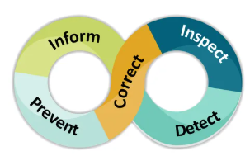
Systematic Considerations
Timely walkthroughs or observations
Establish timelines for when IEPs are due
Attend and actively participate in IEP meetings,
  sharing strengths and concerns
Listen to understand, not to respond
Communicate clearly and effectively
  utilize translators when appropriate
Consider multiple solutions to the concerns and collectively decide which option is best
Document options discussed and parents wishes thoroughly
Most disputes are not about intent, they are about…
Communication, Timelines and Clarity of Decisions

Slide 35
Summary
Across all themes:
Meaningful parent participation
Timely evaluations
IEP implementation
FAPE
Prior Written Notice
CLARITY, COMMUNICATION & DOCUMENTATION
Clarity, communication and documentation significantly reduce state complaints, mediation and due process filings

Slide 36

Resource

Slide 37

Resource

Slide 38
Future Policy and Practice Webinars
Upcoming Topic and Date (8:30 am - 9:30 am )
June 10, 2026: End of Year Program Evaluation (ACHIEVE) and Year-to-Year Data Comparison

Slide 39

Please Complete the Survey
Please take a moment to complete the
Special Education Policy and Practice Webinar Series Survey.
Your feedback is appreciated.
The survey links will be provided in Chat. It will also be available on the DE’s Special Education Policy and Practice webpage until 5/29/26.

Slide 40
Thank You!

