Slide 1
Agenda
2026-2027 Perkins V Application Walkthrough for Grant Recipients
Wednesday, May 6, 2026 @ 2:00 PM
The application deadline is June 30, 2026 @ 11:59:59 PM.
Amy (email) - FY 2027 Budget Prior Approval for Upload into FY27 Perkins Application
Completing the FY27 Perkins Application Forms in IowaGrants
Required no more, win! – Cover sheet: General Information (Secondary/Postsecondary)
Cover page - Perkins Basic (Secondary/Postsecondary)
    Must include Business Manager Contact Information
Consortium Members (Secondary only)
(Amy V.) Perkins V Budget Form (Secondary/Postsecondary) - Upload approved budget template; simply enter ($) amounts by budget line by Perkins Activity
Spring ‘26/CLNA4 Outcomes Form (9 Questions)
Minority Impact Statement (2008 Iowa Acts, HF 2393, Iowa Code Section 8.11)
Assurances/Agreements (Secondary/Postsecondary)
Notes:
ADD SLIDES FOR CONTENT AND SCREENSHOTS DIRECTLY FROM GUIDEBOOK.

Slide 2
FY27 Perkins Local Application Resources
Perkins Local Application Technical Assistance
The FY27 Perkins V Secondary and Postsecondary applications are posted in funding opportunities in the IowaGrants system.
FY27 - Perkins V Secondary Application (CLNA4 - Spring 2026)
FY27 - Perkins V - Postsecondary Application (CLNA4 - Spring 2026)
The following guidance, memos, and videos provide more information and assistance with completing the application.
FY27 Perkins Grant Application and Claim Submission Instructions (Will be posted to website ASAP)
FY27 IowaGrants Application Webinar PPT (Will be posted to website ASAP)
Memos
Consortium Requirements for Distribution of Perkins Funds to Secondary Education
Videos
FY27 Perkins V Application Recording (will be posted to website asap)

Slide 3
Notes
PLEASE update contact information in the FY27 application that will be in effect for the 2026 - 2027 academic year (I.e., Effective 7/1/2026).
Consortium member Superintendents, HIgh School Principals, CTE contacts, etc.
Secondary / Postsecondary fiscal agents / business officers, etc.
Secondary / Postsecondary additional contacts (See handbook page #3)
Perkins Application Budget: Webinar Template (Approved Budget is renamed with “G” number, e.g., G-PER 27-101 Keystone).
Perkins Activities: Sum the totals (of each budget code i.e., purchased services, equipment, supplies, travel) within each activity
Enter activity totals in each line items Iowa Grants
Budget Approval - Email for approval if submitted more than five business days with no update.
Budget Highlights:
Industry Recognized Credentials (IRCs)
FBLA - Two claims (Airfare and registration FY 2026). All other expenses claimed in the fiscal year in which the activity took place.
FCCLA - Two claims (Airfare and registration F 2026) All other expenses claimed in FY 2027.
Assessments and Credentials are Perkins eligible for students (if not funded by a non-federal source in the prior fiscal year).
Marketable credentials for educators are ineligible and supplant prior non-Federal funding sources, remove federal funding from school districts when a taxpayer funded and credentialed instructor leaves the district, and create a condition whereby a credentialed instructor is able to personally benefit by charging and receiving compensation for credentialing students/customers beyond/outside of the classroom.

Slide 4
FY 2027 Budget
Delayed OCTAE Allocations - Complete updates prior to finishing the Perkins Application
OCTAE Memo : April 2, 2026 release (FY27)
Budget Prior approval confirmation (Contact Amy if you haven’t received the approval email)
Update the 2027 allocation amount after the webinar today.
Adjust Budget line items to the updated allocation
Sort the Budget Template by the “Perkins Activities” column.
Enter totals into the Iowa Grants Budget Form
Note: You are not required to spend Perkins funding in every Perkins Activity. Many non-Federal funding sources are already spent in every Perkins category including state, local grant funding, student activities funds, facilities funding, district, etc.).
Perkins Activity | Perkins Activity Description | Activity Amount
Activity One | Career | $0
Activity Two | Professional Development | $5,364.00
Activity Four | Academic Integration | $0
Activity Five | CTE Implementation | $11,954.71
Activity Six | Evaluation | $450.00
CTSO | CTSO | $1,975.00
Admin | Admin | $1,013.85
 | Total | $20,757.56

Slide 5
FY27 Perkins V Grant Application Handbook Walkthrough
This document provides general directions for submission of the FY27 Perkins Grant Application (secondary and postsecondary); it does not provide detailed instructions for each section of the application. Although these directions apply to secondary and postsecondary applications, many of the screenshot examples are from the secondary application. The postsecondary screens will look very similar.
IowaGrants is the state’s enterprise online grant management tool. The platform manages and streamlines the grant process including application submission, review, scoring and awards, and claim submission and approval, report scheduling and approval, and maintains a historical record of grant activity.
All individuals using the iowagrants.gov system must be registered.
IowaGrants Login Instructions - first time and returning users
Watch a video with detailed instructions for logging into the IowaGrants platform.
External User Guide for New IowaGrants Platform
IowaGrants Management Resources from the Iowa Department of Management
Designate one person to create the application in www.IowaGrants.gov­­- known as the “primary grantee contact” regardless of whether you are applying as a standalone district, Perkins consortium, or community college.
Once the application has been started, the “registered applicant” can add “additional contacts” in the “General Information” screen (see page 4).
All individuals tied to an application have access to all portions of the application.
Once all edits and new information have been entered into a form, make sure to click the “Mark as Complete” link. Note: Even though a form has been marked as complete, it can continue to be edited until the application is officially “submitted.”
Once the information for any form has been updated and/or completed, 1st click “Save Form” and then 2nd click “Mark as Complete.”

Slide 6
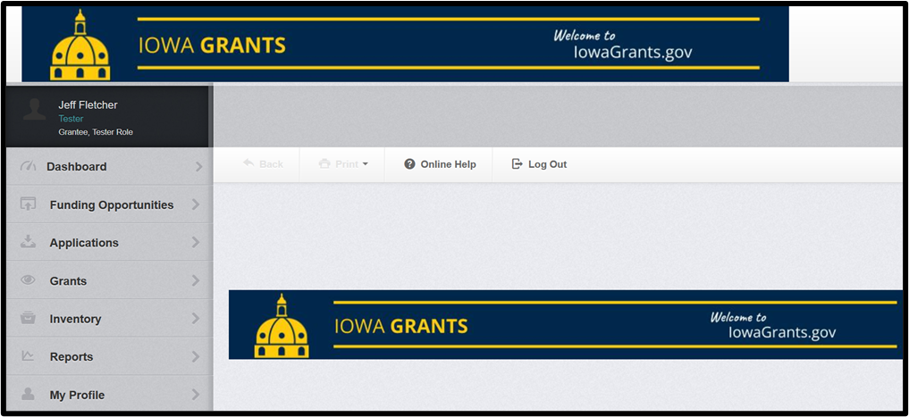
Navigating to Perkins Funding Opportunity
Follow the Iowa Grants Login Instructions for returning users.
Click “Funding Opportunities” from the Main Menu. Note: Once a new application has been started, it will be located within the “Applications” section.

Slide 7
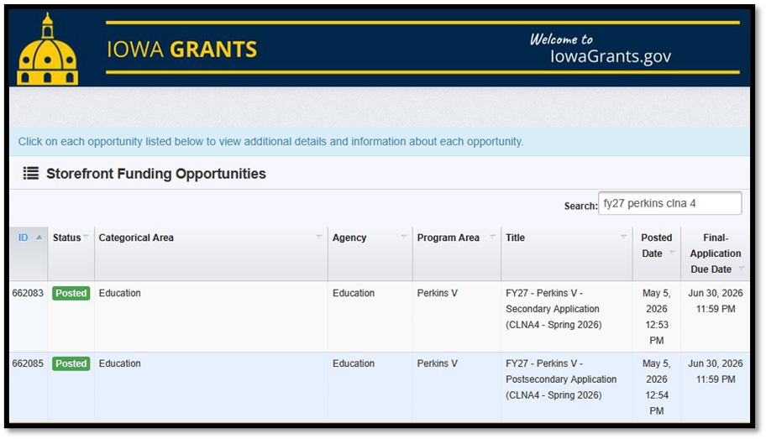
Scroll (or use search tool) until you see the FY27 Perkins V Secondary or Postsecondary Application. Click on the FY27 Perkins V application (either secondary or postsecondary) to open the posting.

Slide 8
Application Forms
The Perkins V FY27 application cycle requires all eligible entities to complete an application by July 1, 2026. The application will close on June 30, 2026 @ 11:59:59 PM.
APPLICATION FORMS CHECKLIST – DUE JUNE 30 @ 11:59:59 PM
o Cover Page Perkins Basic – Secondary or Postsecondary
o (Secondary only) Consortium Members
o Spring '26/CLNA 4 Outcomes– Secondary or Postsecondary
o Perkins V Budget form
o Minority Impact Statement (2008 Iowa Acts, HF 2393, Iowa Code Section 8.11)
o Assurances/Agreements – Secondary or Postsecondary
Near the top of the Funding Opportunity description click on “Start a New Application”

Slide 9
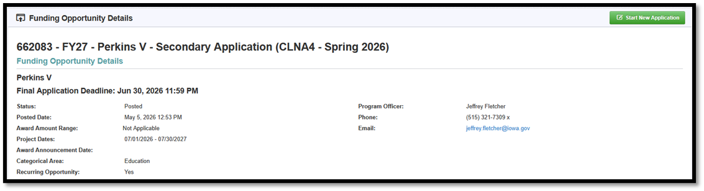

Naming Your Application/Grant Title & Adding Additional Contacts During the Application Creation Wizard Process
Near the top of the Funding Opportunity description click on “Start a New Application
For application title, you must enter the following naming convention based on grantee type. Please see the table below for quick examples. Click “Save Form Information.”
Secondary – Independent Recipient | Secondary – Consortium Recipient | Postsecondary Recipient
FY27 Ankeny CSD | FY27 North Metro Consortium | FY27 IWCC

Slide 10
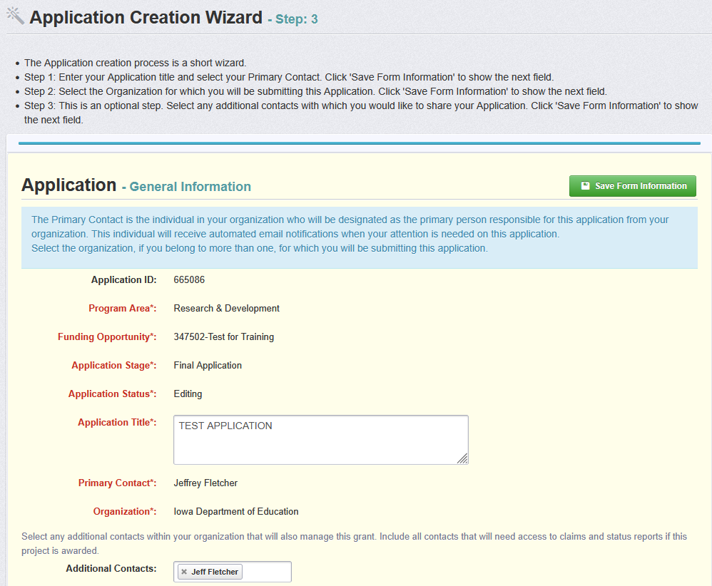
Naming Your Application/Grant Title & Adding Additional Contacts During the Application Creation Wizard Process
Please review the “Additional Applicants” list; identify, select, and click on each additional contact that must be involved with the grant before clicking “Save Form Information.”
At a minimum, you MUST include the business officer contact for the grant subrecipient who will be submitting claims, especially, if this is not the same person submitting the application.
“Additional applicants” become “additional contacts” once it becomes a grant project, which means additional users will have access to the Perkins grant project. E.g., fiscal agent’s business officer ability to submit claims. Doing this now will save some headache to gain access for users after-the-fact.

Slide 11
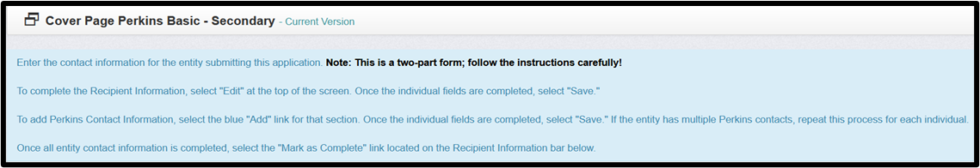
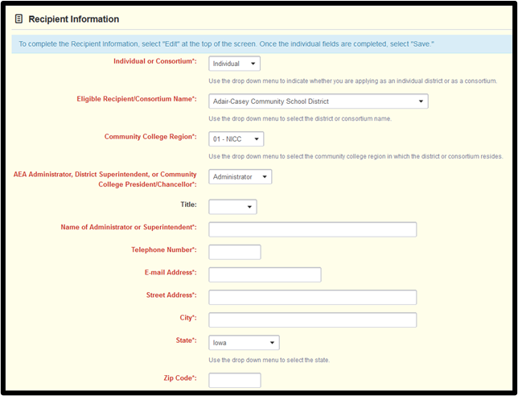
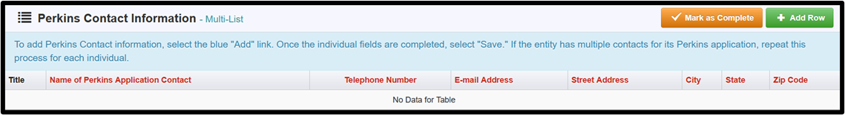
Cover Page for Perkins
Under “Perkins Contact Information”, enter the contact information of the applicant completing the IowaGrants application as well as additional contacts involved in managing this grant. Click “+ Add Row” for at least one primary Perkins contact for each consortium district member. Once the individual fields are completed, select "Save." If the entity has multiple Perkins contacts, repeat this process for each individual.

Slide 12
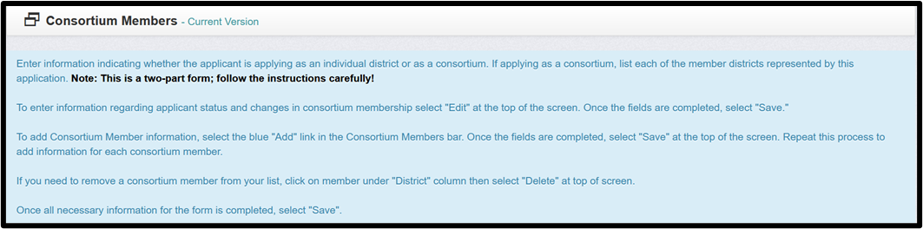
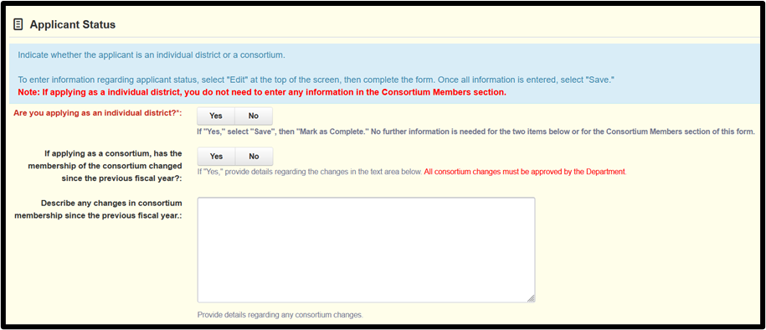
Consortium Member Form (Secondary Only)
Enter information indicating whether the applicant is applying as an individual district or as a consortium. If applying as a consortium, list each of the member districts represented by this application. Note: This is a two-part form; follow the instructions carefully!
To add Consortium Member information, click the green "Add row" button in the Consortium Members bar. Once the fields are completed, click "Save Form."
Repeat this process to add information for each consortium district member.
If you need to remove a consortium member from your list, click on a member under the "District" column then select "Delete."
Once all necessary information for the form is completed, click "Save Form" then “Mark as Complete.”

Slide 13
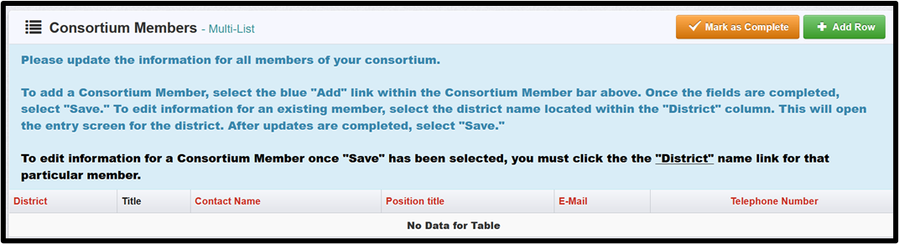
Consortium Member Form (Secondary Only)

Slide 14

Spring '26/CLNA 4 Outcomes IowaGrants Form (Secondary & Postsecondary)
Based on the results of your comprehensive local needs assessment, please answer questions 1 - 9 below. Each question is structured using the "rich text editor" feature of IowaGrants, which allows text narrative, website links, hyperlinks for GoogleDocs, DropBox, OneDrive, or other file formats such as Excel, PDF, etc.
The CLNA focuses on six broad elements.
Each question prompt on this form utilizes IowaGrants’ “rich-text editor” data-entry field, which allows the user to utilize many tools beyond standard text; e.g., embedded hyperlinking, tables, videos, graphics, charts, videos, and more.
For question #2, upload a combined PDF of approved self-studies from IowaSTICS system requires a mandatory upload, the verbatim instructions are provided on the form in IowaGrants and also below.

Slide 15
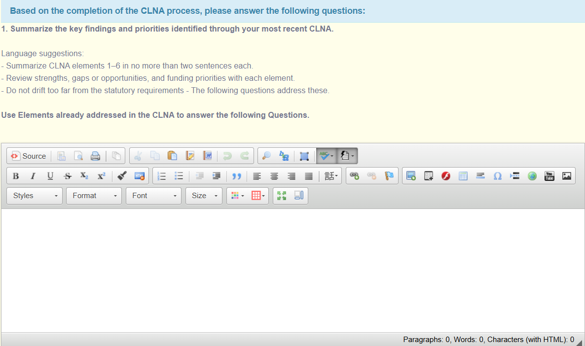
Spring '26/CLNA 4 Outcomes IowaGrants Form

Slide 16
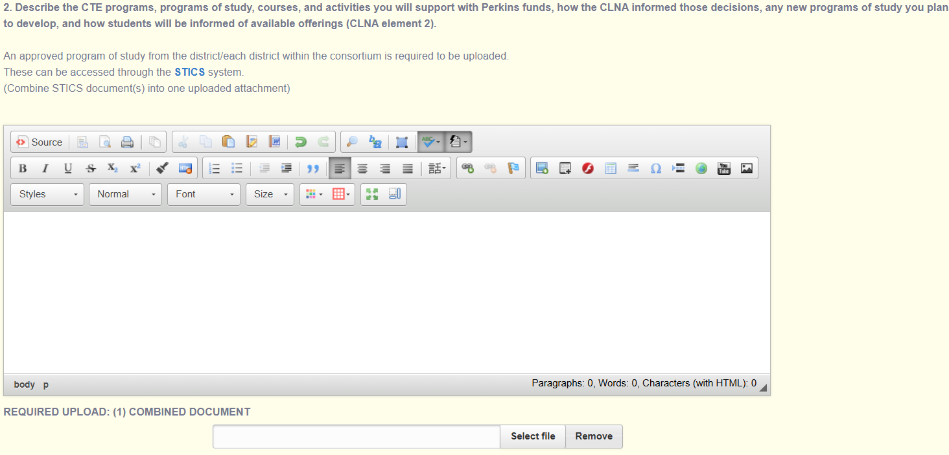
Spring '26/CLNA 4 Outcomes IowaGrants Form

Slide 17
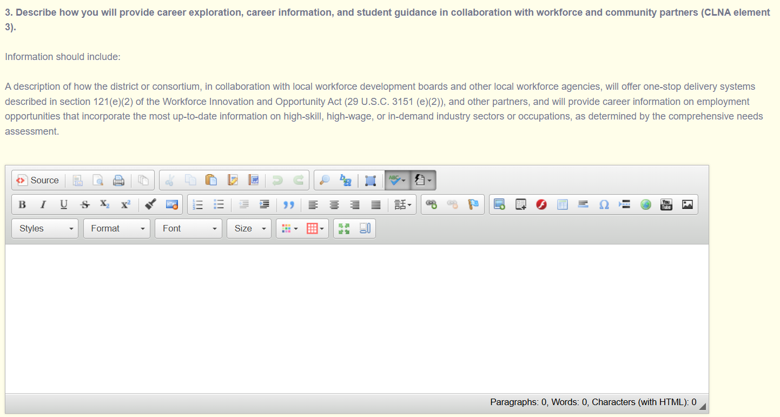
Spring '26/CLNA 4 Outcomes IowaGrants Form

Slide 18
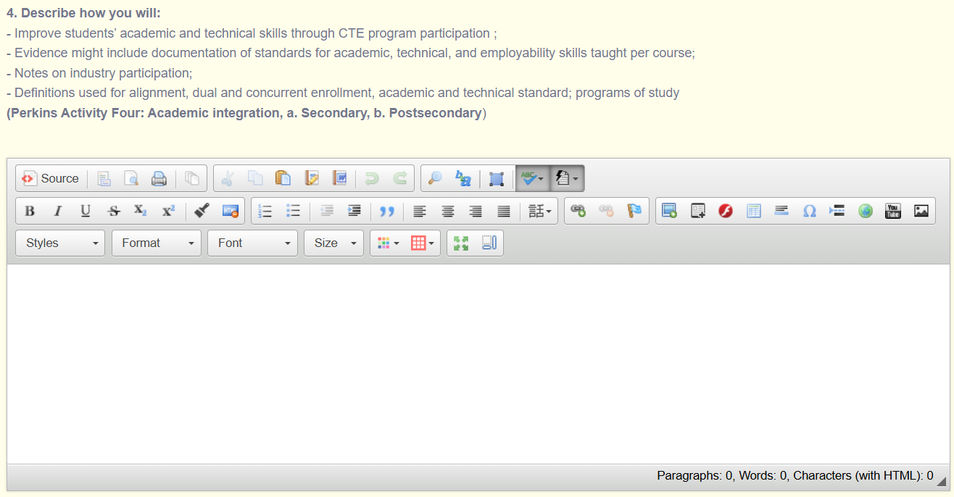
Spring '26/CLNA 4 Outcomes IowaGrants Form

Slide 19
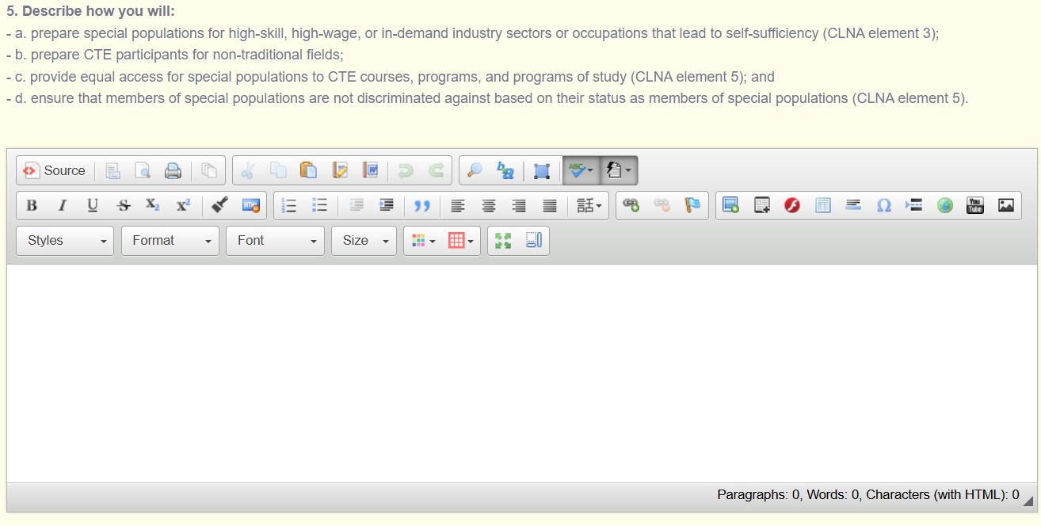
Spring '26/CLNA 4 Outcomes IowaGrants Form

Slide 20
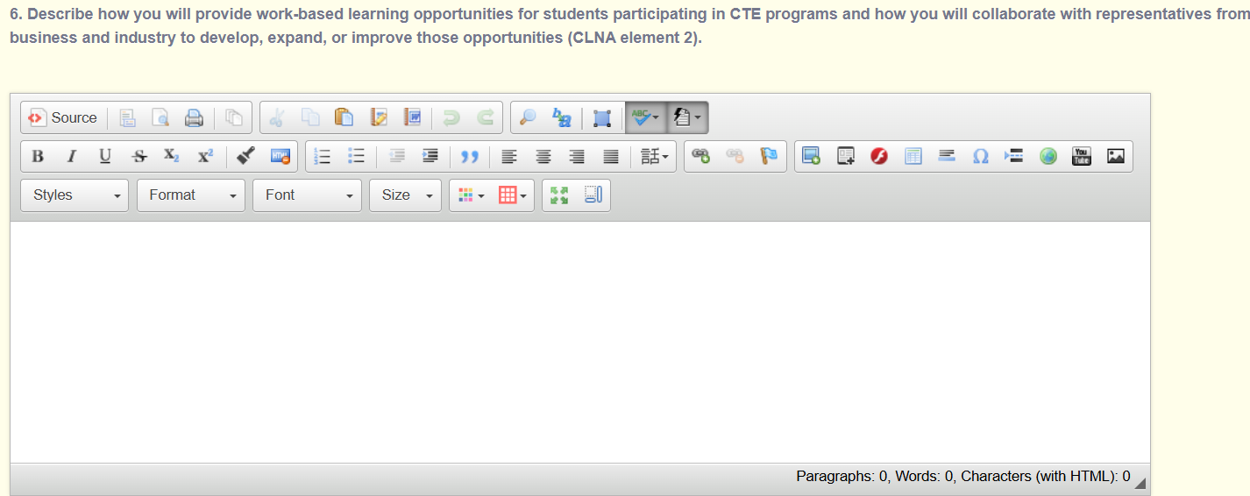
Spring '26/CLNA 4 Outcomes IowaGrants Form

Slide 21
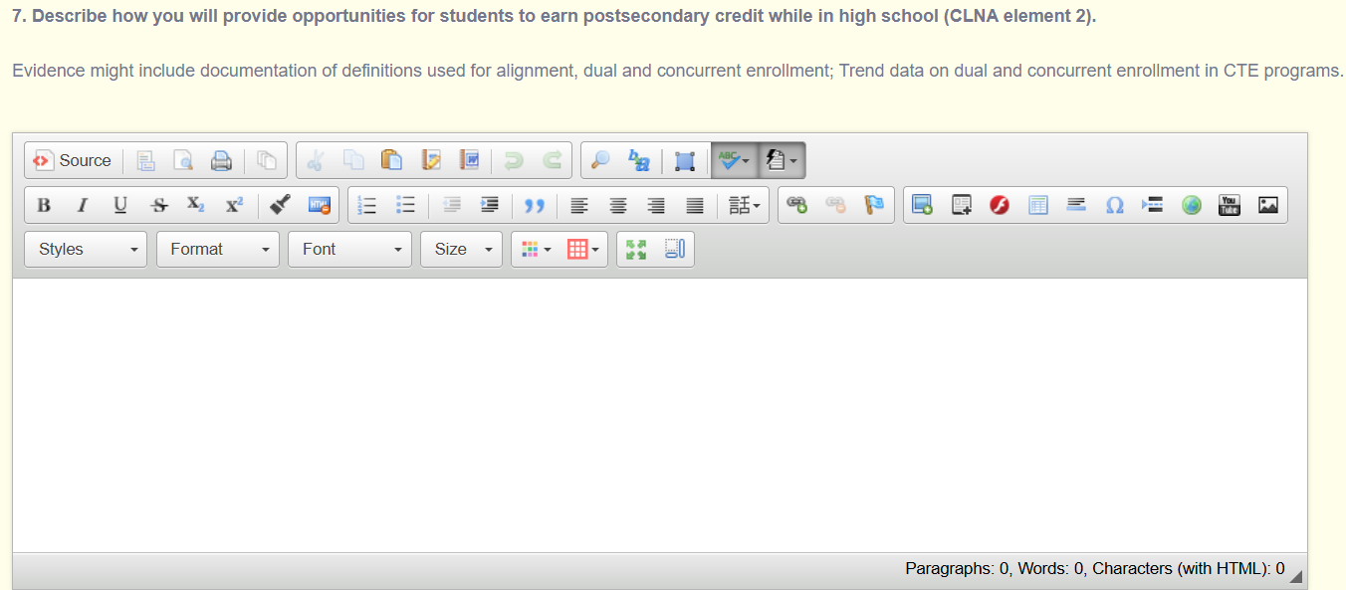
Spring '26/CLNA 4 Outcomes IowaGrants Form

Slide 22
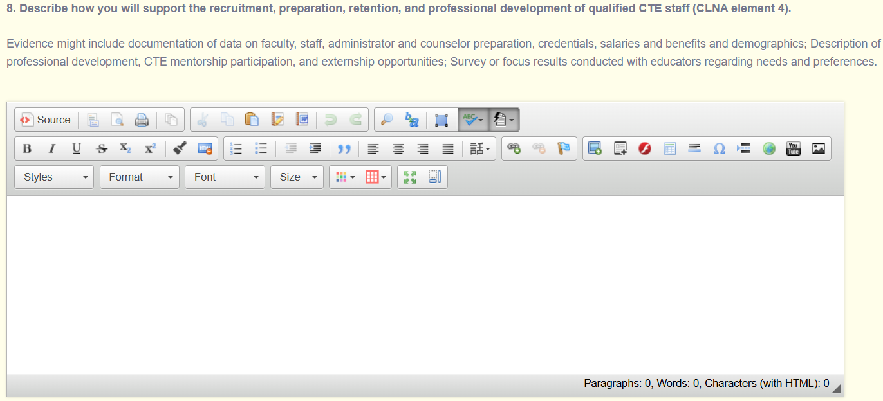
Spring '26/CLNA 4 Outcomes IowaGrants Form

Slide 23
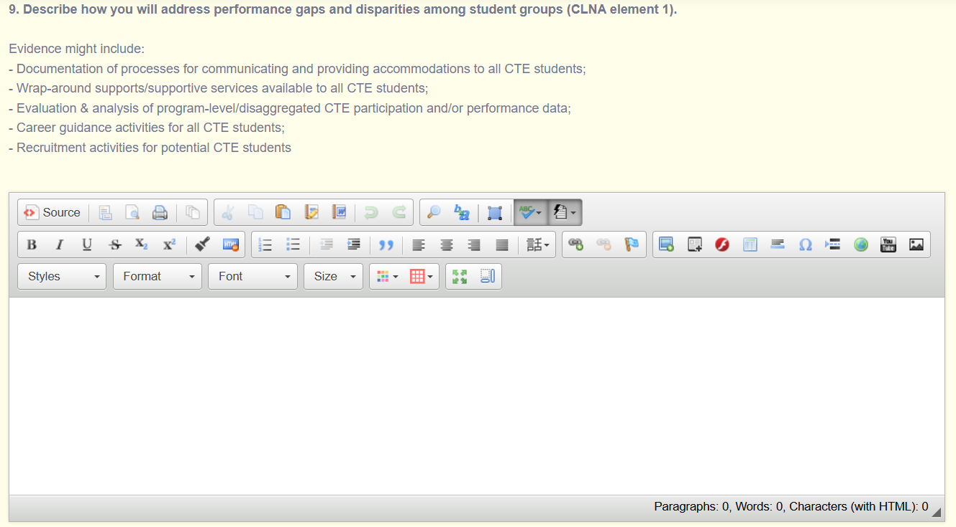
Spring '26/CLNA 4 Outcomes IowaGrants Form

Slide 24
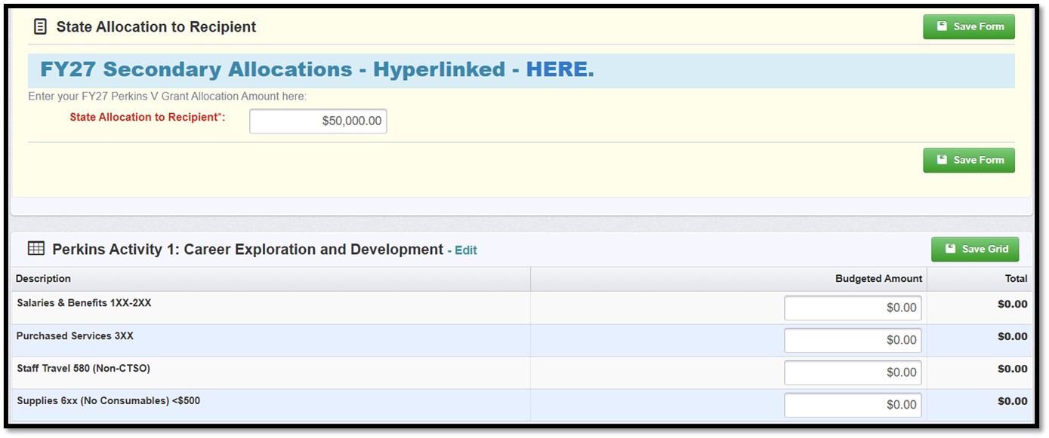
Secondary/Postsecondary Budget Form
The budget summary form “state allocation to recipient” must be updated to reflect the FY27 dollar amount. To access this information, use the hyperlink in the budget summary instruction section.
The allocations table is also attached to the funding opportunity public posting link under “attachments”. When the new FY27 allocation amount is entered, select “Save Form” to reset the calculations and then “Edit” to update individual budget line items.

Slide 25
Secondary/Postsecondary Budget Form
Secondary/Postsecondary Budget Form
The FY27 budget form categories align with the Perkins V expenditure categories. Each category has specific budget codes that delineate between secondary and postsecondary expenditures. Invoices and receipts are the only sufficient form of documentation and are not submitted with claims but are kept on file with each claim and available upon request. (Exception: Embed CTSO institutional memberships in the summary sheet for claim approval).
Secondary Budget Codes
Postsecondary Budget Codes
101 Personnel Services (Salaries & Wages)
301 Curriculum and Training Materials
505 Software Licensing Fees
202 In State Travel - Professional Development (Meals, Lodging, Registration)
405 Contracts for Services
205 Out of State Travel - Professional Development (Meals, Lodging, Registration)
812 CTSO Affiliation Memberships
Salaries & Benefits 1XX-2XX | Purchased Services 3XX | CTSO: Salaries, Stipends, Off-Contract Pay 1XX-2XX
Rentals Computers & Technology 443 | Software 735 | CTSO: Affiliate Membership 812
Equipment 731 (>$500) | Supplies (no consumables) 6XX<$500 | CTSO Student Competitor Registrations 580
Rentals 442 | Staff Travel 580 (Professional Development Non-CTSO)

Slide 26
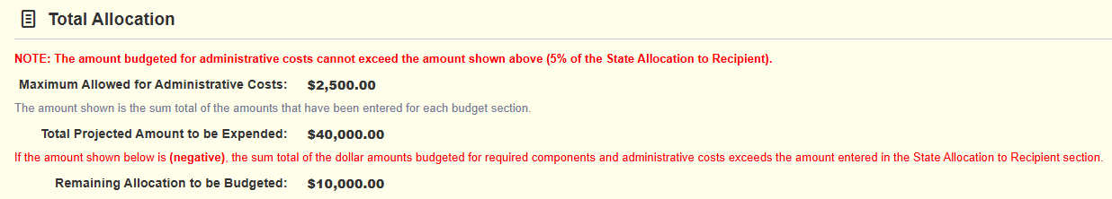
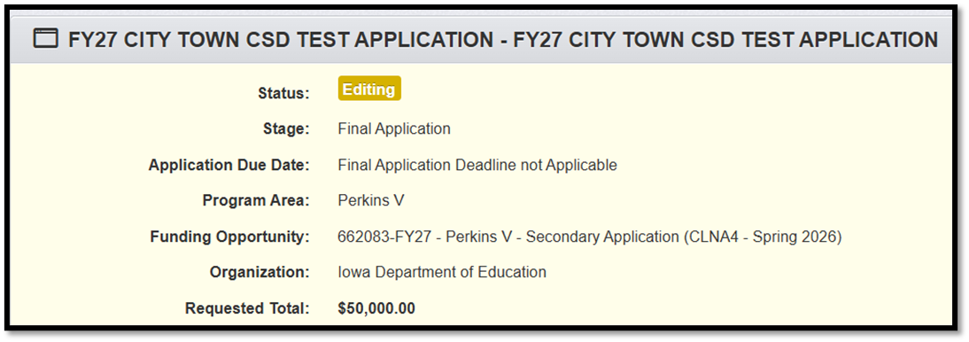
Secondary/Postsecondary Budget Form
Upload the approved budget with your entities unique Iowa Grants “G” number. E.g., “G-PER 27-101 Keystone”.
The approved budget is the only allowable upload. Do not list purchases. Enter “see attached” in the first text field.
Each budget line item will be connected back to the Spring ’26 – CLNA #4.
Purchases not listed in the attached, approved budget are not eligible for reimbursement. It will be up to the Perkins contact to ensure all expenditures are eligible for reimbursement.
Please follow the instructions in the form to “save” and then “mark as complete.”
See Allowable and Unallowable Expenditures or contact Amy Vybiral at amy.vybiral@iowa.gov.
At the end of the budget form, there are calculation fields built into the budget form that show the maximum amount that can be budgeted for administrative costs, which is still 5.00%, and the amount left to be budgeted anytime new information is entered and after clicking “Save Form.”
Administrative Costs - Administrative costs must not exceed 5% of the total grant award. Contact Amy Vybiral at amy.vybiral@iowa.gov for assistance.
As before, every dollar must be budgeted so that the “requested total” IowaGrants system calculation equals the State Allocation to Recipient.

Slide 27
Assurances/Agreements – Secondary or Postsecondary
To receive funds through the Carl D. Perkins Act, the Administrator, Superintendent, or Designee for the consortium member institutions must sign this assurance statement on behalf of the eligible recipient(s) to certify commitment to abide by these requirements through the period of this grant award.
To enter the Information for the entity submitting this application, select "Edit" at the top of the screen. Once the individual fields are completed, select "Save."
Once all information is saved, select the "Mark as Complete" link in the Perkins Assurances/Agreements bar below.
Assurances
The undersigned certifies that the district or consortium members will abide by the assurances listed below during the grant award period. The undersigned also certifies that, to the best of their knowledge, the information contained in this application is correct and complete.
The local education agency, community college, or area education agency acting as the fiscal agent over this application agrees to maintain financial records and provide such information to the Iowa Department of Education as may be required for fiscal audit.
The eligible recipient agrees to report annually to the Department of Education progress of the eligible recipient in achieving state adjusted levels of performance on core indicators of performance for all career and technical education programs. PL 115-224 (Perkins Act), Title I, Section 113(c)(i)
The eligible recipient agrees that “funds made available under this Act for career and technical education activities shall supplement, and not supplant, non-federal funds expended to carry out career and technical education activities." PL 115-224 (Perkins Act) Title II Sec. 211(a)
The eligible recipient agrees to retain certification on non-debarment and suspension from any contractor who will have single or aggregate contracts of $100,000 or more. (98-III-USDE-282-7)
The eligible recipient certifies the agency and its principal officers are not suspended or debarred.(98-III-USDE-282-7)
Funds will not be used to acquire equipment, including computer software, in any instance in which such acquisition results in a direct financial benefit to any organization representing the interests of the purchasing entity, its employees, or any affiliate of such an organization. PL 115-224 (Perkins Act) Title I Sec. 122(13)(B).
Funds will not be used for the purpose of directly providing incentives or inducements to an employer to relocate a business enterprise from one state to another state if such relocation will result in a reduction in the number of jobs available in the state where the business enterprise is located before such incentives or inducements are offered. PL 115-224 (Perkins Act) Title II Sec. 222.
No federal appropriated funds have been, or will be paid by or on behalf of the undersigned, to any person for influencing or attempting to influence an officer or employee of any agency, a member of Congress, an officer or employee of Congress in connection with making of any federal grant, the entering into any grant or cooperative agreement, and the extension, continuation, renewal, amendment, or modification of any federal grant or cooperative agreement. Sec. 1352, Title 31
The eligible recipient agrees to provide a career and technical education program that is of such size, scope, and quality to bring about improvement in the quality of career and technical education programs. PL 115-224 (Perkins Act), Title I, Section 135(b)
The eligible recipient ensures students who participate in assisted career and technical education programs are taught to the same coherent and rigorous content aligned with challenging academic standards as are taught for all other students. PL 115-224 (Perkins Act) Title II Sec. 134(b)(4)(B).

Slide 28
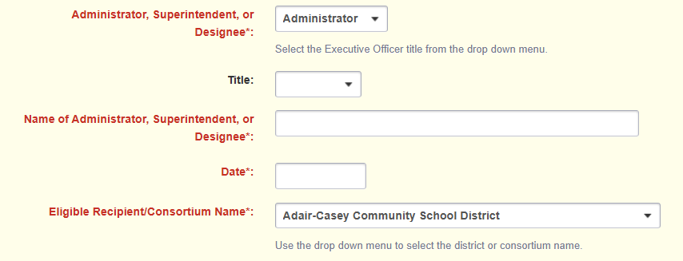
Assurances/Agreements – Secondary or Postsecondary

Slide 29
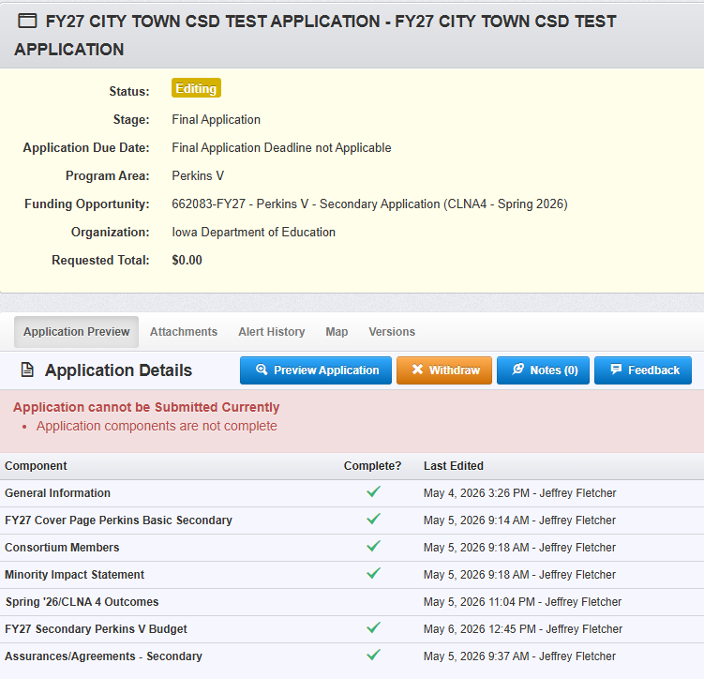
Wrap-Up
The status of each form will be summarized on the Application Forms list within the “Complete?” column. When all forms have been marked as complete, the application is ready for submission. To submit the application, click the “Submit” link.
After all steps of the submission process have been completed, the person submitting the application will receive a system-generated notification stating the application has been successfully submitted. The notification message, as well as other correspondence generated via iowagrants.gov, will come from the dullestech.com domain. Please make sure your email system is set to allow these messages to be delivered.
If you have questions regarding the FY27 Perkins Grant application forms, please contact Jeffrey Fletcher, Perkins Accountability Consultant, Bureau of Career and Technical Education at jeffrey.fletcher@iowa.gov or 515-321-7309.

Slide 30
REMINDERS
CTSO budget section
Marketable Credentials for educators are ineligible for reimbursement. Erroneously reimbursed credentials must be returned to the state Perkins allocation.
Only applications with approved budgets (indicated by the assigned “G” number in Iowa Grants and uploaded into the Perkins application) will be moved to underway status for FY 2027.
Please reach out if you have any questions
IowaGrants – jeffrey.fletcher@iowa.gov
Budget – amy.vybiral@iowa.gov

Slide 31
Webinar - Wednesday, May 13 @ 10 AM: Demonstration of IowaGrants’ Spring '26/CLNA 4 Outcomes Form
Regularly scheduled webinar, Wednesday, May 13 @ 10 AM.
Demonstration of IowaGrants’ Spring '26/CLNA 4 Outcomes Form
Demo to link completed “CLNA elements 1 - 6” to “Perkins V questions 1 - 9” found on the IowaGrants’ Spring ‘26/CLNA 4 Outcomes form of the application.
Amy will send the Agenda with the Zoom link May 7.

Slide 32
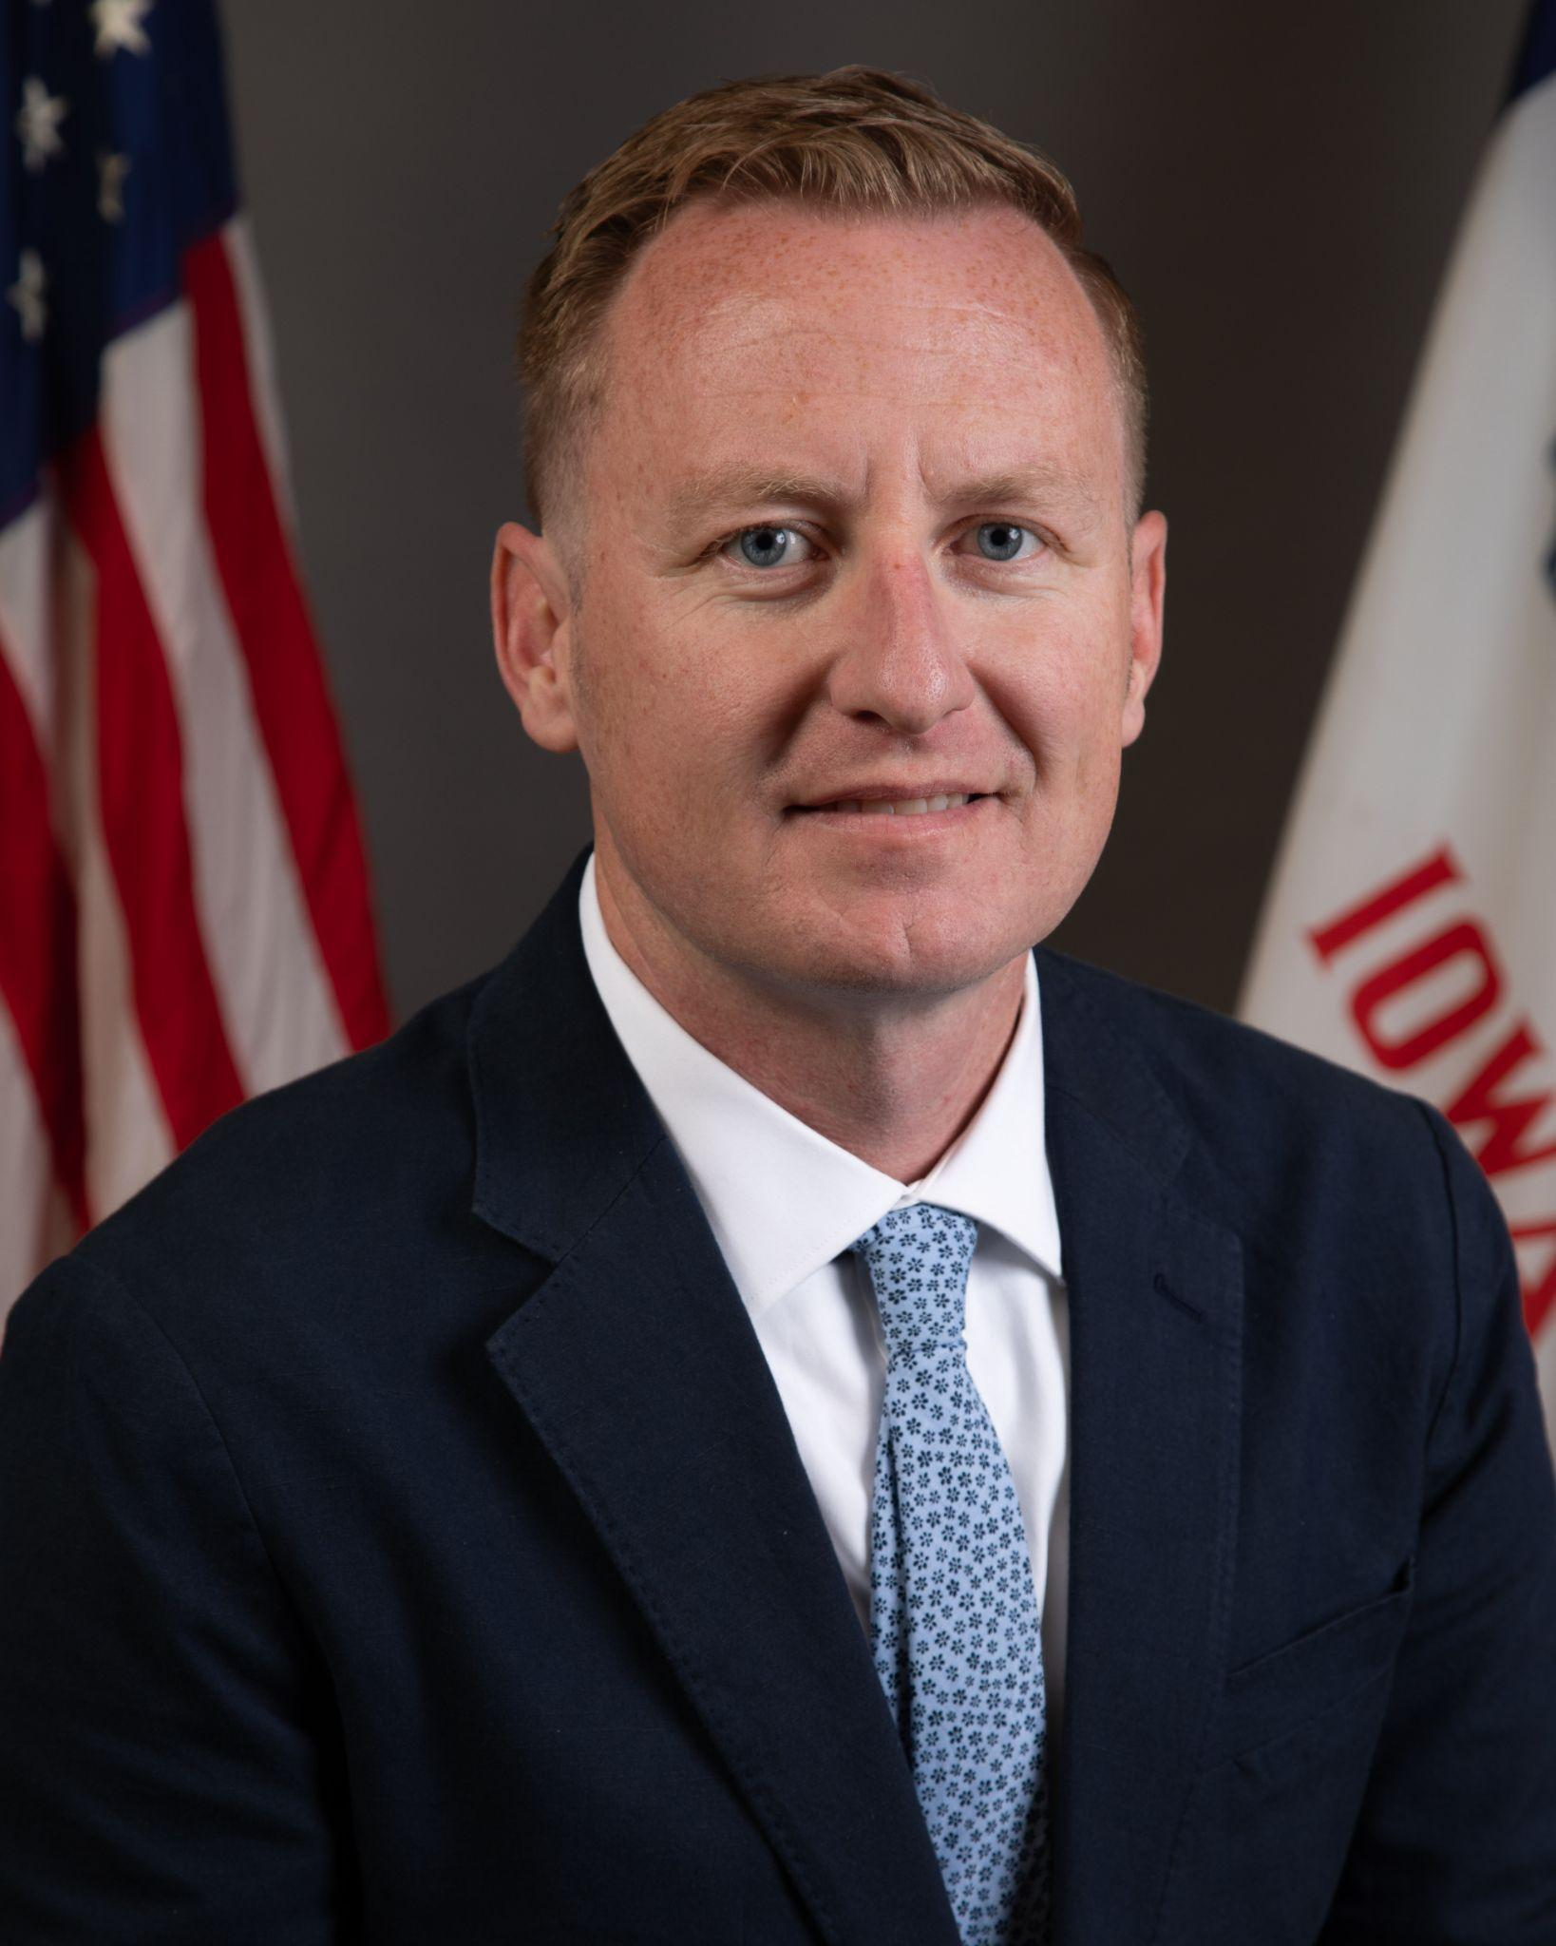
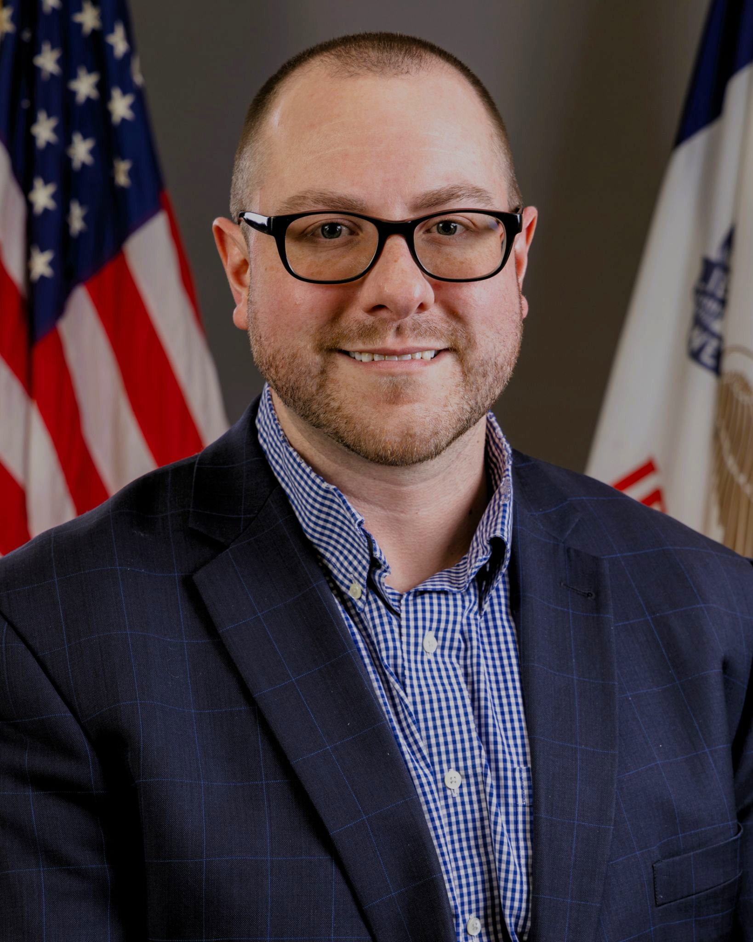
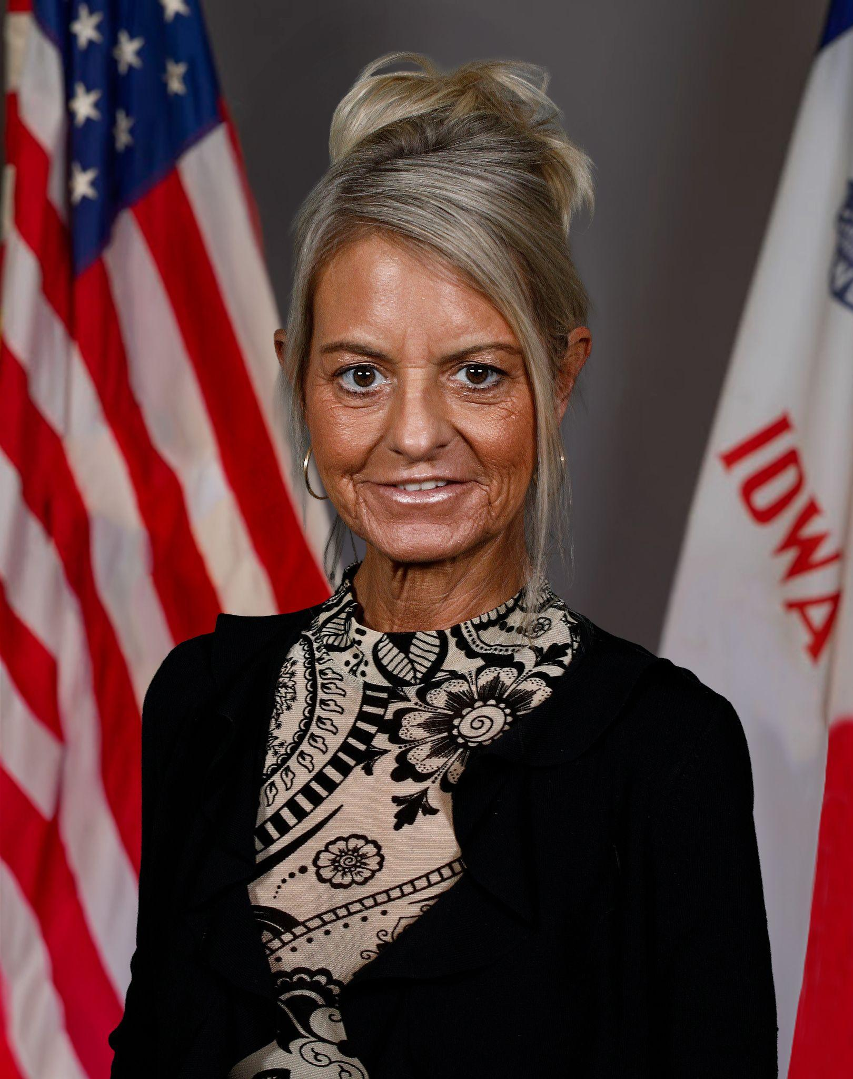
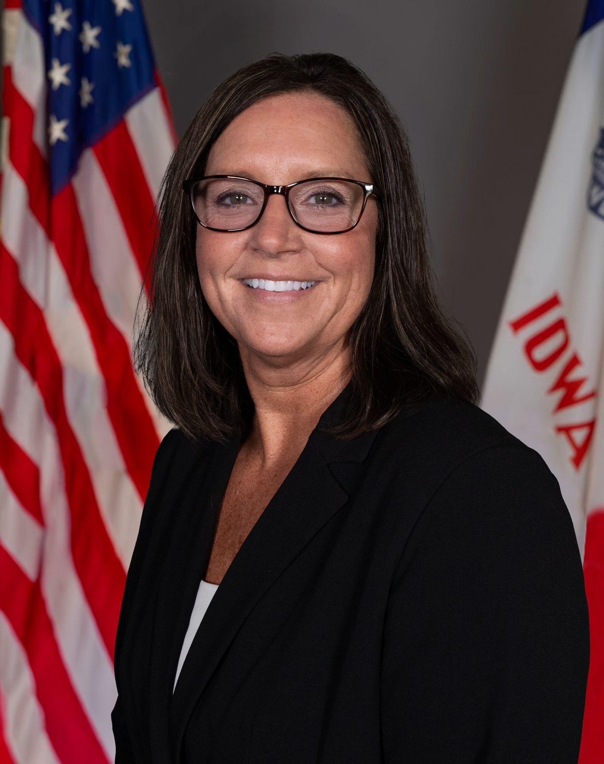
Contact Information
Cale Hutchings
Bureau Chief - CTE
cale.hutchings@iowa.gov
515-975-8193
Jeffrey Fletcher, PhD, MPA
Consultant - Perkins, IowaGrants
jeffrey.fletcher@iowa.gov
515-321-7309
Amy Vybiral
Consultant - Perkins Budgets and Claims
amy.vybiral@iowa.gov
515- 339-4520
Shelly Duwa
Consultant - Business Ed and CTSOs
shelly.duwa@iowa.gov
515-971-0669

Slide 33
END WEBINAR

Slide 34
ADDITIONAL BUDGETARY &
CLAIM SUBMISSION INFORMATION

Slide 35
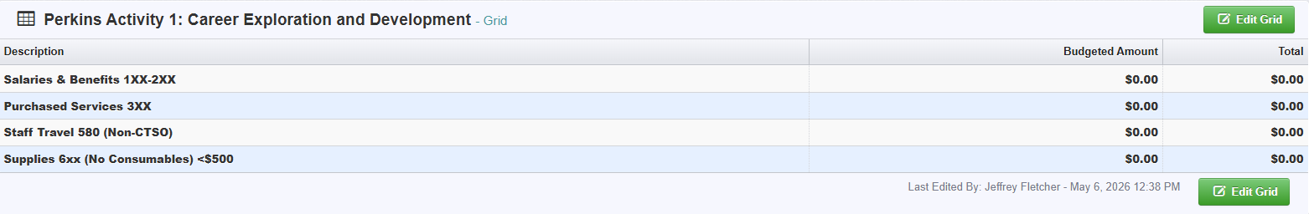
Secondary - Additional Budget Form Details
Perkins Spring 2026 (FY 2027) Budget Negotiation
FY 2076 Perkins application approval will occur after the 2027 budget is approved.
Budget negotiation and approval deadline - March 31, 2026
Contact Amy Vybiral with budget approval questions. 515-339-4820 amy.vybiral@iowa.gov
Specific Purchases by Perkins Activity
Secondary Perkins Budget Form
Activity One – Career exploration and development
Salaries
    Time and effort job duties must be exclusive to CTE students, programs and services supporting CTE specific content areas that include advising CTE students, reporting CTE outcomes, and developing CTE pathways. Percentage of contract pay required when applicable).
o Purchased Services - Training and facilitators, e.g., Vendor training Transfer VR Career Exploration Headsets
Staff Travel (Non-CTSO) – CTE career cluster related professional development

Slide 36
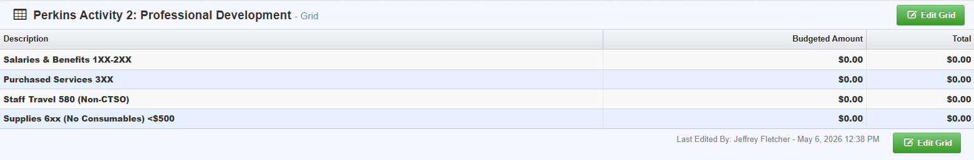
Secondary - Additional Budget Form Details
Activity Two – Professional Development
Salaries – Substitute teacher pay for CTE Teachers to attend conferences.
Purchased Services – Credentialed NC3 instructor certified in-house instructor (district reimburses the credentialing instructor with the district board-approved contract hourly pay, mileage, and ancillary costs).
Staff Travel – (non-CTSO) Registration, mileage, airfare, baggage, hotel, meals, parking, 15% gratuities for CTE licensed instructors, administration, administrative assistants, WBL coordinators, and other CTE related career professionals to attend CTE and content related professional development.
Supplies – Internal informational material for technical assistance opportunities.

Slide 37
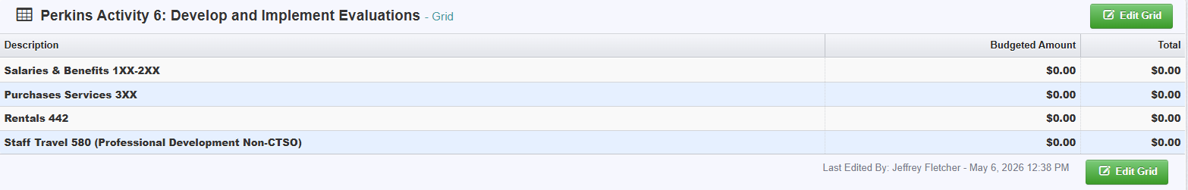
Secondary -Additional Budget Form Details
Activity Four – Integration of Academic Skills
Salaries – Substitute teacher pay for CTE teachers engaged in professional development to integrate math, ELA, and science into CTE curriculum.
Purchased Services – Contracted services to integrate academic strategies to teach Math in CTE
Activity Five - Implementation of CTE see slide 36
Activity Six – Develop and Implement Evaluations
Salaries – Summer Off Contract, Pre-CLNA data review with CTE teachers and staff.
Purchased Services – Data consultant to organize and prioritize CLNA outcomes with staff.
Rentals Equipment – Do not use. Year-end budget adjustments.
Staff Travel 580 (non-CTSO) – Mileage for off contract data review

Slide 38
Secondary - Additional Budget Form Details
CTSOs
Off-contract or stipend pay (ends June 30, 2028).
    Time and effort job duties must be exclusive to CTE students, programs and services supporting CTE specific content areas that would include advising CTE students, reporting CTE outcomes and, developing CTE pathway. Percentage of contract pay required when applicable).
Purchased Services – Vendor contracts
CTSO Student Competitor registration costs - In-state and Out-of-state.
Staff Travel 580 (CTSO related events only) CTSO Conferences and student competition travel reimbursement for CTE licensed instructors BPA, FBLA, FFA, FCCLA, HOSA, SkillsUSA, & TSA.
Supplies – Materials for Competitions
Affiliation memberships – Quantity of one (professional and instructor memberships are ineligible).

Slide 39
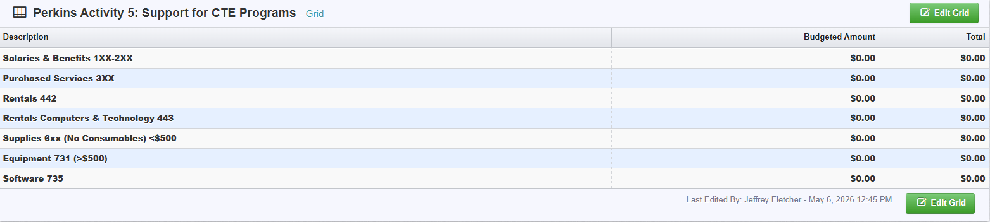
Secondary -Additional Budget Form Details
Activity Five
Salaries – Off-Contract Pay (Limited to self-studies and CLNA)
    Time and effort job duties must be exclusive to CTE students, programs and services supporting CTE specific content areas that include advising CTE students, reporting CTE outcomes and, developing CTE pathway. Percentages required.
Rentals - Welding Gas Tanks
Rentals (Technology) - Cell phone contracts (iPads for drones)
Purchased Services – Contracts for services (vendor training, AEA services to school districts, consortia, and colleges.
Equipment ≧ $500
Supplies ≦ $499
Software
The following should be budgeted and claimed in the appropriate budget categories within Activity Five:
Equipment, technology, machinery, tools, implements, WBL, IRCs, distance learning, increased access to STEM and non-Trad,
employability skills, and CTE accelerated learning programs.

Slide 40
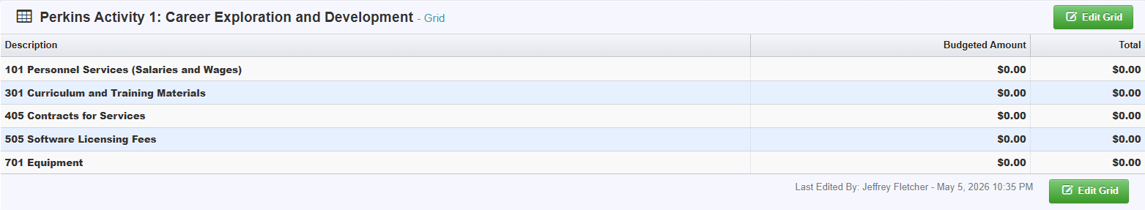
Postsecondary - Additional Budget Form Details
Activity One – Career Exploration and Development
101 Personnel Services (Salaries and Wages)
o Time and effort job duties must be exclusive to CTE students, programs and services supporting CTE specific content areas that include advising CTE students, reporting CTE outcomes and, developing CTE pathway. Percentages required.
o Supplanting: May decrease the percentage over time but never increase the percentage.
301 Curriculum and Training Materials
405 Contracts for Services
505 Software licensing fees
701 Equipment

Slide 41
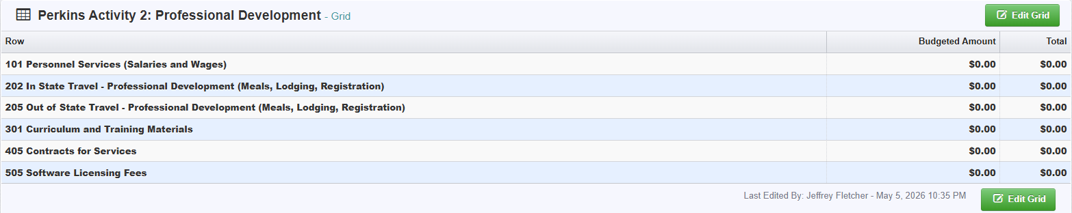
Postsecondary - Additional Budget Form Details
Activity Two – Professional Development
101 Personnel Services (Salaries and Wages)
  Time and effort job duties must be exclusive to CTE students, programs and services supporting CTE specific content areas that include advising CTE students, reporting CTE outcomes and, developing CTE pathways. Percentages required.
202 In-State Travel Professional Development (Meals, Lodging, Registration)
205 Out of State Travel (Professional Development ( Meals, Lodging, Registration)
301 Curriculum and Training Materials
405 Contracts for Services
505 Software Licensing Fees
Activity Four – Integration of Academic Skills
101 Personnel Services (Salaries and Wages)
405 Contracts for services – Vendor contracts – Math in CTE Professional Development with all CTE Faculty

Slide 42
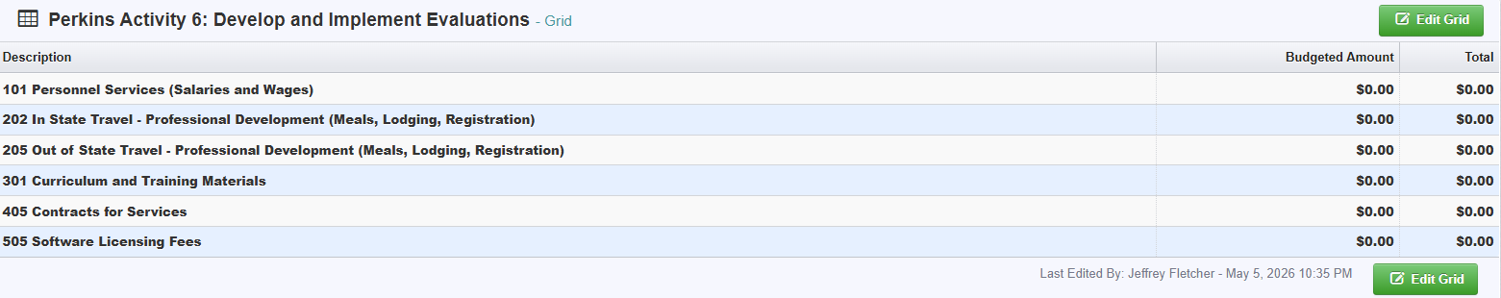
Postsecondary - Additional Budget Form Details
Activity Six – Develop and Implement Evaluations
101 Personnel Services
  Time and effort job duties must be exclusive to CTE students, programs and services supporting CTE specific content areas that include advising CTE students, reporting CTE outcomes and, developing CTE pathway. Percentages required.
202 In-state and
205 Out of state travel – Data meetings/conferences
301 Curriculum & Training Materials
405 Contracts for Services
505 Software Licensing Fees

Slide 43
Postsecondary - Additional Budget Form Details
CTSOs: Career and Technical Student Organizations
101 Personnel Services
    Time and effort job duties must be exclusive to CTE students, programs and services supporting CTE specific content areas that include advising CTE students, reporting CTE outcomes and, developing CTE pathway. Percentages required.
202 In-state Travel – CTSO related events only
205 Out of state Travel – CTSO Related events only
301 Curriculum and Training materials – Materials required for Student competition only. Classroom materials - Activity five
405 Contracts for Services
812 Affiliate Dues for Membership in Professional Organizations

Slide 44
Jeff will add p. 20-21 after the webinar
Claim Submission Instructions
Contact CTE Bureau if assistance is needed to edit and submit a claim.
From the Side Menu:
Click on ‘Grants’
Select the Grant you would like to access in the ‘Active Grants’ listing.
Once you have selected the Grant, you will be directed to the Grant Components.
Select ‘Claims’ from the list of Grant Components.
Click on the green “+ Add Claim” button to initiate a claim.

