Slide 1
Individualized Education Programs
Iowa Students with Disabilities Parentally Placed in Accredited Nonpublic Schools
Presenter(s): Janelle Danner and Katherine Hall
April 15, 2026

Slide 2
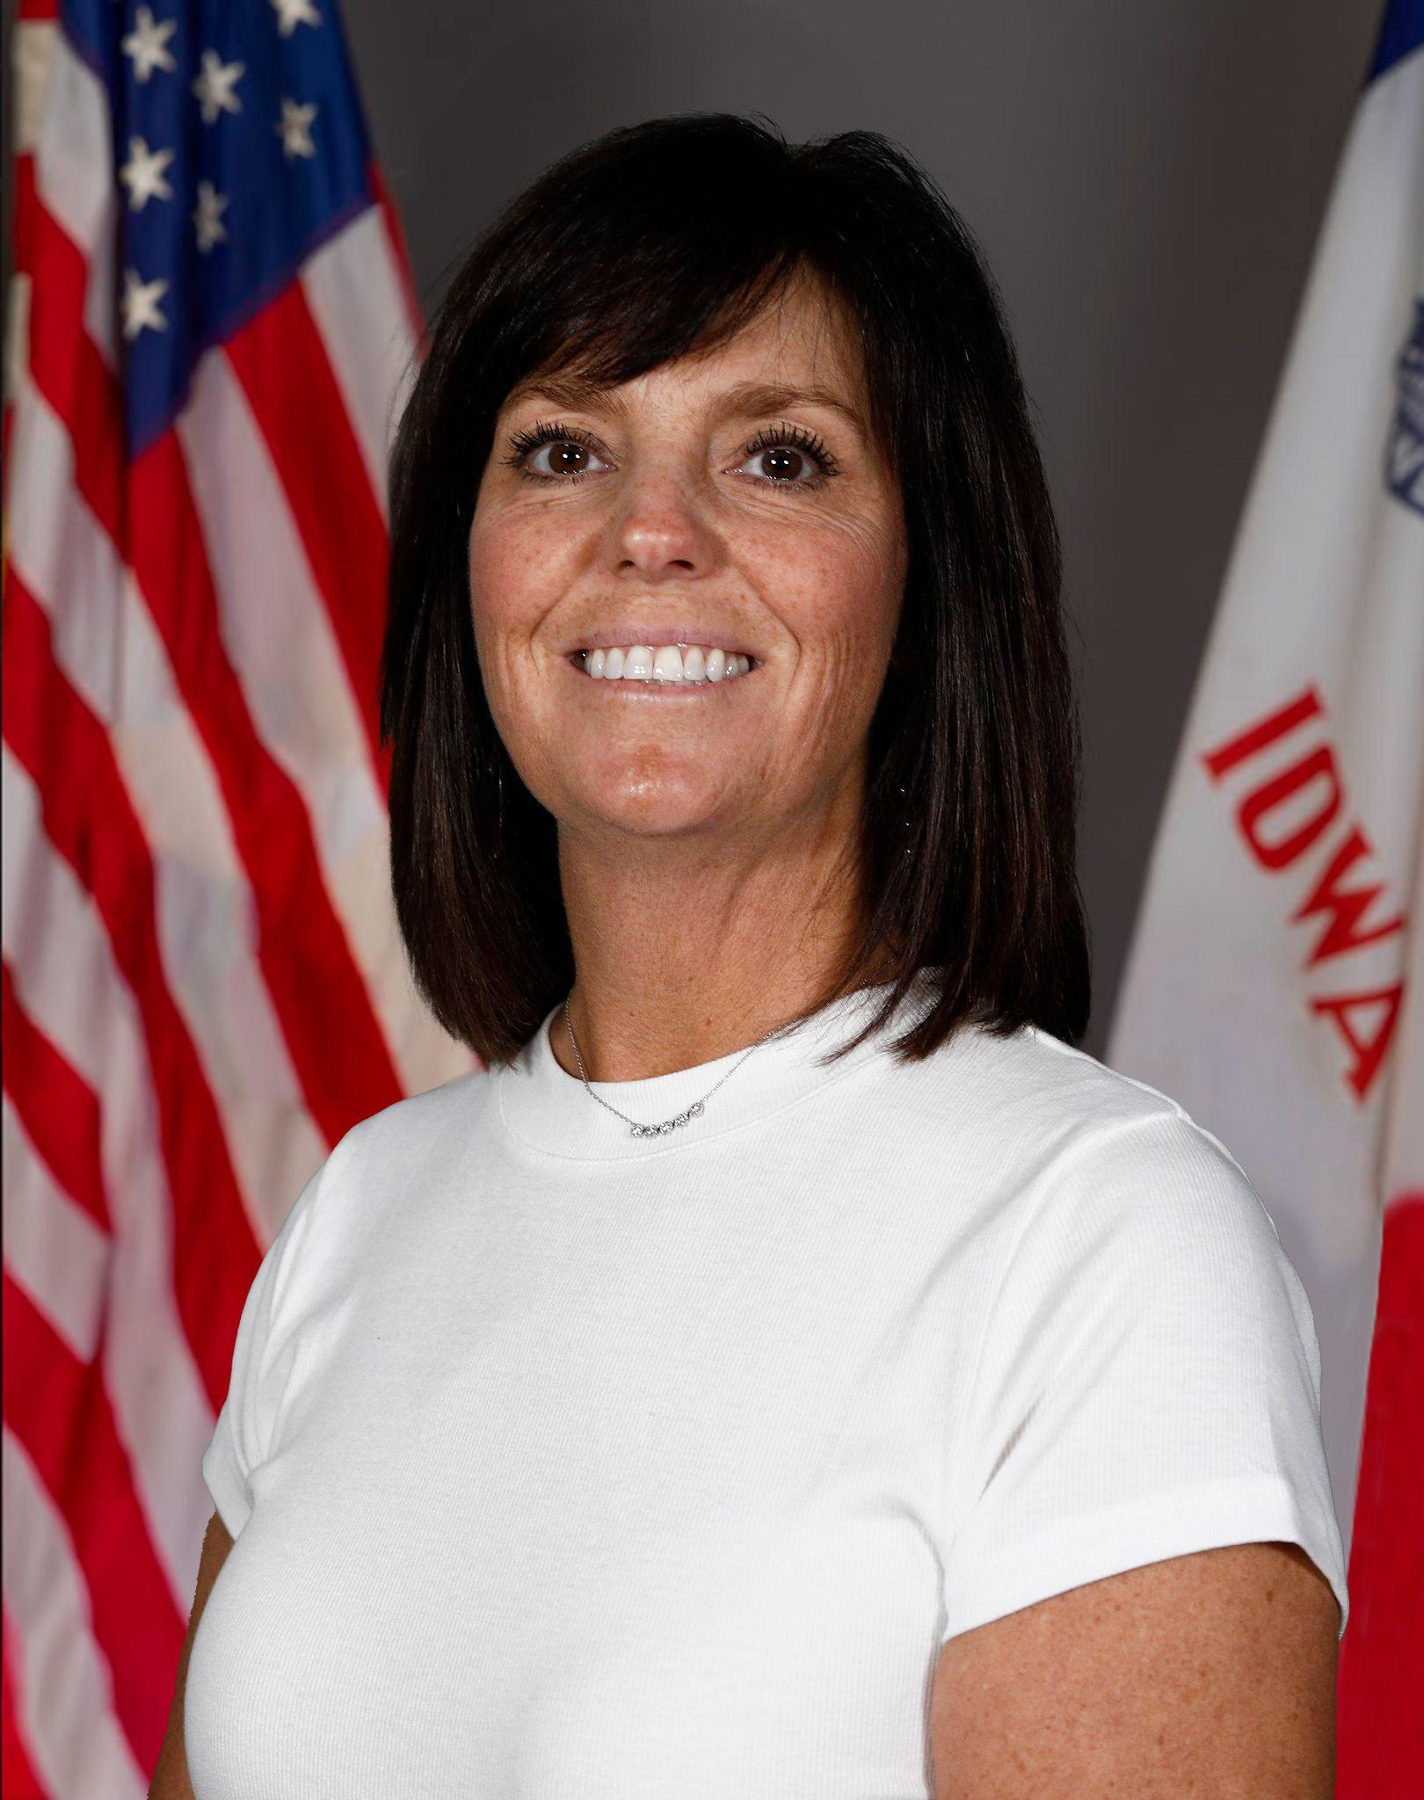
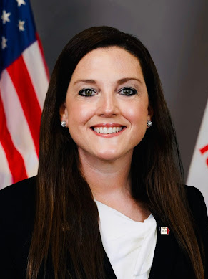
Today’s Presenters
Janelle Danner
Nonpublic School Liaison
Katherine Hall, PhD
IEP Development

Slide 3
Overview of Today’s Content
Understanding the IEP process and team roles
Student strengths, areas of concern, and PLAAFP
Goal development and progress monitoring
Services, supports, accommodations, and modifications
Placement, LRE, and ensuring FAPE
Family Portal and communication tools
Location of services and service delivery considerations
Accredited nonpublic schools and partnership

Slide 4
Qualified for Special Education Services
What is next?

Slide 5
Understanding Your Role and the Process
Valuable members of the IEP team
Ask questions and stay engaged in the process
Listen for how roles and responsibilities are defined
Clear systems support communication and problem solving
If there are questions or concerns, start with your IEP team

Slide 6
Parent Rights and Procedural Safeguards
Parents receive Procedural Safeguards under IDEA
Explains parental rights in the special education process
Provided at key points, including evaluation and IEP meetings
Applies to students who are, or may, be eligible for special education services.
Services are based on student need as determined by the IEP team

Slide 7
IEP Teams MUST Include
Parents of the child
At least one general education teacher of the child
At least one public special education teacher of the child
Public agency representative
  Qualified to provide or supervise SDI
  Knowledgable about general education curriculum
  Knowledgeable about public agency resources
Individual who can interpret evaluation results
Other individuals who have knowledge or special expertise regarding the student
Whenever appropriate, the student*
Note: One person may fill more than one role, but the public agency roles are always required. Iowa Code 281-41.321

Slide 8
Accredited Nonpublic IEP Team Members
Participants may also include:
Other accredited nonpublic general education teachers
Other accredited nonpublic special education teachers
Accredited nonpublic representative
  Knowledgable about general education curriculum
  Knowledgeable about the resources of the accredited nonpublic school
Other individuals who have knowledge or special expertise regarding the student

Slide 9
The PLAAFP
Present Levels of Academic Achievement and Functional Performance

Slide 10
Strengths, Skills, Preferences, Interests
Strengths and Skills
What the student can do and how they learn best
Conditions that support success and engagement
Academic, social, communication, and life skills
Performance across routines and settings (school, home, community)
Inform instruction and access to learning
Preferences & Interests
What the learner likes, chooses, and is motivated by
How the learner engages best in learning
Helps guide instruction, supports, and engagement strategies

Slide 11
Considerations and Special Factors
Teams must consider required factors (factors that may impact learning)
  Accessible Educational Materials
  Assistive Technology
  Communication
  English Learner
  Health
  Hearing
  Social Emotional Behavior
  Vision
Key point: If there is a need identified within the special factors based on the disability, it must be addressed in the IEP

Slide 12
Areas of Concern / Need
How the disability affects learning
Specific and individualized
Impact of disabilty in classroom and community
Areas of concern / need
Data informed
Observations
Interviews with parents, teachers and the student
Identify skill gaps or challenges
Information that guides services and supports

Slide 13
Secondary Transition
Secondary Transition (14-21) addresses:
Planning and preparing for life after high school
Services and supports for living, learning, and working after high school
Graduation requirements
Classes aligned to address future goals
Adjustments based on student needs
Transfer of rights at age 18

Slide 14
A Strong PLAAFP
Strengths and skills
Preferences and interests
Current performance (based on data)
Impact of the disability
Family and team concerns
Specific and clearly written
Focused on real-life impact
Guides IEP decisions

Slide 15
Measurable Goals

Slide 16
Writing Strong Goals
Based on PLAAFP- present level
Compare to expectations (peers, standards)
Target specific skill deficits
Measurable and observable
Aligned to student need
Support meaningful progress

Slide 17
Services and Support

Slide 18
Special Education Services (What is Provided “As Written”)
Services are planned, ongoing supports provided to a student over time to meet their needs.
Each service should clearly describe:
How often it happens (frequency)
How long it lasts (minutes)
Where it takes place (setting)
Who is responsible for providing it
What Makes It a “Service”?
Includes frequency, minutes, setting, and provider
A formal commitment by the school/AEA
Must be delivered as written

Slide 19
Special Education Services- Examples
Specially Designed Instruction (SDI)
Adapts content, instruction, or delivery to meet unique needs
Designed and monitored by a licensed special education teacher
Related Services (Examples)
Speech-language services
Occupational or physical therapy
Transportation or health/nursing services
Other Specialized Services (Examples)
Assistive technology services
Interpreter or vision/hearing services
Paraprofessional support (instructional or health)

Slide 20
Activities and Supports (How Students Access Learning)
Activities & Supports = flexible supports that help students participate
Assistive Technology
Devices (text-to-speech, communication tools)
Supports (training, setup, troubleshooting)
Access & Participation
Accessible materials (audio, Braille, digital)
Program modifications (adjusted expectations)
Transition & Real-Life
Job exploration
Independent living skills
Support for Staff
Training, collaboration, implementation planning
Key Difference
Less formal (not tracked by minutes)
Support participation and skill use
Aligned to IEP goals

Slide 21
Accommodations
Accommodations change how a student learns or shows learning, without changing what is being taught
Accommodations During the School Day
Extended time for assignments or tasks
Small group or reduced-distraction setting
Visual supports, graphic organizers, or checklists
Breaks or chunking of assignments
Assessment Accommodations: Classroom, District, and State Assessments
Extended time, small group
Read-aloud or text-to-speech (when allowed)
Frequent or scheduled breaks

Slide 22

IEP Decision Making in Pratice

Slide 23
FAPE, LRE, & Placement
FAPE (Free Appropriate Public Education)
The legal obligation to provide services that support meaningful progress
Includes instruction, supports, and related services
LRE (Least Restrictive Environment)
Access to general education and peers to the maximum extent appropriate
Instruction with nondisabled peers whenever possible
Data-driven and individualized
Placement
Educational environment or setting
Reflects supports needed by the student
Determined after strengths, needs, and goals are identified

Slide 24
Placement, LRE & FAPE in Practice
These decisions are inseparable in the IEP process
obligation (FAPE)
access (LRE)
environment and services (placement)
They continuously influence each other
Key Idea
IEP decisions sit at the intersection of obligation, access, and environment

Slide 25
Family Portal

Slide 26
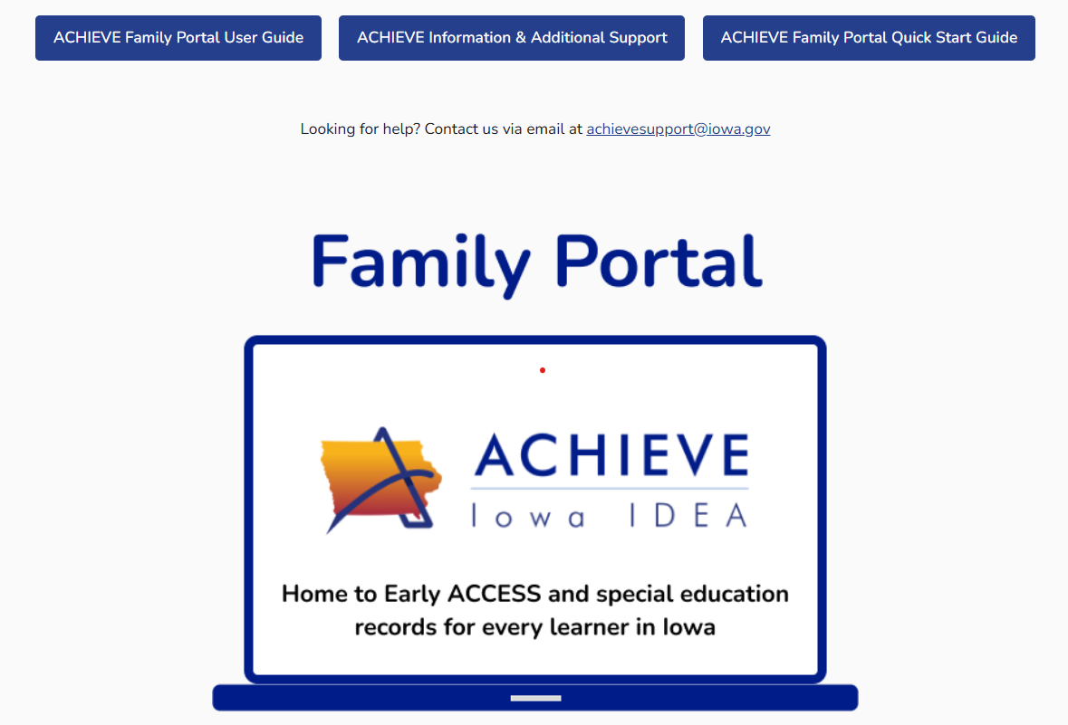
ACHIEVE- Family Portal
ACHIEVE
Parent Portal
Allows parents access to resources and information in their child’s IEP

Slide 27
Accredited Nonpublic Schools

Slide 28
Location of Services and Transportation
Location of Services
Refers to the physical place (building) where special education and related services are delivered in implementing a student’s IEP
Services may be provided on the premises of an accredited nonpublic school with appropriate consent
Decisions regarding location must consider relevant variables and are ultimately made by the public agency responsible for services
Transportation
If services are provided at the public school, the public school is required to provide transportation to and from those services, if applicable.

Slide 29
Provision of Special Education Services
Eligible accredited nonpublic school students receive special education services “in the same manner and to the same extent” as public school students
Equal ≠ identical, services are not less than, not more than public school services
Ensures full FAPE for eligible students
IEP processes are the same for all students
Strong partnerships support effective implementation
Service delivery model is determined by the district

Slide 30
Partnerships
Building Effective Public–Accredited Nonpublic Partnerships
Shared committment for implementing IEPs
Embedded supports throughout the student’s day
Respect for:
  District accountability for FAPE
  Nonpublic school environment & operations
Ongoing collaboration:
  Communication systems
  Information and data sharing
  Collaborative problem-solving

Slide 31
Wrap-Up/Key Takeaways
The IEP is built from a clear understanding of the student’s strengths and needs
The PLAAFP is the foundation for all decisions in the IEP
Goals, services, and supports must align and work together
Placement, LRE, and FAPE work together to ensure the right level of support, access to peers, and meaningful progress
Clear roles, communication, and systems support consistent implementation
Strong partnerships and collective commitments between public schools, accredited nonpublic schools, and families are essential

Slide 32
Q&A
Questions will be compiled and added to the FAC on the Accredited Nonpublic Schools webpage

Slide 33
DEPARTMENT OF EDUCATION
SPECIAL EDUCATION
ACCREDITED NONPUBLIC SCHOOLS
Accredited Nonpublic Schools and Special Education

Slide 34
Next Webinar - May
Discipline
Guidance on when behavior is related to a disability, understanding Functional Behavior Assessments and Behavior Intervention Plans, the role of the accredited nonpublic school, and how manifestation determinations, removals, suspensions, and expulsions affect the provision of services.
Wednesday, May 20, 2026
8:30-9:30 am
using this same Zoom link using passcode 431127

Slide 35
Thanks To
Janelle.Danner@iowa.gov
Thanks to:
Katherine Hall
Betsy Lin

Slide 36
Thank You

Slide 37
Resources
I3 Individualized Education Programs
I3 Procedural Safeguards
I3 Components of an IEP
I3 Secondary Transitions
I3 Special Education Resources
ASK Resource Center FAPE
ASK Resource Center IEP
Iowa DE Parent Information

