Slide 1

Special Education Policy and Practice Webinar Series
FAPE-Special Requests

Slide 2

Welcome
Please post your questions in the Q&A
Slides will be posted on the DE website after the webinar
Policy & Practice Webinar Series & Recordings | Department of Education

Slide 3
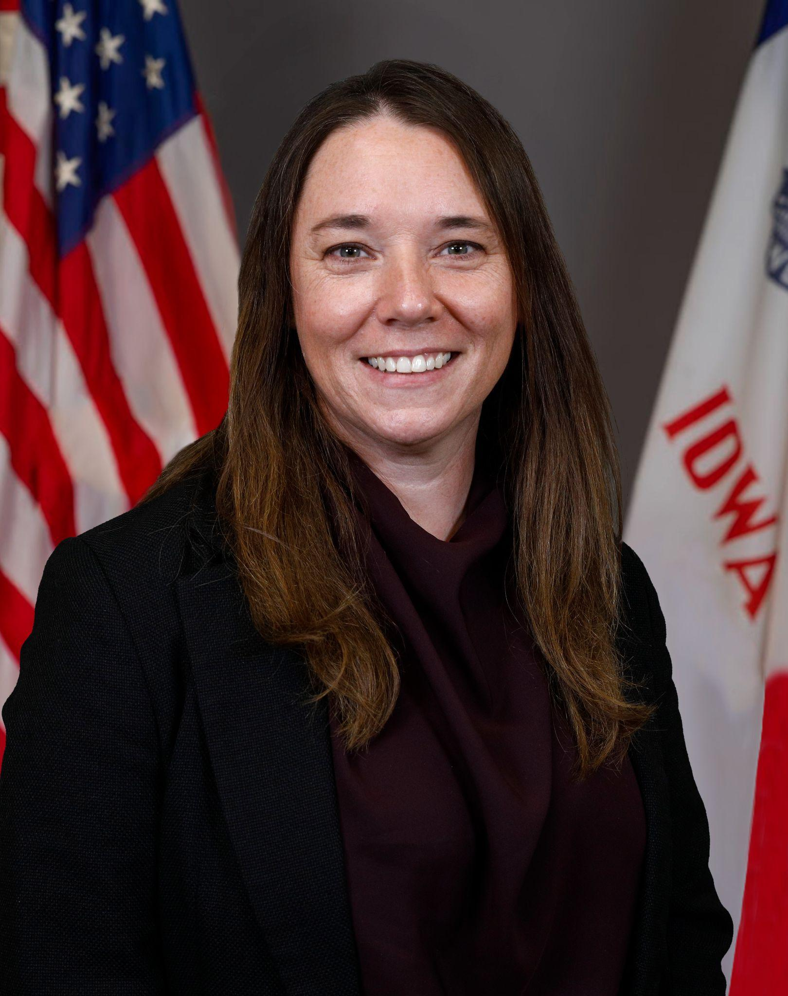
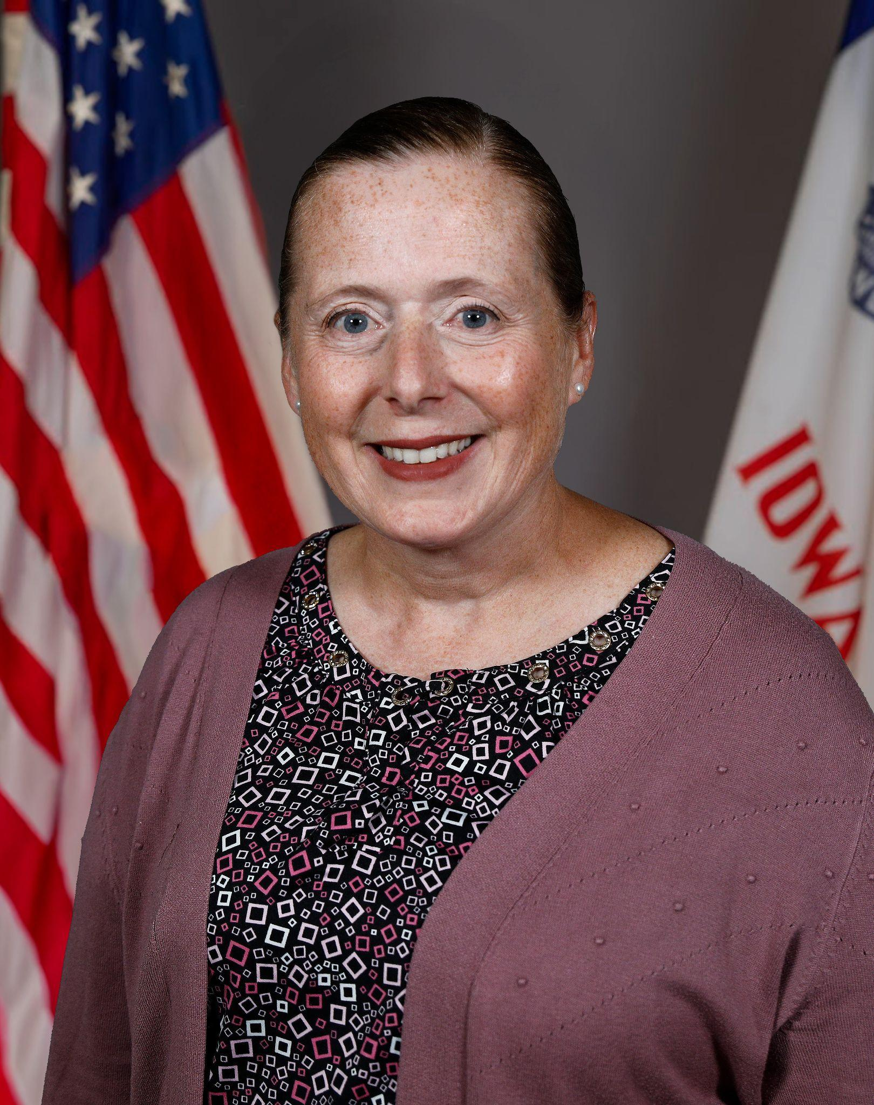
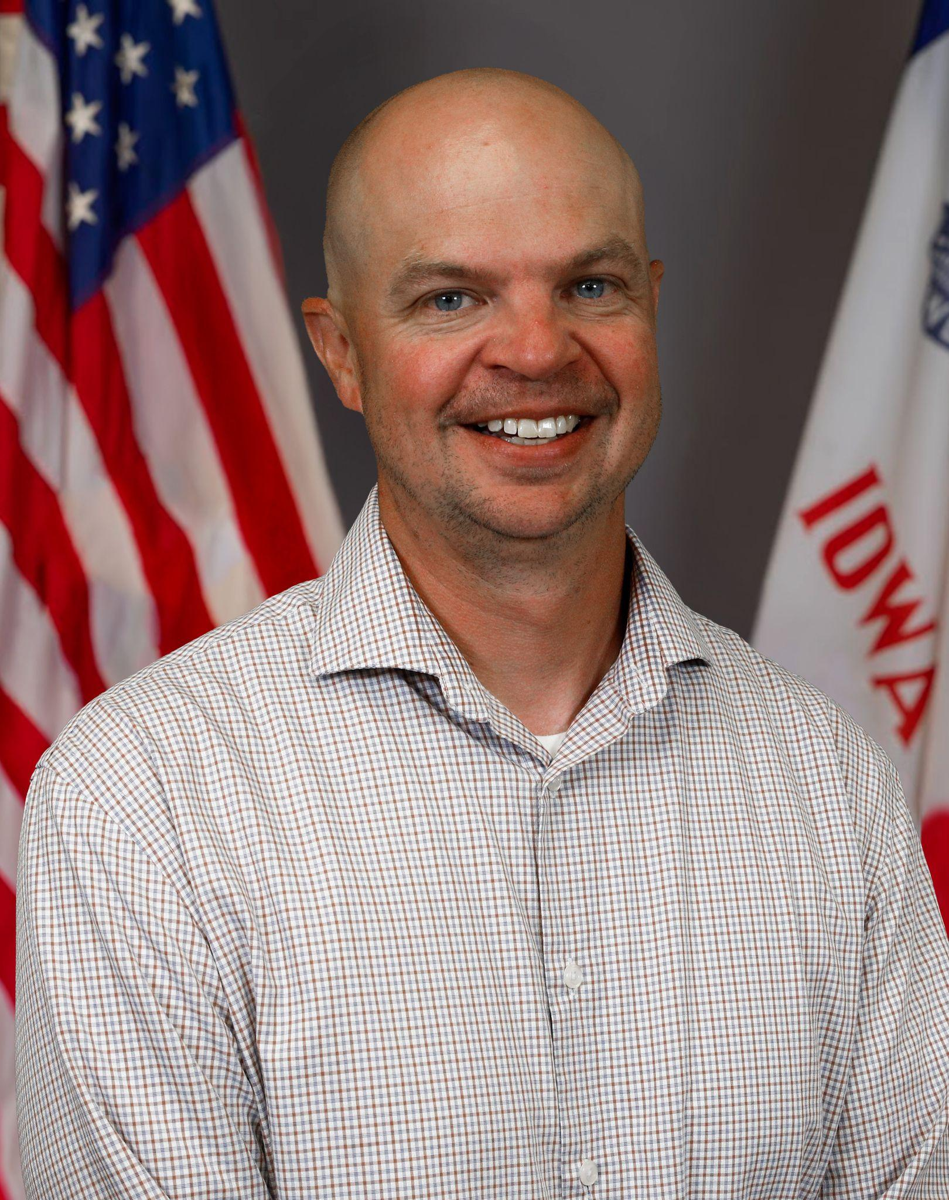
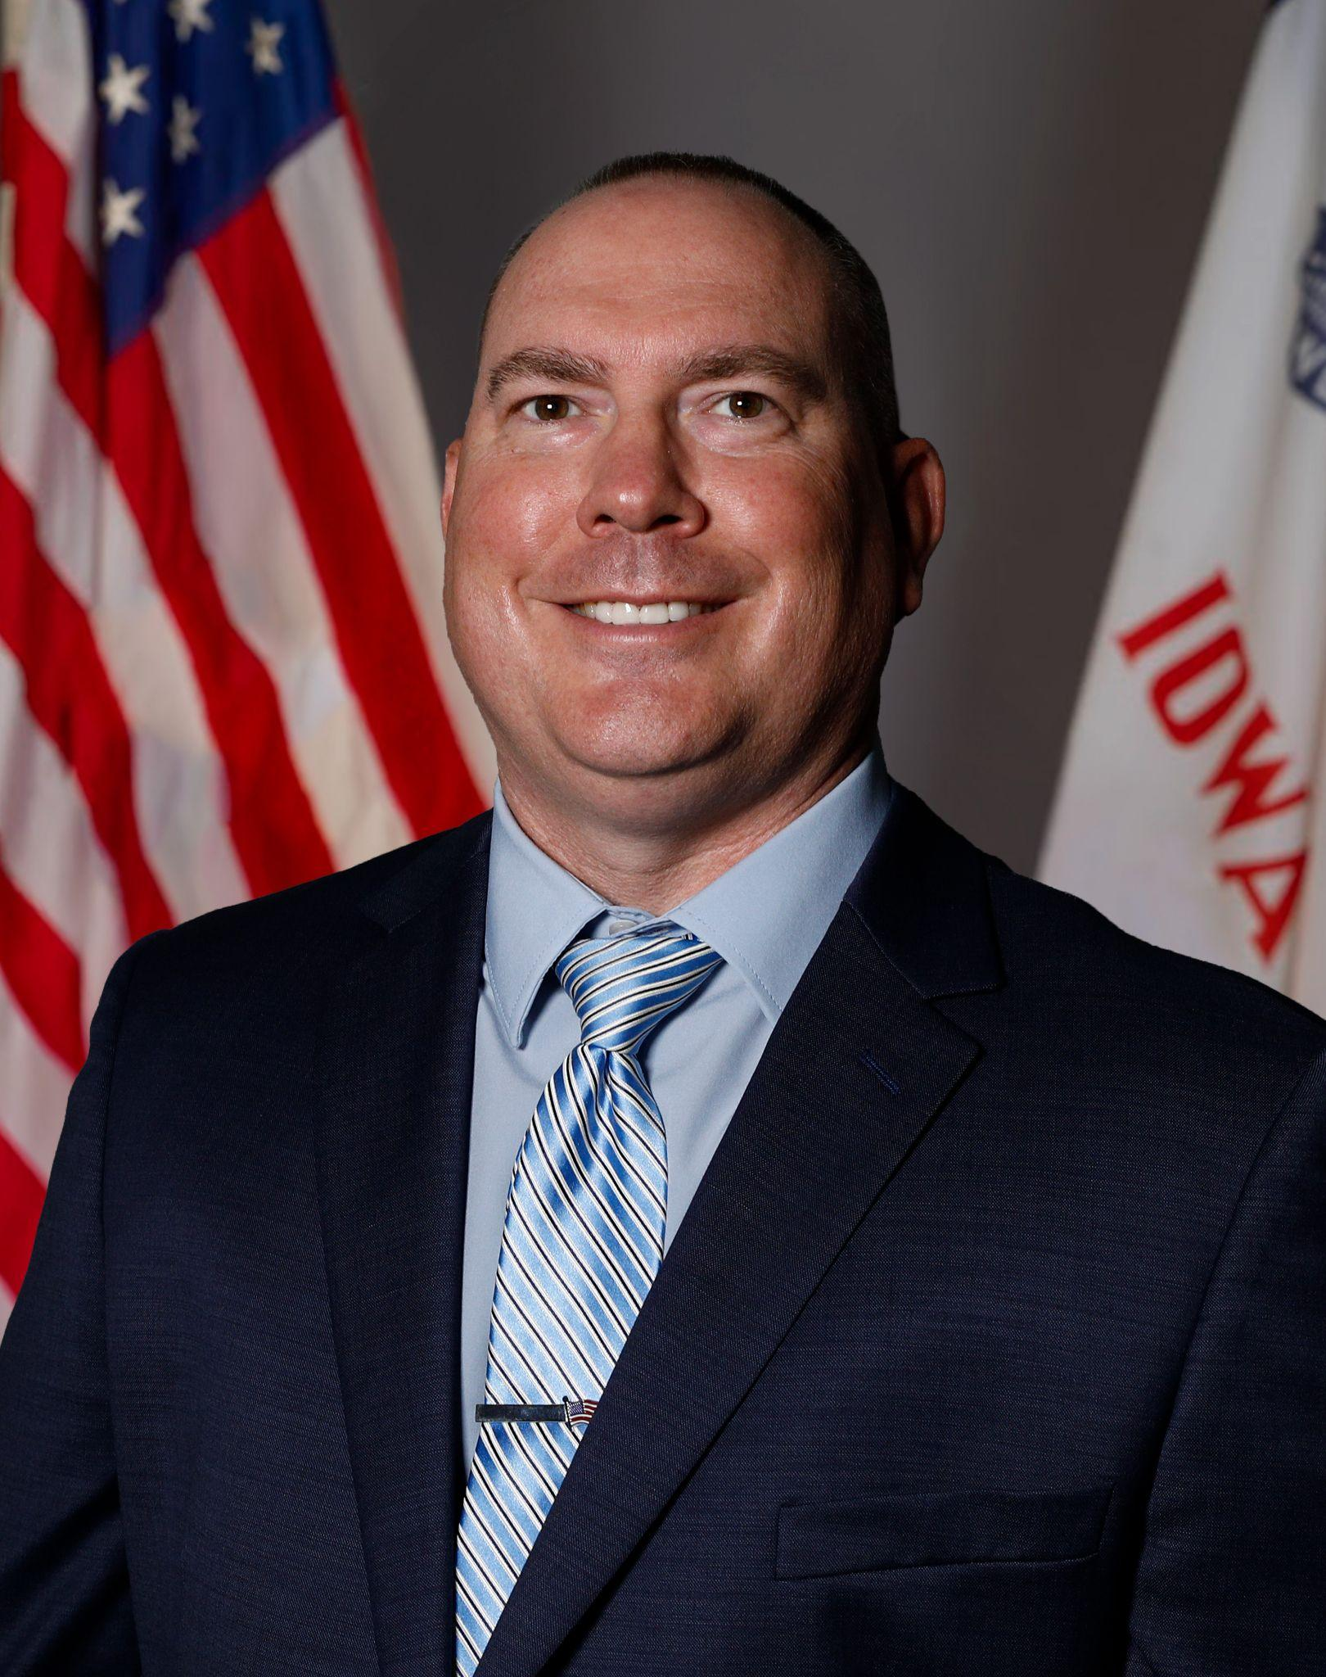
Today’s Presenters
Name: Leisa Breitfelder
Title: Division Administrator
Central Division of Special Education
Name: Name: Melissa Walker, MSN, ARNP, FNP-C
Title: School Health, Administrative Consultant,
Bureau of Accountability, Data and Finance,
Division of Special Education
Name: Patrick Judkins
Title: Regional Special Education Director (Keystone AEA Region)
Division of Special Education
Name: Matt Cretsinger
Title: Regional Special Education Director (Heartland AEA Region)
Division of Special Education

Slide 4
Participants will understand:
How to respond to parent requests
How to appropriately convene an IEP team to discuss a student’s access to FAPE
Information related to common parent requests
What to consider when discussing proposals and refusals related to common parent requests
What to consider when documenting IEP team determinations
Relevant case law implications related to parent requests and FAPE
Notes:
LEISA
At the conclusion of this presentation participants will understand:
How to respond to parent requests for supports and services not currently included within the child’s IEP.
How to appropriately convene an IEP team to discuss a student’s access to a Free and Appropriate Public Education (FAPE).
Examples of common parent requests and response considerations.
What to consider when documenting IEP team determinations.
And relevant case law implications related to parent requests and a child’s access to FAPE.
I am going to now hand it over to Matt.

Slide 5
IEP Team Response to Parent Requests

Slide 6
General Education Programming
The State Educational Agency (SEA) establishes the standards for education in Iowa.
IEP teams must consider the general education curriculum.
The Iowa Academic Standards
Essential Elements or
Early Learning Standards
Additional educational standards established in Iowa include:
Chapter 12 - General Accreditation Standards
Chapter 103 - Corporal Punishment, Physical Restraint, Seclusion and other physical contact with students
Every other chapter of law that establishes standards for education in Iowa

Slide 7
Free Appropriate Public Education (FAPE)
Special education and related services that:
(a) Are provided at public expense, under public supervision and direction, and without charge
(b) Meet the standards of the SEA
(c) Include an appropriate preschool, elementary school, or secondary school education
(d) Are provided in conformity with an individualized education program (IEP) that meets the requirements of §§300.320 through 300.324. (34 C.F.R. § 300.17; Iowa Administrative Code r. 281-41.17)
Source: https://educate.iowa.gov/media/6323/download?inline

Slide 8
Individualized Education Program (IEP)
An IEP serves as the articulation of the IEP team’s vision of FAPE.
The process of developing, reviewing and revising an IEP includes five phases:
Identify present levels of academic achievement and functional performance.
Develop measurable annual goals and determine effective progress monitoring strategies.
Determine and describe all special education services, activities and supports.
Determine the least restrictive environment (LRE) and additional considerations.
Determine how progress will be reported to parents.
Source: https://iowaideainfomation.org/special-education/individualized-education-programs/components-of-an-iep/

Slide 9
Responding to Requests for Services and Supports
Pause and Respond
Identify necessary IEP team members and schedule an IEP team meeting
Collect relevant data and develop proposal(s) for the IEP team to consider
Convene the IEP team meeting, providing opportunities for input and feedback from all team members
Provide Prior Written Notice, amend IEP as needed and implement action steps with fidelity

Slide 10
Pause and Respond
Pause
After receiving a parent request, pause
  Remain neutral
  Ask clarifying questions
  Paraphrase
  Do not make any decisions or suggestions outside of the IEP team
Respond
Considerations
  “Tell me more about…”
  “Thank you for sharing…”
  “You are an essential member of the IEP team, our next step is to schedule an IEP meeting.”
  “It sounds like this may be a conversation for the IEP team.”
  Conclude the conversation with actionable next steps.

Slide 11
Identify Necessary IEP Team Members and Schedule IEP Team Meeting
IEP Team Members (IAC § 281-41.30; IAC § 281-41.321)
Required Team Members
  Parent(s) of the student and child (when appropriate)
  Regular and special education teachers
  Representative of the public agency (LEA)
  Individual who can interpret evaluation results
  Other individuals who have knowledge or expertise
Schedule IEP Team Meeting (IAC § 281-41.322)
Considerations
  Timely response and mutually agreeable
  Participation of necessary IEP team members
  Notification of IEP meeting

Slide 12
Collect Relevant Data and Develop Proposals
Relevant Data (IAC § 281-41.324)
Use of multiple data sources
  RIOT - Review, Interview, Observe, Test
  SCIL - Setting, Curriculum, Instruction, Learner
Student strengths and interests
Postsecondary expectations
Outside reports or additional information provided by the family
Proposals
Consider any and all options that might address the parent’s request and provide the learner with access to a FAPE in the child’s LRE
  Supports
  Services
  Additional Information or Knowledge

Slide 13
Convene IEP Team Meeting
Procedural Safeguards (IAC § 281-41.613)
Review at the beginning of the meeting
Document review
During the Meeting
Engage in conversation to review the data and provide input on what is needed for the student to receive FAPE
Ensure that all IEP team members’ input is heard and considered
Plan and identify next steps
Develop, review and revise the IEP as determined by the IEP team

Slide 14
Documentation and Implementation
Examples of Documentation
List of dates and times of communication or attempts made
Summary of parent concerns and/or team responses
When procedural safeguard options were provided
Prior Written Notice (PWN) (IAC § 281-41.503)
Indicate the parent request and how the IEP team responded to that request
  Example: “The parent requested… The IEP team met and discussed…” then describe the decision.
Identify proposed or refused action
Clearly outline the reasoning
Provide parents with the PWN prior to the implementation of proposal/refusal
Implementation of Plan
Update IEP components and share
Ensure any changes are implemented as indicated

Slide 15
Special Requests

Slide 16
Nursing and Health Services
Parent Request for Health Service
Examples:
  Specific review of diet plan including snacks
  Regular nursing check-ins and instruction throughout the school day
Considerations
  Arrange an IEP meeting with appropriate team members in attendance
    LEA team member [when considering allocation of funds]
    School nurse
  Listen to parent concerns and ask clarifying questions about request
    “Can you tell us more about your request?”
  Consider requesting the school nurse complete the Special Health Care Needs Assessment Form Template

Slide 17
Nursing and Health Service Provider
Parent Request for Specific Health Service Provider
Examples:
  Specific Nurse or Paraprofessional
  Contracted Agency Nurses
  Parent as Provider
Considerations
  Arrange an IEP meeting with appropriate team members in attendance
    LEA team member [when considering allocation of funds]
    School nurse
  Teams determine provider roles and schools determine personnel assignments
  What is required to provide access to a FAPE?
  Consider requesting the school nurse complete the Special Health Care Needs Assessment Form Template

Slide 18
Online Learning
Parent or student request for online learning
Examples
Online credit recovery
Online school or classes
Considerations
IEP team determines if the learner’s IEP can be provided in the virtual setting, with or without supplementary aids and services or modifications (281 IAC 41.116(1))
  IEP teams may not use a child’s “weighting” as a decision-making factor for online learning (281 IAC 41.114(3))
Does the online learning environment meet the requirements of LRE? Will the learner have the same access to general education programming and peers they would have in the brick and mortar setting?
Provide notice of the decision through the PWN (281 IAC 41.503-.504)

Slide 19
Transportation
Specialized Transportation Requests
Examples (281 IAC 41.412)
  Travel to and from school and between schools
  Travel in and around school buildings
  Specialized equipment, such as special or adapted buses, lifts and ramps
Considerations (281 IAC 41.412)
IEP team determines transportation arrangements that are required for FAPE
  Transportation to and from the eligible individual’s residence (child care)
  Special assistance or adaptations
  Reimbursement mutually agreed upon
  No reimbursement to parents who elect to provide transportation

Slide 20
Specific Service Delivery Provider/Materials Requests
Unique Requests
Examples:
  Specific curriculum materials be used (example Orton-Gillingham or Barton System)
  Specific Service Provider (example: specific special education teacher or paraprofessional)
Considerations
Pause and Respond (ex. Tell me more about why this program or person is important to you?)
Strategies and characteristics of the request
IEP meeting
  District is responsible for allocation of resources
Provide parents with procedural safeguards
Provide PWN

Slide 21
Specific Service Requests
Unique Requests
Examples:
  Applied Behavioral Analysis (ABA)
  Music Therapy
Considerations
Pause and Respond
IEP meeting
  Data-based decision
  District is responsible for allocation of resources
Provide parents with procedural safeguards
Provide PWN

Slide 22
Consenting to Some, but Not All of the IEP
Parent request to consent to parts of the IEP (Part B-eligible student)
Examples:
Parents want academic goals/services but not the behavior goal/supports.
Parents want speech and language services but not academic goals/services.
Considerations
A parent cannot accept or decline individual services and supports that have been deemed to be essential to ensure FAPE by the IEP team.
PWN outlining explanation
Procedural Safeguards for Parents
Parents have the right to revoke consent

Slide 23
Communication
Unique Communication Requests
Examples:
  Daily behavior data
  Health reports weekly
  Conversation or daily notebook
Considerations
Parental Safeguards
  Parent’s rights to inspect and review any education records related to their child.
    Education records include: cumulative file, attendance records, health records, e-mails sent back and forth between home and school
    Special education records including progress monitoring information
Progress monitoring and reporting
IEP team member input

Slide 24
Extracurricular Participation
Non Academic and Extracurricular Activities Requests
Examples (281 IAC 41.107)
  Athletics and Fine Arts
  Special interest groups or clubs sponsored by the public agency
  High School Academic Bowl or After School Elementary Art Club
Considerations (281 IAC 41.107)
Non Academic Services
  Equal opportunity for participation in those services and activities
  Supplementary aids and services
More than just sports and clubs, what do all kids have access to?
Clarify student needs and how they can be met
Include staff who oversee the activity in the discussion

Slide 25
Remember IEP Documentation

Slide 26
Prior Written Notice
After the IEP team has met, a Prior Written Notice (PWN) should be completed to document the proposal/s and refusal/s.
  As always, it is important to document all considerations and why decision(s) were made.
If the team has determined that the request is not required for, or hinders, the child’s access to a FAPE, it is important that parents are also made aware of their parental rights. The procedural safeguards should be provided with the PWN.

Slide 27
IEP Documentation and Communication
IEP Updates
Update relevant IEP components
  Services, supports, etc…
  Do not update items that were not discussed
Share the updated information
  Parents
  Service and support providers
Consider fidelity of IEP implementation

Slide 28
Court Case Implications

Slide 29
Legal Trends and Considerations
R.N. v. Iowa Dep't of Education - Eighth Circuit 2015 - rejecting an assertion that participation in show choir was necessary for a FAPE (student did not make show choir after competitive tryouts)
Minnetonka Pub. Schs. v. M.L.K. - Eighth Circuit 2021 - rejecting parents' request for Wilson Reading program based on the school's evidence that student did not have the attention necessary to succeed in the Wilson Reading program
IDEA State Complaint (Iowa, 2024) - District was found out of compliance with its response to a parent requesting ABA therapy; the District unilaterally moved the student to dual enrollment without properly considering the request and informing the parents of the consequences to dual enrollment

Slide 30

Questions from the Field
Please post your questions in the Q&A
Contact your RSED with any follow up questions
Slides will be posted on the DE website after the webinar
Policy & Practice Webinar Series & Recordings | Department of Education

Slide 31
Future Policy and Practice Webinars
Upcoming Topics and Dates (8:30 am - 9:30 am)
May 13, 2026: Dispute Resolution
June 10, 2026: End of Year Program Evaluation (ACHIEVE) and Year-to-Year Data Comparison

Slide 32
Thank You!

