Slide 1
Perkins V
#6 FY 2027 Perkins Allowable & Unallowable Costs
April 8, 2027
10:00 a.m. to 10:55 a.m.
Amy Vybiral, MS Ed.
515-339-4520
amy.vybiral@iowa.gov

Slide 2
Agenda
Housekeeping items
FY 2027 Perkins Allowable & Unallowable Costs
Emerging Questions (FY 27 budget submissions)
  CTSO Stipends and conference travel
  Record keeping subscription services (Ineligible Platforms)
Updates: FY 2027 Perkins Application & Allocations (redirects to slide 19)
  FY27 Secondary & Postsecondary Grant Allocation Updates
  FY27 Secondary & Postsecondary/Community College Application
Perkins Webinar Resources

Slide 3
Before we begin…
3rd Quarter Claim - Due Friday April 10th
Alphabetical Lists - items listed twice
Seek prior approval (and check with your Perkins contact - consortium and independent local control-processes)
Equitable expenditures state-wide
Supplanting. Is this purchased with another fund for any other (non-cte) instructor, program, student, purpose, reason?
Allowances and restrictions are limited to federal and state requirements.
All States are required to follow the Office of the White House, OMB Compliance Supplement and Perkins Sec. 211 supplement not supplant
Due diligence - accommodating capacity at the state level (CTSO Invoices - 2027)
  Not all states have the same state code
  Example from WBL Conference - Why is this different for other states?
  Iowa passed House File 2392 in 2016 - Any state requirements are automatically Perkins ineligible.

Slide 4
Allowable Costs
Administrative costs (up to five percent)
Advertising to recruit career and technical education (CTE) instructors and personnel (Do not use “marketing.”)
Advisory committee member mileage, supplies (Meals and snacks are ineligible.)
All curriculum for Agricultural Science Education (CASE) program start-up materials and supplies (consumables with a first-time purchase) are eligible if taught by a CASE-certified, CTE-licensed instructor. (CASE instructor certification costs are ineligible.)
Comprehensive Local Needs Assessment (CLNA) development and evaluation materials (seek prior approval for off-contract pay and stipends).
CTE content specific conference costs (registration and travel expenses for CTE staff) (Individual and professional membership dues, CE Units and marketable credentials are ineligible. Diversity, equity, and inclusion related conferences - use non-Federal funding sources.)
CTSO teacher conferences and student competitive events (instructor must be licensed by the BOEE). Do not use “sponsor” or “mentor.”

Slide 5
FBLA Expenses in Two Fiscal Years - Allowable Costs
FBLA Crosses Fiscal Years
Claim expensed in two fiscal years.
Airfare and registrations can be expensed in FY 2026 in order to purchase a reasonable fare and receive the early bird discount.
Obligated prior to June 30th.
Everything else (hotel, meals, baggage, transportation, parking) must be expensed in the fiscal year in which it took place (invoice or receipt date).
This will also apply to student competitor travel in FY 2027 only*

Slide 6
Allowable Costs
Equipment
  All equipment must be inventoried. See Inventory Template (will be posted July 1, 2026 emailed April 8).
  $500 threshold for secondary school districts
  $5,000 threshold for postsecondary school districts
Equipment training fees for vendor-led training (off-contract pay and stipends are Perkins ineligible).
Games that allow for simulation and situational learning
Guest speaker mileage (stipends are Perkins ineligible).
Industry-recognized credentials (students only) including assessment costs (Practice assessment purchases are ineligible.)
Instructional materials (Supplemental only, workbooks and consumables are ineligible.)
Kits (reusable only). Institution assumes the cost to replace consumable workbooks after the first set of workbooks. (Consumable kits e.g., robotics, horticulture, etc. are ineligible for reimbursement.)
Maintenance, repair and service contracts for CTE equipment purchased with Perkins funding (to keep equipment in an efficient and operating condition).

Slide 7
Allowable Costs - #2
Middle school CTE (See Perkins V Middle School Prior Approval Form)
Off-contract pay for CTE staff (limited to CTSO Stipends, self-study, and CLNA and approved . All off-contract pay must have prior approval).
Professional development costs provided for internal school district or community college staff including mileage and materials
In-state and out-of-state professional development (registration, airfare, parking, ground transportation, hotel, mileage, meals, baggage) includes CTSO conferences for CTE staff.
Printers, limited to Stratasys, MakerBot, 3D, blueprint, large format (≥ 24” wide), CAD, Texture UV, Edible, Direct-to-Film (DTF) digital transfer, and new and emerging technology. (Inkjet and laser printers are ineligible) Seek prior approval
Subrecipient institutional, organizational & professional membership (not individual instructor/person) in a professional organization (e.g., Home Builders Association).
Project Lead the Way (PLTW) equipment and supplies, if taught by a CTE-licensed and PLTW-endorsed instructor (PLTW instructor certification costs are ineligible).
Rentals and leases (welding tanks, technology contracts)

Slide 8
Allowable Costs - #3
Reusable and rebuildable EV car kits (e.g. Switch Lab EV)
Stipends (limited to CTSO stipends, self-study, and CLNA. All off-contract pay must have priorapproval).
Substitute teacher pay for CTE staff who are out of the office to attend conferences and professional development events.
Student assessment and certification fees (e.g., CNA, CMA, OSHA 10)
Textbooks (only for new courses with new competencies).

Slide 9
CTSOs Allowable Costs
Students (competitors only)
  Registration costs for in-state & out-of-state competitions
Instructors/Advisors (Must be CTE licensed by the BOEE do not use “mentor” or “sponsor”)
  Stipends (seek prior approval - ends June 30, 2028)
  All additional CTSO costs except for garments that stay with the program (jackets, welding gloves/aprons, etc.) are Perkins ineligible beginning July 1, 2026. See Unallowable Costs.
All professional development conferences and CTSO competition travel costs
Institutional/Affiliated Memberships
  Memberships in a quantity of one - Eligible Invoice Examples
CTSO claims FY 2027
  Claims without required eligible invoices will be revised & paid without the CTSO reimbursement
  Memo and revised documentation will be returned to recipients.
  CTSO reimbursement will be paid with the next eligible claim.

Slide 10
Unallowable Costs - #4
Building Projects (ineligible consumable purchases – see page five for detailed auditing issues).
Cancelled conferences costs with prepaid registrations & airfare, etc.
  Contact CTE Bureau to determine if intervention with the organization for refunds is possible). Jeff Fletcher
  Recipient policy must follow Department Policy regardless of the cancellation reason (per BC and CFO Dec 11, 2025, Bureau of Agency Finance).
Capital expenditures (facilities, HVAC, permanent structures, immobile greenhouses) - seek prior approval for wiring
Career Information Systems (e.g., IHAPI, Kuder, Xello, YouScience). HF2392
  May not be purchased as “supplemental curriculum” for secondary and postsecondary WBL programs (supplanting).
Commencement and graduation costs
Computers (must exceed technological specs used for school district-funded devices, for purposes of accommodating software needs: artificial intelligence related purchases, gaming, CAD, complex 3D models, computer science software, Adobe Suite/Photoshop, Microsoft Office - Seek prior approval
Consumable items (consumable kits, paper, batteries, toner, food, varnish, wood, shelving, storage, welding glasses).

Slide 11
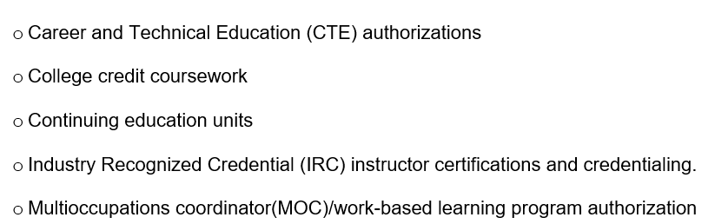
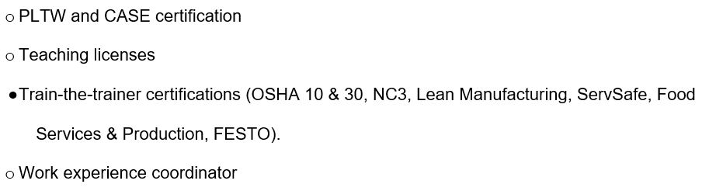
Unallowable Costs - #5
Guest speaker stipends
  E.g., speakers offering on-site, project and work-based experiences may have items eligible for reimbursement - Seek prior approval
Installation costs required to meet code requirements for CTE equipment purchased - Seek prior approval
Interactive Panels: Promethean, i3TOUCHX2, Smart Whiteboards, Interactive Touch Panels.
IRC Practice Tests (no credential results from the assessment).
  Use non-Federal funding sources for practice tests.
Marketable credentials, endorsements, certifications and degrees for CTE staff (see page five).
  Erroneously reimbursed credentials funding must be returned to the state Perkins allocation via check.
  Contact Amy Vybiral or Jeff Fletcher for reimbursement instructions.

Slide 12
Unallowable Costs - #6
More examples…
Entertainment, tickets to sporting events, Furniture - All classroom furnishings are ineligible (supplanting). School district assumes responsibility for tables, chairs, desks (including mobile whiteboard desks and tables), benches, ergonomic workspaces, sectionals, end tables, carpet, lamps, lighting, workstations and area rugs. Furniture will not be approved as “equipment.” Gifts, raffles and door prizes, promotional materials (t-shirts, pens, cups, key chains) | Insurance Items retained by students (blazers, uniforms, jump drives, t-shirts) Marketing costs of student-run businesses, student activity costs, clubs Meals (meetings, student camps, professional development or advisory meetings) Memberships (individual instructor, staff, student) in CTSOs or professional organizations Newspaper subscriptions Individual student and instructor memberships to professional organizations or CTSOs

Slide 13
Unallowable Costs - #7
● Textbooks for existing courses (unless the curriculum is “supplemental” but may not use approved CISs from IAC 279.61)
● Transportation for students (supplanting)
● Vehicles including: automobiles, trailers, trucks, buses, helicopters, ATVs, gators, tractors, tractor tillers, airplanes, boats,
golf carts, snowmobiles, motorcycles, heavy equipment, skid loaders, and electric vehicles.
Career and Technical Student Organizations (CTSO)
Student travel costs
Student CTSO membership fees
Note: eligible course materials and supplies should be purchased as part of the instructors’ course/program budgets that go through the Perkins budget approval process in March of each year.

Slide 14
Limits to Stipends and Off-Contract Pay FY 2027
Supplanting
Limit stipends and off-contract pay to self-study and CLNA work.
Non-CTE instructional use
Uniform Grant Guidance
“Reasonable, necessary, “prudent person” standard.
Ineligible
Advisory meetings, claims, ordering, inventory, lab maintenance, reporting, career fairs, open houses, back to school, CTE advising, etc.
Events and activities that non-CTE instructors are expected to facilitate and attend.

Slide 15
Supplanting
Perkins monies may be used as a first-time funding source for new CTE initiatives, equipment, salaries, institutional memberships, conferences, in- and out-of-state travel, CTE program costs, off-contract pay, CLNA and program evaluation costs.
However, if at any time the above costs are paid for with non-federal funding sources, the costs may not be paid for with Perkins monies in subsequent years. This applies to all Perkins expenditures
Supplanting has occurred when the school district or community college:
Was required to make the item available under other federal, state or local law (e.g., career information system IHAPI, Kuder, Xello, YouScience etc. or OSHA or other safety requirements), or
Purchased the same or similar item(s) or service(s) with non-federal funds in the prior year.
School districts and community colleges may not exclude CTE students, programs, courses or classrooms from purchases of the same or similar item(s) and service(s) purchased for non-CTE students, programs, courses or classrooms.

Slide 16
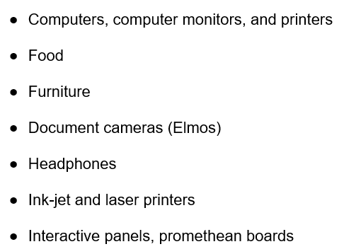
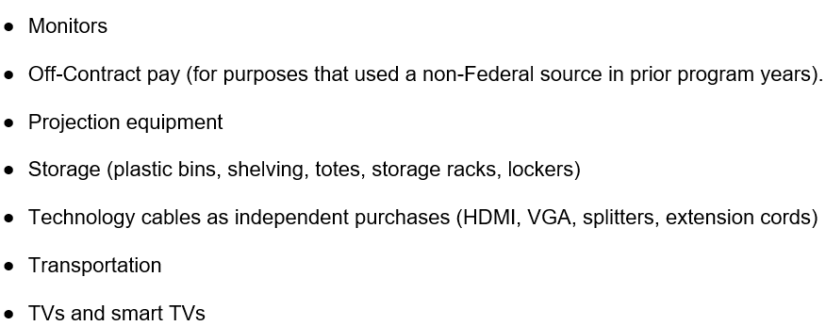
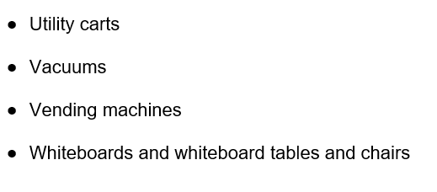
Supplanting Examples
Reminder: School districts and community colleges may not exclude CTE students, programs, courses or classrooms from purchases of the same or similar item(s) and service(s) purchased for non-CTE students, programs, courses or classrooms.

Slide 17
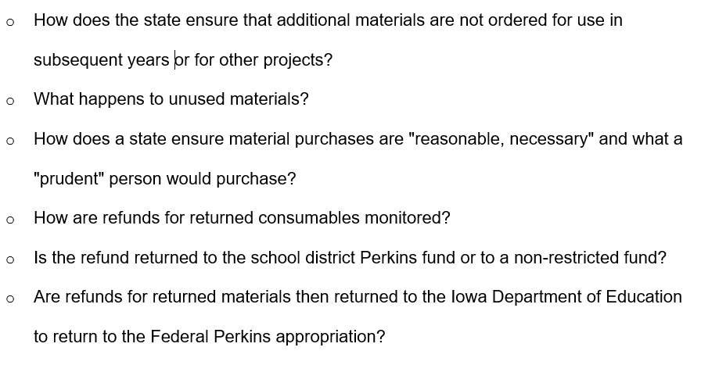
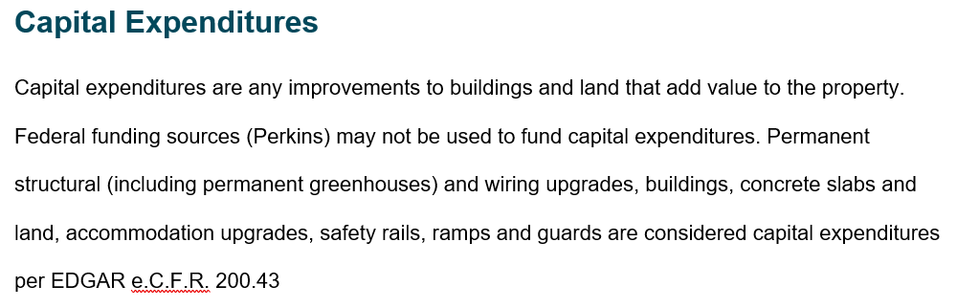
Building Projects & Capital Expenditures
Student projects are valuable experiences, building projects that require consumable purchases are ineligible for the following reasons (auditing challenges); I.e., permanent structures that increase the value of property & land:
When does a project become a capital expenditure?
  Is it a shed or a building?
The state is not able to audit consumables

Slide 18
Updates: FY 2027 Perkins Application & Allocations
FY27 Secondary & Postsecondary Grant Allocations updates
US DE, OCTAE - PROGRAM MEMORANDUM 26-4 released nationally 4/1/26
Waiting on ‘final approval’ for the full draft FY27 Iowa Perkins V budget
FY27 Community College allocations – closing EOB, 4/8/26: Annual Iowa CTE-Pell Audit Verification Process
FY27 Secondary & Postsecondary/Community College Application
The FY27 Perkins V Secondary and Postsecondary applications are anticipated to open in the IowaGrants system on or around May 1, 2026. The application deadline will be June 30, 2026.
FY27 - Perkins V - Secondary Application to be posted on or around May 1, 2026
FY27 - Perkins V - Postsecondary Application to be posted on or around May 1, 2026
TBA: 2026-27 Perkins V Application Demonstration for Grant Recipients Webinar
(Document) ~ 5/1/26: FY27 Perkins Grant Application with Claim Instructions: General Instructions for Submission
  Updated annually - walks through each step of each form, including the clicks to make with “screenshots”
Career and Technical Student Organizations (CTSO) Student Competition Funding ; Perkins Consortium FAQs ; Consortium Requirements for Distribution of Perkins Funds to Secondary Education

Slide 19
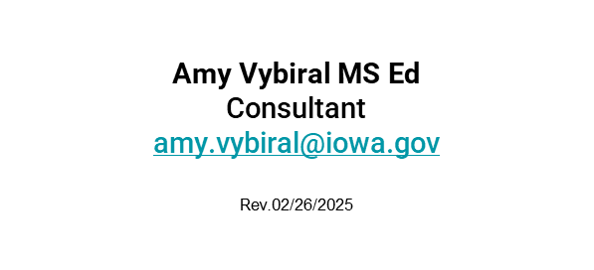
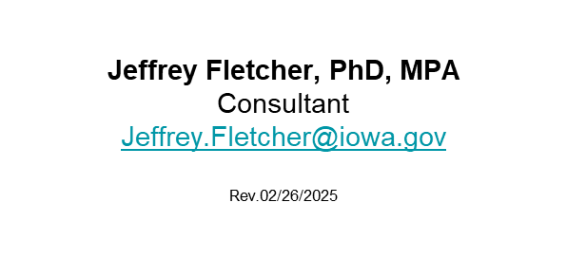

Contact Information

