Slide 1
Education Flexibility (Ed-Flex) Program
Authorized under the Education Flexibility Partnership Act of 1999,
as amended by the Every Student Succeeds Act (20 U.S.C. § 5891b).
Notes:
Joe- Welcome and opening

Slide 2
Agenda
Components of Iowa’s Unified Allocation Plan
Educational Flexibility: Description and Purpose
Iowa’s Approved Waivers
Provisions Excluded from Waiver Authority
Ed-Flex Application (Forms, Requirements, Completion)
Resources
Contact Information
Questions & Discussion
Notes:
Joe-

Slide 3
Components of Iowa’s Unified Allocation Plan
Federal approval of critical steps in Unified Allocation Plan allows Iowa to:
1. Operate a Block Grant for Federal State-Level ESEA Funds
Title II, Part A (Supporting Effective Instruction)
Title III, Part A (English Language Acquisition, Language Enhancement, and Academic Achievement)
Title IV, Part A (Student Support and Academic Enrichment)
Title IV, Part B (21st Century Community Learning Centers)
2. Provide Targeted Local Flexibilities for School Districts
Iowa may approve school district requests to:
Carry over up to 100 percent of Title I, Part A funds to support significant, evidence-based instructional investments; and
Waive up to 100 percent of Title IV, Part A spending limitations, including requirements that larger grants allocate set percentages to well-rounded education, safe and healthy schools, and education technology.
Iowa also may approve state institutions’ requests to use up to 100% of Title I, Part D funds to support educational transitions for students in nontraditional home settings and justice-connected youth.
3. Advance Modernized Reporting and Administrative Alignment
The U.S. Department of Education committed to advancing Iowa’s request to streamline programmatic and fiscal reporting as a model for the nation.
This will:
Rightsize administrative workloads, reducing time and resources spent on duplicative administrative duties
Continue to ensure transparency and accountability
Notes:
Jillian

Slide 4
Educational Flexibility: Description and Purpose
Ed-Flex is a program that allows the Secretary of the U.S. Department of Education to delegate to State educational agencies (SEAs) the authority to waive statutory or regulatory education requirements that may, in particular instances, impede local efforts to reform and improve education.
Ed-Flex is designed to help local educational agencies (LEAs), educational service agencies (ESAs) and schools carry out educational reforms and raise the achievement levels of all children by providing increased flexibility in the implementation of federal education programs.
Notes:
Jillian

Slide 5
Iowa’s Approved Waivers
In January 2026, the United States Department of Education approved the Iowa Department of Education’s (Department) request for targeted local flexibilities, allowing the Department to consider and approve subgrantees’ requests for the following programs:
Title I, Part A: Waives the 15% carryover limitation (once every three years)
Allows 0–100% carryover annually for SEA-approved, evidence-based supports
Title I, Part D: Allows subgrantees to reserve more than 30% for transition services
Permits up to 100% of funds for transition services for justice-connected youth (with approval)
Title IV, Part A: Waives spending limitation requirements under ESEA section 4106(e)(2)(C)–(E)
*Approved until the 2029-2030 school year
Notes:
Veronica

Slide 6
Provisions Excluded from Waiver Authority
A State cannot grant any waiver that would undermine the underlying purposes of the statutory requirements of the program for which a waiver is sought (20 U.S.C. § 5891b(c)).
In addition, the Ed-Flex program does not authorize an SEA to waive any statutory or regulatory requirements relating to:
Standards, assessments, and accountability requirements under ESEA section 1111
Maintenance of effort
Comparability of services
Equitable participation of students and professional staff in private schools
Parental participation and involvement
Distribution of funds to LEAs
Serving eligible school attendance areas in rank order in accordance with ESEA section 1113(a)(3)
The selection of a school attendance area or school under subsections (a) and (b) of ESEA section 1113
Use of Federal funds to supplement, not supplant, State and local funds
Notes:
Veronica

Slide 7
Ed-Flex Application (Forms)
Any LEA that would like to request an Ed-Flex waiver will need to complete the Ed-Flex Waiver Request Form that is available in the Consolidated Accountability and Support Application (CASA) 2025–26 Dashboard.
Ed-Flex Waiver Request Forms for FFY 2025 (school year 2025-2026) are due April 15, 2026.
LEA waivers are granted for one federal fiscal year and require annual renewal.
Notes:
Isbelia

Slide 8
Ed-Flex Application (Requirements)
An LEA, ESA or school requesting a waiver must provide its SEA with an application that:
Indicates each Federal program that would be affected and each statutory or regulatory requirement that would be waived
Describes the purposes and overall expected results of waiving each requirement
Describes, for each school year, specific, measurable educational goals for each LEA, ESA or school affected by the proposed waiver, and for the students served by the LEA, ESA or school who are affected by the waiver
Explains why the waiver will assist the LEA, ESA, or school in reaching these goals
In the case of an application from an LEA or ESA, describes how the notice and comment requirements in 20 U.S.C. § 5891b(a)(7) have been met
Any additional information that the SEA reasonably requires (20 U.S.C. § 5891b(a)(4)(A)).
Requirements outlined in 20 U.S.C. § 5891b(a)(7).
Notes:
Isbelia

Slide 9
Public Comment Requirements
The Department collected robust feedback from multiple educational stakeholder groups throughout the development of the Unified Allocation Plan, in accordance with federal law (20 U.S.C. § 5891b(a)(7)).
In accordance with federal requirements (20 U.S.C. § 5891b(a)(7)), subgrantees seeking an Ed-Flex waiver must:
Provide the public with adequate notice of the proposed waiver, including a description of any improved student performance that is expected to result from the waiver, in a widely read or distributed medium;
Provide the opportunity for parents, educators, and all other interested members of the community to comment on the proposed waiver;
Provide the opportunity for the comments to be reviewed by any member of the public; and
Submit the comments received with the agency’s application to the Department, if requested.
Notes:
Isbelia

Slide 10
Accessing the Ed-Flex Application in CASA
Steps to Begin:
🔐 1. Log In
Access CASA and open the 2025–2026 Dashboard
📋 2. Locate Waivers Section
Under Consolidated Application Requirements, find Waivers
▶️ 3. Start the Application
Click the “Not Started” button next to Waivers
✏️ 4. Enter Data
Select Data Entry to begin the request
Notes:
Luke

Slide 11
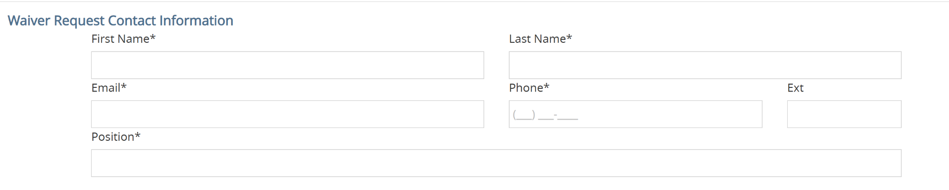
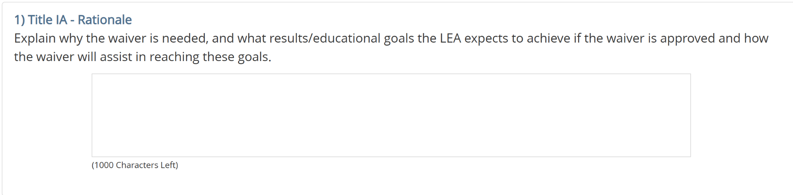
Completing the Ed-Flex Waiver Application
Notes:
Luke

Slide 12
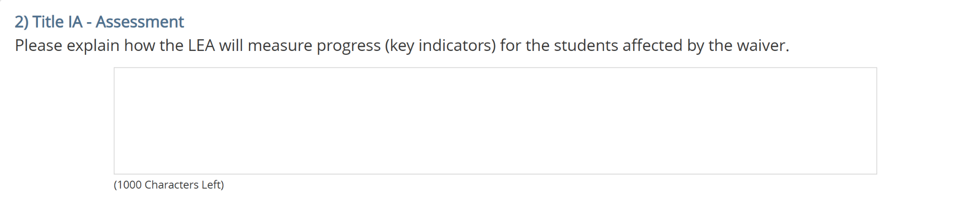
Completing the Ed-Flex Waiver Application 1
Notes:
Luke

Slide 13
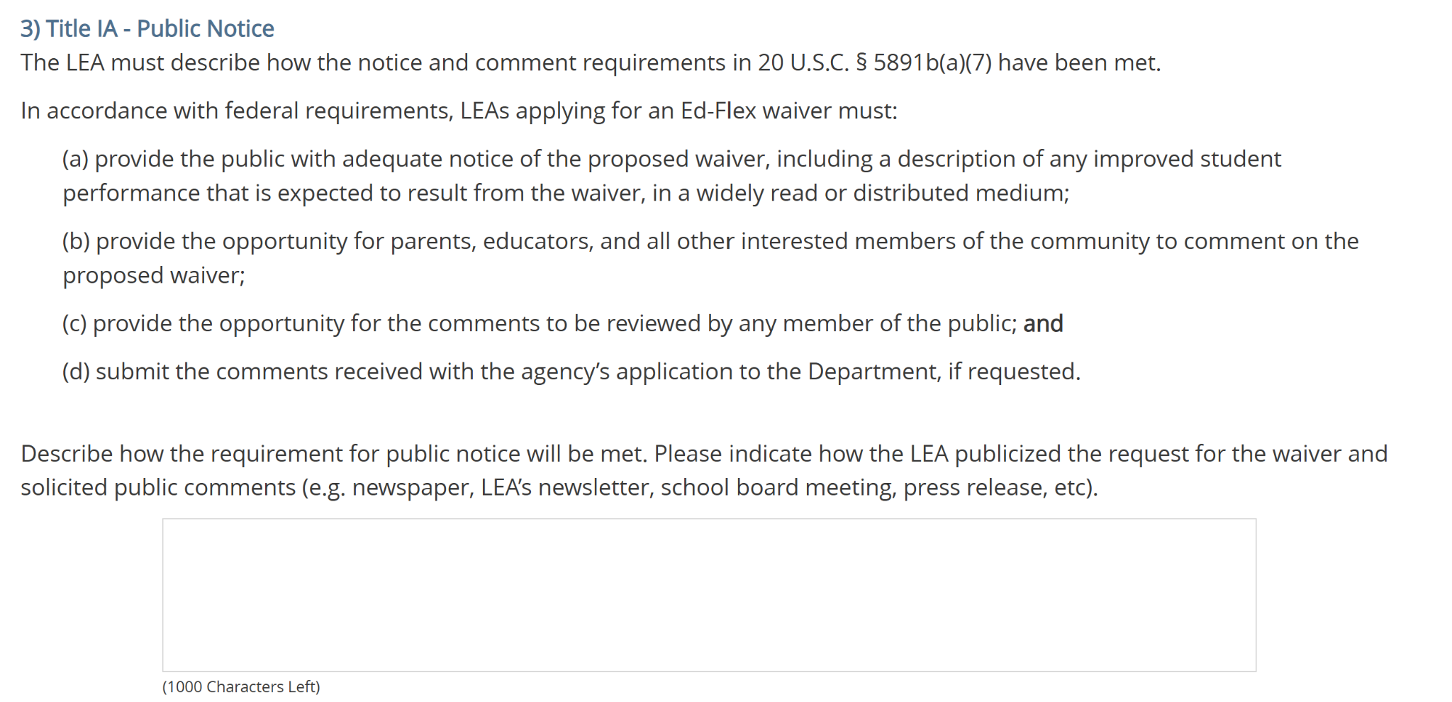
Completing the Ed-Flex Waiver Application 2
Notes:
Luke

Slide 14
Resources
Unified Allocation Plan
ESEA Programs - Guidance and Allocations
ESEA Programs - Office Hours
ESEA Programs Professional Learning Recordings
FAQ
Contacts
Notes:
Jina-

Slide 15
Questions and Discussion
Notes:
Jina- Conclusion of the presentation, open it up for questions

