Slide 1
Child Find and
Foundations of FAPE
Iowa Students with Disabilities Parentally Placed in Accredited Nonpublic Schools

Slide 2
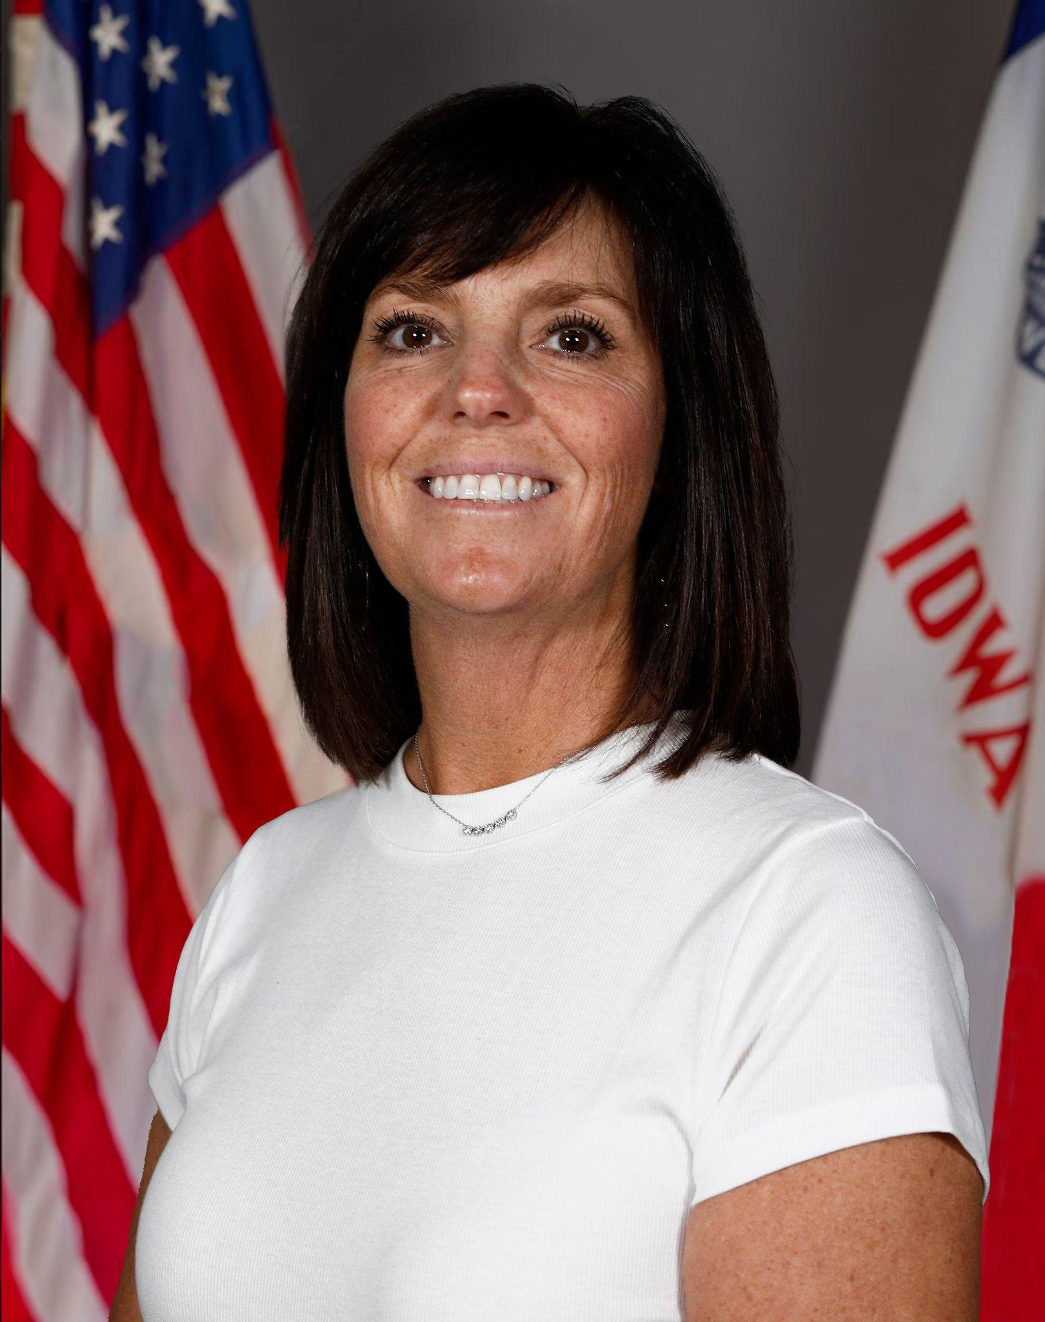
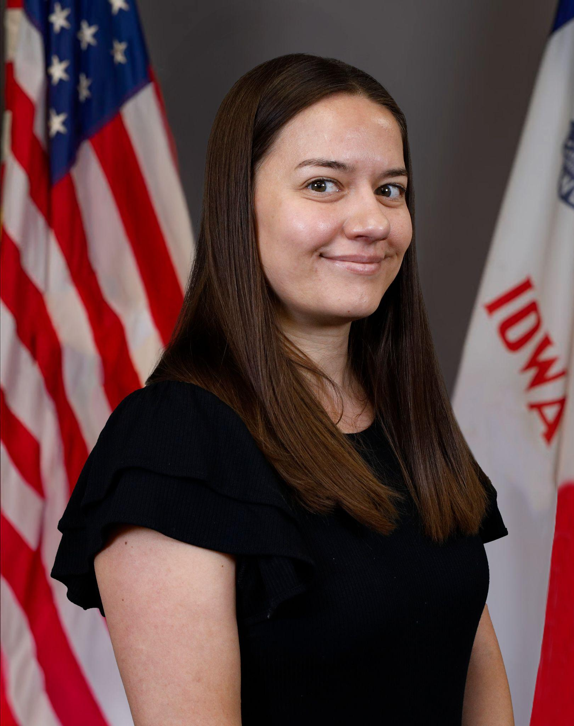
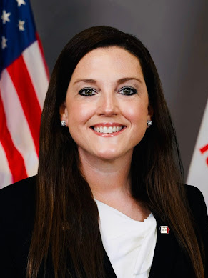
Today’s Presenters
Janelle Danner
Nonpublic School Liaison
Jessica Hernandez
Child Find
Katherine Hall
IEP Development

Slide 3
Child Find
Iowa rules about Child Find and accredited nonpublic schools
What Child Find means
How concerns about a student begin the process
What families and schools should expect during initial evaluation
How AEAs, public schools, accredited nonpublic schools, and families work together
Topics We Will Cover:

Slide 4
Iowa Rules about Child Find and Accredited Nonpublic Schools
Iowa rules require AEAs to:
Locate and evaluate students with disabilities in accredited nonpublic schools
Ensure students can participate equitably
Use processes similar to those used for public school students
Complete the process in a comparable timeline
IAC 281-41.131
IAC 281-41.132
IAC 281-41.134

Slide 5
Planning Through Consultation
AEAs, public school districts, accredited nonpublic schools and parent representatives meet to plan:
How Child Find will operate
How families will learn about the process
How special education services shall be available to eligible accredited nonpublic school students in the same manner and to the same extent that they are provided to public school students

Slide 6
Roles in the Child Find Process
AEA
Ensures a Child Find plan exists
Coordinates evaluation processes
Maintains required records
Accredited Nonpublic Schools
Help inform parents of the Child Find Process
Provide data evidence about student performance that supports the concern
Collaborate with team
Communicate with families
Participate in evaluation and eligibility meetings
Families
Can raise concerns at any time
Share information about their child
Participate in meetings and decisions
Public School Districts (collaborative partner, as requested)
May provide district staff when identification, evaluation and reevaluation require district expertise
The public school district may provide specialized expertise, tools, or staff as requested by the AEA, but they do not replace the AEA’s responsibility for Child Find

Slide 7
Where Child Find Activities May Occur
Child Find activities may occur:
At the accredited nonpublic school, or
At the public school
This depends on the situation and available resources.

Slide 8

Parent Permission and Sharing Information
If a student attends an accredited nonpublic school outside the family’s resident public school district:
Parent permission is required before schools share student information.

Slide 9

Child Find Process

Slide 10

What is Child Find?
Child Find is the process used to determine whether a child:
Has a disability, and
Needs special education services
Child Find applies to children ages birth through 21.

Slide 11

How Does the Child Find Process Start?
The process may begin when concerns arise in areas such as:
Academics (reading, writing, math)
Behavior or social-emotional development
Communication
Hearing or vision
Physical development
Health
Life or independent living skills

Slide 12

Evidence Is Needed to Support Concerns
Concerns about a student should be supported by data, such as:
Classroom assessments
Screening results
Observations
Attendance or behavior information
Reports from families or medical providers

Slide 13
Determining Whether a Disability Is Suspected
The AEA reviews available data evidence to answer four key questions:
Is there information suggesting a possible diagnosis that is affecting the student’s school performance?
Is the student not meeting standards and is unique compared to peers?
Is the student receiving high quality instruction but is not meeting standards and not making progress?
Does the student appear to need intensive support to succeed in school?

Slide 14
Important: Evaluations Should Not Be Delayed
If a disability is suspected, the evaluation process should move forward
An evaluation should not be delayed because:
the school wants to try more interventions first
a specific system (like RTI or MTSS) has not been used
a student hasn’t gone through “enough” general education supports

Slide 15
If a Disability Is Suspected
If the AEA determines a disability may be present:
Parents receive Consent for a Full Evaluation
If a parent requested the evaluation and a disability is not suspected:
Families receive a written explanation of the decision

Slide 16

Suspicion does not equal eligibility

Slide 17
Evaluation

Slide 18
Evaluation Timeline
Once both occur:
A disability is suspected
Parent consent is received
The evaluation must be completed within 60 calendar days.

Slide 19

How the Evaluation is Completed
Evaluations contain information gathered through multiple sources:
Understanding the Student
Review of records
Interviews with people who know the student
Background information
Observing and Measuring Learning
Observations
Learner strengths and concerns
Present levels of performance
Assessments or testing
Instructional and intervention plans
Planning for Educational Need
Concepts and skills
Method and delivery of instruction
Accommodations and learning supports

Slide 20
What the Evaluation Looks At
The evaluation examines three key areas:
Performance
How the student is currently performing compared to expectations
Progress
How the student responds to instruction and support
Needs
What the student requires in order to learn and succeed

Slide 21
Factors That Cannot Be the Main Cause
A student cannot be identified with a disability if the primary reason for difficulty is:
Lack of appropriate instruction in reading
Lack of appropriate instruction in math
Limited English proficiency
Cultural, environmental, or economic factors

Slide 22

Eligibility Meeting

Slide 23
Eligibility Team Meeting
A team meeting is held to determine if a student is eligible, or qualifies, for special education.
Participants may include:
AEA evaluation staff
Teachers
Public school representatives
Accredited nonpublic school representatives
Parents
Others with knowledge of the student

Slide 24

Determining Eligibility
To qualify for special education, the team must determine:
The student has a disability, and
The student needs special education services.

Slide 25
If a Student Is Eligible
An Individualized Education Program (IEP) must be developed within 30 days.
An IEP meeting must occur
The student’s educational needs are reviewed
The team develops a plan for services and supports

Slide 26
Practice Scenario: Teacher Concerns and Raising DS
A teacher at an accredited nonpublic school notices a student struggling in reading.
What data evidence might help support the concern?

Slide 27

Collaboration is Key!
Child Find works when:
Families share concerns
Schools provide data and support
AEAs coordinate the evaluation process

Slide 28
Free Appropriate Public Education (FAPE)
Iowa Students with Disabilities Parentally Placed in Accredited Nonpublic Schools

Slide 29
Where FAPE Fits
Child Find → Identifies students
Evaluation → Defines needs
FAPE → Defines the student’s educational program
FAPE connects needs to service, supports and outcomes.

Slide 30
Participants will:
Free Appropriate Public Education
Understand what FAPE means
Learn how decisions about services are made
Know what to look for to determine if FAPE is being provided

Slide 31
FAPE Definition
Free: No cost to families
Appropriate: Designed for meaningful progress
Public: District remains responsible
Education: Academic + functional skills
IEP: Services must be delivered as written

Slide 32
FAPE in Accredited Nonpublic Schools (Iowa)
AEA/Public school districts are responsible for ensuring FAPE
Applies to students in accredited nonpublic schools
Special education services are provided at no cost to families
Services may be delivered at the accredited nonpublic school or at another location
Location decisions are made by the district/ AEA

Slide 33
What does “Appropriate” Mean in FAPE?
Grounded in IDEA and court decisions
Individualized to the student
Designed for meaningful progress
Progress looks different for each student
Not based on a standard formula

Slide 34
“Appropriate” in Context to FAPE
Amy Rowley was a student who is deaf. Her parents requested a full-time interpreter. The school provided other supports. Amy was making progress in school.
Parents’ concern: Was this enough, or should she receive additional service (full-time interpreter)?
Court decision: Schools must provide access to education and some educational benefit - not maximize services
What this means for FAPE:
Students must have access to education
IEPs must provide meaningful educational benefit (more than trivial)
Schools are not required to provide the maximum possible services
Board of Education v. Rowley (1982)

Slide 35
What does “Progress” Really Mean?
Endrew F. was a student with autism whose IEP goals remained largely unchanged, resulting in limited progress.
Parents concern: The plan was not supporting meaningful growth
Court decision: IEPs must be reasonably calculated to enable meaningful progress based on the child’s unique needs
What this means for FAPE:
Students should make meaningful, individualized progress
IEPs must be tailored to the student - not one-size-fits-all
Schools must aim beyond minimal progress
Endrew F. v. Douglas County School District RE-1 (2017)

Slide 36
What FAPE Is and Is Not
FAPE is:
Individualized
Designed for meaningful progress
Based on current data and student needs
Provides access to general education
FAPE is NOT:
The ‘best’ possible program
A guarantee of outcomes
One-size fits all
Static from year to year

Slide 37
Why Misunderstandings About FAPE Persist
FAPE is a legal standard, not a checklist
Services should be based on student need, not just what’s typically offered
Misunderstandings can happen when communication isn’t clear
What worked before may not be what’s needed now

Slide 38
FAPE as an Ongoing Obligation
Determine using current data
Revisited as student needs change
Implemented over time, not decided once
Requires ongoing team judgement based on data

Slide 39
Q&A
A Q&A document will be posted along with these slides on the website

Slide 40
DEPARTMENT OF EDUCATION
SPECIAL EDUCATION
ACCREDITED NONPUBLIC SCHOOLS
Accredited Nonpublic Schools & Special Education

Slide 41
Next Webinar- APRIL
Individualized Education Programs (IEPs) & FAPE
Wednesday, April 15, 2026
8:30-9:30 am
Same Zoom link
Guidance on IEP development, implementation and alignment with Iowa’s ACHIEVE system, with attention to shared roles, documentation and the family portal.
Zoom using passcode 431127

Slide 42
Thank You!

