Slide 1
Maximizing ESEA Programs
Braiding and Blending ESEA Programs and Funds

Slide 2
Purpose
Provide guidance to support the braiding and/or blending of federal funds to meet specific identified student and staff needs resulting in improved student outcomes and closing student achievement gaps.

Slide 3
Comprehensive Needs Assessment
Based upon district need
Funding requirements/limitations
Effective and efficient use of funds
Identify stakeholders who need to be involved in the decision-making process.
Identify student and staff needs to determine how the federal and state funds can be most effectively utilized to address those needs

Slide 4
Braiding and Blending
Braiding or Coordinating Uses of Funds
Blending
Refers to the weaving together of federal, state, and local funding streams.
Coordinates funds from different sources for one purpose or initiative.
Funding sources keep their specific identify.
Each funding stream maintains its own reporting requirements.
Refers to co-mingling the funds into one source in which leaders can draw down service funding, pay for personnel expenses, or meet other program needs.
Combines funds from multiple sources into a single pot for a common purpose or initiative.
Funding sources lose their individual identity.
The blended pot of funds has its own reporting requirements.

Slide 5
Braiding
Multi-Tiered System of Supports
Service delivery framework
  Problem solving
  Prevention
  Data
Connects all of the academic and nonacademic interventions, supports, and services available to support instruction and eliminate barriers

Slide 6

Tier Services
Tier 1 - All students receive Tier 1 instructional services and supports
A three-tiered theory of action framework exemplifies a standard theory of action
Tier 2 - Some students receive Tier 2 services/support. Students receive supplemental support, in addition to Tier 1 services.
Tier 3
Tier 2
Tier 3 - Small number of students receive Tier 3 services/support. Students receive supplemental support, in addition to Tier 1 and Tier 2 services.
Tier 1

Slide 7
Blending
Blended funds lose their character or identity.
When blending or consolidating funds in a Title I, Part A schoolwide program, the intent and purpose of those funds must still be met.

Slide 8
LEA ESEA FUNDING FLEXIBILITY
ESEA provides LEAs with three additional types of funding flexibility
1
2
3
Transferability
Alternative Fund Use Authority
Consolidating funds in a Title I, Part A schoolwide program

Slide 9
Transferability Slide 1
Flexibility Authority
An LEA may only transfer funds from Title II, Part A and Title IV, Part A
There are no limits on the percentage of funds an LEA may transfer from those Title Programs-it can be all or a portion of the allocation
The LEA must consult with the appropriate nonpublic school officials before transferring funds
LEAs must consult with local stakeholders
LEAs must notify the Iowa Department of Education 30 days prior to the transfer of funds through the submission of the Consolidated Application in CASA
The transferred funds lose their original identity/purpose/use and are accounted for as additional funds available for the receiving program.
Transferred funds retain their fiscal year identity (finance code) for which they were appropriated.

Slide 10
Requirements for Transferred Funds
Transferred funds
  become funds of the program to which they are transferred
  are subject to all the rules and requirements of the programs to which the funds are transferred
  should be treated as if they were an increase to the initial allocations of the program
The requirement to include the purposes of the Title IV, Part A program as part of a comprehensive needs assessment still applies prior to the decision to transfer.
Required Set Asides
If there are required set-asides for the program(s) to which LEAs are transferring funds, the transferred funds need to be applied to the required set-asides for the/those program(s).
Spend transferred funds in accordance with requirements of the receiving program, including statutory set-asides.

Slide 11
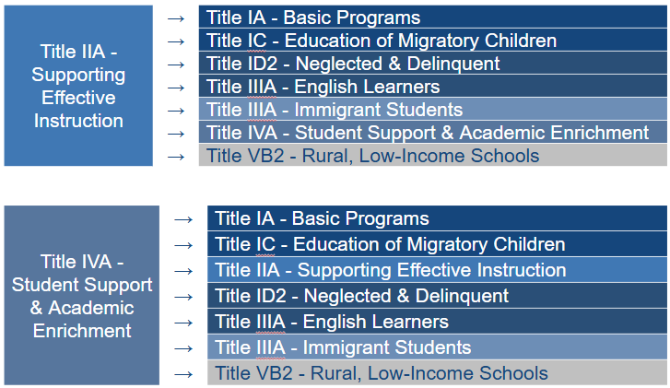
Transferability Slide 2

Slide 12
Alternative Fund Use Authority (AFUA)
Small, Rural School Achievement (SRSA) eligible LEAs (including dual-eligible LEAs that elect to receive Rural and Low-Income School (RLIS) funds) may exercise this key flexibility.
Authorizes SRSA-eligible LEAs to spend any Title II, Part A and Title IV, Part A funds they receive on activities authorized under several ESEA programs.
Designed to give small, rural LEAs greater latitude to spend their federal funds in ways that best address their particular needs.
ESEA Sec. 5211

Slide 13
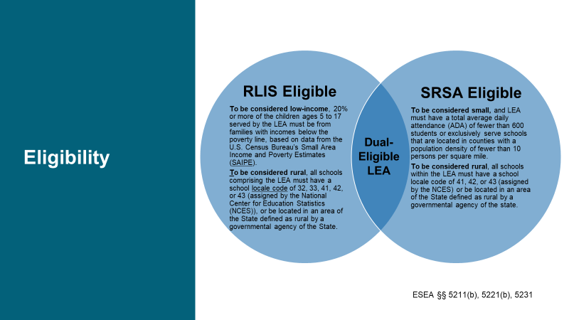
Eligibility

Slide 14
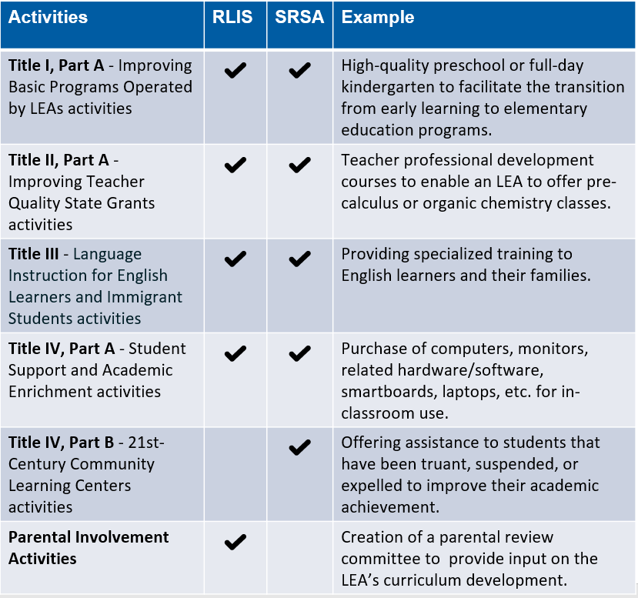
Allowable Uses of Funds

Slide 15
Consolidating Funds in a Title I, Part A Schoolwide Program
A school operating a Title I, Part A schoolwide program has the flexibility to consolidate funds from Title I, Part A with other federal funds as well as with state and local funds
The school accounts for the consolidated funds as though they were one single “pool". The funds from the contributing programs in the school lose their individual identities and the school has one flexible pool of funds.
General rules apply
Supplement, not Supplant
Meeting the intent of each program that contributed to the pool

Slide 16
Resources
ESEA Guidance and Allocations
ESEA Programs - Professional Learning
Title I, Part A
Title I, Part C
Title I, Part D - Subpart 2
Title II, Part A
Title III, Part A
Title IV, Part A
Title IV, Part B
Title V, Part B - Subpart 2
ESEA Programs - Contacts

