Slide 1

Special Education Policy and Practice Webinar Series
Extended School Year Services (ESYS)

Slide 2

Welcome
Please post your questions in the Q&A
Slides will be posted on the DE website after the webinar
Policy & Practice Webinar Series & Recordings | Department of Education

Slide 3
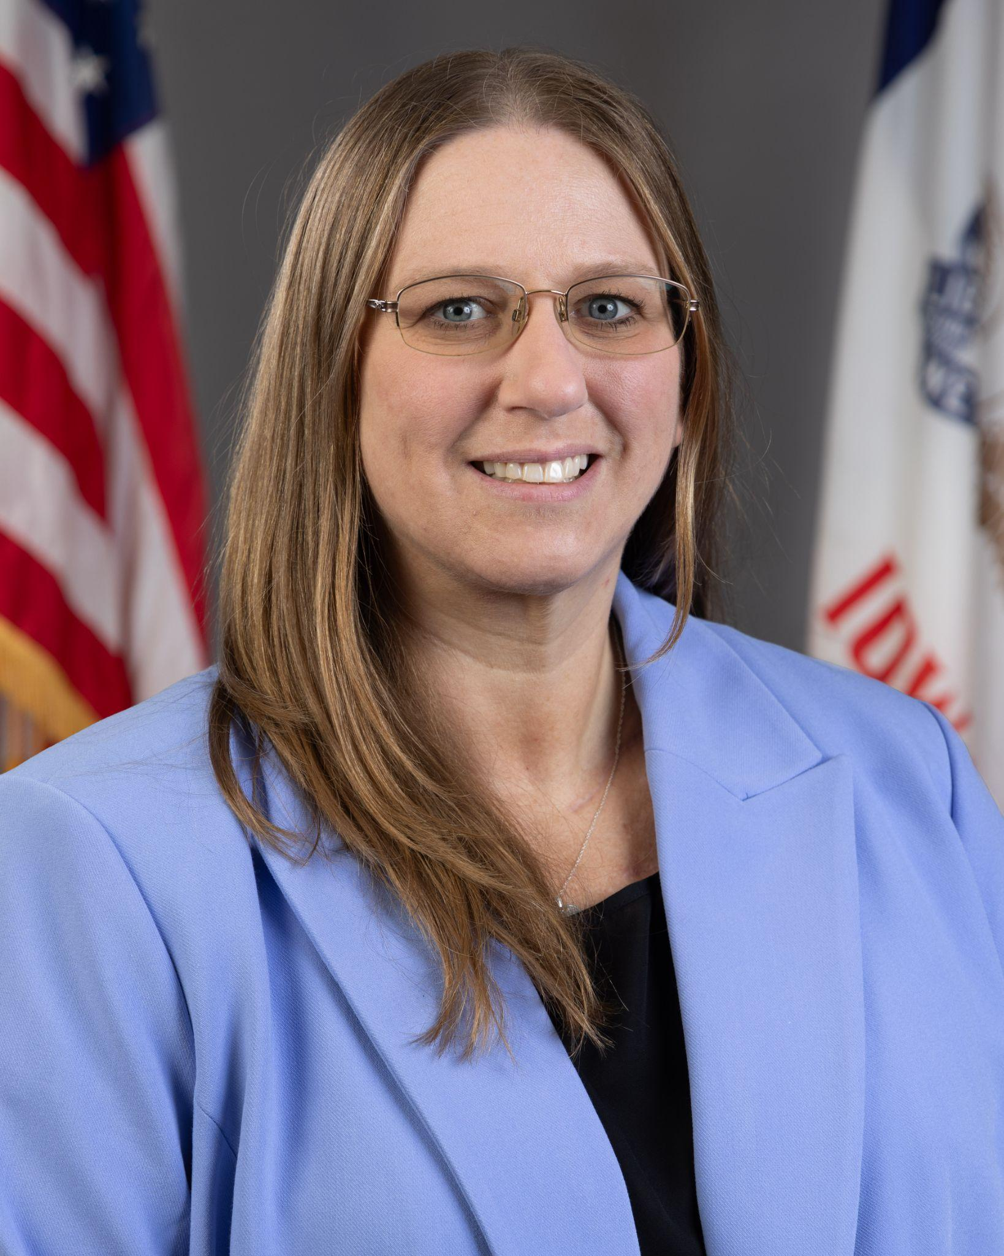
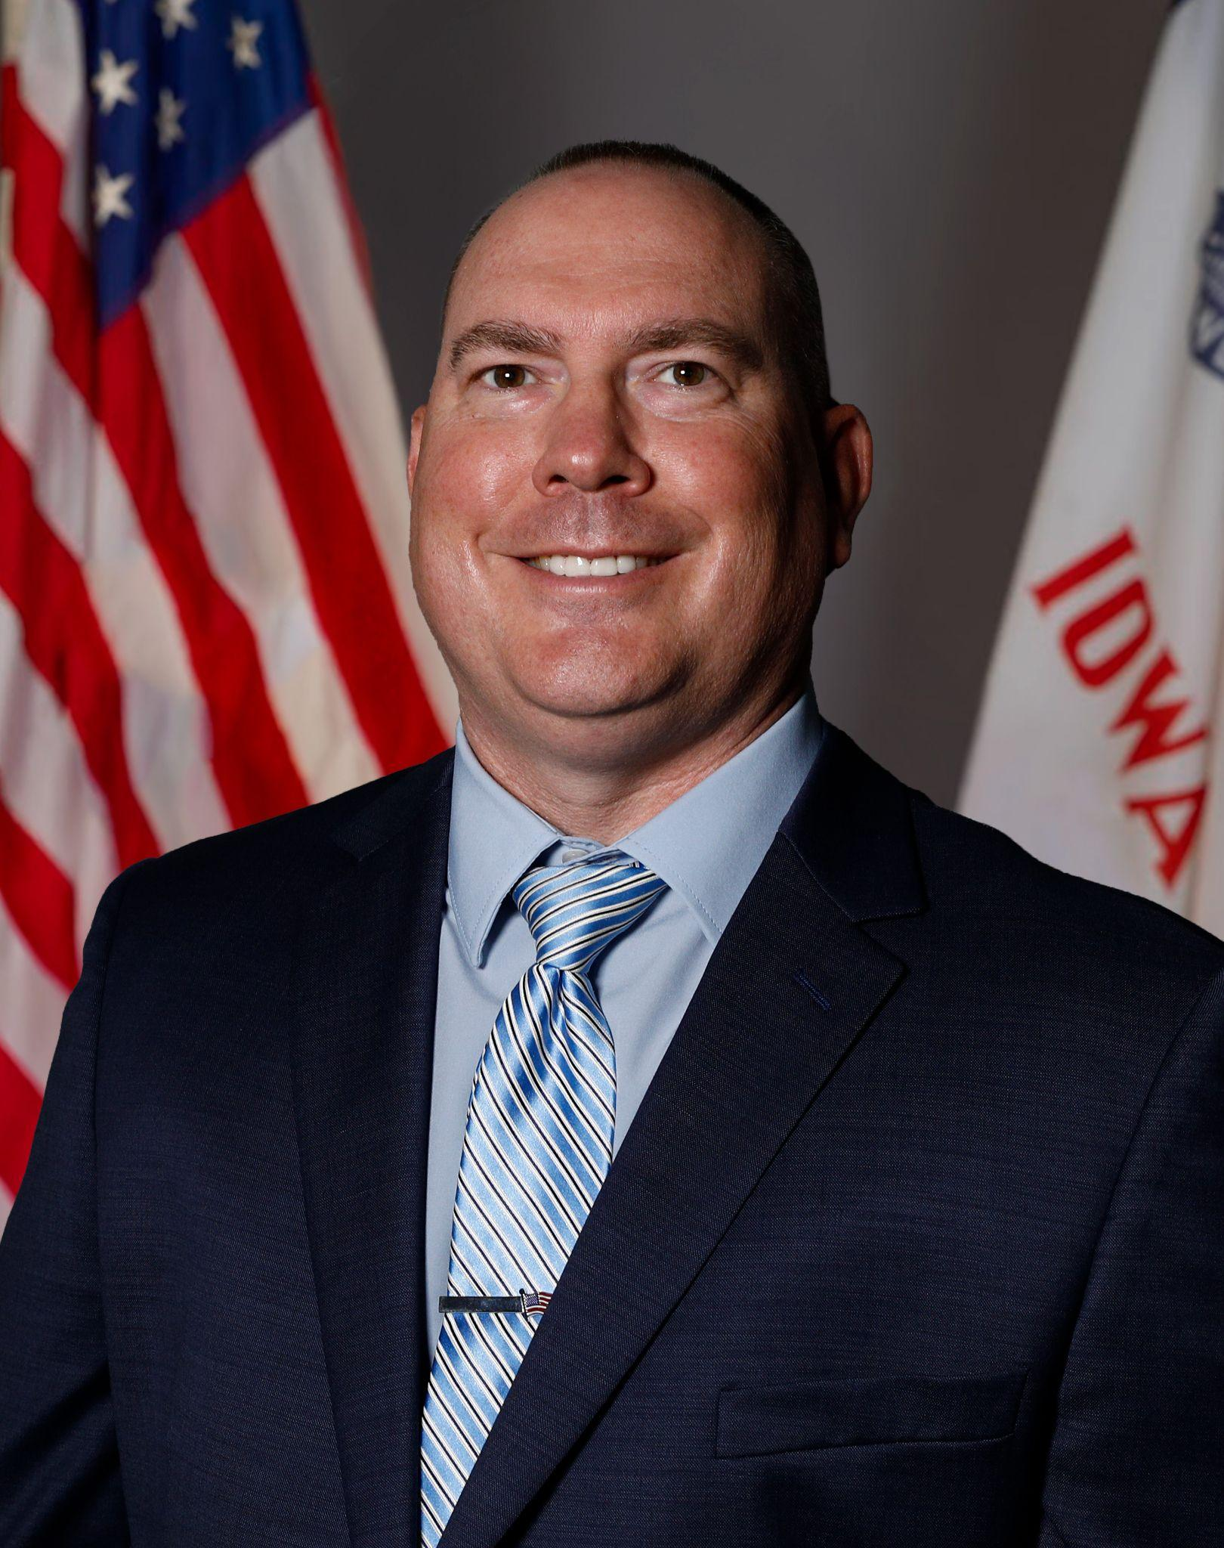

Today’s Presenters
Name: Angelisa Fynaardt
Title: Division Administrator for Special Education Continuous Improvement & Compliance; Regional Special Education Director-Great Prairie
Division of Special Education
Name: Matt Cretsinger
Title: Regional Special Education Director-Heartland
Division of Special Education
Name: Betsy Lin
Title: Bureau Chief,
Student Evaluation, Instruction, and Services,
Division of Special Education

Slide 4
Learning Objectives
Participants will be able to:
Articulate the legal requirements and rationale for providing Extended School Year Services (ESYS) as part of a Free Appropriate Public Education (FAPE).
Facilitate and oversee IEP team discussions regarding ESYS eligibility using multiple sources of individualized data.
Identify common pitfalls or misunderstandings related to ESYS eligibility and service provision.
Determine when ESYS are appropriate to maintain critical skills and ensure continued access to FAPE.
Ensure ESYS decisions are team-based, defensible and applied consistently across students and services.
Describe the administrator’s role in overseeing ESYS decision-making, implementation and documentation.

Slide 5
Policy

Slide 6

Individuals with Disabilities Education Act (IDEA)
and
IA Admin Code
281 — 41.106
§ 300.106 Extended school year services.
(a) General.
(1) Each public agency must ensure that extended school year services are available as necessary to provide FAPE, consistent with paragraph (a)(2) of this section.
(2) Extended school year services must be provided only if a child's IEP Team determines, on an individual basis, in accordance with §§ 300.320 through 300.324, that the services are necessary for the provision of FAPE to the child.
(3) In implementing the requirements of this section, a public agency may not –
(i) Limit extended school year services to particular categories of disability; or
(ii) Unilaterally limit the type, amount, or duration of those services.

Slide 7
Individuals with Disabilities Education Act (IDEA)
and
IA Admin Code
281 — 41.106
§ 300.106 Extended school year services.
(b) Definition.
As used in this section, the term extended school year services means special education and related services that -
(1) Are provided to a child with a disability -
(i) Beyond the normal school year of the public agency;
(ii) In accordance with the child's IEP; and
(iii) At no cost to the parents of the child; and
(2) Meet the standards of the SEA.

Slide 8
Important Considerations for ESYS
ESYS is required if it is necessary to provide a FAPE.
ESYS decisions are to be individualized.
ESYS must be provided by appropriately licensed personnel, based on the nature of the ESYS provided.
IDEA’s requirements for the development, implementation and revision of IEPs apply to ESYS.
IEP Teams must consider ESYS for children who have “support services only” IEPs.
Source: Extended School Year Services (ESYS): General Guidance | Iowa IDEA Information (2026)

Slide 9
Important Considerations for ESYS (continued)
IEP Teams must consider ESYS for children with disabilities who are enrolled in accredited nonpublic schools.
The IEP process and decision for ESYS is ongoing.
IEP Teams must make the ESYS determination annually.
ESYS does not need to solely be extended school year, it could also include extended day, school week or alterations to the school calendar.
ESYS is not provided for non-education needs or non-FAPE educational needs.
Source: Extended School Year Services (ESYS): General Guidance | Iowa IDEA Information (2026)

Slide 10
ESYS is a Service Not a Program
Summer school may be a delivery location for ESYS - but it does not replace ESYS
ESYS must be individualized in frequency, duration and goals
Compensatory education is different from ESYS - it remedies a past denial of FAPE

Slide 11
Practice

Slide 12
ESYS Decision Making: Data to be Considered
The ESYS decision should be based upon an examination that may include, but is not limited to, the following:
review of the current IEP goals, objectives or benchmarks;
observation and data from teachers, related service providers, parents and others having direct contact with the student before and during breaks in educational programming;
data and observations regarding the student’s performance after long weekends, vacations and past summer breaks;
assessment or information maintained on the student, including pretest and post-test data; and
curriculum-based assessment, including pretest and post-test data; and other relevant factors.
Source: Extended School Year Services (ESYS): General Guidance | Iowa IDEA Information (2026)

Slide 13
Need for ESYS: Recoupment-and-Regression
“Has there been (or is there a potential for) significant regression during periods of interruption that would require significant recoupment?”
Examples:
A child who has just begun to demonstrate mathematics progress after sustained and repeated specially designed instruction in mathematics might be a candidate for ESYS if the data shows that the child would require substantial relearning or skill reacquisition in the fall before new skills are introduced.
A child whose aggressive behaviors have recently begun to subside in lieu of prosocial replacement behaviors might be a candidate for ESYS if repeated practice in using the prosocial replacement behaviors is necessary for the child to receive a FAPE.
Source: Extended School Year Services (ESYS): General Guidance | Iowa IDEA Information (2026)

Slide 14
Need for ESYS: Recoupment-and-Regression
Questions for determining whether the recoupment-and-regression standard is met.
Does the student need extensive review to demonstrate previously learned skills?
What inconsistencies does the student demonstrate in mastered or partially acquired skills?
Has the student reached a critical point of instruction or behavior management where a break in services would have serious, detrimental effects?
Does the student demonstrate behaviors or deficits that would cause significant regression if breaks in services occur?
Is there a medical condition that might cause regression?
Will a break in services jeopardize the student's placement in the least restrictive environment?
Source: Extended School Year Services (ESYS): General Guidance | Iowa IDEA Information (2026)

Slide 15
Need for ESYS: Rare and Unusual Circumstances
The student is in a “critical stage” of development when there is a “window of opportunity” that will be lost if services are not provided.
Continuous or year-round treatment is an integral part of the methodology deemed to be appropriate for the student.
Special needs for services arising out of a student’s individual circumstances.
Source: Extended School Year Services (ESYS): General Guidance | Iowa IDEA Information (2026)

Slide 16
Need for ESYS: Other Considerations
The degree of impairment of the child;
The degree of regression [sustained] by the child;
The child’s recovery time from regression;
The ability of the child’s parents to provide educational structure at home;
The child’s behavioral and physical problems;
The availability of alternative resources;
The ability of the child to interact with [children without disabilities];
The areas of the child’s curriculum that need continuous attention; and
The child’s vocational needs.
Source: Extended School Year Services (ESYS): General Guidance | Iowa IDEA Information (2026)

Slide 17
ESYS Decision Making: Goal Area of Concern
The child’s data, when considered as a whole, must demonstrate that the child will not receive a FAPE if the school or AEA did not provide ESYS related to that goal.
Failure to meet an IEP goal during the school year is not enough to establish ESYS eligibility.
Failure to make progress toward an IEP goal, standing alone, is not enough to establish ESYS eligibility.
The fact that the student would benefit from additional services is, standing alone, an insufficient basis to establish ESYS eligibility.
Maximization of the child’s achievement in the goal area is not the purpose or criterion for ESYS.
Source: Extended School Year Services (ESYS): General Guidance | Iowa IDEA Information (2026)

Slide 18
ESYS Service Delivery Examples
Once a child has been determined to need ESYS, the district or AEA is required to provide such services as are necessary to meet that need. ESYS is a service, not a location or program. Those services are not necessarily the same services, or provided in the same location, as they were during the school year.
school-based settings
cooperative programs with other agencies
multi-system shared settings
contractual arrangements with service providers or agencies
community-based settings
vocational settings

Slide 19
Need for ESYS: More Considerations
Additional Considerations
IEP teams must consider ESYS for children who are transitioning from Early ACCESS to early childhood special education.
When a student transfers from different districts or states, receiving districts (while temporarily providing required services) must have its own discussion of the need for ESYS.

Slide 20
Common Misunderstandings
“ESYS is provided when parents request it.”
  Correction: ESYS is determined by the IEP team to ensure FAPE.
“ESYS is only for academic goals.”
  Correction: ESYS can include any domain, not just “academics.”
“ESYS only occurs in the summer.”
  Correction: ESYS is not the same as summer school and is not solely for summer break.
“All students on Alternate Assessment qualify for ESYS.”
  Correction: ESYS is an IEP team decision for each individual learner.
“School teams can look at graphs to determine who is eligible for ESYS.”
  Correction: IEP teams, including parents, determine ESYS qualification.
ESYS in Iowa must follow the student’s unique needs and the IEP should specify the type, frequency, duration and location of services.

Slide 21
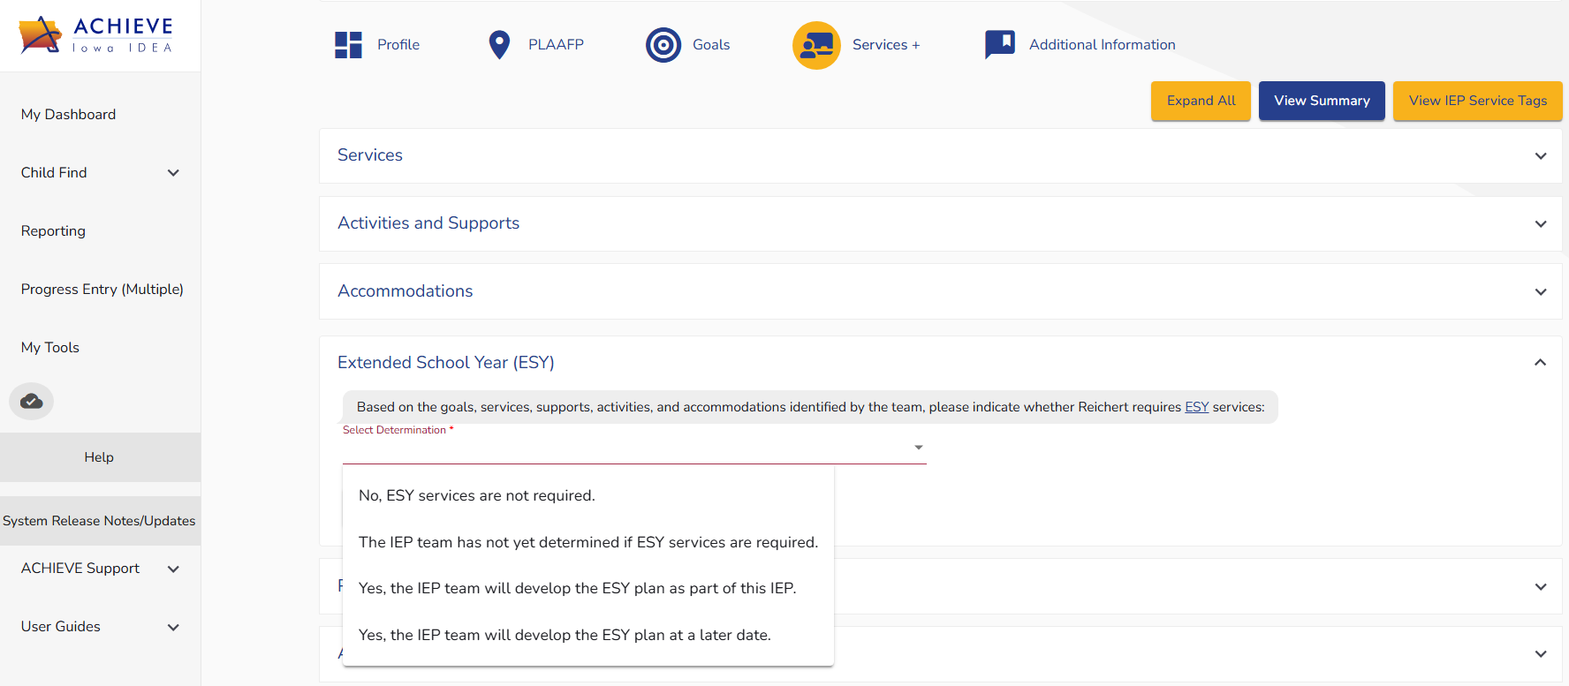
ESYS in ACHIEVE

Slide 22
ESYS Documentation
Prior Written Notice must be given at the following times:
  When a student has been determined to need ESYS by the IEP team
  When a parent requests ESYS, but the other IEP team members decide ESYS are not warranted
  When a student is found eligible for ESYS but parents refuse
  Other considerations
Progress must be monitored, documented and shared.

Slide 23
Legal Overview

Slide 24
Regression, Recoupment and Individualization
Appellate Authority:
Armstrong v. Kline, 612 F. 2d 543 (3d. Cir. 1979): Established regression/recoupment framework.
Johnson v. ISC No. 283 (8th Cir. 1982) - Binding in Iowa: Requires individualized ESY decisions
What this Means for ESYS Decisions:
Consider substantial regression
Consider reasonable recoupment time
Analyze whether interruption would significantly jeopardize IEP benefit
Decisions must be individualized
No categorical denials
Armstrong v. Kline, 612 F.2d 543 (3rd Cir. 1979)
Johnson v. Independent School District No. 283, 921 F.2d 1022 (8th Cir. 1990)

Slide 25
Predictive Evidence and Expanded ESYS Analysis
Appellate and District Authority
Cordrey v. Euckert (6th Cir. 1990): Predictive evidence is permissible
Reusch v. Fountain (D. Md. 1994): ESYS analysis extends beyond regression
What this Means for ESYS Teams:
Teams do not have to wait for documented regression
Prior data may support predictive analysis
Emerging skills must be protected
Degree of progress and severity may be considered
No “wait to fail” standard
Cordrey v. Euckert (6th Cir. 1990)
Reusch v. Fountain (D. Md. 1994)

Slide 26
State Complaint (2023): ESYS Predetermination and Unilateral Limitation
Allegation:
District staff member informed parent student was not eligible for ESYS
No documented IEP team discussion regarding ESY occurring prior to that communication to parent
Findings:
ESYS decisions must be made by the IEP team
District may not predetermine eligibility
District may not unilaterally limit type, amount or duration of ESYS
Parents are entitled to Prior Written Notice
Outcomes:
IEP meeting was convened
ESYS provided (12 two-hour sessions)
Services delivered by special education teacher and associate within summer program

Slide 27
Administrative Support

Slide 28
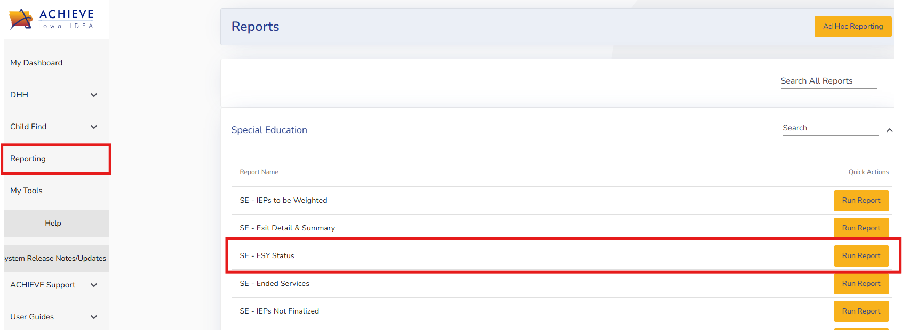
ESYS ACHIEVE Report
Reporting
  SE - ESY not yet determined

Slide 29
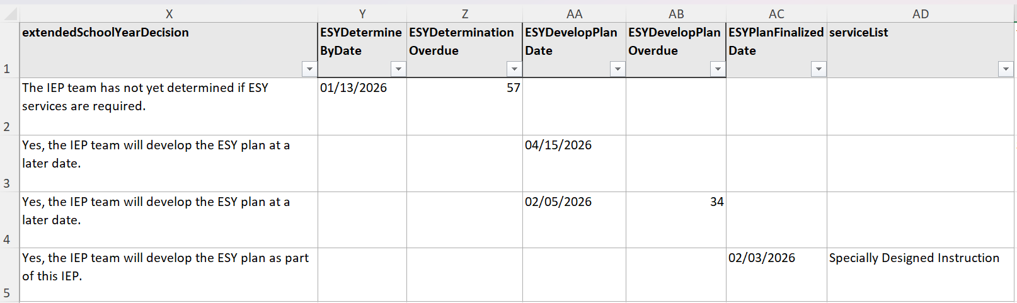
ESYS Status Report

Slide 30
Considerations for Administrative Support
Be an active participant in individualized decisions regarding ESYS
Support the IEP team in the development of ESYS plans
Monitor dates for ESYS decisions
Ensure Prior Written Notices are appropriately documented and sent to families prior to implementation
Allocate appropriate licensed staff and location for ESYS
Monitor ESYS data is collected after the break

Slide 31
Questions from the Field
Please post your questions in the Q&A
Contact your RSED with any follow up questions
Slides will be posted on the DE website after the webinar
Policy & Practice Webinar Series & Recordings | Department of Education

Slide 32
Future Policy and Practice Webinars
Upcoming Topics and Dates (8:30 am - 9:30 am)
April 8, 2026: FAPE - Special Requests
May 13, 2026: Dispute Resolution
June 10, 2026: End of Year Program Evaluation (ACHIEVE) and Year-to-Year Data Comparison

Slide 33
Thank You!

