Slide 1
#5 FY 2027 Perkins Job Descriptions & Time and Effort
March 11, 2026
10:00 a.m. to 10:55 a.m.
Amy Vybiral, MS Ed.
Education Program Consultant
Bureau of Community Colleges and Postsecondary Readiness
515-339-4520
amy.vybiral@iowa.gov
Jeffrey Fletcher, PhD, MPA
Education Program Consultant
515-321-7309
jeffrey.fletcher@iowa.gov

Slide 2
Agenda
Compensation
Time and Effort
Documentation
Creating an eligible job description
  Perkins Activity References

Slide 3
Compensation §2 CFR 200.430
Eligible Compensation:
  Limited to CTE activities.
  Performed during the grant period of performance.
  Included in the approved budget.
  Additional costs have prior approval.
  Reasonable for services rendered.
    Within a normal work period.
    Aligns with written HR and payroll policies.
  Time and effort documentation accurately reflect duties performed.
  Charges reconcile to the general ledger and financial reports.
Ineligible Compensation:
  Exceeds approved budget for compensation.
  Job duties exceed grant-funded scope of Perkins Activities and CLNA Elements.
  Time and effort are not accurately documented or certified.
  Incentive pay (robust justification is required for stipends outside of contract pay).
    e.g., Remuneration for teacher training time is ineligible for Federal reimbursement.
    §200.403(b) Factors affecting allowability of cost “reasonable” “prudent person” thresholds.

Slide 4
The Challenge - Time & Effort §2 CFR 200.430
Due to multiple-factors: clarity, consistency, and uniformity has been lacking with regard to the local documentation standards of Time and Effort (T&E) reporting related to state and federal grants and funding.
Is Time and Effort Reporting a requirement?
Yes. All sources of federal funding (direct and pass-through) must meet the guidelines established by Uniform Guidance for internal control and personnel costs (2 CFR 200.1, 200.430).
Federal Entity/Direct:
Office of Career, Technical and Adult Education (OCTAE)
Pass-through:
Iowa Department of Education / State Education Agency (SEA)
Local Recipient:
Independent CSD, Consortium, or Community college

Slide 5
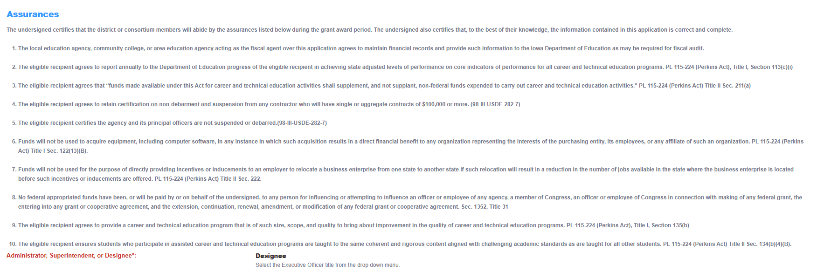
Executive Assurances/Agreements - Time & Effort §2 CFR 200.430
Snippet - Annual IowaGrants Perkins V Application Executive Assurances/Agreements Form

Slide 6
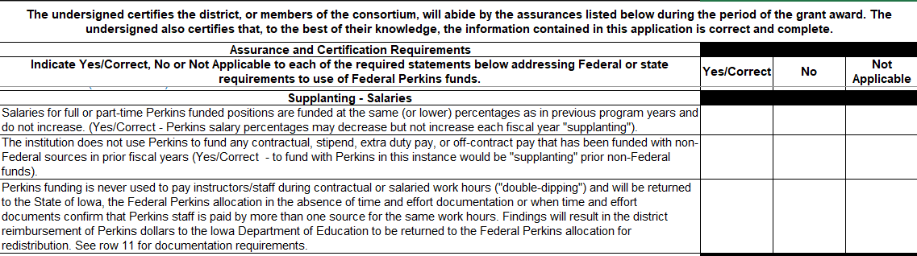
Perkins V Claims Template - Time and Effort §2 CFR 200.430
Snippet - Assurances/Certification, quarterly claim templates

Slide 7
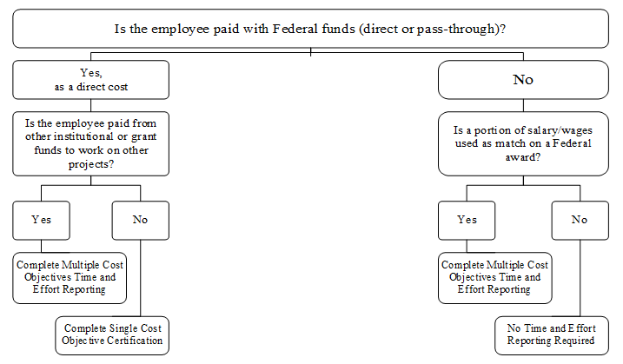
Does my funding source/employee require time & effort (T&E) reporting?
Does my funding source/employee require time & effort (T&E) reporting?
Before deciding whether or not to begin/cease T&E reporting, always reach out to the CTE Bureau.

Slide 8
Why Documenting Locally Matters
According to Education Department General Administrative Regulations (EDGAR) 2 CFR Part 200, Sections §200.329; §200.331; §200.332, the Bureau of Career & Technical Education (pass-through) is required to monitor Perkins grant sub-recipients to ensure compliance for Federal Awards with fiscal and management requirements of the Strengthening Career and Technical Education for the 21st Century Act (Perkins V) and applicable federal and state legislation, rules, regulations, and policy according to subpart D – uniform administrative requirements (i.e., day-to-day grant management), Subpart E – cost principles, and Subpart F – Audit Requirements. (Perkins V Secondary and Post Secondary Monitoring)
Documents to attach
Community Colleges: 5-years worth (5-year cycle; alternates w/interim/HLC accreditation cycle)
Secondary: 3-years worth (3-year cycle; or as needed (should it be necessary or if there is an “event”)
1. (If applicable) Job description(s) documentation for staff funded 0.00 – 100.00% with Perkins V funds.
2. (If applicable) Payroll records showing how salaries/benefits were charged for Perkins grant coordinator/staff/other if supported 0.00 – 100.00% with Perkins V funds.
3. (If applicable) Personnel Activity Reports (PARs) or equivalent time-and-effort documentation for staff charged to the grant if supported 0.00-100.00% with Perkins V funds.
4. Inventory of equipment purchased (including items purchased, date of purchase, location of equipment, ID#) – one consortium-wide inventory or individual district inventories.
5. (Optional) Additional electronic documentation and/or information (website, Google Docs, or other electronic methods) about programs of study (POS) not already documented in the Iowa STICS program review system. See the Program of Study Guidance webpage.

Slide 9
Time and Effort §2 CFR 200.430
Time and Effort
Time & Effort requirements (EDGAR) – 2 C.F.R. § 200.430 (Perkins Monitoring)
Documentation for personnel expenses - Charges to Federal awards for salaries and wages must be based on records that accurately reflect the work performed.
Follow your organization’s policies for documenting time and effort.
If you are unaware of your time and effort process, contact your human resources office.
Before deciding whether or not to begin/cease T&E reporting, please always reach out to the CTE Bureau; Jeff Fletcher or Amy Vybiral

Slide 10
Perkins Job Descriptions
Eligible
  Perkins activities one through six and administrative costs.
  Up to 100%
  Services extended to non-CTE related duties must be coded to other cost centers and documented within time and effort.
  Services extending to non-CTE students –see above.
  Job descriptions (with funding source percentages) must be on file.
Ineligible (requires accurate time and effort documentation):
  Any activity that exceeds the scope of career and technical education (supplanting).
  Time and Effort exists to document funding sources and activities to avoid supplanting.
Eligible Job Descriptions
  Use Perkins reference activities one through six and use CTE qualifiers.
  Select specific job duties from sample job descriptions or reference activities.

Slide 11
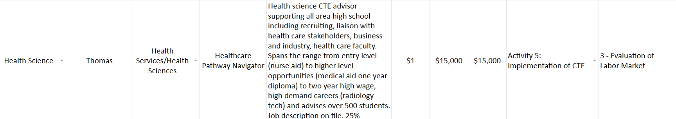
Salaries by Perkins Activity
Activity Five: Implementation of CTE - Appropriate for Director, Administrator, WBL/Apprenticeship, Business & Industry engagement.
Activity Two: Professional Learning - Appropriate for teacher training, recruiting, retention.
Activity One: CTE Student Engagement - Structured career exploration for CTE connected students, non-trad, skilled trades, workforce aligned pathway
Perkins funded positions must have job descriptions on file with the specific duties that are exclusive to CTE and the percentage of the position funded by Perkins.
Job description must include non-CTE job duties (when applicable) and the percentage funded by non-Federal sources.
FY 2027 Budget – Attach job descriptions.
Note that a time and effort process is in place (on the budget form).

Slide 12
Job Duties from Perkins Statute
CTE Career Exploration Navigator_TEMPLATE
CTE Professional Learning Coordinator and Trainer_TEMPLATE
Work-based Learning, QPA, and Apprenticeship Coordinator_TEMPLATE
Job Description Reference Activities_TEMPLATE
  Director of Career and Technical Education Training Programs
Be specific by content area when applicable:
Agriculture, Food, and Natural Resources
Applied Sciences, Technology, Engineering, and Manufacturing
Business, Finance, Marketing, and Management
Health Science
Human Services
Information Solutions
Note:
Duties already performed within another job position must be removed and the Federally-funded percentage reduced (supplanting).
Position titles are examples only and must be edited to reflect the position your organization will fund (is currently funding).

Slide 13

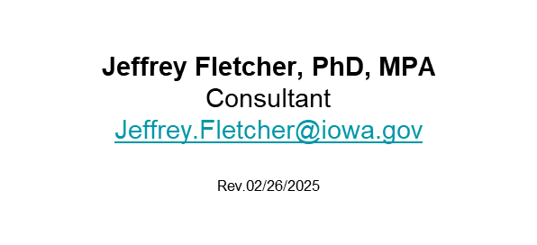

Contact Information

