Slide 1
#4 FY 2027 Perkins Budget Prior Approval and Perkins Use of Funds
February 27, 2026
10:00 a.m. to 10:55 a.m.
Amy Vybiral, MS Ed.
Education Program Consultant
Bureau of Community Colleges and Postsecondary Readiness
515-339-4520
amy.vybiral@iowa.gov

Slide 2
Agenda
Timelines and Due Dates
Allowable and Unallowable Costs
Budget Template
OCTAE Requirements for Purchases & DCLs
CTSOs
Salaries, job descriptions, & time and effort
Examples of Perkins Activity & CLNA Alignment

Slide 3
FY 2026 Timelines and Housekeeping
Perkins Final Purchases and Claims
February 27 - Perkins Budget Prior Approval Form sent to school districts and colleges.
March 31 - FY 2027 Perkins budget due to CTE Bureau
April 1 through April 30 - Schedule Zoom for FY 2027 budget approval
May 1 - FY 2027 Perkins Application released (Approved budget uploaded into application)
June 30 - Perkins application and CLNA Due to CTE Bureau
July - Award letters sent to recipients

Slide 4
Timelines for FY 2026
FY 2027 Perkins Budget Template
  Input from CTE instructors and staff
  Review local program title from Element 2 (Size Scope and Quality)
  Have instructors “make their case” for purchases after investigating labor market information (Element 3)
  Budget is determined by the 2026 CLNA
  The approved budget is uploaded into the FY 2027 Perkins application.
    Amy Vybiral 515-339-4520
Perkins FY 2027 Perkins V Application (Released on or around May 1, 2026)
  Allocation tables are hyperlinked in the FY27 application-budget form in IowaGrants
  Allocation tables are also attached as a PDF with the funding opportunity posting in IowaGrants
  Allocation tables will also be emailed post-webinar (w/other resources) after the FY27 IowaGrants Perkins V Application Webinar
    TBD/TBA (April, 2026): FY27 Perkins V IowaGrants Application Webinar
  FY27 Perkins applications are due June 30, 2026, 11:59:59 PM.
    Jeff Fletcher 515-321-7309

Slide 5
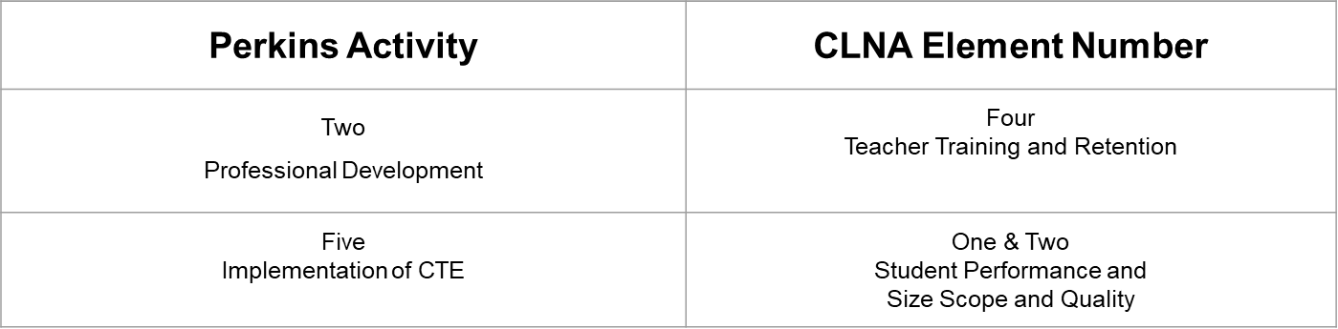
Budget Planning
Leadership Priorities in the Perkins State Plan→ Accountability Indicators
  Work-based learning (WBL)
  Industry Recognized Credentials (IRCs)
  Career and Technical Student Organizations (CTSOs)
All purchases will align with Perkins Activities and CLNA Elements

Slide 6

Before we jump in…..
Budget Review Goals
Review 2027 Use of Funds and Unallowable Costs
All purchases should be easily identifiable as CTE purchases.
  All purchases are exclusive to CTE (new and emerging or size scope and quality)
Shouldn’t take more than 5 minutes to review and approve a Perkins budget.
  Determine eligibility
  Calculate total
  Confirm 5% admin.
Allowable, Reasonable, Necessary, Prudent Person, Climate, your institutional funding sources.
Des Moines Register and Cedar Rapids Gazette.
Salaries - Eligible Job Duties? Exclusive to CTE?
Trucks, trailers, Prometheans and Interactive Whiteboards, Advertising for SPs
Item-by-item basis.
Federal, state, and local law (OMB, Office of the White House Compliance Supplement (Supplanting) - SL DCLs)

Slide 7
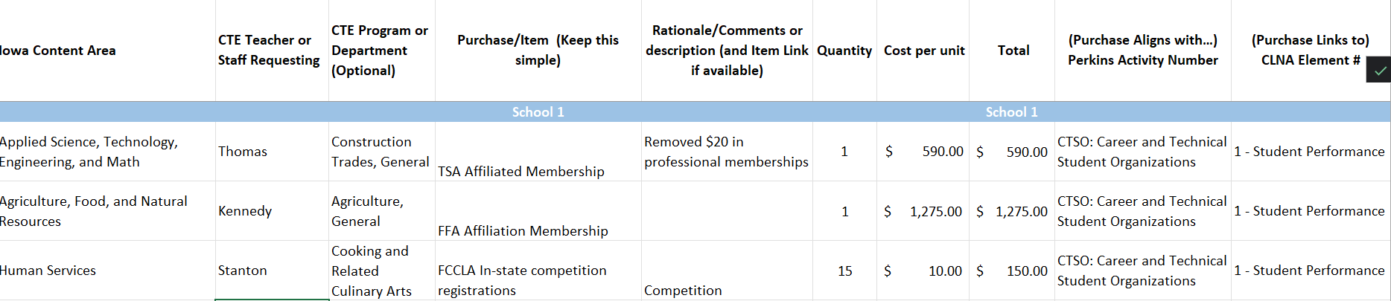
The Template CTSOs
Populate the necessary/applicable menus/dropdowns 2) Purchase- Keep it simple 3) Rationale- only if necessary 4) Align Perkins Activity with CLNA Element
Competitors only. Remove professional memberships (see TSA).
Ensure invoices received are in a quantity of one.
See Eligible invoice Examples

Slide 8
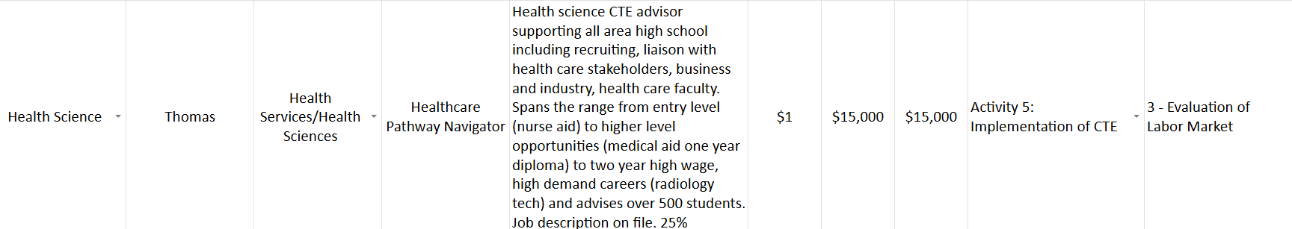
The Template - Salaries
Populate the necessary/applicable menus/dropdowns 2) Purchase - Keep it simple 3) Rationale - only if necessary 4) Align Perkins Activity with CLNA Element
Intentional and specific about CTE, content area, career cluster, job duties exclusive to CTE programs, courses, students, stakeholders, labor market, credentials, diplomas, degrees (not more than two-year per statute revision) percentage of salary allocated.
Note that job description and time and effort are on file.
Career (Activity One) less clarity than Activity Five.

Slide 9
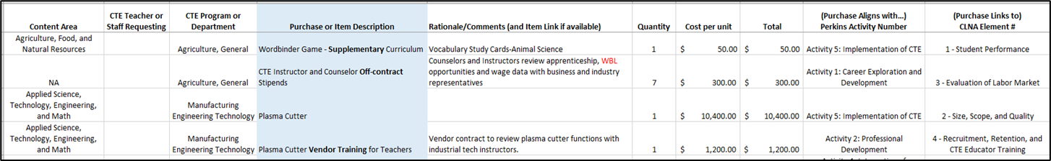
The Template
Key words in bold identify why items are eligible.
Curriculum must be “supplementary” to be eligible.
Stipends must be outside of an instructor’s contract or “off-contract.
  If Perkins funds a percentage of a total contract, a job description, time and effort, and percentage must be included.
“Vendor equipment and software training” must be specified so that other item eligibility can be determined (this is “in-house” so no mileage or meal reimbursement is eligible).
Include Accountability measures when possible.
Align Perkins Activities with CLNA Elements for every purchase.

Slide 10
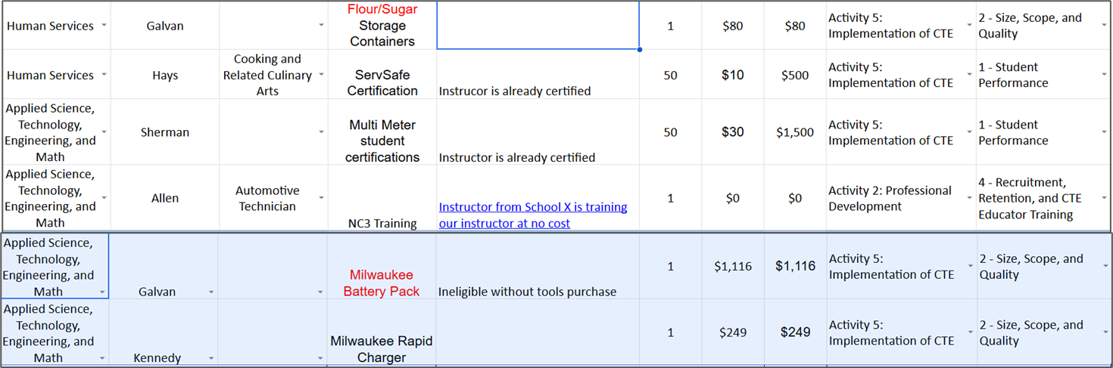
The Template - Other
Populate the necessary/applicable menus/dropdowns 2) Purchase - Keep it simple 3) Rationale - only if necessary 4) Align Perkins Activity with CLNA Element
Highlight why storage is eligible, let me know you’re not asking for marketable credentials.
Consumables are eligible with a tool purchase.
Kit purchases - indicate if kits are reusable from class to class, year to year (eligible).
“One-and-done” kits are ineligible.
Supplies & Miscellaneous - Will be returned.

Slide 11
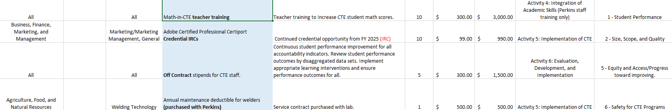
The Template
Key words in bold identify why items are eligible.
IRCs are a new accountability indicator.
Access statements should include statements that learning interventions are for all students in the disaggregated data sets (February 2025 DCL).
Stipends must be outside of an instructor’s contract or “off-contract.
  If Perkins funds a percentage of a total contract, a job description, time and effort, and percentage must be included.
Maintenance plans are eligible for items that were purchased with Perkins.
Align Perkins Activities with CLNA Elements for every purchase.

Slide 12
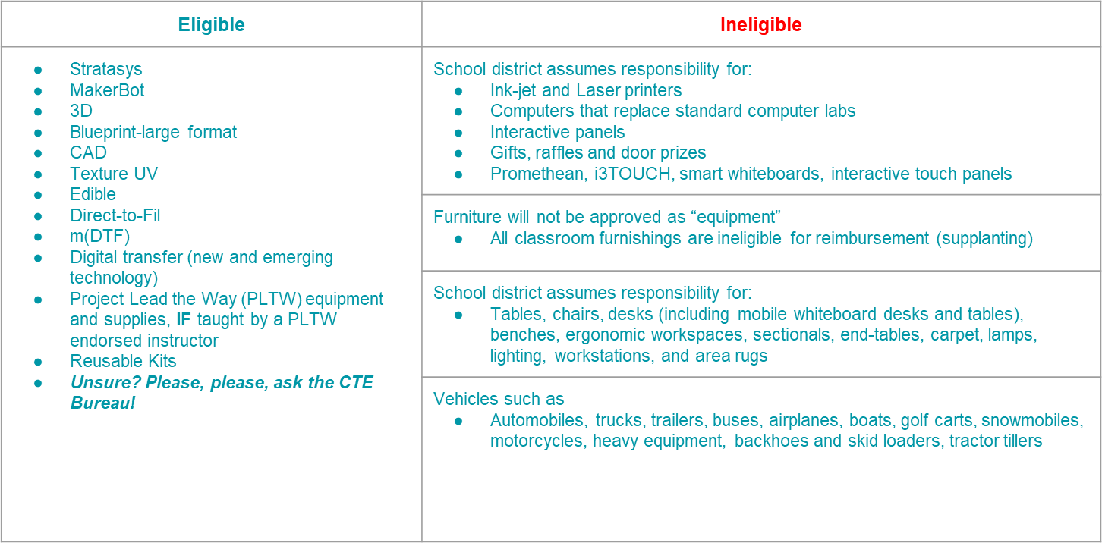
2027 Allowable and Unallowable Costs
Technology and Supplanting List

Slide 13
