Slide 1
The AEA Consultation Process: Accredited Nonpublic Schools, AEAs and LEAs
Child Find through the delivery of special education services for Iowa Students with Disabilities Parentally Placed in Accredited Nonpublic Schools

Slide 2
Welcome
This recorded presentation, the Guidelines Document, Slides and associated support materials will be posted on the DE Special Education Accredited Nonpublic School website after the webinar. Look for those materials there soon.
Please post your questions in the Q&A

Slide 3
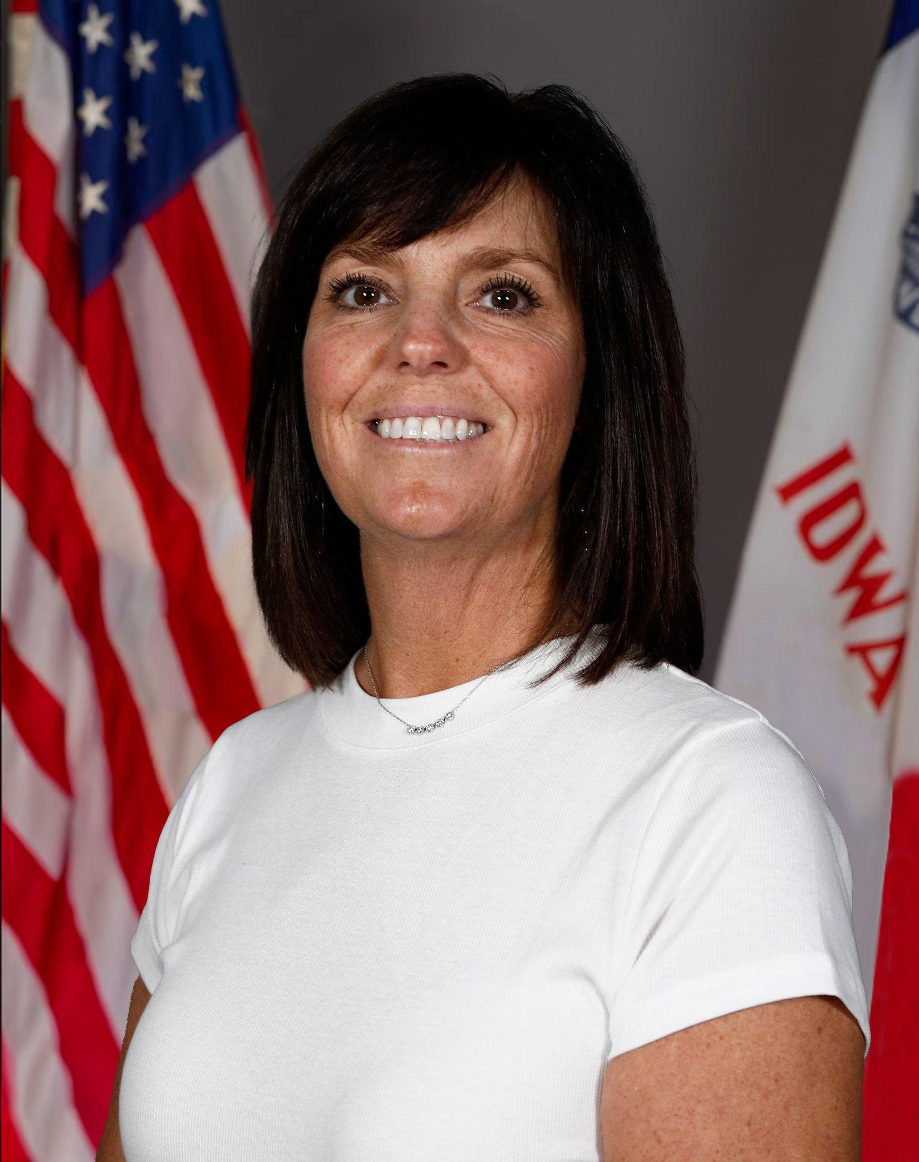
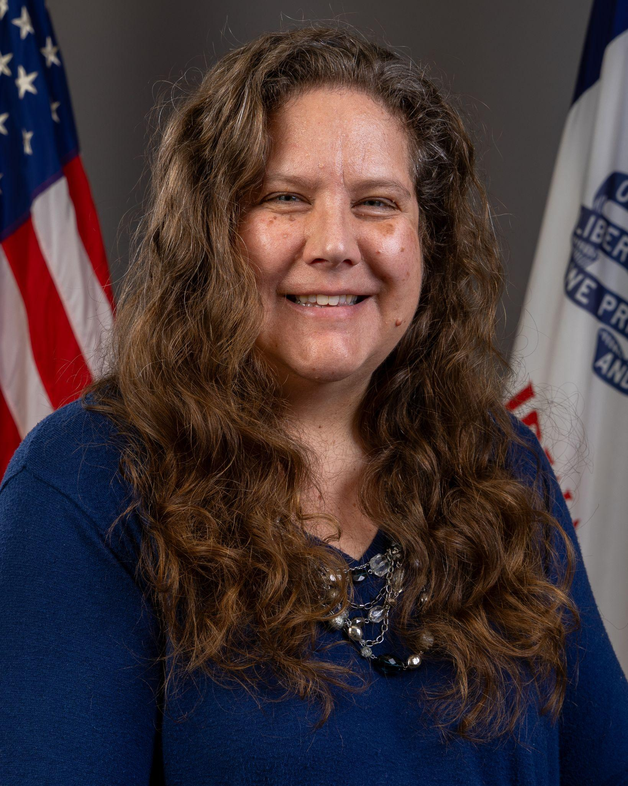
Today’s Presenters
Janelle Danner
Nonpublic School Liaison
Betsy Lin
Bureau Chief,
Bureau of Evaluation, Instruction, and Services

Slide 4
Participants will:
Understand the AEA consultation meeting through Iowa Code 256.12
Review the required components of the consultation meeting, applying them to the full scope of coordinated service delivery among AEAs, LEAs, and accredited nonpublic schools to fully reflect Iowa’s commitment to FAPE
Focus on roles and responsibilities of AEAs, LEAs and accredited nonpublic schools
Center shared understanding, communication, and collaboration in the development of special education service delivery for eligible students with disabilities parentally placed in accredited nonpublic schools

Slide 5
I. Iowa’s Legal Framework
Iowa Code § 256.12(2)
Students with disabilities enrolled in accredited nonpublic schools be provided special education services “in the same manner and to the same extent that they are provided to public school students” (emphasis added)
Iowa goes above the minimum requirements for parentally placed accredited nonpublic school students under federal law.
Eligible students are counted in the resident LEA’s weighted special education funding
Federal Nonpublic Requirement – IDEA CFR §§ 300.130–144
IAC 281-41.130-144

Slide 6
II. Purpose of Guidelines
All consultation and service delivery decisions are informed by IDEA, Iowa Code § 256.12, and Chapter 41 regulations.
The guidelines offer support for collaboration among AEAs, LEAs, and accredited nonpublic representatives, helping partners work together to meet student needs while honoring Iowa’s higher standards for FAPE.
IAC 281-41.137(1)

Slide 7
Purpose of Guidelines-Collaboration
Support Collaboration Among AEA/LEA and Accredited Nonpublic Schools
Communication systems
Collective understandings
Coordinated Child Find Activities
Collaborative Planning of Service Delivery for Accredited Nonpublic Students

Slide 8
III. The Consultation Process
AEA Level
  AEA, LEA, Nonpublic Representatives must attend
  Child Find
  Service Delivery
    How, Where and By Whom to ensure FAPE
  Due Consideration of All Views
IAC 281-41.134

Slide 9
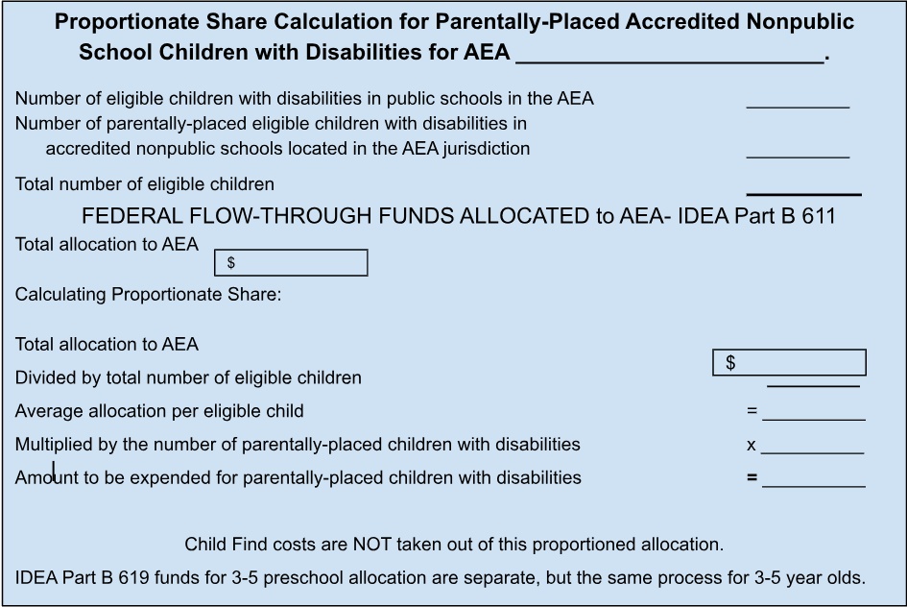
Consultation- Funding
Review of proportionate share-
while this review reflects a federally mandated consultation requirement, service decisions remain based on student need and Iowa’s FAPE obligations, not funding sources
(see Appendix J)

Slide 10
Effective Consultation
Supporting all accredited nonpublic schools by providing resources
Collaborating among AEAs, LEAs and accredited nonpublic schools
Coordinating services and supports to fulfill FAPE
Communicating through collaboratively developed systems that support ongoing cooperation beyond the consultation meeting
Aligning access to special education and related services for accredited nonpublic students with IEPs in the same manner as for public school students.

Slide 11
Appendices
Guiding questions, tools, templates to support Consultation process and documentation
Appendix A: Guiding Questions
Appendix B: Child Find Template
Appendix C: Documentation of Due Consideration
Appendix D: Written Explanation
Appendix E: Affirmation of Consultation
Appendix F: Documentation of Consultation
Appendix G: Notice to Representatives
Appendix H: Consent of Identifiable Information
(See also ACHIEVE)
Appendix I: References
Appendix J: Federal Funding Requirements
AEAs, LEAs and accredited nonpublic schools, should maintain documentation that ensures transparency and accountability.

Slide 12
IV. Child Find for Accredited Nonpublic Students
The Child Find process consultation must include:
A system for accurate count of identified children
How eligible students can participate in services
The process for referral and evaluation
How parents, teachers and accredited nonpublic school officials will be informed of the process
Consent to Exchange Personally Identifiable Information

Slide 13
AEA Role (Primary)
Ensure timely location, identification, evaluation and reevaluation
Lead all Child Find activities
Develop and implement a plan to ensure informed accredited nonpublic stakeholders
Conduct and manage evaluations and reevaluations
Coordinate with LEAs and accredited nonpublic schools to ensure access, communication and procedural compliance
Schedule and facilitate eligibility meetings to determine student eligibility for special education

Slide 14
LEA Role (Collaborative Partner):
Participate in evaluations and team processes, as applicable
Provide district staff when identification, evaluation and reevaluation require district expertise
Support the evaluation process as requested
Participate in the eligibility determination meetings

Slide 15
Accredited Nonpublic School Role:
Assist in communicating with families and school staff
Share data and observations regarding student performance and concerns
Participate in communication and scheduling of evaluation
Implement and document agreed upon instructional strategies and monitor progress as appropriate
Collaborate with the evaluation team regarding student needs and the learning environment
Participate in the eligibility determination meetings

Slide 16
V. Providing Special Education Services to Students in Accredited Nonpublic Schools
Coordination of Service Delivery
Special education and related services include:
Specially designed instruction
Related services
A full continuum of supports
Transportation when required
Ongoing planning for service delivery, staffing, and ensuring FAPE

Slide 17

Obligation to Provide FAPE
Endrew F. v. Douglas County School District RE-1, 580 U.S. 386 (2017)

Slide 18
IAC 281-41.134-.136 and FAPE
How, where and by whom special education services will be provided
Types of services to be delivered
How and when these decisions will be made
How the process will operate throughout the year
(see Appendix C to support documentation of the above questions)
Written explanation will be provided if disagreements (see Appendix D)
Written affirmations from nonpublic representatives (see Appendix E)
Documentation of consultation (see Appendix F)
Right to submit a complaint (see Appendix G)

Slide 19
LEA Role- service delivery
Planning for and ensuring access to special education and related services consistent with the LEA’s continuum of service delivery
Providing staff, scheduling services and coordinating with AEA consultants
Ensuring the IEP team makes decisions based on student need, not funding source or location of services

Slide 20
Public Agencies as Fiscal Agent and Responsible Party
Child Find activities
Provision of special education and related services
Ensuring the student has access to general education curriculum as appropriate
Monitoring IEP implementation and student progress
Engaging in active collaboration and communication with accredited nonpublic school staff
Ensuring services meet FAPE and state standards

Slide 21
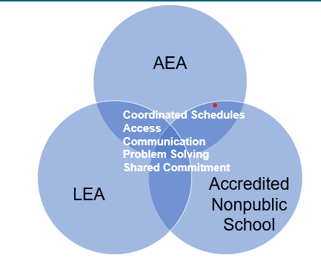
Collaboration Expectations

Slide 22
VI. Accountability and Reporting
AEAs, LEAs and accredited nonpublic schools are responsible for accurate reporting related to:
Child Find
Student count
Consultation
Consent of Identifiable Information
IEP implementation
Documentation of services
All records should be maintained for state review as required.

Slide 23
VII. Summary of Key Principles
Iowa Code § 256.12(2)(a) guarantees accredited nonpublic students with disabilities FAPE
LEAs must serve accredited nonpublic students with IEPs, just as they do public students
Collaboration among AEAs, LEAs and accredited nonpublic schools is essential for both federal compliance and state-mandated service delivery
Child Find processes must ensure accredited nonpublic students are located, identified, evaluated and reevaluated in the same manner as public school students
Documentation requirements under 281—41.130–41.136 ensure transparency and accountability

Slide 24
Q&A
A FAQ document will be posted on the website soon

Slide 25
DEPARTMENT OF EDUCATION
SPECIAL EDUCATION
ACCREDITED NONPUBLIC SCHOOLS

Slide 26
Next Webinar- MARCH
Child Find & Free Appropriate Public Education (FAPE)
Wednesday, March 25, 2026
8:30-9:30 am
same Zoom link
Overview of Child Find responsibilities under Iowa law, including how children are located, identified, evaluated, counted and reevaluated, with a focus on accessibility and understanding for nonpublic stakeholders. Discussion of FAPE for accredited nonpublic students, including topics that may be addressed such as provision of services “in the same manner and to the same extent” as public school students, LRE, placement, location of services and transportation.
Zoom using passcode 431127

Slide 27
Thank You!
janelle.danner@iowa.gov

