Slide 1
Supporting
ACHIEVE Family Portal
Engagement

Slide 2
ACHIEVE Family Portal Accounts
As of 01/16/2026:
~8,200
active accounts
10.25% of learners
have at least one family contact
with an active account

Slide 3
Requirements to Create an Account
Step 1: Consent for Services

Slide 4
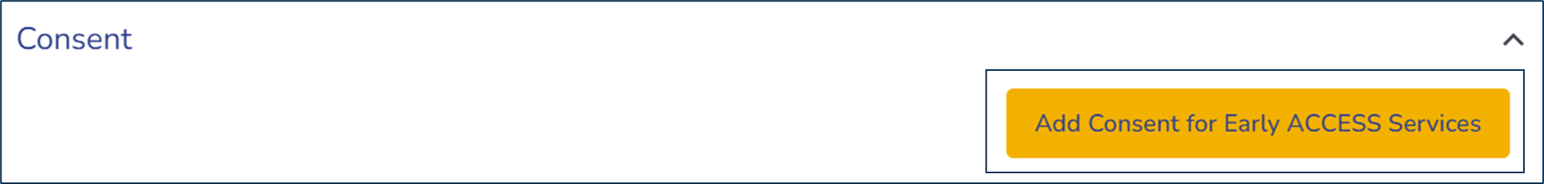
Obtaining Consent
Informed parental consent is required before Early ACCESS services can be provided.
  An approved Consent for Early ACCESS Services form must be stored in ACHIEVE before IDEA Parents may create an ACHIEVE Family Portal account.

Slide 5
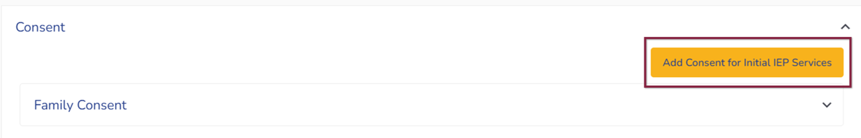
Obtaining Consent
Informed parental consent is required before special education and related services can be provided.
  An approved Consent for Special Education and Related Services form must be stored in ACHIEVE before IDEA Parents may create an ACHIEVE Family Portal account.

Slide 6
Requirements to Create an Account
Step 2: Family Contact Validation

Slide 7
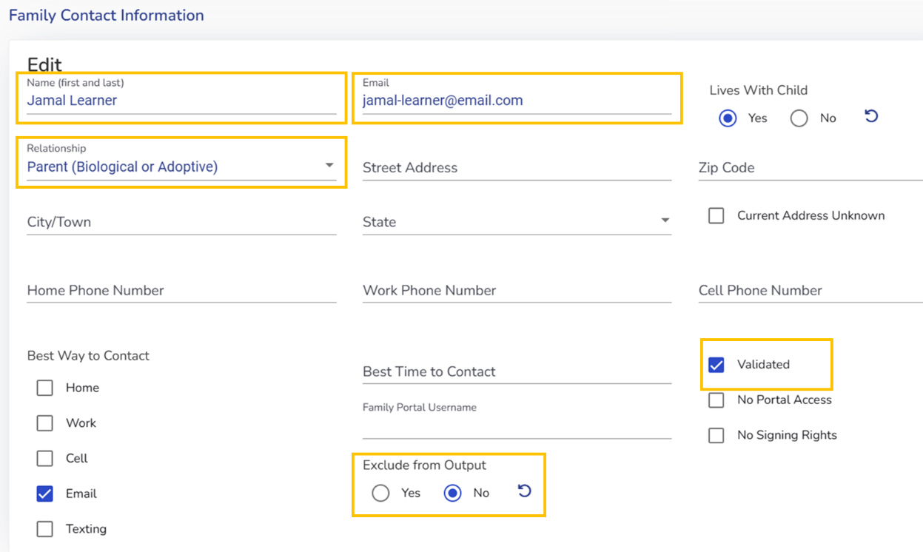
Validating Early ACCESS Family Contact Information
Family Contact Information in ACHIEVE
Validate Information in the Family Contact Stepper
Family contact information is initially pulled once from Early ACCESS referral.
The IFSP team is responsible for verifying and updating family contact information in ACHIEVE on a regular basis.

Slide 8
Validating Special Education Family Contact Information
Family Contact Information in ACHIEVE
Validate Information in the Family Contact Stepper
Family contact information is only pulled once from the local Student Information System.
The IEP team is responsible for verifying and updating family contact information in ACHIEVE on a regular basis.

Slide 9
EA Family Contact Data Elements to Review
Review and confirm accuracy of family contact information stored in ACHIEVE with family members.
Relationship Status:
  Confirm relationship type for each family contact.
  Select/update corresponding relationship type from the drop-down menu as needed.
  Only IDEA Parent contacts will be eligible to create an account in the ACHIEVE Family Portal.
  Surrogate decision-makers must be added and validated by select AEA staff.
Email Address:
  Confirm the accuracy of each family contact’s email address or update as needed.
  Each contact must have a unique email address. If a contact does not have a unique email address, leave the field blank. (Do NOT enter a fake email address as a placeholder!)
Validation Checkbox:
  After reviewing the relationship status and email address, select the Validated checkbox.
  The Invite to Portal button will not be enabled until IDEA Parent information is validated.
Exclude From Output:
  Selecting Yes will exclude email address information on finalized documents.
  Selecting No will include email address information on finalized documents.

Slide 10
SE Family Contact Data Elements to Review
Review and confirm accuracy of family contact information stored in ACHIEVE and details in the district’s Student Information System with family members.
Relationship Status:
  Confirm relationship type for each family contact.
  Select/update corresponding relationship type from the drop-down menu as needed.
  Only IDEA Parent contacts will be eligible to create an account in the ACHIEVE Family Portal.
  Surrogate decision-makers must be added and validated by select AEA staff.
Email Address:
  Confirm the accuracy of each family contact’s email address or update as needed.
  Each contact must have a unique email address. If a contact does not have a unique email address, leave the field blank. (Do NOT enter a fake email address as a placeholder!)
Validation Checkbox:
  After reviewing the relationship status and email address, select the Validated checkbox.
  The Invite to Portal button will not be enabled until IDEA Parent information is validated.
Exclude From Output:
  Selecting Yes will exclude email address information on finalized documents.
  Selecting No will include email address information on finalized documents.

Slide 11
Additional EA Family Contact Email Validation Tips
For security purposes, when an email address is saved within a family contact’s record, a unique email account must be associated with each person.
  This means:
    Shared family email accounts may only be stored in ACHIEVE for one family member.
      An email address is not required to validate a family contact record.
    Personal email addresses are always preferred for family members.
      Professional email accounts are more likely to prevent messages being delivered from unknown senders.
    Family contacts who access ACHIEVE in a professional role should not have their professional email address stored in the ACHIEVE Family Contact record.
      The same email address cannot be used to access ACHIEVE and the ACHIEVE Family Portal.

Slide 12
Additional SE Family Contact Email Validation Tips
For security purposes, when an email address is saved within a family contact’s record, a unique email account must be associated with each person.
  This means:
    Shared family email accounts may only be stored in ACHIEVE for one family member.
      An email address is not required to validate a family contact record.
    Personal email addresses are always preferred for family members AND learners.
      Professional email accounts are more likely to prevent messages being delivered from unknown senders.
    Family contacts who access ACHIEVE in a professional role should not have their professional email address stored in the ACHIEVE Family Contact record.
      The same email address cannot be used to access ACHIEVE and the ACHIEVE Family Portal.

Slide 13
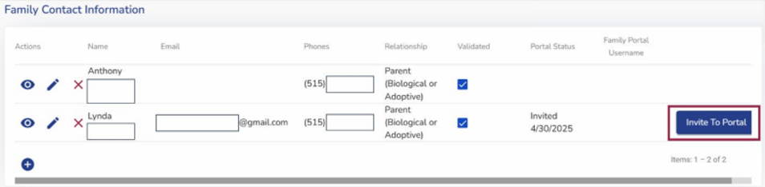
Invite to Portal Button
Once account eligibility requirements are met, the Invite to Portal button is enabled on the Family Contact stepper.
  An automated nightly ACHIEVE process automatically sends an initial email invitation to eligible Family Contacts.
  Teams may also manually send an invitation by selecting the Invite to Portal button.
    Note: You may need to scroll to the right on the Family Contact table to see this button.
  Additional instructions are available on the ACHIEVE web page.

Slide 14
Requirements to Create an Account
Step 3: ACHIEVE Family Portal Account Registration

Slide 15
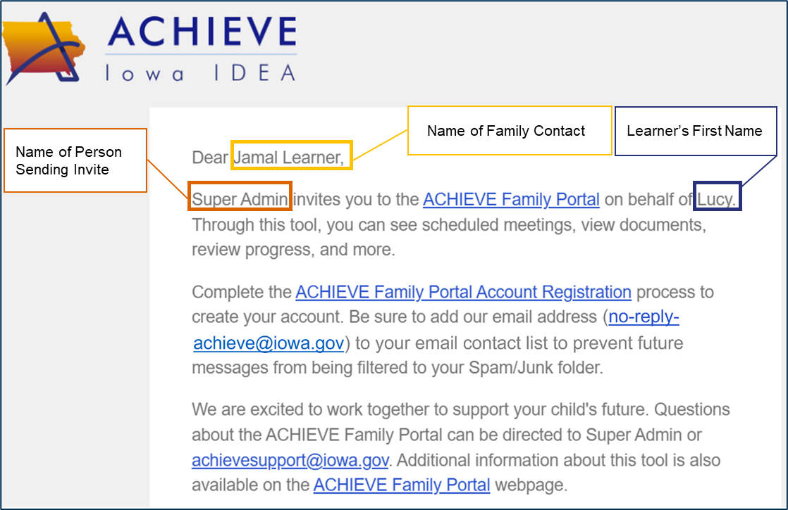
Receive Email Invitation
IDEA Parent contacts who have been invited to the portal will receive an email invitation to create an account.

Slide 16
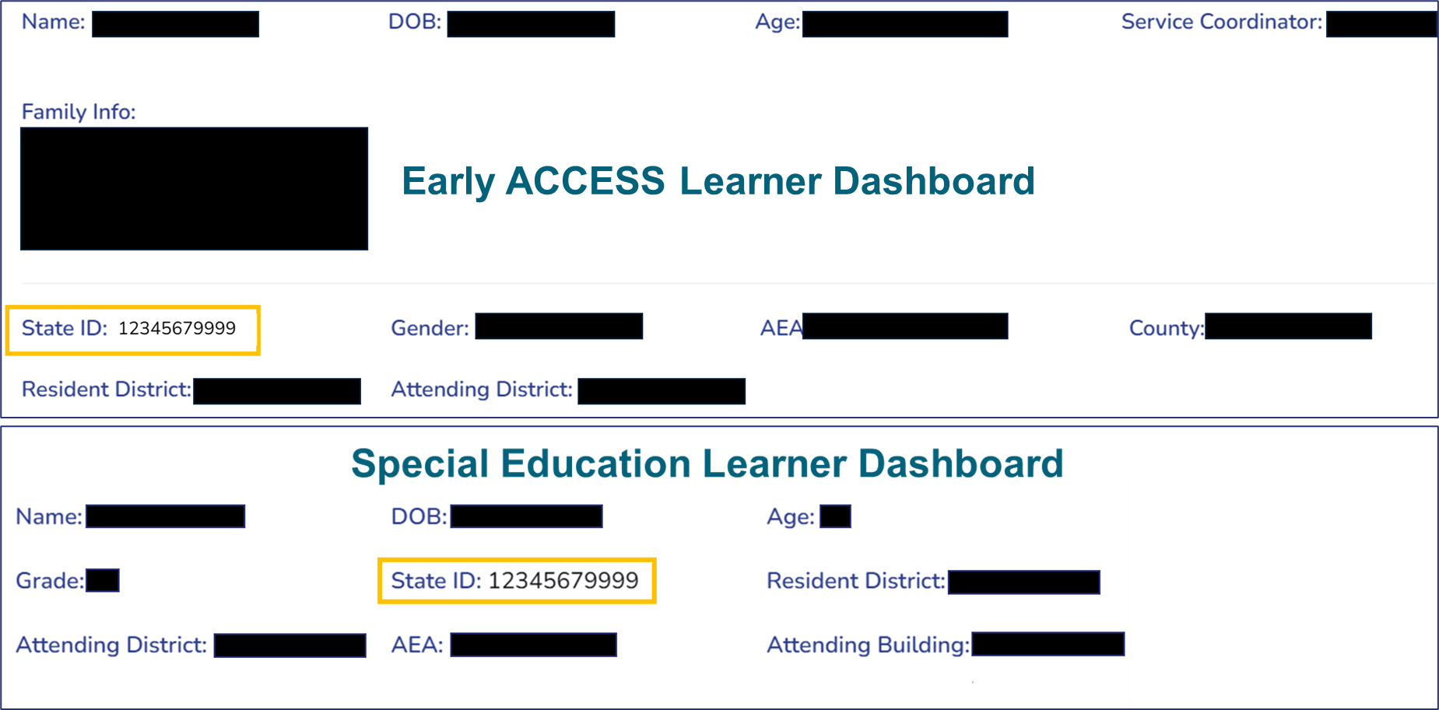
Locating the Last 4 Digits of a Learner State ID
State ID information can be found at the top of the Learner Dashboard page and on the Family Portal Access Report.

Slide 17
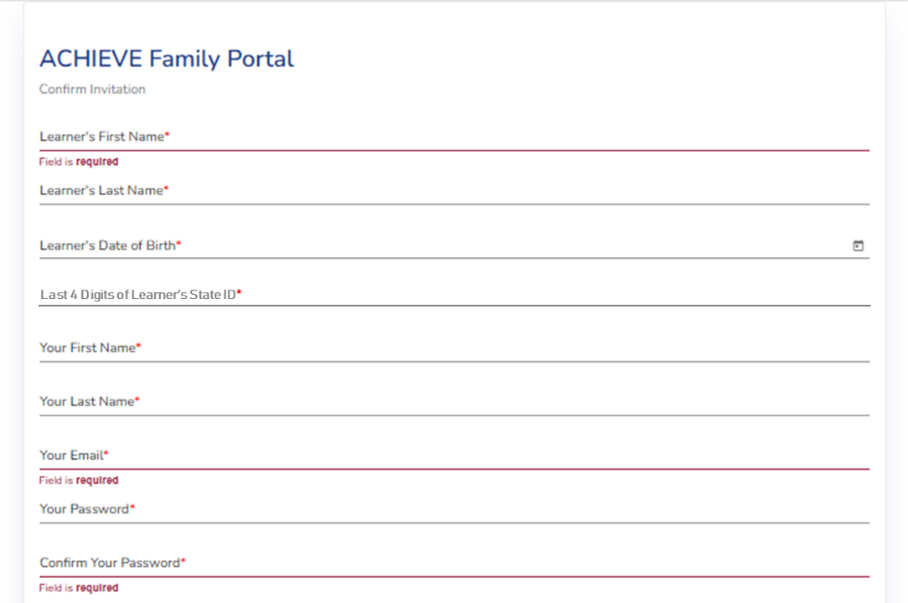
Establish Connection to Learner(s)
IDEA Parents must: Validate data elements for each learner to establish a connection to data from ACHIEVE
IFSP/IEP teams must: Provide IDEA Parents with the last 4 digits of the learner’s State ID to support the link to the ACHIEVE Family Portal

Slide 18
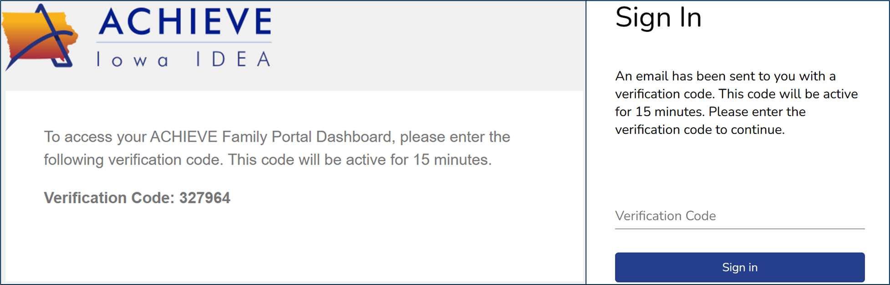
Complete Multi-Factor Authentication
After successfully creating an account, family members must enter a 6-digit verification code, sent to their email address, before accessing ACHIEVE data.

Slide 19
Troubleshooting Common Account Creation Issues
Not Receiving Invitation:
  Verify that the email address in the Family Contact stepper is correct.
  Confirm professional email address is not stored in ACHIEVE Family Contact table.
  Suggest family members add no-reply-achieve@iowa.gov to their email contact list.
Unable to Complete Account Registration:
  Confirm the family member is entering the last 4 digits of the learner’s State ID (in lieu of SSN or School ID).
  Share the Quick Start - Create Your Account guide for additional support.
  Share the Language Translation Guide for help translating a web page or a PDF into a preferred language.
Still Having Difficulty?
  Refer to the Family Support Guide.
  Encourage the family member to submit an ACHIEVE Family Portal Support Request for assistance.

Slide 20
Resources for Family Contacts
The ACHIEVE Family Portal web page contains many resources for family members.
Family Member User Guides
  Account Creation Quick Start Guide
  Complete User Guide
  Interactive Activity Guide
  Language Translation Guide
ACHIEVE Family Portal Account Sign In
What is the ACHIEVE Family Portal?
  Early ACCESS handout
  Special Education handout
  Overview Video
Who is eligible to create an account?
Other Frequently Asked Questions

Slide 21
Best Practices to Increase Family Engagement
Strategies to Increase Knowledge & Awareness

Slide 22
Understand and Promote Account Benefits
Stay Engaged
Review meeting notices, Prior Written notices and upcoming deadlines
Prepare for Meetings
Review the Procedural Safeguards Manual for Parents
Track Progress
Review, download and/or print records anytime
Encourage participation by inviting your learner to create an account
Complete annual family engagement surveys
Print requested consent forms or provide digital signature
Review draft documents (if shared by team)
See real-time progress towards outcomes/goals
Support transitions in development and learning

Slide 23
Use Your Resources
The ACHIEVE web page contains many resources for AEA, CHSC, and LEA staff.
  Sample Communication Guides contain templates that can be used for newsletters, social media posts, email announcements, web page content and more.
  Quick Start Guides for Staff:
    Early ACCESS Team Members
    Special Education Team Members
What is the ACHIEVE Family Portal?
  Early ACCESS handout
  Special Education handout
  Overview Video
Who is eligible to create an account?
Other Frequently Asked Questions
Look and Feel of ACHIEVE Family Portal
  Early ACCESS
  Special Education

Slide 24
Family Portal Registration Workshop
Consider hosting ACHIEVE Family Portal Registration workshops.
Technology You Will Need:
  Access to laptops or computers for staff to access ACHIEVE
  Ability to review, edit and validate Family Contact information in ACHIEVE and a method to provide the last 4 digits of a learner’s State ID to family members
  The Family Portal Access Report in ACHIEVE will identify which families have/have not yet created an account
  Laptops, computers, or tablets for families to complete account registration process
Other Paper Resources You Will Need:
  Copies of Early ACCESS and/or Special Education handouts
  Copies of Language Translation Guides
  (In English and translated into preferred languages of families in your community)
  Copies of Account Creation Quick Start Guide (In English and translated into preferred languages of families in your community)

Slide 25
Best Practices to Increase Family Engagement
Strategies You Can Use Prior to the Meeting

Slide 26
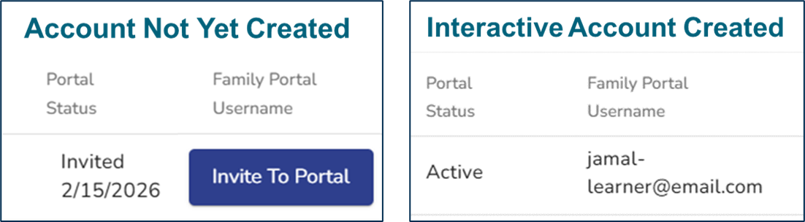
Prior to the Meeting
Determine whether an account has been created by reviewing the Portal Status column of the Family Contact table.
  If Invite to Portal button is displayed, the family contact has not yet created an account. Select the button to re-send the email invitation.
  If Active is displayed, the family contact has created an interactive portal account. The account username will be displayed in the Family Portal Username column.
  If Active-View Only is displayed, the family contact has created a view-only portal account. The account username will be displayed in the Family Portal Username column.

Slide 27
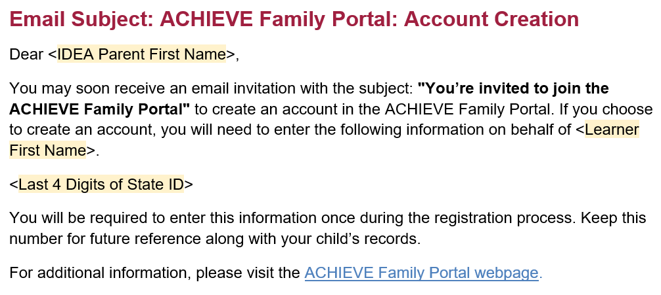
Leverage Templates and Resources
Utilize Sample Communication templates to send information to families about the ACHIEVE Family Portal along with the last 4 digits of the learner’s State ID.

Slide 28
Best Practices to Increase Family Engagement
Strategies You Can Use During the Meeting

Slide 29
During the Meeting
Confirm email address and other contact information for each IDEA Parent, updating family contact fields in ACHIEVE as needed.
Provide copies of Early ACCESS and/or Special Education handouts to families along with the last 4 digits of learner’s State ID.
  NOTE: State ID information can be found on the Learner Dashboard and on the Family Portal Access Report.
Consider pushing a draft copy of documents (IFSP, IEP, Reevaluation, BIP, etc.) to the portal using Push to Portal button.
Request needed consents and indicate that family members can review and print paper copies of consent forms OR provide digital signatures.

Slide 30
How Draft Documents Work
Draft PDF documents only appear in the ACHIEVE Family Portal if team members select the Push to Portal button.
If a second copy of a draft document is pushed to the portal, the original draft is replaced.
When records are finalized in ACHIEVE, any draft documents are removed/replaced by finalized copies of PDF documents.
Draft documents are not stored in the Documentation stepper of ACHIEVE or the ACHIEVE Family Portal.

Slide 31
Best Practices to Increase Family Engagement
Strategies You Can Use After the Meeting

Slide 32
Provide Real-Time Progress Monitoring Data
Enter progress monitoring data in ACHIEVE
Demonstrate how families can generate progress report at any time
Encourage families to review data prior to or after parent-teacher conferences
Notify family contacts when finalized documents are ready for review (PWN, IEP, Amendment, FBA, BIP, etc.)

